Slide 1
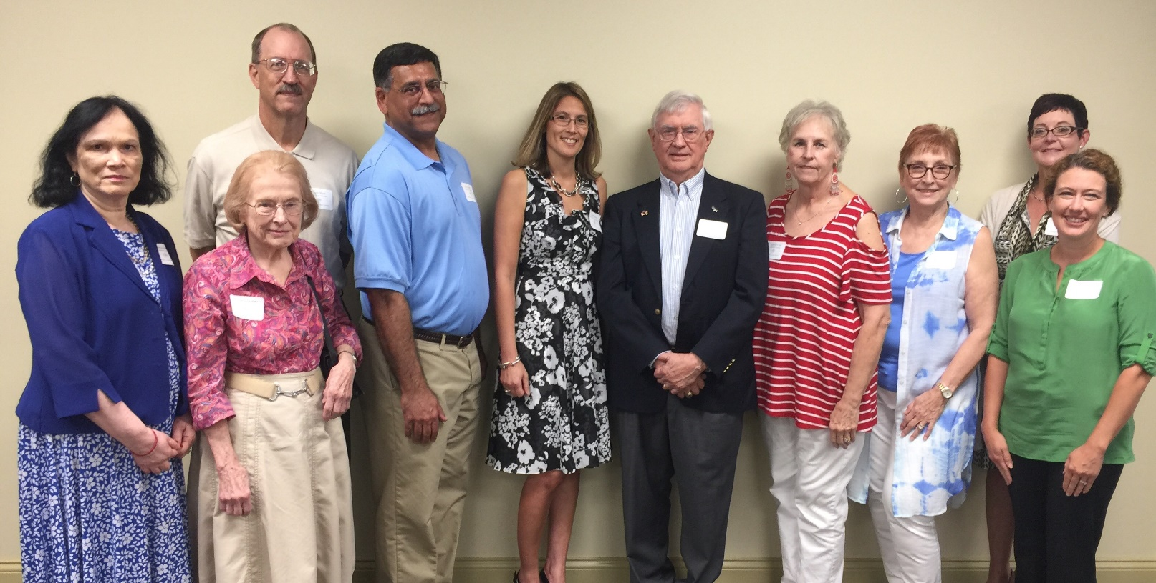
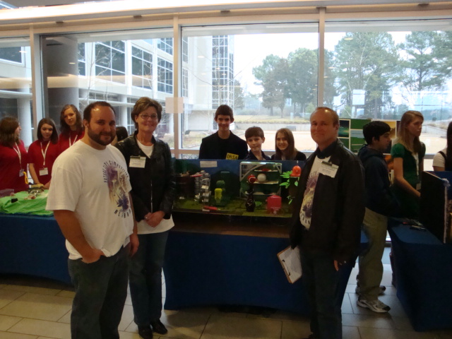
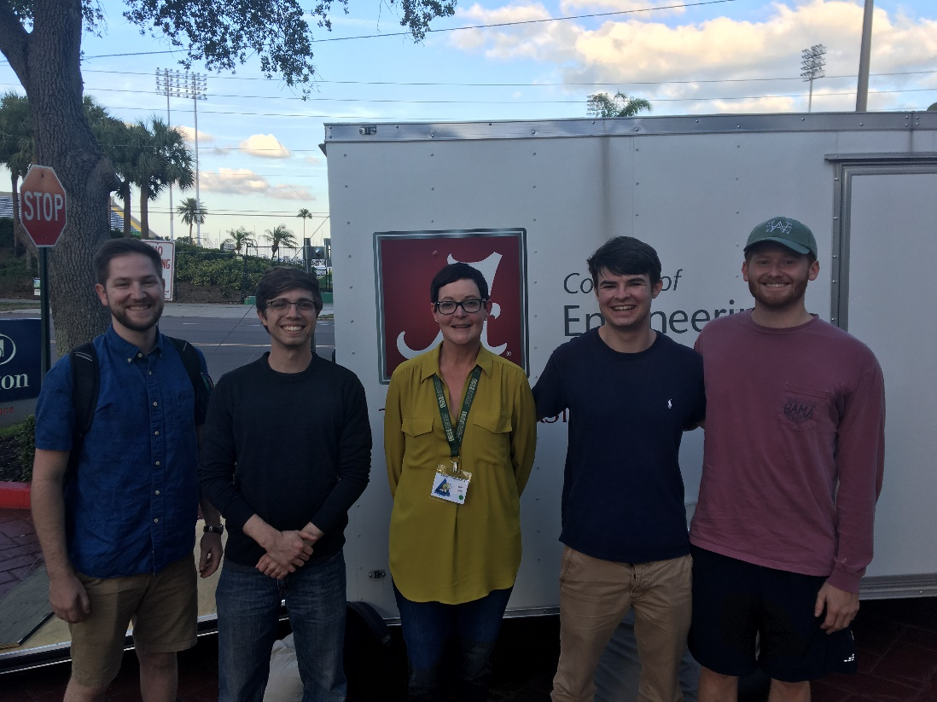
Transparency and Trust / Cooperation and Inclusion / Financial Transparency
Susan K. (Kathy) Land, FIEEE
IEEE 2020 President-Elect Candidate

Slide 2
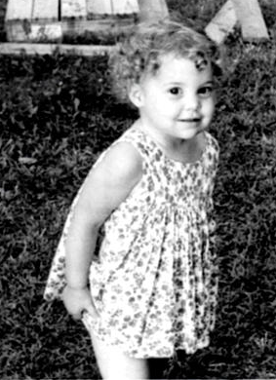
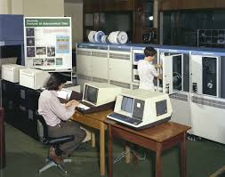
Who am I?
1963 Memphis, TN/ Athens, GA
1985 Computer Systems Specialist,
Pacific Missile Test Center/Pt. Mugu, CA
Standard Missile Laboratory
Dawn of electronic warfare, focus on early warning radar
Weapons Performance Division: HWIL missile testing early
Standard, Phoenix and AMRAAM missile systems
1992-2000 3246th Test Wing, Eglin AFB FL
Flight mission planning software
Author/ IEEE and Software Engineering Best Practices
2000-2007 Northrop Grumman
Program Manager/Information Technology Fellow
Technical Director Huntsville Operations
2007 – 2010 MITRE
Principle Software Systems Engineer/MDA
US Missile Defense Agency
Program Manager/Chief Engineer
2nd successful fielding for US Missile Defense in 8 yrs.
Current Budget; $120M/2 year program
Previous; $1.2 B/5 year program
Industry/DoD (30+ years)

Slide 3
Experience & Qualifications
Current IEEE Committees:
Strategic Planning Committee
Entrepreneurship Committee
Ad Hoc Committee on Diversity& Inclusion
Advisory Group to Support Financial Improvement
Conference Finance Management Remediation (CFMR)
HAC World-Wide Disaster Relief Project (Mobile MOVE)
IEEE BOD-Level Experience
Division Director; V 2014-15, VIII 2011-12
Multiple IEEE-Level Committees / IEEE Fellow
Technical Activities Board
Technical Activities Past-Vice President; 2019
Technical Activities Vice President; 2018
President, Computer Society (CS); 2009
CS Vice President Conferences; 2007-2008
IEEE MGA
Advisory committee of WIE ILS Bangalore 2019
Region 3; ExCom/Awards Chair; 2016-2017
IEEE WIE Committee; 2008, 2010-2012
2018 Moquin Award/ Huntsville Section Prof. of the Year
IEEE Standards Association
IEEE CS Vice President Standards Activities; 2004 – 2006
IEEE Standards Medallion; 2007
IEEE USA
Board Member; 2013 & 2016
US Government Community of Interest; Vice Chair 2018
IEEE-USA MOVE Fundraising; 2017-2018

Slide 4
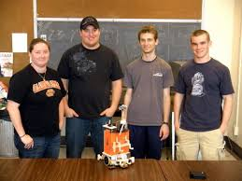
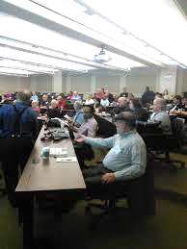
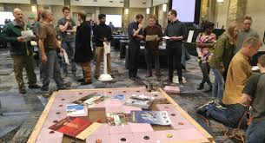
What do our Members Want? What does our organization need?
2016 Membership Segmentation Survey
To remain technically current
To join IEEE societies
To network with others in the profession
To participate with others in local activities
2015 All Societies Research Project (ASRP)
To network
To serve as a volunteer
To attend local chapter activities
2018 Focus Group Project
Focus on existing programs
Communicate more effectively
Do more locally
I support the IEEE leadership vision of membership expansion… a redefinition of membership & engagement

Slide 5
Why I am Qualified & Platform
Demonstrated experience across the depth and breadth of our organization.
30+ years industry technical and executive management experience to leverage in this role.
Uniquely qualified to understand the challenges and opportunities that exist within IEEE today.
Through my combined experience, I have come to understand that while we are ‘One IEEE’, IEEE is a varied and large organization and one size does not fit all. I commit to:
Increased support for STEM, YPS, Entrepreneurship/NeXT and WIE
More support for Chapters, Sections – work to fix what is broken
Opportunity for Community engagement with STEM memberships!
To make IEEE a fair and equitable place for technical interchange where our diversity is represented
Encourage interaction and engagement among the IEEE operating activities and within its technical member communities
The IEEE Senior Executive – must remain agile and sensitive to ALL constituencies and their unique needs

Slide 6
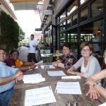
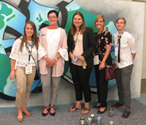
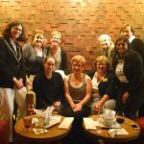
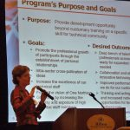
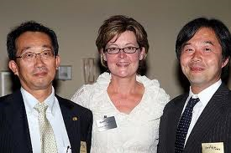
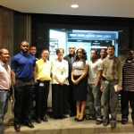
My Promise…
to be a dedicated steward of the position
To act in the best interest of IEEE – the President is an empowered servant
To earn and maintain the trust of the BOD through the ethical application of the IEEE Constitution, Bylaws and Policies and Procedures
To work as diligently as I have in other IEEE positions
To always remember the members we serve
I am requesting your support

Slide 7
Thank You!
www.susankathyland.com
Instagram: susankathyland
Twitter @skland1
Susan K. Land skland@ieee.org +1 256-426-5900

