Slide 1
2020 President-Elect Nominee Statement, Region 1
Milojicic Dejan, Ph.D., IEEE Fellow
(2018-19) 2015-17, IEEE Industry Engagement Committee (Past) Chair
2018 IEEE Audit Committee Chair
2017-2018 Division VIII Director
2014 IEEE Computer Society President
13 April 2019, Huntsville, AL
Notes:
Thank you for the opportunity to be considered as a potential candidate for this key IEEE leadership position.

Slide 2
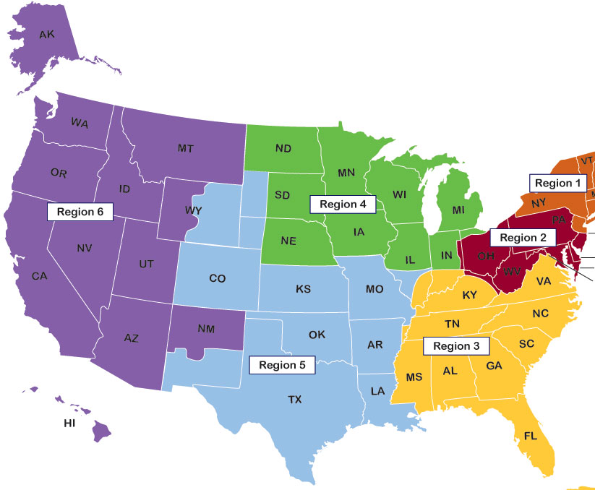
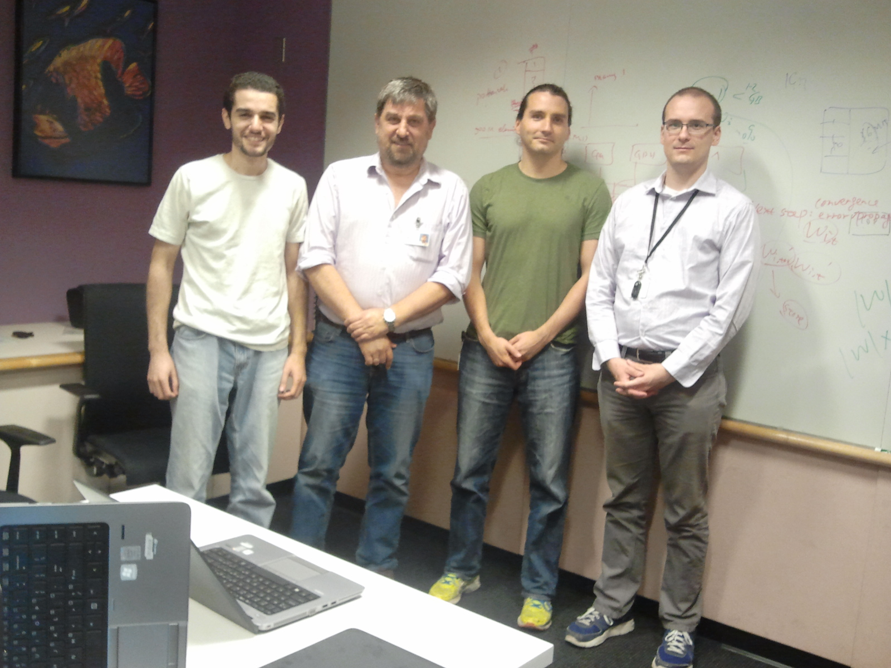
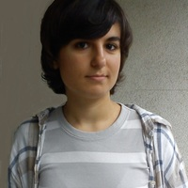
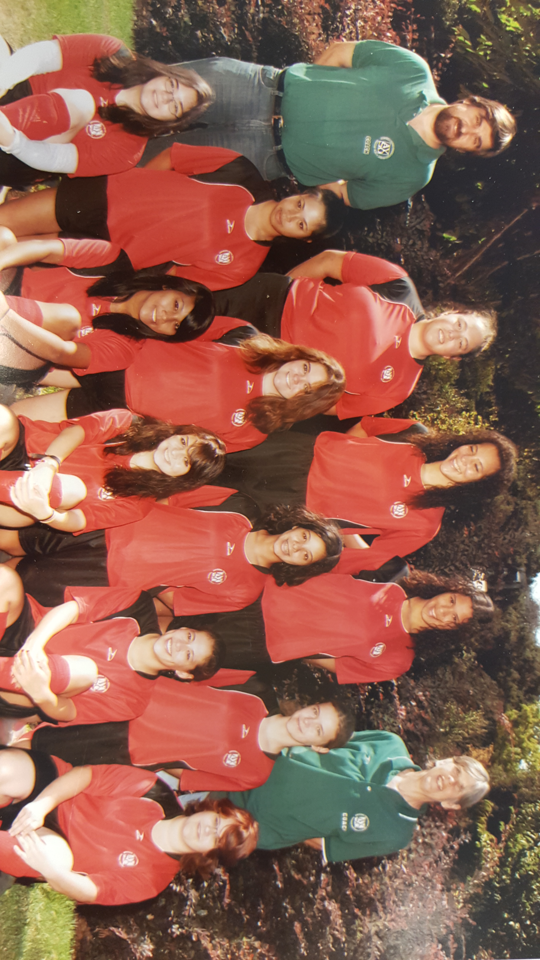
Collaborated with GaTech for the past 25 years
~15 interns, 1 postdoc, on 3 PhD thesis committees
Best paper award, 9 patent applications, 2 journal papers
My daughter lives in Orlando, FL, working for a startup
Coached U19 soccer team at National Games in West Palm Beach, FL

Slide 3

Technology Inflection Point:
Many changes, and this is the time to make a lasting impact
Technology
Global Challenges
End of Moore’s Law and Data Growth
Concerns of supply chain hacks
Spectre and Meltdown vulnerabilities
Race to Exascale: China, Europe, US
Sustainability issues: global warming
Global hunger: solution through supply chain?
Talent training, recruiting, evolving
Power AI: explosion of HW accelerators
Automotive: self-driving cars: Tesla, Baidu, Audi
Quantum Computing, Blockchain, AR/VR
Technology convergence: SW-defined, hpc/data
IEEE is at the heart of the technology revolution, with impact on humanity
However, IEEE is not acting with the same sense of urgency as industry is!

Slide 4
IEEE Today
#members
~420K
Survey of Membership | 2000 | 2004 | 2008 | 2012 | 2016
Private industry | 60% | 54% | 52% | 44% | 39%
Educational Institutions | 14% | 17% | 18% | 24% | 29%
50x
25x
Fellow Elevation Type (‘07-’17) | %
Researcher/ Scientist | 80.8
Technical Leader | 10.4
App. Engineer/ Practitioner | 5.9
Educator | 2.9
Average Age
2017 Rank | Country | 2017 | 2007 | % Change
1 | USA | 180,952 | 212,838 | -14.98%
2 | India | 52,410 | 23,496 | 123.06%
3 | China | 18,919 | 4,897 | 286.34%

Slide 5

Statement: IEEE has not kept pace with the changing profession. It must adjust or gradually diminish in relevance!
Relevance to industry, and tie better to academia and government, e.g.:
  Consulting services to corporate, government, e.g. cross-technology evaluation
  Practitioner reports and trend papers of timely, practical value
  Host modern events targeted to industry, culminating in Industry Congress
Innovate IEEE by introducing offerings, e.g.:
  Recruit members from 18M SW developers, talent mgmt., new member grades
  Tighter workflow connecting TAB and SA for right-timing of agile standards
  Corporate Partnerships with SMBs and startups, in addition to enterprises
Global Membership, expand into Asia/Africa, strengthen Americas/Europe:
  Grow IEEE-USA into IEEE-Global-Policy, extend with IEEE-Asia, IEEE-Europe
  Collaborate with sister organizations, such as NAE, AAAI, ACM, ASM

Slide 6
Vision: 1) Protect, preserve the core (membership)
2) Transition to long-tail (by engagement)
3) Incubate high-end services (by association)
Create Value
3
Vision
Value delivered, revenue earned
Today
1
2
Create Knowledge
Attract Membership
Instances of IEEE products

Slide 7
Membership Vision
Academia
#Members
Revenue
Time Period
Contracts
8M
$2B
>3y
(3)
Industry
Predictions
Focused events
Technologists
Trending
2M
$1B
now-4y
(2)
Convene
Governments
Global Store
Communities
Tech
Studies
Archive
Paying
Members
400K
$500M
now
Grading
Conferences
(1)
Global
Tech
Policies
Roadmap
Publications
Standards
Membership | Association | Engagement | Subscription
Target | Prof. devel. | Engineers | Members
Biz Model | Contracts | Ads, Partners | Membership
Non-membership
Membership

Slide 8
IEEE Vision: IEEE, a preferred technology advisor to corporations, governments, NGOs
IEEE should connect all those we serve to our global technical community
This means delivering high value, high margin services, e.g.
IEEE advising the UN on application of AI to automotive using neuromorphic computing with ethical constraints
To reach this vision requires three phases
  PROTECT, GROW MEMBERSHIP: Our credibility relies on preserving our core products which are converging: journals-conferences, standards-pubs, etc
  EMBRACE ENGAGED: converged products to the long tail (tools, e.g. HotCRP, ShareLatex, Mendeley-like developer networks, certified citations, etc.)
    Delivering standardized/unified products to the long-tail requires automated customization at low price, low touch, and at large scale.
  BROADEN THE REACH: High margin services require new skills, partners, high touch, markets; it will take effort, but position IEEE to reach its full potential
    Realizing an ambitious new vision is a multi-year process and requires members and staff to share that vision

Slide 9
Innovation in Standards
New opportunities from new standards growing countries (China, India)
  High speed trains, UAVs (drones), SmartGrid
  Unchartered territory with AI chips, huge impliations on AR/VR
New technologies demand reverse cycle of technology->standards
  Standards-driven Technical Communities created from standards activities
  AI, post-Moore’s, ethics considerations, require broader, innovative standards
  Pre-standardization activities: roadmapping, white papers, rapid reaction, etc.
  Light consensus building: open source, industry consortia, SW interoperability
  Perpetual adaptation of processes, people, and locations
  Increased presence in technology-savvy regions: Silicon Valley, Chicago, Boston
  Industry connections lead to practitioner membership and executive buy-in
  Need critical mass: cross-IEEE coordination and synergy

Slide 10
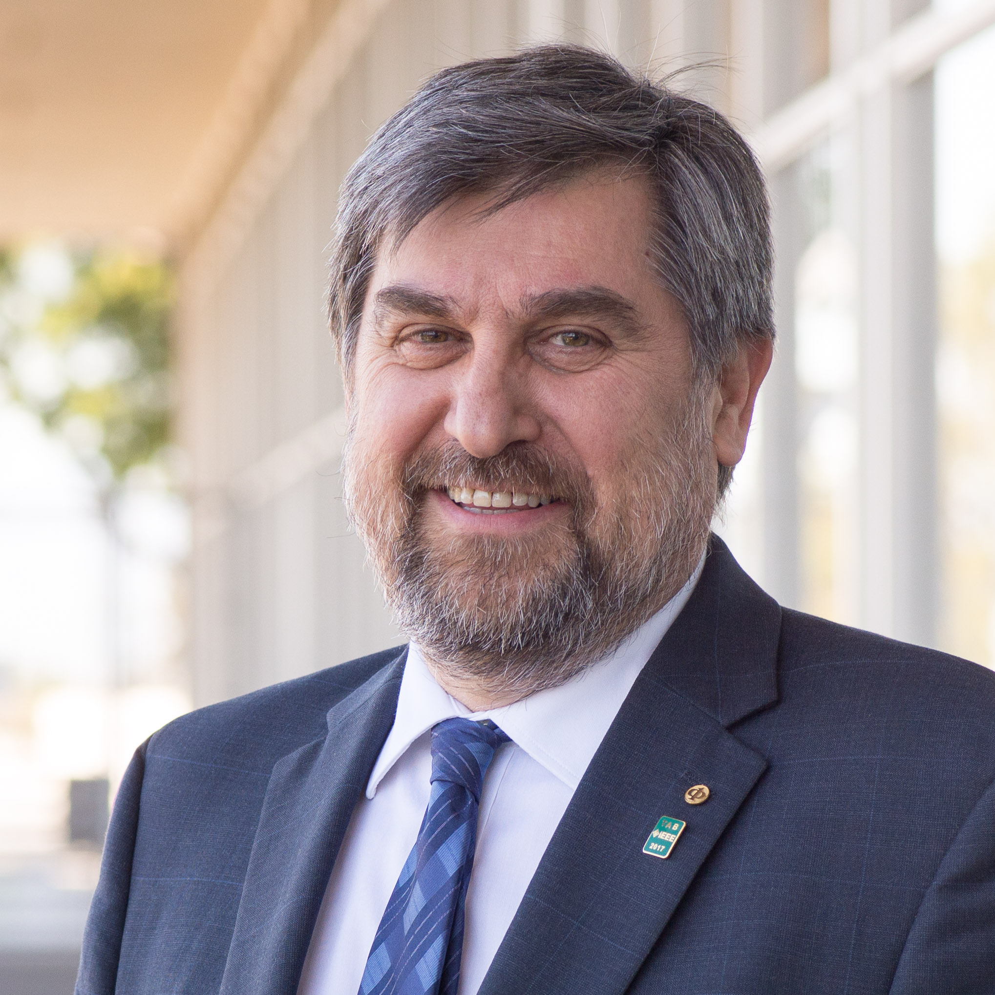

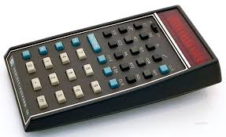
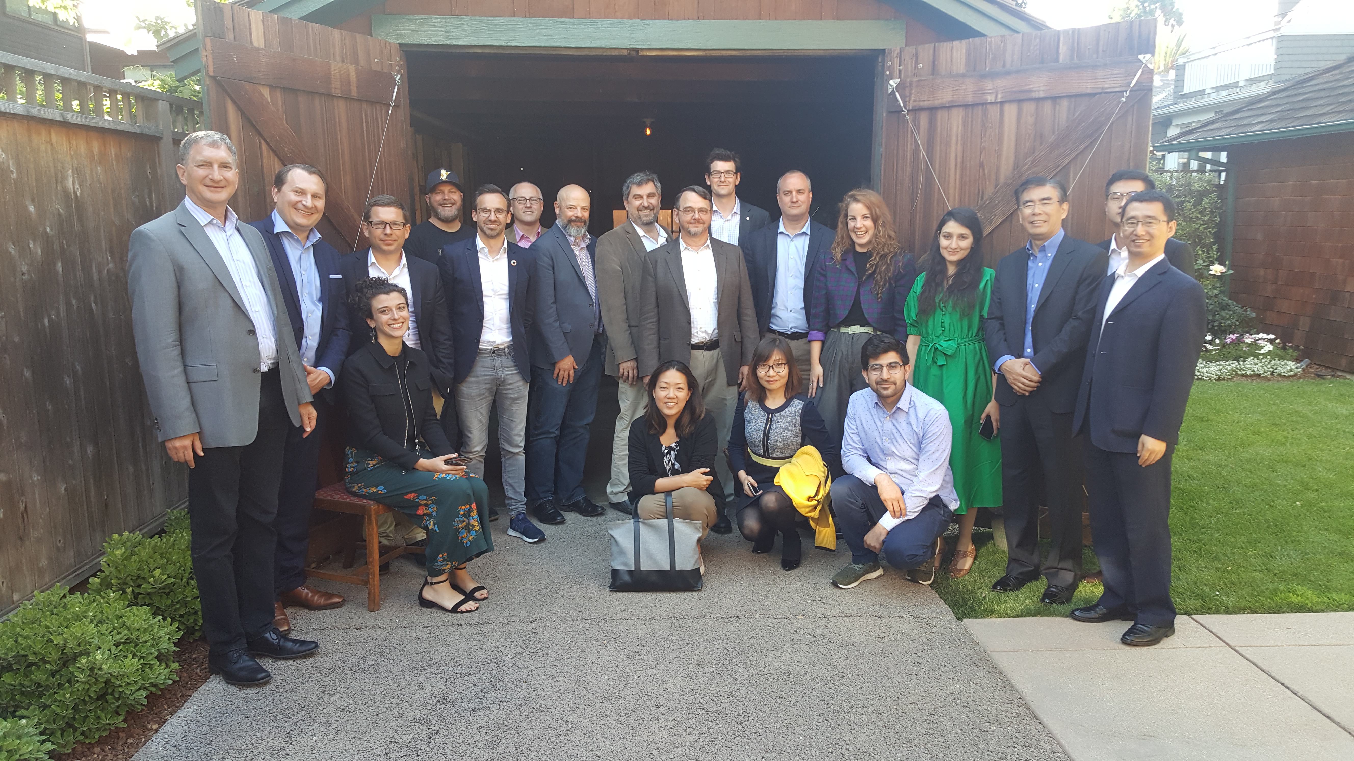

Who Am I? A catalyst of change, a technical leader in system software
Distinguished Technologist at Hewlett Packard Labs
  ‘98-now at HP(E) Labs working on systems software
  ‘94-‘98 at OSF Research Institute, Cambridge MA
  ‘91-‘94 PhD at University of Kaiserslautern, Germany
  ‘83-‘91 Institute “Mihajlo Pupin”, Belgrade, Serbia
Working at the birthplace of Silicon Valley
  Regularly presents to CTO of HPE customers
  Exposed to dynamic industry, startups, VCs
Innovator
  31 patents, 126 patent app, 2 books, >180 papers, 6891 citations, h-i:35, i10:87
  Fellow of IEEE (2010), ACM Distinguished Engineer
Global reach, extensive management experience
  Managed teams in India, Brazil, Singapore, China, US
  Works with UIUC, Purdue, GaTech, ETH, Technion, etc.
  Managed OpenCirrus Cloud Computing Testbed with 16 sites around the world
  Strong support of HPE CTO and Lab VP

Slide 11









What Have I Accomplished in IEEE?
(Past) Chair of Industry Engagement (2018-19) 2015-17
  Portfolio: Industry Advisory Board, Infrastructure Conference,
  Confluence of AI & Cybersecurity, Industry Summit, etc.
  Formed IEEE Industry Engagement Committee
  Worked closely with all VPs, Volunteers, Mgmt Council, Staff
  Working towards Industry Congress
Audit Committee Chair, 2018
  Oversaw Global Spec; Harmonized Committee with MOUs
  Computer Society President
  Reduced financial deficit by 37%, new revenue sources
  Introduced prestigious “Spirit of Computer Society” Award
  IEEE CS 2022 Report, Tech Trends, Computing Now,
  Special Technical Communities; started 3 conferences
  on Magazine/Transactions boards, 2 conferences PC chair

Slide 12
Summary
Additional President’s Responsibilities
  Align membership and drive organization behind ambitious vision and compelling goals
  A role model: strong technically, skilled organizationally, and driven by business needs
  Inclusive in execution, work exceptionally well with all Volunteers and Staff
As an innovator from industry with strong ties to academia and government,
with a global history, I have a proven track record as a catalyst of change
It is time for an IEEE President with a strong technology background, who works for a technology company and understands what technologists want
Please consider supporting my nomination!

Slide 13





Thank you!
Contact me at: dejanm@ieee.org
Please visit: https://dejan.milojicic.com
twitter.com/dejanm
www.linkedin.com/in/dejanm
www.facebook.com/dejan.milojicic
www.instagram.com/dejanmilojicic

Slide 14
