Slide 1
Region 3 Section Support Committee
Mark Torres
SoutheastCon 2019, Huntsville, AL
April 12 – 14

Slide 2
Section Support Committee
Vision & Mission
Region 3 Vision: Engage every Member through Communities of Interest
Fundamental Position
The Member IS IEEE and their ACTIVE PARTICIPATION is essential to achieving the IEEE Mission
The Section OWNS the Member RELATIONSHIP and IS IEEE to the Member
The Region is the ENABLER of full member ENGAGEMENT
Section Support Committee Mission: Assist the Sections to:
To stimulate the interest of IEEE members
To motivate members to volunteer
To encourage professional and technical growth of all members
To share best practices with other Sections
To form Engineering Affinity Groups.
Reference: IEEE MGA Vision, Mission, Guiding Principles, Goals, and Strategies
Notes:
The IEEE Geographic structure (Regions/Sections/etc.) all report back to MGA and the MGA Board.
We’re all working towards this vision & vision.

Slide 3
Section Support Committee
Responsibilities
Encourage and enable Sections to engage members through Communities of Interest with Affinity Groups and Society Chapters with emphasis on Young Professionals, Women in Engineering, Senior Members and Life Members.
Encourage Sections to sponsor Senior Member and Fellow elevation programs
Assist Sections in the use of collaborative tools and other technologies with ongoing training events that support Section and Region activities.
Encourage Sections to sponsor projects to facilitate the active involvement of members in IEEE activities.
Assist sections in developing technical programs for their members and accessing other technical activities in the Institute.
Provide assistance and support to Sections and Chapters having difficulties meeting the requirements to remain active and viable.

Slide 4
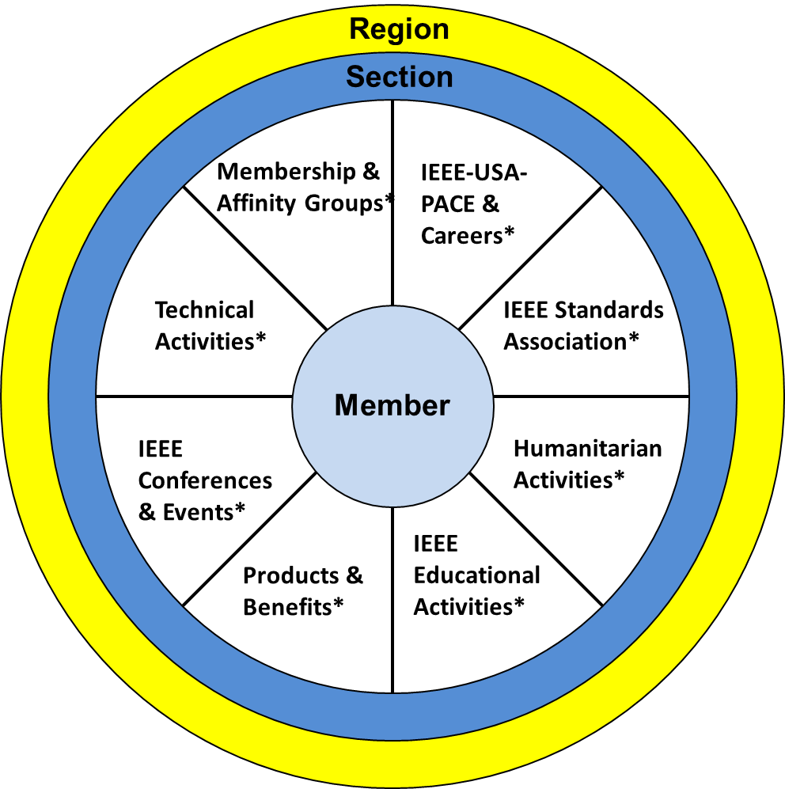
Member View of IEEE
Notes:
In this view:
The member is the focus
They joined for anyone of the “reasons” represented by the segments of the pie or also known as “communities of interest”
When a member joins, they are looking for IEEE to fulfill a need.
However, many do not realize the full depth and breadth of IEEE.
The Section is there to support the members locally
The Region is there to support the Sections and volunteers to do their jobs effectively and efficiently
There is staff that supports all of these functions, however, members do not have direct access to staff outside of the IEEE Contact Center resources.
Per our Member satisfaction survey:
Members find IEEE products “difficult to use”.
If you’ve ever tried to find anything at IEEE there is A LOT of content to go through.
Members do not necessarily see the value or state “membership is too expensive”.
These two concepts are related.
If a member can’t find what you need/want, there is no perceived value.
So…..

Slide 5
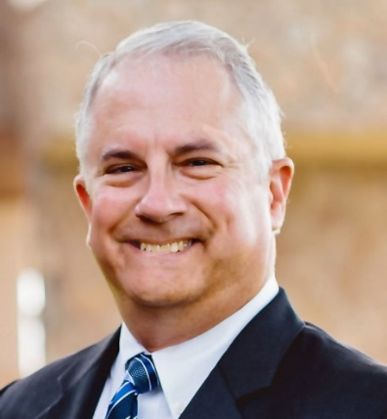
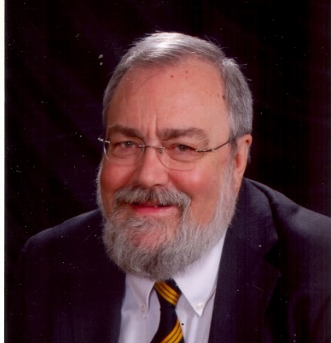
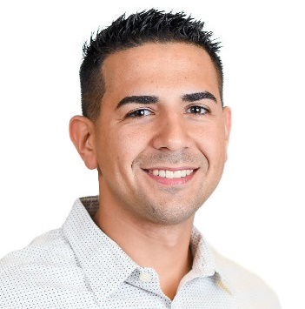
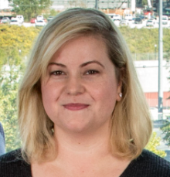
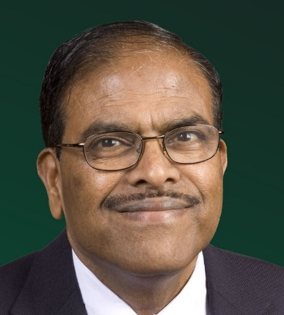
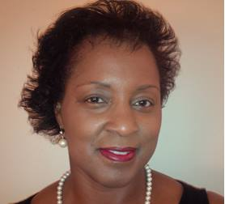
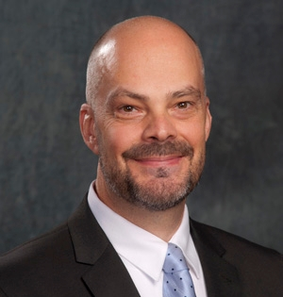
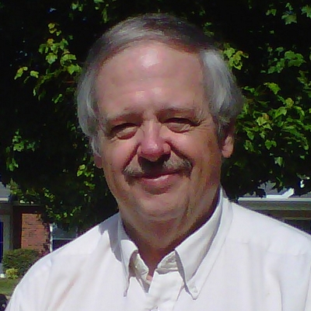
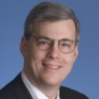
Section Support Committee Members
Mark Torres
Committee Chair
Bill Ratcliff
Committee Mentor
Edwin Mastache
Young Professionals
Allison Mercer
Women in Engineering
Tom Bellarmine
Life Member
Jacquelyn Cunningham
Senior Member Elevation
Glenn Parker
Technical Activities
Grayson Randall
Projects
Charles Lord
Operations Specialist
Bill Marshall
Operations Specialist

Slide 6
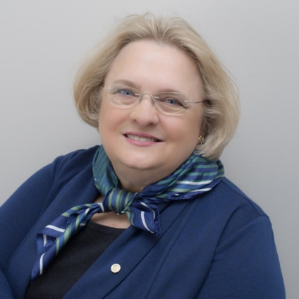
Section Support Committee Members
Mark Torres
Committee Chair
Mary Ellen Randall
Committee Mentor
Edwin Mastache
Young Professionals
Allison Mercer
Women in Engineering
Tom Bellarmine
Life Member
Jacquelyn Cunningham
Senior Member Elevation
Glenn Parker
Technical Activities
Grayson Randall
Projects
Charles Lord
Operations Specialist
Bill Marshall
Operations Specialist

Slide 7
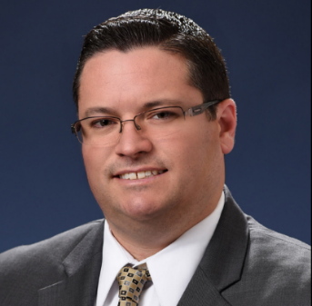
Committee Goals
Section Support Committee
SSC Chair: Mark Torres
2019 Goals
Focus on relationship with member (intentional and personal connections)
Coordinate Affinity Groups (activities or areas of passion)
Leverage the Section Support Forum to share information on member engagement with Section leaders.
Coordinate YP, WIE and SAC to focus on student member transition following graduation.
Emphasize the value of Projects and Collabratec to engage members
Advocate on behalf of Region 3 Sections
Bill Ratcliff
Committee Mentor
SoutheastCon 2019 Activities
Section Support Committee Meeting
Roles of Officers 201, Fri @ 9:05
Engagement: Events, Outreach, Fri @ 2:35 & 3:00
WIE/YP/Senior Member Event Ideas, Sat @3:35
Mary Ellen Randall
Committee Mentor
Chris Wright
IEEE HQ Staff

Slide 8
IEEE Young Professionals
Section Support Committee
Coordinator: Edwin Mastache
2019 Goals
Energize & Grow existing YP Affinity Groups
Organize new YP Affinity Groups in Region 3 Sections
Lead Region 3 YP Section Support Committee
Provide Region 3 YP Section Coordinator’s collaborative network
Encourage joint activities using projects to keep affinity groups active
SoutheastCon 2019 Activities
YP Networking at the Reception, VBC South Hall
WIE, YP and Senior Member Event Ideas, Saturday at 3:35pm in the Breakout Sessions
YP, WIE and Student Networking after Awards Banquet, Saturday from 10:00pm – 11:00pm in the VBC South Hall 2

Slide 9
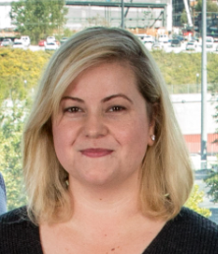
Women in Engineering (WIE)
Section Support Committee
Coordinator: Allison Mercer
2019 Goals
Listen and learn the needs of Sections with respect to WIE activities.
Reach out to WIE groups and develop an updated contacts list for WIE Liaisons.
Implement Region 3 WIE five-year plan with respect to both sustainment and growth
Attend / participate in WIE committee webinars
Encourage joint activities using projects to keep affinity groups active
SoutheastCon 2019 Activities
WIE Training, 4 Speakers on Friday April 12th from 8:30am – 11:50am in the VBC Ball Room 5
Topics Include: Power Skills, Reaching back in STEM, Balancing Being Right & Being Effective, and Leadership
Speakers are experts from: Booz, Allen Hamilton, Raytheon, University of Alabama, and NASA / MSFC
WIE Networking Luncheon, Friday April 12th from 12 noon – 1:00pm in the Embassy Atrium (RSVPs only)
WIE networking at Friday Reception, VBC South Hall
WIE, YP and Senior Member Event Ideas, Saturday at 3:35pm in the Breakout Sessions
YP, WIE and Student Networking after Awards Banquet, Saturday from 10:00pm – 11:00pm in the VBC South Hall 2

Slide 10
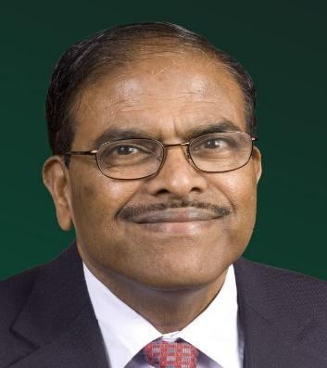
Life Member (LM)
Section Support Committee
Coordinator: Tom Bellarmine
2019 Goals
Increase in the number of Life Members Affinity group meetings in Region 3 Sections
Assist Sections establish new Life Members Affinity groups
Provide Life Members Affinity groups with best practices on conducting meetings and events
Secure Life Member Funds for the 2019 SoutheastCon Student Hardware Competition
Encourage joint activities using projects to keep affinity groups active
Region 3 Life Members Affinity Groups
Tallahassee LM Affinity Group was established on Sept 19, 2018
11 Existing LM Affinity Groups: Alabama, Atlanta, Daytona, East Tennessee, Florida West Coast, Huntsville, Louisville, Melbourne, North West Florida, Tallahassee and Winston-Salem
2018 LM Affinity Group Meetings: Alabama (2), Atlanta (2), Daytona (2), East Tennessee (2), Florida West Coast (2), Melbourne (2), North West Florida (6) & Tallahassee (2)
Inactive LM Affinity Groups: Huntsville, Louisville and Winston-Salem
Sections with plans to establish LM Affinity Groups: Coastal South Carolina

Slide 11
Life Member (LM)
Section Support Committee
Coordinator: Tom Bellarmine
February 13, 2019 – Life Member Committee Meeting, Tampa Florida
Approved the 2019 Budget
Reviewed and Approved revisions to:
Life Members Committee Operations Manual
Life Members Affinity Group Procedures
Life Members Affinity Group Achievement Award

Slide 12
Senior Member Elevation
Section Support Committee
Coordinator: Jacquelyn Cunningham
2019 Goals
Support and collaborate with Sections to achieve Region 3 Senior Member Elevations Goal
Collaboratively work with IEEE Headquarters to enhance the Senior Member Program’s reporting and assurance of GDPR and data compliance.
Reintroduce the Senior Member Program in Region 3; employ lessons learned in the Senior Member Elevation process and in practice.
Emphasize the value of Projects and Collabratec to engage members
SoutheastCon 2019 Activities
Support Sections on Region 3 2019 Senior Member Elevations Goal
Survey Sections understanding of Senior Member Elevation
WIE, YP and Senior Member Event Ideas, Saturday at 3:35pm in the Breakout Sessions
Notes:
In this view:
The member is the focus
They joined for anyone of the “reasons” represented by the segments of the pie or also known as “communities of interest”
When a member joins, they are looking for IEEE to fulfill a need.
However, many do not realize the full depth and breadth of IEEE.
The Section is there to support the members locally
The Region is there to support the Sections and volunteers to do their jobs effectively and efficiently
There is staff that supports all of these functions, however, members do not have direct access to staff outside of the IEEE Contact Center resources.
Per our Member satisfaction survey:
Members find IEEE products “difficult to use”.
If you’ve ever tried to find anything at IEEE there is A LOT of content to go through.
Members do not necessarily see the value or state “membership is too expensive”.
These two concepts are related.
If a member can’t find what you need/want, there is no perceived value.
So…..

Slide 13
Technical Activities
Section Support Committee
Coordinator: Glenn Parker
2019 Goals
Survey all Sections to determine their health and primary needs from the Section Support Committee.
Support and collaborate with Sections to encourage members to become a Profession Engineer
Emphasize the value of Projects and Collabratec to engage members
SoutheastCon 2019 Activities
Hands-On FPGA Workshop (8 hours on Thursday, April 11)
Engaging Industry with Your Section , Fri @ 1:00
Judging the Software competition, Sat @ 8:00 - 12:00
Notes:
In this view:
The member is the focus
They joined for anyone of the “reasons” represented by the segments of the pie or also known as “communities of interest”
When a member joins, they are looking for IEEE to fulfill a need.
However, many do not realize the full depth and breadth of IEEE.
The Section is there to support the members locally
The Region is there to support the Sections and volunteers to do their jobs effectively and efficiently
There is staff that supports all of these functions, however, members do not have direct access to staff outside of the IEEE Contact Center resources.
Per our Member satisfaction survey:
Members find IEEE products “difficult to use”.
If you’ve ever tried to find anything at IEEE there is A LOT of content to go through.
Members do not necessarily see the value or state “membership is too expensive”.
These two concepts are related.
If a member can’t find what you need/want, there is no perceived value.
So…..

Slide 14
Projects
Section Support Committee
Coordinator: Grayson Randall
2019 Goals
Introduce the SIGHT team concept at SoutheastCon with information on the program and how to create a SIGHT team.
Facilitate SIGHT team creation in Region 3 sections and affinity groups
Facilitate information sharing on SIGHT through the use of Collabratec.
SoutheastCon 2019 Activities
Introduce and inform Sections on IEEE SIGHT teams. With teams of 6 or more IEEE volunteers, we can encourage our members to be active in projects that engage our members and help our communities.
MOVE Truck Tours, Fri & Sat @ 9:00 – 5:00
Engagement: Projects, Fri @ 11:30 & 3:00
“Doing Projects” under the SIGHT banner, Sat @ 3:00 – 4:00
MOVE Report, Sat @ 1:45

Slide 15
Sections Operations Specialists
Section Support Committee
Charles Lord & Bill Marshall
2019 Goals
Provide training and support to the Region, Sections, Chapters and Branches on effective use of vTools, OU analytics and Collabratec.
Provide support to the Region, Sections, Chapters and Branches on GDPR and data compliance.
Develop & lead training and workshop Sessions at SoutheastCon and other Region meetings on vTools, OU analytics and Collabratec
Work with Region, Section, Chapter and IEEE HQ leaders to develop recommendations to enhance vTools, OU analytics and Collabratec
SoutheastCon 2019 Activities
Roles of Officers 101, Fri @ 9:05
Tools for Section, Fri @ 10:15
OU Analytics – Introduction, Fri @ 1:00, Advanced, Fri @10:15 & Breakout, Sat @ 3:35
Survey Section leaders on biggest challenges and recommend actions to meet those challenges (e.g., training, workshops, guidelines, cookbooks, etc.)
Challenge Sections, Area & Committee chairs to collect ideas on how to achieve the Region Strategic Plan

Slide 16
Committee Contact Information
Section Support Committee
Committee Position | Name | Email Address
Section Support Committee Chair | Mark Torres | mgtorres@ieee.org
Life Member Coordinator | Tom Bellarmine | t.bellarmine@ieee.org
Young Professional Coordinator | Edwin Mastache | eng.edwin.m@ieee.org
Women in Engineering Coordinator | Allison Mercer | Allison.Mercer@gtri.gatech.edu
Senior Member Elevation Coordinator | Jacquelyn Cunningham | jdnc@ieee.org
Sections Operations Specialists (Position 1) | Charles Lord | c.j.lord@ieee.org
Sections Operations Specialists (Position 2) | Bill Marshall | marshalliv@ieee.org
Project Coordinator | Grayson Randall | g.randall@ieee.org
Technical Activities Coordinator | Glenn Parker | Glenn.Parker@gtri.gatech.edu
Section Support Committee Mentor | William (Bill) Ratcliff | w.ratcliff@ieee.org
Section Support Committee Mentor | Mary Ellen Randall | merandall@ieee.org
Support Team | Name | Email Address
Member Activity Committee Chair | Sonya Dillard | sonya.dillard@ieee.org
Student Activities Coordinator | Victor Basantes | victor.basantes@ieee.org
Region 3 Director | Gregg Vaughn | g.vaughn@ieee.org
Region 3 Director Elect | Jill Goslin | Jill.Gostin@gtri.gatech.edu
Region 3 Past Director | Jim Conrad | jmconrad@uncc.edu
IEEE HQ Region 3 Staff Contact | Chris Wright | wright.c@ieee.org
IEEE HQ Young Professional Staff Coordinator | Kristen Mahan (YP) | k.mahan@ieee.org
IEEE HQ Women in Engineering Staff Coordinator | Paola Bringas (WIE) | p.bringas@ieee.org;
The IEEE Support Center is a great online resource.

Slide 17
Thank you!
Region 3 Section Support Committee
You are not alone … We are here to help
Assisting our members to find and engage with IEEE Communities of Interest requires many levels of engagement … Again we can help
Relationships are a network, not a hierarchy
Region 3 to Sections
A Section to other Sections
Members to other Members
Mark Torres, mgtorres@ieee.org

