Slide 1


Mercer – A Partner for Life
How The Member Group Insurance Program adds value to IEEE

Slide 2
How The Member Group Insurance Program adds value to IEEE
Program milestones: 1962 to present
Participation
Retention
Advertising
Sponsorship

Slide 3
A brief history of the IEEE Member Group Insurance Program
The Beginning
January 1, 1963
The Institute of Electrical and Electronics Engineers, Inc. was formed by the merger between the American Institute of Electronic Engineers and the Institute of Radio Engineers
1963
IEEE and Smith Sternau Company, Inc. agree to offer insurance plans to IEEE members.
The initial coverage offerings were:
▪ Member Group Term Life Insurance
▪ High-Limit Accident Insurance Plan
At its formation, IEEE had 150,000 members, 140,000 of whom resided in the United States

Slide 4


1970’s-1980’s, period of growth for IEEE and Plans
The Member Group Insurance Program expanded to meet the growth of IEEE, by adding these Plans:
1974
The Disability Income Insurance Plan
1986
The Medicare Supplement Insurance Plan
1988
Long-Term Care Insurance
Group Universal Life Insurance
Professional Liability Insurance
1989
Small Employer Group Insurance Plan
1988
IEEE membership grew to more than 300,000 members

Slide 5

1990’s
1993
IEEE launched the Financial Advantage Program, which included financial services, discounts and insurance under one umbrella
1995
Short-Term Medical Insurance Plan is introduced
1996
Free Prescription Discount Drug Card is introduced
Dental Insurance Plan is introduced
1998
The Term Life Insurance Plan maximum benefit is raised to US$1,000,000.
November 9, 2000

Slide 6

The Program expands in the early 2000’s
2006
E-commerce functionality is added to www.ieeeinsurance.com
20-Year Level Term Life Insurance Plan is introduced
2008
The Professional Liability Insurance Plan underwritten by Certain Underwriters at Lloyds’ of London rates are reduced by 10%

Slide 7
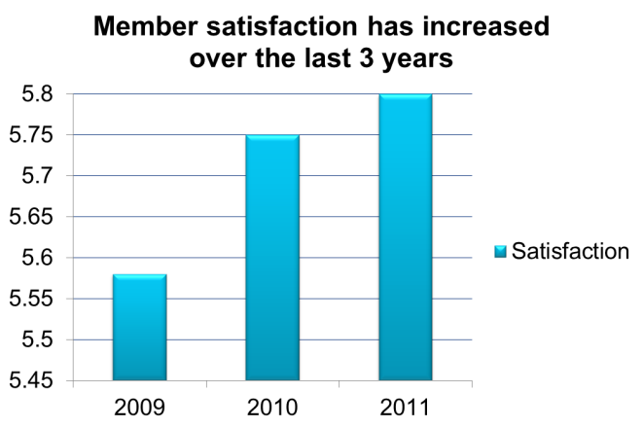

Rates down, satisfaction up
2010
The Term Life Insurance Plan base rate is reduced 5% for nonsmokers and 2.5% for smokers.
The General Liability Insurance Plan for computer technologists, who work from home, is offered to IEEE members.
2011
The Professional Liability Insurance Plan is launched in Canada (except Quebec).
The 10-Year Level Term Life Insurance Plan is offered a 10% premium credit.
The Disability Income Insurance Plan monthly maximum is increased to are reduced by 12.5%.
What members are saying about the IEEE Member Group Insurance Program:
“Good, consistent value has made it easy for me to plan and adjust through my career AND price/value is the best I have found.”
“I have only used the IEEE Life Insurance which I have for many years. An excellent value!”
“I think this is a wonderful program! Such a value!”
“Thank you for adding online payment of premiums!”
This is a good program. Just keep it up!”

Slide 8

Celebrating 50 Years
2012
IEEE and Marsh celebrate the 50th anniversary of the Member Group Insurance Program
The Term Life Insurance Plan base rate is reduced 10% and an additional rate reduction of 5%-20% is available for select ages.

Slide 9


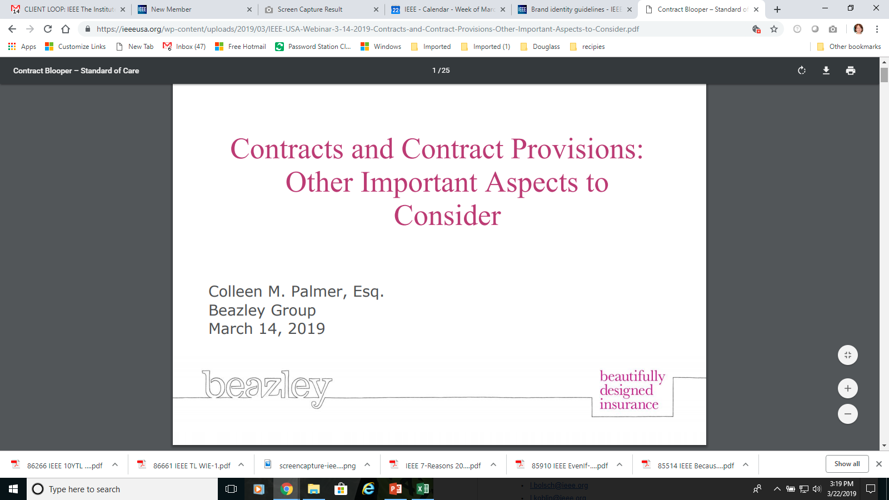
Mercer’s solutions for self-employed technologists
2014
Private exchange for those who need individual and small employer group plans
2015
Introduction of Beazley professional liability policies and risk management education to the business insurance program

Slide 10
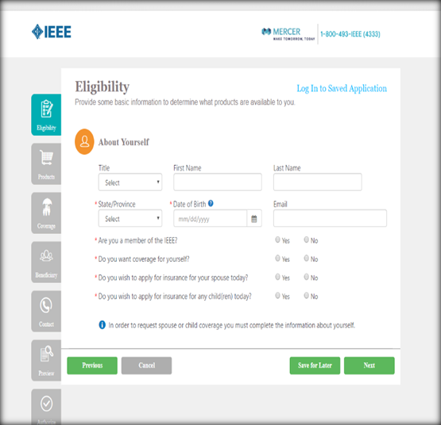
Recent enhancements respond to member needs
2017
Leave of Absence or Lay-off Provision and Covered Residual Disability benefit added to the IEEE Member Group Disability Income insurance plan, to support career and family needs
2018
Chronic Illness rider added to the IEEE Member Group Term Life Insurance plan to support members’ financial needs
New York Life introduces its first online portal enabling immediate underwriting decisions for life insurance benefits up to $500,000

Slide 11
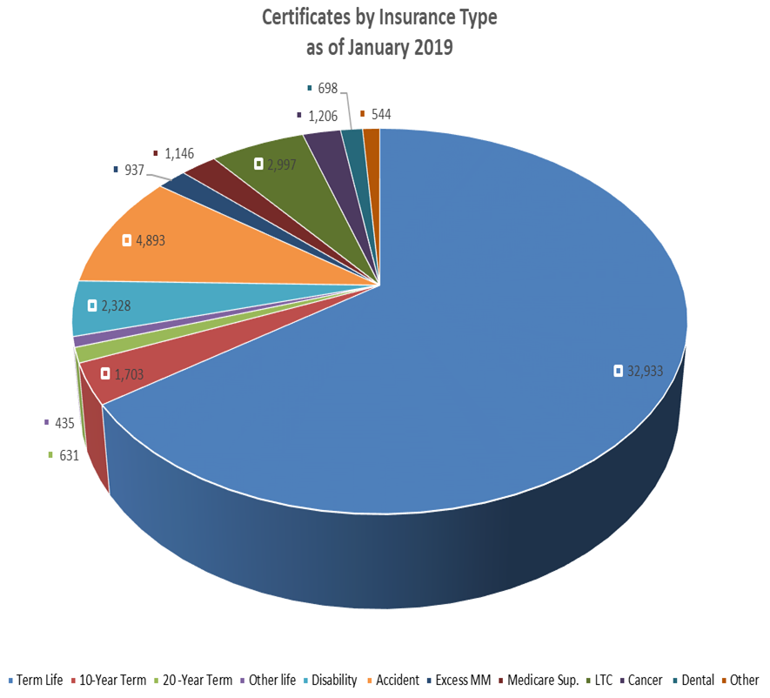
Current Participation in IEEE Member Group Insurance Plans
Insurance Plan | Certificates
Term Life | 32,933
10-Year Term | 1,703
20-Year Term | 631
Other Life | 435
Disability | 2,328
Accident | 4,893
Excess MM | 937
Medicare Sup. | 1,146
LTC | 2,997
Cancer | 1,206
Dental | 698
Other | 544
Total | 50,451

Slide 12
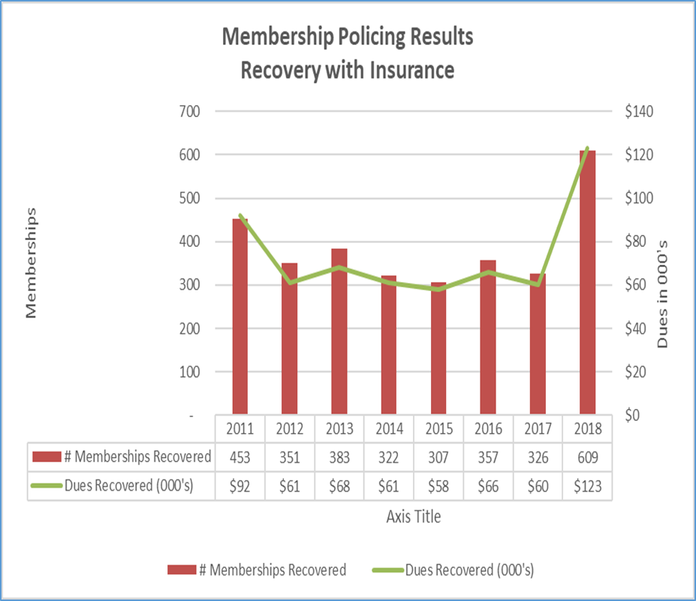
Annual Membership Retention-Recovery

Slide 13


Advertising Examples- addressing the generations
New members and younger members will learn the value propositions with new “seven reasons” theme

Slide 14
WIE - inspired advertising themes

Slide 15


Themes about what concerns all of us…

Slide 16




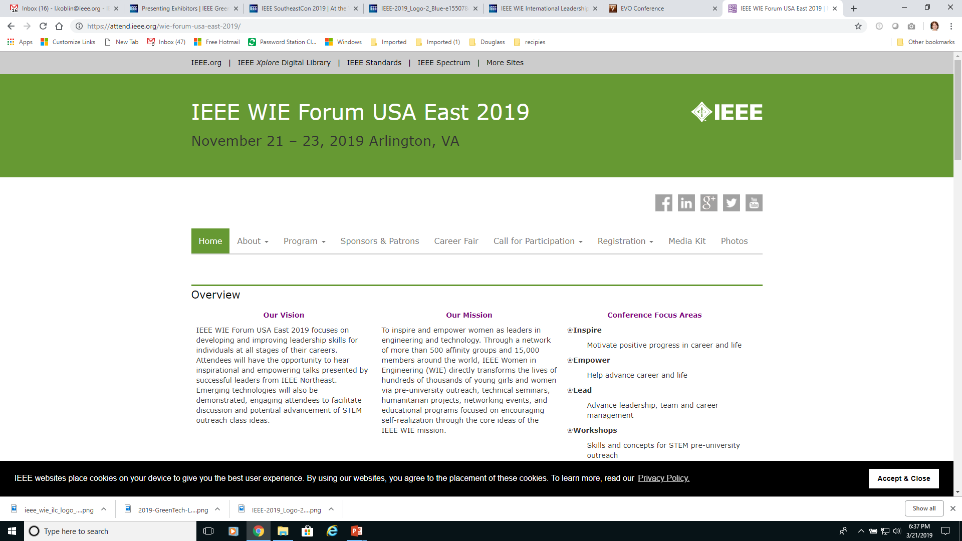
Mercer Sponsorship Commitments – 2019 examples

