Slide 1
MOVE Community Outreach
An IEEE-USA Initiative
Mary Ellen Randall IEEE Past MGA VP IEEE Past Region 3 Director MOVE IEEE-USA Community Outreach merandall@ieee.org
Notes:
Presenter, the following presentation is adaptable to your audience. Please see the notes sections for additional information, links, and other information that can improve the experience for your audience.

Slide 2
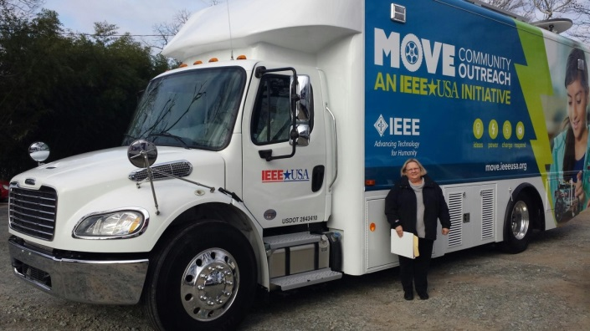
MOVE: In a Nutshell
For Disaster Survivors
Who have survived the initial catastrophe,
MOVE (Mobile Outreach VEhicle )
Is an IEEE Project that creates and operates a vehicle for disaster relief
That provides needed communications, light & power support to victims
Unlike some First Responder Efforts (e.g., ARRL, RACES)
Our project is intended to help the disaster survivors by supplying valuable services until normal infrastructure is restored.
Additionally it energizes the IEEE volunteer base, highlights skills, promotes public awareness and more
2018
Result
2 Natural Disasters (11 program total)
50,000 STEM & Public Visibility
NATIONAL American Red Cross partner

Slide 3
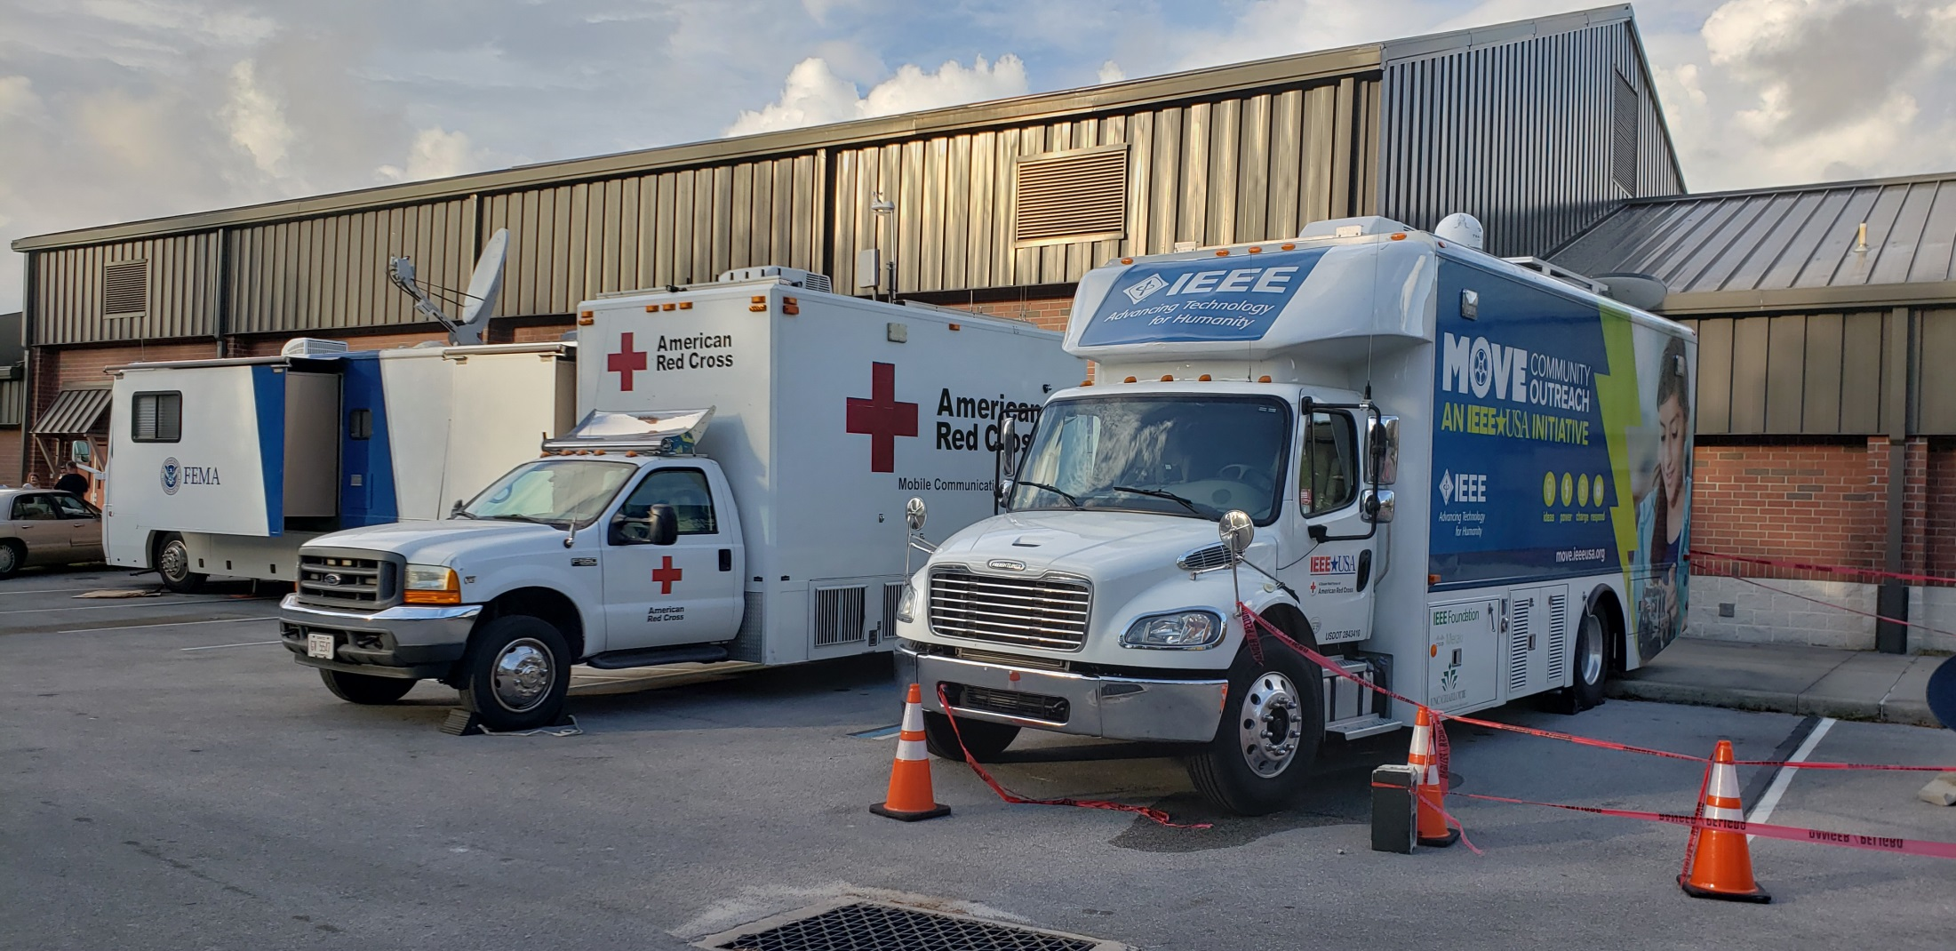
National American Red Cross Partner
David Sewell, American Red Cross Instructor is here!

Slide 4
Disaster Relief
Hurricane Florence
Supported 3 Red Cross district offices with communications and networking support
Fayetteville
Greenville
Wilmington
Supported 4 shelters with internet Wi-Fi
Hurricane Michael
Responded to Panama City FL less than 24 hours after landfall
NO power, water, or communications, including cell towers inoperable
Supported initial primary communications with Red Cross Headquarters in Tallahassee
Supported first responder communications with families
Provided internet Wi-Fi to shelter with several hundred people

Slide 5
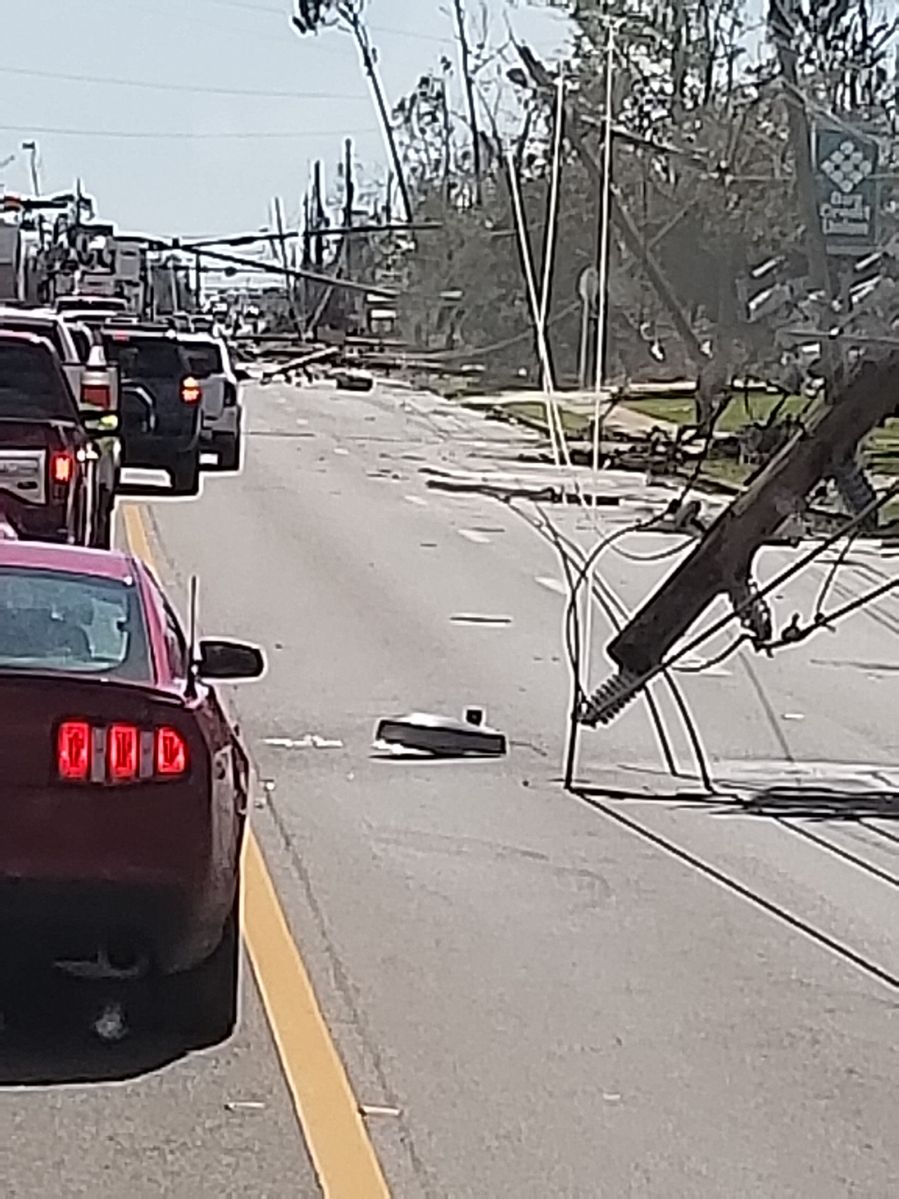

Slide 6
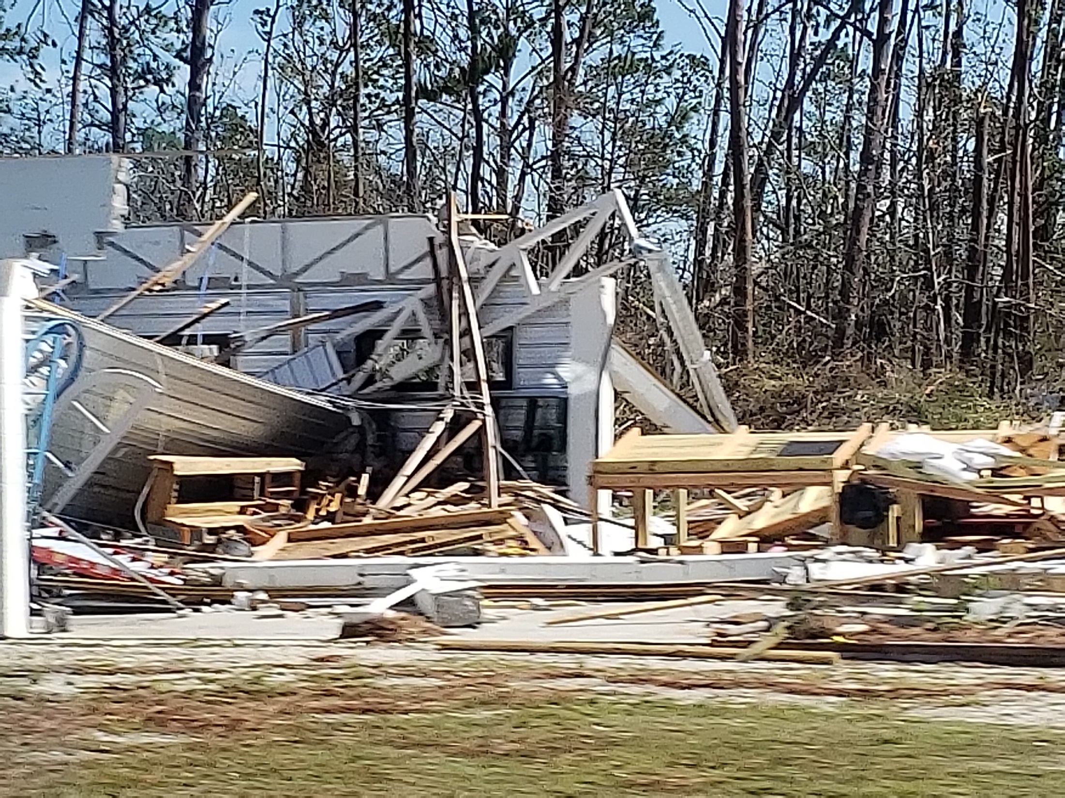

Slide 7
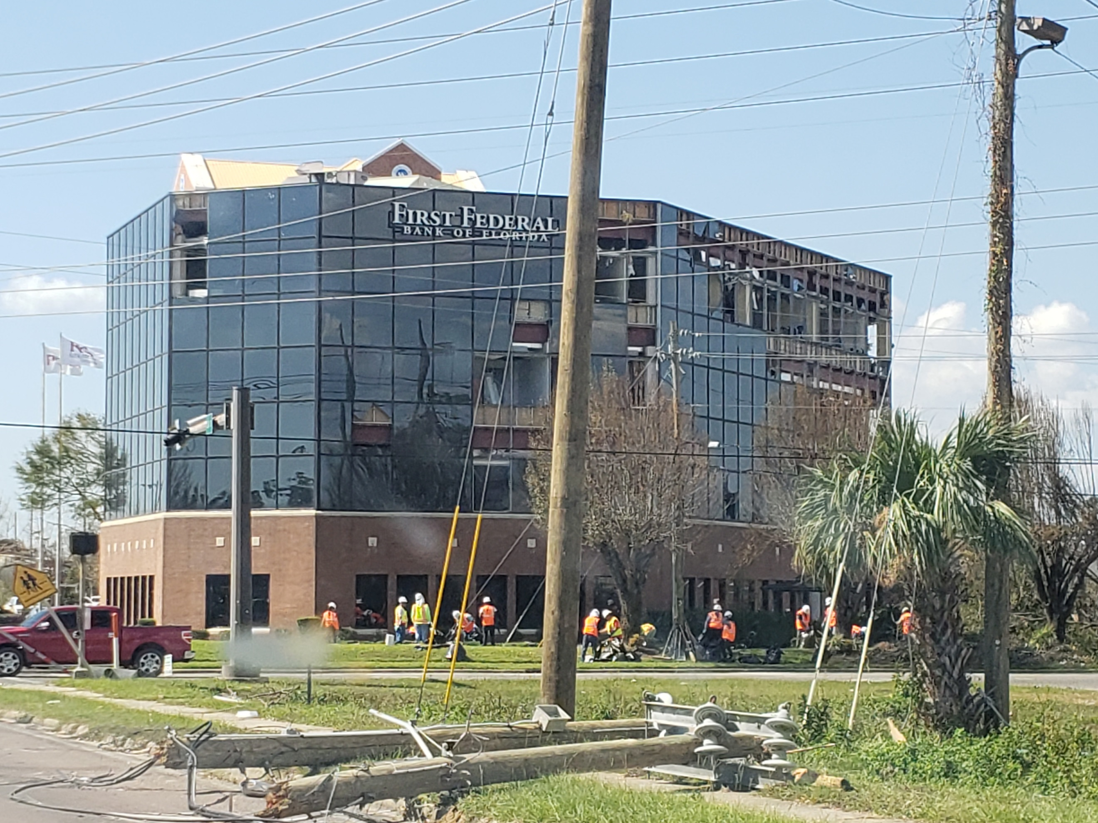

Slide 8
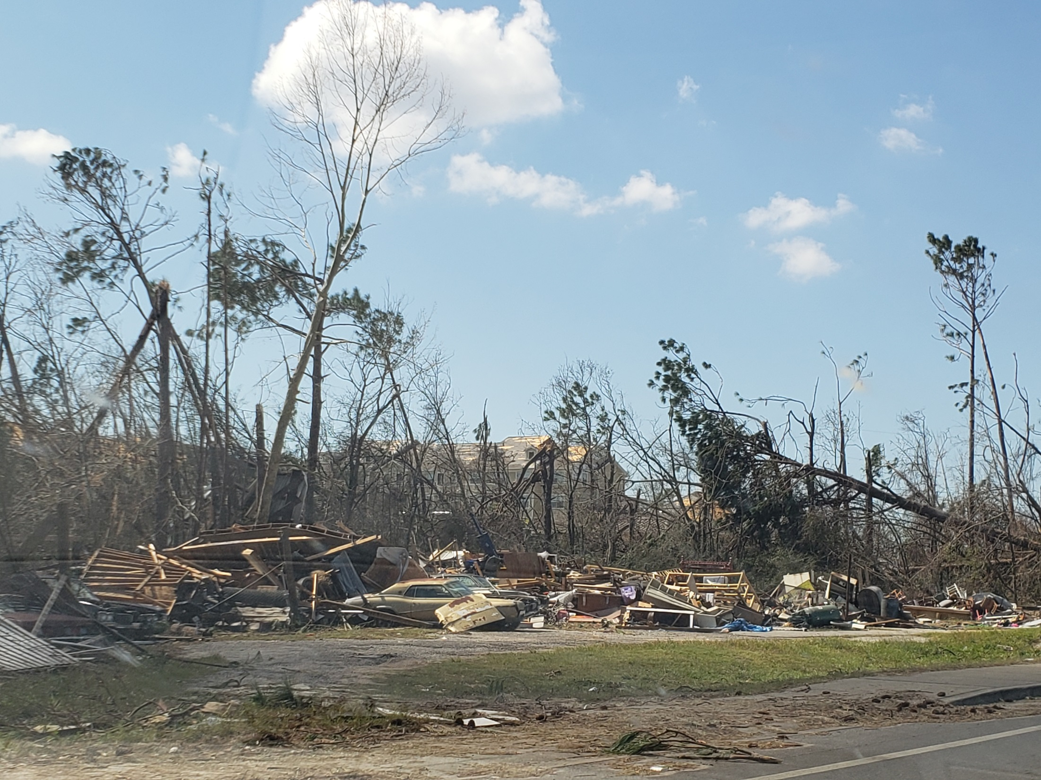

Slide 9
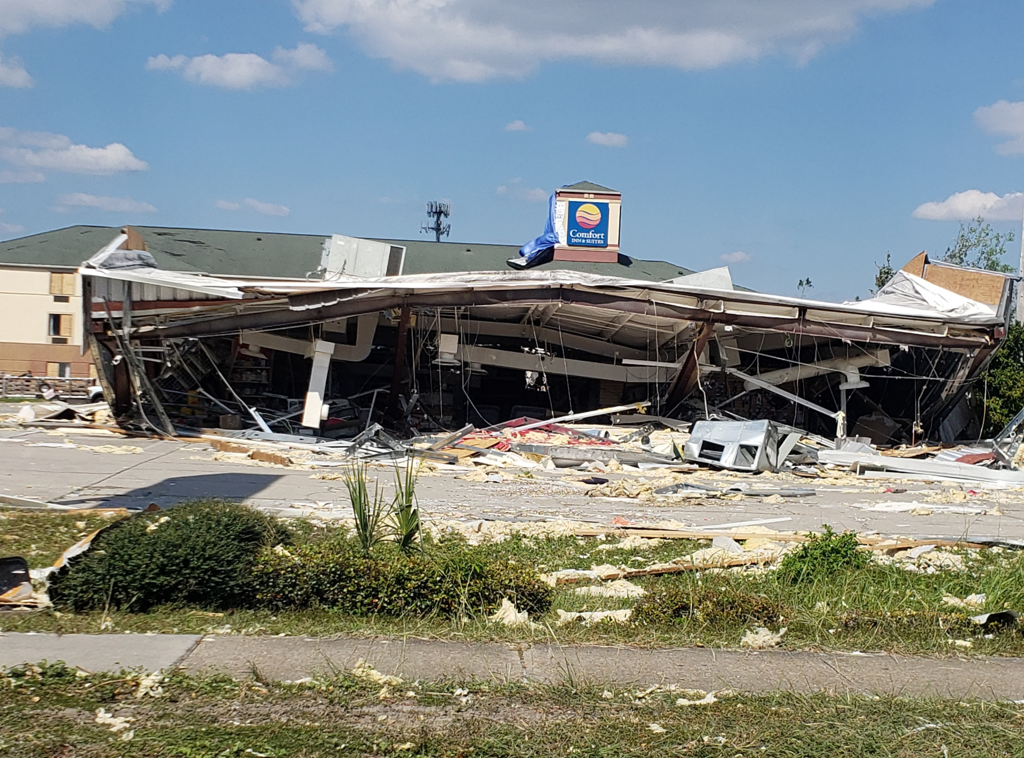

Slide 10
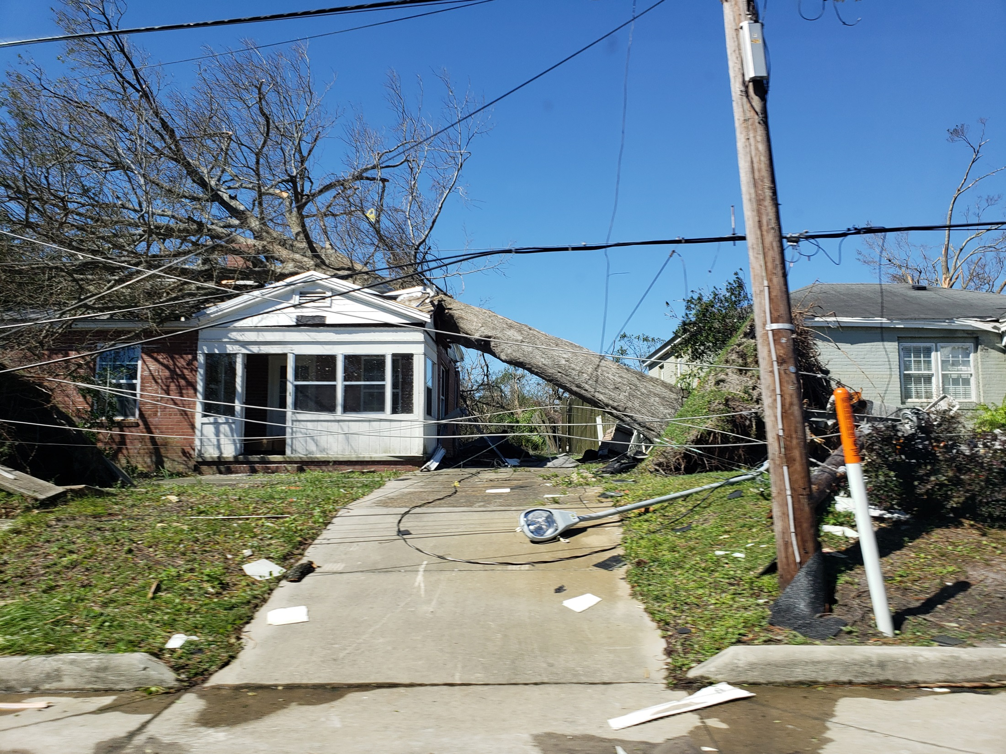

Slide 11
Entire streets destroyed

Slide 12
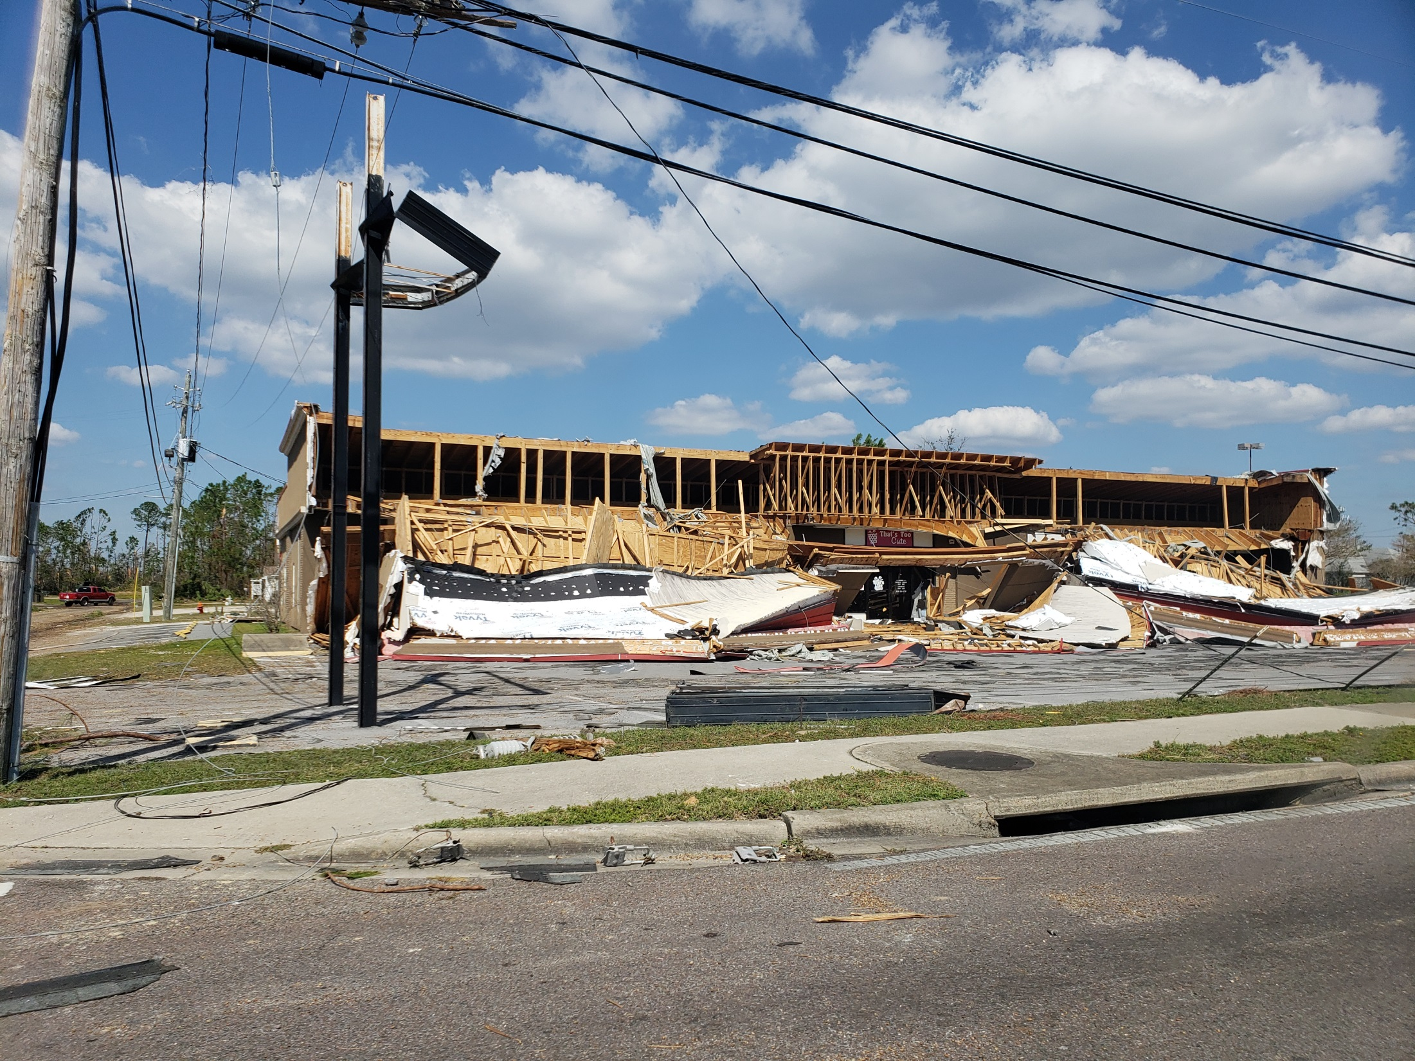

Slide 13
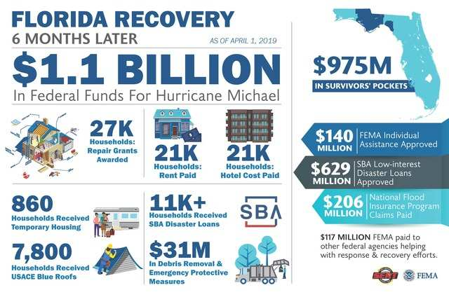
What is our impact - Florence?

Slide 14
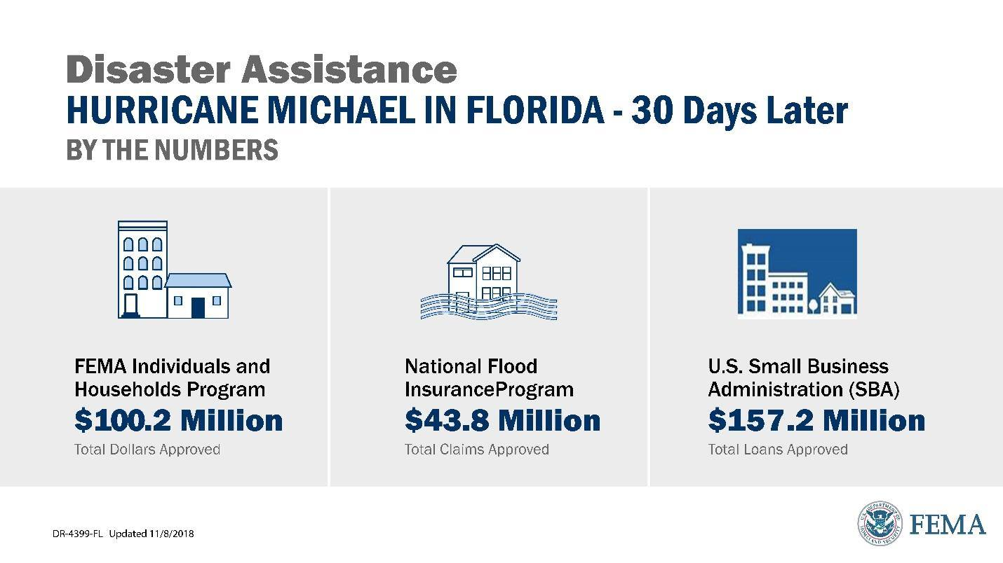
Impact of Hurricane Michael

Slide 15
Alabama Tornado – current

Slide 16
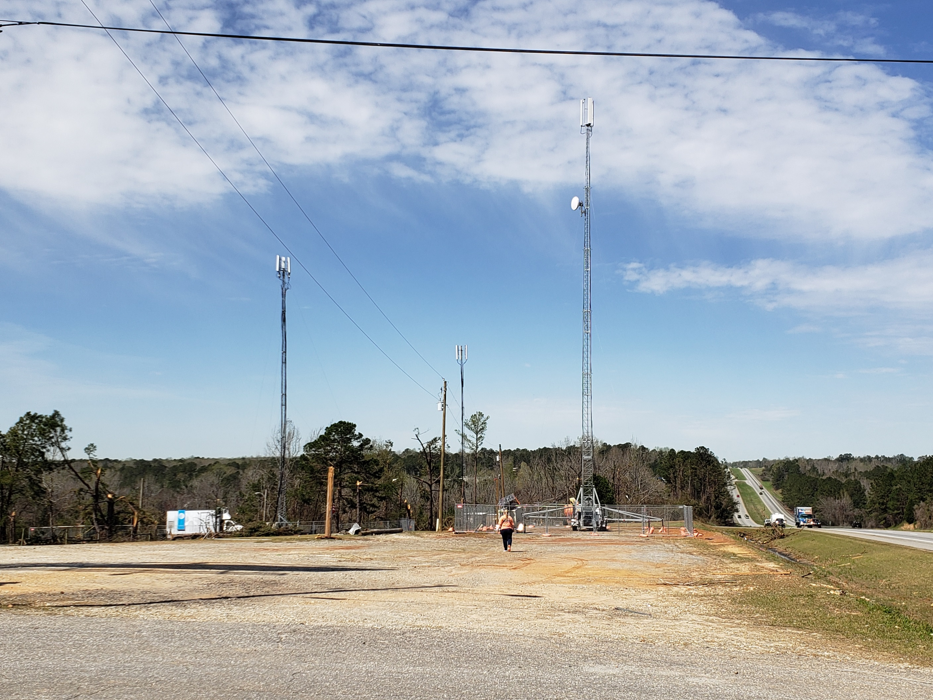

Slide 17
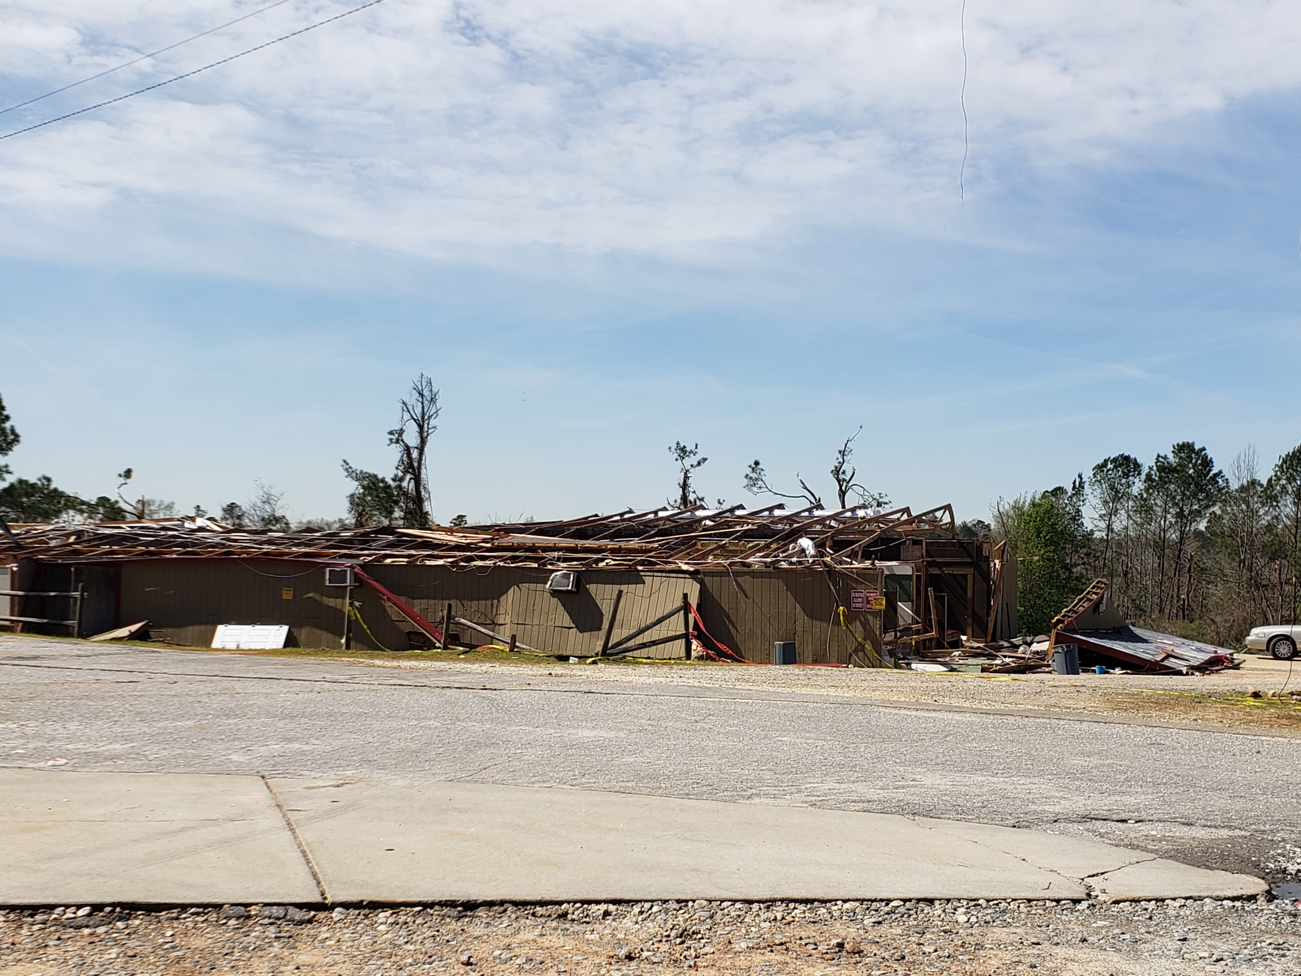

Slide 18
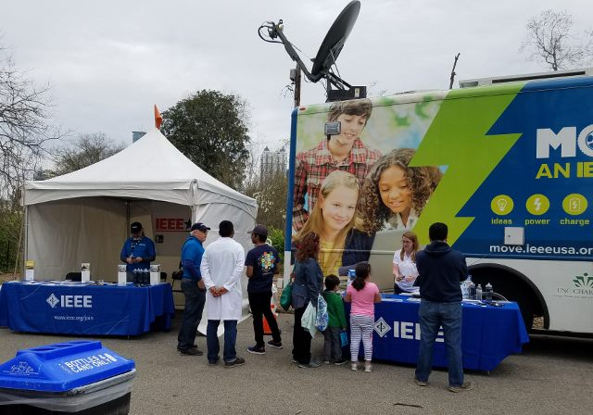
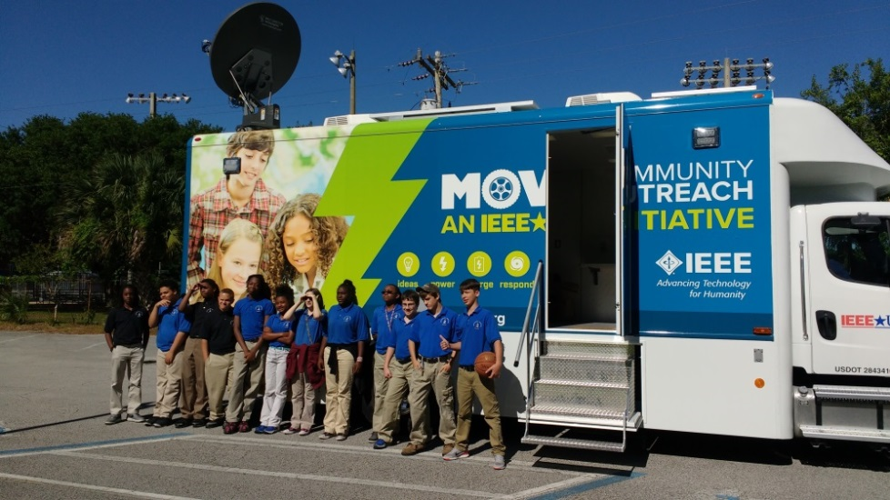
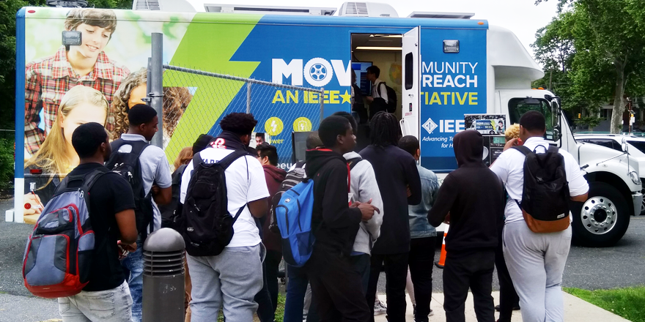
STEM & Public Visibility
Over 50,000 reached in 2018
Notes:
January 14 - Alabama Regional Future City Competition – Huntsville, AL
January 14 - Technical Activities Miniseries
January 15 - MOVE Training Class – Huntsville, AL
February 22 - Union Intermediate School – Engineers Week – Clinton, SC
March 2-4 - Red Cross Disaster Institute 2018 – Pamlico County, NC
Marcy 3 – MOVE Presentation to R10 Executive Committee – Langkawi, Malaysia
March 24 – Atlanta Science Festival – Exploration Expo - Atlanta, GA (29,000 attendees)
March 25 - MOVE Training –– Atlanta, GA
March 27 - Wellcome Middle School STEM Fair - Greenville, NC
April 5 - Red Cross Middle School STEM Event – Durham, NC
April 10 - Red Cross Triangle Chapter Volunteer Luncheon - Cary, NC
April 19 - MOVE Red Cross DST 101 Training (SoutheastCon) - St. Petersburg, FL
April 22 - MOVE Truck Systems Training (SoutheastCon) - St. Petersburg, FL
April 28 - Burlington Maker Faire – Burlington, NC (8,000 attendees)
April 29 – University of North Carolina Science & Technology Expo - Charlotte, NC (10,000 attendees)
May 19 – 2018 Cape Fear Preparedness & Safety Expo - Wilmington, NC
May 30 – Philadelphia - Charter Schools

Slide 19
HOW TO HELP
We are funded by donations – MOVE Fund of IEEE Foundation
http://move.ieeeusa.org
Volunteer for a STEM, Disaster Relief team or Public Visibility team
Take MOVE training
Like (5 stars) our Facebook page ieeeusamove
Help with planning and preparation
Ask your company to help

Slide 20
For More Information
merandall@ieee.org
Thank you for your support!
Mary Ellen Randall
MOVE Community Outreach Program Director

