Slide 1
IEEE SECTIONS CONGRESS 2020
21-23 August 2020
Ottawa, Ontario, Canada

Slide 2
IEEE Sections Congress 2020 Theme
Leading Our Global Technical Community

Slide 3
Sections Congress 2020
SC2020 Chair: Loretta Arellano
Selection of Program Chair and remainder of committee is under consideration
Ottawa Section volunteers will support the Local Organizing Committee.

Slide 4

Ottawa
Ontario, Canada
Capital of Canada
Population: 1.25 million
Official Languages: English and French
Brand new light rail through downtown opening this year.
Weather in August: Highs around 78℉ (25℃) / 58℉ (14℃)
With 80,000 people employed in ICT, Ottawa is Canada’s most technology-intensive city; leading sectors include software, communications, defense and aerospace, clean tech, life sciences, and digital media

Slide 5
Shaw Centre
The Centre houses 192,000 sq. ft. of flexible, state-of-the-art function space spread over four floors
Recently named one of the top 3 convention centers in the world in AIPC’s World’s Best Convention Centre rankings
20-minute commute from the airport
Within a short walk of 6,000 downtown hotel rooms

Slide 6
Sections Congress Meeting Space at the Shaw Center
Level 2 for meetings
Level 3 for exhibits and plenary

Slide 7
Sections Congress Hotels
Andaz Ottawa ByWard Market
325 Dalhousie Street
Room Rate: CAD 249.00
Proximity To Shaw Centre in Meters (Km/Miles): 300m / .186 miles
Fairmont Chateau Laurier
1 Rideau Street
Room Rate: CAD 275.00
Proximity To Shaw Centre in Meters (Km/Miles): 300m / .186 miles
Novotel Ottawa
33 Nicholas Street
Room Rate: CAD 189.00
Proximity To Shaw Centre in Meters (Km/Miles): 450m / .280 miles
The Westin Ottawa
11 Colonel By Drive
Room Rate: CAD 275.00
Proximity To Shaw Centre in Meters (Km/Miles): Directly connected

Slide 8
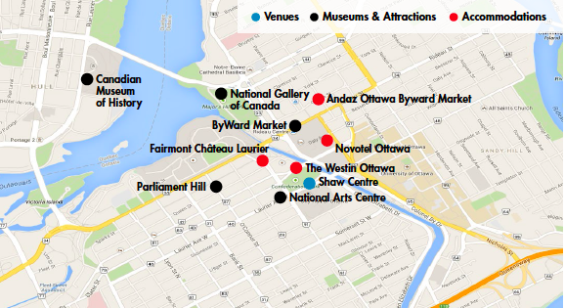
Ottawa Local Area

Slide 9
Region/Section Participants in SC2020
MGA will cover
1 Primary Delegate per Section
Regions 1-10 WIE, SAC, YP (affinity group coordinators) from each region will be covered at 50% with equal 50% paid by their region. No Substitutions or last minute appointments will be accommodated
(Note: Honors Ceremony and CONVENE not held in conjunction with SC2020.)
Timing/schedule considerations:
Each Region to communicate to MCE about their Region Meeting at SC 2020 by 12/31/19
Region lists with their Primary Delegates, Student, Young Professional and Women In Engineering Coordinators are required by February 2020 Board Series

Slide 10
MGA Budget Considerations for Region/Section Participants
Expenses to be reimbursed for those MGA is covering:
Travel
  Limited to 3 Nights hotel stay at one of the designated hotels
  Economy Class Airfare Only (no exceptions will be reimbursed) or Ground Transportation (max of $200USD)
Meals:
  $50 per night (USD) for dinner allowance up to 2 nights, inclusive of Tip, Tax & Beverage (receipts needed)
  Meals included in Congress event will be: Welcome Dinner Friday; Sat & Sun Breakfast, Lunch and AM and PM Breaks
Expenses that will not be reimbursed
No Travel Insurance
No breakfasts & lunches outside of the Congress

