Slide 1
Candidate for IEEE R3 Director-Elect 2020-2021
Theresa Brunasso, theresa.brunasso@ieee.org
SoutheastCon 2019, Huntsville, AL

Slide 2
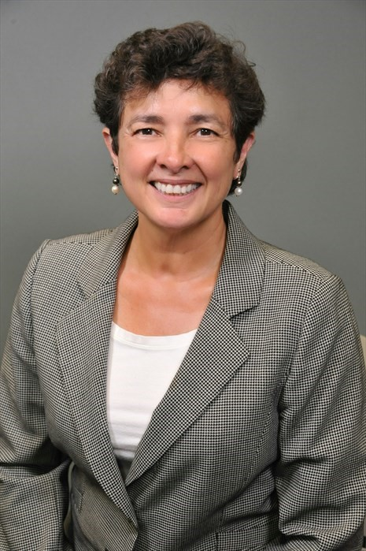
Who am I?
Working Engineer
Small Business Owner
Frequent Volunteer
Named Georgia’s Woman of the Year in 2008 by Women in Technology
Wife to Brian Boe (UGA Math professor) since 1987
Love to travel, hike, cook, and laugh!

Slide 3
IEEE Activities
Member since 1982
Society Memberships
Microwave Theory & Techniques
Antennas & Propagation
TAB Conferences Committee 2019
Region 3 Professional Activities Committee Chair 2017 to present
Region 3 PACE chair 2015, 2016, 2017, 2018 and 2019
Atlanta Section Chair 2016 & 2017
Atlanta Section Vice Chair 2015
Atlanta Section Secretary 2013 & 1014
Atlanta PACE Chair 2012, 2013 & 2014
Employment Assistance Volunteer 2011
Atlanta WIE Secretary 2011 - 2015

Slide 4
IEEE Accomplishments
Region 3 Outstanding Volunteer Award in 2018 for work as Atlanta Section Chair and Region 3 Professional Development Committee chair.
IEEE-USA Board of Directors Regional Professional Leadership Award in 2015
Region 3 Professional Leadership Award in 2012 for developing multiple PACE activities
Atlanta Section Volunteer of the Year in 2011 for developing employment assistance activities.
As Atlanta Section Chair
Started two new chapters (TEM & ED/PHO)
Won honorable mention for member retention in 2016
Won the Region 3 award for the most Senior Member upgrades in 2017

Slide 5
My IEEE Goals
Provide more Region support for local Sections and Councils.
I believe that the biggest impact on members occurs at the Section level, and our region has the largest number of Sections in the U.S.
Some of our Sections are struggling, and I want to help them thrive.
I would work to have events and meetings in different sections to provide both exposure and support.
I want to replace the IEEE-USA PACE funding that is vanishing in a few years, so that Sections and Councils can continue to provide Professional Activities for their members.

Slide 6
My Day Job
Microwave Engineering for Satellite communications, radar, and electronic defense
Started my consulting business, D&S Microwave, Inc., in 2010, after 25 years in industry.
Selected Past Projects:
Mars Science Laboratory
DirecTV
XM-Radio
INTELSAT IX
MILSTAR II
DarkStar
Current Projects:
National Spectrum Consortium for Georgia Tech Research Institute
Phased array design for Atlanta based company

Slide 7
When will all this happen?
Voting will be early August through early October
Elected individual will serve as:
Director-Elect in 2020-2021
Director in 2022-2023
Past Director in 2024-2025

Slide 8
Please contact me if you have questions or suggestions Thank you!
Theresa Brunasso, theresa.brunasso@ieee.org

