Slide 1
SoutheastCon 2022 Site Selection Motion
Sean Haynes, Region 3 Conferences Committee Chair
Charles Lord, Region 3 SoutheastCon Subcommittee Chair

Slide 2
Selection Process
Several Locations Researched
Space Coast, FL
Daytona Beach, FL
Charleston, SC
Myrtle Beach, SC
Mobile, AL
Knoxville, TN
Memphis, TN
SoutheastCon Subcommittee Performed Site Visits
Conference Committee Sent Motion to EXCOM
EXCOM Approved Motion to Send Recommendation to Region Committee

Slide 3
Selected Location
Mobile, AL
Renaissance Mobile Riverview Plaza Hotel
$149/night
Outlaw Convention Center
CVB has comped our use of the Convention Center
Mobile Section
University of South Alabama
March 30 – April 3, 2022

Slide 4
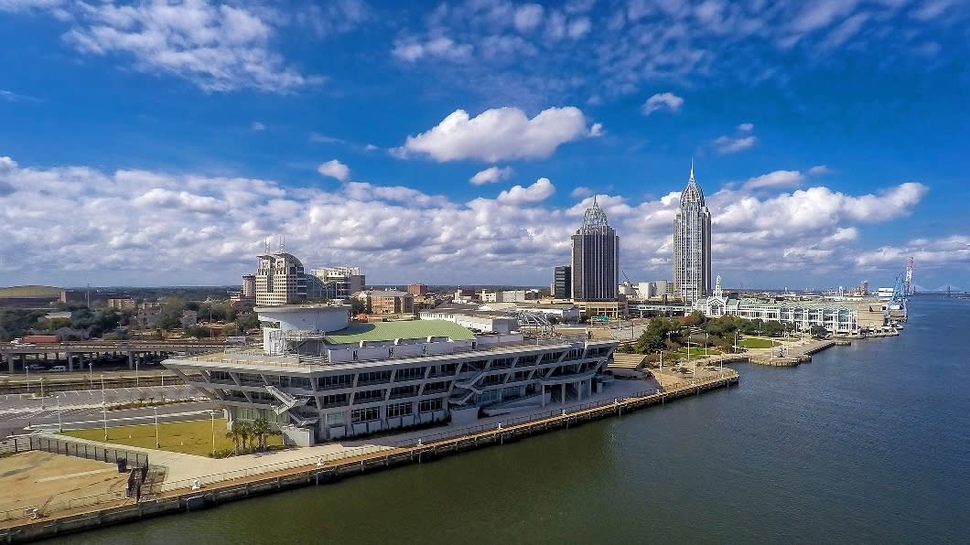
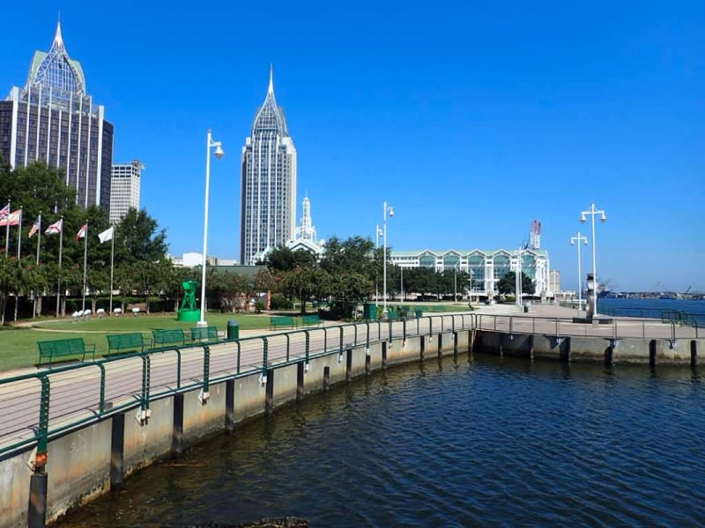
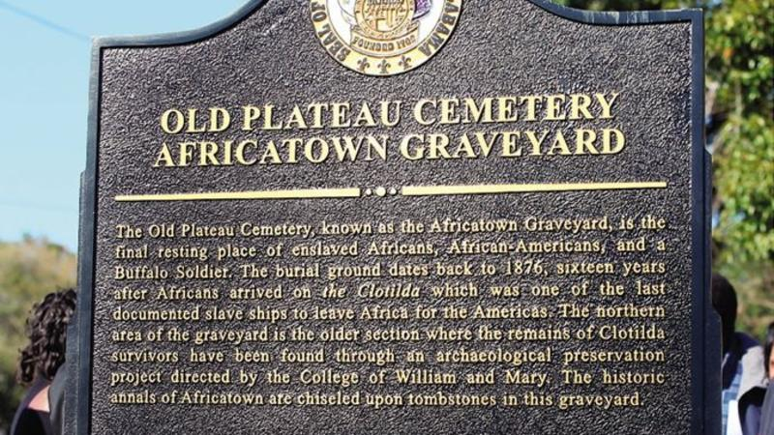
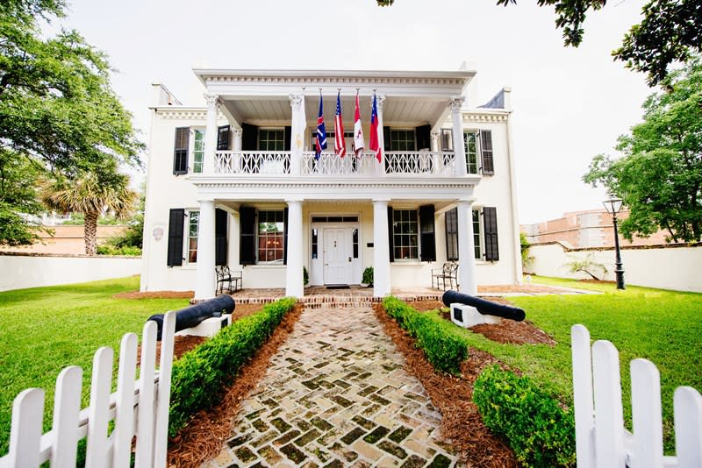
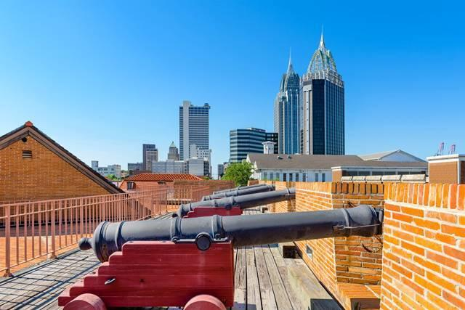
Mobile, AL
The Birthplace of Mardi Gras in America!

Slide 5
Renaissance Riverview Plaza Hotel
373 Guestrooms
Overflow space available at the Renaissance Battle House (Sister Property)
44,000 Square Feet of Meeting Space
Downtown Location
Near many local outlets (Food & Shopping)
Near many local attractions and museums
Airport MOB
14 Miles from Hotel
No Hotel Shuttle – Cost up to $40
On-Site Parking - $20/night

Slide 6
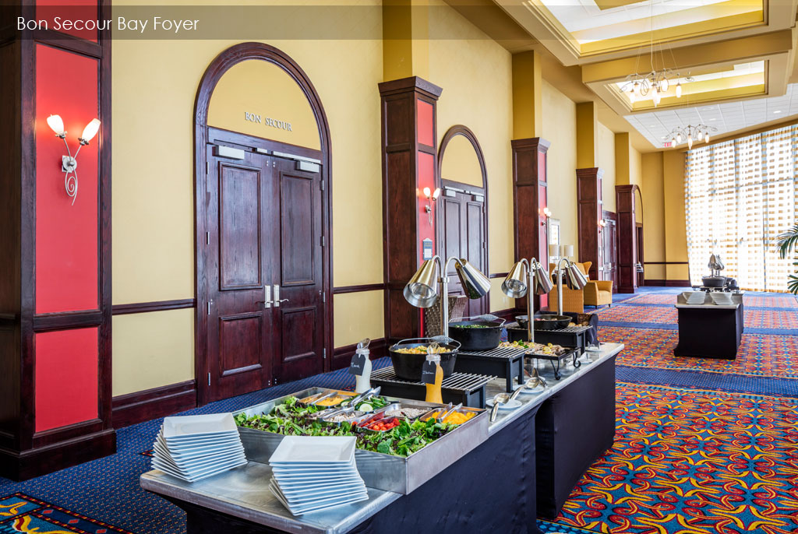
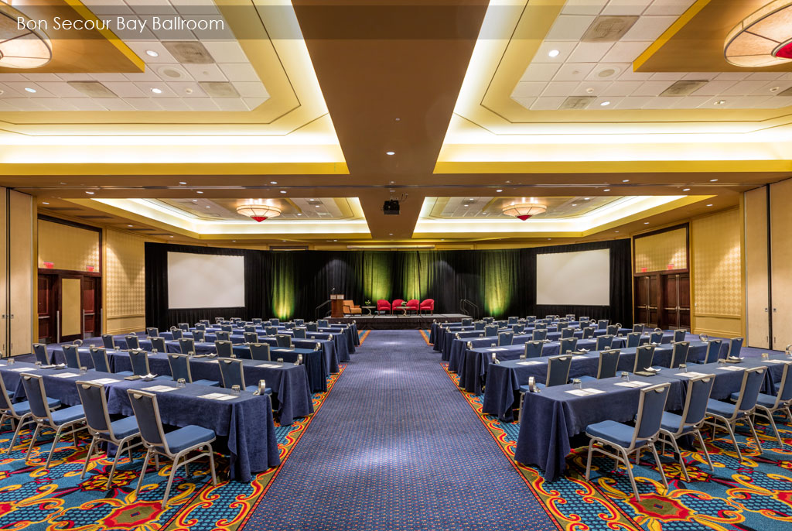
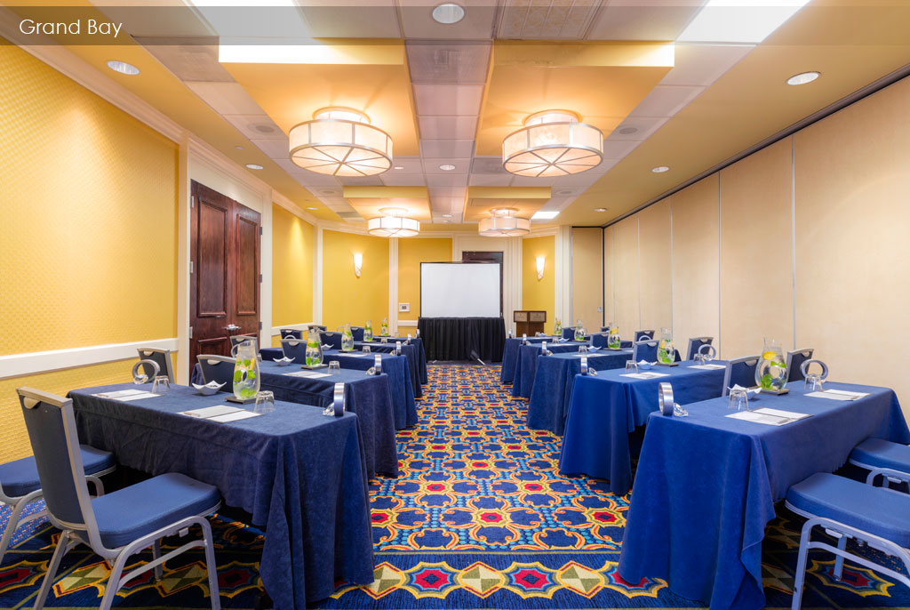
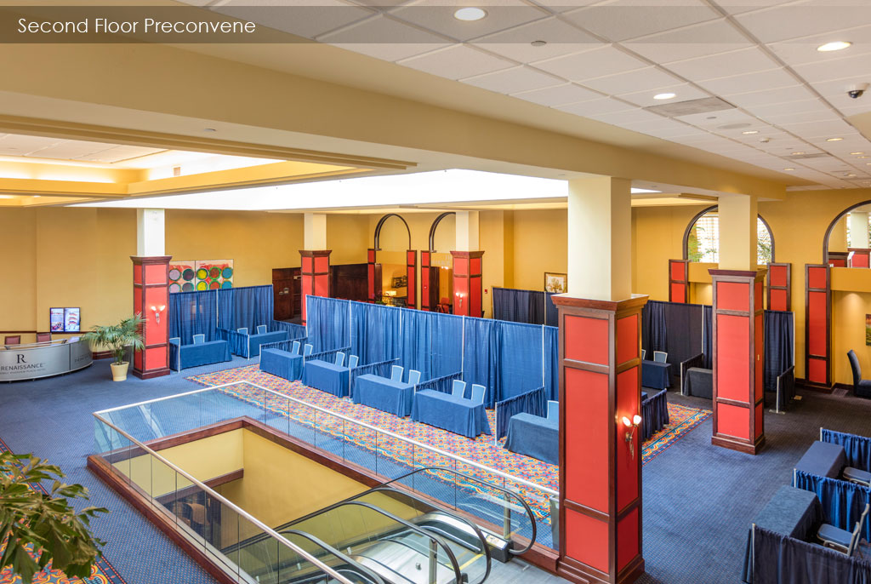
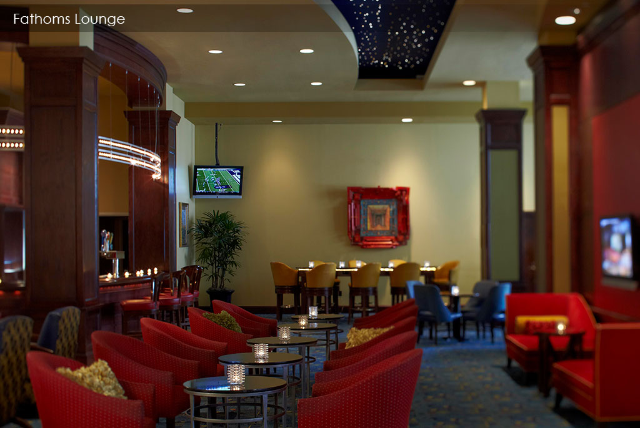
Photo Gallery
Renaissance Riverview Plaza Hotel

Slide 7
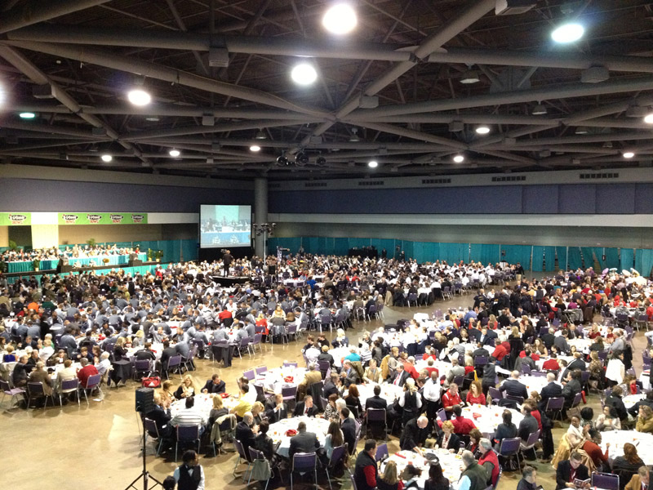
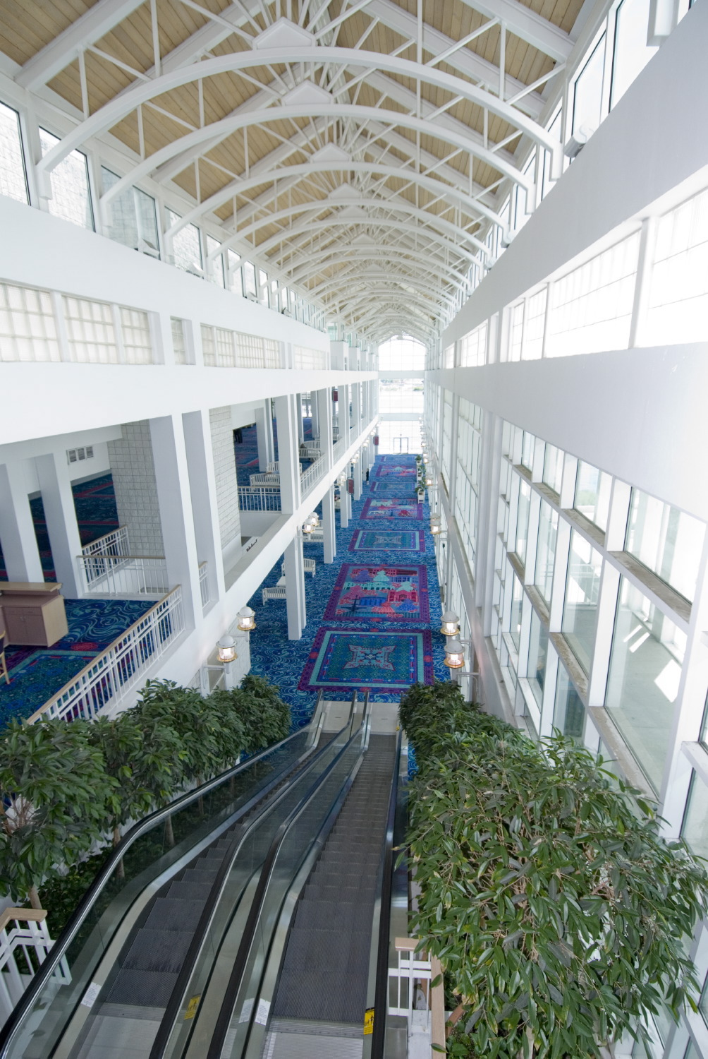
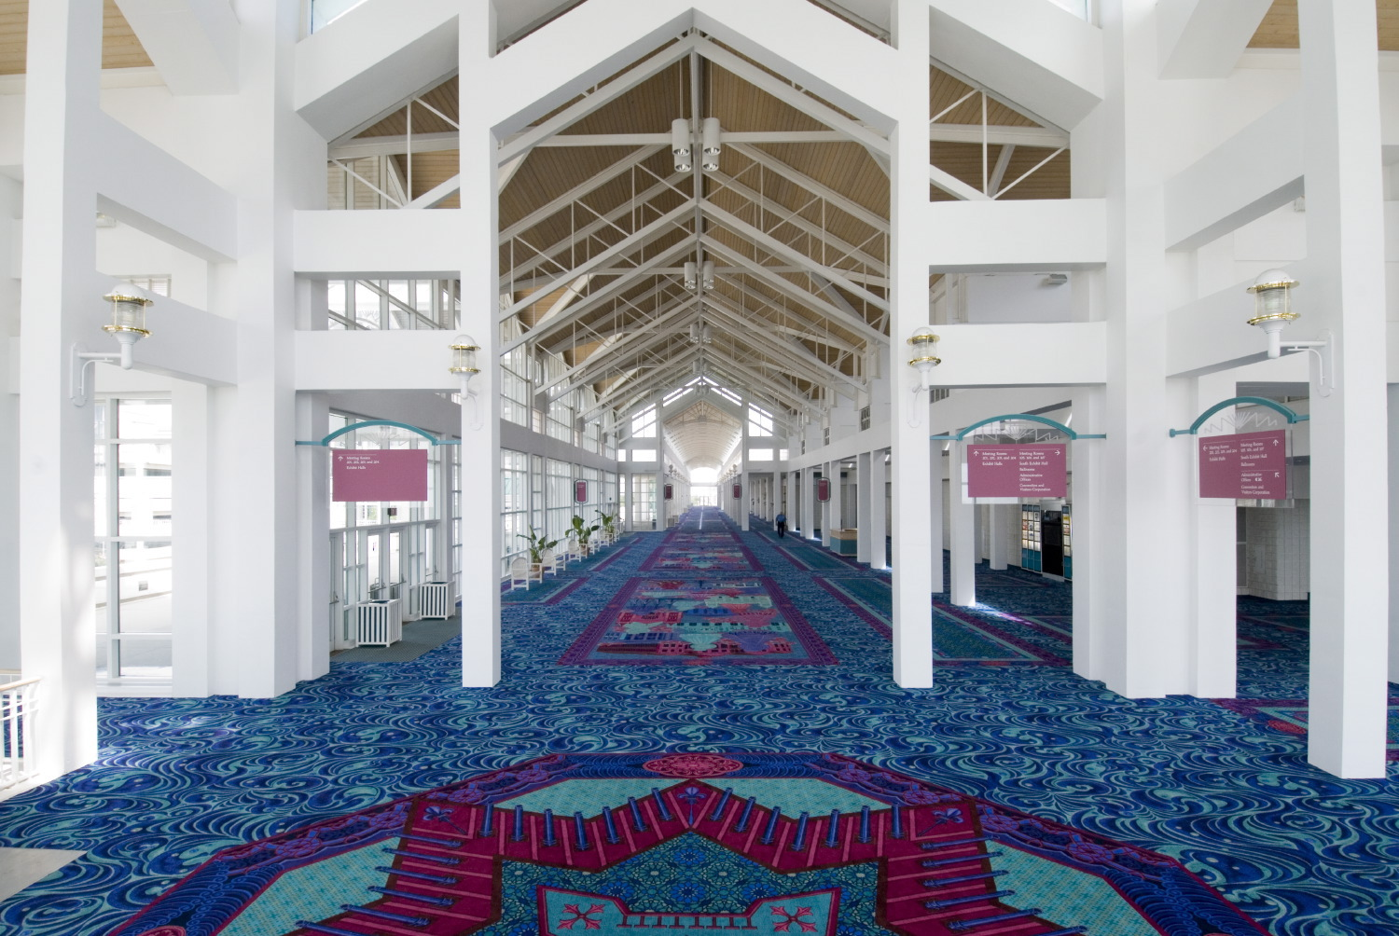
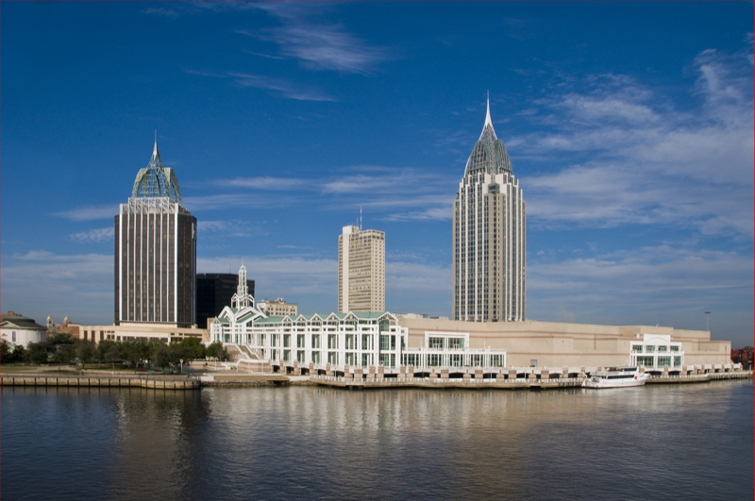
Photo Gallery
Arthur R. Outlaw Convention Center

Slide 8
Mobile Section
The Conference Committee met with the officers of the Mobile Section at the University of South Alabama on March 4
The section has pledged their commitment to making SoutheastCon 2022 a success
The SoutheastCon subcommittee has been asked to provide mentoring and support in the operation of the conference
There are a number of large industrial companies in the area that will be solicited for sponsorship as well as additional volunteer resources
The section plans to use the conference as an opportunity for growth in the section as well as improving relations and outreach with local industry

Slide 9
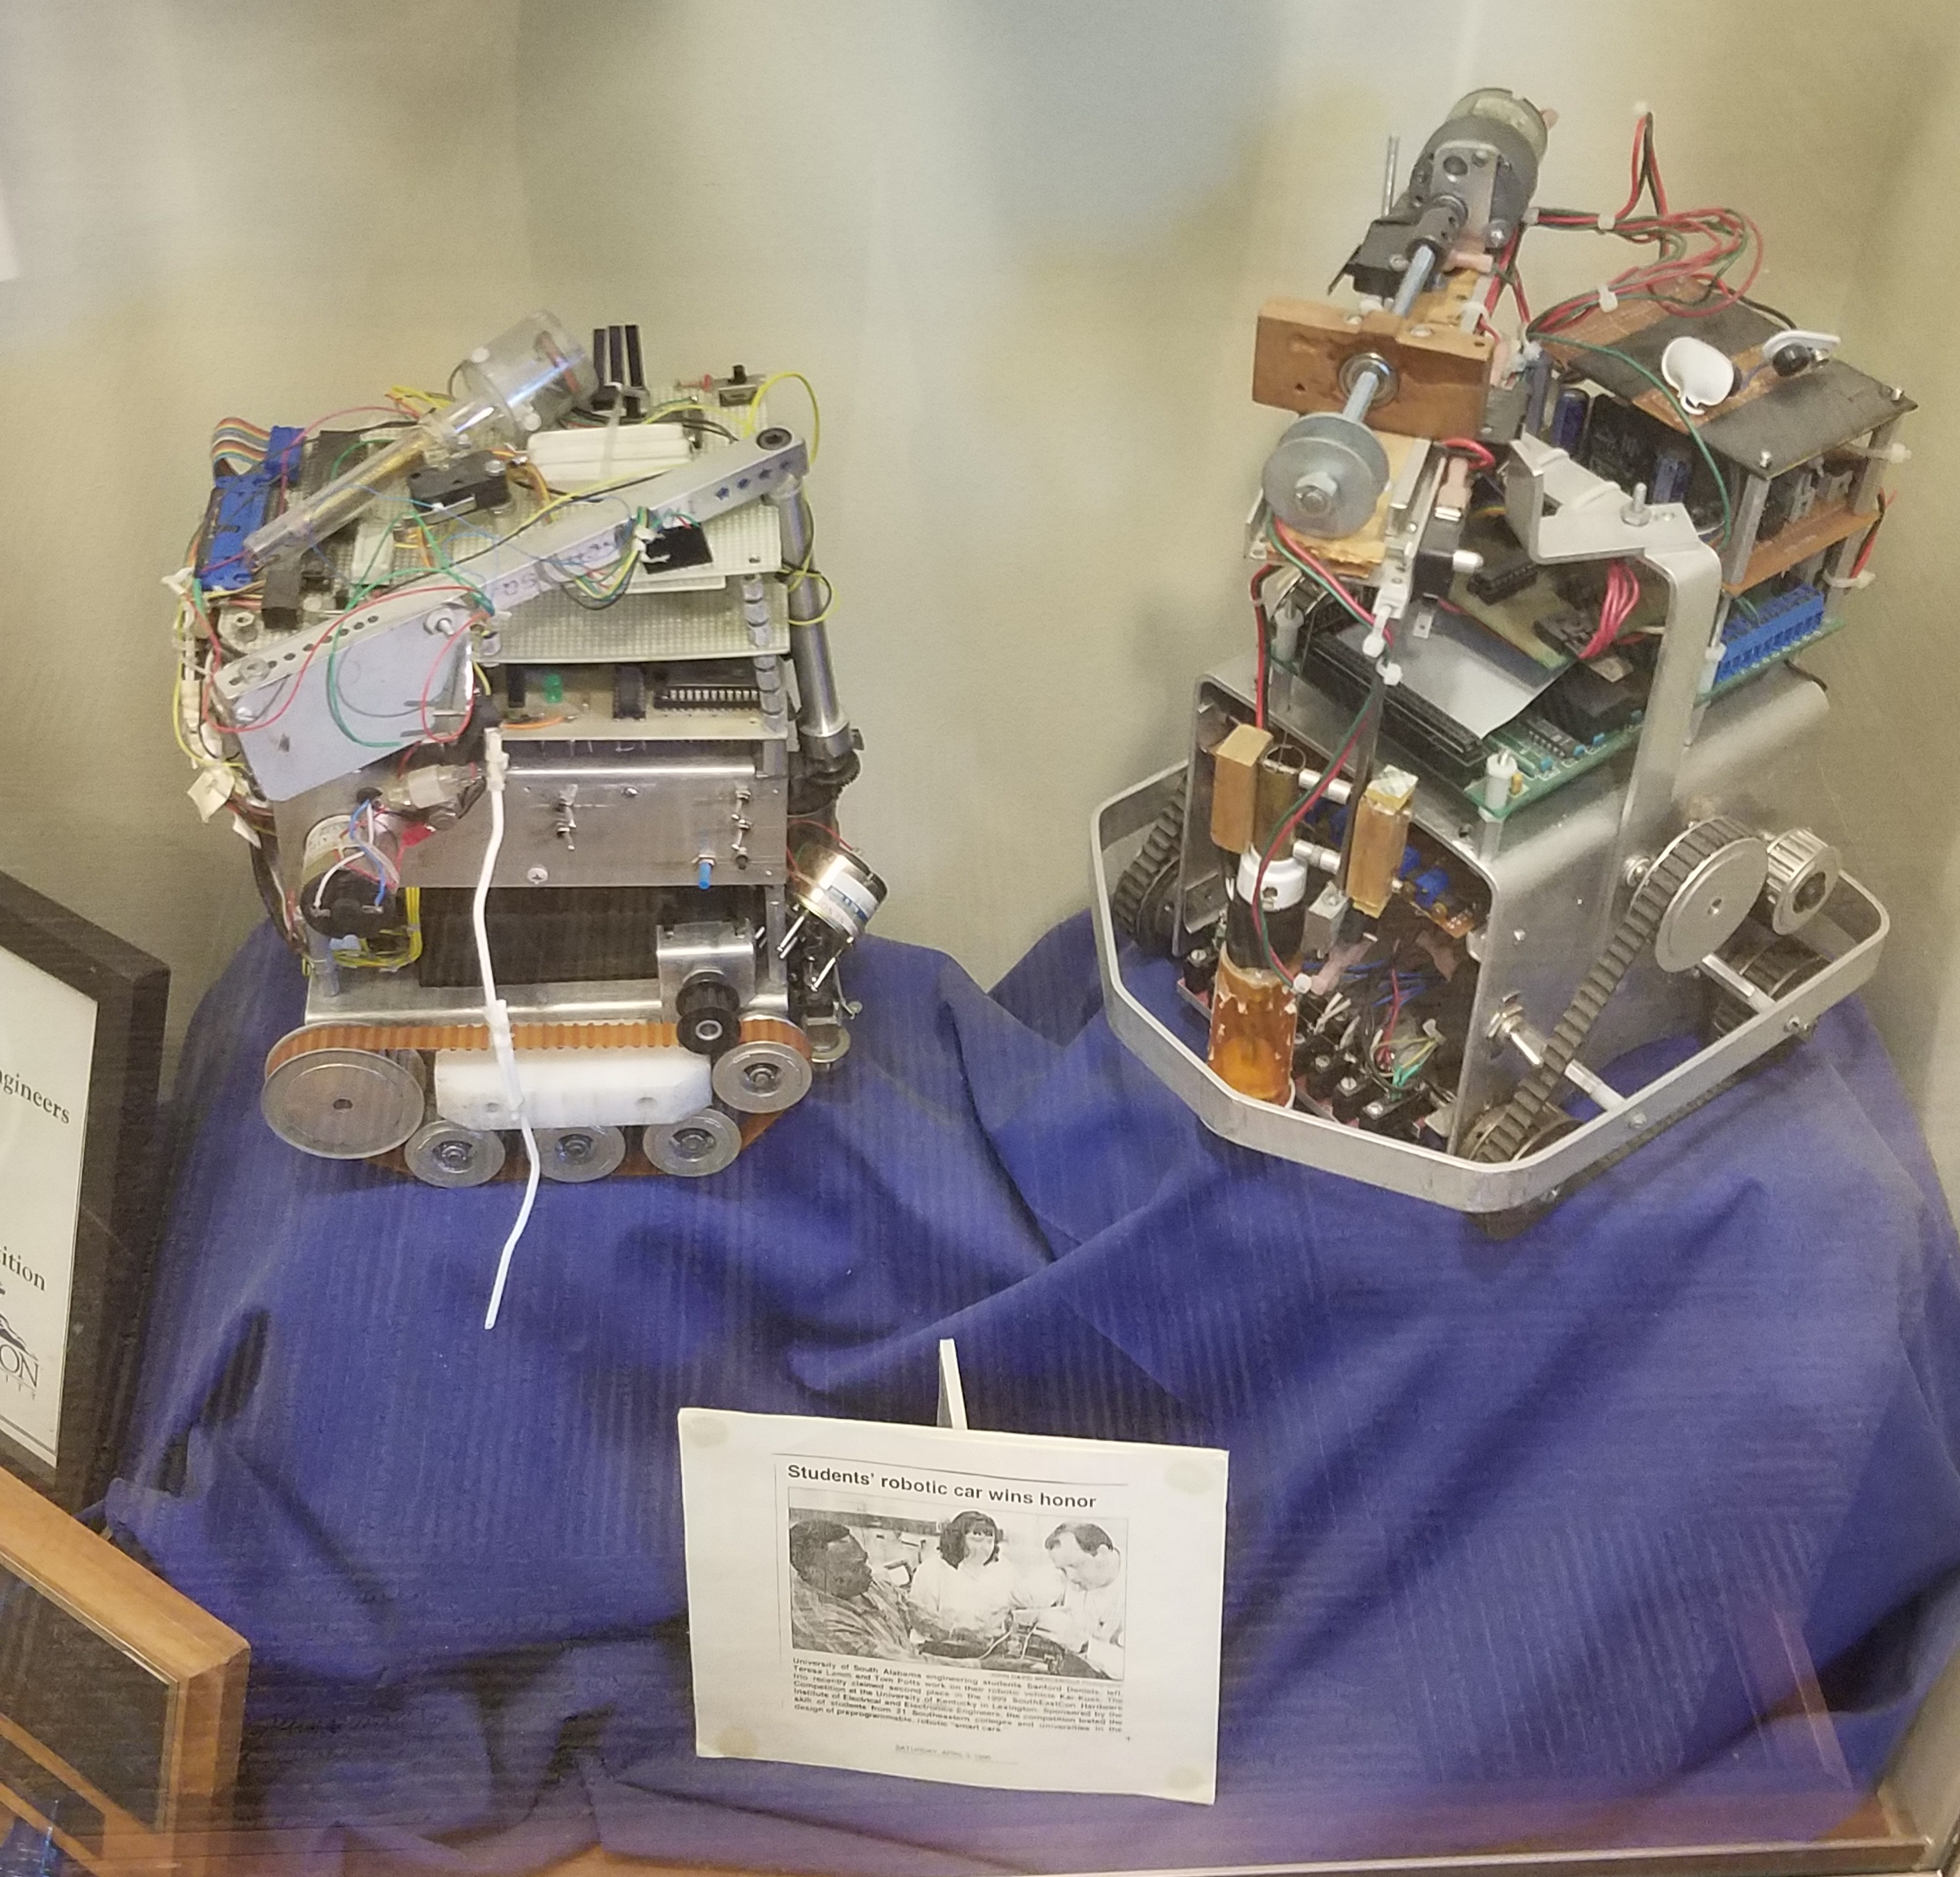
Host Student Branch – University of South Alabama
The core team in Mobile are also senior faculty at the University of South Alabama
The USA student branch has been a very active participant in past SoutheastCons
The USA faculty has pledged support for the student branch for developing and hosting the hardware, software, and other competitions at IEEE SoutheastCon 2022

Slide 10
Motion
The Conference Committee moves that Mobile, AL and the Mobile Section with the University of South Alabama at the Renaissance Riverview Plaza on March 30 – April 3, 2022 be selected as the host site for IEEE SoutheastCon 2022.

Slide 11
Thank you!
Sean Haynes, s.a.haynes@ieee.org
Charles J. Lord c.j.lord@ieee.org

