Slide 1
Promoting Public Policy & Member and Career Services, plus…
Tom Coughlin
President, IEEE-USA
2019 Region 3 Meeting
Huntsville, AL| 13 April, 2019

Slide 2
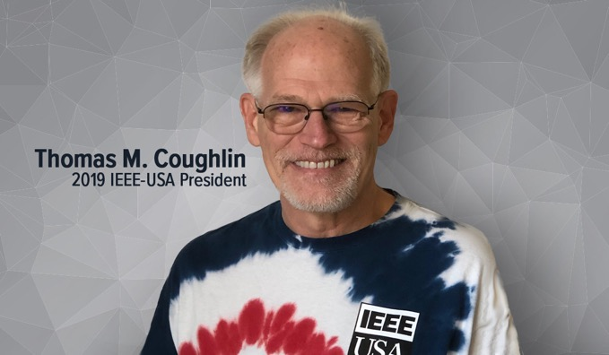


Technology, for

Slide 3
IEEE USA
IEEE USA promotes public policies to support our members and the profession
IEEE USA supports member development through professional development ebooks, webinars and other educational resources, the salary survey, Consultants Network and Entrepreneur
IEEE USA runs programs such as EVO19 for young professionals in August 2019

Slide 4


IEEE-USA Advocates on Issues That Affect You
Helped defeat plan to tax graduate assistantships
Supporting basic & applied research
Improve regulatory environment for start-ups and small and mid-sized tech companies
Ensure strong intellectual property protections
Understanding implications of AI & Autonomous Systems
Setting U.S.’s future course in space
Promoting strong encryption and protection of your digital privacy
Find Issues That Matter to You at:
ieeeusa.org/advocacy

Slide 5
Government Relations
Over 350 volunteers serving on 10 committees
5 staff registered as lobbyists
Gov’t Fellowships supported in Congress, State Department and USAID
Sponsor 2-3 student members annually in Washington Internships for Students of Engineering (WISE) program.
IEEE-USA Public Policy Committees
Government Relations Council
Artificial Intelligence & Autonomous Systems Policy
Communications Policy
Transportation and Aerospace Policy
Energy Policy
Entrepreneurship Policy and Innovation
Government Fellowships
Intellectual Property
Research and Development Policy
Washington Internships (WISE) Task Force
And more…

Slide 6

Professional Development Webinars https://ieeeusa.org/careers/webinars/
Examples
How to Get Invited Into the Boy’s Club – And Why Its Important
Good Girls Ask – Negotiations for Women
Helping You – and the Children in Your Life – Learn STEM Subjects More Efficiently
Engineering Careers in Social Innovation and Global Sustainable Development
What Hiring Managers Want to Hear from Candidates in a Phone Interview
Tips for a More Fulfilling Career Without Starting Over
IEEE Collabratec – Why You Should Join an On-line Community
Building the Consultants Practice of Tomorrow Using
Today’s Online Tools
Communicating 300% Better
Will offer 25+ new professional development webinars in 2019.
Over 200 archived webinars with supporting slides and documents are also available on demand.
Got a topic or speaker to suggest? Contact Darryl Griffin at d.r.griffin@ieee.org

Slide 7

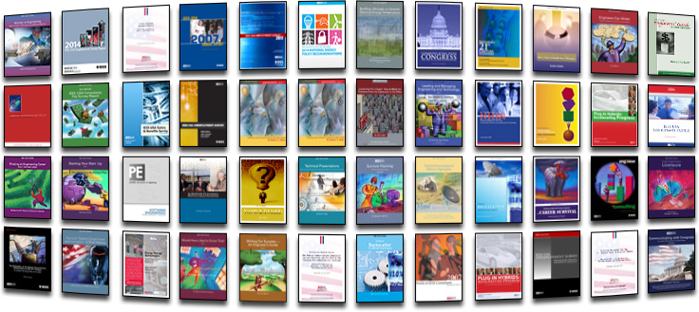
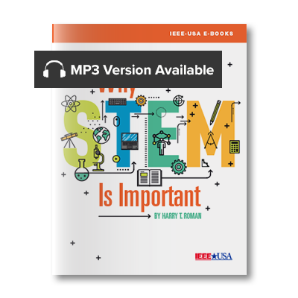
Free eBook And Audiobooks Featured Monthly!
Teaching Your Kids to Think
and Solve Problems
Free Ebook (Feb-March 2019)
Over 250 eBooks in our on-line catalog
Typically priced $2.99 member; $4.99 non-member
Nearly 700K+ downloads (mostly free titles)
Why STEM is Important
Free Audiobook (March 2019)
https://ieeeusa.org/shop/
Featured (Free) Ebook for Feb-March 2019

Slide 8
Salary and Benefits Service https://ieeeusa.org/careers/salary-service/
Data collected in a comprehensive survey of IEEE U.S. members; most granular survey on ECE professionals in the market today.
Survey participants earn free uses of the salary benchmarking tools in exchange for participating in the survey.
IEEE-USA also publishes five industry-specific salary reports along with the annual Salary & Benefits report, dating back to 2013.

Slide 9
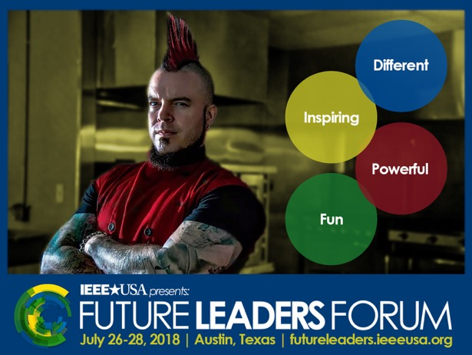
Professional Development Conferences
2016 - New Orleans
2018 - Austin
2019 - Pittsburgh
Register Now!
Evoconference.org

Slide 10

My Objectives:
Work to create a top level membership experience and increase membership in IEEE and IEEE-USA (retention and growth)
Create a more efficient and cost effective IEEE USA
Represent the interests of our members to the government
Increase awareness of IEEE-USA and its value
Increase IEEE-USA connections with industry
Increase our engagement and perceived value to other IEEE OUs
Have fun! (The Pursuit of Happiness)

Slide 11
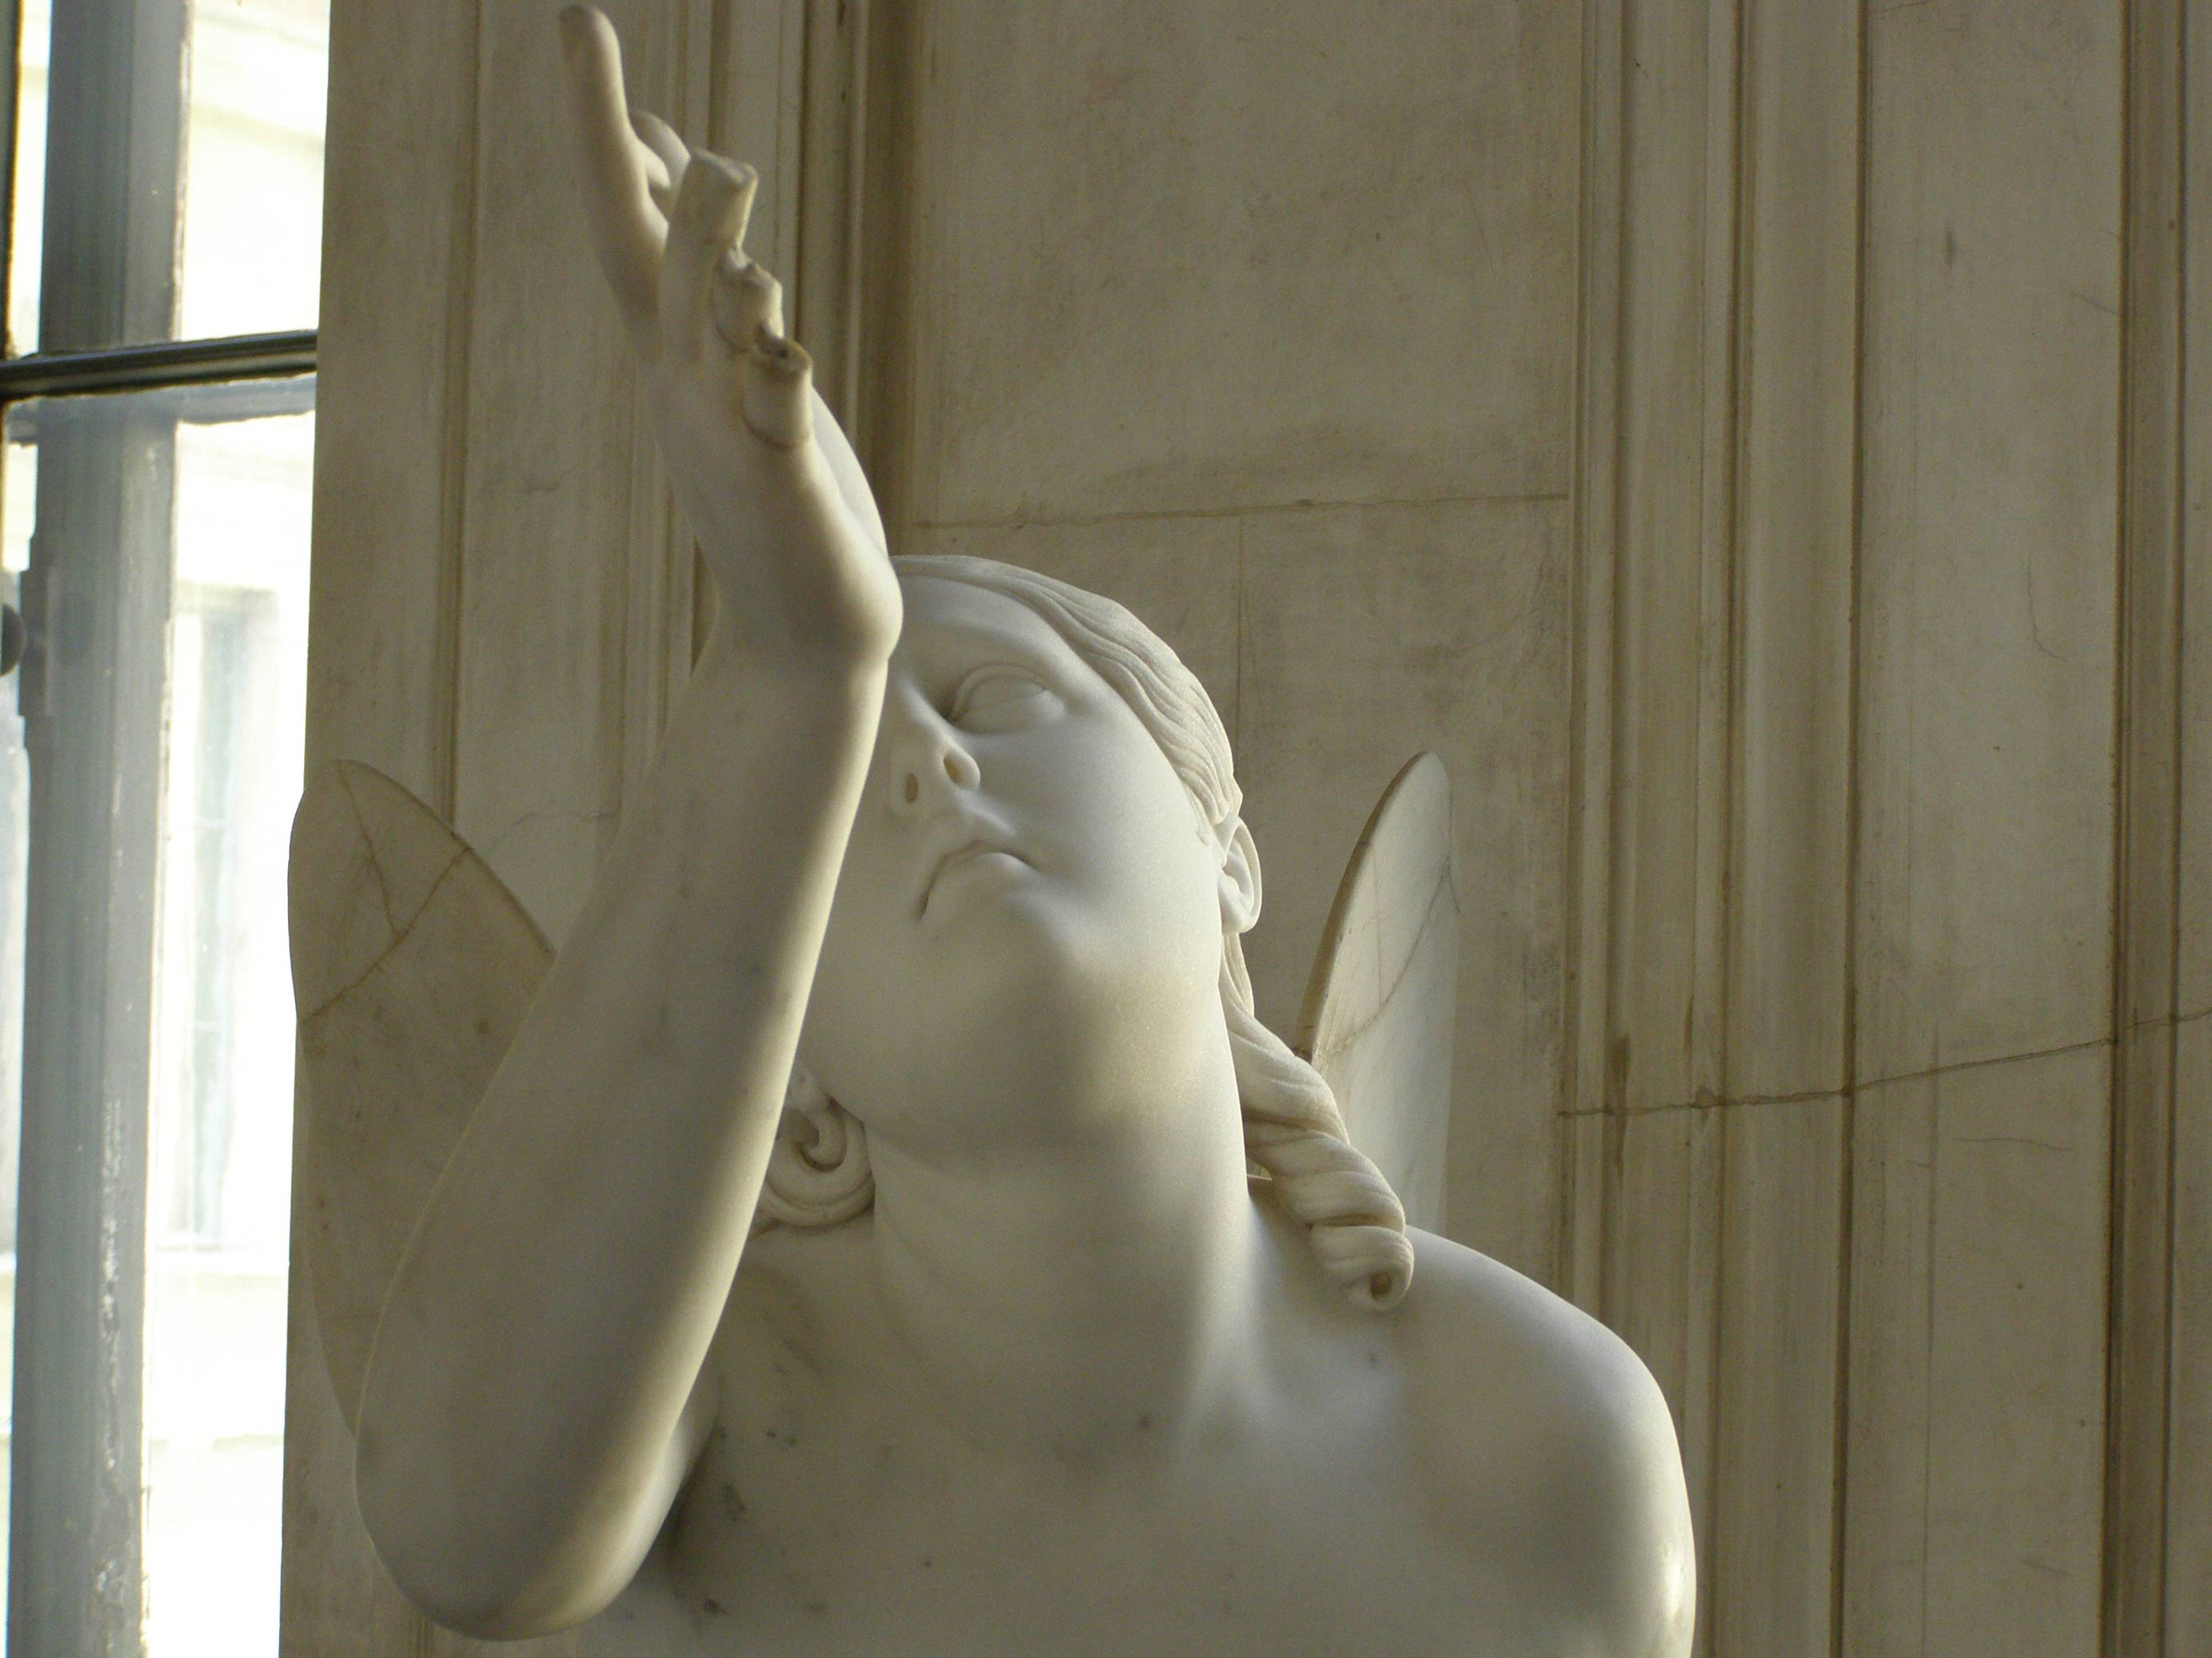
Our Challenge
In today’s world, with all its distractions and uncertainties, how can we be the people our culture needs us to be?
How can we attract the next generations of technologists into the IEEE, with their diversity and different approaches to getting things done?
We must change, or die…
If you’re not busy being born, you’re busy dying (Bob Dylan)

Slide 12

What We Should Do
Actively support entrepreneurs and consultant members
Support regional activities and tie to IEEE-USA
Support and expand IEEE USA public policy
Increase IEEE USA public visibility
  Continue and augment our successful social media campaign
  Video membership campaign in 2019-20 (with other OUs)
  New Shirts

Slide 13
What We Should Do (2)
Pursue industry engagement
  Work with IEEE Industry Engagement Committee
Return to membership growth in the US Regions—focus on member retention and corporate memberships (with MGA, CS, Com Soc and PES--NIC video proposal)
Work with other IEEE OUs to create a stronger and more efficient and effective IEEE
Support PACE activities as our budget allows, such as:
  Supporting the next generation of technologists—participate in STEM, Maker Faire, FIRST Robotics, etc.
Create effective involvement in humanitarian activities

Slide 14

IEEE USA is like a canary in a coal mine
Losing members, losing volunteers, losing money…

Slide 15
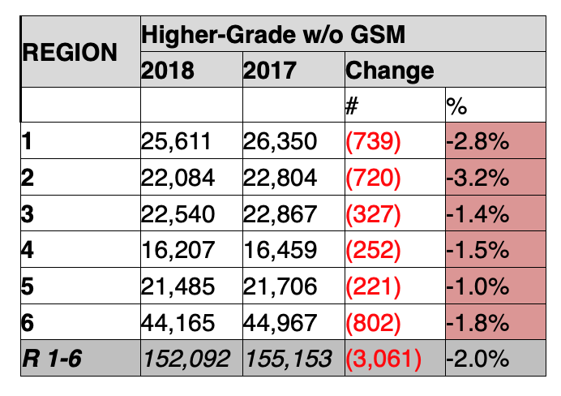
December 2018 US Member Numbers
Year end (December 2018, compared with 2017) numbers for U.S. higher grade members were down 2% or just over 3000 members.
This reflects a decline from where we were at the end of the 2018 membership year in August.
Since 2001 we have lost 25% of HG membership

Slide 16
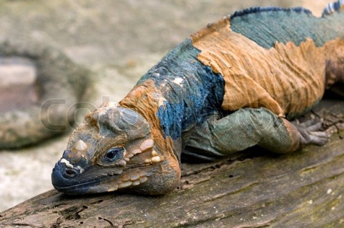
We need to act, now!
But time is not on our side.
We are constrained by time and resources (both staff and volunteer energy)
Many traditional professional organization are having a hard time of it
But there is a greater need than ever for technical professionals to solve the daunting problems that face our society
To do nothing is to accept whatever happens to us—why should we?

Slide 17
How can we grow the IEEE?
Let’s be cool
Let’s be creative
Let’s invite and keep people in our ”tribe”

Slide 19
Increasing membership in Regions 1-6 (Questions)
  Why is the value of IEEE-USA to members?
    Let them know we act as a national society
  If our target membership pool is not increasing, how can we increase the pool?
  What can we offer that attracts new members?
  What can we do to keep these members engaged?
  What is the role of IEEE-USA in these activities?
  How can we be more exciting and necessary to our target population?

Slide 20
How can we get membership growth in the USA?
Increase our membership recruitment
  Promote the value of IEEE membership including networking, mentorship and personal development
  Expand our target membership pool (e.g. IT folks)
  Work with MGA and sections on local community membership projects (membership campaigns and SM elevations)
Increase our membership retention
  Promote and demonstrate the value of IEEE membership
  Be part of a community working to make a better world
Increase our membership recovery
  We have had success with a micro-volunteering sectional calls to members who had not renewed—value of local community

Slide 21
Community Membership Drive
Let’s have our sections try to bring non-returning members back—their membership was terminated in February
This is best done by a micro-volunteering project of having local members call/email folks who didn’t renew, finding out why and what we could have done better—in the course of this some folks will likely renew
If you are interested in running this project in your Section, please contact Chris Wright (wright.c@ieee.org) of IEEE’s Member and Geographic Activities staff for more details.

Slide 22
New Initiatives Committee in 2019: $1M Challenge
Seeking innovative ideas towards big challenge $1M/y, details to be shared
In the areas of
  broadening membership through engagement
  education of underserved communities
  new style events
Value external to IEEE support (in-kind and financial)
Multiple OU encouraged and valued, *anyone* can submit

Slide 23
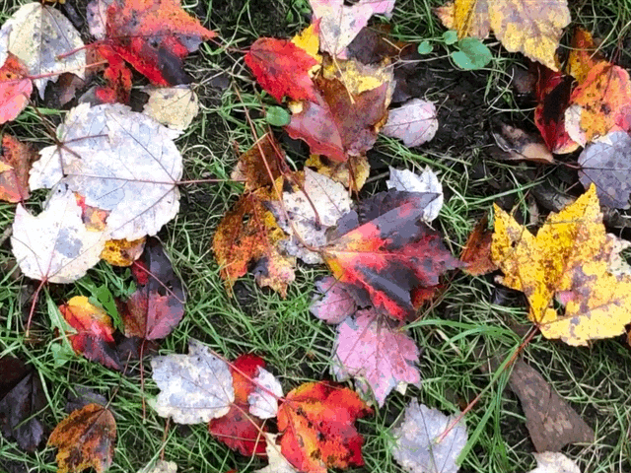
Questions?
Tom Coughlin
IEEE-USA President
tom@tomcoughlin.com

