Slide 1
Effective Administrative Meetings
Dave Green
SoutheastCon 2019, Huntsville, AL

Slide 2
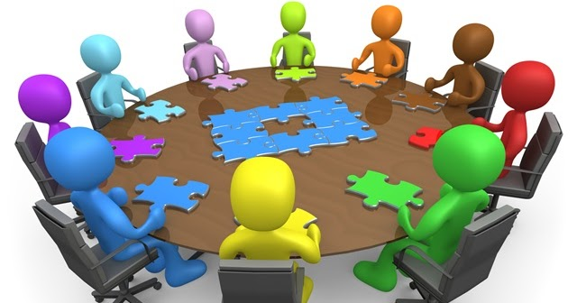
Effective Administrative Meetings
Outline
Goal
Life Cycle
Best Practices
Other Resources
This Photo by Unknown Author is licensed under CC BY-SA
This Photo by Unknown Author is licensed under CC BY-NC-ND

Slide 3
Goals
Conduct the business of the section in an effective, transparent, collaborative manner
Ensure that team members participate and are heard
Be timely
Enjoy
Photo by Campaign Creators on Unsplash

Slide 4
Life Cycle of Meeting
Announce Meeting
Distribute Agenda
Conduct Meeting
Distribute Minutes

Slide 5
Announce the meeting
Time, Date, Location/Online Info
Consider announcing in vTools Events
Consider sending out a calendar entry
Call for agenda items
Call for reports
This Photo by Unknown Author is licensed under CC BY-SA-NC

Slide 6
Distribute the agenda
Structure
Planned motions (Action Agenda)
With back up material
Provide time to be read and prepare
Notes:
Attachment icon: This Photo y Unknown Author is licensed under CC BY-SA-NC

Slide 7
Conduct the meeting
Welcome
Ensure quorum
Approve agenda
Approve minutes
Officer reports
Action items
Discussion items
Other reports
Old business
New business
Review action Items
Next meeting
Adjourn
This Photo by Unknown Author is licensed under CC BY-SA

Slide 8
Approvals
Approve the agenda
Note changes since distribution
Solicit changes
Approve (as amended)
Approve the minutes
Note corrections and changes as submitted
Solicit corrections and changes
Approve (as corrected)

Slide 9
Officer reports
Chair
Vice Chair
Treasurer
Secretary
Chair
Note upcoming meetings
Review actions
Distribute information from incoming ”IEEE Notices”
Vice Chair
Those items delegated by Chair or assigned by OU’s governing documents
Treasurer
Overview of account status
Review check register since last meeting
Secretary
Communications
Records

Slide 10
Action Items
- Motions
Pre-meeting distribute motions and support
Move approval for recommend to the Region 3 Committee the selection of the Mobile Section
as the host for SoutheastCon 2022 to be held in the Renaissance Mobile Riverview Plaza Hotel and Arthur R. Outlaw – Mobile Convention Center on March 30th through April 3rd.
(ex. Motion from Conference Committee to ExCom)

Slide 11
Discussion Items
Discussion Item
Introduce topic and goal of discussion
Facilitate discussion -- seek involvement not repetition
Note follow-up items
Motions can occur here if the group is ready to make a decision or take an action
- Stay within time budget
May postpone less important discussions in favor of present discussion if progress is being made (and will of group)

Slide 12
Other reports
By position
Ongoing projects
Note the reports submitted by those not present at meeting

Slide 13
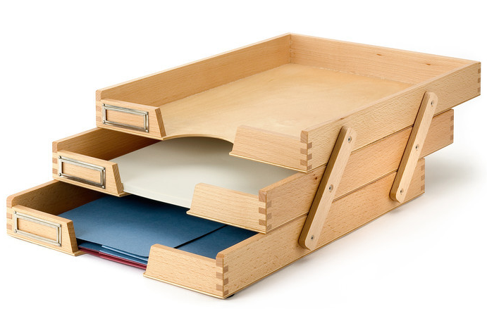
Other business
Old Business
Follow-ups expected to be status reports on continuing items not needing action or significant discussion
New Business
Things brought in after agenda preparation that don't fit above
This Photo by Unknown Author is licensed under CC BY-SA-NC

Slide 14
Wrap up
Review
Follow-up items (noting expected result, who is responsible and any deadlines)
Next meeting
Adjourn
Thank participants for their participation
This Photo by Unknown Author is licensed under CC BY-SA-NC

Slide 15
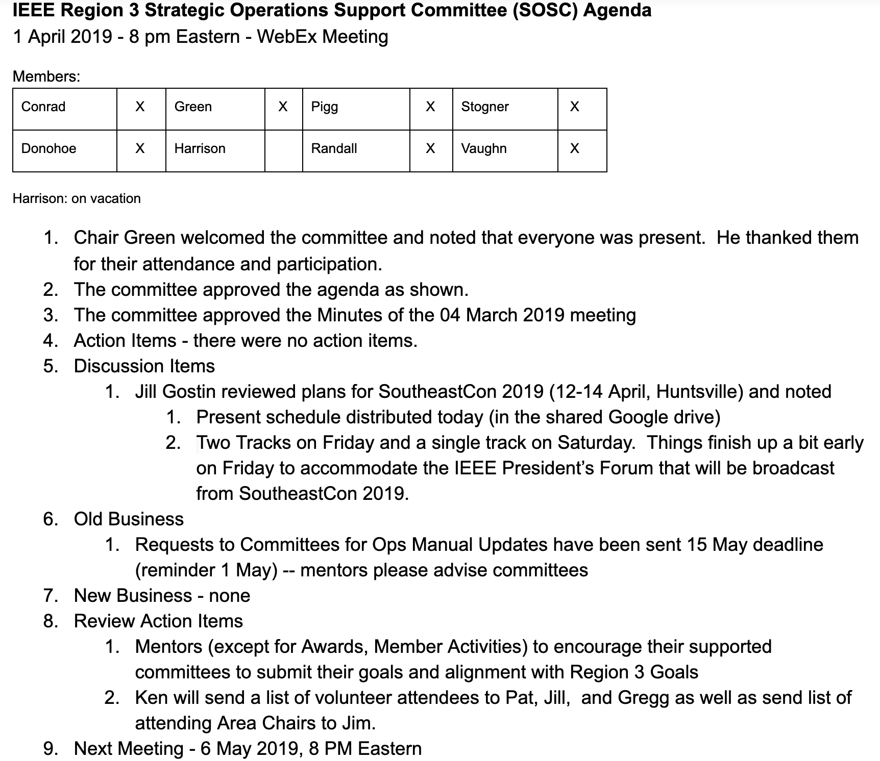
Distribute minutes
Capture decisions
Capture action items
(Potentially) Capture topics discussed
Report administrative meeting in vTools Events
( Example modified from SOSC Minutes)

Slide 16
IEEE Tools
Google for OUs
https://www.ieee.org/membership/products/google-apps.html
http://sites.ieee.org/vtools/files/2016/11/FAQs-G4O.pdf
WebEx - http://sites.ieee.org/vtools/tools-ok/webex/
With at least the facilitator using IEEE GoogleApps (https://www.ieee.org/membership/products/google-apps.html)
Google Meet (up to 25 with IEEE-based account) - https://meet.google.com
Calendar – https://calendar.google.com

Slide 17
Best Practices #1
Begin on time, end on time
Convener or delegate should be early
Ensure engagement of participants
Try to bring out all sides in discussion
Consider "without objection" passing of non-major proposals
Have regular meeting time / place
Create templates
Agenda
Minutes
This Photo by Unknown Author is licensed under CC BY-SA

Slide 18
Best Practices #2
Motions should be crisp
Backup material should acknowledge known cons (as well as pros)
Sample motion
Executive session for confidential information (mostly if discussing people)
Go into executive session limiting meetng to voting members and those whose contribution is needed
All agree that discussion is confidential to participants and only those items agreed to be shared can be shared
After executive session announce what has been agreed to be announced (often just topic with any decisions)
Only include the post executive session announcement in the (open) minutes

Slide 19
Resources
Robert's Rules of Order
http://diphi.web.unc.edu/files/2012/02/MSG-ROBERTS_RULES_CHEAT_SHEET.pdf
IEEE Center for Learning Excellence: Suggestions for Leading a Committee
https://ieee-elearning.org/CLE/
Region 3 Tools
http://www.ewh.ieee.org/reg/3/r3_tools.html

Slide 20
Thank you!
Dave Green, d.green@ieee.org

