Slide 1
Managing and Strengthening Your Sub-Units
Kristin Bing
SoutheastCon 2019, Huntsville, AL

Slide 2
Administrative

Slide 3
Easy Administrative Options
Interface
Hold regular Section meetings (think recurring calendar event)
Atlanta holds Section-wide meetings on 4th Tuesday of odd months
Have a Section ExCom member attend at least 1 meeting for each chapter per year and explain benefits of section, senior member elevation, etc. to attendees
Be accessible
Make sure Section and chapter contact information is up-to-date in vTools and on websites
Help chapters with officer reporting
Create email aliases
Be proactive
Keep tabs on good and bad chapter performance through vTools
Actions can take in both cases are to be discussed
Encourage new volunteers
New volunteers bring new ideas and are more likely to stay in IEEE
Ask professors at local universities if they have graduate students, post-docs, research engineers, or fellow faculty who would like to volunteer in chapter
Publicize open volunteer positions or roles at work

Slide 4
Easy Administrative Options
Publicize
Send out regular eNotices for all Section events
Atlanta sends a notice once a month, pulls all Section and Chapter events from vTools, and solicits last minute additions as well
Make sure your website is up to date and includes automatic feeds on meetings from vTools as well as eye-catching pictures from events
Set up a Facebook and LinkedIn page for your Section
Set up a Collabratec group
Train
Make new chapter/sub-section/affinity group officers aware of Center for Leadership Excellence
Conduct IEEE 101 training on common and required actions
Working with Netsuite
Creating events in vTools
Filing L31s in vTools
Sending eNotices

Slide 5
Chapter Events

Slide 6
Suggestions for Chapter Success
Time, Location, and Food
Example: Lunch and Learn
IEEE meetings during lunch can be successful if they are at or near target employers
Distinguished Lecturers
Most societies share the travel costs with the local chapter for DLs
DLs can attract greater attendance
Joint Meetings
Topics applicable to multiple chapters can be held jointly
Awards
Recognize the outstanding chapters and volunteers in your Section at an annual awards ceremony
You can mirror the R3 awards and nominate your individual (engineer, educator, service, etc.) award winners at the higher level in the next awards cycle
Many societies (Computer, Power and Energy, etc.) have Outstanding Chapter awards
Ensure chapters know about upcoming IEEE awards deadlines at all levels

Slide 7
Add Variety
Try a variety of events and continue to offer the well-attended types
Technical meetings
Seminars
Tours
Professional meetings
Mentoring Program
Improv Workshop
Hiring Event
Networking
Tutorials
Society Highlights
Board Meetings
Senior Membership Round-up
Nontechnical meetings
Family Science Nights
Girl/Boy Scout STEM
Local Science Festivals
MOVE training
Other STEM
Social events
Section awards banquet
Administrative
Section ExCom/AdCom
Chapter ExCom/Board meetings

Slide 8
Outstanding Chapter Evaluation Criteria
Based on Society Awards
Technical Activities
Educational Activities
Societal Activities / Promotion of engineering profession objectives
Membership Advancement, Fellow Nominations and Awards
Increase in the number of new Chapter Society members
Activities with students
Support to conferences
Chapter webpage

Slide 9
Thank you!
Kristin Bing, Atlanta-Chair@ieee.org

Slide 10
BACK-UP: STEM

Slide 11
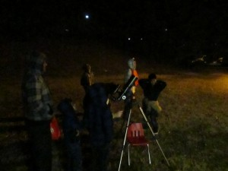
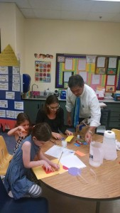
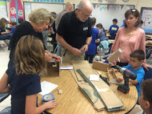
Family Science Nights
Atlanta K-12 Outreach Chair – Melody Richardson, Atlanta-K12@ieee.org
Demonstrates the importance of science, technology, engineering, and mathematics in our students’ daily lives
Designed to build connections between classroom science and its real word applications
Engage with practicing engineers in every activity
Stimulates parents’ interest in science and their children’s science education

Slide 12
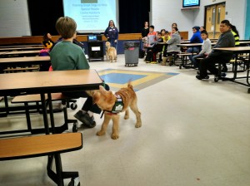
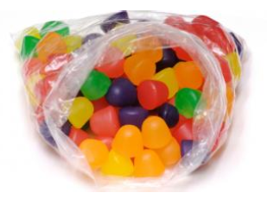
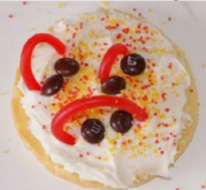
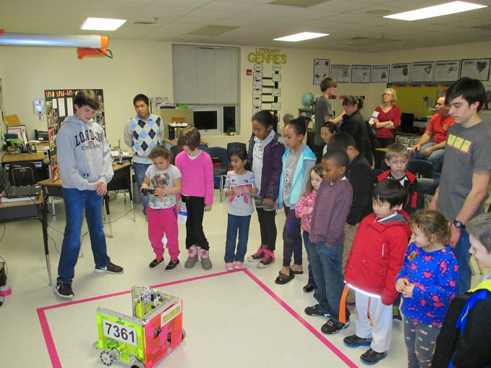
FSN - Most Popular Activities
Georgia Reptile Society
Dogs!
Service Dogs via local police department
Canine Assistants
GA K-9
Imaginarium
Helps with late comers
Constantly changing room filled with quick science activities where children can lead themselves
Three Little Pigs STEM Challenge, Edible Spine, Paper Plate Marble Maze, Marshmallow Geometry, and Straw Airplanes
Build a Better Candy Bag
Solar Cookies
Robot Demonstrations

Slide 13
Family Science Nights
By the Numbers
Presented to over 15,000 students in their families since 2008
During the 2016-2017 school year, IEEE’s FSN was scheduled in 9 schools throughout Atlanta area (5 counties)
Average of 400 students and their families per FSN with an average of 18 different activities
Serve elementary school kids aged 3-10 and their families

