Slide 1
Managing Section Finances
Ken Pigg
SoutheastCon 2019, Huntsville, AL

Slide 2
AGENDA
Introductions
Guidance
Resources
“Free” Advice
Budget
Operating Reserve
Income
Expenses
Account Reconciliation
Financial Status
End of year Reporting
Audit
Phishing Trip
Questions

Slide 3
Introductions
Ken Pigg
Current:
Region 3 Treasurer and Finance Committee Chair
Eastern North Carolina Section Treasurer
SoutheastCon 2020 Treasurer
Past:
Region 5 Treasurer & Audit Committee member
Section Treasurer – Oklahoma City and Eastern NC
NC Council Treasurer
IEEE MOVE Project Treasurer

Slide 4
Introductions
BRIEFLY
Name
Your section and section volunteer role
Financial wizardry level?
Have you ever reconciled a checking account?
How does your section manage finances day to day?

Slide 5
Guidance
IEEE Constitution & Bylaws
IEEE Policies
IEEE Financial Operations Manual
IEEE chart of accounts
IEEE MGA Operations Manual
IEEE Region 3 Operations Manual
Section bylaws, if they exist
Must be consistent with MGA Operations Manual

Slide 6
Resources
IEEE Center for Leadership Excellence
Section Treasurer - Training
NetSuite
training resources available by request from finance-solutions@ieee.org
Task specific instructions available
inside NetSuite website
https://mga.ieee.org/resources-operations/geographic-unit/reporting-rebates/financial
More on this topic in another session

Slide 7
“Free” Advice
Avoid any perception of impropriety
KSA – KEEP SHORT ACCOUNTS
Utilize IEEE Concentration Banking (CB)
NetSuite
Send request to finance-solutions@ieee.org for NEW credentials
Section Chair - ask for read only access
Keep a copy
Stay organized, ready for an audit

Slide 8
Budget
It is a plan – it can be revised
Start by December for the upcoming year
Typically approved by Section Committee
Use IEEE MGA chart of accounts
Chapters must be funded
Sub categories?

Slide 9
Operating Reserve
http://www.ieee.org/documents/section03109903.pdf
3.2 ADMINISTRATION OF MGA FINANCES
A. Reserves.
Per the IEEE Financial Operations Manual, the MGA Board will try to maintain reserves of about 50% of annual expenses, exclusive of those dedicated to Sections Congress.
Region 3 Operations manual, Section III says 35% to 50% of average expenses over last 4 years

Slide 10
Income
Annual rebate, based on:
Meetings reported (section and chapters)
Number of members
Number of active chapters
Meet early reporting deadline to get an extra 10%
Conference sponsorship – with risk
Other local events
Deposits for CB accounts sent by prepaid mailer or local Wells Fargo branch

Slide 11
Expenses
Member Engagement
Meetings and events
Travel
Region 3 travel policy
Region 3 expense report form
Concentration Banking (CB) debit cards available
Get receipts and document purpose
Typically treasurer and section chair should be on your bank account

Slide 12
Account Reconciliation
Do it monthly, as soon as bank statements are available
Run reconciliation report

Slide 13
Financial Status
Publish reports monthly, as soon as reconciliation completed
Reports
Income Statement
Budget Report
Balance Sheet
Reconciliation Report
Treasurer’s report should be on each EXCOM agenda

Slide 14
End of Year Reporting
Same reports as monthly but for the full year
Section includes chapters and affinity groups but not student branches
No more L50, all transactions in NetSuite
10% early reporting bonus deadline (was February 15 in 2019)
Drop dead for section rebate (was February 28 in 2019)
Compliance Reporting
More on this topic in another session

Slide 15
Audit
Prior year, after reporting complete
Required if revenue or expenses > $250k
Self audit guide and checklist available
Treasurer wants an audit as a CYA

Slide 16
Phishing Trip
From and to are the “right people”
NEVER allow yourself to be rushed
NEVER send a wire without VERBALLY discussing it the requestor
If you have ANY question, pick up the phone and call the requestor

Slide 17
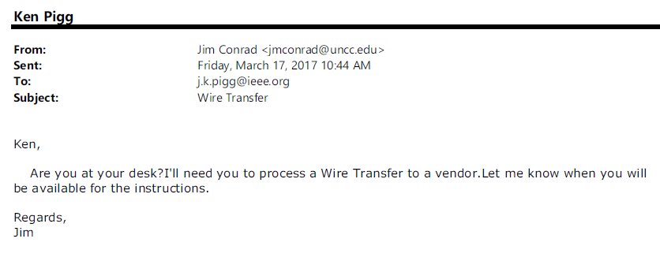
Spear Phishing – Example 1

Slide 18
Spear Phishing – Example 2

Slide 19
Spear Phishing – Example 3

Slide 20
Thank you!
Ken Pigg, j.k.pigg@ieee.org

Slide 21
3/4/2019 guidance from Jill Gostin
Friday, 1:30-2:05 pm, Managing Finances. This is part of the Section Foundations Track, so assume most
attendees will be fairly new volunteers. This can cover money flow, CB accounts, budgeting, reporting – and
emphasize that you will have a deeper-dive breakout on NetSuite during Breakout Session 1 on Saturday.

