Slide 1
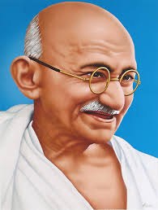
“A customer is the most important visitor on our premises. He is not dependent on us. We are dependent on him. He is not an interruption to our work. He is the purpose of it. He is not an outsider in our business. He is part of it. We are not doing him a favor by serving him. He is doing us a favor by giving us an opportunity to do so.”
- Mahatma Gandhi
Notes:
This quote is painted on the wall of an IEEE Human Resources conference room at the Operations Center in Piscataway, NJ.

Slide 2
Engagement: Events, Outreach Foundations
Mark Torres
SoutheastCon 2019, Huntsville, AL

Slide 3
What is your Section’s Vision & Mission
Section Region 3 Vision: Engage every Member through Communities of Interest
Fundamental Position
  The Member IS IEEE and their ACTIVE PARTICIPATION is essential to achieving the IEEE Mission
  The Section OWNS the Member RELATIONSHIP and IS IEEE to the Member
  The Region is the ENABLER of full member ENGAGEMENT
Section Support Committee Mission: Assist the Sections to:
  To stimulate the interest of IEEE members
  To motivate members to volunteer
  To encourage professional and technical growth of all members
  To share best practices with other Sections
  To form Engineering Affinity Groups.
Reference: IEEE MGA Vision, Mission, Guiding Principles, Goals, and Strategies
Notes:
The IEEE Geographic structure (Regions/Sections/etc.) all report back to MGA and the MGA Board.
We’re all working towards this vision & vision.

Slide 4
Section Responsibilities
Engage members through Communities of Interest with Affinity Groups and Society Chapters with focus on Young Professionals, Women in Engineering, Senior Members and Life Members.
Sponsor projects to facilitate the active involvement of members in IEEE activities.
Provide high quality technical programs for members of the Section, Chapters & Student Branch
Sponsor Senior Member Elevation programs
Use collaborative tools and other technologies to support Section activities.

Slide 5
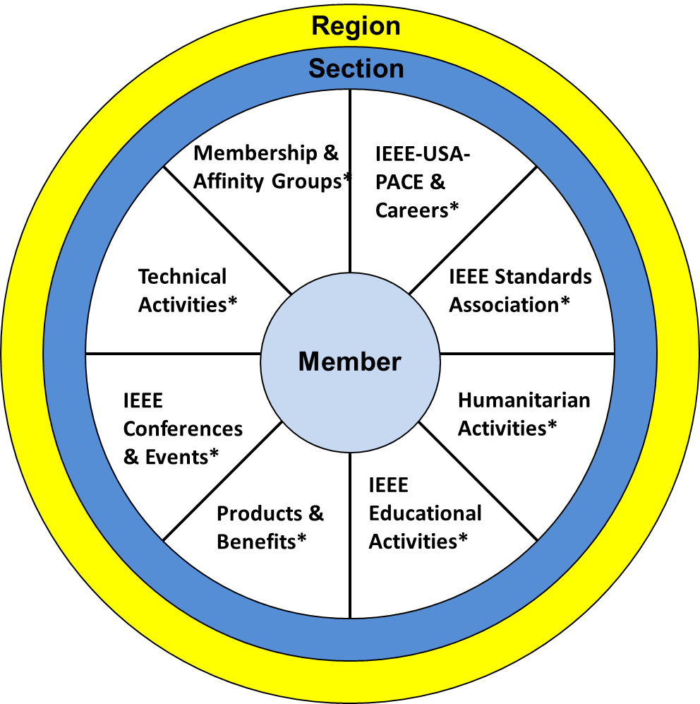
Member View of IEEE
Notes:
In this view:
The member is the focus
They joined for anyone of the “reasons” represented by the segments of the pie or also known as “communities of interest”
When a member joins, they are looking for IEEE to fulfill a need.
However, many do not realize the full depth and breadth of IEEE.
The Section is there to support the members locally
The Region is there to support the Sections and volunteers to do their jobs effectively and efficiently
There is staff that supports all of these functions, however, members do not have direct access to staff outside of the IEEE Contact Center resources.
Per our Member satisfaction survey:
Members find IEEE products “difficult to use”.
If you’ve ever tried to find anything at IEEE there is A LOT of content to go through.
Members do not necessarily see the value or state “membership is too expensive”.
These two concepts are related.
If a member can’t find what you need/want, there is no perceived value.
So…..

Slide 6
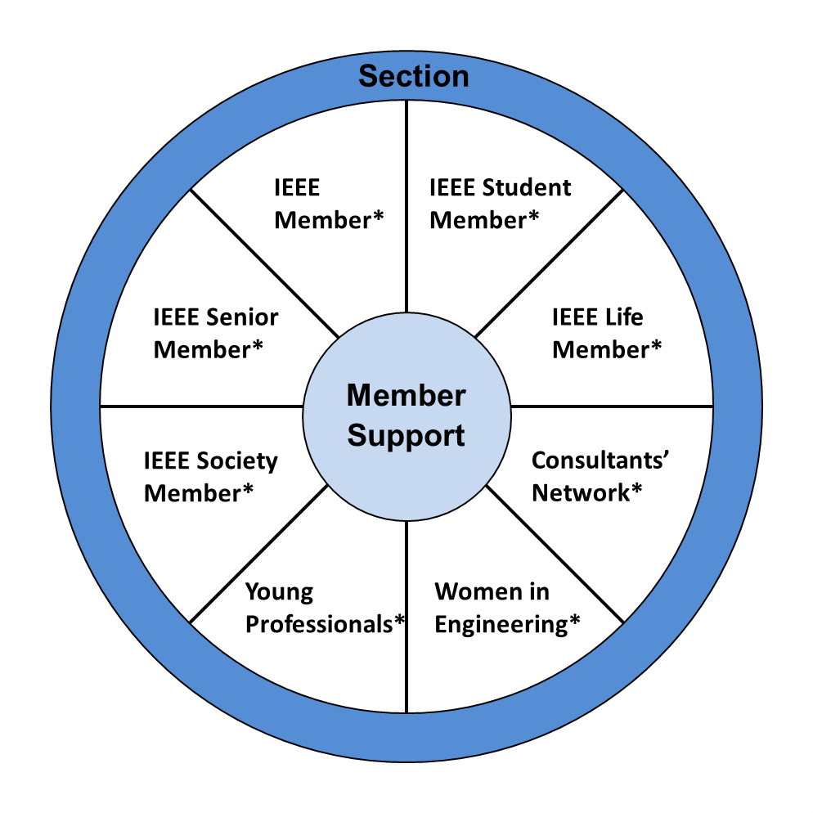
Section Volunteer View of IEEE
Notes:
This is why IEEE relies on the local volunteers to deliver an excellent “member experience”
To deliver this experience, volunteers would again rely on their members’ communities of interest
It is important to note each Section’s communities of interest are unique; There is no universal answer
It will take member engagement to learn what your specific members are interested in to deliver.
The challenges are:
Volunteers are more often than not still working in the profession, in school etc. which limits their time.
Many Sections do not have volunteers to service all of the various member interest
Again, there is staff support available for these categories, but in this case volunteers DO HAVE ACCESS to staff to ask questions and get support to service their members.
Adrienne Hahn (volunteer resource for Regions 1, 2, &4)
Chris Wright (volunteer resources for Regions 3, 5 & 6)
Along with the staff who support the various interests
This is also where the Region Executive Committee come in.

Slide 7

What’s Should You Emphasize?
Local Opportunities
Start by creating a list of your opportunities
  Local volunteers are the “boots on the ground”
  Use it as the basis for all your communications
What to include
  Upcoming events, activities etc.
  Identify a list of what the Section needs help with
  Ways to connect with your Section committees:
    Volunteer contact information
    Website
    Social Media accounts
    CollabratecTM Communities
Make sure the list is re-visited regularly
Notes:
Staff communications lack the local aspect of membership.
There is no local personalization.
We need to communicate what we are doing locally

Slide 8
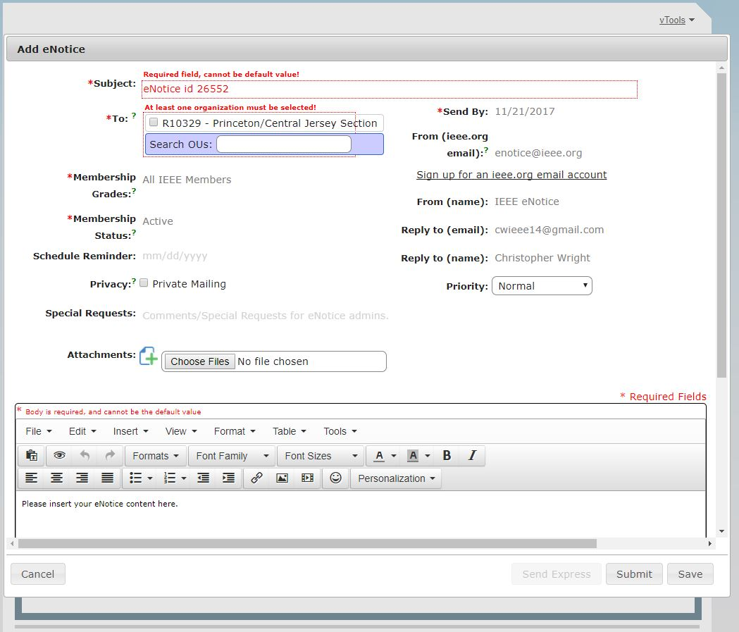
Use eNotice to Communicate
Why use eNotice?
Messages can be sent same day without staff intervention
Lists are pulled in real-time
  Compliant with member communication preferences and GDPR
New features to speak to your members
  Target by Chapters, Student Branches Affinity Groups
  Personalize:
    Who the message is sent by
    The message to include the recipient’s name and other details
Tutorials are available
enotice.vtools.ieee.org
Notes:
To create and send your communications, use eNotice.
There is very little reason to pull your own lists anymore
eNotice has had a number of updates made over the past year or so.
We advocate using eNotice instead for the following reasons:
All lists are pulled in real-time versus pulling member lists
Member lists that are pulled from OU Analytics need to be updated each time they are used to account for changes in the contact data
All messages comply with member communication preferences from a GDPR perspective
New features
We've built in various levels of segmentation and targeting based on member grade and Section sub-units, provided your Section has them).
Personalize the message

Slide 9
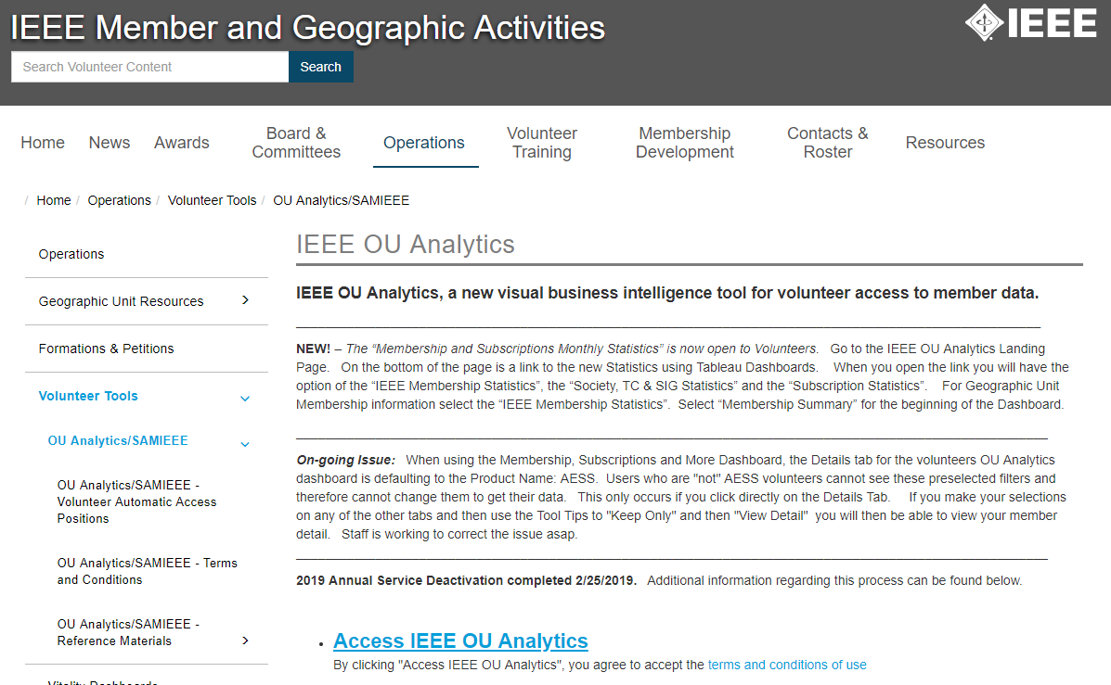
OU Analytics
Understanding Your Members
OU Analytics is a powerful tool
  Lots of data is made available
  It is all in how you use it
Create a profile of your members
  Compare it to your opportunities list
  Make sure you are offering what your members want
  Plan accordingly
Notes:
So what are we going to use OU Analytics for?

Slide 10

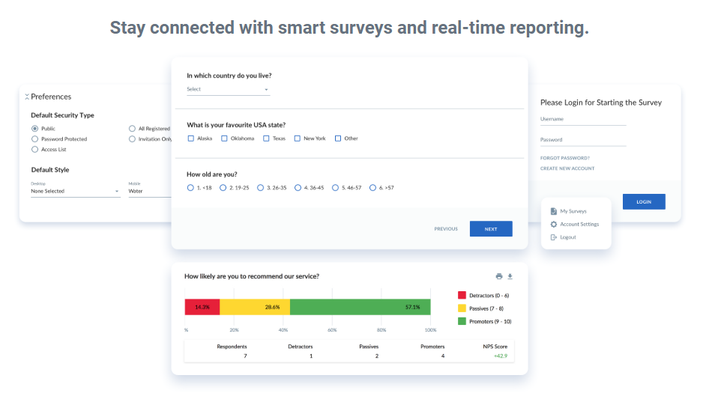
Volunteer Survey Tools
Volunteers can request access to Checkbox
Suggest using surveys to:
  Fill the gaps in member data
  Better understand your members
Template questions are available

Slide 11




Share the IEEE Member Experience
IEEE.tv Membership Experience Channel
Collabratec^{TM -} - IEEE’s social platform for technology-minded professionals
Follow us on Social Media:
@IEEExp
IEEE Membership
Notes:
We need to do a better job of promoting IEEE Membership
Use the IEEE Member Experience Channel for videos to show during your events
Use Collabratec to create a community where your members can communicate among each other and with the volunteers
Groups and Communities can be created for a Section
Use Social media as well.
If you don’t have a social media account have your YP’s and students help you with them
Make sure to use the hash tag #IEEExp so staff can find you.

Slide 12

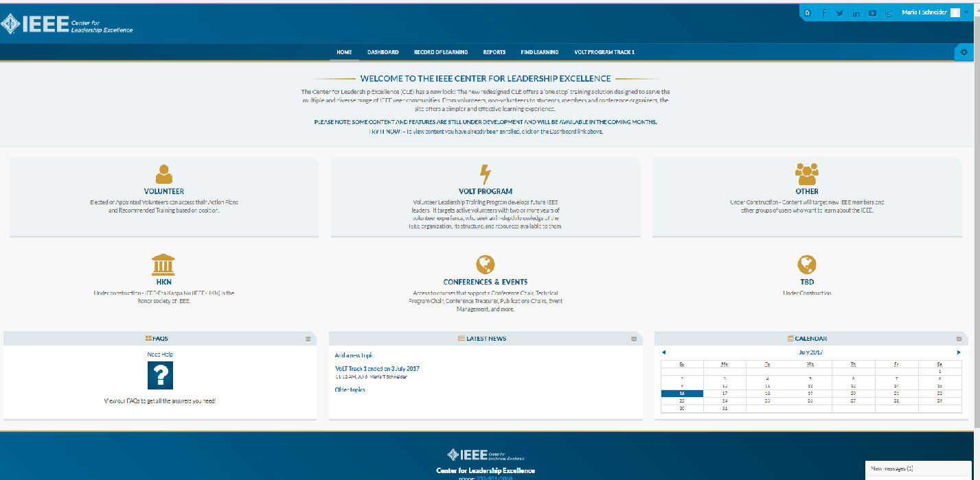
IEEE Center for Leadership Excellence
ieee-elearning.org/CLE/
Simple to use, self-paced
Offers help to Volunteers in their new role with ACTION PLANS!
Access with IEEE Account
Please note: Content is updated regularly – Check back often!
Notes:
Bill Marshall is covering this in the Tools for Sections session in Track 1.
This is the training resource for volunteers to learn more about their job descriptions and action plans.
All Section Volunteer job descriptions are loaded
Region volunteers will be available in the near future
You will need your IEEE user name and password to login to the tool.
Suggest EVERYONE takes the Membership Development (MD) Training
All volunteer roles have an element that speaks directly to serving the members’ needs and giving them the best possible experience.
The MD training addresses how to do this.
Most Section Leader job descriptions are now available

Slide 13
Thank you!
Region 3 Section Support Committee
You are not alone … We are here to help
Assisting our members to find and engage with IEEE Communities of Interest requires many levels of engagement … Again we can help
Relationships are a network, not a hierarchy
  Region 3 to Sections
  A Section to other Sections
  Members to other Members
Mark Torres, mgtorres@ieee.org

Slide 14
Region 3 Section Support Committee
Committee Member Contact Information
Committee Position | Name | Email Address
Section Support Committee Chair | Mark Torres | mgtorres@ieee.org
Life Member Coordinator | Tom Bellarmine | t.bellarmine@ieee.org
Young Professional Coordinator | Edwin Mastache | eng.edwin.m@ieee.org
Women in Engineering Coordinator | Allison Mercer | Allison.Mercer@gtri.gatech.edu
Senior Member Elevation Coordinator | Jacquelyn Cunningham | jdnc@ieee.org
Sections Operations Specialists (Position 1) | Charles Lord | c.j.lord@ieee.org
Sections Operations Specialists (Position 2) | Bill Marshall | marshalliv@ieee.org
Project Coordinator | Grayson Randall | g.randall@ieee.org
Technical Activities Coordinator | Glenn Parker | Glenn.Parker@gtri.gatech.edu
Section Support Committee Mentor | William (Bill) Ratcliff | w.ratcliff@ieee.org
The IEEE Support Center is a great online resource.

Slide 15
vTools Events

Slide 16
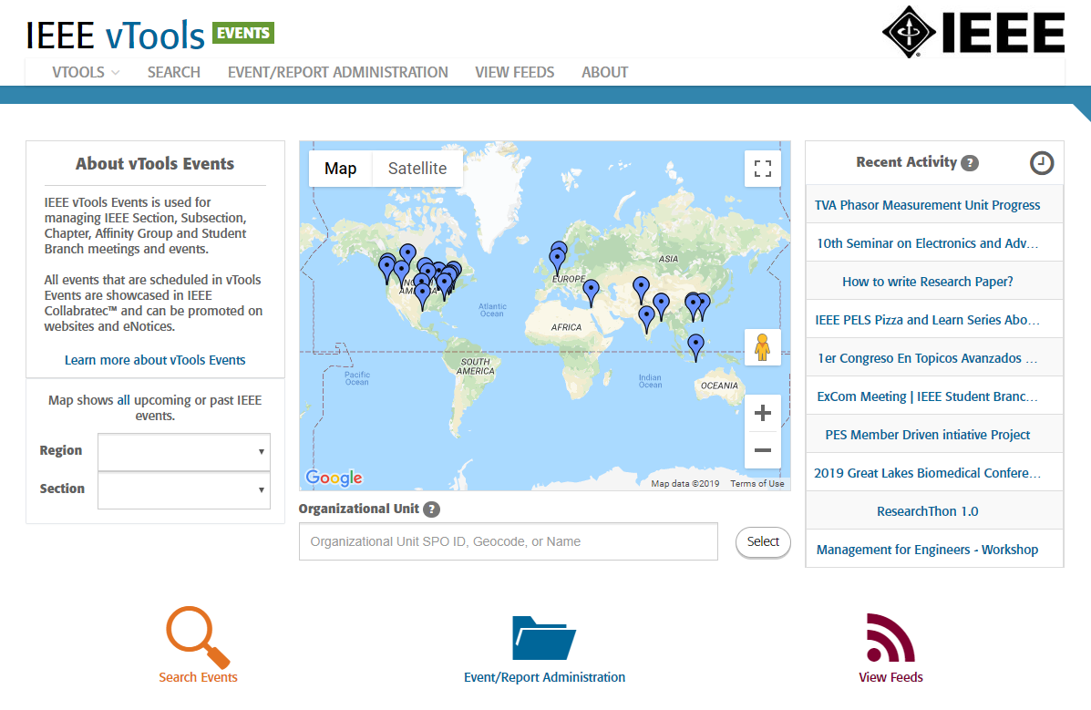
vTools Events
Event Planning Tool
  End-to-end event/meeting management tool
  Set up event
  Promote the event from the Tool
    Send an eNotice
    Posts to 3 IEEE Event Finders
  Take registration before and during your events
    Can send an eNotice post event
  Connects to reporting for quick submission
events.vtools.ieee.org
Notes:
Available to Regions, Sections and all sub-units
We know volunteers use a variety of Event scheduling/planning tools like Eventbrite.
Like Eventbright, Events is an end to end planning tool. You can set up your event, announce it, take registrations, etc.
Member advantages:
Your members can use this tool to find your events/meetings activities
When a member logs in it will give them upcoming events
Can easily Search from front page

Slide 17
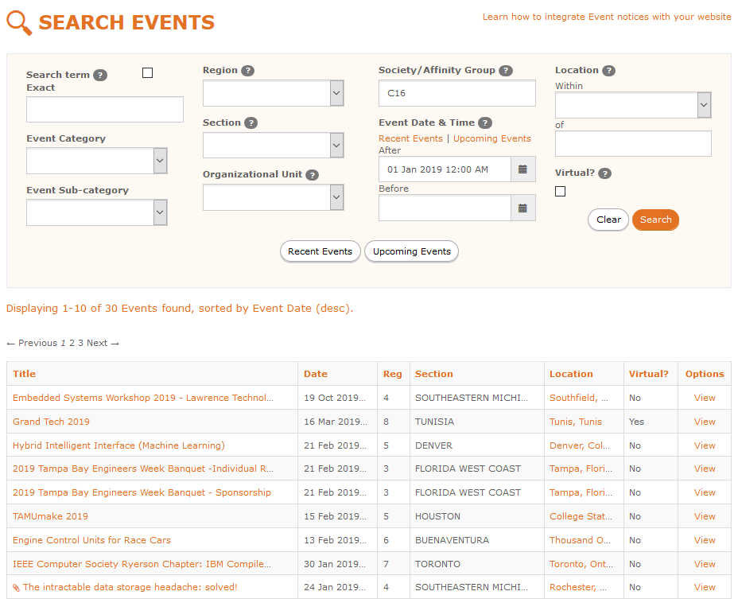
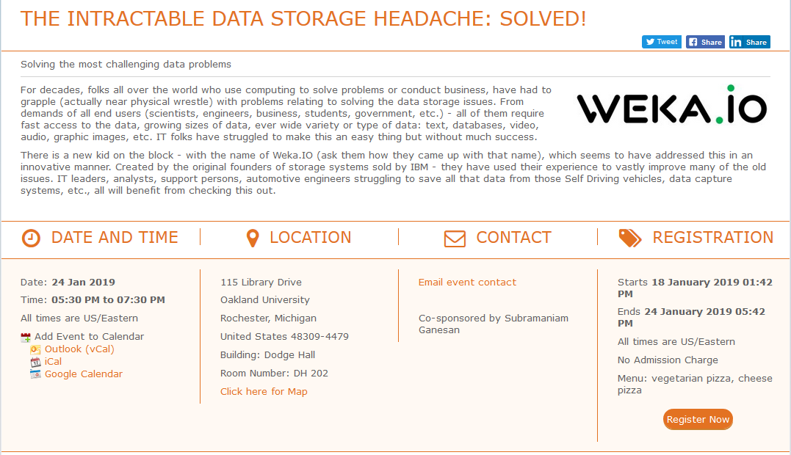

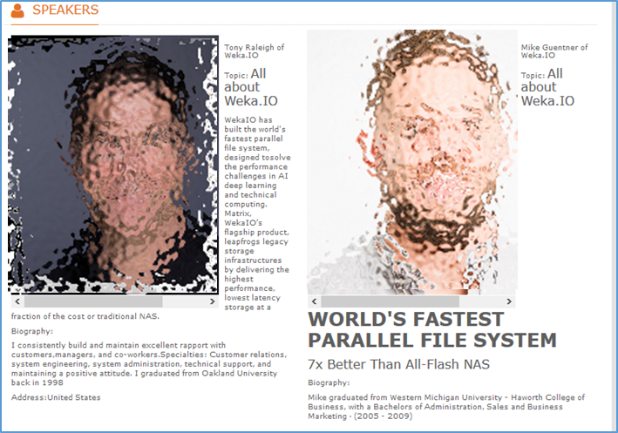
vTools Events for Members
Public View of an Event
Host/Sponsors:
Notes:
Your members can use this tool to find your events/meetings activities
When a member logs in it will give them upcoming events
Can easily Search from front page

Slide 18
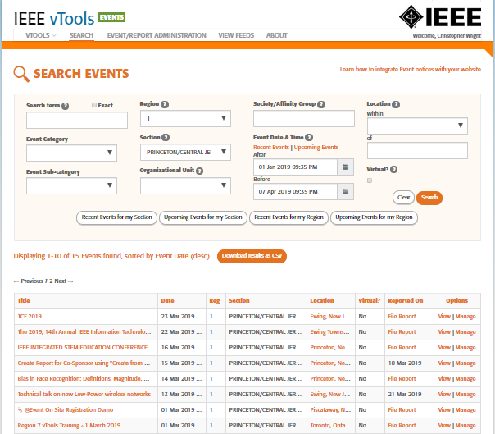
vTools Events
Best Practice #1: Audit
  Check to see what has been reported and what hasn’t
  Offer assistance to sub-units
  Suggest doing this quarterly
Best Practice #2: Planning
  Review Section events
  Use this for future planning
Notes:
Best Practice #1: Audit
Thank you Christopher Sanderson, 2019 R5 South Area Chair
Simply fill out the Search Criteria for Region, Section and a time frame.
Can download the report for later use
The download includes:
All the Event Details
Plus Attendance data, provided it is filled in
Best Practice #2: Planning
Look through it to see what types of communications your Section has sent
Get an understanding of what types of events/meetings have been run
Use it to plan or improve on future communications

Slide 19
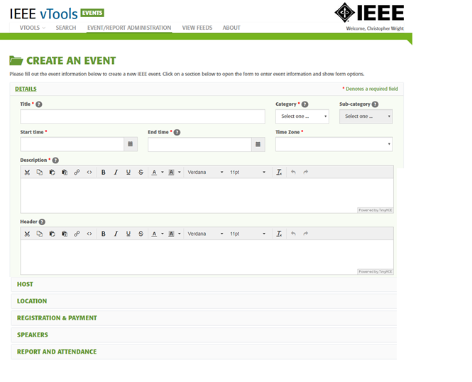
vTools Events
Advantages for Volunteers
Events is also used to submit Section Reporting (L31)
Users do not have to upload invite lists – uses eNotice
Messages are compliant with
  IEEE member communication preferences
  GDPR.
Manage registration and payments
All Events are made public via a number of IEEE channels
Notes:
Events is the tool used to submit Section Reporting
If you use another tool, you will have to duplicate the effort just to report your event for L31 purposes
If you use Events, you can submit your report in one click
User does not have to upload invite lists
as communications are sent through eNotice
Messages are compliant with all IEEE member communication preferences and GDPR.
With Eventbright, the user (i.e. volunteer) is responsible for complying with the preferences.
All Events are made public via a number of IEEE channels
including the IEEE Event Finder App, Collabratec's Event Finder and the Event Finder Map.
SIMPLE PROMOTION WITH LITTLE WORK.

Slide 20
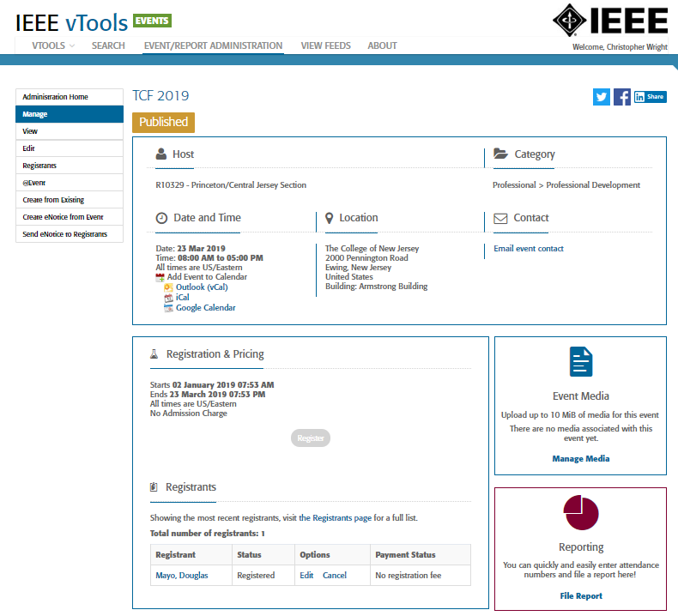
vTools Events
Better Event Management
@Event feature for onsite event registration
  Can accept on-site registrations for walk-ins
  Take attendance
Users can send post-event communications to registrants
  Not just IEEE members – ALL registrants
  Types of messages
    Thank you for attending
    Announcements for upcoming events.
Load media (presentations, flyers etc.) for inclusion in your eNotices

