Slide 1
Beyond Your Section
Jill Gostin
SoutheastCon 2019, Huntsville, AL

Slide 2
Outline
Why Should I Become More Involved?
What Can I Do Beyond My Section?
Who is Already Involved In Other Parts of IEEE?
How Can I Become More Involved?
Where Can I Be Involved?
When Can I Get Started?

Slide 3
Why Should I Become More Involved?
When the time is right…
Expand your network
Increase your technical knowledge
Get involved in Humanitarian Outreach
Influence the next generation through STEM
Mentor others
Get leadership experience for your resume / performance review
Becoming involved can benefit you, your employer, and the community around you.

Slide 4
What Can I Do Beyond My Section?
Depends on your interests
Serve on committees - can evolve into Elected and Appointed leadership roles
Educational Activities involvement
Standards, Publications, Policy
Membership Activities/Committees
Technical Activities – Societies, Councils, Technical Committees/Communities
Humanitarian and STEM Outreach
There are many options for involvement; you can find one that suits your passion!

Slide 5
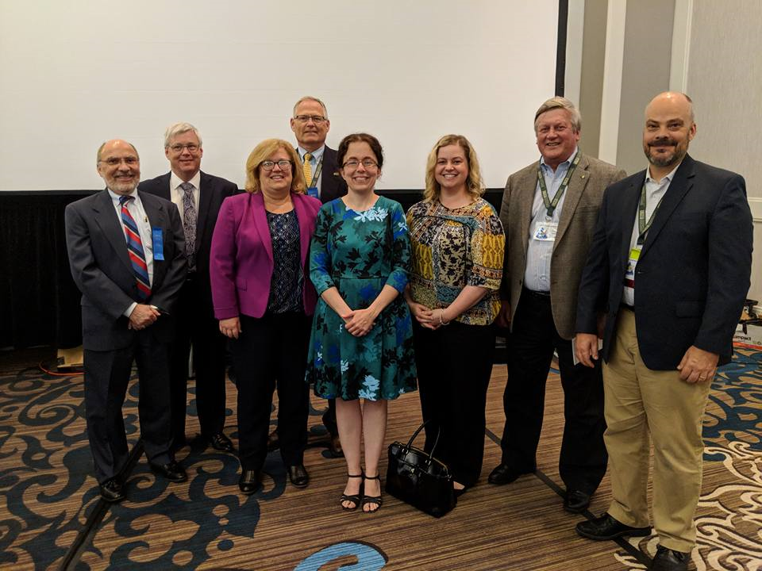
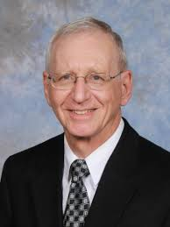
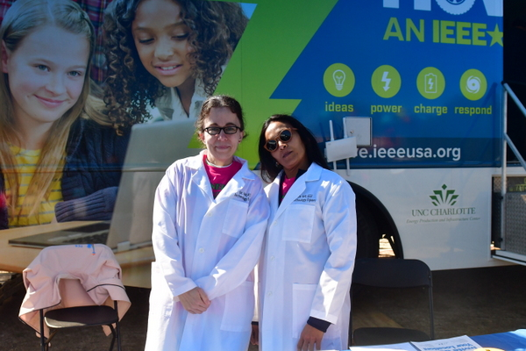
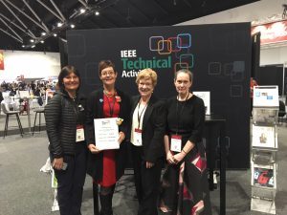
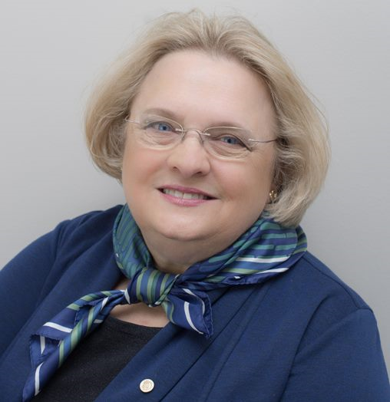
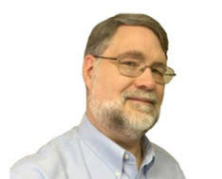
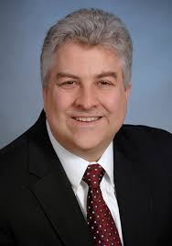
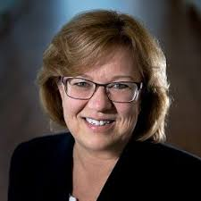
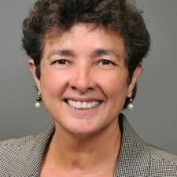
Who is Already Involved In Other Parts of IEEE?
A Small Sample
Gregg Vaughn, IEEE BoD, IEEE Region 3 Director, IEEE Audit Chair
Mary Ellen Randall, a past VP MGA, MOVE
Dave Green, IEEE Foundation BoD (Treasurer), Collabratec Steering Committee
Jim Conrad, IEEE-USA Pres Elect, HKN, R3 Past Director, Humanitarian Activities
Kathy Land, Past VP TAB, IEEE Strategic Planning Committee
Jill Gostin, R3 Dir-elect, Computer Society BoG, Past VP Sensors Council
Theresa Brunasso, TAB Conference Committee
Kristin Bing, IEEE-USA Awards Committee
Feel free to reach out to any of us; we will help you find the appropriate contact person
Notes:
Others:
Eric Grigorian, Sonya Dillard, and Jim Anderson on Jim’s Humanitarian Activities Committee
Don Wright, a Past Pres of the Standards Association

Slide 6
How Can I Become More Involved?
Take the first step
Talk to those on the previous slide
Review IEEE Committee descriptions
Review IEEE Position descriptions
Nominate yourself or ask someone to nominate you
Go to a meeting; talk with those involved
Contact leaders of groups you are interested in
The key is to let someone know that you are interested and want to help

Slide 7
Where Can I Be Involved?
Many options!
Locally – e.g., a Society’s conference near you
Regionally – Be a Region 3 volunteer; plus often Societies and other IEEE groups have Region positions
USA – Especially if you are interested in Policy!
World-wide – Humanitarian outreach, conferences, Committee and Board meetings
Where you can be involved will change over time

Slide 8
When Can I Get Started?
Today!
For many positions, it takes time
The earlier you start putting your name out there, the better
Ask questions all along the way
You can begin a long-term plan for where you want to be in the future
Start today!
T O D A Y
Did I say today? ☺ Yes, today – just let me know what you’re interested in. I’ll find a way to help you get started.

Slide 9
Thank you!
Jill Gostin, jgostin@ieee.org

