Slide 1
OU Analytics 101
Charles J. Lord. PE
SoutheastCon 2019, Huntsville, AL

Slide 2
“How can I…”
Know my membership numbers?
Know who my members are?
Know my members’ interests?
Find out who my officers are?
Find out who is the [officer] in the [section / council / area]?
Find a mentor for myself or other officers?
Find the data I need to organize an election – or report officers?
Organize a senior member roundup?

Slide 3
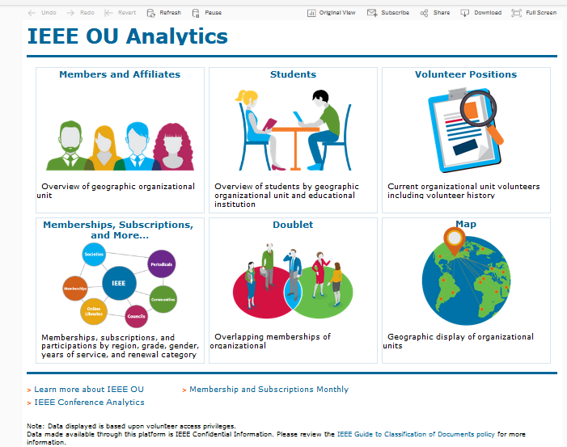

Slide 4
Use, don’t abuse
IEEE member and volunteer data is CONFIDENTIAL within IEEE
IEEE information list CANNOT be given out to outside sources (lists, mail lists, emails, etc)
Cannot use this data for any personal or business purposes

Slide 5
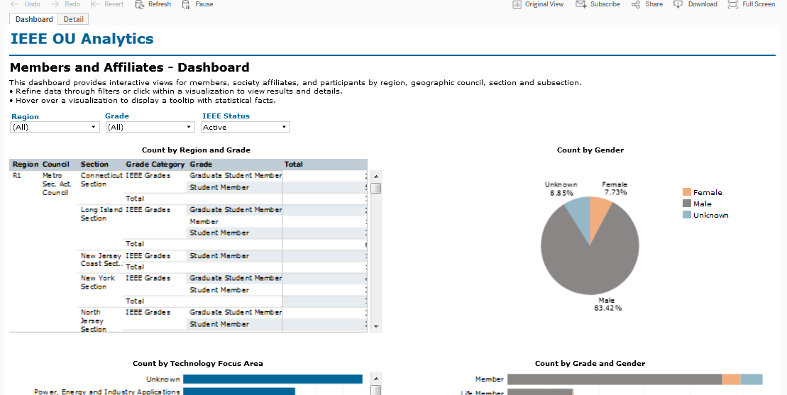
Who are my members?
OU Analytics shows you the data for YOUR area of responsibity

Slide 6
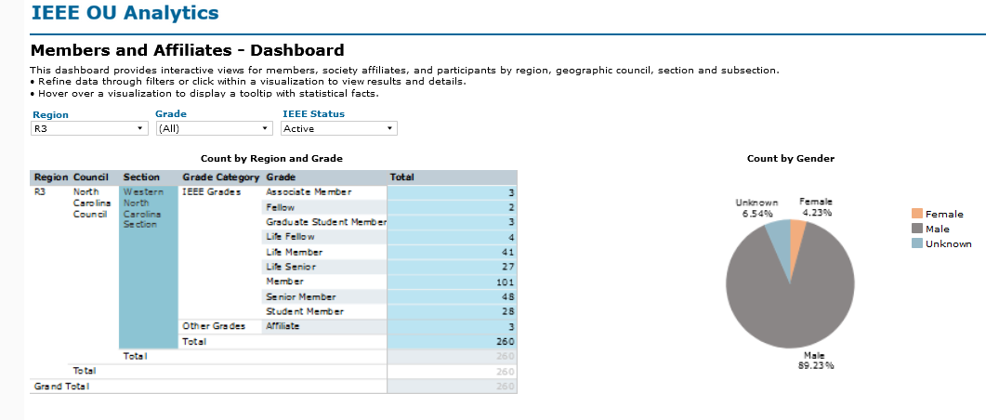
Select the level you want

Slide 7
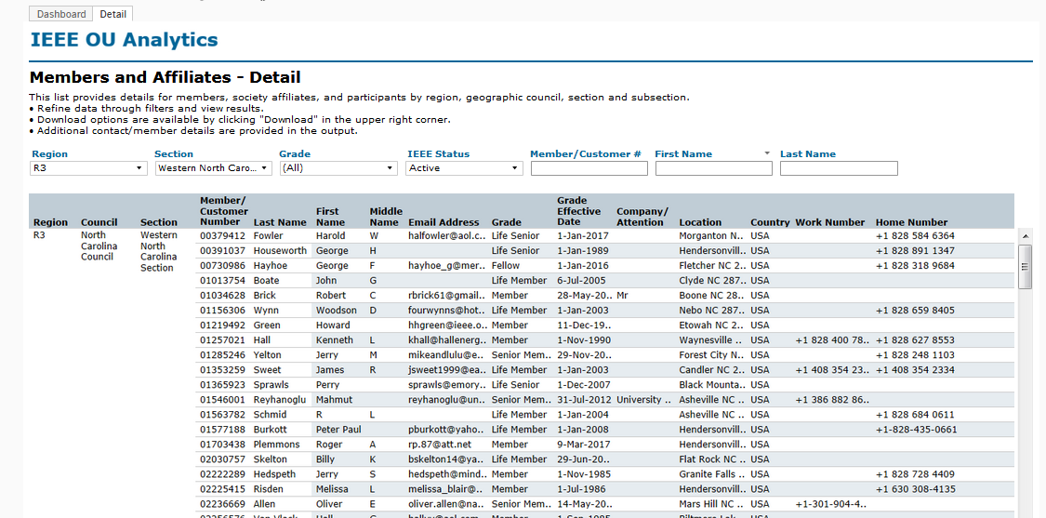
Click on “detail”

Slide 8
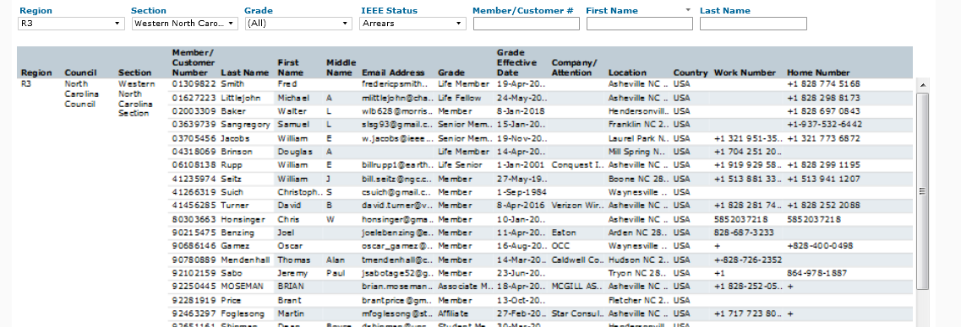
Arrears! Let’s try to get them back!

Slide 9
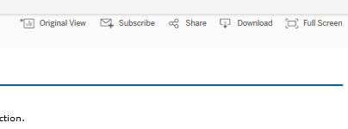
Downloading Data
DANGER DANGER DANGER WILL ROBINSON
Upper right hand corner
Can display
Can – in many cases – download CSV to Excel
REMEMBER the rules for proper use of the data!

Slide 10
Once in Excel…
Sort for all Senior Members and Fellows – sort for a Members for at least 5-10 yrs
Senior member roundup!
Sort for location – find out where people work / live!
Sort for primary area of interest – what topics should we plan for meetings!
Sort for…
Watch the OK to Contact flags!!!!!

Slide 11
Volunteers
#1 – CHECK WHO IEEE THINKS ARE YOUR OFFICERS
Use vTools Officer Reporting to correct if incorrect
Find out who are your peers in nearby sections – NETWORK!
Make use of the Volunteer History to find mentors! Make use of them!

Slide 12
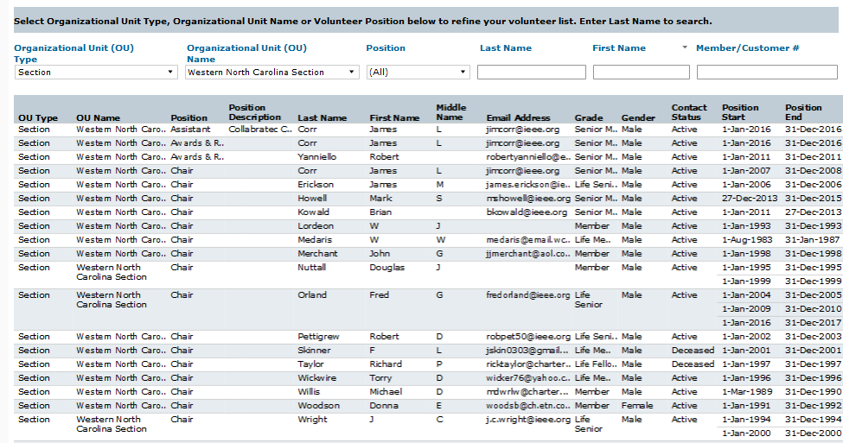

Slide 13
Nominating a new officer
Both vTools Elections and Officer Reporting need the membership number!

Slide 14
Tips
Things I still forget
Patience! The larger the data set, the slower the system is
Click on “ALL” to clear the default of all choices
Click on the unit name to select subsets of data
ALWAYS sort downloaded data by “do not contact” flags. DON’T SPAM! (GDPR)
Deep dive tomorrow afternoon!!!

Slide 15
Thank you!
Charles J. Lord c.j.lord@ieee.org

