Slide 1
IEEE OU Analytics

Slide 2
IEEE OU Analytics
Powered by Tableau
Tableau is an Online Business Analytics tool that allows users to view and further define visualizations based on IEEE data.
Tableau uses the same data source used by SAMIEEE, IEEE Renewal, Collabratec, the vTools Applications….
This training will show users how to access OU Analytics and interact with the Landing page and six dashboards.
Begin at http://www.ieee.org/ouanalytics

Slide 3
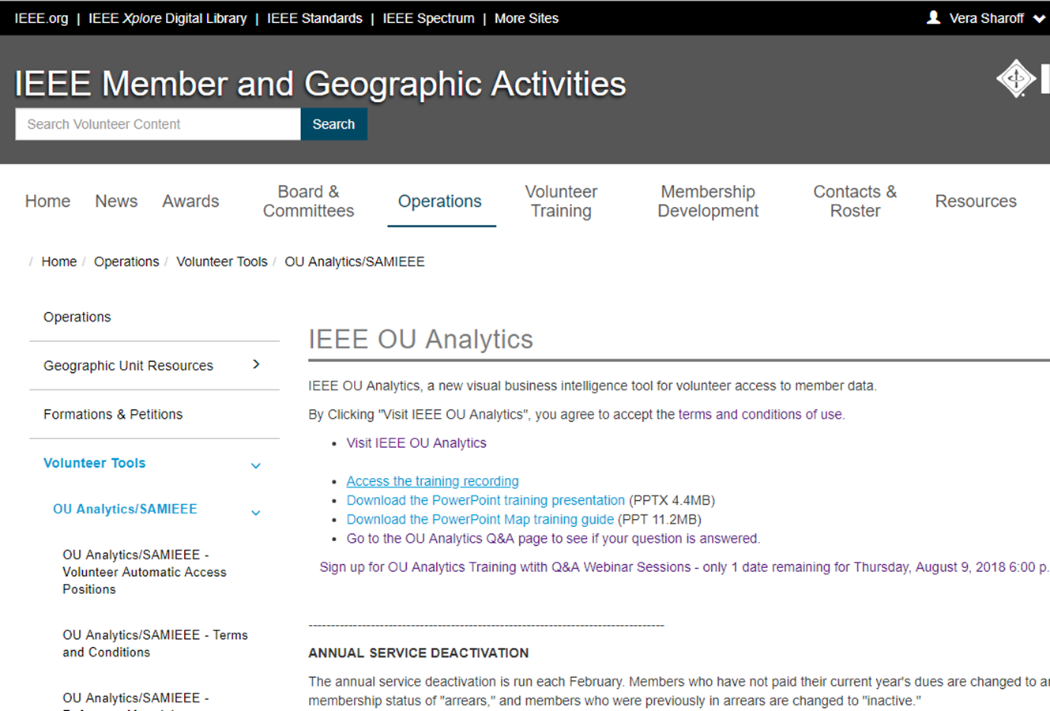

Slide 4
IEEE OU Analytics
http://www.ieee.org/ouanalytics
Access is based on the volunteer position and Organizational Unit (OU) ie: Section, Chapter, Society, region etc…
A list of authorized volunteer positions is available from http://www.ieee.org/ouanalytics

Slide 5
IEEE OU Analytics - Terms and Conditions
Conditions of data availability and use
IEEE member data is released for use only by IEEE members, officers, and committee members. Member information may not be furnished, with or without compensation, to outside entities, or be used by IEEE members for any other than approved IEEE business.
It is the responsibility of the volunteer to keep informed of IEEE Policies governing mailings and the use of labels and email addresses, including the regulations governing electioneering for IEEE offices. The information is found in Section 14.1 of IEEE Policies published every January and is available on request or from the IEEE Governing Documents website.
It is also the responsibility of the volunteer to keep informed of the IEEE member Privacy and Security policies and Email Terms and Conditions.

Slide 6
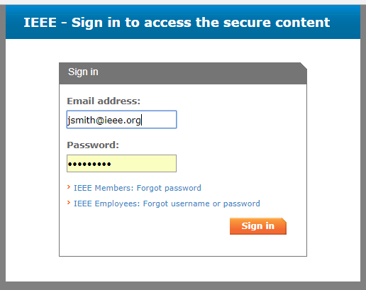
IEEE OU Analytics
Sign in
IEEE web Account User Name and Password

Slide 8
IEEE OU Analytics
The landing page is divided into six areas
Members and Affiliates
Member Lookup* by Region, Section and Subsection, contact information, grade, gender, HKN status.
Memberships, Subscriptions and More … Memberships, subscriptions, and Technical Committee participations
Region, Section, Subsection, grade, gender, years of service and renewal category*.
Students
An overview of attending students (all grades) by Section and School.
* New feature

Slide 9
IEEE OU Analytics
The landing page is divided into six areas
Doublet
IEEE wide view of overlapping memberships
Volunteer Positions
Current OU volunteers and volunteer history.
Map
Geographic display of organizational units and counts

Slide 10
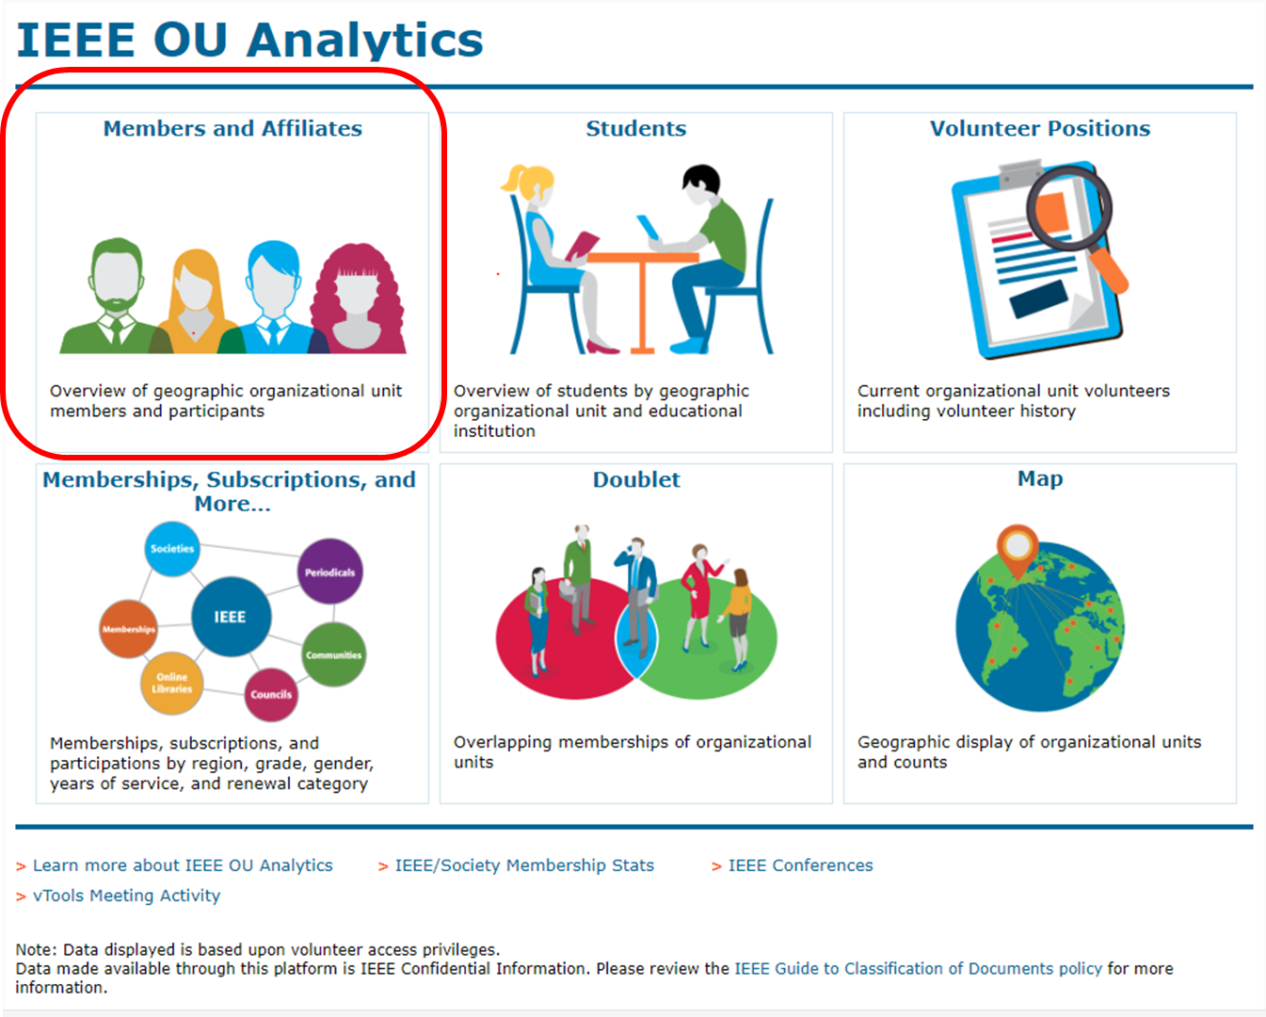

Slide 11
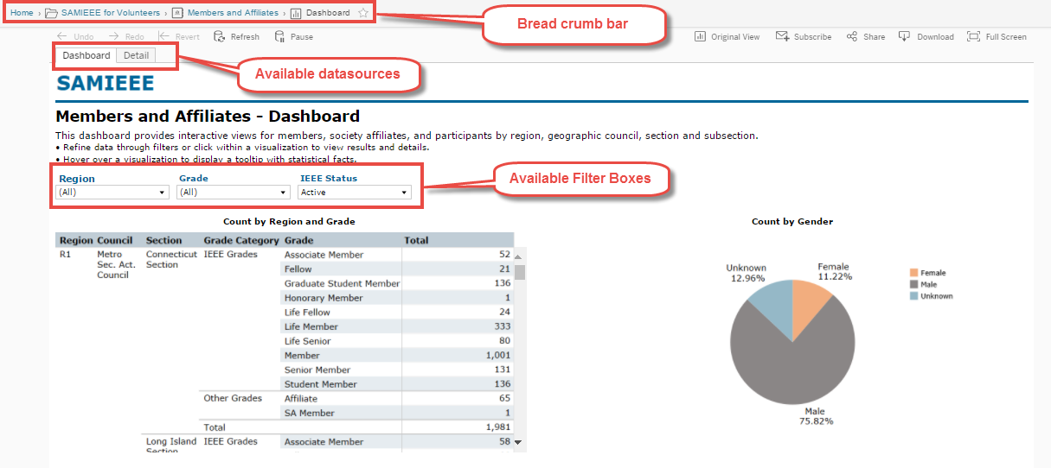
IEEE OU Analytics
How to navigate the new dashboards
On the dashboard pages (example: “Members and Affiliates” link.) users will see . . .

Slide 12
IEEE OU Analytics
Navigating the Dashboards . . .
The breadcrumb bar appears at the top left of the screen and provides the navigation path. Clicking within the breadcrumb allows you to navigate back to a prior screen.
Most dashboard views contain several visualizations of data including information such as Count by Region, Grade, Gender, Product type or name, and Renewals with a link to Member Details.
Each display is interactive and allows you to see more, less or different information by using drop-down filters, hovering over, or clicking on chart elements.
Drop-down filter options vary depending on the content in the dashboard. Use drop-down filters to modify the results displayed in all the visualizations for that dashboard.

Slide 13
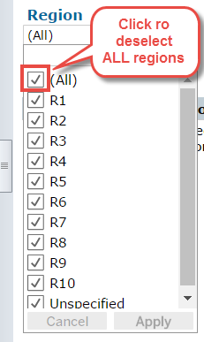
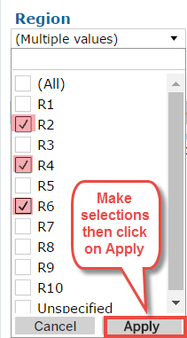
IEEE OU Analytics
Navigating the Dashboards . . .
To filter data using the drop-down menu
Click on the desired drop-down filter
Click All to deselect all filters
Click items you want to filter on (ex. Regions 2, 4, 6)
Click on Apply and then click on any white space to close the filter box.

Slide 14
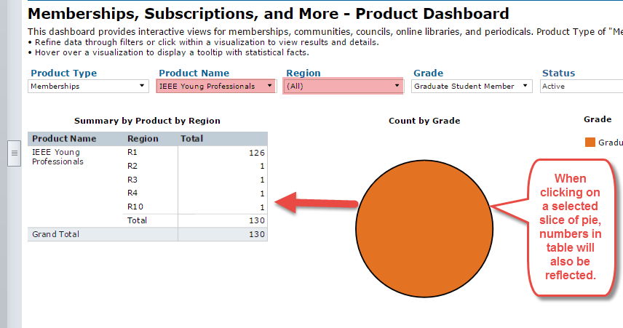
IEEE OU Analytics
Navigating the Dashboards . . .
Interacting with Content – Filtering Within a Visualization
In addition to drop-down filters, users can filter data directly from the visualization.
Click on the data point on the chart you wish to explore. The selected data
area will open and will be automatically filtered. (Example: on the “Count by Grade” pie chart in “Memberships, Subscriptions, and More – click on the GSM slice. You will see only GSM’s displayed on the chart and counts in the table also reflect GSM’s only.

Slide 15
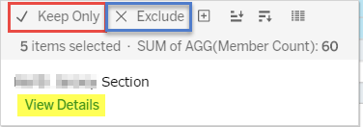
IEEE OU Analytics
Navigating the Dashboards . . .
Tool Tip: Provides another option for filtering visualizations. Click on the data point and then hover over the filtered area. A tool tip will appear and you can choose one of the following:
Keep only – keeps the selected data in the view, all other data will be removed.
Exclude – excludes the data from the view, all
other data will be retained.
View Detail – launches Detail View, which
provides a list of the chosen data with detail
information.
To clear the filter in the Tool Tip, click “Undo” at the top of the page and then click within white space to return the visualization to its original display.

Slide 16
IEEE OU Analytics
Navigating the Dashboards . . .
Various visualizations provide an option to expand or collapse columns. This can be done before or after applying filters.
Example: The “Renewal Category by Region by Grade” tab in the Memberships, Subscriptions, and More Dashboard allows for the expansion of the “Region” column to display counts by GeoCouncil and Section within the Summary by Product by Region visualization.

Slide 17
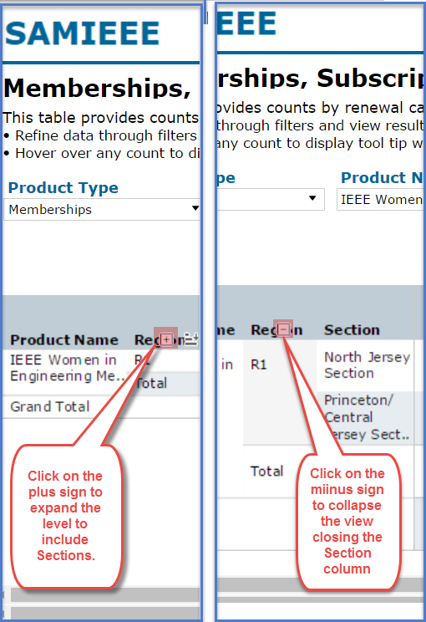
IEEE OU Analytics
Navigating the Dashboards . . .
Expanding or Collapsing Columns: Hover over column headings of a data table to see the expand and collapse buttons, if available.
Click the plus sign to expand the column
Click the minus sign to collapse the column; the plus sign will then appear
Click Revert button to return to where you started.

Slide 18
IEEE OU Analytics
Navigating the Dashboards . . .
Undo changes
Use the Undo button to reverse back through the changes you’ve made to the view. It will remember each step and undo one at a time.
Revert
Use the Revert button to restore filters to original view maintained on dashboard. This action reverts all dashboards to original view and removes all changes/selections made to filters.

Slide 19
IEEE OU Analytics
Downloading Data
Tableau provides many tools for displaying, filtering, and manipulating data. However, if you need to download, there are several options found under the Download button.
To download the data for a pie chart, for example, click on the title of the pie chart. Then click on the Download button on the top right of the screen. The following options will appear:
Image – downloads the image on your screen to a png file.
Data – (not recommended) downloads the data to a csv file. This option requires multiple steps for downloading to a text file and does not retain format.
Crosstab – (recommended download option) downloads the data to a csv file.
PDF – downloads the image on the screen to a PDF file.
Important note, if you do not select the title of the visualization before clicking Download, the data and crosstab options will be grayed out.

Slide 20
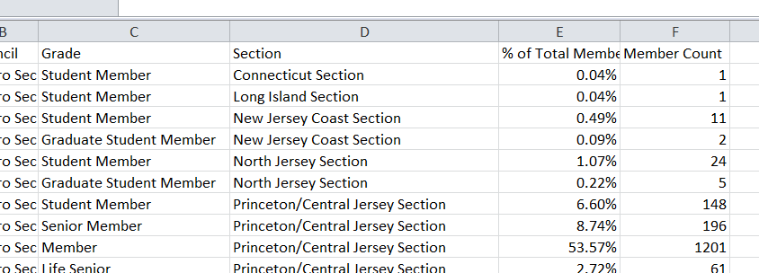
IEEE OU Analytics
Downloading Data
Examples:
Crosstab: Data downloaded from Pie Chart View.
Data: Data downloaded from Table View will first display a screen titled Summary. Click on the link “Download all rows as a text file” to download into a csv file.
When completed, it will download a csv file.

Slide 21
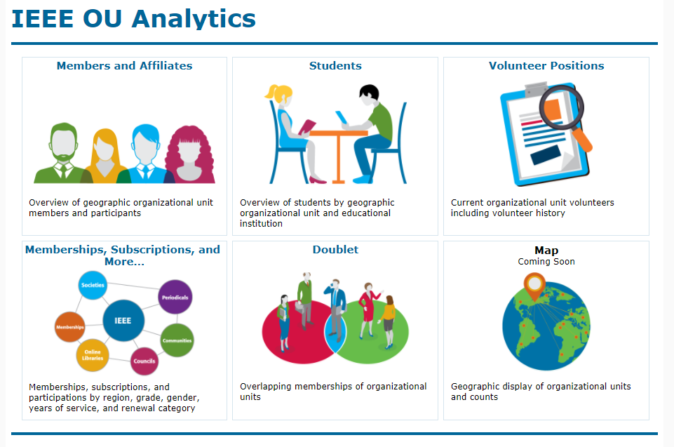
IEEE OU Analytics
Now for a closer look at the
individual dashboards

Slide 22
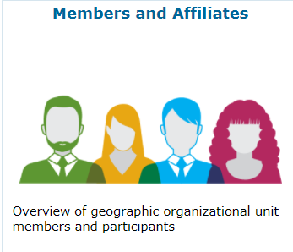
IEEE OU Analytics
Members and Affiliates Dashboard
The Members and Affiliates Dashboard provides an overview of IEEE members, society affiliates, and SA members by their geographic organizational units.
An overview count of members by Region, Council, Section and Subsection is available.
There are multiple visualizations:
Table of Count by Grade
Pie chart of Count by Gender
Bar graph for Count by Technology Focus Area
Bar graph for Count by Grade and Gender

Slide 23
IEEE OU Analytics
Members and Affiliates - Dashboard
There are two tabs available.
Dashboard – shows the predefined tables and charts available for a breakdown view of your members.
Detail – contains the individual member information. Access the member information by clicking on “View Details” in Tool Tips or clicking on “Detail” tab.
Detail shows member contact information.
Download contains additional fields depending on dashboard.

Slide 24
IEEE OU Analytics
Members and Affiliates - Dashboard
Count by Region and Grade
The data table is grouped by Region, Council and Section. If you have a Subsection, breakdown can be expanded by clicking on the expand button located in the middle of the Section column title.
Users can filter their view by Region, Grade and IEEE Status.
Views may display other Regions/Sections. These other geographic areas displayed represent the preferred address (e.g. home) of students attending school in your Region/Section. For example, a Connecticut section chair will see the Santa Clara Valley Section displayed because of a student attending the University of Connecticut (in Connecticut Section) who resides in the Santa Clara Valley Section.

Slide 25
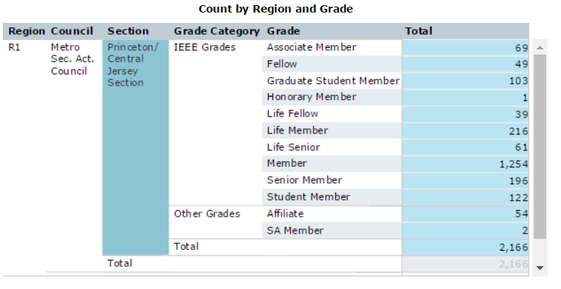
IEEE OU Analytics
Members and Affiliates - Dashboard
To further define your view to a specific section, click your cursor on the Section name. The view will appear highlighted in blue.
Click on Revert or white space on page to remove the view.

Slide 26
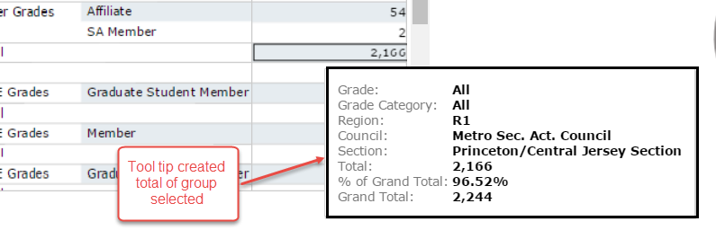
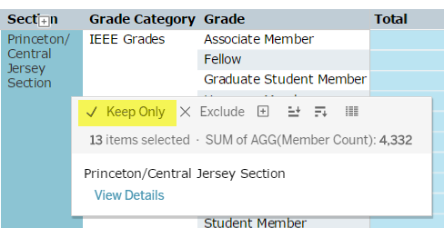
IEEE OU Analytics
Members and Affiliates - Dashboard
Hover over any visualization to display a Tool Tip. The tool tip gives further statistical information regarding that specific count or visualization.
To lock in a detailed view, such as your Section members only, click on the Section name in the table, hover over column and a tool tip will appear. Select “Keep Only” and this view will be locked. When locked, this selection will carry throughout other visualizations.

Slide 27
IEEE OU Analytics
Members and Affiliates - Dashboard
Within the tool tip, user can also select “View Details” This brings you to the Details View which will only include the member records for the selected data. Download by clicking in the data table header (grayed out area) and then clicking on download on the top right of screen. Download may include additional member details.
Count by Gender (pie chart) – will display all results or results based on filter and/or further definitions.
Count by Technology Focus (bar graph) – will display all results broken down by the 16 Technology Focus Areas. Results based on filter and/or further definitions.
Count by Grade and Gender (bar graph) – will display Gender breakdown (bar) by Grade. Results based on filter and/or further definitions.

Slide 28
IEEE OU Analytics
Students - Dashboard
The Student Dashboard provides information regarding members (any grade) attending educational institutions. Information is grouped by Region, Section and School.
There are two dashboard tabs available:
Dashboard – shows the predefined tables and visualizations available for a breakdown view by School, Grade, Gender and Field of Study.
Detail – contains the individual member information. When selecting a count, specific filters, using “Keep only” in Tool Tip, or selecting a slice of a pie chart or bar chart, Detail will display ONLY those records.
Top level filtering is on Region, Grade and IEEE Status.

Slide 29
IEEE OU Analytics
Students - Dashboard
Student Count by Section and School (bar chart table) – Displays total count of attending students (any member grade), by School’s Section and School Name. Click on the school name or the count of students to obtain specific list.
Sections may also view schools that are not a part of their OU. These schools contain attending students (any member grade) whose preferred address is in your Section view.
Student Count by Grade (table) - Displays attending students (any member grade) by region, council and section.
Sections may also view other sections of attending students (any member grade) who are enrolled in a school in your section but whose preferred address is in another Section.

Slide 30
IEEE OU Analytics
Students - Dashboard
Student Count by Gender (pie chart) - displays results based on filter, if applicable, and/or further definitions.
Student Count by Grade (data table) – displays breakdown by School and Grade. Chart columns can be expanded or collapsed by using the expand buttons over the Region, Council and Section columns. Table will display results based on filter and/or further definitions.
Student Count by Field of Study (bar chart) – displays count of members by Field of Study selected on member records.
Student View – Please note – for a Section volunteer – user may view schools that are not part of their OU. These are members that go to a school outside of your Section, but still report their preferred address as their home. This places them in your Section view.

Slide 31
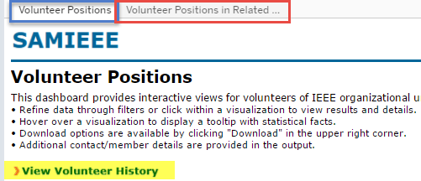
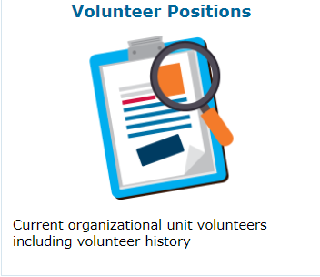
IEEE OU Analytics
Volunteer Positions - Dashboard
The Volunteers Dashboard has two tabs and one link available.
Volunteer Positions – lists “all” current IEEE volunteer positions. Use filter options to select a specific OU type and OU Name. Example: select Section as Type and then select a Section Name. List contains all volunteer positions (including vacant) on the Section Level. Filter/search can also be used on Last Name field to find a specific volunteer.

Slide 32
IEEE OU Analytics
Volunteer Positions - Dashboard
Volunteer Positions in Related Organizational Units – select OU Type and OU Name to view all related volunteer positions. Example: select Section as Type and then select a Section Name. List will contain all Affinity, Chapter, Student Branch, etc. volunteers under that Section
View Volunteer History (link) - provides a list of all “past” volunteer positions recorded in the IEEE database. Define search using the OU Type and OU Name filters. Search on the last name to find a specific individual. Example: Select Affinity as OU Type and a specific OU Group (Dallas Section Affinity Group, WIE) and apply. Results will display all volunteers holding past positions for that group.

Slide 33
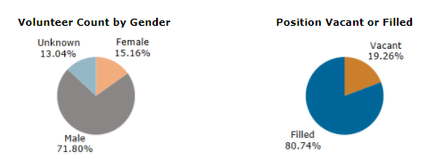
IEEE OU Analytics
Volunteer Positions - Dashboard
Two pie charts are also available:
Volunteer Count by Gender – will display visualization based on filters selected.
Positions Vacant or Filled – will display count of positions vacant or filled based on filters selected. Further statistical information is available using the Tool Tip on the selected slice of the pie.
Download selection by clicking in the data table header (grayed out area) and then click on Download on the top right of screen.

Slide 34
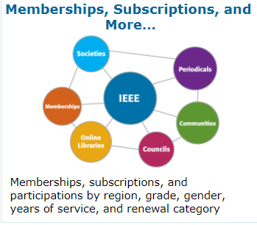
IEEE OU Analytics
Memberships, Subscriptions, and More… - Dashboard
Membership, Subscriptions, and More… Dashboard provides information for memberships, subscriptions and participations by region, grade, gender, years of service, and renewal category.
Society, Council, Community, Chapter and Affinity Group users access information for their specific group using filter options available. Filter by Product Type (memberships, councils, periodicals, etc.), Product Name (selection viewed is based on product type chosen), Region, Grade, and Status.

Slide 35
IEEE OU Analytics
Memberships, Subscriptions, and More… - Dashboard
There are five (5) tab options available:
Product Dashboard
Product Summary by Region by Grade
Renewal Category Dashboard
Renewal Summary by Region by Grade
Detail
Product Dashboard – contains four (4) visualizations.

Slide 36
IEEE OU Analytics
Memberships, Subscriptions, and More… - Dashboard
Summary by Product by Region (data table) – provides a summary of product selected, using Filters. For example, Product Type Memberships is preselected; select Product Name (e.g. a specific Society or Affinity Group Membership). Affinity groups include Consultants Network, WIE, and YP). Click apply and view the total membership count. Hover over count to view tool tips with statistical information. Click View Details to view individual member information.
Count by Grade (pie chart) – provides count of members by grade. You can modify results through Filters or clicking within visualizations. Hover over pie slices to view tool tip with statistical information. Click on a grade slice within pie to select a specific grade. Click View Details to view individual member information.

Slide 37
IEEE OU Analytics
Memberships, Subscriptions, and More… - Dashboard
Count by Gender (pie chart) – provides count of members by gender. Hover over pie slices to view tool tip with statistical information regarding gender count. Click on a gender slice within pie to select gender type. Click View Details to view individualmember information for selection.
Count by Grade and Years of Service (bar chart) – Chart displays count of members by grade and years of service. Hover over chart to view tool tip with statistical information for a specific grade and year(s) selected or use Filters. To obtain member detail, click on a specific grade within bar chart, hover over to view Tool Tip and click. Select View Details. You can also click on the Years of Service count to View Details for a full list of members by grade for those “Years of Service”.
Note for Joint Chapter Chairs: Membership counts displayed may contain duplicates due to members belonging to more than one society. Pie charts (Grade and Gender) provide unique member counts.

Slide 38
IEEE OU Analytics
Memberships, Subscriptions, and More… - Dashboard
Product Summary by Region, by Grade – provides a data table to view counts by grade for memberships, communities, councils, online libraries and periodicals. Filter down by Product Type (Memberships is preselected), Product Name, Region, Grade and Status.
Region can be expanded to include counts by Section and Subsection by selecting the “expand” button on the Region field title.
Hover over counts to view tool tips with statistical information. Click View Details to view individual member information
To download, click on table title, click on Download on the top right of screen. Download to Crosstab. Download will provide additional detail information for the members selected.

Slide 39
IEEE OU Analytics
Memberships, Subscriptions, and More… - Dashboard
Renewal Category Dashboard – provides product renewal information based on filters selected. Renewal categories provided are: Renew, First Year Renewed, New, Reinstated, Not Yet Renewed and Cancelled.
Filters provided are Product Type, Product Name, Region, Grade, and Status.
Overview of Product Renewals (bar chart) – provides a breakdown by renewal categories. Hover over to view additional statistical information. Click within bar chart and Click View Details to view individual member information.
Product Summary by Region by Renewal Category (data table) – provides a count of members by Region by Renewal Category. Expand Region to view counts by Section and Subsection by selecting the “expand” button on the Region field title. Hover over counts to view additional statistical information and Click View Details to view individual member information.
Recommendation: Downloading Column and Row Totals default to “Grand Total” counts, which can be significant and provide excess data. Use Filters to refine data per OU.

Slide 40
IEEE OU Analytics
Memberships, Subscriptions, and More… - Dashboard
Renewal Summary by Region by Grade – provides a data table containing counts by renewal category. It is further defined by Grade.
Filters provided are Product Type, Product Name, Region, Grade, Renewal Category and Status.
Hover over the Region header to expand view to include Section and Subsection.
Hover over counts to view tool tips with statistical information.
Click View Details to view individual member information. Download details for additional member information that displayed in view.
Recommendation: Downloading Column and Row Totals default to “Grand Total” counts, which can be significant and provide excess data. Use Filters to refine data per OU.

Slide 41
IEEE OU Analytics
Memberships, Subscriptions, and More… - Dashboard
Detail View – provides details of the members/participants for memberships, communities, councils, online libraries and periodicals.
Refine data using filters available (Product Type, Product Name, Region, Grade, Status, Gender, Years of Service and Renewal Category).
Table includes breakdown by Region and Section.
Other than member details displayed, there are additional member details available in download option.
To download full list, click on table title line (gray shaded). Then select Download on top right of screen, and select download to Crosstab.

Slide 42
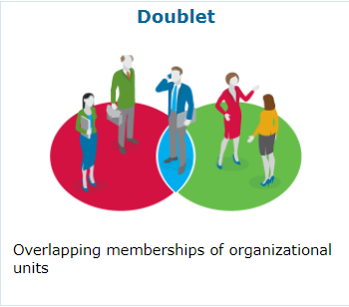
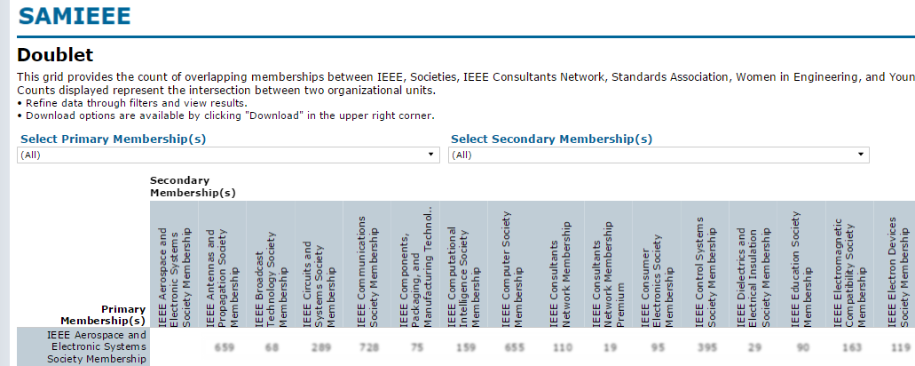
IEEE OU Analytics
Doublet - Dashboard
The Doublet Dashboard only contains one view. It provides counts of overlapping memberships between IEEE, Societies, IEEE Affinity Groups and Standards Association.
The table uses two filters:
Select Primary Membership(s)
Select Secondary Membership(s)

Slide 43
IEEE OU Analytics
Doublet - Dashboard
Select your Primary Membership from the list, click Apply. Then select your Secondary Membership, click Apply. The chart will produce the count of overlapping memberships without duplication.
Example: Select IEEE Computer Society Membership for your Primary and then IEEE Women in Engineering Membership as your secondary. Results will show how many of your members belong to BOTH societies (and possibly others).
Download is only available for the table, as is – counts only. Viewing Member Details is not available.

Slide 44
IEEE OU Analytics
Save and Manage a “View”
Users have the option to save a frequently used “View”. When setting up a specific filter, a user can save and name a view to be pulled up as needed. View pertains to “only the Dashboard it is created on.”
In this example, in Memberships, Subscriptions, and More – Product Summary, a filter has been set for YP’s, Region 1, Status Active and Inactive – Section field opened.

Slide 45
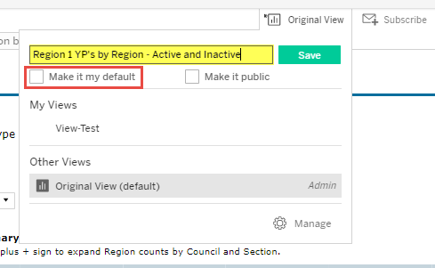
IEEE OU Analytics
Save and Manage a “View”
Click on “Original View” located on the upper right side of screen.
In the “Name this view” field, type in the name you would like to save this view as.
If you wish to open to that specific view each time you open this dashboard, select “Make it my default”.
Click on Save

Slide 46
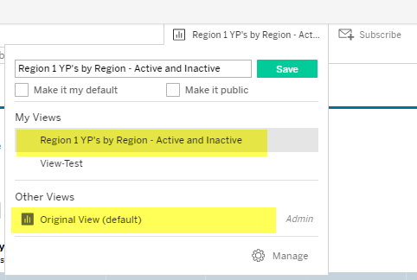
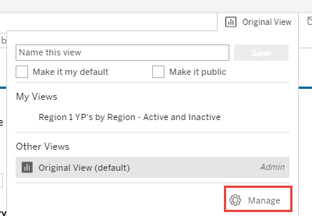
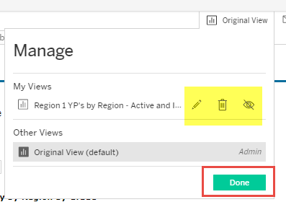
IEEE OU Analytics
Save and Manage a “View”
The view marked as “Default” will show on the View Area.
To change, click on the view title and in the My Views or Other Views areas – select Original view or any other view title available – click on title to select.
To Manage (rename or delete), click on Views and then select “Manage.” Make changes and when completed, click on Done.

Slide 47
IEEE OU Analytics
Questions & Assistance
If you have any questions regarding the new tool or need further assistance send an email to samieee@ieee.org
Here are additional contacts:
GEOGRAPHIC ORG UNITS CONTACTS
Helen Shiminsky (primary)
Email: h.shiminsky@ieee.org
+1 732 562 5517
Vera Sharoff (alternate)
Email: v.sharoff@ieee.org
+1 732 552 5509
SOCIETY ORG UNITS CONTACTS
Mary Curtis (primary) Tina Cordeiro (pimary)
Email: m.curtis@ieee.org t.cordeiro@ieee.org
+1 732 562 3904 +1 732 562 5329
Rosanne Loyal (alternate)
Email: r.loyal@ieee.org
+1 732 562 3903

