Slide 1
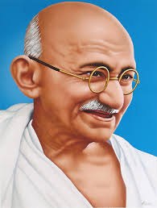
“A customer is the most important visitor on our premises. He is not dependent on us. We are dependent on him. He is not an interruption to our work. He is the purpose of it. He is not an outsider in our business. He is part of it. We are not doing him a favor by serving him. He is doing us a favor by giving us an opportunity to do so.”
- Mahatma Gandhi
Notes:
This quote is painted on the wall of an IEEE Human Resources conference room at the Operations Center in Piscataway, NJ.

Slide 2
Roles of Officers 201
Mark Torres
SoutheastCon 2019, Huntsville, AL

Slide 3
What is your Section’s Vision & Mission
Section Region 3 Vision: Engage every Member through Communities of Interest
Fundamental Position
  The Member IS IEEE and their ACTIVE PARTICIPATION is essential to achieving the IEEE Mission
  The Section OWNS the Member RELATIONSHIP and IS IEEE to the Member
  The Region is the ENABLER of full member ENGAGEMENT
Section Support Committee Mission: Assist the Sections to:
  To stimulate the interest of IEEE members
  To motivate members to volunteer
  To encourage professional and technical growth of all members
  To share best practices with other Sections
  To form Engineering Affinity Groups.
Reference: IEEE MGA Vision, Mission, Guiding Principles, Goals, and Strategies
Notes:
The IEEE Geographic structure (Regions/Sections/etc.) all report back to MGA and the MGA Board.
We’re all working towards this vision & vision.

Slide 4
Section Responsibilities
Provide an excellent member experience and everything else will follow
Engage members through Communities of Interest with Affinity Groups and Society Chapters with focus on Young Professionals, Women in Engineering, Senior Members and Life Members.
Sponsor projects to facilitate the active involvement of members in IEEE activities.
Provide high quality technical programs for members of the Section, Chapters & Student Branch
Sponsor Senior Member Elevation programs
Use collaborative tools and other technologies to support Section activities.

Slide 5
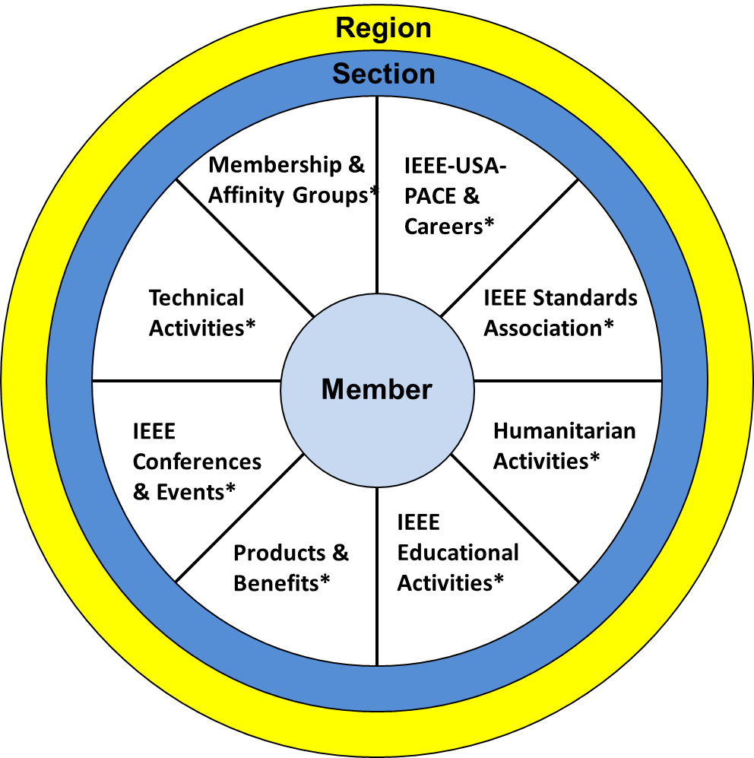
Member View of IEEE
Notes:
In this view:
The member is the focus
They joined for anyone of the “reasons” represented by the segments of the pie or also known as “communities of interest”
When a member joins, they are looking for IEEE to fulfill a need.
However, many do not realize the full depth and breadth of IEEE.
The Section is there to support the members locally
The Region is there to support the Sections and volunteers to do their jobs effectively and efficiently
There is staff that supports all of these functions, however, members do not have direct access to staff outside of the IEEE Contact Center resources.
Per our Member satisfaction survey:
Members find IEEE products “difficult to use”.
If you’ve ever tried to find anything at IEEE there is A LOT of content to go through.
Members do not necessarily see the value or state “membership is too expensive”.
These two concepts are related.
If a member can’t find what you need/want, there is no perceived value.
So…..

Slide 6
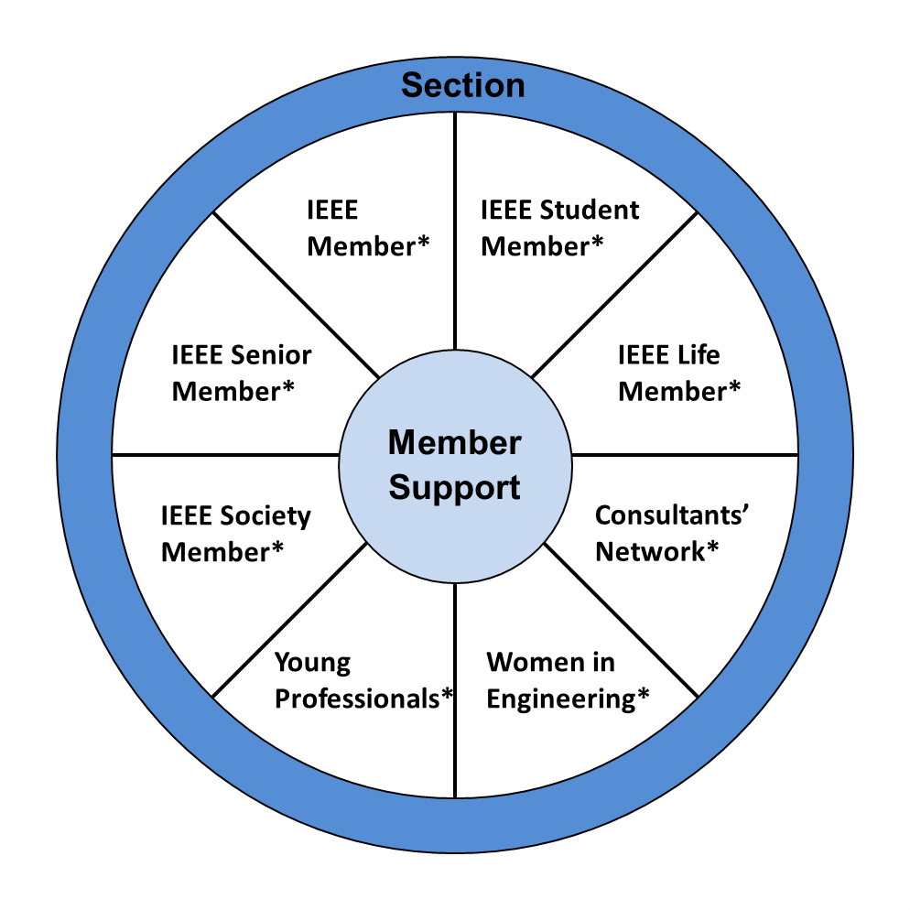
Section Volunteer View of IEEE
Notes:
This is why IEEE relies on the local volunteers to deliver an excellent “member experience”
To deliver this experience, volunteers would again rely on their members’ communities of interest
It is important to note each Section’s communities of interest are unique; There is no universal answer
It will take member engagement to learn what your specific members are interested in to deliver.
The challenges are:
Volunteers are more often than not still working in the profession, in school etc. which limits their time.
Many Sections do not have volunteers to service all of the various member interest
Again, there is staff support available for these categories, but in this case volunteers DO HAVE ACCESS to staff to ask questions and get support to service their members.
Adrienne Hahn (volunteer resource for Regions 1, 2, &4)
Chris Wright (volunteer resources for Regions 3, 5 & 6)
Along with the staff who support the various interests
This is also where the Region Executive Committee come in.

Slide 7
What do we need to do?
Organize the Section Leadership Team
Engage members
Communicate!
Plan Compelling Programs
Recognize member’s contribution & accomplishments
Notes:
As a team, these are some of the things that need to be accomplished, through each volunteer doing their job and working together as a whole.

Slide 8
Section Chair
Make an Impact >> Define & Implement the Section Goals and Focus Areas
Organize the Section Leadership Team
(Chair, Vice Chair, Secretary, Treasurer, MD Chair, Awards Chair, N&A Chair, etc.)
Empower your team – do they need help?
Engage with Communities of Interest >> Chapters, Affinity Groups, Projects, etc.
Engage & Support Student Branches >> They are our future
Work with the Section Past Chair on the Section Officer Succession Plan
Use the OU Analytics, vTools and IEEE web site resources
Represent the Section at Region Committee meetings.
Review Section finances
Notes:
Refer to full documents of VIP, and CLE descriptions

Slide 9
Section Vice Chair
Support the Section Chair as “Second in Command”
Make an Impact >> Assist with Implementation of Section Goals and Focus Areas
Develop recommendations on next years Section Goals and Focus Areas
Coordinate with Chapters, Affinity Groups and Student Branches in your Section
Chair the Section Programs Committee which should be composed of both long-time and new members
Coordinate Section meeting logistics (location, food, etc.)
Coordinate Officer Election schedule and activities

Slide 10
Section Treasurer
Review all financial statements monthly
Report on financial status at Section meetings
Keep NetSuite current; attend NetSuite training
Meet IEEE deadlines
Preparing the Section annual budget
Communicate with and assist chapter and branch treasurers
Work with previous treasurer to learn how the Section finances operate
Act as a mentor to your successor

Slide 11
Section Secretary
Create and submit annual report to IEEE
Section vTools and OU Analitics coordinator (use and training)
  Meeting announcements & reporting, eNotices, officer updates
  Assist chapters with using vTools
Take minutes and attendance at meetings; post or share via email after approved
Supervise the records keeping for the Section
Work with webmaster to ensure website is current
Use Social Media to publicize and generate interest in Section Activities

Slide 12

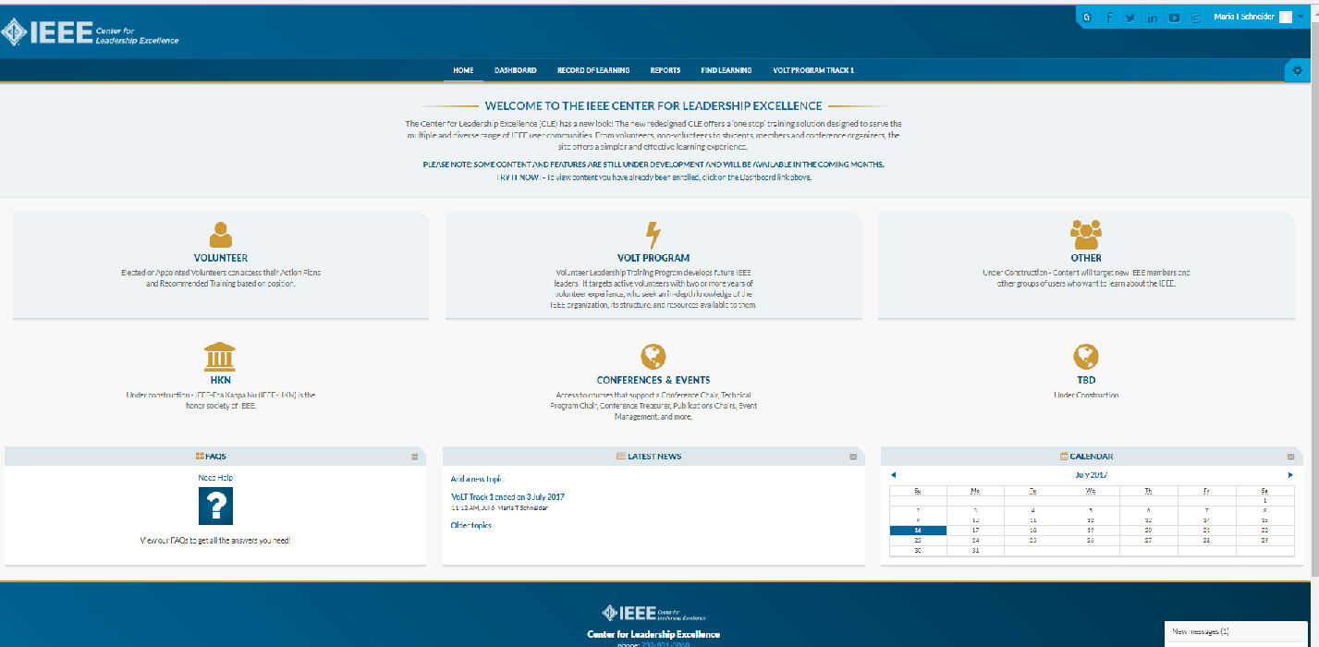
IEEE Center for Leadership Excellence
ieee-elearning.org/CLE/
Simple to use, self-paced
Offers help to Volunteers in their new role with ACTION PLANS!
Access with IEEE Account
Please note: Content is updated regularly – Check back often!
Notes:
Bill Marshall is covering this in the Tools for Sections session in Track 1.
This is the training resource for volunteers to learn more about their job descriptions and action plans.
All Section Volunteer job descriptions are loaded
Region volunteers will be available in the near future
You will need your IEEE user name and password to login to the tool.
Suggest EVERYONE takes the Membership Development (MD) Training
All volunteer roles have an element that speaks directly to serving the members’ needs and giving them the best possible experience.
The MD training addresses how to do this.
Most Section Leader job descriptions are now available

Slide 13
Region 3 Section Support Committee
Committee Member Contact Information
Committee Position | Name | Email Address
Section Support Committee Chair | Mark Torres | mgtorres@ieee.org
Life Member Coordinator | Tom Bellarmine | t.bellarmine@ieee.org
Young Professional Coordinator | Edwin Mastache | eng.edwin.m@ieee.org
Women in Engineering Coordinator | Allison Mercer | Allison.Mercer@gtri.gatech.edu
Senior Member Elevation Coordinator | Jacquelyn Cunningham | jdnc@ieee.org
Sections Operations Specialists (Position 1) | Charles Lord | c.j.lord@ieee.org
Sections Operations Specialists (Position 2) | Bill Marshall | marshalliv@ieee.org
Project Coordinator | Grayson Randall | g.randall@ieee.org
Technical Activities Coordinator | Glenn Parker | Glenn.Parker@gtri.gatech.edu
Section Support Committee Mentor | William (Bill) Ratcliff | w.ratcliff@ieee.org
The IEEE Support Center is a great online resource.

Slide 14
Thank you!
Region 3 Section Support Committee
You are not alone … We are here to help
Assisting our members to find and engage with IEEE Communities of Interest requires many levels of engagement … Again we can help
Relationships are a network, not a hierarchy
  Region 3 to Sections
  A Section to other Sections
  Members to other Members
Mark Torres, mgtorres@ieee.org

