Slide 1
Engagement: Professional Development Events
Theresa Brunasso
SoutheastCon 2019, Huntsville, AL

Slide 2
Types of Professional Development Events
Presentation Skills
Technical Writing
Networking Skills
Hiring Skills
Leadership Skills
Program Management Skills
Business Development Skills
Leveraging LinkedIn
Resume Writing
Interviewing Skills
Preparing for Performance Reviews
Starting Your Own Business
Patent Writing

Slide 3
Identify and Recruit Speakers
Colleagues
Other IEEE members
Ed Kirchner on Career Development
Local book authors
Local TEDx speakers
New business owners who want to increase visibility
PR releases of local companies and universities

Slide 4
Consider Holding a Panel Discussion
Often easier to get someone to agree to be part of a panel that to be a speaker
If one speaker pulls out, you don’t have to cancel
They don’t need to prepare a presentation
You can provide them a list of questions before the event so they will be prepared
An opportunity to have more companies involved

Slide 5
Consider a Dinner or Lunch Event
Members need to eat
A popular or catering restaurant can be a draw
Charge a minimal fee to decrease the number of no shows
Typically on 60% of registrants show up to free events
Even a $5 charge for lunch or a $10 charge for dinner is enough for people to show up
Use PACE matching funds to help cover the costs
All professional development events are eligible for PACE funds

Slide 6
Event Advertising
V-tools e-mail sent to all members, including those in arrears
Separate e-mail sent to student chapters
Separate e-mail to attendees of previous events
Reminder e-mail sent the week before the event
Reminder e-mail sent to registrants the day before.

Slide 7
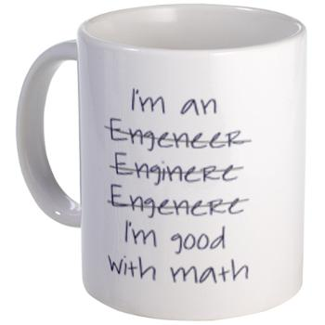
Speaker Appreciation
All speakers volunteer their time for free
All should receive thank-you e-mails
Any compliments from participants should be forwarded to the speakers.
All speakers should receive a gift

Slide 8
Questions and Suggestions

Slide 9
Thank you!
Theresa Brunasso, theresa.brunasso@ieee.org

