Slide 1
Engaging Industry with Your Section
Glenn Parker, Huntsville Section Chair, R3 Technical Activities
SoutheastCon 2019, Huntsville, AL

Slide 2
Agenda
IEEE Entities: What is a Section?
What Does Industry Gain by Being Involved?
What Does the Section/Society Gain?
Finding Contacts
Examples of Huntsville Section Activities
Secrets to Success

Slide 3
IEEE Entities
What is a Section? What is a Chapter?
An “IEEE Section” is an IEEE entity which caters to the needs of a specified geographical area
“The Section OWNS the Member RELATIONSHIP and IS IEEE to the Member” – Mark Torres
A Chapter is a local technical community within a Section and is a local link to IEEE resources and its 39 technical Societies
Chapters consist of members from one or more IEEE Societies who share both technical interests and geographical proximity
Chapter Activities Include:
Guest speakers Conferences
Workshops Tutorials
Seminars Social Functions

Slide 4
IEEE Organization
IEEE Technical Activities Board (TAB)
IEEE Member and Geographic Activities (MGA)
Societies & Councils
Regions
Young, Women, Consultants, Life
Sections
Chapters
Student Branches (SB)
Affinity Groups (AGs)
Student Chapters
WIE Student AGs
Local representation. “Engaging industry”
can and should involve all of these.

Slide 5
What Does Industry Gain by Engaging with Your Section?
Collected group of:
Engineers interested in the subject area
Professionals who work in the subject area and may be current customers
Potential users of their products or services
Participants can interface with the vendor on issues
Get help from vendor to resolve
Participants at the meeting can also help resolve the issue
Participants benefit from questions and answers from other attendees
“Group think” can help the vendor better know what problems need solving
Vendors get to show off new features or get feedback on future products

Slide 6
What Does the Section/Society Gain?
Vendors provide society personnel to present at technical meetings
You can also find your next ExCom members from the vendors
Sponsors who provide a meal to the participants at the monthly technical meetings
Attendees receive:
Latest technical information and insight into problems of interest to them
Awareness of new equipment to help in analysis or testing
Help on issues that they have experienced

Slide 7
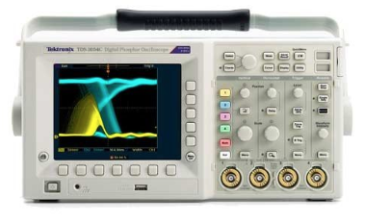
Finding Contacts
A Huntsville EMC perspective
IEEE members reach out to all EMC/EMI vendors that different members interface with
Ask if they would be willing to support the EMC Society, either as a presenter or as a meal sponsor
We set the schedule a year in advance
Ask vendors to sign up for a specific data ahead of time
Some vendors sponsor on an annual basis
All vendors have been very responsive
They understand that current and future customers are in attendance
They are allowed to do product placement and distribute literature

Slide 8
Use Humor, Good Food, and Consistency
Same place, same time
Good food
Spice potentially “boring” talks with humor and wit

Slide 9
Examples of Activities
Providing good technical talks and a free meal
EMC Huntsville Chapter consistently has 30-50 attendees at monthly technical meetings
Team multiple chapters together:
2018 Huntsville EMC and Computer Society fall technical meeting
IEEE distinguished lecturer
150 attendees
Guess where it was held?
Constant contact with vendors for presenters or meal sponsors
Has resulted in the next year meeting being filled before the previous year is complete
For two years now, the EMC Chapter has not had to send out a call for presenters or meal sponsors for the upcoming year

Slide 10
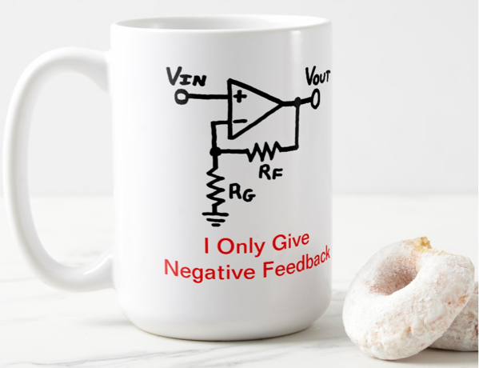
Secrets to Success
#1: Keep a long-term focus; mentor young talent and ask people to step up
The bad news: it takes years to build up the pipeline of actions leading to strong participation by attendees, meal sponsors and technical speakers
Do the simple things well:
Keep talks interesting and varied/eclectic in addition to the primary subjects of a given chapter
Leadership should be friendly in one-on-one interaction with attendees
Be friendly during preliminary announcements and slide presentation
Always make meal sponsors feel valued/appreciated and give them some time to strut their stuff
Make sure there is applause for the meal sponsors and speakers
Give gifts/gift certificates and a certificate of appreciation for the technical speaker
Hold meetings in the same place as much as possible
A chapter should:
Develop its own unique personality and always be doing things to strengthen core attendee loyalty
Groom people to serve in leadership
Expect to take a few years to grow into the place where the chapter wants to be
Be positive! Even EE’s can build strong communities.

Slide 11
Thank you!
Glenn Parker, glenn.a.parker@ieee.org

