Slide 1
The Culture of Engagement / Mentoring
William Ratcliff
SoutheastCon 2019, Huntsville, AL

Slide 2
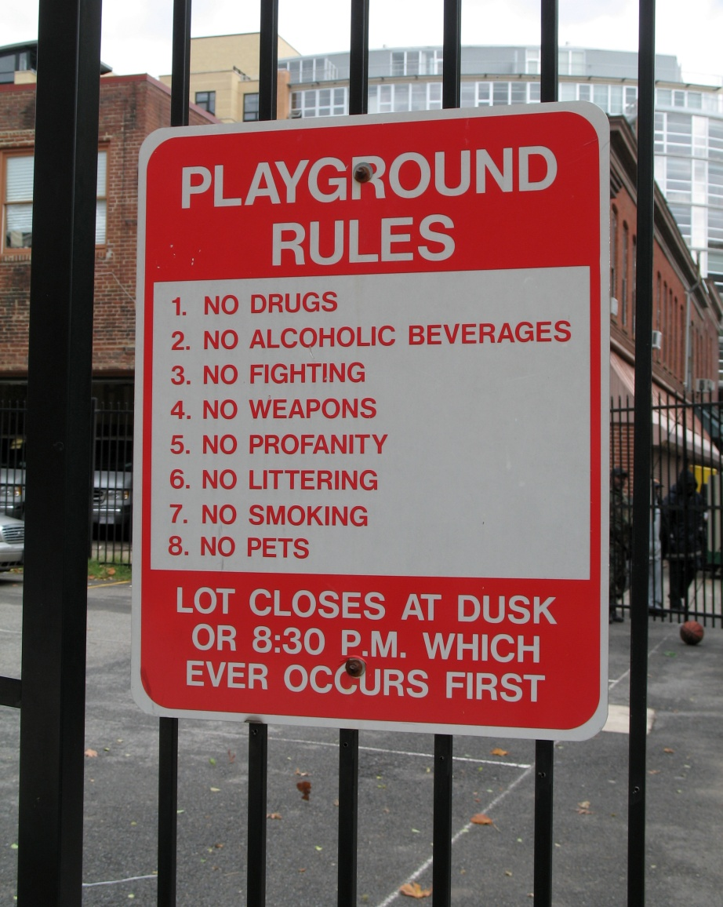
House Keeping
Be sure to sign in
Check “baggage” at the door … Keep your Open Mind
Ask your questions anytime.
Remember we have 20 minutes this afternoon but this discussion can be continued off line.
This Photo by Unknown Author is licensed under CC BY-SA

Slide 3
Key Concepts (Critical Success Factors for Mentoring)
A Culture of… must be present
Encounter and Engagement, which builds and maintains the network
Inclusion, which supports diversity
Belonging, in which the individual participation matters
The following relationships … are essential
One to Many that describe Direction (Purpose, Shared Values, Objectives…)
Many to One that describe Alignment (to create the one direction)
Many to Many Network that describe Member Interaction (What we do and how we achieve the common direction)
This Photo by Unknown Author is licensed under CC BY-NC-ND

Slide 4
Where are we on our journey?
Do you have a Mentor?
Are you a Mentor?
Does your Section encourage Networking to assist each other?
How many mentors do you need?
Is your Mentor older than you?
How did you find your mentor?
Are you aware of continuous mentoring?
Photo by Vlad Bagacian on Unsplash

Slide 5
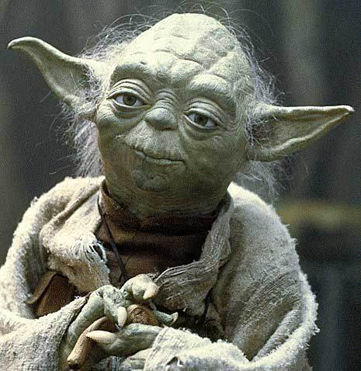
Myths
One Mentor is all you need… One size fits all.
The Mentor is always older than the Mentee.
Information, advise, knowledge always flows from Mentor to Mentee
Once a Mentor always a Mentor.
To be a Mentor you need to have gray in your hair.
Models many there are!
This Photo by Unknown Author is licensed under CC BY-NC
Notes:
https://starwars.fandom.com/wiki/Gimer_stick/Legends - yoda from here.

Slide 6
Truths
Mentoring is a type of engagement
Mentoring relationships are multi-directional.
The process of mentoring can be learned and must be understood by all thru negotiations.
The “doing” must become part of the culture!

Slide 7
Five Step Process of Engagement
Encounter People
Determine mutual areas of interest, expertise, and need to share
Form Relationships
Action – Doing Something… collaboration, cooperation, shared responsibility
Knowing when we have arrived (achieved a specific result)… then evaluate relationships

Slide 8
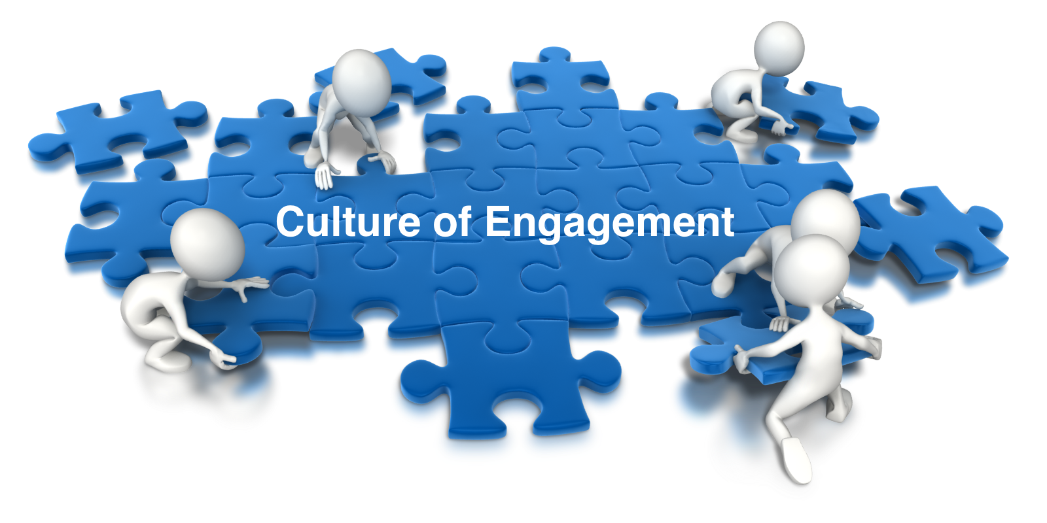
How can we start building a
Affinity relationships (often dynamic )
Birds of a feather – small transient groups
Common social / political / technical problems that require the knowledge of technology to help solve
Common interest Projects
Determining the need for helping each other “mentoring”

Slide 9
Where from here???
Continue the discussion?
Workshops on Mentoring Processes ?
Resources
Collabratec
People in your Section, Chapter … Life Members
People here at SoutheastCon
Start small groups with common interests?
Technical areas
Problems requiring solutions
Projects
This Photo by Unknown Author is licensed under CC BY-SA-NC

Slide 10
Thank you for mentoring me today!
w.ratcliff@ieee.org
The Journey continues…

