Slide 1
Engagement: Events, Outreach Growth
Mark Torres
SoutheastCon 2019, Huntsville, AL

Slide 2
Section Responsibilities
Engage members through Communities of Interest with Affinity Groups and Society Chapters with focus on Young Professionals, Women in Engineering, Senior Members and Life Members.
Sponsor projects to facilitate the active involvement of members in IEEE activities.
Provide high quality technical programs for members of the Section, Chapters & Student Branch
Sponsor Senior Member Elevation programs
Use collaborative tools and other technologies to support Section activities.

Slide 3

2018 Presidents Forum - What did members tell us?
2018 Presidents Forum - Major Member Themes
“IEEE needs to deliver direct value to its members”
“Focus on member development rather than membership development”
“Members joined IEEE as a professional organization, not a social service organization”
“Focus more on members not just all the various IEEE products”
Notes:
“IEEE needs to deliver direct value to its members”
This is especially true for the practicing engineer.
Members believe IEEE might need re-invention or reorganization.
“Focus on member development rather than membership development”
Members believe this would create membership growth and improve member retention.
Members believe IEEE does a poor job promoting the profession.
“Members joined IEEE as a professional organization, not a social service organization”
Members believe IEEE has shifted too far toward social service and do not think this is appropriate.
The recent Summary Annual Report only re-enforced this opinion.
“Focus more on members not just all the various IEEE products”
Speak more directly to members
Listen more, sell less. IEEE communications tend to be about selling IEEE, rather than addressing members needs.
Continue holding President Forums on an annual basis.
From a Region 5 Perspective – Volunteers are asking for support
We heard your request
This presentation will discuss both member value and how to communicate it

Slide 4
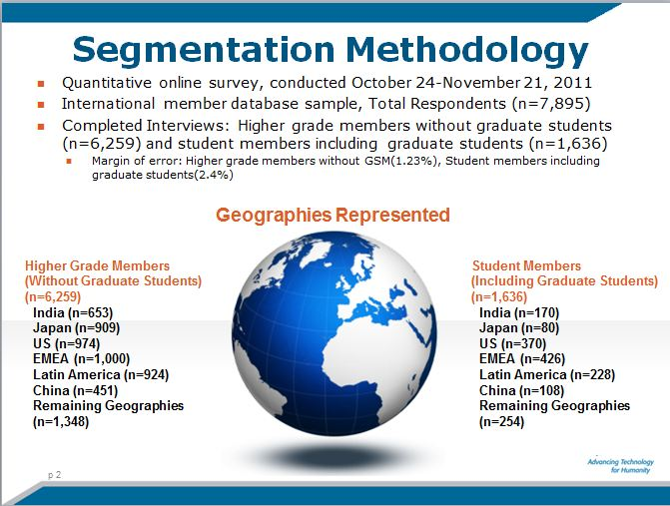
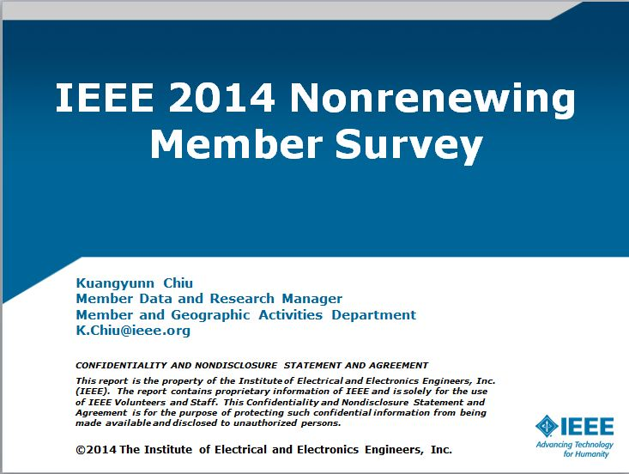
Member Research Studies
Segmentation study
  Every 3 years
  Identifies key segments of membership
  Latest survey is in process
Non-renewing member survey
  Relevancy based on the make up of the section
Notes:
If you are interested in seeing the survey data, please let your IEEE Staff Support person know.

Slide 5

What We Learned…
Five areas consistently rate as the most important:
  Ability to Stay Technically Current
  Networking
  Continuing Education
  Career Services
  Discounts
These are very broad categories
Not all benefits are relevant to every Section or Member

Slide 6
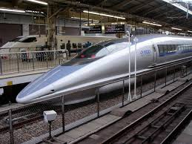
So What is the Value of IEEE Membership?
This answer will be different for each member you engage
What do our Members value?
  Deeper than the broad categories
  Everyone’s definition is different
  Plan around your members’ “communities of interest”
Every volunteer should have an answer to the following:
  Why are you an IEEE Member?
  What do you “value” from your IEEE membership?
Notes:
There is no silver bullet answer to this question.
We need to understand and serve our members’ needs so they can grow and develop in the profession.
To do so will requires multiple strategies
What do our Members value?
Deeper than the broad categories
Everyone’s definition is different
Plan around your members’ “communities of interest” – This ia concept coined by Region 3 and their Section Support committee
Every volunteer should have an answer to the following:
Why are you an IEEE Member?
What do you “value” from your IEEE membership?
These are important questions to ponder because if you can’t describe what you value in IEEE how can you explain/deliver to your members?
Example: Steve Lien of the Southwest Missouri Section in Region 5 created a 35 min webinar titled “40 Years in the IEEE: Develop, Sustain and Grow Your Career”. It is available via IEEEtv at the following link:
https://ieeetv.ieee.org/careers/40-years-in-the-ieee-develop-sustain-and-grow-your-career-webinar-steve-a-lien?

Slide 7
Communicating the Value of Membership

Slide 8
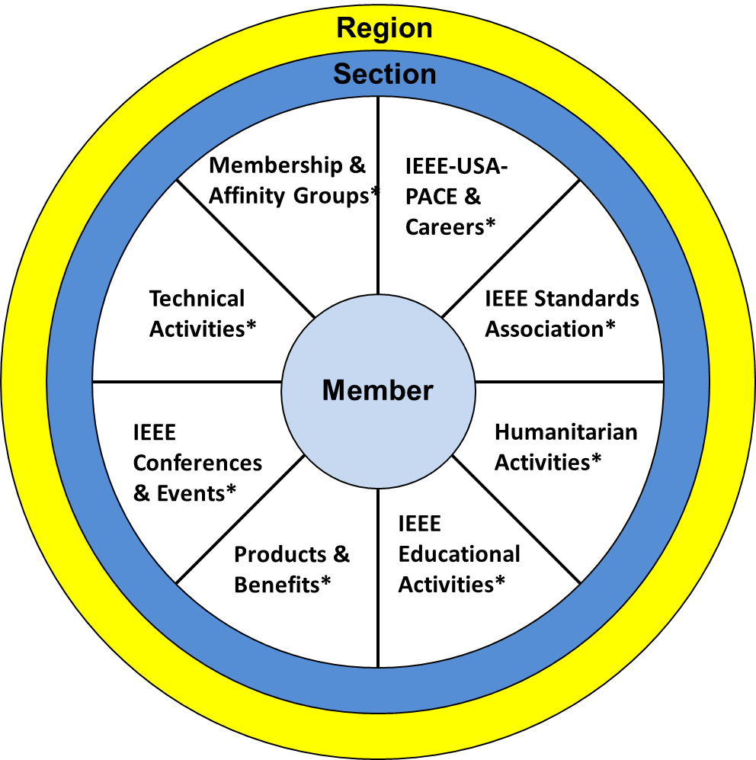
IEEE Membership Development
Presidents Forum Theme: “Focus on member development rather than membership development”
What does this mean?
  At it’s core – MEMBER SUPPORT
Whose role is it?
  IEEE Staff
  Region Volunteers
  Section & Sub-Section Volunteers
  Basically it’s EVERYONE’s responsibility
Where to start:
  Email communications
  Newsletters
  Social media
Notes:
Before we can tackle communicating, we need to level set expectations.
If we look back at the Presidents Forum Themes there is a call to “Focus on member development rather than membership development”
What does this mean?
At it’s core – MEMBER SUPPORT
We need to help our members navigate IEEE so we’re serving them their value not making them find it.
Whose Role is it:
IEEE Staff is responsible for:
Supporting the multitude of programs IEEE offers
High level membership communication
Recruiting Campaigns
Initial contact with first year members
Member Newsletters
Renewal communications
Supporting the committees and volunteers
IEEE Region is here to support their individual Sections.
Section/Sub-Section volunteers are responsible for:
Providing their members the best possible member experience.
Have to have a base level understanding of IEEE and its benefits to start
Don’t have to have all the answers –
That’s why you have IEEE Staff and the Regions – We’re here to help you
Where to start:
Have your Section ExCom review your current communication vehicles.
Make sure you are pointing your members to what they value
Have to be honest with yourselves. Are you really pointing your members to what they want or what you THINK they want?
Examples:
Could start with dedicating space in your messages to focus on one or two specific benefits per month
During your Events –
having a running presentation in the background that speaks to what your Section offers
Highlight benefits that are relevant to the topic of the event etc.

Slide 9
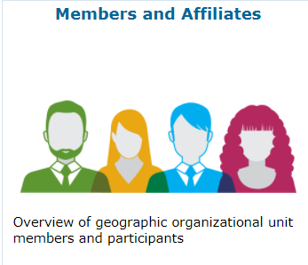
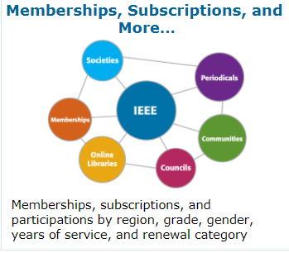
  Get to Know our Members
Use the available data in OU analytics
  Members and Affiliates Dashboard
  Memberships, Subscriptions and More Dashboard
During meetings/events:
  Make a personal connection
  Set aside time for group discussion
  Use both to get to know them
Notes:
OU analytics has statistics and contact lists based on:
Member Grade
Society and Affinity Group Memberships
Years of Service
And more
During Meetings
Personal Connection
Who are they?
What are their interests?
What do they want/need from IEEE?
Good time to ask for volunteers to help

Slide 10
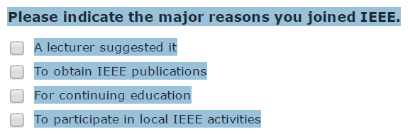
Survey Your Members
Use surveys as an opportunity to engage your members
Dig deeper into the broad interest categories
Find those who are interested in helping your ExCom
IEEE offers a survey tool called Checkbox
  Volunteers need to request access
What, if anything, can your IEEE Section do to increase the value of your IEEE membership?
Please include any benefits you need assistance finding or section activities you might be interested in attending, other than those listed above.
Notes:
Your IEEE Support Person has access to sample survey questions if you need them.

Slide 11
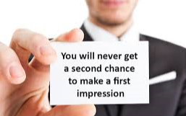
Connect with Your First Year Members
Communication early increases the chances a member stays
Reach out:
  Introduce yourself and your Section
  Find out what they are interested in
  Let them know what your local IEEE group is doing
Pull the list of new members from OU Analytics
  Membership, Subscriptions and More Dashboard
Notes:
You are the front line in delivering the Member Experience
The IEEE Membership Development team offers email templates. Visit: www.ieee.org/md
Don’t be afraid to call them, just be sure to honor their communication preferences which are included in the OU Analytics data
Invite them to your upcoming events.
Membership, Subscriptions and More Dashboard Instructions:
Open OU Analytics and select the dashboard
Change the product filter from Memberships to IEEE Memberships. Memberships refers to the Society memberships.
Select Apply
Once the report runs, open the Detail Tab
In the Detail tab, use the Renewal Category Filter to find your new members.

Slide 12
Member Benefits Cheat Sheet
Stay Technically Current
IEEE Publications
IEEE Society Membership
IEEE xPlore
Professional Networking
Local Section/Society/Affinity Group Events
Opportunities via CollabratecTM
Volunteering
Career Development
Find a Job
Soft Skills Training
Visit: www.ieee.org/careers
Continuing Education
Online Training
Educational resources from IEEE Societies
Visit: www.ieee.org/education
Notes:
You do not have to know all 90 benefits IEEE offers
You only have to have a high-level knowledge of some offerings; That’s what this cheat sheet provides.
Why? This will help you engage in the conversation with the member to get to know.
Do not be afraid of being unsure
It’s OK to say something like “I’m not exactly sure, but let me research it and get back to you.”
From here, rely on your Executive Committee, Region volunteers and IEEE Staff support to find your answers.
The Key is to:
Actively Listen to what the person is saying.
Take Notes if Necessary
FIND AN ANSWER AND RESPOND TO THE MEMBER’S INQUIRY
Stay Technically Current
IEEE Publications
IEEE Spectrum Magazine - Monthly, the award-winning IEEE Spectrum magazine explores the creation, application and implications of new technologies
The Institute Newsletter - Monthly (4 print, 8 online) newsworthy IEEE activities both in professional and technical areas
IEEE Society Memberships
39 Societies representing a full spectrum of technical interests
Local technical chapters
Subscriptions and online content
IEEE Xplore Digital Library - Table-of-contents and abstracts (nearly 4.0 million full-text documents)
Professional Networking
Opportunities via CollabratecTM
Access the IEEE Member Directory
Online platform to engage and collaborate globally
Career Development BONUS MATERIALS
Mentoring via CollabratecTM - Participation in the program is completely voluntary and open to all IEEE members (all grades) and Society Affiliates: https://www.ieee.org/mentoring
IEEE Awards and Recognition – IEEE members are recognized in the industries we serve as being above average
Continuing Education BONUS MATERIALS
IEEE Conferences & Events – Offers a conference search function: https://www.ieee.org/conferences/index.html
IEEE vTools Events – Volunteer Led activities and events. There are versions for iOS and Android: https://events.vtools.ieee.org/
IEEE-USA offers a number of online Webinars - https://ieeeusa.org/careers/webinars/
Opportunities to earn CEU and PDH credits

Slide 13
Member Benefits Cheat Sheet
Discounts
Reduced rates on IEEE Products
Discounts on financial services, insurance, etc.
Visit: www.ieee.org/discounts
Humanitarian Efforts
Programs designed to impact the Common Good
IEEE Pre-University Programs –STEM, etc
Visit: www.ieee.org/doing-good
To learn more about IEEE’s 90+ benefits visit: www.ieee.org/benefits

Slide 14
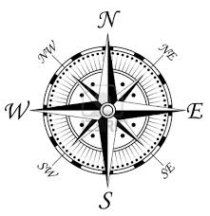
Moving Forward…
Member Value is an individual proposition
  There are many factors that will impact this
  The value will change for each member over time
  Needs to be revisited frequently
Research has shown us the basic path to member value
  We need to fine it tune based our members’ needs
As volunteers, your job is to support your members in navigating IEEE’s landscape
  Help deliver the value to them
  Let’s not make our members find it

Slide 15




Share the IEEE Member Experience
IEEE.tv Membership Experience Channel
Collabratec^{TM -} - IEEE’s social platform for technology-minded professionals
Follow us on Social Media:
@IEEExp
IEEE Membership
Notes:
We need to do a better job of promoting IEEE Membership
Use the IEEE Member Experience Channel for videos to show during your events
Use Collabratec to create a community where your members can communicate among each other and with the volunteers
Groups and Communities can be created for a Section
Use Social media as well.
If you don’t have a social media account have your YP’s and students help you with them
Make sure to use the hash tag #IEEExp so staff can find you.

Slide 16

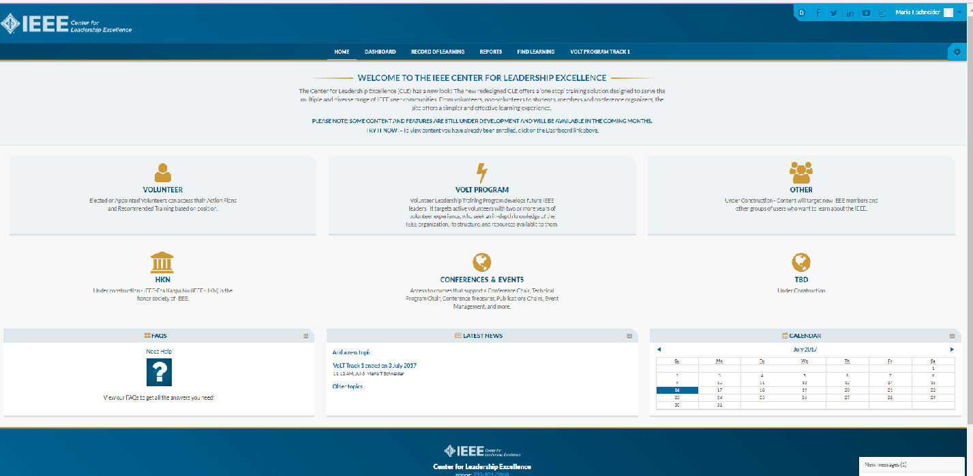
IEEE Center for Leadership Excellence
ieee-elearning.org/CLE/
Simple to use, self-paced
Offers help to Volunteers in their new role with ACTION PLANS!
Access with IEEE Account
Please note: Content is updated regularly – Check back often!
Notes:
Bill Marshall is covering this in the Tools for Sections session in Track 1.
This is the training resource for volunteers to learn more about their job descriptions and action plans.
All Section Volunteer job descriptions are loaded
Region volunteers will be available in the near future
You will need your IEEE user name and password to login to the tool.
Suggest EVERYONE takes the Membership Development (MD) Training
All volunteer roles have an element that speaks directly to serving the members’ needs and giving them the best possible experience.
The MD training addresses how to do this.
Most Section Leader job descriptions are now available

Slide 17
Thank you!
Region 3 Section Support Committee
You are not alone … We are here to help
Assisting our members to find and engage with IEEE Communities of Interest requires many levels of engagement … Again we can help
Relationships are a network, not a hierarchy
  Region 3 to Sections
  A Section to other Sections
  Members to other Members
Mark Torres, mgtorres@ieee.org

Slide 18
Region 3 Section Support Committee
Committee Member Contact Information
Committee Position | Name | Email Address
Section Support Committee Chair | Mark Torres | mgtorres@ieee.org
Life Member Coordinator | Tom Bellarmine | t.bellarmine@ieee.org
Young Professional Coordinator | Edwin Mastache | eng.edwin.m@ieee.org
Women in Engineering Coordinator | Allison Mercer | Allison.Mercer@gtri.gatech.edu
Senior Member Elevation Coordinator | Jacquelyn Cunningham | jdnc@ieee.org
Sections Operations Specialists (Position 1) | Charles Lord | c.j.lord@ieee.org
Sections Operations Specialists (Position 2) | Bill Marshall | marshalliv@ieee.org
Project Coordinator | Grayson Randall | g.randall@ieee.org
Technical Activities Coordinator | Glenn Parker | Glenn.Parker@gtri.gatech.edu
Section Support Committee Mentor | William (Bill) Ratcliff | w.ratcliff@ieee.org
The IEEE Support Center is a great online resource.

Slide 19
Appendix

Slide 20
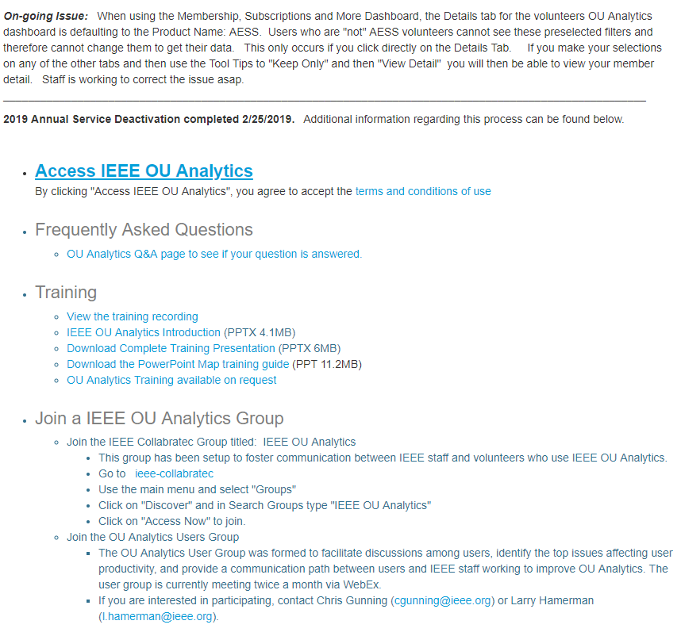
Best Practices for OU Analytics
Bookmark the main OU Analytics
landing page
Access OU Analytics from here
  Announcements and Updates are posted at the top of the page
Links to:
  Frequently Asked Questions
  Training
Join an IEEE OU Analytics Group
Notes:
These are more housekeeping items but important.

Slide 21
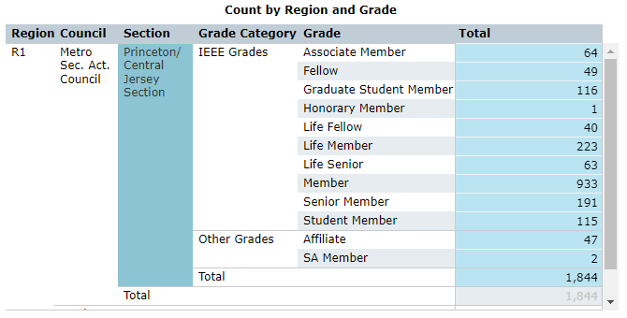
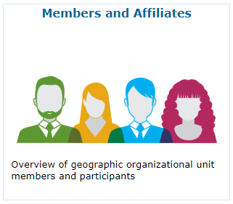
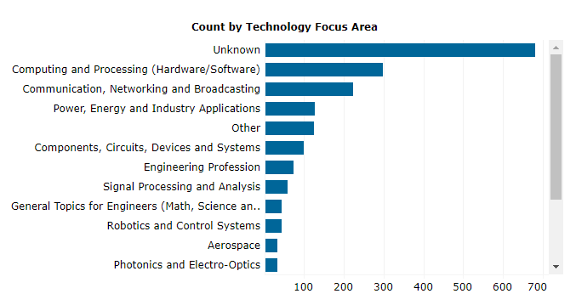
Creating The Section Interest Profile
Page 1 High Level Statistics
Member Counts by Grade
Which Dashboard to use:
Notes:
When you open the Members and Affiliates Dashboard, you may see data for other Regions and Sections
Look Closely – the counts are more than likely small
These represent students who are going to school in your Section, but have a primary address outside of your Section
For this exercise in most cases, it is OK to ignore these counts as we’ll cover students later
To show only the counts for the Section, double click on the Section Name.
The query will briefly run and reset to show just your Section.
You can export the data into
A PDF file
A Crosstab, which converts the data to a .CSV file which can be opened in Excel
Does anyone notice anything odd about the data?
Large population of members with an “Unknown” Technical preference
It is important to remind our members to keep their member profile up-to-date
This can be done in via IEEE.org in the member’s account information

Slide 22
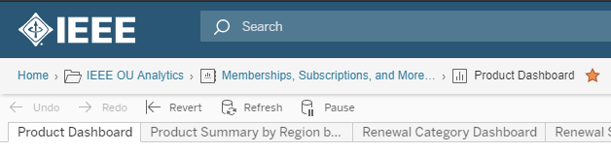
Creating The Section Interest Profile
Page 1 High Level Statistics
Member Counts by Grade
Which Dashboard to use:
Notes:
Quick Tip: If you look on the upper left hand just above the dashboard tabs and the undo command
Note the breadcrumb trail of dashboards/reports
There is a star at the end.
Click the star so it highlights in yellow
This will save the the dashboard view as a favorite for easy reference later
Be sure to do this for each step in this report

Slide 23
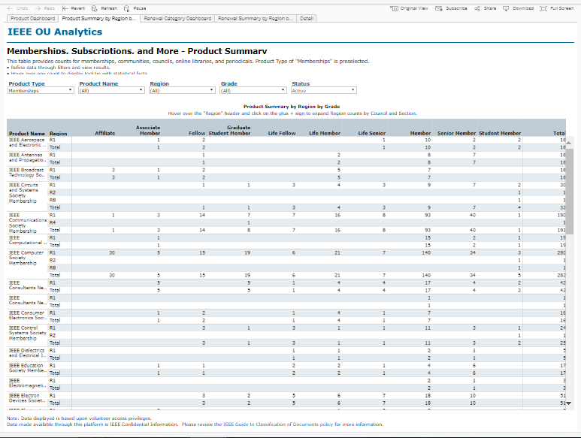
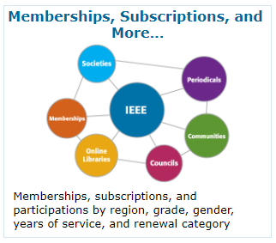
Creating The Section Interest Profile
Page 2 – Other IEEE Memberships
Member Counts by Grade for:
  Society Memberships
  Affinity Memberships*
Which Dashboard to use:
Notes:
When you open the Membership Subscriptions and More Dashboard, you will see a list of all the other memberships you members have
There are also a number of tabs along the top. Click the Second tab for “Product Summary by Region by Grade”
For Society and Affinity Memberships it is important to note that your Section may have members in these groups
But your Section MAY NOT HAVE A CHAPTER OR AN AFFIINTY GROUP TO SERVE THEM
This represents an opportunity
In these cases, eNotice cannot send to these members
You will have to download the list of members to communicate with them
To do so click on the header row of the table first
This lets the tool know which data you want to download
Click Download in the upper right hand corner
Select Crosstab
Depending on the size of your Section, this report can be quite long
Houston’s Report covers 4 pages

Slide 24
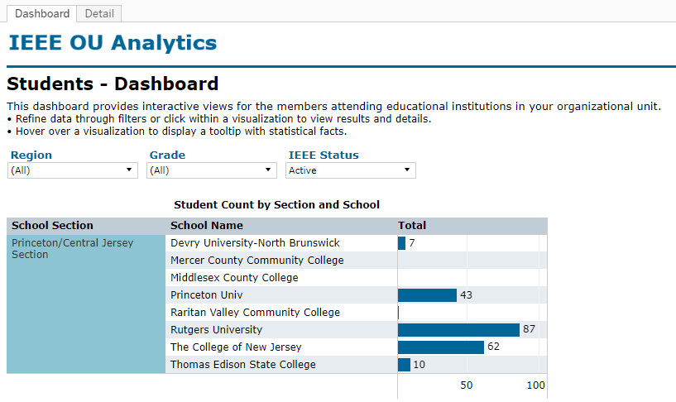
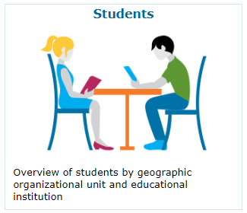
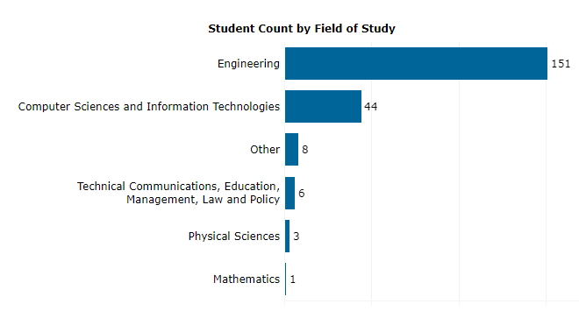
Creating The Section Interest Profile
Student Data
Student Member Counts by School
Which Dashboard to use:
Notes:
As the name of the Dashboard indicates, this is where you can see the breakdown of student membership
Based on two factors
Those students who are enrolled at Universities in your Section
Those student who have a Primary address in your Section but go to school elsewhere
In this case to show only your Section of schools, click on the Section Name in the Table
From this data you will want to select two graphs:
Student Count by Section and School
Student Count by Field of Study
Like the Society/Affinity Membership data, just because a school is listed doesn’t mean it has a branch
This presents an opportunity to set one up as long as
There are more than 12 active members attending the school
And 3 have to be active members above student grade

Slide 25
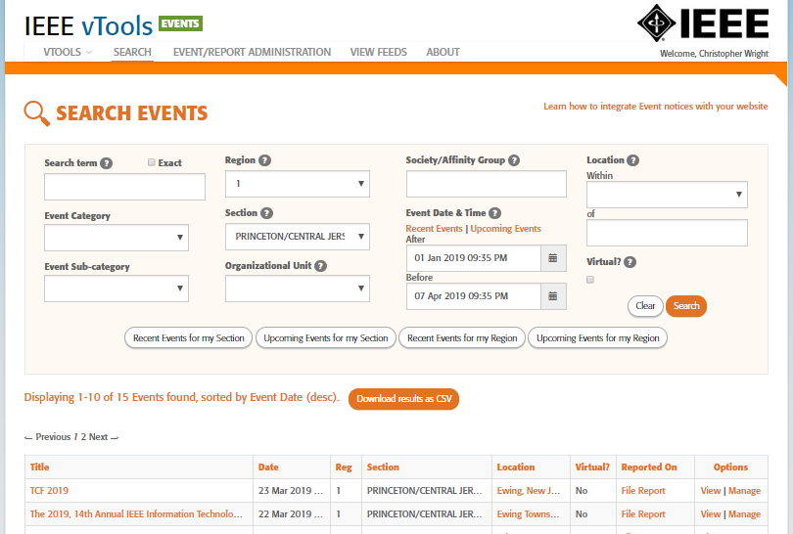
Creating The Section Interest Profile
Member Engagement
Notes:
Use vTools Events for this
Pull a list of your past Events using the Search Events Function
Users can download the Event details into a report that can be sorted, etc.
For Houston, they sort by highest attendance

Slide 26

Is that it for OU Analytics?
Next we’ll cover how to:
Pull a list of members
Pull a list of New Members
Explore the Map Dashboard

Slide 27
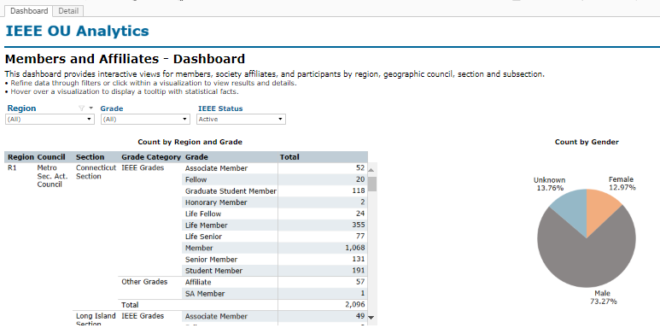
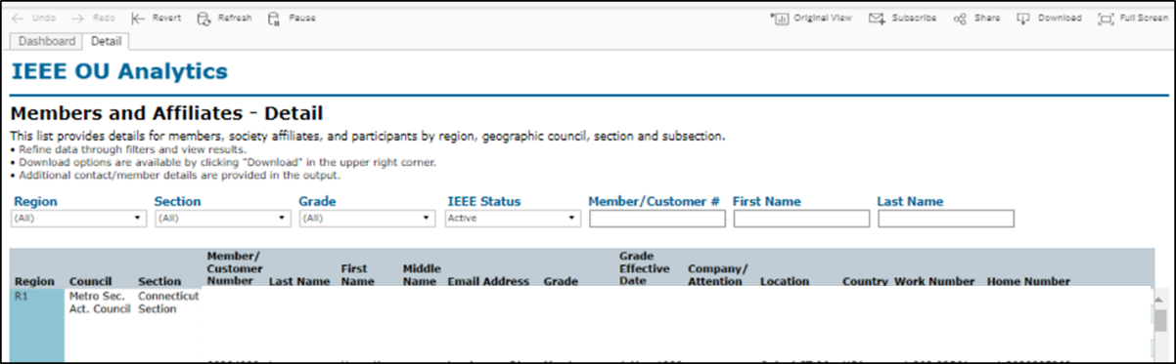
OU Analytics –
Active Member List
Screen 1:
Screen 2:
Use the Members and Affiliates Dashboard
Click the Details Tab
Click the Header Row
  Tells the tool what data to download
Click Download
  Select Crosstab
  Creates a .CSV file to download
Communication preferences are
included in the download
Once your project is finished,
DELETE THE FILE!
Notes:
PLEASE NOTE: By downloading this data, the user assumes the responsibility of honoring any and all contact communication preferences which are included in the download. Users can be held liable for failing to comply with this requirement and may be deemed in breach of the IEEE Code of Conduct and Data Usage policies. The user should also use caution and delete files as soon as they are finished using the data. For details visit the IEEE GDPR Volunteer Dashboard: sites.ieee.org/gdpr

Slide 28
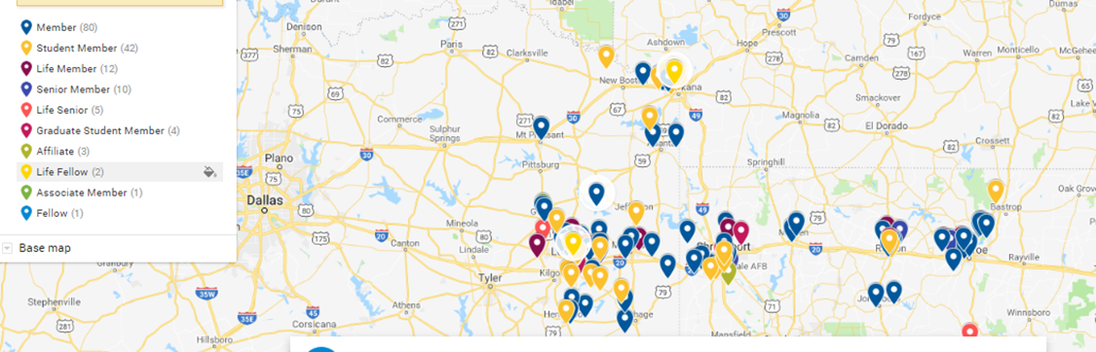
Best Practice: Map Your Membership
Thank you Matt Francis! East Area Chair, Ozark Section Chair
Use Google Maps
  There is a How-to Guide via Google
See Matt Francis for Details
Why?
  Allows the user to visualize the data
  Identify if your Section needs satellite locations
Notes:
This is also something Steve Lien of the Southwest Missouri Section has done with great success
Helped to better organize and support members that Geographically dispersed

Slide 29
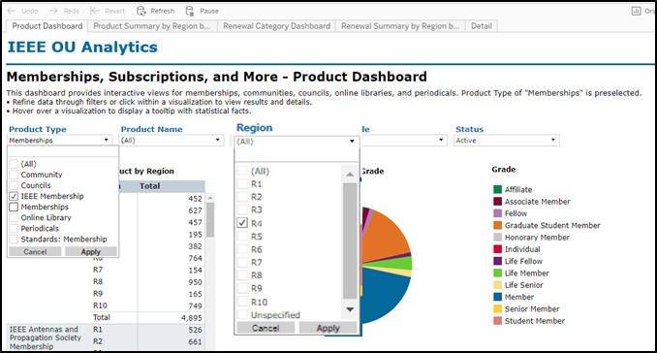
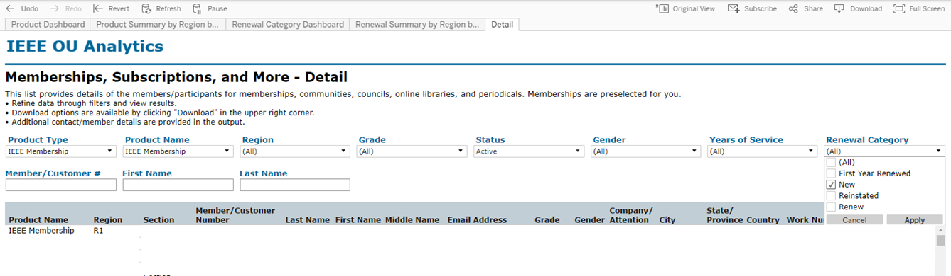
OU Analytics –
New Member List
Screen 1:
Screen 2:
Use the Memberships, Subscriptions
and More Dashboard
Set the Product Type Filter to
IEEE Membership
Click the Detail Tab
Set the Renewal Category Filter to
New
Click the Header Row
Communication preferences are
included in the download
Once your project is finished,
DELETE THE FILE!
Notes:
Note the other Renewal Categories in this filter.
Before Deactivation, this is where the user can see members who have not year renewed.
Post Deactivation, the members are set to Arrears and can be found on the Members and Affiliates Dashboard
PLEASE NOTE: By downloading this data, the user assumes the responsibility of honoring any and all contact communication preferences which are included in the download. Users can be held liable for failing to comply with this requirement and may be deemed in breach of the IEEE Code of Conduct and Data Usage policies. The user should also use caution and delete files as soon as they are finished using the data. For details visit the IEEE GDPR Volunteer Dashboard: sites.ieee.org/gdpr

Slide 30
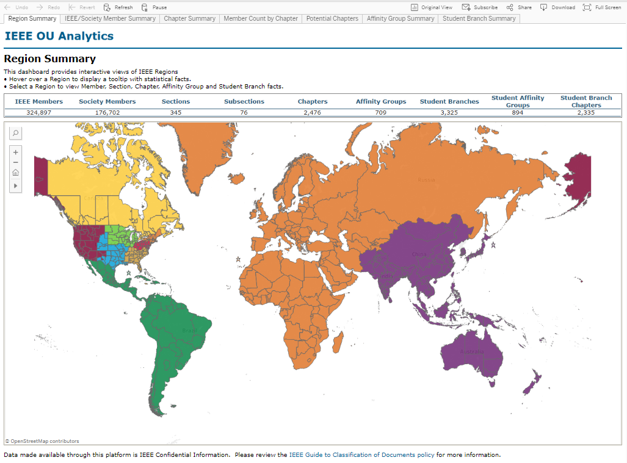
OU Analytics – Map Dashboard
Notes:
Unlike the other dashboards which are governed by your volunteer positions this dashboard is open to all volunteers
Meaning – any volunteer can use the tool to look data on any Region, Section etc.
Only shows stats; there is no personal data available.
There are six different views of this dashboard available
Region Summary
IEEE/Society Member Summary
Chapter Summary
Member Count by Chapter
Potential Chapters
Affinity Group Summary
Student Branch Summary
It is important to note that most of these dashboard are only relevant if the Sections have established sub-units (Student Branches, Chapters & Affinity Groups)

Slide 31
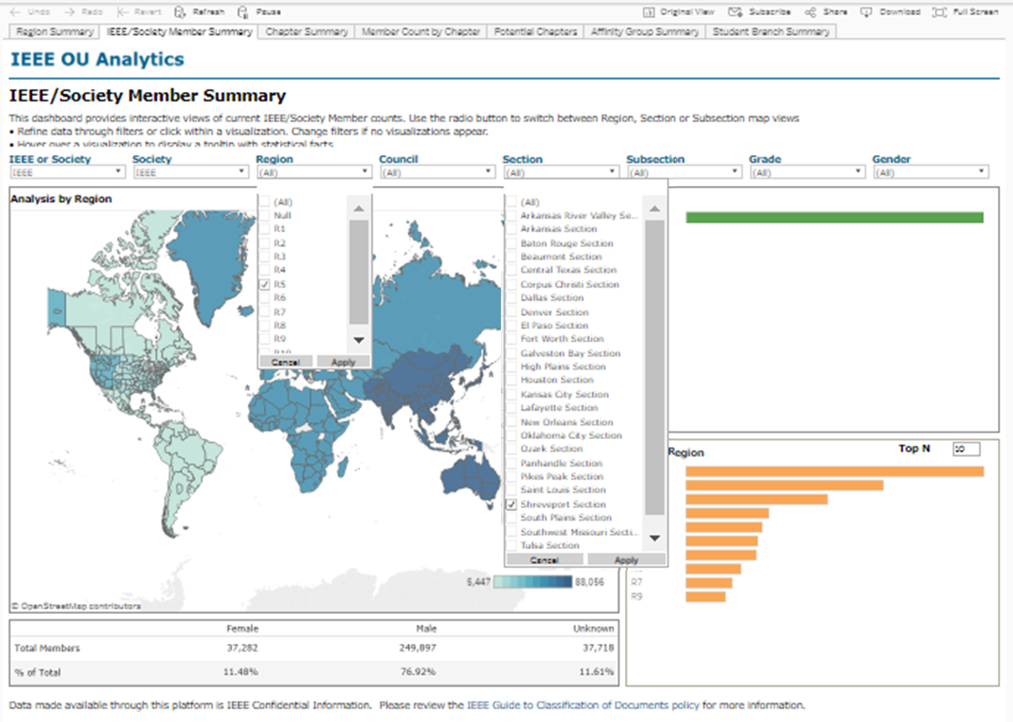
OU Analytics – Map Dashboard
IEEE/Society Member Summary Tab
Notes:
For the next few slides, we’ll look at the Shreveport Section
Matt is doing a great job of trying to revitalize the Section
Set your Region Filter; Click apply
Set your Section Filter; Click Apply

Slide 32
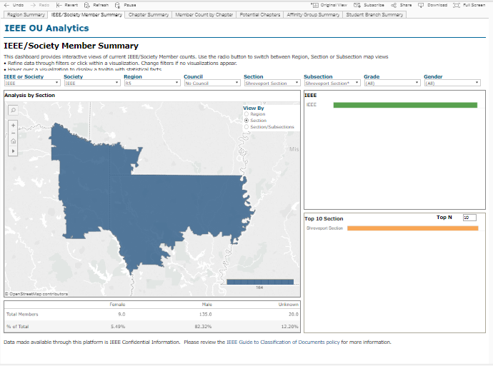
OU Analytics – Map Dashboard
IEEE/Society Member Summary Tab – After Filters
Count of Members
Notes:
If we left this at just the Region level, we’d see a list of Sections and their counts

Slide 33
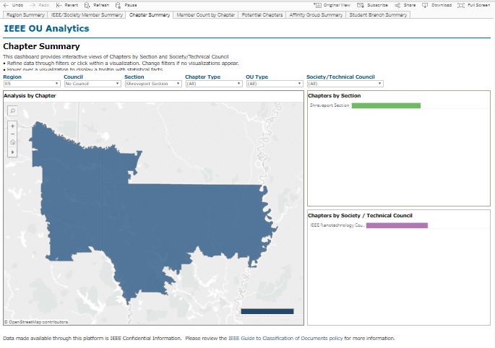
OU Analytics – Map Dashboard
Chapter Summary Tab
Count of Chapters
Breakdown of Chapters
Notes:
For larger Sections or Sections with more sub-units these counts the breakdown of Chapters by Society/Technical Council becomes more detailed
For those with Chapters, congratulations
Most members are here for Technical Content and Education
Provided by the Societies
If a you have a lot of chapters, be sure you are regularly communicating and working with them
Promote the chapter opportunities to all members
There could be IEEE members who aren’t aware and need/want the technical aspect
Distinguishes between:
Section Chapters & Student Branch Chapters by Society
Joint Chapters
Councils

Slide 34
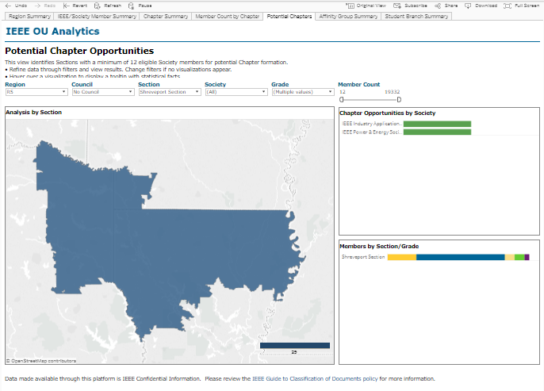
OU Analytics – Map Dashboard
Potential Chapters
Notes:
Identifies if there are enough members in the Section to establish a chapter
Bottom Graph shows the number of Members by Grade for the total Chapter opportunities
Adjust the filters to show just a particular society to get the member breakdown
For those with only a few or no chapters, this presents an opportunity
Use the Memberships, Subscriptions and More Dashboard to pull a list of members in an identify society
Mind the communications preferences
Reach out to them to see if they would be interested in getting things started for the society to better serve than needs

Slide 35
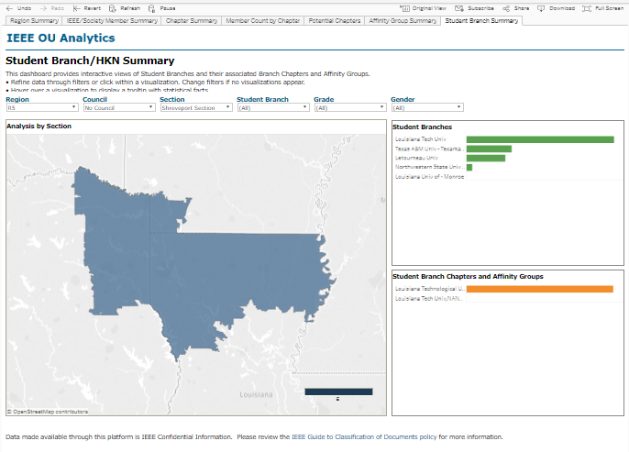
OU Analytics – Map Dashboard
Student Branch Tab
Notes:
For those who have a number of student branches, congratulations!
Your ExCom should establish a relationship with them if you already haven’t
Have a Student Activities Representative on the ExCom
Invite a Student Branch Rep to serve on the ExCom
Compare the list of Student Branch Chapters in your Section to the Student Dashboard
Presents an opportunity
Use the Student Dashboard to compare where you do not have branches.
Pull the list of student members
Mind the communications preferences
Reach out to students/engineering departments at universities who do not a branch
See if they would be interested in getting a branch started

Slide 36
Moving Forward…
Checklist for Events and OU Analytics
Use Events to plan, manage and promote your activities
Use OU Analytics to generate your Section Member Profile
  Lots of data that can be useful
Combine the power of all the tools to better serve your members
Notes:
As you can see, if you use all of the tools, they interact and connect quite well

