Slide 1
Conference Committee
Eric Grigorian, Region 3 Conference Committee Chair
6/15/2020

Slide 2
Region Conferences
Opportunities abound!
Besides SoutheastCon, multiple conferences are being held within the Region
Region has been requested to promote couple of upcoming conferences, re-starting conversations within the Conference Committee on how to engage
Information regarding technical conferences within Region 3 is not well publicized
Updates to the Region 3 website provides the opportunity to evaluate method by which we can reach out to Region 3 members on upcoming events
Opportunity to further promote technical activities within the Region
Opportunity to engage and increase membership
Pull data from IEEE Meetings, Conferences, & Events (MCE)

Slide 3
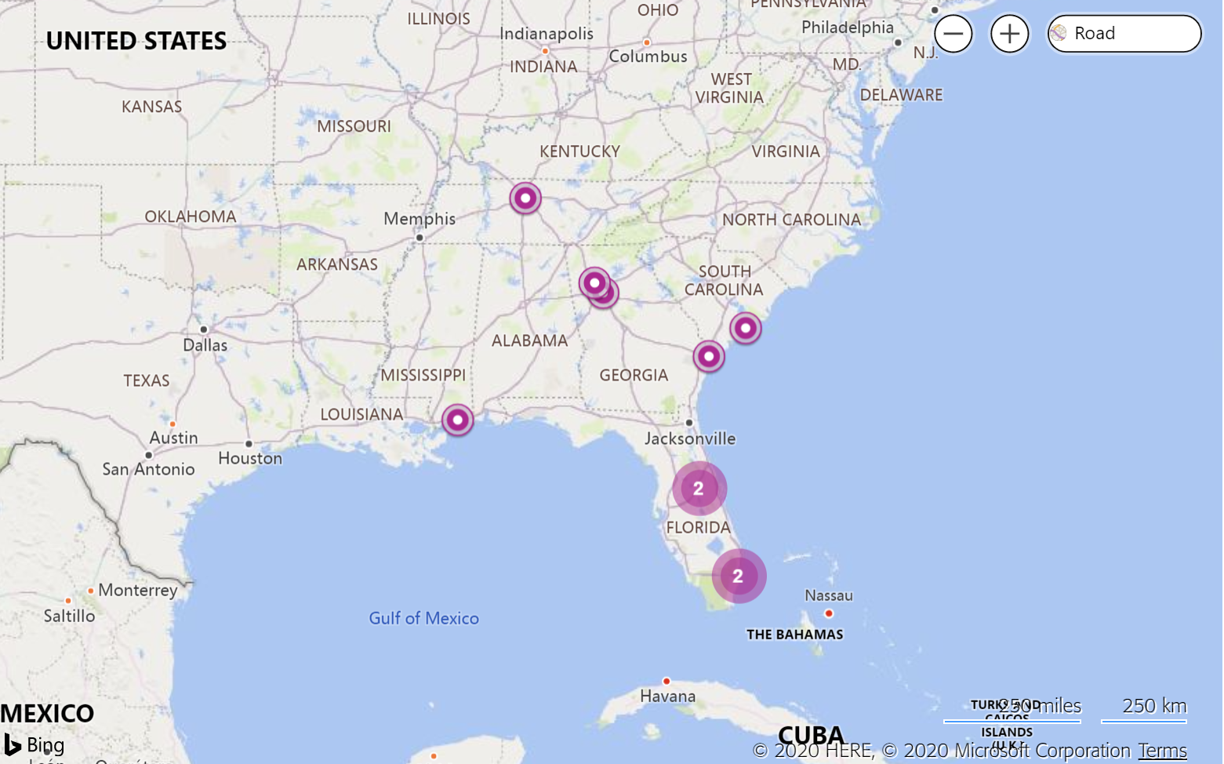
24 Registered Conferences in Region 3

Slide 4
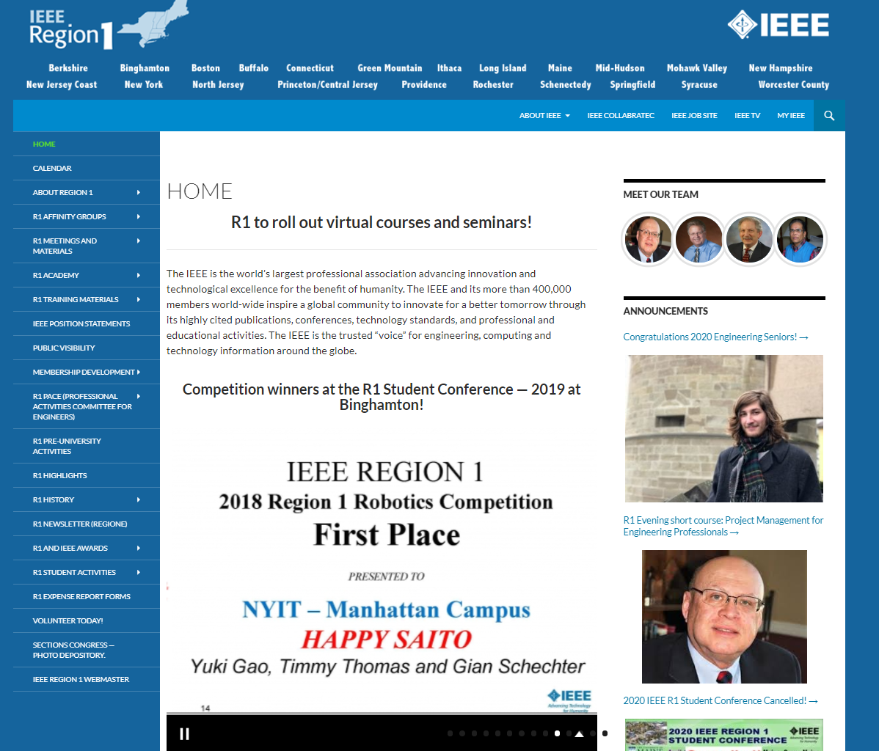
Region 1
No Specific Conference page
First page has a rolling info on conference winners that could be updated with upcoming conferences

Slide 5
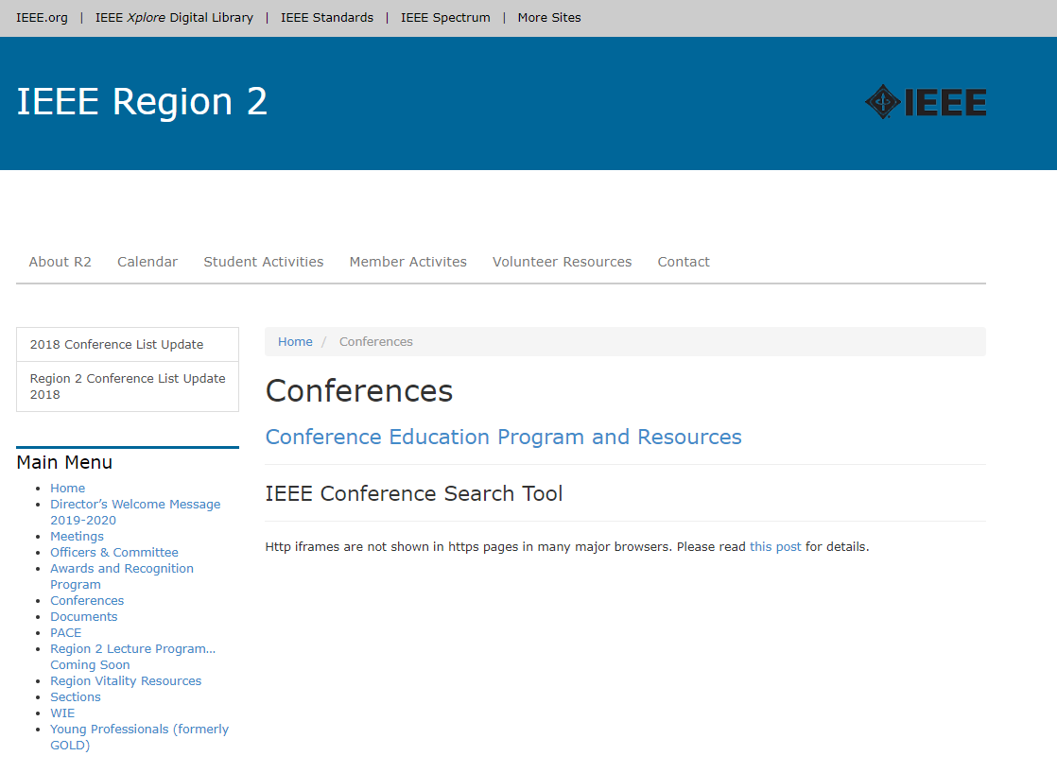
Region 2
Dedicated page for conferences
Includes a link to MCE portal

Slide 6
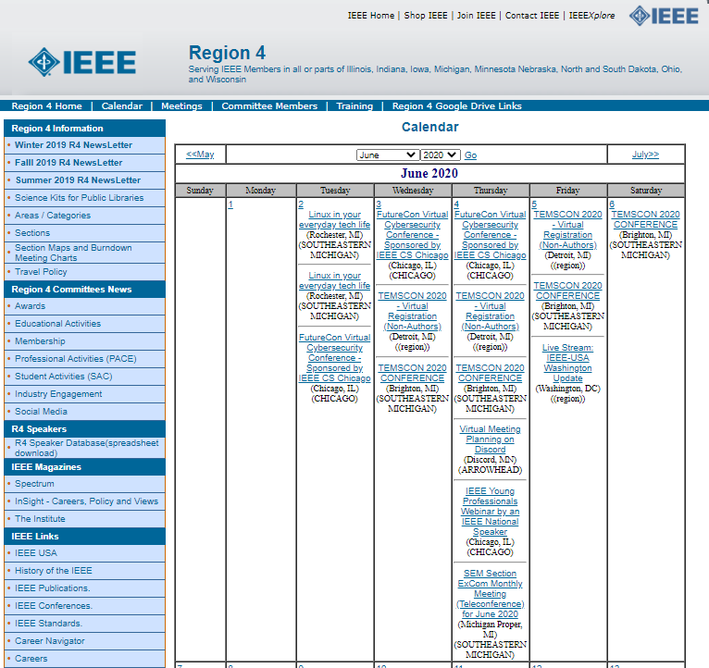
Region 4
No Dedicated page for Conferences
Two types of Calendar ( grid based and by day) used to provide link to conferences within Region with additional details provided on the same page

Slide 7
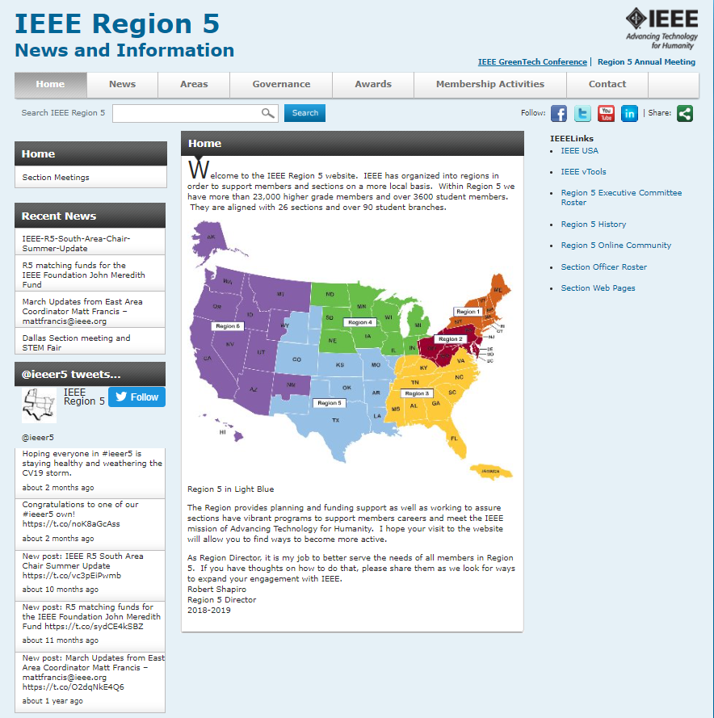
Region 5
No dedicated page for conferences
Search capability but information is stale

Slide 8
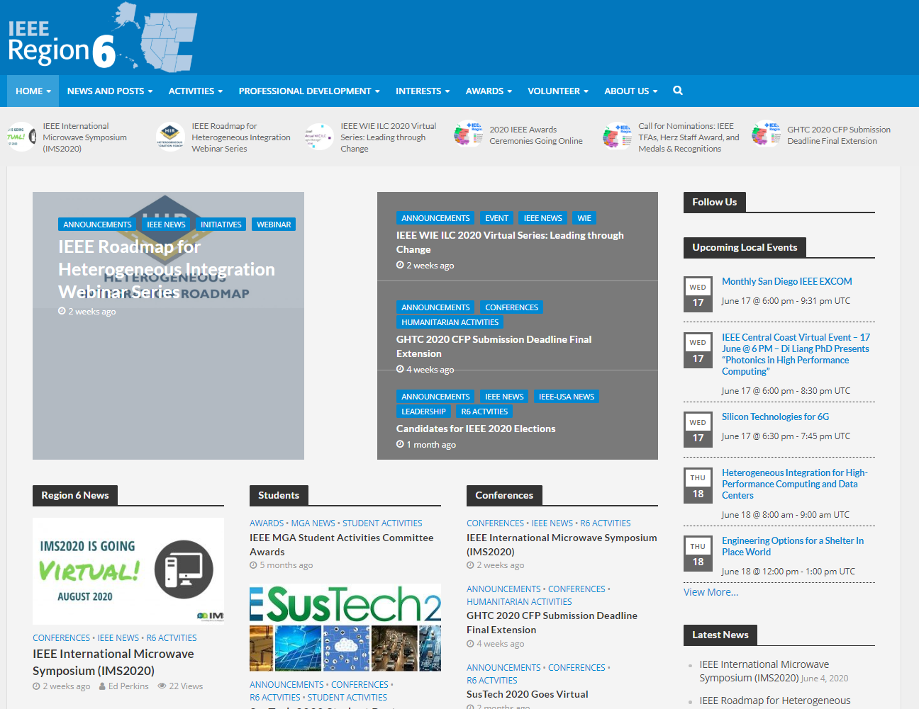
Region 6
Region conferences included on home page
Dedicated page for all conferences held within Region

Slide 9
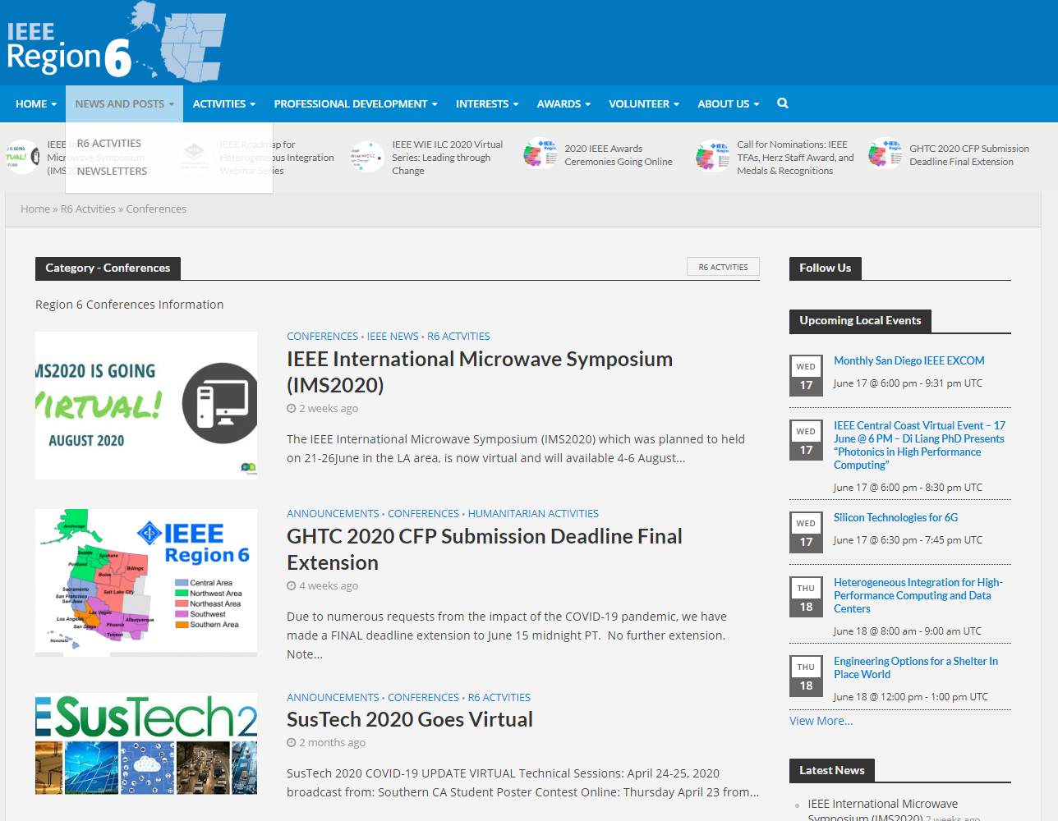
Region 6

Slide 10
Region 7
Dedicated page for conferences
Includes a link to upcoming and past conferences
Includes additional resources for conference organizers
Interesting Note: the website has advertisers such as Dell.

Slide 11
Recommendation
Update the new website to include a conference announcement capability similar to Region 4, Region 6, Region 7, or a hybrid version
Incorporate Social Media capability that can be linked to the Region 3 Conference page to promote conferences and key dates
Request a feature request to MCE to provide RSS/XML feed so as to automatically retrieve approved conference details (done!)

Slide 12
Thank you!
Eric Grigorian, egrigorian@ieee.org

