Slide 1
IEEE Membership Development Status
Sonya Dillard, IEEE R3
Member Communications Committee (MCC)
IEEE Huntsville Section
Oct 19th, 2020

Slide 2
IEEE Member Communications & Member Development Roles
Member Communications Committee Roles:
To support and facilitate the effective, seamless and interactive sharing of information and knowledge with members of Region 3.
To serve our members by disseminating R3 newsletters, meeting and event announcements, social media posts and information sharing via the R3 website.
Member Development Chair Roles:
To shepherd the activities pertaining to membership development recruitment and retention in order to deliver an excellent member experience.
To Retain, engage and develop existing members
To promote member elevations (students to professionals)
To Grow and Attract new members

Slide 3







IEEE at a Glance: “Defining Member Value in the Current Climate”
Our Global Reach
421,000+
Members
39
Technical Societies
160
Countries
Our Technical Breadth
1,600
Annual Conferences
3,900,000+
Technical Documents
170+
Top-cited Periodicals
Notes:
Membership is the foundation upon which IEEE grows.
- Today, IEEE is expanding in many ways: people, communities, nations, collaborative settings, intellectual properties, and more.
Presenter, reference more robust data at this Web page:
http://www.ieee.org/about/today/index.html

Slide 4
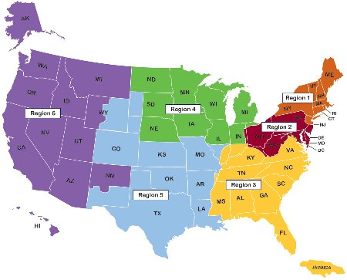
IEEE US Regions 1-6
Region 1: Northeastern U.S.
Region 2: Eastern U.S.
Region 3: Southern U.S
Region 4: Central U.S.
Region 5: Southwestern U.S.
Region 6: Western U.S.

Slide 5
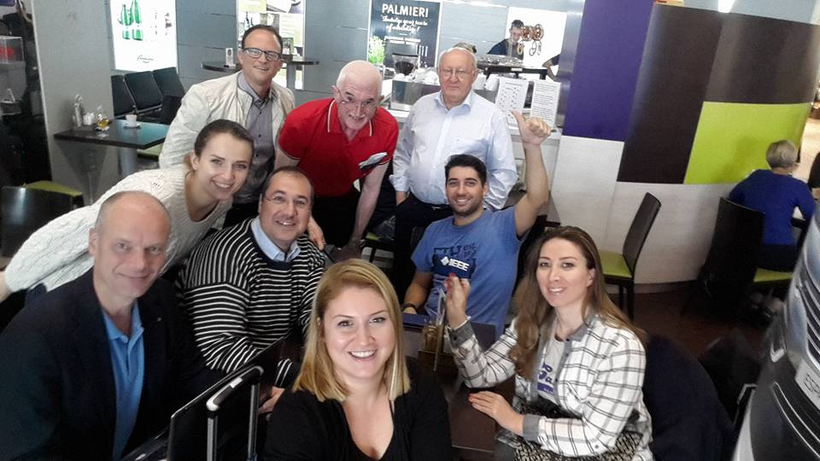
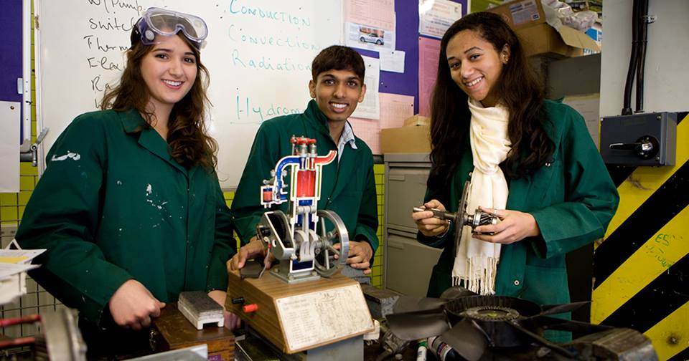
  Making New Connections:
  “Virtual Professional Networking”
Member Communications eNotice Initiative:
  Local Sections can collaborate virtually throughout Region 3
  Any member can participate in selected monthly meetings in R3
  Sections are requested to submit those meeting links during the 3rd week, that can be attended virtually by all R3 members.
  A Monthly eNotice will go out to all R3 members during the last week of each month, for upcoming meeting invitation/registration.
Notes:
Sections, Student Branches, and Technical Chapters
Local, face-to-face technical and social meetings
Engage peers through informative technical meetings
Recognition of accomplishments
IEEE MemberNet
Gain access to the authoritative member directory of IEEE
Networks personalized to each member
Opt-in privacy protection
IEEE Collabratec
Connect with global technology professionals by location, technical interests, or career pursuits
Access research and collaborative authoring tools
Establish a professional identity to showcase key accomplishments
Volunteering
Opportunities that build leadership skills and networking opportunities
Developing critical, non-technical skills that enable you to be more effective professionally
Humanitarian Programs - IEEE Humanitarian Technology Activities & workshops
STEM Education Tools and programs -I ntroduction of engineering and technology to young people worldwide
Local and Regional Volunteer Opportunities – Become of part of the member volunteers who help deliver the value of IEEE locally.

Slide 6
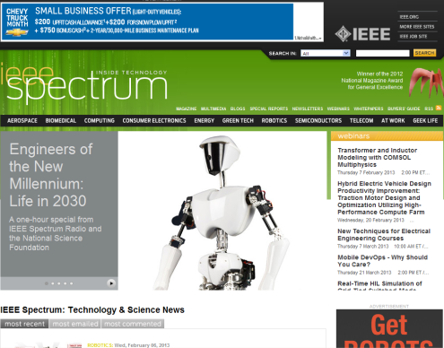
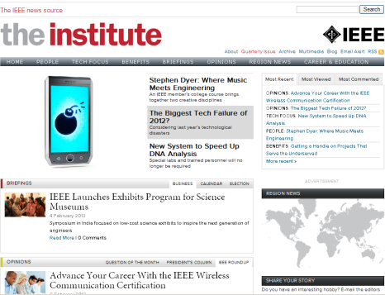
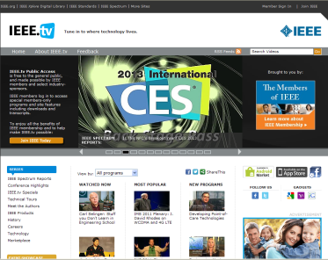
Making New Connections:
“Staying Technically Current”
Member Development Training Initiative:
  Hosting several virtual sessions to train members in various areas within IEEE.
    Member Value and Benefits
    OU Analytics Tutorial
    IEEE Collabratec
    Vtools Tutorial
    Recruitment and Engagement
    Member Discount Programs
    Submission of Section MD Plans
    Closing Session with Q/A
  All Sections encouraged to join!
Notes:
IEEE Spectrum Magazine
Monthly, the award-winning IEEE Spectrum magazine explores the creation, application and implications of new technologies
The Institute Newsletter
Monthly (4 print, 8 online) newsworthy IEEE activities both in professional and technical areas
IEEE Xplore Digital Library
Table-of-contents and abstracts (nearly 2.0 million full-text documents)
IEEE-Wiley Press E-Books Classics
250+ digitized books downloadable from IEEE Xplore, with 6 new e-books added annually
IEEE.tv
IEEE’s Internet television network, with exclusive Member programming, downloading privileges, and transcripts

Slide 7
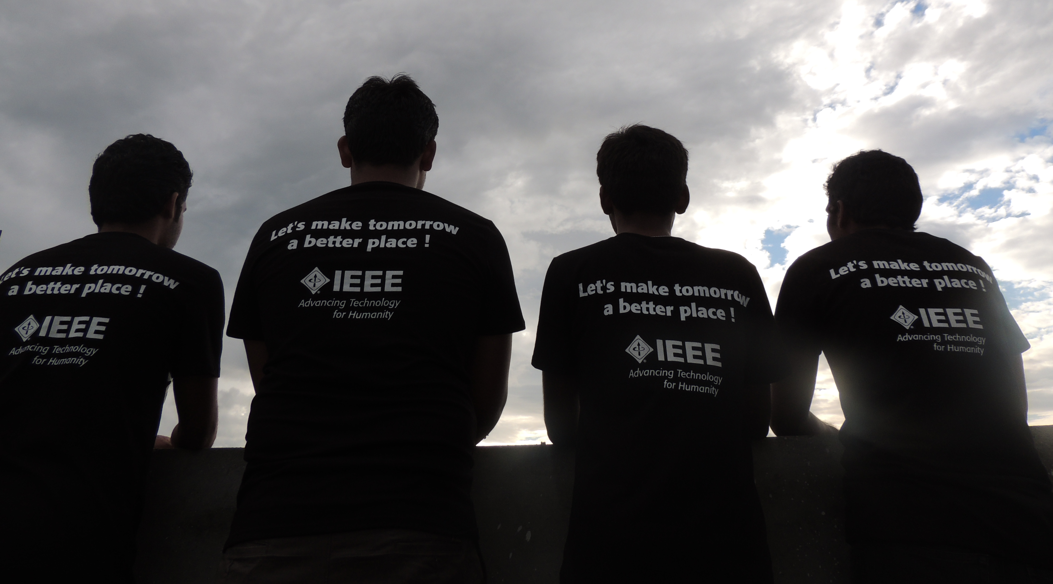
Thank you!
Let’s HEAR from YOU! ☺
Send us your membership ideas, new trending activities and programs, event announcements, photos and Region 3 success stories.
Sonya Dillard,
R3 MCC Chair
Sonya.Dillard@ieee.org

