Slide 1
IEEE R3 YP Plan 2021

Slide 2
R3 YP

Slide 3
Current Status
2019
2020
Total YPs in R3 – 5607
11 AGs
Serving 2882 members
~50% unserved by AGs
30 events
3 events per year
~5 AGs on probation for 2020 from total 11
Total YPs in R3 – 5215
12 AGs
Serving 2844 members
~50% unserved by AGs
24 events
2 events per year
0 AGs on probation for 2021 – Only Region in IEEE

Slide 4
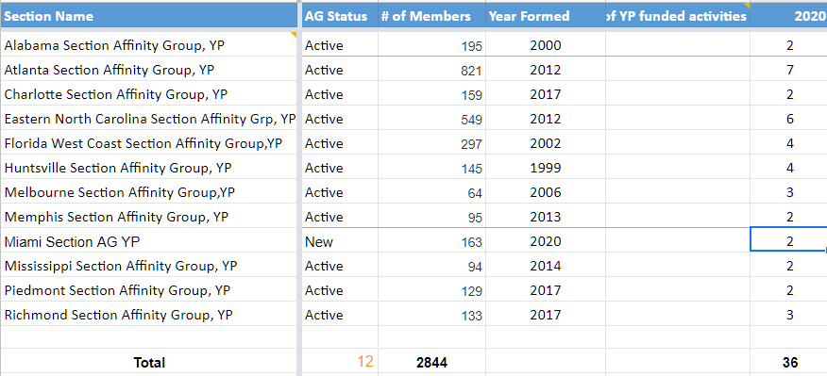
R3 – YP AG

Slide 5
Operational Plan 2020
Revitalization – Bring 2 AGs back to active status – All active – One pending
Quarterly webinar - 2 Webinar series
Annual Town hall – 3 Town Halls
YP Presence at SoutheastCon - IEEE Enlightenment
Award – 2 awards – 1 YP Award
Website-blog/Listserv – Listserv -50, Website
Facebook – Linkedin
A team of 7 volunteers taking roles in the region
Mentoring Program
RS 2021 funding

Slide 6
Potential Ambitious Addons to the Operational Plan 2020
No | Item | Description | Requirements/effort | Value
1 | Town hall with Region Director, President Elect and IEEE-USA President |  | SSC WebEx |20 | Brand, Governance 20
2 | Mentoring Program | 10 mentors to 10 mentees pilot | Collabratec , 1 volunteer $ 250 |40 | Membership benefits | 60
3 | YP Event – SoutheastCon | Entrepreneurship, leadership, communication and networking – ½ day event | 1 volunteer, coordination with Conference committee, fund $500 |60 | Membership benefits, Brand Will not be enough to attract new participants to SC20, could be organized with local YP AG, Increase Student transition and retention by 5% |30
4 | R10 - 8 SYP | Send at least one R3 leader to R8 and R10 SYW Congresses in 2020 | 2 volunteers, fund $ 2500-3500 |30 | Volunteer training, succession planning |40
5 | R3 SYPWLM | 2.5 day Congress | 4 member core team |100 | Brand, strong member benefits, succession planning, negative – Risk |100

Slide 7
Atlanta Section | 2,963
Eastern North Carolina Section | 2,135
Florida West Coast Section | 1,140
Orlando Section | 917
East Tennessee Section | 813
Huntsville Section | 734
Alabama Section | 639
Central Tennessee Section | 608
Richmond Section | 553
Charlotte Section | 529
Central Virginia Section | 471
Virginia Mountain Section | 448
Hampton Roads Section | 426
Miami Section | 400
Piedmont Section | 389
Palm Beach Section | 360
Gainesville Section | 333
Mississippi Section | 331
Melbourne Section | 330
Memphis Section | 319
Broward Section | 305
Lexington Section | 282
Columbia Section | 281
Chattanooga Section | 262
Coastal South Carolina Section | 261
Louisville Section | 243
Jacksonville Section | 233
Tallahassee Area Section | 233
No | Item | Description | Requirements/effort | Value
5 | Start new YP AGs | 9 potential new YP AGs | 1 Volunteer – Target 2 annually |20 | Local member benefits |60
6 | Revitalization – Maintain all 11 YPs in active status |  | 1 volunteer |20 | Volunteer training, succession planning | 20

Slide 8
Strategy
High quality events
Increase brand value
Attract talented volunteers

Slide 9
Prioritization

Slide 10
Operational Plan 2021
All of 2020
R3 SYP – East Coast
STEP – 1 Event
YP Blog / Podcast
Succession Plan (7 in core team – transition to 2022)

Slide 11
Discussion
Where and how should YP be positioned
Committee –voting /adhoc – Op manual?
Liaisons to other committees (SAC/ Conferences+SEC)
Strategic plan for further discussion
Activities + ideas to look at for 2021

Slide 12
Feed back – R3 Planning meeting Dec 2020
Panel/Meet-Up hosted at SEC by ENCS YPs – Mary Allen +Bill M+ Greg
YP Sub-commitee – Mary Allen
Mentoring – Bill Ratcliff+Dave with YP leader
Charles – ask to be put in the loop SEC – by Pat
Same person to be liaison to SAC as liaison to SEC20 - Pat
IEEExtreme mentoring for students – same SAC liaison - Jim

