Slide 1
Region 3 Section Growth (Track 2)
Eric Grigorian, Director-Elect

Slide 2
Agenda - Track 2: Section Growth
Region 3 Meeting – Friday 4/1/2022
8:00 AM – 12:00 |  | Track 2: Section Growth, Part 1
8:00AM | 15 | Welcome and Introductions | Grigorian | Conv 203A
8:15AM | 5 | Section Growth Intro | Grigorian | Conv 203A
8:20AM | 25 | Converting from Bylaws to Ops Manual (2023) | Green | Conv 203A
8:45AM | 30 | Use of Member Information | Green | Conv 203A
9:15AM | 45 | MGA Update/IEEE 201 | Gostin | Conv 203A
10:00AM | 15 | Break/MOVE tour |  | Conv 203A
10:15AM | 40 | Advanced OU Analytics | Lord | Conv 203A
10:55AM | 15 | Beyond your Section | Gostin | Conv 203A
11:10AM | 30 | Engagement: Projects | Jones | Conv 203A
11:40AM | 20 | Recognizing contributions - Awards program | Lorenco | Conv 203A
12:00PM | 60 | Lunch |  | Conv 203A
1:00 - 4:00 PM |  | Track 2: Section Growth, Part 2
1:00PM | 30 | Engagement: Industry | Guendert | Conv 203A
1:30PM | 25 | Engagement: Conferences | Ackerman | Conv 203A
1:55PM | 20 | Engagement: Professional Development Events | Fillion | Conv 203A
2:15PM | 15 | Break/MOVE tour |  | Conv 203A
2:30PM | 25 | Engagement: Technical Events | Syed | Conv 203A
2:55PM | 25 | Engagement: Hybrid Events | Lord | Conv 203A
3:20PM | 35 | Managing Finances with NextGen | Pennisi | Conv 203A
3:55PM | 5 | Section Growth Wrap-Up | Grigorian | Conv 203A

Slide 3
Agenda
Region 3 Meeting – Friday 4/1/2022
4:00PM | 30 | Break/MOVE Tour | ME Randall
4:00PM | 30 | Section Support Committee meeting | Bing | Conv 201D
4:30PM | 60 | Area Meetings:
4:30PM | 60 | Area 1 Meeting (NC & VA) | Imanian | Conv 201D
4:30PM | 60 | Area 2 Meeting (GA & SC) | Williams | Conv 202B
4:30PM | 60 | Area 3 Meeting (FL) | Ortega | Conv 203A
4:30PM | 60 | Area 4 Meeting (KY & TN) | Kuban | Conv 203B
4:30PM | 60 | Area 5 Meeting (AL, MS, & Jamaica) | Kung | Conv 204AB
5:30PM | 30 | Area Chairs meet with Director & Director Elect | Brunasso/Grigorian | Conv 204AB
6:00PM | 120 | Reception |  | Bon Secour I-III
8:00PM | 60 | YP Roundtable (informal) | Cramer | Jubilee (Hotel)

Slide 4
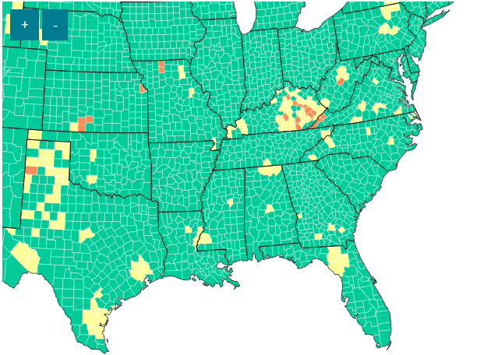
COVID Pre-Cautions
Health and Safety Information
The health and safety of the conference attendees remains our top priority. The 2022 organizing committee continues to monitor the impact of COVID-19, as well as updates and recommendations from public health officials, federal, state, and local authorities. We will adhere to all local guidelines and hotel-specific standards in order to host the event safely and effectively.
Increased Sanitization for Your Safety
The Renaissance Mobile Riverview Plaza Hotel will follow all best practices and protocols as established within Marriott’s – Commitment to Clean program to ensure you enjoy a safe and clean environment during your time at the event
Hand sanitizing products are available throughout the event space
Sanitizing wipes will be provided in every room for speaker use at the podium
Audio-visual equipment such as keyboards, laser pointers, and mics will be wiped down with sanitizer wipes between each session and at regular intervals throughout the day
What You Can Do to Help Onsite
The U.S. Centers for Disease Control (CDC) recommends these everyday actions to help prevent the spread of any respiratory virus, including COVID-19:
Consider wearing a mask, however, masks are not required. Vaccinated or not, wearing a mask in indoor public spaces can help protect you and everyone close to you.
Wash your hands frequently with soap and water for 20 seconds or use an alcohol-based hand sanitizer.
Cover coughs and sneezes with a tissue, then throw the tissue away.
Avoid touching your eyes, nose, and mouth with unwashed hands.
Practice social distancing between yourself and anyone who is coughing or sneezing.
Discourage physical greetings like handshakes, high fives, fist or elbow bumps, and hugs.
Avoid close contact with people who are sick.
Follow the U.S. Centers for Disease Control and Prevention’s (CDC) guidelines to prevent the spread of infectious diseases at the event.
If you show any potential symptoms during the conference, please isolate and stay in your room. We will miss you greatly, but for your recovery, your colleagues’ safety, and the health of everyone that you may come into contact with, please take the necessary precautions.

Slide 5
Agenda - Region Support of Your Section
Region 3 Meeting – Saturday 4/2/2022
8:00 AM – 12:00 |  | Region Support of Your Section
8:00AM | 10 | Intro: Committee Reports | Grigorian | Conv 204AB
8:10AM | 20 | Awards and Recognition Committee | Nelson | Conv 204AB
8:30AM | 35 | Member Communications Committee | Dillard | Conv 204AB
9:05AM | 20 | Conference Committee | Ackerman | Conv 204AB
9:25AM | 20 | Finance Committee | Pennisi | Conv 204AB
9:45AM | 20 | Section Support Committee | Bing | Conv 204AB
10:05AM | 15 | Break
10:20AM | 20 | Nominations & Appointments Committee | Gostin | Conv 204AB
10:40AM | 20 | Operational Audit Committee / Edu Activities | Wickramamayake | Conv 204AB
11:00AM | 20 | Professional Activities Committee | Fillion | Conv 204AB
11:20AM | 20 | Strategic Operations and Support Committee | Green | Conv 204AB
11:40AM | 20 | Student Activities Committee | Bailey | Conv 204AB
12:00PM | 60 | Lunch
1:00PM | 20 | MOVE Report | M E Randall | Conv 204AB
1:20PM | 45 | IEEE-USA President-Elect Candidates | Conrad | Conv 204AB
2:05PM | 30 | Tools for Automatic Website Updates | Hopkins | Conv 204AB
2:35PM | 30 | IEEE-USA Overview & Policy | Conrad | Conv 204AB
3:05PM | 15 | Break
3:20PM | 10 | Deeper Dive Breakouts Overview | Brunasso | Conv 204AB
1:00PM | 20 | MOVE Report | M E Randall | Conv 204AB
1:20PM | 45 | IEEE-USA President-Elect Candidates | Conrad | Conv 204AB

Slide 6
Agenda - Region Support of Your Section
Region 3 Meeting – Saturday 4/2/2022
3:30PM | 30 | Session 1 Breakouts
 |  | Running Section Projects | Jones | Conv 204AB
 |  | Hosting a Conference | Ackerman | Conv 202B
 |  | Senior Member Roundup | Seely | Conv 203A
 |  | NextGen Tips and Tricks | Pennisi | Conv 203B
4:00PM | 5 | Move to another Breakout
4:05PM | 30 | Session 2 Breakouts
 |  | Professional Development Events | Fillion | Conv 204AB
 |  | Hosting a Conference | Ackerman | Conv 202B
 |  | Senior Member Roundup | Seely | Conv 203A
 |  | NextGen Tips and Tricks | Pennisi | Conv 203B
4:35PM | 5 | Move to another Breakout
4:40PM | 30 | Session 3 Breakouts
 |  | Professional Development Events | Filliion | Conv 204AB
 |  | Hosting a Conference | Ackerman | Conv 202B
 |  | Senior Member Roundup | Seely | Conv 203A
 |  | NextGen Tips and Tricks | Pennisi | Conv 203B
5:10PM |  | End of Session, Break before Banquet
6:00PM |  | Banquet |  | Bon Secour I-III

Slide 7
Thank you!
Eric Grigorian, egrigorian@ieee.org

