Slide 1
IEEE 101 / MGA Update
1 April 2022
Jill Gostin, IEEE-Vice President Elect, MGA
jgostin@ieee.org
IEEE Region 3 SoutheastCon 2022
IEEE PROPRIETARY

Slide 2
IEEE

Slide 3
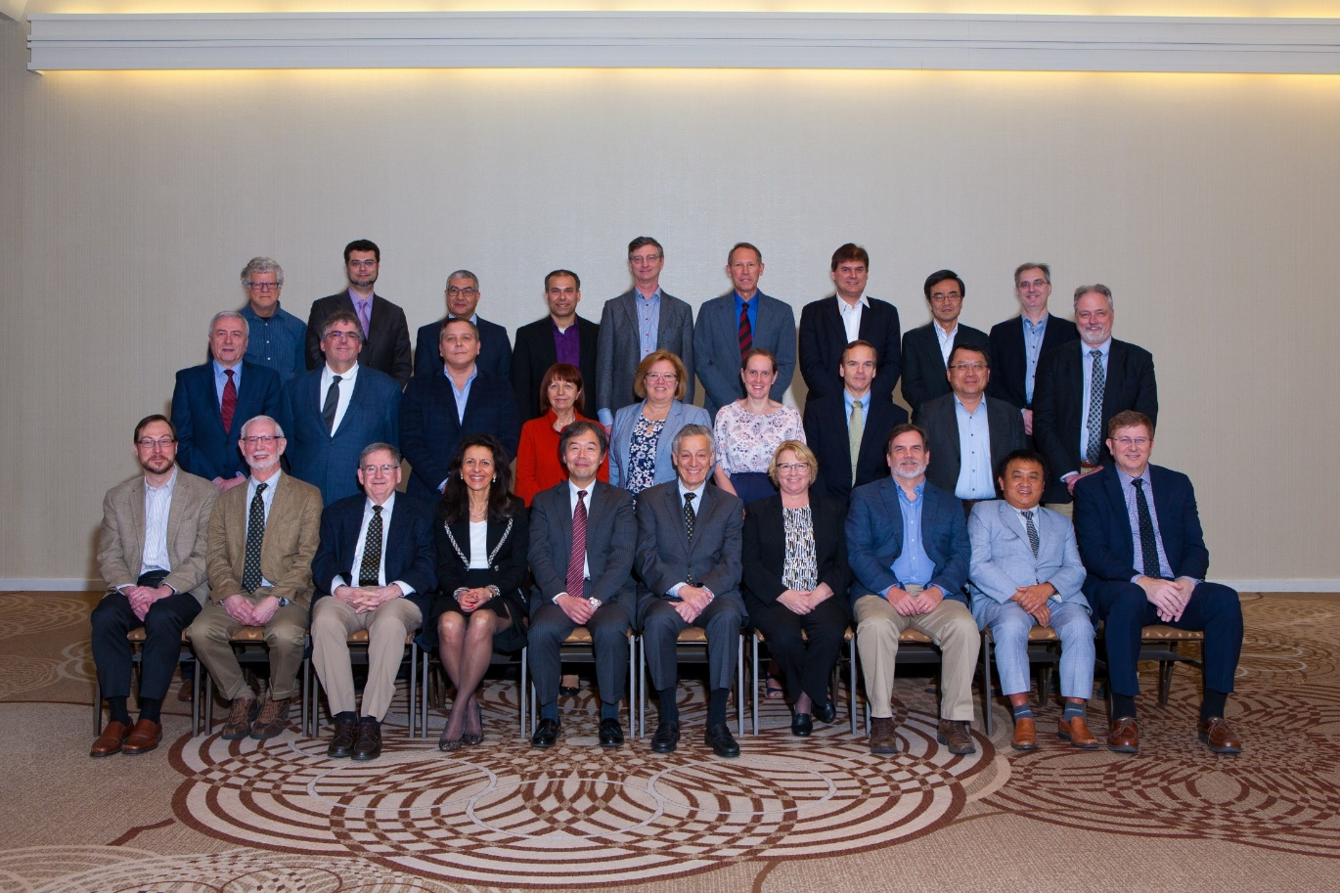
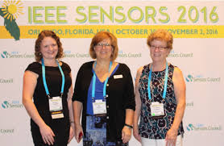
What is IEEE?
IEEE is the world’s largest technical professional association, dedicated to advancing technology for humanity.
It is designed to serve professionals (and students!) involved in all aspects of the electrical, electronic and computing fields and related areas of science and technology.
It is a non-profit organization formed by the merger in 1963 of the Institute of Radio Engineers (IRE, founded in 1912) and the American Institute of Electrical Engineers (AIEE, founded in 1884)
It has the most members of any technical professional organization in the world,
with ~420,000 members in over 160 countries
3

Slide 4
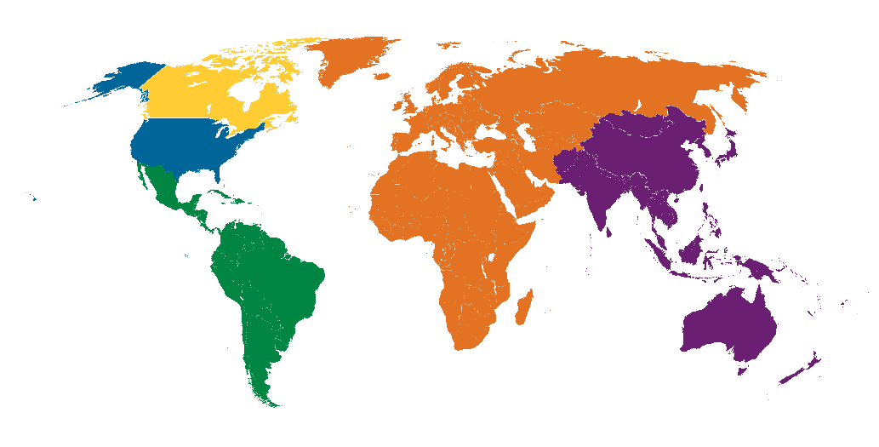
One Diverse IEEE – inspiring a global community for a better tomorrow
Total Membership
421,427
R10 — 158,395
R7 — 14,381
4.5B
38M
R1 to 6 — 155,349
329M
R8 — 76,355
2.4B
R9 — 16,947
664M
IEEE membership
Global Population
As of 31 Jan 2022
IEEE PROPRIETARY

Slide 5






IEEE at a Glance
Our Global Reach
420,000+
Members
46
Technical Societies and Councils
160+
Countries
Plus an active portfolio of ~1,100 standards and more than 984 standards projects in development.
Our Technical Breadth
1,900+
Annual Conferences
5,000,000+
Technical Documents
180+
Top-cited Periodicals

Slide 6

IEEE: Humanitarian and STEM Outreach
https://move.ieeeusa.org/
Notes:
IEEE actively supports programs that reach out and ignite curious young minds to the wonders of technology.
- Real, fascinating technology projects and games for students
- Lesson plans for teachers
https://stemportal-tryengineering.ieee.org - Intended for pre-university students, parents, teachers, school counselors, and the general public, TryEngineering.org lets visitors explore how to prepare for an engineering career, ask experts engineering-related questions, and play interactive games.
The Teacher In-Service Program (TISP) provides a forum for IEEE volunteers to demonstrate the application of engineering, science and mathematics concepts by sharing their real-world experiences with local pre-university educators.
https://move.ieeeusa.org/
https://hac.ieee.org/
https://sight.ieee.org/
https://www.ieeefoundation.org/what-to-support
https://trynano.org/
https://www.ieee.org/education/preuniversity/index.html
https://spectrum.ieee.org/covid19-ieee-resources
Https://spectrum.ieee.org/ieee-free-resources
https://spectrum.ieee.org/ieee-covid-19-resources-for-members

Slide 7
IEEE Simplified Structure
BoD
Assembly
IEEE-USA
EAB
TAB
PUB
SAB
MGAB
46 Societies
and Councils
10 Regions
7

Slide 8
MGA

Slide 9
MGA Mission & Vision
Mission
  Ensure quality member opportunities for continuous engagement.
Vision
  Inspire, Enable, Empower and Engage Members of IEEE
  For the purposes of:
    Fulfilling the mission of IEEE
    Enhancing the members growth and development through their life cycle
    Providing a professional home
MGA Strategic Plan 2020-2025 can be found at: mga.ieee.org/strategic-plan

Slide 10
Vitality in MGA
Different perspectives on vitality are addressed throughout MGA
  Members – MGA partners with other OUs to reach and engage
    Member Dues Revenue
    Membership statistics
    Member research and engagement
  Volunteers
    Supporting current and future leaders
    Providing opportunity to learn and grow
  Geographic Units
    Increasing the number of units and expanding scope and depth of the local units
    Assessing vitality of local activity networks, GeoUnit vitality
    Providing insights and data that enable volunteers to be effective
  Digital strategy/initiatives to ensure MGA and GeoUnits have the necessary tools and related resources to meet current needs with the focus on online IEEE program/service delivery
10

Slide 11
Senior Member Elevations
Region | 2021 Goals | 2021 Elevations | 2020 Elevations | 2019 Elevations | 2018 Elevations
R1 | 190 | 157 | 155 | 246 | 201
R2 | 160 | 146 | 150 | 181 | 164
R3 | 220 | 428 | 229 | 228 | 191
R4 | 170 | 154 | 164 | 139 | 118
R5 | 160 | 143 | 170 | 226 | 146
R6 | 470 | 309 | 485 | 459 | 310
R7 | 150 | 102 | 151 | 121 | 91
R8 | 830 | 860 | 897 | 1,067 | 846
R9 | 150 | 153 | 161 | 184 | 109
R10 | 1,500 | 2,055 | 1,747 | 1,496 | 1,205
Totals | 4,000 | 4,507 | 4,309 | 4,347 | 3,381
Elevations Remained Strong in 2021!
Ongoing collaboration with WIE, YP & Societies to promote Senior Member grade
A&A Committee Members will continue to be the champion of Senior Member grade for their Regions, promoting applications for Senior Membership, holding (Virtual) Senior Member drives, etc.
Support / Modernizing Volunteer Experience
Continue to hold Online/Virtual panel meetings due to COVID-19 pandemic. Virtual Panel meetings enable:
Engaging more Senior Members to serve as panelists
Easy addition of elevation panel meetings to address SM elevation volume when needed
11

Slide 12
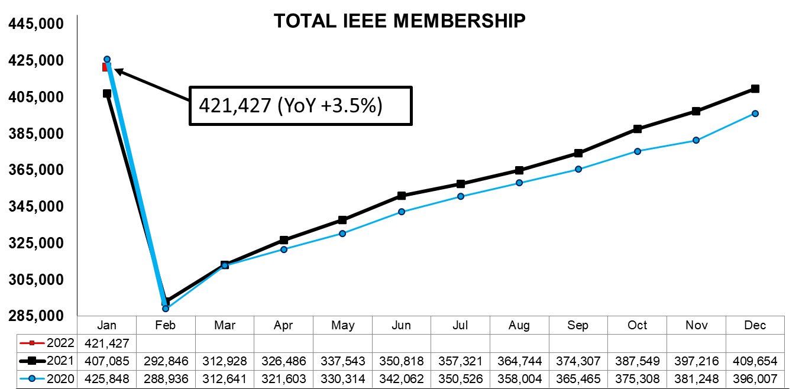
After deactivation, Feb 2022 total membership was 302,145
12
IEEE PROPRIETARY

Slide 13
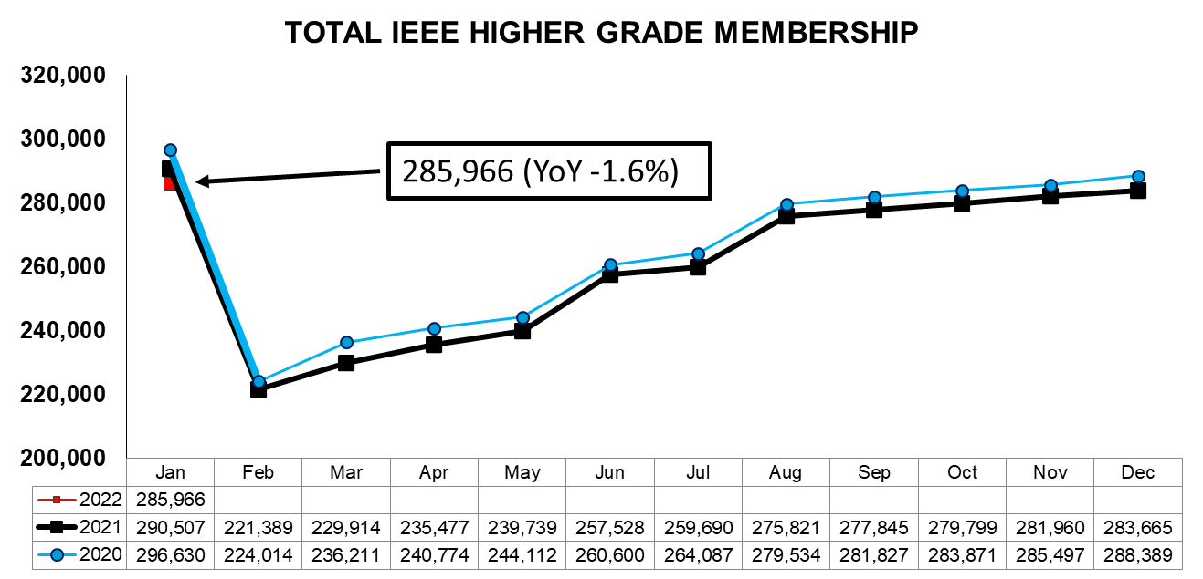
After deactivation, Feb 2022 HG membership was 218,011
13
IEEE PROPRIETARY

Slide 14
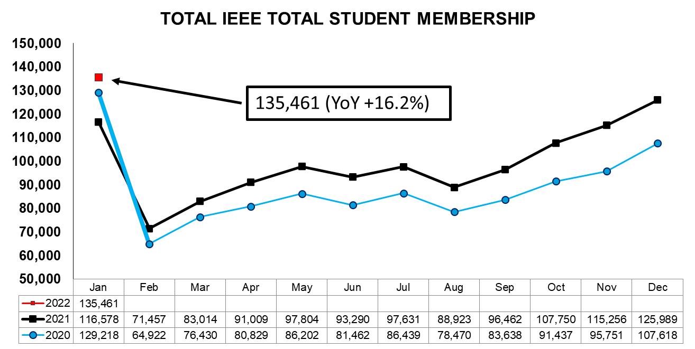
After deactivation, Feb 2022 Student membership was 84,134
14
IEEE PROPRIETARY

Slide 15
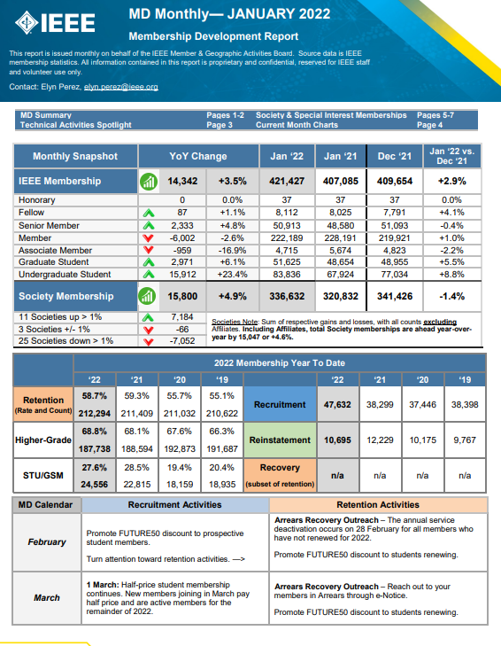
MD Monthly provides timely data and analysis to volunteers and staff
Statistical ‘pulse’
Membership Trends
Goal Achievements
MD Calendar guidance
MD-related announcements, activities
Posted in the Membership Development Volunteers Community in Collabratec, and on the MD portal
15
IEEE PROPRIETARY

Slide 16
IEEE PROPRIETARY

Slide 17
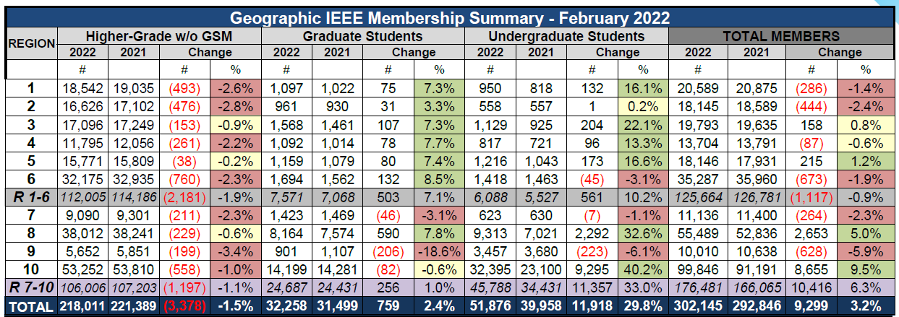
IEEE PROPRIETARY

Slide 18
Membership Retention by Tenure
Engagement in the first 3 years is most critical for member longevity
Retention Rate
Cumulative Years of Membership
18
IEEE PROPRIETARY
Data: as of 15 August 2021
Notes:
Plans for retention over first 3 years:
Builds on the success of the new member onboarding series
Messages and trigger events help shape how we communicate with members after they renew:
Thank you for renewing your membership
Thank you for referring a member to join
Recognizing years of service as an IEEE member
Content streams sent to individuals who have checked off specific topics in their IEEE membership interest profile.
Source content throughout the organization and send "bite sized" emails highlighting specific items such as webinars, newsletter opt ins, articles, new discounts, programs, and more
Outreaches to IEEE Spectrum online readers and Collabratec registrants provides GDPR compliant pathway to membership
Four-message series to non-members that have opted in to learn more about IEEE membership
~2,000 opts in per week
Ongoing testing and refining of message content
Three-message series to ‘incomplete’ joins prompting them to complete their application
Member JOIN page added to IEEE Spectrum

Slide 19
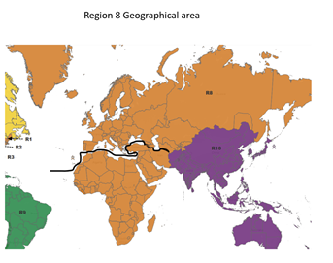
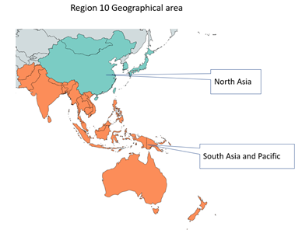
2022 MGA Region Realignment
2022 Region Realignment Ad Hoc Committee appointed
MGA February Board Meeting
  Two zones in both Region 8 and Region 10
  Two additional attendees at MGA Board meetings this June and November
Next Steps:
  Consolidation of Regions 1-6 to 5 Regions
  Define zone (sub-region) concept
  Propose changes to governance documents
  Split Region 10 into 2 Regions
19

Slide 20
2022 MGA Priority Projects
Priority Projects support MGA strategic areas and goals
Membership is a core MGA responsibility and strategic focus. These projects build on key member strategies and sustaining operations. They add specific focus due to particular ad hoc efforts from the IEEE BoD and MGA
Major IEEE-wide and MGA-led initiatives that will require significant volunteer and staff efforts to achieve successful completion.
Next Gen Volunteer Adoption
MGA Finances
MGA Complaint/Compliance Resolution
SC 2020 Recommendations (Education and Industry Local Engagement)
Grow IEEE Membership and Dues Revenue
Member Value Inventory and Taxonomy
SC 2020 Recommendation (3-5 Year Dues)
MGA geographic unit vitality is a competitive advantage of IEEE and MGA’s strategic focus. These projects define new capabilities that are underway or being created to strengthen the resources available to local geo units for engaging members and the public.
Maintain an inventory and capability/usage assessment of those tools developed and or supported by MGA that are being used to accomplish our strategies and goals.
Geo unit Elections
vTools Nomination/Petition Tool Enhancements
MGA Volunteer Resource Webpage
MGA Relationship Management Solution
Best Practices and Hybrid Meeting Resources for Geo Units

Slide 21
MGA – Geographic Units
(as of 1 February 2022)
Regions | 1 | 2 | 3 | 4 | 5 | 6 | 7 | 8 | 9 | 10 | Grand Total
Section | 22 | 20 | 41 | 23 | 27 | 35 | 21 | 59 | 35 | 60 | 343
Sub-section | 2 | 2 | 2 | 3 | 4 | 2 | 2 | 11 | 16 | 41 | 85
Council | 1 | 0 | 4 | 0 | 0 | 2 | 0 | 1 | 5 | 6 | 19
Chapter* | 178 | 104 | 114 | 105 | 114 | 208 | 152 | 625 | 241 | 779 | 2,620
Affinity | 49 | 27 | 42 | 41 | 41 | 54 | 51 | 116 | 68 | 119 | 608
Student Branch | 89 | 86 | 113 | 67 | 99 | 89 | 61 | 702 | 560 | 1,710 | 3,576
Student Branch Chapter | 60 | 31 | 63 | 50 | 64 | 67 | 51 | 490 | 789 | 1,551 | 3,216
Student Branch Affinity | 4 | 7 | 9 | 4 | 4 | 5 | 17 | 150 | 175 | 432 | 807
Grand Total | 405 | 277 | 388 | 293 | 353 | 462 | 355 | 2,154 | 1,889 | 4,698 | 11,274
*Joint Chapters of two or more Sections and/or two or more Societies are counted as one Chapter

Slide 22
MGA Chapter Operations Support Committee
The MGA Board approved the Chapter Operations Support Committee as a standing Committee in February 2022
The group previously worked as an Ad Hoc beginning in 2019 with a focus on the issues Chapters are facing. The issues identified are fundamental to being a successful volunteer: communications, funding resources, best practices and engagement, training, and support infrastructure.
Some of the completed projects include:
  Welcome letters sent to Chapter Officer, with links to training and other resources
  Implemented a Chapter self-assessment, similar to the Section self-assessment that is done annually
  Added an area within the Center for Leadership Excellence specifically for Chapters https://www.ieee.org/cle
  Updated content on Chapter Resource website https://mga.ieee.org/resources-operations/geographic-unit/chapters
  Encouraged all S/Cs, Regions and Sections with multiple Chapters to have a Chapter Coordinator; create a position description and began identifying necessary governing document changes
  Created a report tool showing Chapter activities (planned meetings, meetings held, number of attendees, etc.)
  Improved L31 reporting by automatically notifying chapter officers to submit their report (after the date of a scheduled meeting has passed)
  Updated MGA governing documents to clarify issue with Chapter finances

Slide 23
Volunteer Tools
vTools are a suite of applications that are volunteer designed and approved
  Staff built and maintained
  Automates required volunteer responsibilities
  Integrates with the IEEE Member Database (Siebel) for real time changes (Officer Reporting)
  Integrates with the IEEE Data Warehouse for web service/data feeds
  Uses IEEE Single Sign on
Seven vTools applications
  vTools Events - WebInABox
  vTools eNotice - IEEE Xtreme Registration
  vTools Voting - Student Branch Reporting
  Online Officer Reporting
IEEE OU Analytics is the visual business intelligence tool for volunteer access to member data. Access is automatic for many executive committee members and can be designated to others.
EWH is a web hosting service, sponsored by MGA, that supports for all IEEE OUs. Over 5,000 web sites are hosted. These include Geo Units, Societies and Conferences.

Slide 24
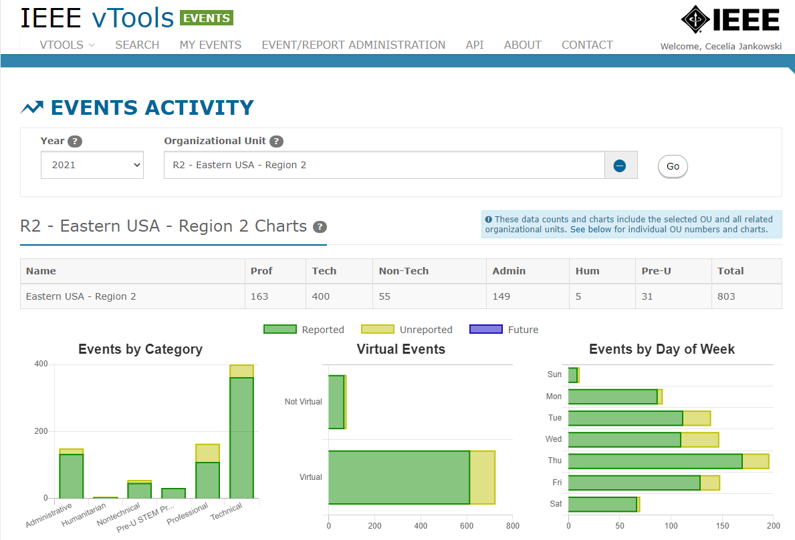
Region 2 vTools Activity for 2021
Total includes all Sections and their OU Activities
Reported (held and reported)
Unreported (held)
Future (scheduled)
24

Slide 25
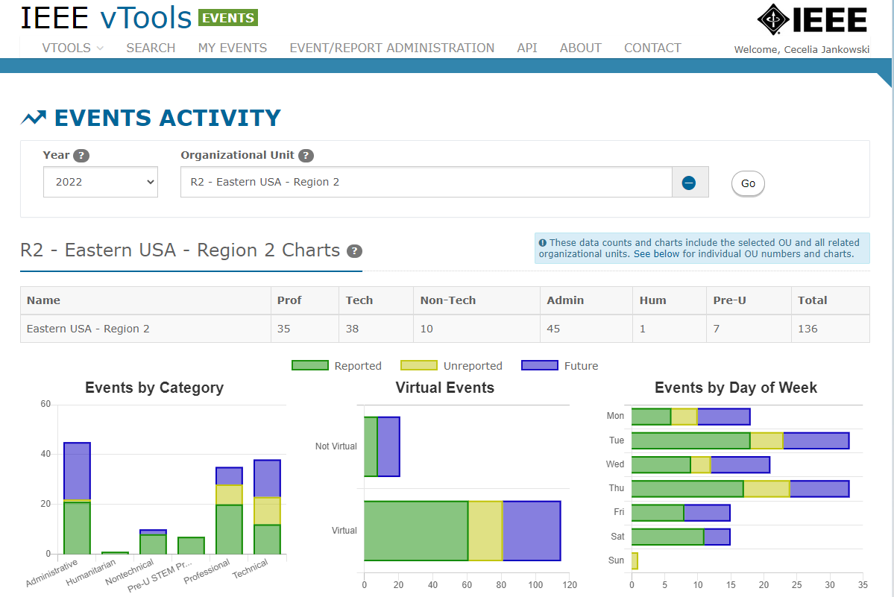
Region 2 vTools Activity for 2022 (to date)
Total includes all Sections and their OU Activities
Reported (held and reported)
Unreported (held)
Future (scheduled)
25

Slide 26
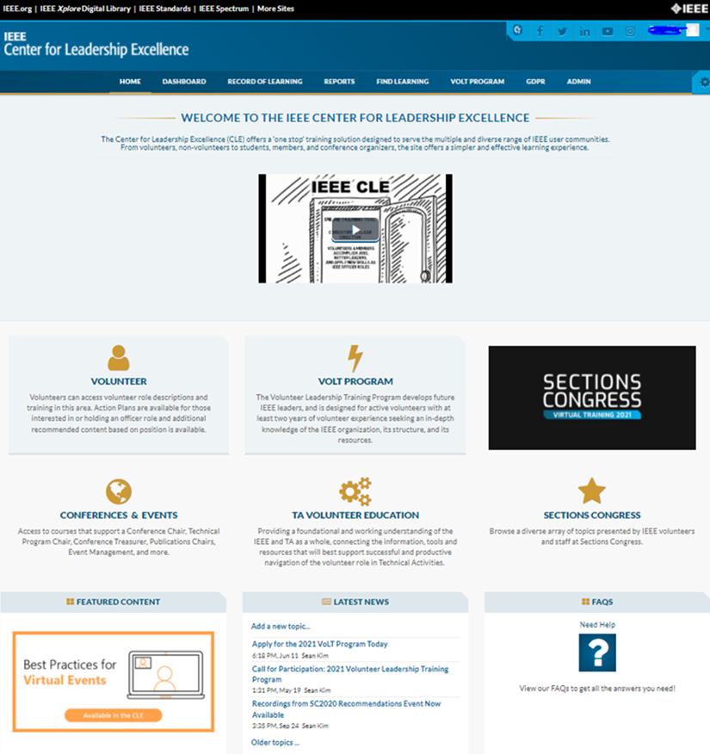
Center for Leadership Excellence
On Demand Training for Local Leaders
Audiences served:
  IEEE volunteers (Region, Section, Chapter, Affinity Group, Student Branch, Section-level committees)
  VoLT Program candidates and students
  Conference organizers + TA volunteers*
Content available
  Action Plans for 23 volunteer roles
  Volunteer role descriptions for 41 positions
  IEEE 101 courses
  80+ recordings on various topics, including professional development, volunteer recruitment, ethics and technology, and more
  SC2020 Recommendations Event recordings and materials
  IEEE Sections Congress Virtual Training 2021
* Content owned and managed by Volunteer Education & Engagement, IEEE Technical Activities
26

Slide 27
Elections: Key Pieces to Executing Successful GeoUnit¹ Elections
Clear and Cohesive Materials
  MGA Operations Manual
  MGA Webpages with Election Information
  GeoUnit Webpages with Election Information
Consistent Use of Tools
  Ready to use Templates
  vTools Voting
  vTools Nomination Tool²
Common Process
  Clear
  Easy to Follow for all GeoUnits
  Efficient Timeline
¹ GeoUnit as used here is focused on all elections conducted by Sections, Chapters, Affinity Groups, and may be extended to Student Branches and Branch Chapters. Elections for Region positions are defined in Region Bylaws, the MGA Ops Manual and in the IEEE Bylaws.
² The vTools Nomination Tool is live and can be used by Sections. There is a link to it from the vTools Home Page. The Election process will be updated to include the Nomination Tool and vTools Voting, during 2022.
27

Slide 28
Elections: MGA GeoUnit Election Process
Project: Update the current GeoUnit Election process to create a clear and cohesive documented process that works efficiently for all GeoUnit under a Region. Clearly identify the steps within the process that must be followed in an easy-to-follow timeline-oriented flow. Includes incorporation of vTools voting for all GeoUnit elections and the vTools nomination tool once the new election process is ready to be implemented.
Key Components:
MGA Operations Manual
  Update the current process to create a clear and cohesive documented process that works efficiently and consistently for all units
  Clearly identify the steps within the process that must be followed in a timeline-oriented manner
Process and Tools
  Creation of clear processes that ensure one process being used by all units for critical parts of the election process
  Creation of templates to assist units with moving through various parts of the election process
  Require use of vTools voting for all elections
  Combine the Tellers and Nominations Committees to form one Election Committee
Election Timeline
  Reduce the minimum of 6 months to execute an election, to 3 months
28

Slide 29
Elections: Nomination Application
vTools
Enables Section volunteers to manage the nomination/petition process
  Step by step, easy to follow
Section Officers Appoint Nominating Committee
Nominating Committee
  Establishes timing
  Sends call for nominations
  Prepares 1st slate of candidates
  Reviews petition candidates
  Send out final slate of candidates
Built-in validations
Built-in email function and with editable templates

Slide 30


MGA Call for Nominations 2023 IEEE MGA Committee Member Positions: Deadline 1 August
MGA Committee Member Positions
IEEE Admission and Advancement
MGA Awards and Recognition
MGA Geographic Unit Operations Support
MGA ieee.tv Advisory
MGA IT Coordination and Oversight
IEEE Life Members
MGA Member Benefits Portfolio Advisory
MGA Nominations and Appointments
MGA Potentials Editorial Board
Strategic Planning
MGA Student Activities
MGA Training
MGA vTools
IEEE Women in Engineering
IEEE Young Professionals
Visit https://mga.ieee.org/board-committees/available-mga-positions for more information!
For questions, email mga-noms@ieee.org
30

Slide 31
Sections Congress

Slide 32
Sections Congress 2020: Top 3 Recommendations
Consideration of a multi-year membership commitment
Provide a high value Continuing Education program for working professionals
Improved resources for sections to serve industry professionals and track industry contacts at the local level
IEEE MGA Ad Hoc Committee on Sections Congress 2020 Top 3 Recommendations Implementation was formed to consider implementation of the recommendations.
Ad Hoc chaired by Jim Jefferies with members from multiple IEEE OUs and committees with knowledge of topics

Slide 33

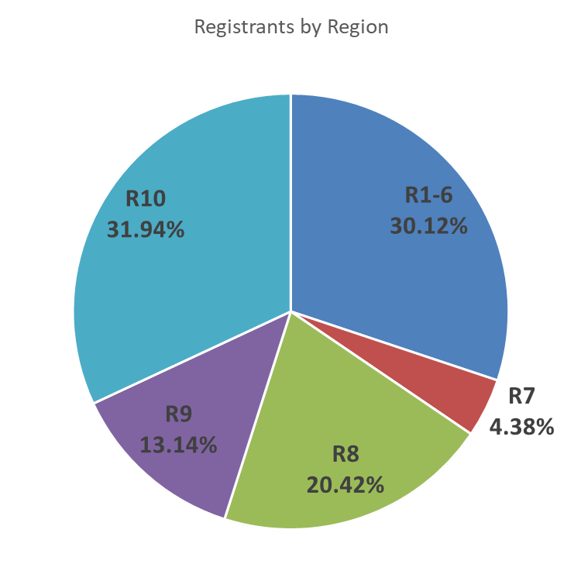
Sections Congress Virtual Training 2021
Held virtually on 9-11 April 2021
First SC event to go virtual and was open to all IEEE volunteers and members
Session formats: Virtual presentations, breakouts, panel, exhibits, networking (SpatialChat)
Hosted more than 1,550 people over the weekend - highest number of attendees at SC ever
  18% Student Members and 8% GSMs
81.5% overall event satisfaction rate
Post-event survey results:
  53% attended SC for the first time
  73% are volunteers with 6 or more years of service
  69% already shared their learnings from the event with their network
  76% intend to make changes as a result of what they learned at the event
  74% felt the duration of the event was just right
Recordings and slides available in the IEEE Center for Leadership Excellence (CLE)
SC website: sections-congress.ieee.org
33
Notes:
228 total survey respondents

Slide 34

IEEE Sections Congress
The Road to Sections Congress
2023
Ottawa, Canada
11-13 August
2026
R8 or R10 (Area 2)
Date TBD
2024
Virtual Event
Date TBD
2025
Virtual Event
Date TBD
IEEE training in-person
Focus on overview of all major IEEE organizational units and initiatives
Session detailing process of recommendations
Status of prior SC recommendations
All Volunteers
Basic IEEE training virtually
Session detailing status of past recommendations
Region breakout –focus on Recommendations (issues and opportunities)
All Volunteers
New IEEE training in-person with in depth MGA Leadership specific events
Develop solutions, improvements
Voting of recommendations
Leadership focus, smaller attendance

Slide 35
IEEE Sections Congress 2023
Sections Congress Planning
  Location: Ottawa, Canada
  Dates: 11-13 August 2023
  Friday Evening, Saturday and Sunday
2023 SC Steering Committee
  General Chair – TBD
  Program Chair – Ruben Barrera (R9)
  Local Organization Chair – Winnie Ye (R7)
  Past Committee Chair – Loretta Arellano (R6)
35

Slide 36

Shaw Centre – Ottawa, Canada
The Centre houses 192,000 sq. ft. of flexible, state-of-the-art function space spread over four floors
Recently named one of the top 3 convention centers in the world in AIPC’s World’s Best Convention Centre rankings
20-minute commute from the airport
Within a short walk of 6,000 downtown hotel rooms

Slide 37
Thank you!
Jill Gostin, jgostin@ieee.org

Slide 38
Backup

Slide 39
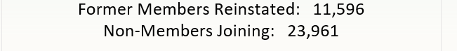

Collabratec has delivered a proven prospect pipeline for IEEE Membership
Non-Member Conversions | 35,557
Higher-Grade | 24,056
Students | 8,091
20 % of Non-members reported that Collabratec had played a role in their decision to join IEEE
*Cumulative through 31 Dec 2021
*Source: 2021 Collabratec Annual User Survey
39
IEEE PROPRIETARY

Slide 40
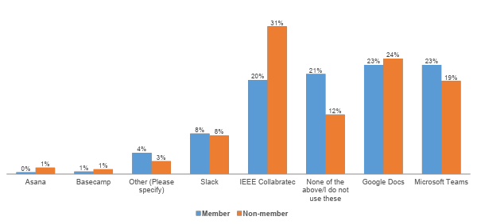
Technology and engineering professionals rank Collabratec among the best for online collaboration
2021 Collabratec User Satisfaction Survey, 2,500 respondents
Collabratec users are asked which platform is most useful for collaboration …
40
IEEE PROPRIETARY

Slide 41

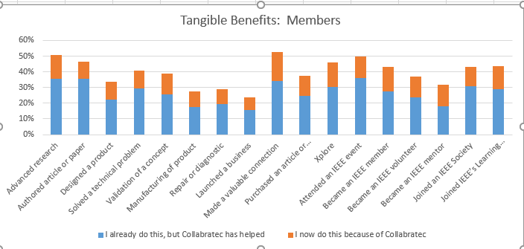
Collabratec delivers tangible member benefits
Top benefits include Connections, Advancing research, IEEE events, Authoring & Purchasing IEEE Xplore articles
41
IEEE PROPRIETARY

Slide 42
Top 10 countries: total IEEE membership
2021 Rank | Country | 2021 Membership | 2011 Membership | % Change Since 2011
1 | USA | 153,177 | 207,096 | -26.0%
2 | India | 59,710 | 41,966 | 42.3%
3 | China | 35,164 | 9,273 | 279.2%
4 | Canada | 14,179 | 16,943 | -16.3%
5 | Japan | 13,753 | 13,872 | -0.9%
6 | United Kingdom | 8,630 | 9,524 | -9.4%
7 | Australia | 7,407 | 7,692 | -3.7%
8 | Germany | 7,396 | 7,703 | -4.0%
9 | Italy | 5,378 | 4,645 | 15.8%
10 | Hong Kong | 5,358 | 2,596 | 106.4%
Data: as of 12-31-2021
IEEE PROPRIETARY

Slide 43
Top 10 countries: Higher Grade Members
2021 Rank | Country | 2021 Membership | 2011 Membership | % Change Since 2011
1 | USA | 133,289 | 176,613 | -24.5%
2 | China | 20,951 | 6,609 | 217.0%
3 | India | 18,702 | 12,158 | 53.8%
4 | Japan | 11,992 | 12,191 | -1.6%
5 | Canada | 11,380 | 13,334 | -14.7%
6 | United Kingdom | 6,839 | 7,510 | -8.9%
7 | Australia | 6,157 | 6,272 | -1.8%
8 | Germany | 5,681 | 5,904 | -3.8%
9 | Hong Kong | 4,918 | 2,199 | 123.6%
10 | Italy | 4,120 | 3,868 | 6.5%
Data: as of 12-31-2021
IEEE PROPRIETARY

Slide 44
Top 10 countries: Student members including GSM
2021 Rank | Country | 2021 Membership | 2011 Membership | % Change Since 2011
1 | India | 41,008 | 41,966 | -2.3%
2 | USA | 19,888 | 30,483 | -34.8%
3 | China | 14,213 | 2,664 | 433.5%
4 | Tunisia | 4,793 | 239 | 1905.4%
5 | Canada | 2,799 | 3,609 | -22.4%
6 | Bangladesh | 2,771 | 472 | 487.1%
7 | Sri Lanka | 2,445 | 612 | 299.5%
8 | South Korea | 2,008 | 1,342 | 49.6%
9 | United Kingdom | 1,791 | 2,014 | -11.1%
10 | Japan | 1,761 | 1,681 | 4.8%
Data: as of 12-31-2021
IEEE PROPRIETARY

