Slide 1
Use of Member Data
Dave Green, R3 SOSC Chair
April 1, 2022

Slide 2
IEEE Data Access and Use Policy
Intent of Policy
To support IEEE’s data privacy compliance efforts
To provide clear expectations of what is expected
Why is this necessary?
Enforcement efforts for the GDPR have begun
Desire to clarify volunteer responsibilities
Greater ease for volunteers

Slide 3
Data Access and Use Policy
Purpose and Scope
Audience
Staff & Volunteers
Applies when Personal Data is:
Collected
Accessed or Processed
Post-Process
Parts of the policy
Data Collection, Access & Use [Collect]
Data Processing & Handling [Process]
Data Management [Post-process]
Data Requests & Incidents
Violations

Slide 4
Data Access and Use Policy
Data Collection, Access and Use
Data Collection
Purpose of the data
Privacy Policy acceptance
Specific terms & conditions if applicable
Do you want to receive other IEEE communication outside of this purpose
When can you communicate with IEEE constituents?
Consent
Legitimate purposes
Legal/Transactional
Tools & Policies
List Validator
Information Classification
Unsubscribe

Slide 5
IEEE Centralized Tools
General Data Protection Regulation
IEEE has developed tools/features to enable IEEE data users to leverage the centralized consent information
eNotice - automatically complies with member preferences assuming content does
Regions, Geographic Councils, Sections, Subsections, Chapters, Affinity Groups, Student Branches, Student Branch Chapters, Student Branch Affinity Groups
Societies
HKN Student Chapters
vTools Events – includes Privacy Policy and Events terms and Conditions Policy for registrants as well as “Can we contact you with additional IEEE information”
List validator
Ability to upload an external list (conference attendee example)
Remove for Do Not Contacts and Erasures
Download confirmed list
Member Validator - validates is person is an IEEE/Society member
UI – ieee.org/mv
API to integrate with external conference applications
IEEE legal approval process
IEEE OU Analytics
Includes OK to Contact Flag (Y/N)

Slide 6
Data Access and Use Policy
Data Management
IEEE Data users must:
Store data in IEEE application or IEEE Database or IEEE GoogleApps@ieee account
See instructions at:
http://sites.ieee.org/gdpr/list/saving-files-to-google-drive/
Ensure secure handling of data
Delete previously stored data [ eg., personal devices and printed data]
Validate data against IEEE Consent Management systems using List Validator
Data shared with 3rd party campaign tools must be purged within 30 days

Slide 7
Data Access and Use Policy
Data Subject Requests and Incidents
Data Subject Requests:
Right of Access
Right to be forgotten
Send an email to privacy@ieee.org with "GDPR Request" in the subject line
Incidents:
Breach
loss of data
loss of equipment containing IEEE data
Send an email to security@ieee.org with the details immediately

Slide 8
Data Access and Use Policy
Violations
Compliance to the policy is mandatory
Violations may result in loss of access to IEEE tools
Potential disciplinary action
Consequences to IEEE

Slide 9
Impact to Volunteers and Staff
Use of List Validator when IEEE applications are not used is a must
Deletion of data from personal devices
Use of GoogleApps@IEEE account vs. personal devices for storing data
Data subject requests and responses [eg., RTF]
Collect consent and honor user preferences
Requirements for greater due diligence in vendor selection both contractually and technically
Send consent collected outside the centralized Consent Management Systems to IEEE
GDPR training rolled out to Staff and Volunteers

Slide 10
IEEE OU Analytics - Terms and Conditions
Conditions of data availability and use
IEEE member data is released for use only by IEEE members, officers, and committee members. Member information may not be furnished, with or without compensation, to outside entities, or be used by IEEE members for any other than approved IEEE business.
It is the responsibility of the volunteer to keep informed of IEEE Policies governing mailings and the use of labels and email addresses, including the regulations governing electioneering for IEEE offices. The information is found in Section 14.1 of IEEE Policies published every January and is available on request or from the IEEE Governing Documents website.
It is also the responsibility of the volunteer to keep informed of the IEEE member Privacy and Security policies and Email Terms and Conditions.
Notes:
From IEEE_OU_Analytics_-_Introduction.pptx on https://mga.ieee.org/resources-operations/volunteer-tools/samieee/11-operations/318-ou-analytics-training-materials

Slide 11
OU Analytics
Communications preferences in OU Analytics have been streamlined
Now Includes One Communications Flag
Eliminates confusion on what members can be contacted
OK to Contact flag in OUA is set to NO if members opt-out of Local IEEE Communications or have selected “Please remove me from IEEE communications not required legally or for the fulfillment of services” in the Member Profile
http://ieee.org/profile

Slide 12
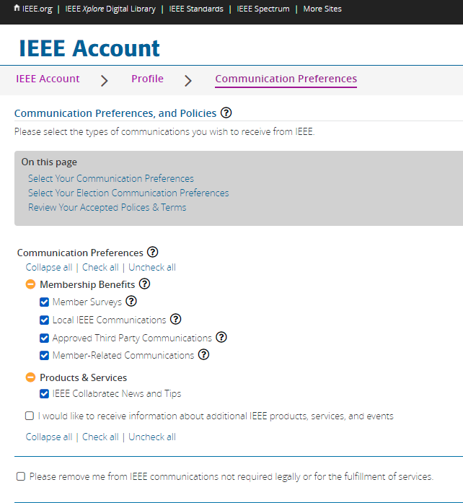
OU Analytics
Communications Preferences
Member Communication Preferences and Policies
Five (5) Standard Communication Preferences
Member Surveys
Local IEEE Communications
Approved Third Party Communications
Member-Related Communications
[ ] Please remove me from IEEE communications not required legally or for the fulfillment of services.
This last flag supersedes all others
Additional Communication Preferences may also be available for other subscribed services such as Collabratec.

Slide 13
OU Analytics
Solution
Today, only one flag exists in OU Analytics
OK to Contact
Logic has been implemented such that if the member chooses not to receive Local Communications or ANY communications, the OK to Contact is set to N
Eliminates confusion on what members can be contacted by the OUs
There is no impact to eNotice as eNotice has always used the same logic

Slide 14
What percentage of Region 3’s membership have “OK to Contact” set for member surveys?
87%

Slide 15
I want to determine those members that appear eligible to be senior members and send them an email to highlight support within the section and invite them to apply.
Can I use IEEE data to support this effort:
Yes, IEEE purpose as long as “OK to Contact” is set.

Slide 16
I have decided to petition the membership to be a candidate for R3 Director.
Can I use IEEE data to support this effort:
No, electioneering is specifically disallowed.

Slide 17
I want to use OU analytics to determine the percentage of Young Professionals to understand the make up of my section.
Can I use IEEE data to support this effort:
Yes, IEEE purpose, aggregation.

Slide 18
I met someone at the section meeting, I want to look up contact information to follow up based on a synergy between our companies
Can I use IEEE data to support this effort:
No. You should exchange contact information when you were meeting or at the next meeting.

Slide 19
I met someone at the section meeting, I want to look up her contact info to encourage participation on the program committee?
Can I use IEEE data to support this effort:
Yes, IEEE purpose as long as “OK to Contact” but still better to get the information and permission from the member at the meeting.

Slide 20
I want to get support for my candidacy for section chair.
Can I use IEEE data to support this effort:
No, electioneering is specifically disallowed. There is some support for the petition process in a vTool (see http://nominations.vtools.ieee.org)

Slide 21
I want to discover which technical topics are likely to be of interest to my members by sending out a survey.
Can I use IEEE data to support this effort:
Yes, IEEE purpose as long as “OK to Contact”.

Slide 22
I want to discover what are the most popular societies in my section to determine if more chapters should be formed.
Can I use IEEE data to support this effort:
Yes, IEEE purpose, aggregation.
There is a ‘Potential Chapters’ tab in the MAP module of OU Analytics. It’s shows where 12 or more members of the same society exist in a section.

Slide 23
A company has come to town and wants to offer jobs to my members. Can I provide them a list?
Can I use IEEE data to support this effort:
No. You may have mechanisms like newsletters, section meeting announcements, etc. to advise members of the opportunity and let them choose to contact the company.

Slide 24
I want to publicize the recent award winners in our section by sending a note to the members.
Can I use IEEE data to support this effort:
Yes as long as the “OK to Contact ”. You may wish to consider whether a note is the best communication mechanism for this. You should, of course, ensure that any announcement is after the proper notifications have been made and consistent with the awards announcement timing.
Only give the names of the winners.

Slide 25
The local university wants to send an announcement of their continuing education program to section members.
Can I use IEEE data to support this effort:
No. You may have mechanisms like newsletters, section meeting announcements, etc. to advise members of the opportunity and let them choose to contact the University. Under no circumstances should the member list be given to the University.

Slide 26
Additional Resources
Volunteer Dashboard: www.sites.ieee.org/gdpr
Compliance Courses
privacy@ieee.org
Emails sent to Privacy@ieee.org
Subject: Data Privacy Request
Automatically opens a ticket
Prompts staff in different groups to investigate and respond
Confer with IEEE Data Governance at IEEEData@ieee.org

Slide 27
Thank you!
Dave Green, d.green@ieee.org

