Slide 1
Region 3 – Professional Activities Committee
David Fillion, Region 3 Professional Activities Committee

Slide 2
Topic
Region 3 Meeting
Professional Activities are activities that are activities not covered by IEEE Technical Activities

Slide 3
Topic
Region 3 Meeting
Some 2021 Activities:
- Career Development
- Senior Member Round Ups
- Banquets
- STEM Activities

Slide 4
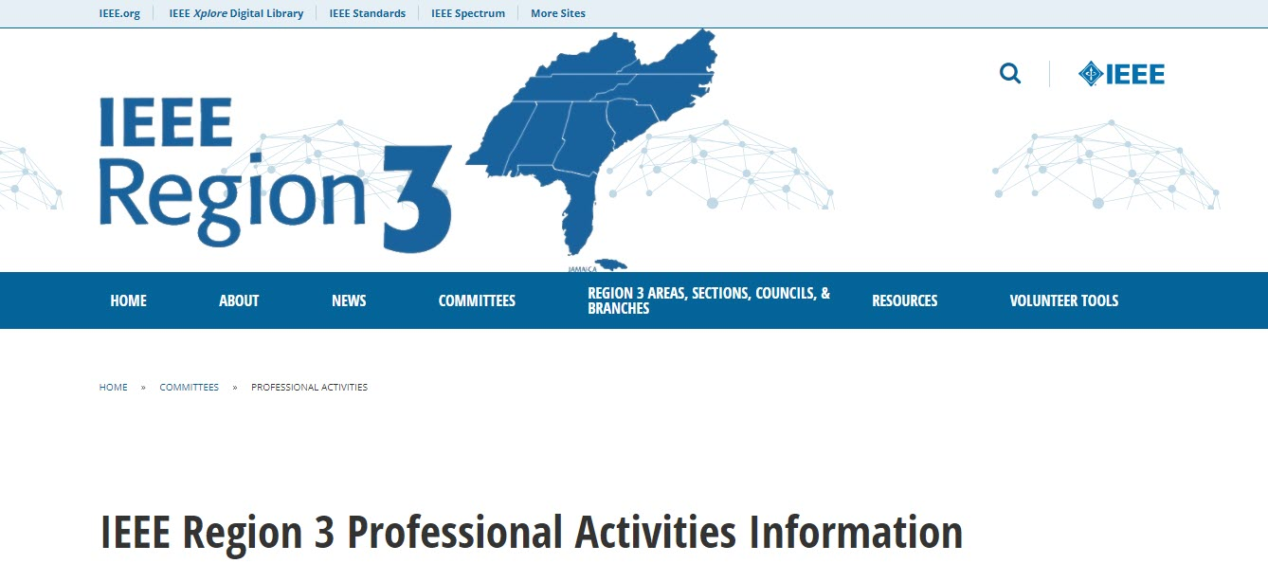
Professional Activities
Region 3 Meeting

Slide 5
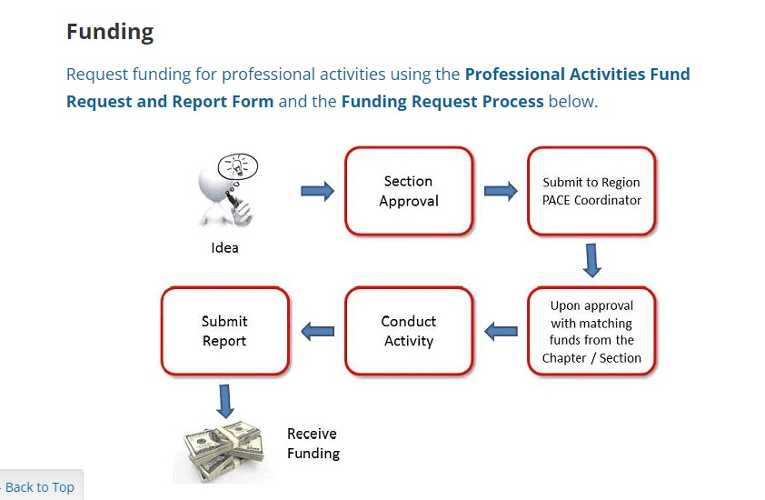
Professional Activities
Region 3 Meeting

Slide 6
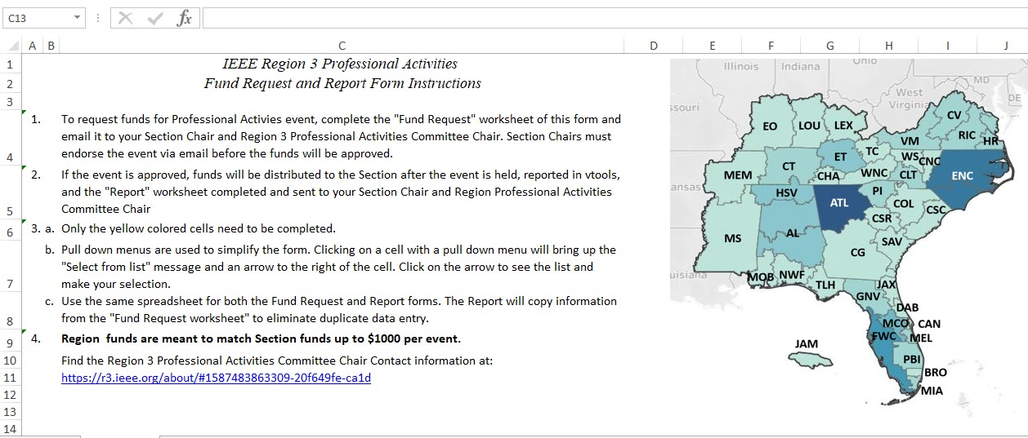
Professional Activities
Region 3 Meeting

Slide 7
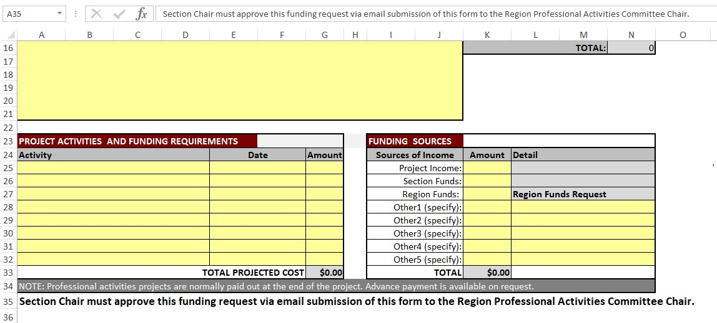
Professional Activities
Region 3 Meeting

Slide 8
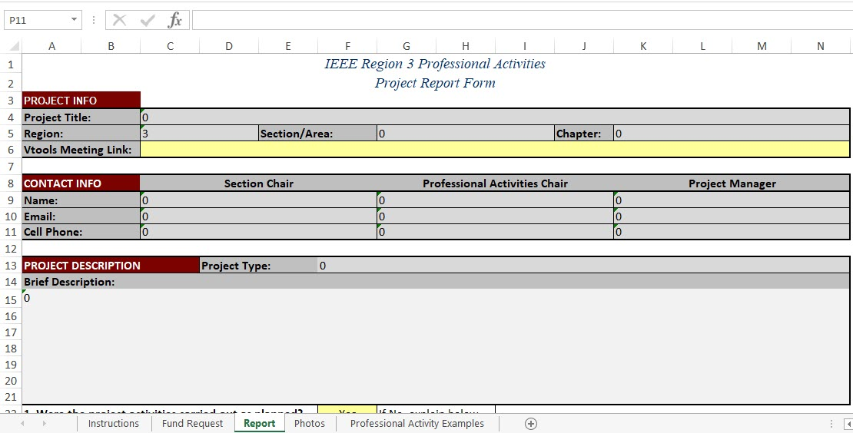
Professional Activities
Region 3 Meeting

Slide 9
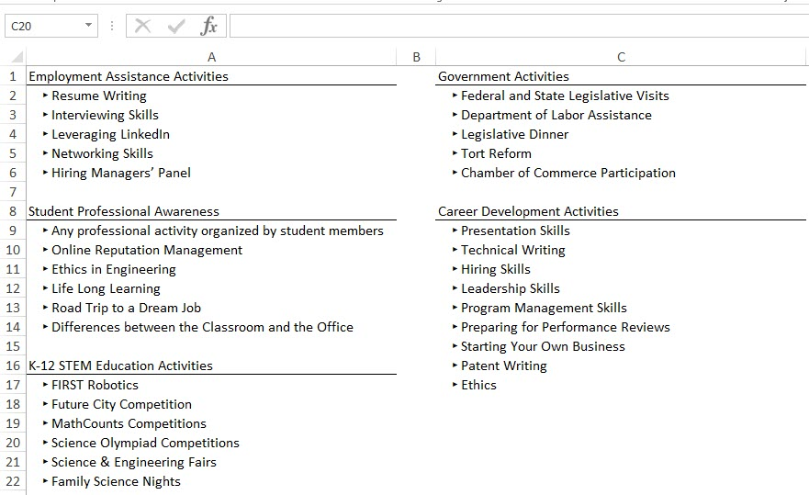
Professional Activities
Region 3 Meeting

Slide 10
Topic
Region 3 Meeting
Recap:
Complete a request with details for approval
Have your event or activity
Report activity and request payment

Slide 11
Thank you!
David Fillion, dfillion@ieee.org
864-901-2780 – Mobile (voice and text)

