Slide 1
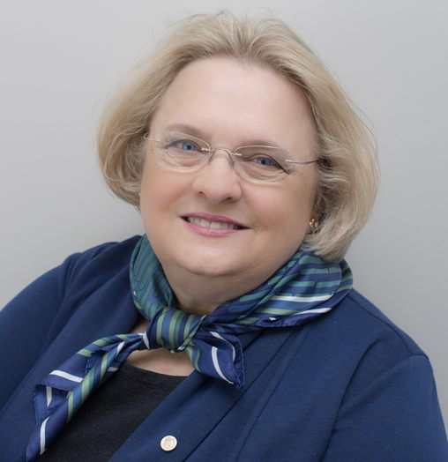
IEEE MOVE Program
Mary Ellen Randall, IEEE Fellow merandall@ieee.org IEEE Treasurer MOVE Outreach International
Notes:
Good day everyone. It is a pleasure to be here with you virtually. My name is Mary Ellen Randall and I am an IEEE volunteer. Today we will discuss the MOVE Program.

Slide 2
MOVE General Description
Objectives
Provide vital services to emergency responders & public in the early phase of a disaster
Deployed as National Red Cross Partner, collaborating with Red Cross Disaster Services Technology team
Independent off-grid setup where power and/or Internet are not available
Set up power, IP Phones, Internet access within 10 minutes of arrival for use by the Red Cross and/or public
When not deployed, provides platform for STEM* Education and Public Visibility events
* STEM = Science, Technology, Engineering, and Math

Slide 3
ORIGINAL MOVE Truck
Equipment racks
Satellite dish
Solar panels
Radio console (in cab)
Storage
Work area
Generator
Notes:
This is what the inside of the MOVE truck looks like. We are self contained with power onboard, a satellite dish so even when the cellular towers are out and power is not available, we can still communicate , access the internet, use Internet Protocol telephones across the satellite, utilize radios and so on. This is how we assist relief workers. We also provide internet to survivors so they can reach their families and ask for help.

Slide 4
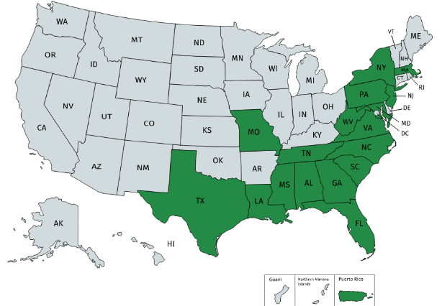
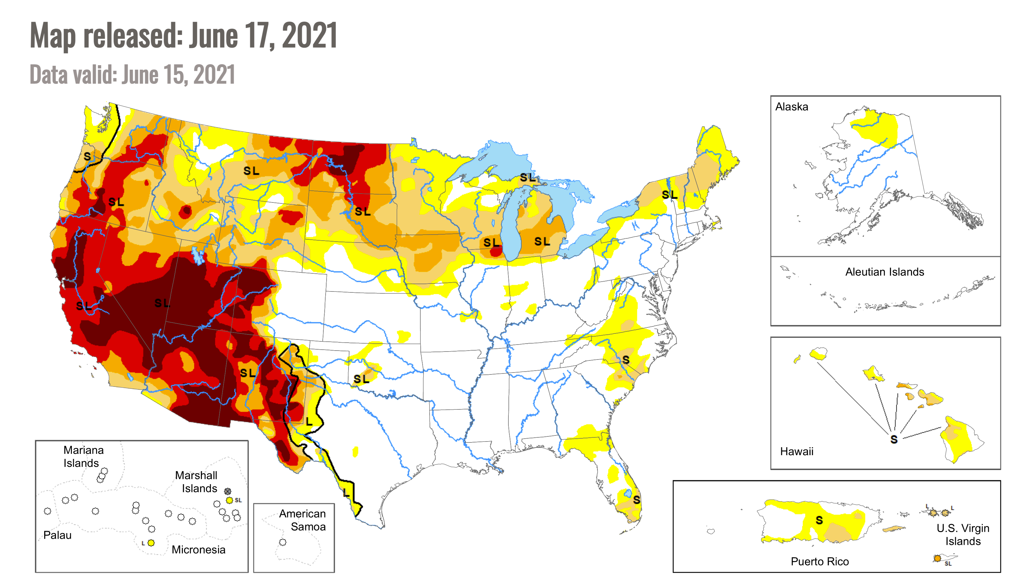
Why Expansion to MOVE
Current MOVE coverage
NOAA predicted a very busy Hurricane 2021 season!
20 named storms (winds of 39 mph or higher) including hurricanes (winds of 74 mph or higher)
Western US wildfires and subsequent floods will be at greatest levels in history
Potential additional MOVE coverage
Notes:
Top right shows current MOVE reach and bottom right shows opportunities (mainly wildfires)
Grateful for IEEE-USA funds to get deployment ready – which was needed for IDA/Nicholas
Here to ask for additional funds

Slide 5
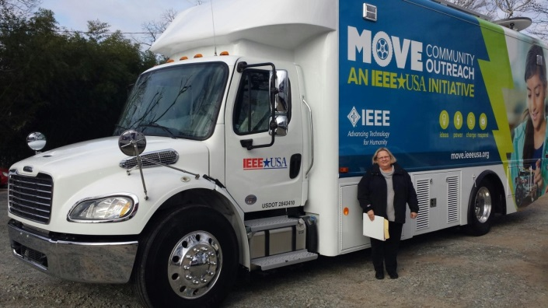
Community Outreach International
Disaster Relief
STEM Educational Outreach
STATUS
Board Of Directors approval
Significant Member Interest
India Volunteers Engaged
Puerto Rico Volunteers Engaged
Evaluating Partner Potential
Modular Units
Other vehicle types considered

Slide 6
MOVE India 2022 Plan Plan for launch of MOVE Truck
4 Phases
Phase I Sponsorship /Call for Volunteer Training/Operations/Partnership reach out
Deadline:31 March 2022
Phase II Purchase of Equipment/Training/ Operations/Partnersreach out
Deadline:30 June 2022
Phase III: Purchase of Vehicle/Training/Operations/Partnership reach out
Deadline:30 September 2022
Phase IV: Installation of equipment and roll out of Truck
Deadline:31 December 2022

Slide 7
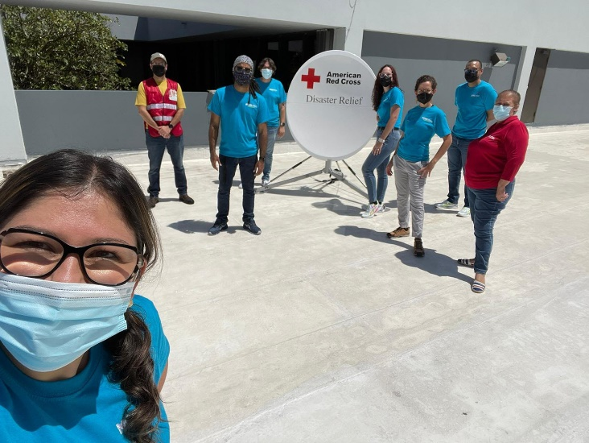
Why Expansion to MOVE
Current MOVE coverage
Notes:
Top right shows current MOVE reach and bottom right shows opportunities (mainly wildfires)
Grateful for IEEE-USA funds to get deployment ready – which was needed for IDA/Nicholas
Here to ask for additional funds

Slide 8
MOVE Disaster Relief Deployments - 26
2019
Hurricane Dorian (FL, SC &NC)
Hurricane Barry (Baton Rouge, Louisiana)
Alabama Tornado Response
2022
Toa Alta and Cataño Flooding
Tornadoes Kentucky area
2018
Hurricane Michael
Hurricane Florence (NC)
2021
Tornado Brunswick County, NC
Tennessee Floods
Hurricanes Ida/Nicholas(3)
Tornadoes Kentucky area to 2022
2017
Missouri Flood Relief
Hurricane Maria
Hurricane Irma (Florida)
Hurricane Harvey (Houston)
2020
Tennessee Tornado
Hurricane Isaias
Hurricane Laura
Hurricane Sally
Hurricane Delta
2016
Tennessee Wildfires
Hurricane Matthew
Hurricane Hermine
Louisiana Flood Relief
West Virginia Flood Relief

Slide 9
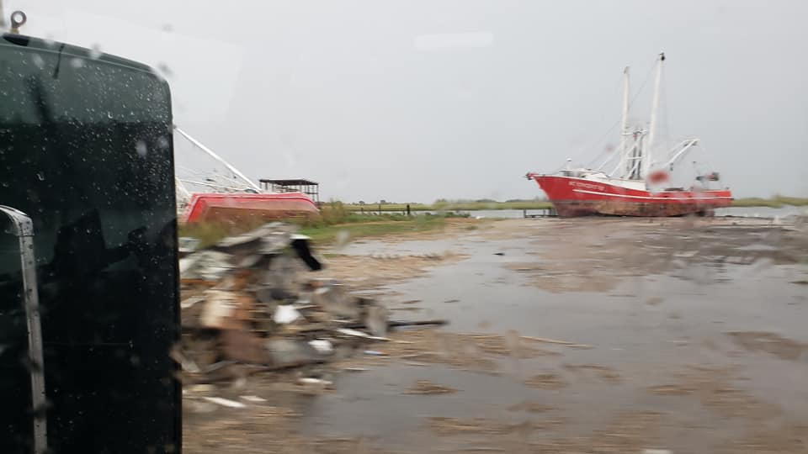
Deployed - Louisiana

Slide 10
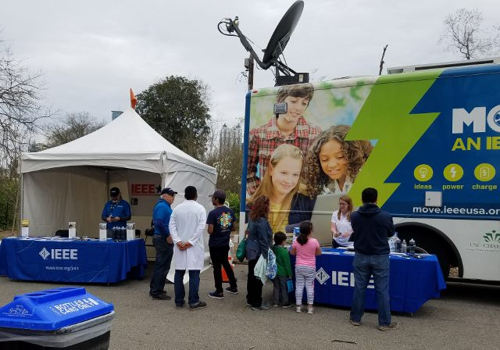
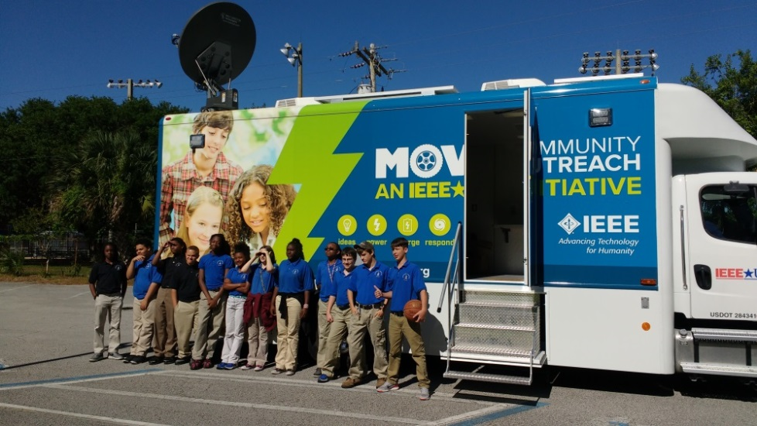
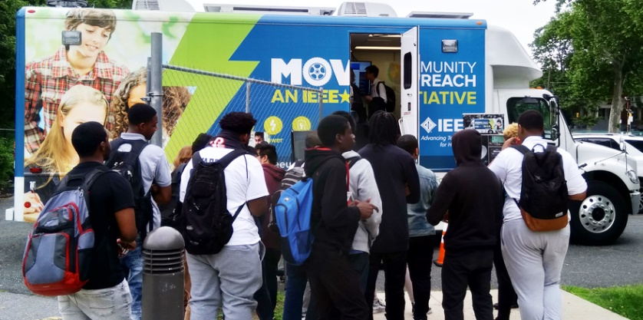
STEM & Public Visibility
Over 50,000 reached yearly*
* Pre-COVID
Notes:
January 14 - Alabama Regional Future City Competition – Huntsville, AL
January 14 - Technical Activities Miniseries
January 15 - MOVE Training Class – Huntsville, AL
February 22 - Union Intermediate School – Engineers Week – Clinton, SC
March 2-4 - Red Cross Disaster Institute 2018 – Pamlico County, NC
Marcy 3 – MOVE Presentation to R10 Executive Committee – Langkawi, Malaysia
March 24 – Atlanta Science Festival – Exploration Expo - Atlanta, GA (29,000 attendees)
March 25 - MOVE Training –– Atlanta, GA
March 27 - Wellcome Middle School STEM Fair - Greenville, NC
April 5 - Red Cross Middle School STEM Event – Durham, NC
April 10 - Red Cross Triangle Chapter Volunteer Luncheon - Cary, NC
April 19 - MOVE Red Cross DST 101 Training (SoutheastCon) - St. Petersburg, FL
April 22 - MOVE Truck Systems Training (SoutheastCon) - St. Petersburg, FL
April 28 - Burlington Maker Faire – Burlington, NC (8,000 attendees)
April 29 – University of North Carolina Science & Technology Expo - Charlotte, NC (10,000 attendees)
May 19 – 2018 Cape Fear Preparedness & Safety Expo - Wilmington, NC
May 30 – Philadelphia - Charter Schools

Slide 11
Thank you to our Supporters!
IEEE Volunteers
IEEE Alabama Section
IEEE Eastern NC Section
For more information, go to: http://move.ieee.org/
or contact
Mary Ellen Randall (MOVE Program Director)
merandall@ieee.org

Slide 12
Result
“I've learned that
people will forget what you said,
people will forget what you did, but
people will never forget how you made them feel.”
Maya Angelou
Author & Poet

Slide 13
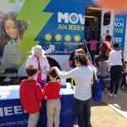
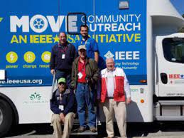
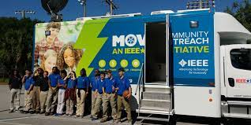
For more information:
Many Thanks to
Our volunteers
And
sponsors
Donate : https://ieeefoundation.org/move to donate today!
Volunteer:
https://move.ieeeusa.org/help/volunteer-resources/
http://move.ieeeusa.org

