Slide 1
Tools for Automatic Website Updates
Stephen Hopkins, Chair NWFL, Website Support, SEC23 HW

Slide 2
Tools for Automatic Website Updates
Region 3 Meeting
vTools information can feed section websites
Two approaches
Pre-designed embedded software tools
Legacy Event Tools (deprecated)
If you are using Legacy Tools, please make plans to migrate to
WordPress tools
Event API (non-WordPress Site)

Slide 3
vTools Automates WordPress
Region 3 Meeting
vTools information feed your section’s WordPress website
Basic process
Update your section vTools information (officers, events, eNotice)
Update your section WordPress website
vTools
https://vtools.ieee.org/

Slide 4
WordPress
Region 3 Meeting
An open-source content management system
Your section site customized and empowered with IEEE tools
The region’s WordPress site: https://r3.ieee.org/
Complete a Web Request form at https://site.ieee.org/web-hosting-request/

Slide 5
vTools Automatic Feed Types
Region 3 Meeting
Legacy Tools
Event RSS, iCal, XML, HTML Feeds

Slide 6
WordPress plugins, widgets, and shortcodes
Plugin
A piece of software that “plugs into” your WordPress site
Widget
A WordPress widget is a modular element that enables you to add a specific feature to your website.
Plugins add new functionality or extend existing functionality on your site
Allowing you to create virtually any kind of website without source code development
Widgets require no code experience or expertise
Widgets can be added to different areas of a website, such as a website's sidebars or footer areas,
Widgets are inherent part of WordPress' design and layout customizations.
Shortcode
A shortcode is akin to a shortcut to add features to your website that would typically require lots of complicated computer code and technical ability
A shortcode is written inside two square brackets.
For example, the [youtube] shortcode can be used to embed any public YouTube video into any page or post.
Region 3 Meeting
Editor
WPBakery Page Builder
Events
The Events Calendar
The Events Calendar Pro
amr shortcode any widget
eNotices
WP RSS (built-in)
Officers
amr shortcode any widget
vTools WebInABox Feeds

Slide 7
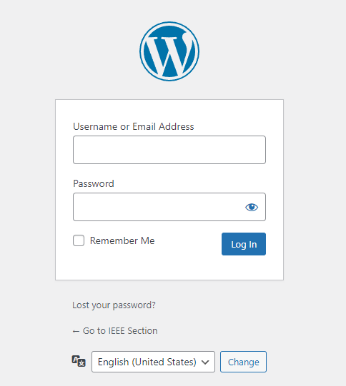
WordPress Login
Region 3 Meeting
Login to your WordPress web site
https://yoursite.ieee.org/wp-admin
Demo site for today’s training
https://r3.ieee.org/demo/wp-admin

Slide 8
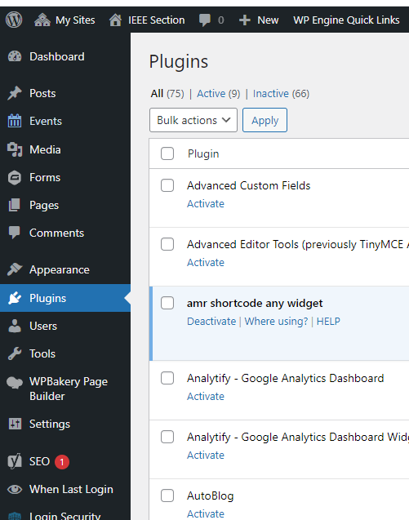
Activate the Plugins
Region 3 Meeting
Go to the Plugins page
Activate the needed plugins
Already activated!
Not activated

Slide 9
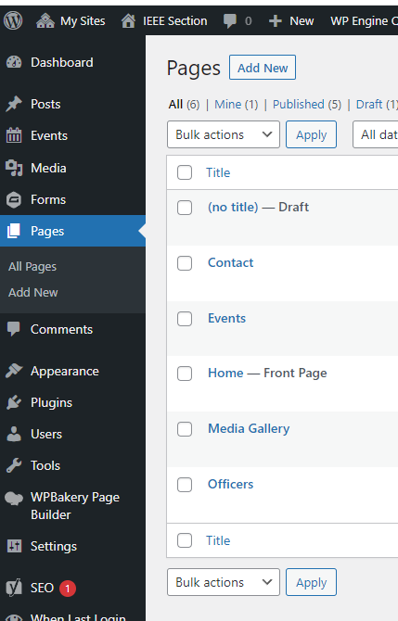
Create or Edit a Page
Region 3 Meeting
Go to the Pages page
New Page
Edit a page (hover over page, click edit)
Select to use WPBakery Page Builder
Edit |Quick Edit | Trash | ...
Edit |Quick Edit | Trash | View | Edit with WPBakery Page Builder

Slide 10
Obtain Events Feed Source (Events Page)
Region 3 Meeting
Go to the vTools Legacy Feeds page
https://events.vtools.ieee.org/main/feeds
(https://meetings.vtools.ieee.org/main/feeds)
Right-click and copy the URL for the desired feed
Link for upcoming events (Events Page)
https://meetings.vtools.ieee.org/meetings/ical/0/90/asc/3/NORTHWEST%20FLORIDA

Slide 11
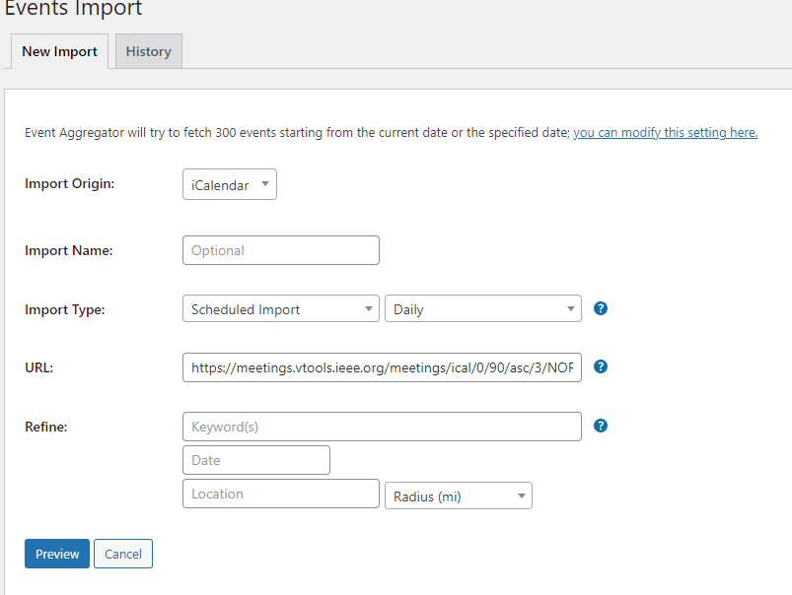
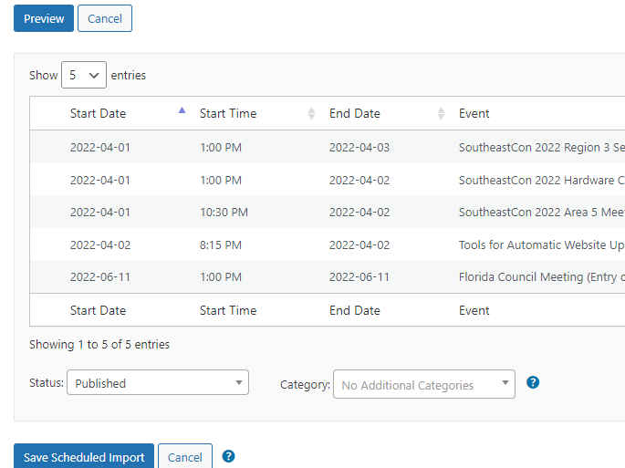
Setup an Events Feed
Region 3 Meeting
Go to the Events page
Click Import
Fill out the import details
iCalendar
Daily
Click Preview
Paste Feed URL
With
?localize=true
appended to URL
Save Scheduled Import
Note – Default time in UTC
Edit |Quick Edit | Trash | ...

Slide 12
Setup an Events Feed – Text Steps
Region 3 Meeting
Navigate to The Events Calendar Import settings: Events -> Import
Select “iCalendar” from the Import Origin drop-down menu:
Select “Schedule Import” and then “Daily”. Please do not select “Hourly” since this would affect the performance of the vTools servers.
In the URL field, paste your iCal feed URL that you had copied from https://events.vtools.ieee.org/main/feeds/ and then append “?localize=true“
Click the “Preview” button and then once results show up, click on “Save Scheduled Import”. If no results are displayed after you click on the “Preview” button, it means that your Organizational Unit does not have any upcoming meetings within 90 days. In this example, the “0” in https://events.vtools.ieee.org/meetings/ical/0/90/asc/5/DALLAS?localize=true represents current day and the “90” represents 90 days in the future.
You can manually import feeds by clicking on “Scheduled Imports”, mouse over your feed and click on “Run Import”

Slide 13
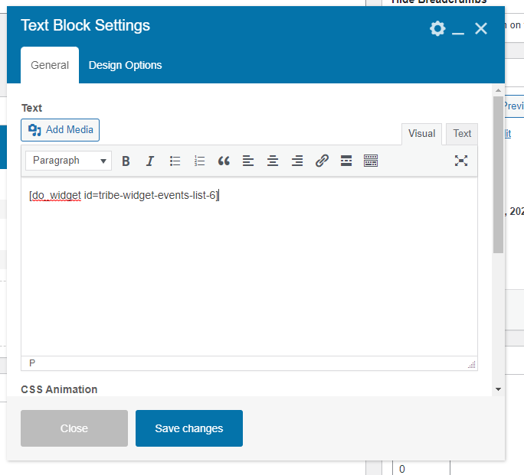
Add Events shortcode to Events Page
Region 3 Meeting
Click the “+” symbol and select a text box
Enter the following shortcode
[do_widget id=tribe-widget-events-list-6]
Save Changes, then publish page

Slide 14
Obtain Events Feed Source (Home Page)
Region 3 Meeting
Go to the vTools Legacy Feeds page
https://events.vtools.ieee.org/main/feeds
Right-click and copy the URL for the desired feed
Link for upcoming events (Home Page)
https://meetings.vtools.ieee.org/meetings/rss2/3/NORTHWEST%20FLORIDA

Slide 15
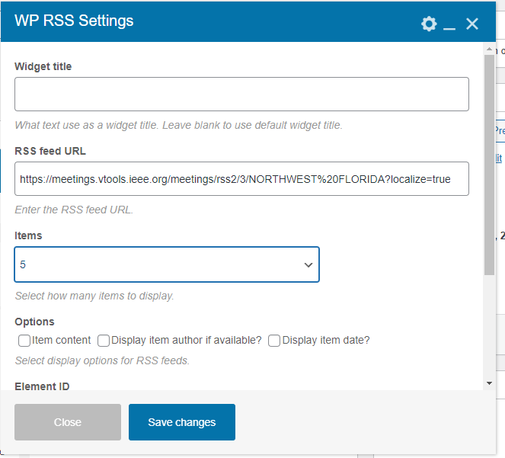
Add Events to Home Page
Region 3 Meeting
Click the “+” symbol and select WP RSS
Paste the RSS link with ?localize=true
https://meetings.vtools.ieee.org/meetings/rss2/3/NORTHWEST%20FLORIDA?localize=true
Save Changes, then publish page

Slide 16
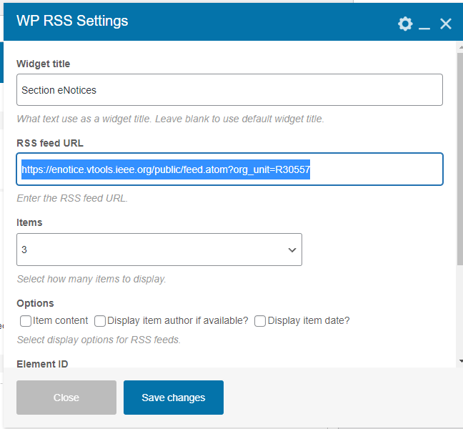
Add eNotices to Home Page
Region 3 Meeting
Click the “+” symbol and select WP RSS
Paste the RSS link with your GEOCODE
https://enotice.vtools.ieee.org/public/feed.atom?org_unit=R30557
Save Changes, then publish page

Slide 17
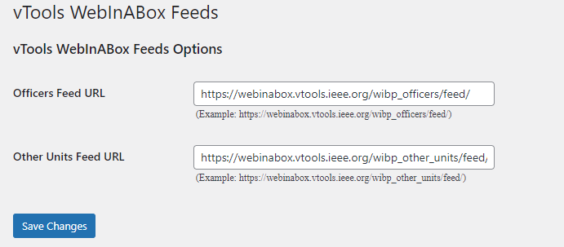
Setup an Officers Feed
Region 3 Meeting
Login to WordPress
Go to Settings -> vTools WebInABox Feeds
Officers Feed – Paste below in your WordPress
https://webinabox.vtools.ieee.org/wibp_officers/feed/
Other Units Feed – Paste below in your WordPress
https://webinabox.vtools.ieee.org/wibp_other_units/feed/

Slide 18
Setup an Officers Feed
Region 3 Meeting
Go to Appearance → Widgets
Expand the “Widgets for Shortcodes” Widget box
Drag and drop the WIBOfficerFeedWidget and the WIBOtherUnitsFeedWidget into the “Widgets for Shortcodes” box and expand them

Slide 19
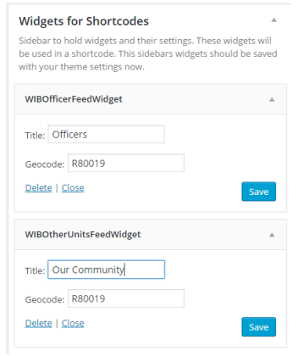
Setup an Officers & Units Feed
Region 3 Meeting
Go to Appearance → Widgets
Expand the “Widgets for Shortcodes” Widget box
You will need your organizational unit’s GEOCODE. Log into https: //officers.vtools.ieee.org and start typing your organizational unit’s name. For example, the GEOCODE for Northwest Florida Section is R30557.
Paste the Geocode into the Geocode field of the WIBOfficerFeedWidget and WIBOtherUnitsFeedWidget Widgets, provide titles for them and save your settings.
Save both

Slide 20
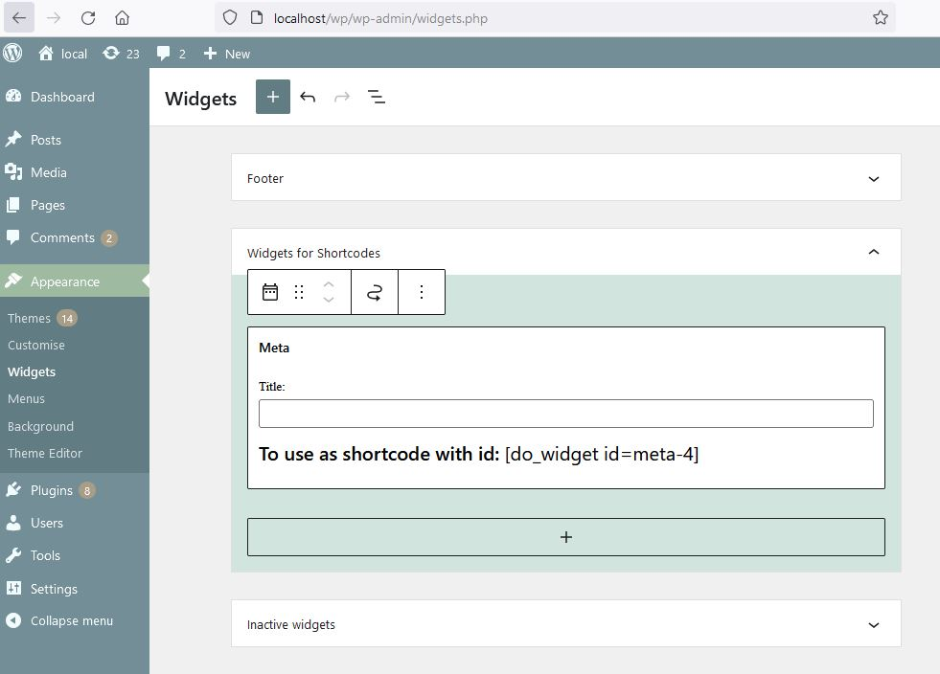
Finding your Shortcode from amr shortcode
Region 3 Meeting
Test your chosen widget in a normal sidebar or widget area first.
Go to Appearance > widgets and find the ” widgets for shortcode” sidebar or widget area
Drag your chosen widget from your normal sidebar to the shortcodes sidebar. Save.
Record your shortcode
More details: https://wordpress.org/plugins/amr-shortcode-any-widget/#description

Slide 21
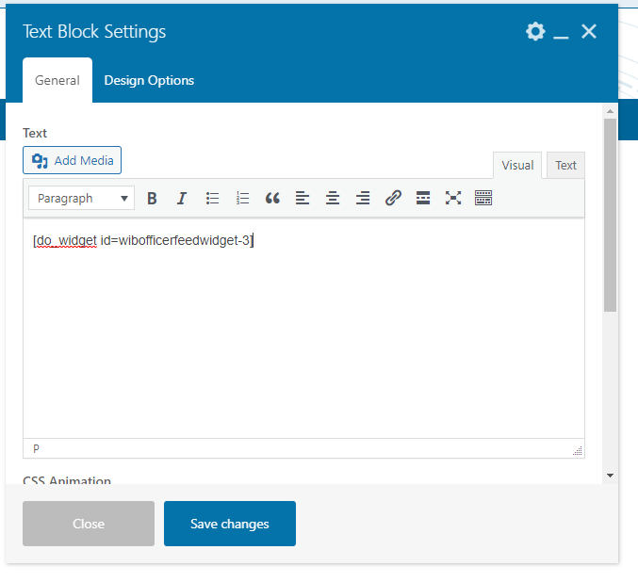
Add Officer shortcode to Officer Page
Region 3 Meeting
Click the “+” symbol and select a text box
Enter one of the following shortcodes
[do_widget id="wibofficerfeedwidget-3"]
[do_widget wibofficerfeedwidget]
Save Changes, then publish page

Slide 22
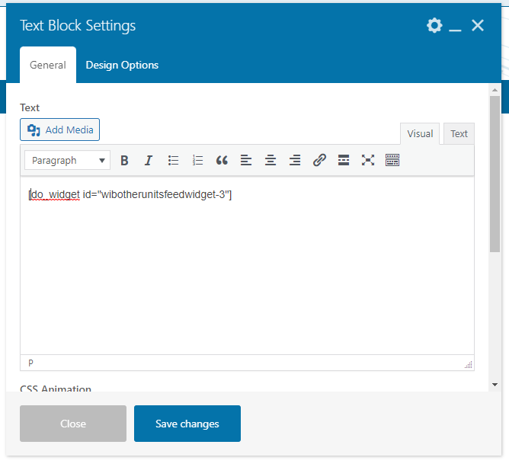
Add Units shortcode to Community Page
Region 3 Meeting
Click the “+” symbol and select a text box
Enter one of the following shortcodes
[do_widget id="wibotherunitsfeedwidget-3"]
[do_widget wibotherunitsfeedwidget]
Save Changes, then publish page

Slide 23
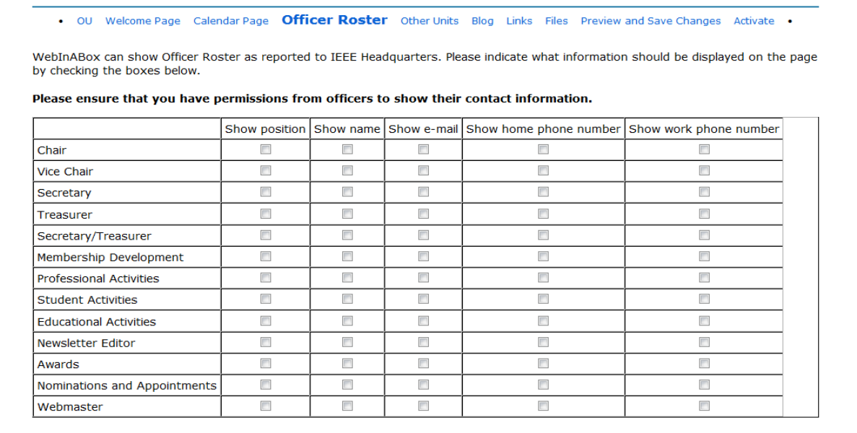
What information will be displayed for Officers
Region 3 Meeting
Officers can decide what information is displayed in the officer feed by going to https: //webinabox.vtools.ieee.org/, logging in with their IEEE Accounts and clicking on the “Officer Roster” link.
Caution
Ask permission of all officers before sharing their information
Recommendations
Use a contact form with positions
Exclude Treasurer’s email (Phishing)

Slide 24
Thank you!
Topic | Training Resource
vTools Tutorial | https://kb.ieee.org/vtools/blog/kbtopic/vtools/
vTools WebInABox | https://kb.ieee.org/vtools/blog/kbtopic/webinabox/
WPBakery Page Builder | https://wpbakery.com/video-tutorials/
The Events Calendar Pro | https://theeventscalendar.com/knowledgebase/
The Events Calendar Pro shortcodes | https://theeventscalendar.com/knowledgebase/k/events-calendar-pro-widget-shortcodes-overview/#event-list-shortcode
amr shortcode | https://wordpress.org/plugins/amr-shortcode-any-widget/#description
Stephen Hopkins, stephen.hopkins@ieee.org

