Slide 1
James Conrad
Past-Past IEEE-USA President

Slide 2
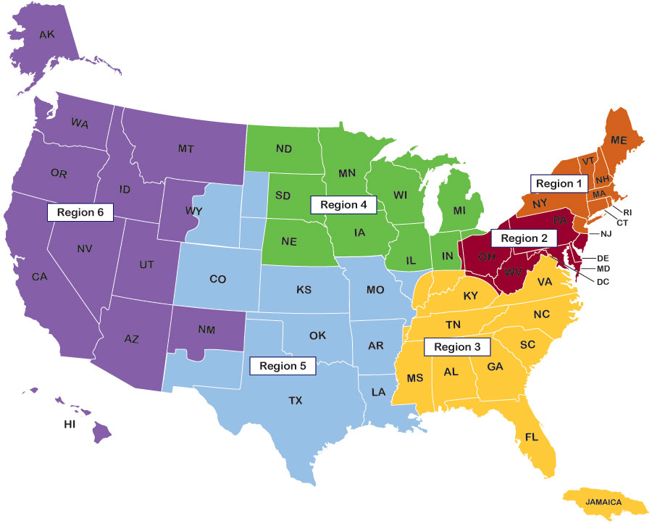
What Does IEEE-USA Do?
Represents IEEE’s U.S. membership on the IEEE Board of Directors
Provides U.S. members’ an effective voice in Washington on legislation and policy issues that affect the profession and our nation’s technological competitiveness and security
Delivers career and professional development and soft skills enhancement
Webinars, ebooks, audiobooks, seminars/workshops, salary survey, and more
Promotes awareness and appreciation of the profession to the public
MOVE, Nat’l Engineers Week, public outreach, awards & recognitions.
Helps U.S. Regions and Sections support local professional activities
Funding grants, conference promotion, SKPL, support for local consultant’s networks, etc.
2

Slide 3
2022 Focus on Careers and Professional Development
Expand successful career webinar program with 20 new presentations
Launch at least one new themed webinar series
Provide career programming for IEEE Education Week and IEEE Day
Solicit priorities of Regions, Sections; seek collaboration opportunities
Recruit local ambassadors, YP, WIE, etc.
Assess and revitalize salary service (achieve financial breakeven)
Conduct two collaborative activities with minority engineering societies

Slide 4
USPTO Copyright, IP, Trademark, and Patent Series
IEEE-USA is partnering with the U.S. Patent and Trademark Office (USPTO) to offer a series of free, monthly webinars on intellectual property basics. The series will feature speakers from USPTO, who will cover intellectual property (IP) basics and potential ways to protect your innovations as you transition from idea to product.
https://ieeeusa.org/tag/uspto-series/

Slide 5
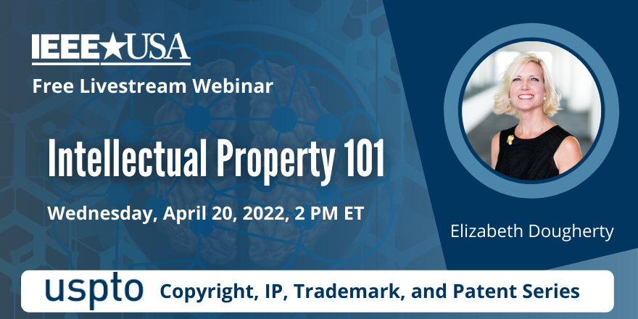
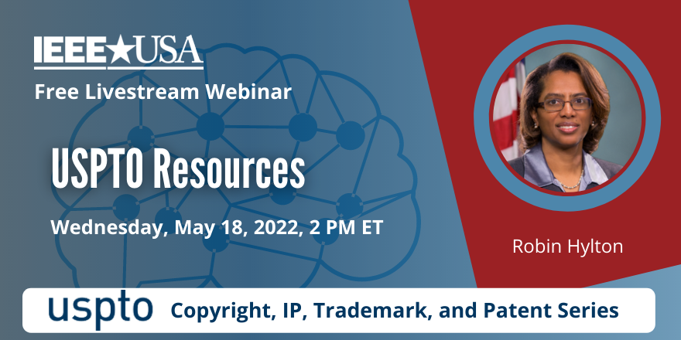
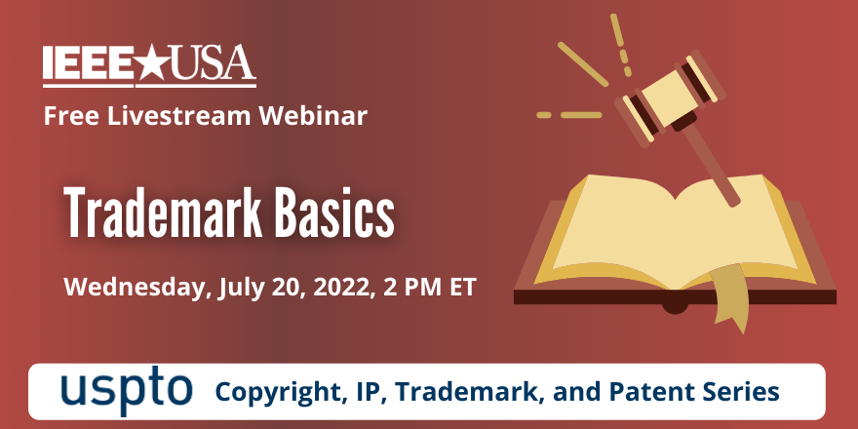
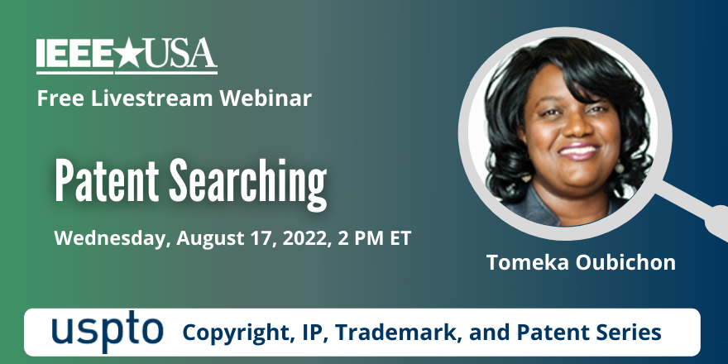
USPTO Copyright, IP, Trademark, & Patent Series
https://ieeeusa.org/tag/uspto-series/

Slide 6
2022 Focus on Consultants Services
Increase Consultant Finder subscribers, and profile views (goal: 20% increase)
Market Consultant Finder to businesses, consultants in publications, social media
Branding (member logos), Badges (Collabratec, LinkedIn, etc.)
Implement strategy to link member consultants to the local networks
Sponsor four webinars to assist current and aspiring consultants
Revitalize at least two of five inactive consultant networks
Hold virtual forums to ascertain how to better assist local networks
Work with inactive networks to identify potential leaders

Slide 7
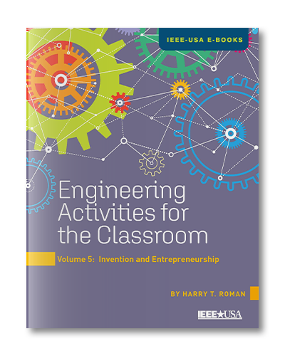
2022 Released & Upcoming eBooks
Women in Engineering—The Complete Collection: Books 1-24 (Jan)
Engineering Activities for the Classroom—Book 5: Invention & Entrepreneurship (February)
Upcoming:
New Series: Women Engineers in History—Book 1: Hedy Lamarr (March)
A Practitioners Guide to Leadership—Book 2
New Series: Creativity—Our Valuable Lifelong Skill
New Series: Electric Vehicle Classroom Activities
New Series: Practical Invention Guidance for the Classroom
Over 125 Titles Currently Free To All Members

Slide 8
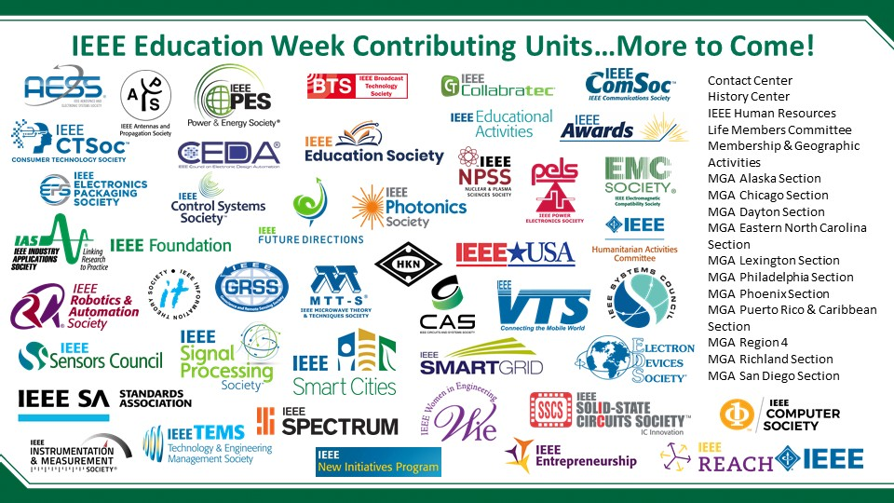
IEEE-USA is Supporting IEEE Education Week, 4-8 April 2022
IEEE-USA is participating in IEEE’s weeklong celebration featuring educational offerings from across IEEE.
Visit the educationweek.ieee.org website to access IEEE-USA’s EdWeek resources including webinars “Out of the Maze” and “Social Media Power Hour”
educationweek.ieee.org

Slide 9
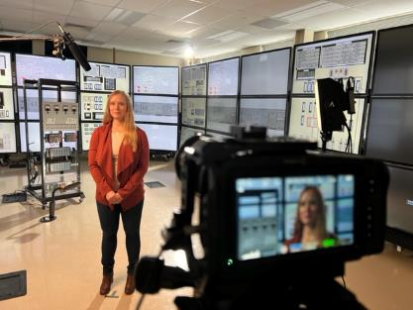
Competitive Edge Campaign Continues…
IEEE-USA is currently working with MGA to extend the Competitive Edge ad campaign with 2 new IEEE member profiles and a FUTURE 50 campaign variant for student member acquisition. Anticipate release in late Spring.
Just completed a shoot at INL (Idaho National Laboratory) in January with Megan Culler, IEEE YP member
The 2021 Competitive Edge marketing campaign placed over 1800 30-sec ads on TV and streaming platforms in 11 key U.S. major cities/markets for 4-6 weeks, generating over 5.1 million impressions and heavy web traffic
Videos are available for use by Regions/Sections in various formats/lengths. Access through IEEE-USA YouTube Page at: https://www.youtube.com/c/IEEEUSA

Slide 10
IEEE-USA JOINS IN BIG HOOPLA
With volunteer support from the IEEE Dayton Section, IEEE-USA sponsored The Big Hoopa, a set of events opening the “First Four” as part of the NCAA’s Men’s Basketball Tournament 13-16 March in Dayton, Ohio.
Its anchor event, The Big Hoopla STEM Challenge, attracted an estimated 3000 parents and children who visited IEEE-USA’s booth to engage in STEM activities and learn more about technology careers.
IEEE was on display prominently throughout the entire weekend of festivities – and was acknowledged as part of the greeting to tens of thousands of attendees to the Big Hoopla Four Miler, Family Festival, Hoopla Reception and STEM Challenge.
In addition to introducing kids and parents to STEM, IEEE-USA and other sponsors made possible the donation of 80 NCAA First Four game tickets for Military active-duty servicemen and their families at Wright Patterson Air Force Base.

Slide 11
IEEE-USA & USPTO PARTNER ON IP PROTECTION WEBINARS
IEEE-USA is partnering with the U.S. Patent and Trademark Office (USPTO) to offer a series of free, monthly webinars for members on intellectual property basics.
The five-part series begins on April 20th and will feature speakers from USPTO covering U.S. intellectual property (IP) laws and processes, and ways that members can protect their innovations as they transition from idea to product.
Information on current dates, topics and speakers can be accessed at: https://ieeeusa.org/tag/uspto-series/

Slide 12
Engineers & Public Policy
Public Policy: The process used to establish the rules that govern society

Slide 13
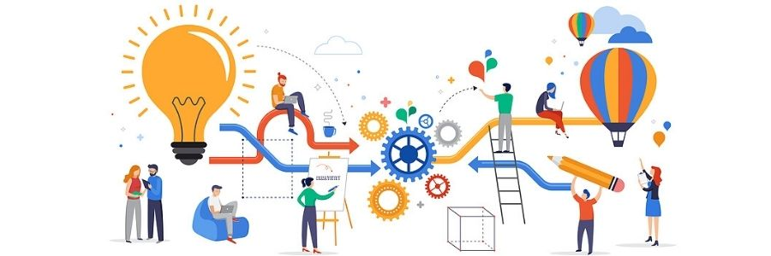
IEEE-USA Public Policy
We are the Eyes, Ears, and Voice or American technology professionals

Slide 14
Elements of Policy
Education: Teaching policy makers what technology does, does not do, and could do
Understanding: Helping policy makers understand the technology ecosystem and the men and women in it.
Advocacy: Convincing policy makers to adopt laws & regulations that improve the technology ecosystem and/or society

Slide 15
Key IEEE-USA Policy Areas
Space policy: Focus on NASA budget and support for private space companies. Shifting to space management & regulation.
Intellectual property policy: Protecting patents and patent holders.
Small Business: Regulatory reform to promote small technology company growth
Autonomous vehicles: Regulation & research. Helping legislators create the legal structures needed to permit AVs on our roads and making sure those AVs are safe.
Immigration: Green cards, not guest workers. Facilitating high-skill immigration while protecting workers from exploitation.
Energy policy: Promoting safe, reliable energy supplies and strengthening the grid that delivers that energy.
AI: Encouraging safe, ethical AI systems.
Cybersecurity, quantum, block chain, and other emerging technologies: Helping policy makers understand what’s coming so they don’t get in the way.

Slide 16
Federal Support for Basic Research
Define “basic research” to policy makers and demonstrate what, exactly, is involved
Explain the role that basic research play in our economy
Tell and show legislators what is done with basic research funding – what does the public get
Highlight specific projects and impacts on their district/state
Introduce policy makers to researchers in their district/state
Ask policy makers to support robust budgets for NIST, NSF, DOD, DOE and other research agencies

Slide 17
Another Example: Space Policy

Slide 18
Needed Space Policy
Space traffic control
Space port licensing & regulation
Space port safety rules
Global space treaties
International cooperative efforts

Slide 19
Autonomous Vehicles
Current U.S. law assumes a driver. It is illegal in all but a few places to have a computer drive a car. Unless this changes, we cannot have autonomous vehicles on our roads, no matter how good the technology.
Congress needs to answer:
How safe do AVs need to be? Perfect? Safer than people? Safer than professional drivers?
Who is liable when an AV gets in an accident? The car companies? The owner? The software programmer?
How alert does the driver have to be? How can you tell? Can you be drunk in an autonomous vehicle? If the car is a better driver than you are sober, why not?
Can all systems be automated? Should drivers be allowed to over-ride the AV? Should they be required to over-ride the AV?
These questions are hard to answer if you don’t understand the technology.

Slide 20
Digital Privacy
How private can on-line transactions be?
What can be done with information? What must be done with information?
How can we balance privacy and usefulness?
Should/can different types of data be handled differently?
Must balance legal rights with technical effectiveness

Slide 21
Role of IEEE-USA Members
IEEE members are uniquely positioned to explain technology policy to policy makers.
We understand the technology, but we do not have a commercial interest in the technology, making us reputable.
We are well placed to see technological changes that are coming, and how they will affect society
Policy makers need to hear from people who understand technology before those policy makers can adopt smart policies regulating that technology
IEEE-USA exists to organize and focus IEEE members to communicate effectively on issues we care about

Slide 22
Ways to Engage
IEEE-USA Policy Committees
IEEE-USA Policy Events: CVD, Legislator visits, Media events, etc
Direct communication with legislators: IEEE-USA can help with messaging, timing, etc.
Policy discussions: IEEE-USA staff can join your sections/chapters to discuss policies relevant to your memebrs
WISE and Fellows programs
Artificial Intelligence | Communications
Energy | Entrepreneurs
Intellectual Property | Research and Development
Transportation & Aerospace | Workforce

Slide 23
IEEE-USA 2022 Congressional Visits Day April 5 & 6
305 IEEE participants
41 states
171 unique Congressional districts
253 potential meetings
47% of Congress, 82% of the Senate!
Focus: Federal R&D policy, Small business research loans, FY 2023 federal budget
As of 3/30/22

Slide 24
Stay Updated – Follow IEEE-USA
Social Media: IEEE-USA updates social feeds at least daily
Click on symbols above to reach sites
LIKE on all our platforms; SHARE to family, friends, co-workers
IEEE-USA Web Site: https://ieeeusa.org
Webinars: https://ieeeusa.org/careers/webinars/
Digital Subscriptions: https://ieeeusa.org/newsroom/email-newsletters/
24

Slide 25
Russ Harrison
Director of Government Relations, IEEE-USA
(202) 530-8326
r.t.harrison@ieee.org

