Slide 1
IEEE 101
Region 3

Slide 2
IEEE is the world’s largest technical professional association, dedicated to advancing technology for humanity.
MISSION
The core purpose of IEEE is to foster technological innovation and excellence for the benefit of humanity.
VISION
IEEE will be essential to the global technical community and to technical professionals everywhere, and be universally recognized for the contributions of technology and of technical professionals in improving global conditions
It has the most members of any technical professional organization in the world,
with ~420,000 members in over 190 countries
2
Notes:
It is designed to serve professionals (and students!) involved in all aspects of the electrical, electronic and computing fields and related areas of science and technology.

Slide 3
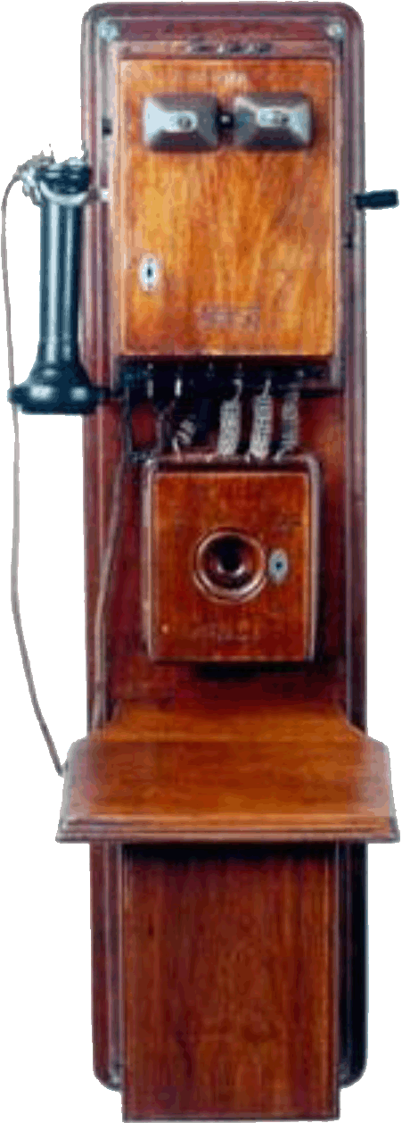
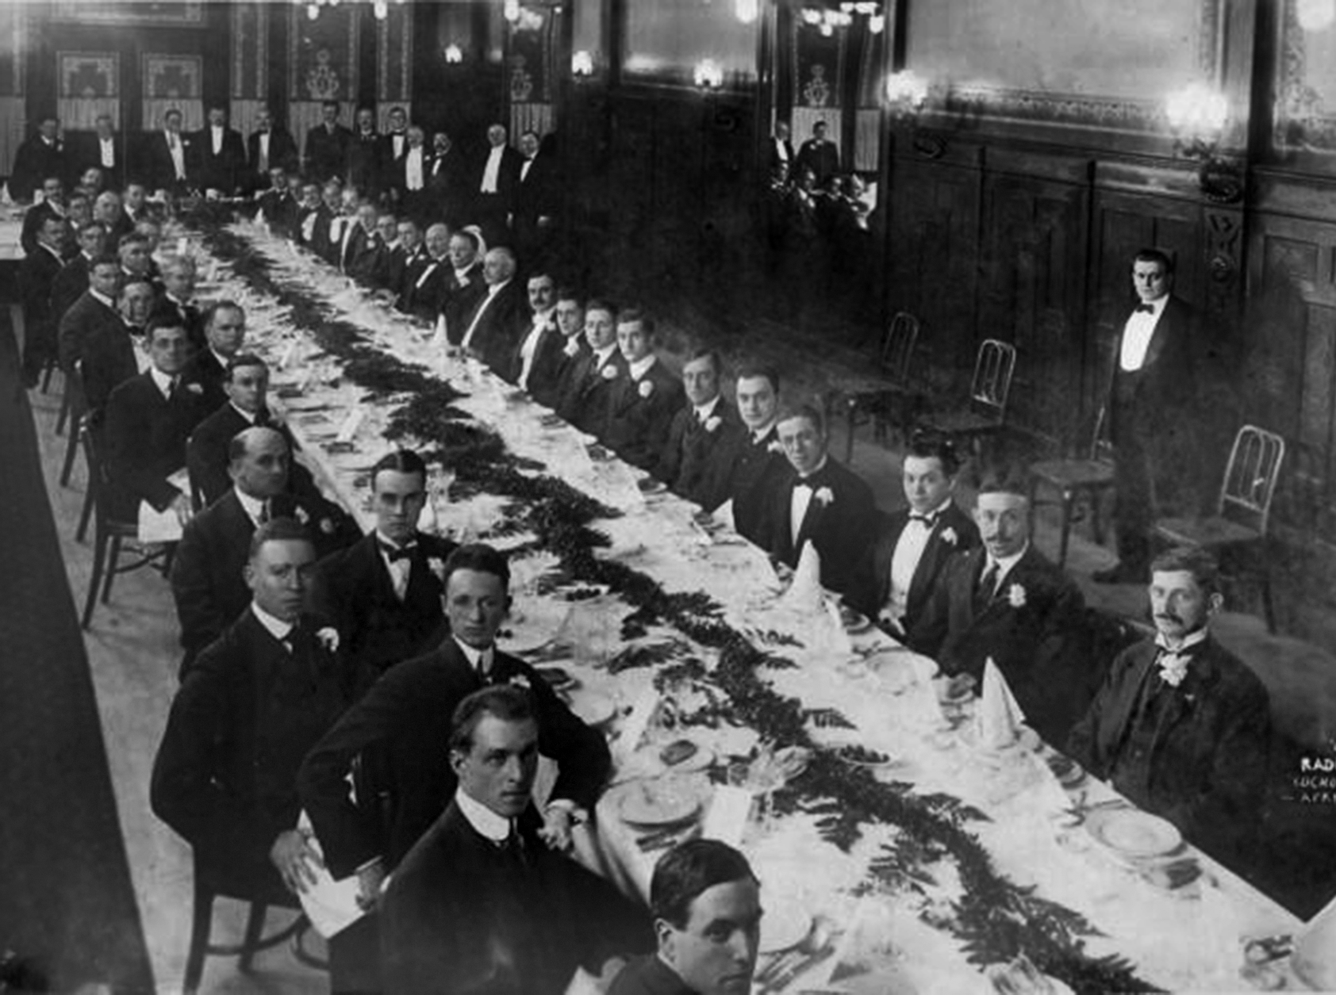

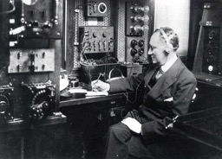

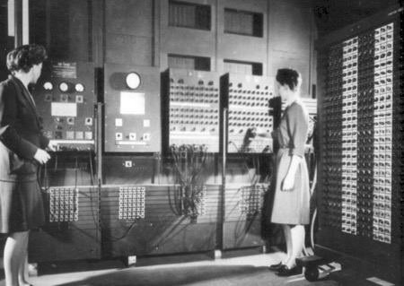
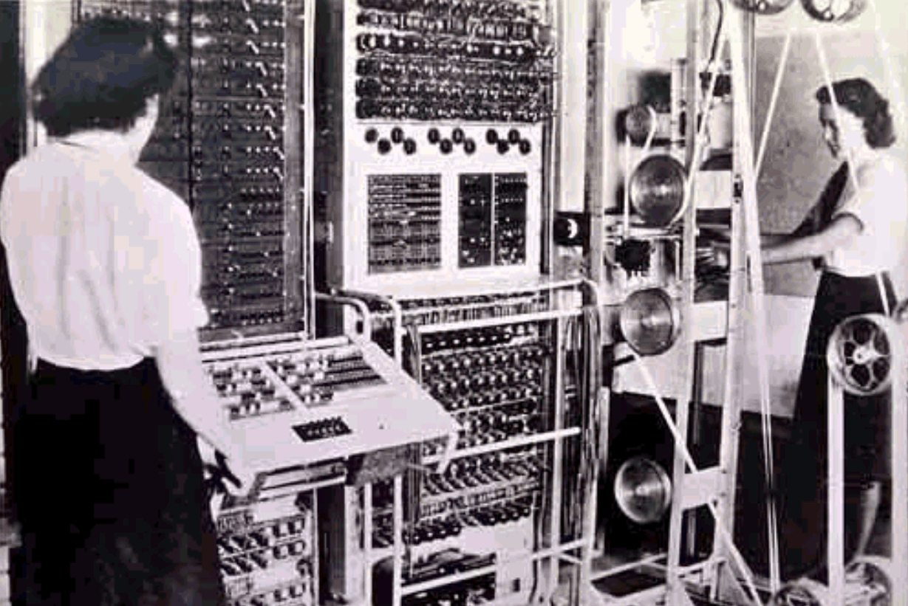
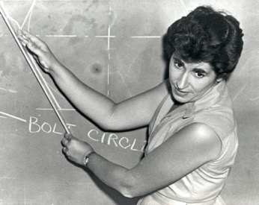
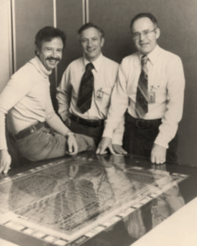
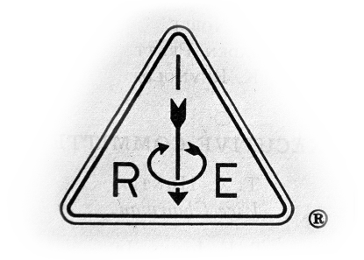

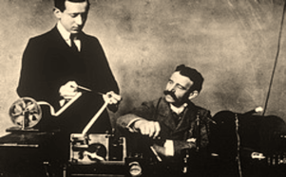
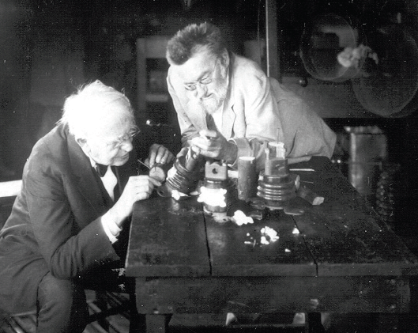

IEEE Legacy
IEEE’s story began with a spark of collaborative spirit
The public‘s need for increased technological innovation brought our
founders together in the spirit of cooperation
Since 1884, IEEE has been fostering technical advancement
for the benefit of humanity
  In 1884, Thomas Edison, Alexander Graham
  Bell, and others founded the American
  Institute of Electrical Engineers (AIEE)
  In 1912, the Institute of Radio Engineers (IRE) formed with a focus on the new industries of wireless technologies and electronics
  Sixty years ago, on 1 January 1963, AIEE and IRE merged to become the Institute of Electrical and Electronics Engineers or IEEE

Slide 4








IEEE Today at a Glance
Plus activities in global public policy and professional ethics
39
Technical
Societies
Global
Reach
420,000+
Members
190+
Countries
60% of whom are from outside the US
and seven
Technical Councils
across 10 geographic Regions
2,000+
Annual Conferences
5,000,000+
Technical Documents
200+
Top-cited Periodicals
1,000+
Active Standards
Technical Breadth
in 106 countries while contributing over 4 million total conference papers to IEEE Xplore® since 1936
via IEEE Xplore digital library, with more than 15 million downloads each month
IEEE journals, conference proceedings, and select content dating back to 1884
and 1000+
more in development
Learn more: ieee.org/about/at-a-glance.html
Notes:
From https://www.ieee.org/about/at-a-glance.html
Last updated December 2022
IEEE has:
Over 427,000 members in more than 190 countries, more than 64 percent of whom are from outside the United States
More than 145,000 Student members
344 Sections in ten geographic Regions worldwide
2,702 Chapters that unite local members with similar technical interests
3,700 Student Branches at colleges and universities in over 100 countries
3,625 Student Branch Chapters of IEEE technical Societies
634 affinity groups; IEEE affinity groups are non-technical sub-units of one or more Sections or a Council. The affinity group patent entities are the IEEE-USA Consultants Network, Young Professionals (YP), Women in Engineering (WIE), Life Members (LM), and IEEE Entrepreneurship
IEEE:
Has 39 technical Societies and seven Technical Councils representing a wide range of IEEE technical interests
Has more than 5 million documents in the IEEE Xplore® digital library, with more than 15 million downloads each month
Has an active portfolio of 1,032 standards and more than 1,045 projects under development
Publishes more than 200 transactions, journals, and magazines
Sponsors more than 2,000 conferences and events in 106 countries while contributing over 4 million total conference papers to IEEE Xplore since 1936, with more than 200,000 new papers added annually

Slide 5
Section – local connections
Section
Society
Chapter
Affinity
Group
Student
Branch
Consultants Network
Life Members
Women in Engineering
Young Professionals
Student Branch Chapters
Notes:
Generally, everyone in this structure is a volunteer not a direct report or employee.

Slide 6
Region
Region 3 Committees
- Section Support
- Awards
- Conferences
- Member Communications
- Student Activities
…
Region
Area
Section
Area
Area
Area
Area
Section
Section
.
.
.
Sections can also form councils
(Florida, North Carolina, Tennessee, South Carolina)

Slide 7
IEEE Simplified Structure
IEEE Board
of Directors
Member-elected portion of BoD
BoD
Member & Geographic
Activities Board
Assembly
IEEE-USA
EAB
TAB
PSPB
SAB
MGAB
Region
46 Societies
and Councils
10 Regions
MGA - ensure quality member opportunities for continuous engagement.
Notes:
Note this is the volunteer/governance structure of IEEE. There is a companion staff structure that is mostly aligned with this structure.

Slide 8
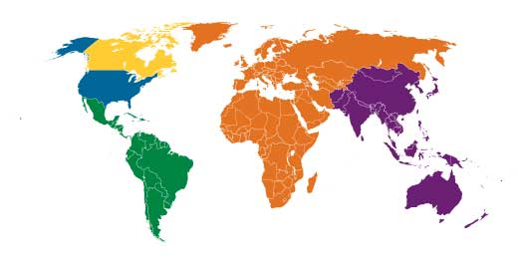
IEEE: Global Reach, Local Engagement
R7: 14,205 (3.3%)
First phase of
Region Realignment
will combine R1+ R2
and split R10 into 2…
R1 to 6: 153,689 (35.9%)
R10: 161,371 (37.7%)
R2 to 6
R10 to 11
R8: 80,727 (18.9%)
R9: 17,788 (4.2%)
Becomes 2 zones
Still a single Region
TOTAL MEMBERSHIP 2022: 427,780
Data as of 31 December 2022

Slide 9
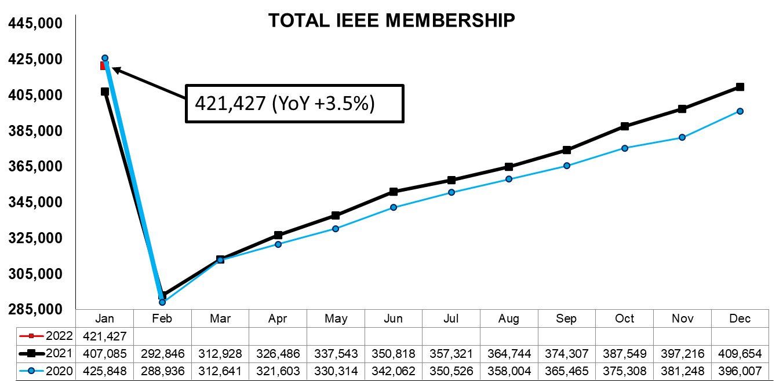
Typical IEEE Membership Statistics Cycle
After deactivation, Feb 2022 total membership was 302,145
9
IEEE PROPRIETARY
Notes:
Official numbers should come from the published 31 Dec/1 Jan value – it is a point where all processes will have been completed the same every year
Service Deactivation occurs at about 1.5 months beyond the deadline for dues renewal. Member Benefit Services are deactivated at that point.

Slide 10
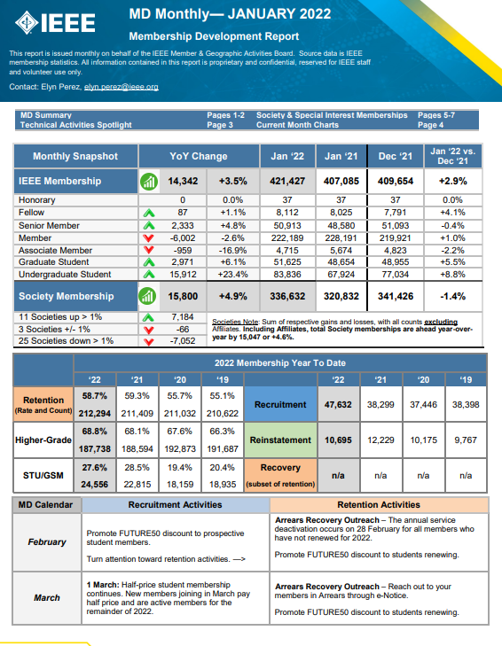
MD Monthly provides timely data and analysis to volunteers and staff
Statistical ‘pulse’
Membership Trends
Goal Achievements
MD Calendar guidance
MD-related announcements, activities
Posted in the Membership Development Volunteers Community in Collabratec, and on the MD portal
10
IEEE PROPRIETARY

Slide 11
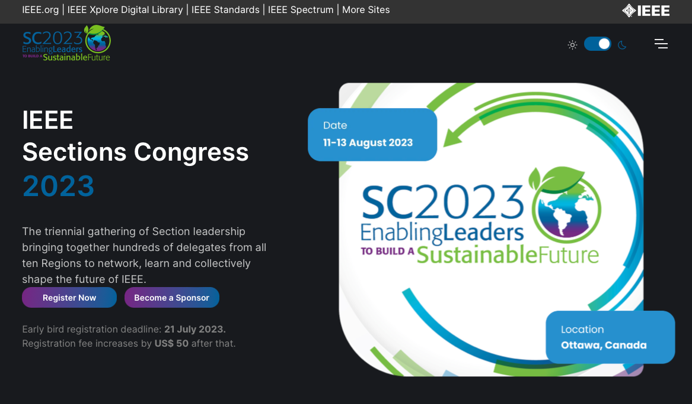


Sections Congress

Slide 12
IEEE Simplified Structure
BoD
Assembly
IEEE-USA
EAB
TAB
PSPB
SAB
MGAB
Region
46 Societies
and Councils
10 Regions
IEEE-USA - recommend policies and implement programs specifically intended to serve and benefit the members, the profession and the public in the United States in appropriate professional areas of economic, ethical, legislative, social and technology policy concern.

Slide 13
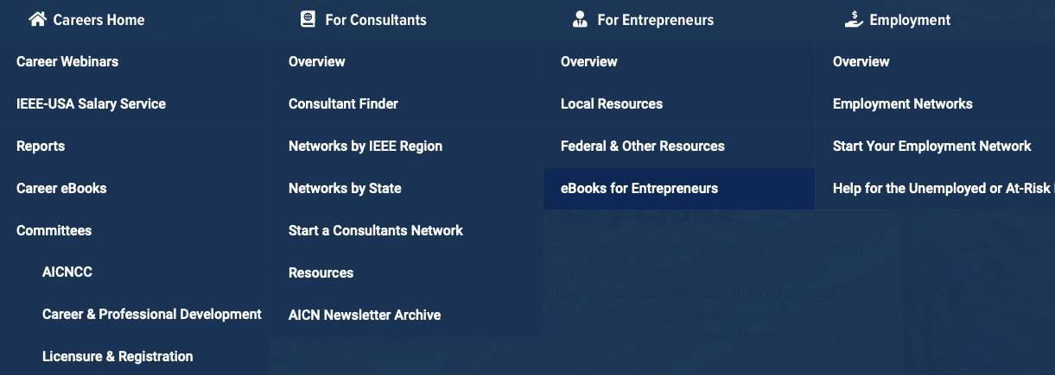
IEEE-USA Careers

Slide 14
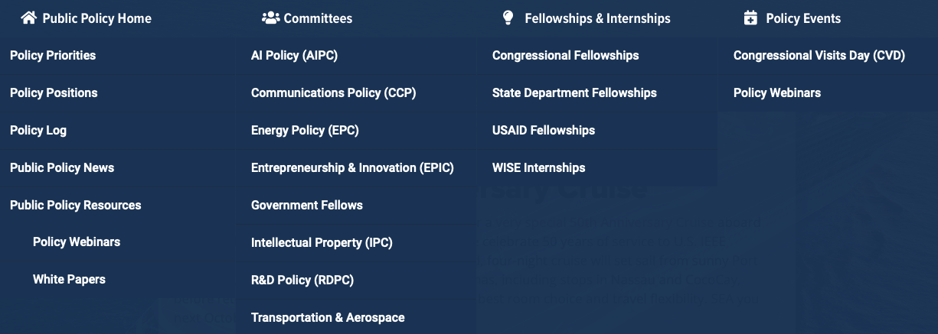
IEEE-USA Public Policy

Slide 15
IEEE Simplified Structure
BoD
Assembly
IEEE-USA
EAB
TAB
PSPB
SAB
MGAB
Region
46 Societies
and Councils
10 Regions
Educational Activities - recommend policies on educational matters and implements programs specifically intended to serve and benefit IEEE members, the engineering and scientific community, and the general public. …It shall provide oversight on IEEE-Eta Kappa Nu (IEEE-HKN) oversee interface to ABET.
(see https://www.ieee.org/education/eab.html for un-paraphrased mission.)

Slide 16
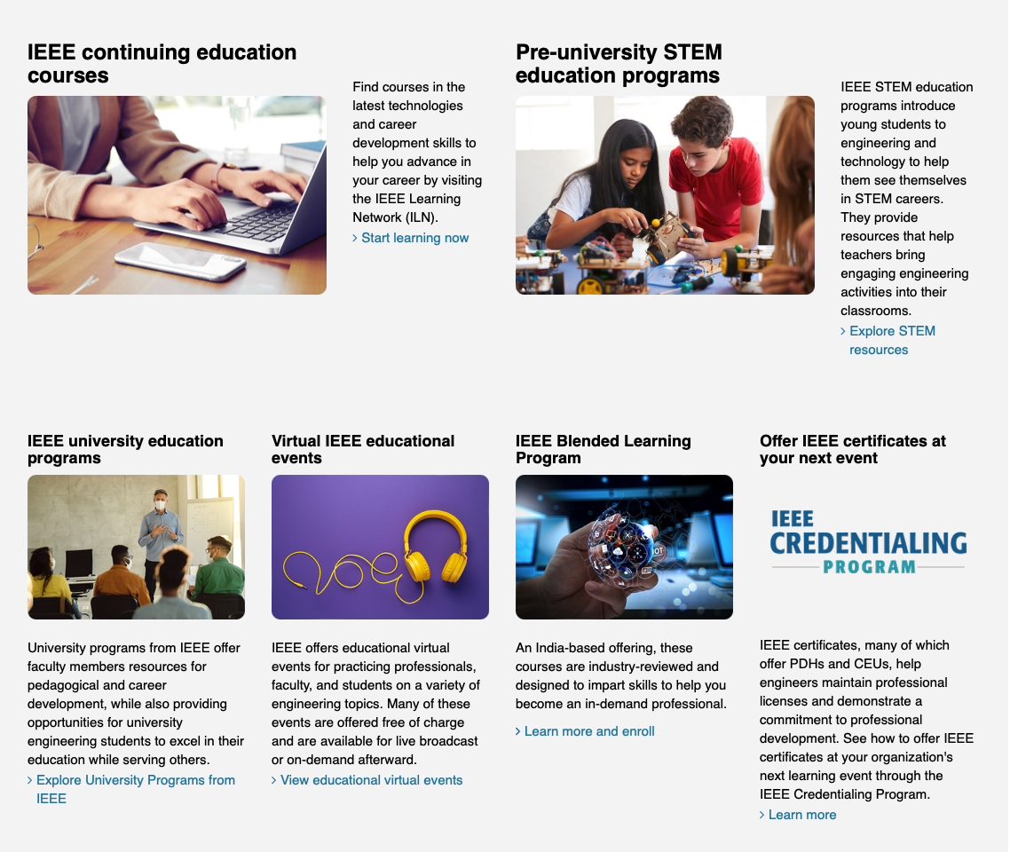
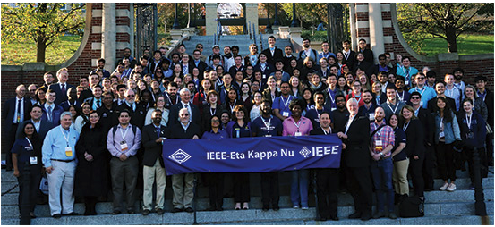
IEEE Education
IEEE HKN

Slide 17
IEEE Simplified Structure
BoD
Assembly
IEEE-USA
EAB
TAB
PSPB
SAB
MGAB
Region
46 Societies
and Councils
10 Regions
Technical Activities - Inspire and engage worldwide technical communities to:
Foster dynamic interdisciplinary collaboration
Motivate participation and leadership
Nurture and promote leading-edge innovative ideas
Empower professionals with relevant knowledge and lifelong development
Provide value

Slide 18

Technical Expertise that is Broad and Deep
IEEE provides thought leadership and resources for the global tech community.
Aerospace & Defense
Biomedical Engineering
Broadcasting
Circuits
Communications
Computer Science
Control and Automation
Cyber Security
Electronics
Environment
Industrial systems
Information Technology
Internet of Things
Life Sciences
Nanotechnology
Optics
Power and Energy
Robotics and AI
Semiconductors
Smart Cities
Smart Grid
Sustainable Energy
Transportation and Vehicles
And more…

Slide 19
IEEE Simplified Structure
BoD
Assembly
IEEE-USA
EAB
TAB
PSPB
SAB
MGAB
Region
46 Societies
and Councils
10 Regions
Publications and Services - responsible for formulating and recommending information-related, published services and products …, establishing and maintaining standards and procedures for IEEE information dissemination, recommending policies and best practices as they relate to the IEEE website, and otherwise coordinating and assisting those activities …
(see PSPB Operations Manual for un-paraphrased mission.)

Slide 20






The Top-cited IEEE Publications in the Fields of Interest
IEEE Publishes:
8 of the top 10 journals in Electrical and Electronic Engineering
9 of the top 10 journals in Telecommunications
3 of the top 5 journals in Artificial Intelligence
3 of the top 5 journals in Automation & Control Systems
3 of the top 5 journals in Computer Science—Hardware & Architecture
3 of the top 5 journals in Computer Science—Software Engineering
3 of the top 5 journals in Cybernetics
3 of the top 5 journals in Imaging
IEEE Journals are:
#1 in Automation & Control Systems, Cybernetics (Computer Science), Hardware & Architecture (Computer Science), Information Systems (Computer Science), and Imaging
The Journal Citation Reports from Clarivate Analytics presents quantifiable statistical data that provides a systematic, objective way to evaluate the world’s leading journals. Based on the 2021 study released June 2022.

Slide 21
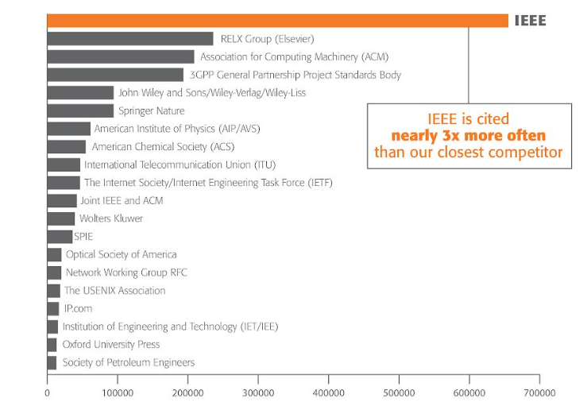
IEEE Research Powers New Patents
IEEE is the most-cited publisher in new patents from top patenting organizations.
A study of the top 50 patenting organizations ranks IEEE #1 again
Nearly 3x more citations than any other publisher
Patent referencing to IEEE increased 864% since 1997
Analyzed by discipline, IEEE is the #1 most referenced publisher in AI, Blockchain, Computing, Cybersecurity, IoT, Power Systems, Semiconductors, Telecom and more
The importance of sci-tech literature in patents is rising
IEEE research is increasingly valuable to innovators
Source: 1790 Analytics LLC, Copyright 2022.
Notes:
Two notes in case it comes up:
1) This slide states IEEE is #1 in patent references from the "Top 50" patenting organizations where the prior version said "top 40'. Since it is not a trending comparison, our analyst sometimes just utilizes a different segment of the data for the annual report.
2) You will note this slide says IEEE is cited nearly 3X more than any other publisher. We did not really "lose ground" here vs the prior report, the make-up of the top patenting organizations simply changes from year to year. This particular year it included more pharma companies which tends to cite IEEE less than other disciplines.

Slide 22
IEEE Simplified Structure
BoD
Assembly
IEEE-USA
EAB
TAB
PSPB
SAB
MGAB
Region
46 Societies
and Councils
10 Regions
Standards Association - provide a globally open, inclusive, and transparent environment for market relevant, voluntary consensus standardization and other consensus activities that serve the global needs of industry, government, and the public. It also works to assure the effectiveness and high visibility of this program both within the IEEE and throughout the global community.
(see SA Operations Manual for un-paraphrased mission.)

Slide 23






IEEE Standards Association (IEEE SA)
Standards nurture, develop, and advance the building of global technologies.
Consumers around the world enjoy the benefits of IEEE Standards:
Provide the bricks and mortar
for a globally level playing field
for innovation
Protect public safety,
health & wellbeing
Contribute to a
sustainable future
COMPETITION
Influencing the competitiveness of industries & companies
CONFIDENCE
Demonstrating quality to customers by meeting expectations & requirements
Global
IEEE
Standards
INNOVATION
Providing an essential platform on which new technologies & processes can build
GROWTH
Facilitating trade & economic growth
PERFORMANCE
Fine-tuning performance and improving efficiency
SUSTAINABILITY
Making technology safer, interoperable and sustainable for the future

Slide 24
IEEE Standards Association Continued Growth
Notable new standards projects
  IEEE P1943, Draft Standard for Post-Quantum Network Security
  IEEE P3181, Draft Standard for Trusted-Environment-Based Cryptographic Computing
  IEEE P3224, Draft Standard for Blockchain-Based Green Power Identification Application
  IEEE P3225, Draft Standard for Using Blockchain in Low Carbon Zones Evaluation
  IEEE P3226, Draft Standard for Trusted Data Circulation Based on Blockchain and Distributed Ledger Technologies (DLT)
Notable new standards
  IEEE Std 2937-2022, IEEE Standard for Performance Benchmarking for AI Server Systems
  IEEE Std 1547.9-2022, IEEE Guide to Using IEEE Standard 1547 for Interconnection of Energy Storage Distributed Energy Resources with Electric Power Systems

Slide 25
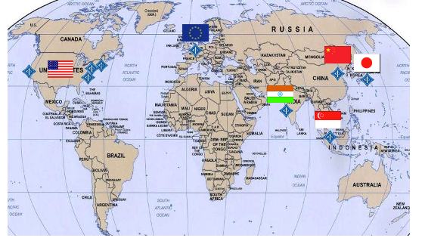
IEEE Staff Locations
IEEE Corporate Headquarters (NY)
IEEE Operations Centers (NJ)
IEEE-USA (Washington DC)
IEEE Computer Society (CA, Washington DC)
IEEE Asia-Pacific Limited, Singapore
IEEE, Inc. Representative Office, China
IEEE Beijing Office Extension in Shenzhen
IEEE Russia Branch
IEEE Technology Centre GmbH
IEEE Tax Registration, Japan
Global IEEE Institute for Engineers, India
see https://www.ieee.org/about/contact.html
With us at SoutheastCon 2023…
Sophie Muirhead, IEEE ED, COO
Cecelia Jankowski, Managing Dir MGA
Vera Sharoff, Dir Information Mgt MGA
Michael Deering, IEEE Foundation

Slide 26
Volunteer Tools (vtools.ieee.org)
vTools are a suite of applications that are volunteer designed and approved
  Staff built and maintained (some are layers built upon external vendor products)
  Automates required volunteer responsibilities
  Integrates with the IEEE Member Database (Siebel) for real-time changes (Officer Reporting)
  Integrates with the IEEE Data Warehouse for web service/data feeds
  Uses IEEE Single Sign on
vTools applications
  vTools Events - WebInABox - Local Groups
  vTools eNotice - Surveys - IEEE Xtreme Registration
  vTools Voting - Student Branch Reporting - Remote Conferencing
  vTools Nominations - Online Officer Reporting - Membership Validator
  vTools Engage - Others…
IEEE OU Analytics is the visual business intelligence tool for volunteer access to member data. Access is automatic for many executive committee members and can be designated to others.
EWH is a web hosting service, sponsored by MGA, that supports for all IEEE OUs. Over 5,000 web sites are hosted. These include Geo Units, Societies and Conferences.

Slide 27

Center for Leadership Excellence
On Demand Training for Local Leaders
Audiences served
  IEEE volunteers (Region, Section, Chapter, Affinity Group, Student Branch, Section-level committees)
  VoLT Program candidates and students
  Conference organizers + TA volunteers*
Content available
  Action Plans for 23 volunteer roles
  Volunteer role descriptions for 41 positions
  IEEE 101 courses
  80+ recordings on various topics, including professional development, volunteer recruitment, ethics and technology, and more
  Updated and expanded frequently
* Content owned and managed by Volunteer Education & Engagement, IEEE Technical Activities
27

Slide 28


IEEE Conferences Strong in 2022
2,081 IEEE conferences are projected to take place in 2022
2022 Conferences*
2022 Conferences by Format*
*
403
943
1,138
Virtual
Technical
867
Financial
In-Person
811
Hybrid
2,081
Total
*Data as of 12 August 2022
forecast changes daily
Notes:
IEEE Conferences continue to bring participants together to share innovations and collaborate on future breakthroughs. Over 1,126 IEEE conferences have already taken place in 2021.

Slide 29

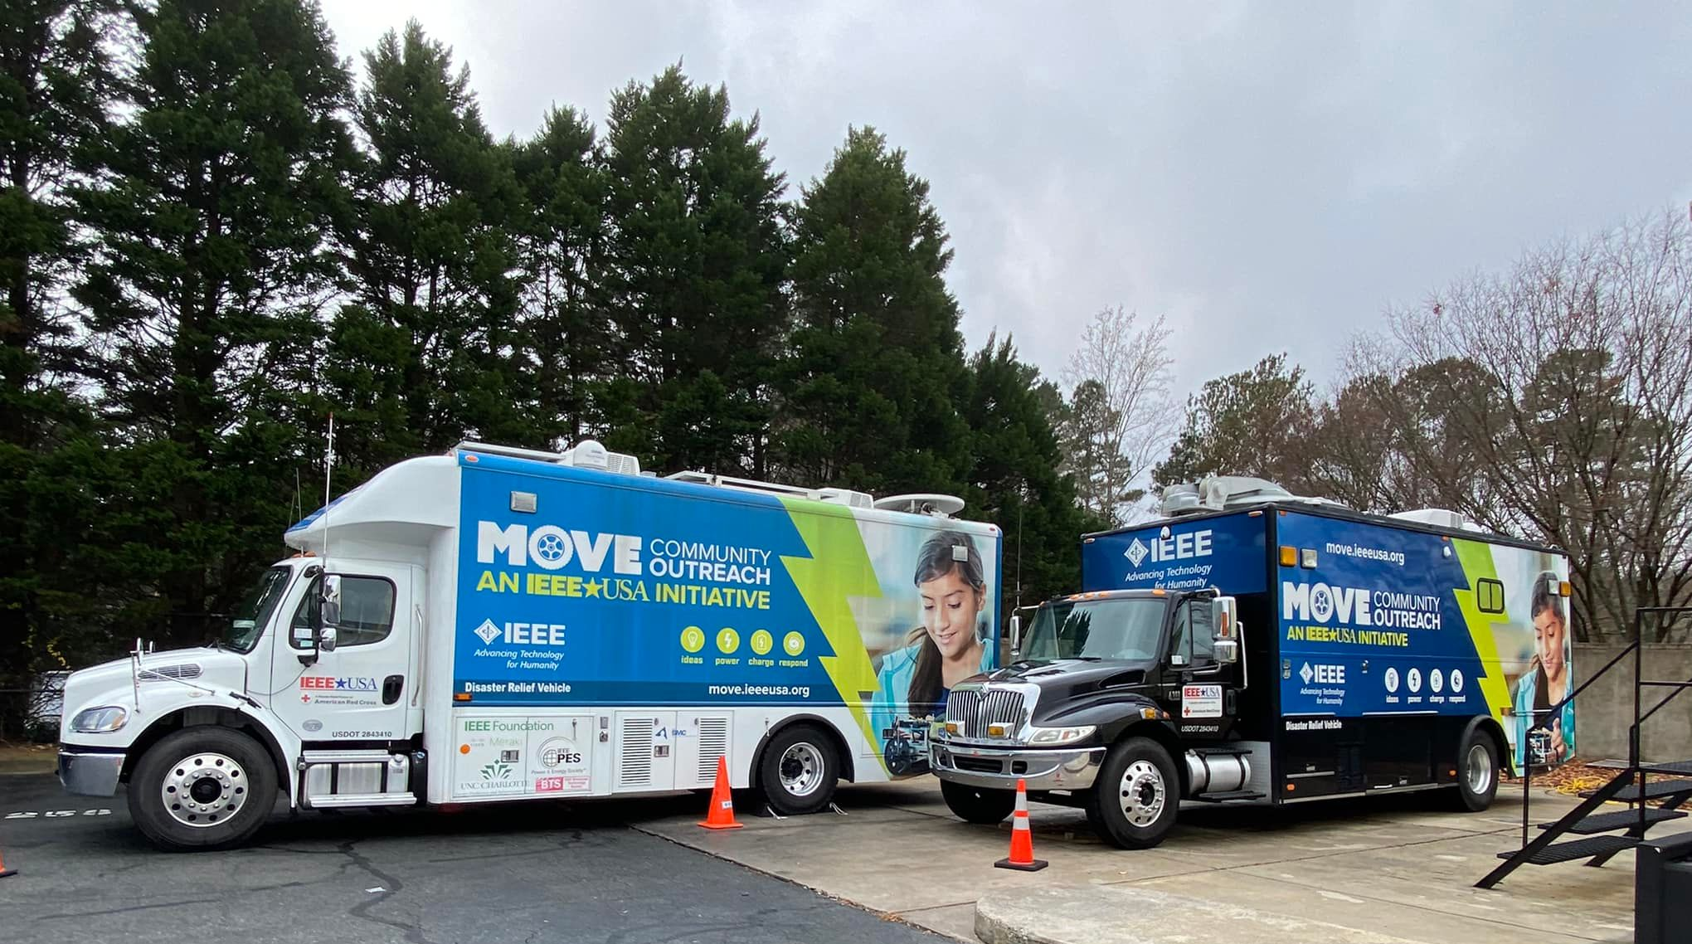
Notes:
Illuminate – technology for humanitarian (Smart Village, IEEE Sight, MOVE
Educate – Try Engineering, Scholarships, MOVE
Engage – Life Member, History
Energize - HKN
Future – WIE,

Slide 30
Backup

Slide 31
References
IEEE Brand Experience (includes logos, slides, poster) https://brand-experience.ieee.org/ieee-brand/brand-overview/

Slide 32
Thanks to
Jill Gostin - prior versions and other material
Jim Conrad - sharing his 2023 version of his intro for HKN

