Slide 1
Section Support Committee
Charles Lord (prepared by Kristin Bing)
April 15, 2023

Slide 2
Assist Sections
Stimulating interest of IEEE members
Motivating members to volunteer
Encouraging professional and technical growth of all members
Sharing best practices with other Sections
Forming Engineering Affinity Groups

Slide 3
Responsibilities
Assist in training section volunteers
Provide assistance and support to those Sections and Chapters that are having problems in meeting the requirements to remain active and viable
Assist Sections in the use of collaborative tools and other technologies that support Section and Region activities
Encourage Sections to sponsor member grade elevation programs
Encourage Sections to sponsor programs that support the interest and continued activity of Life Members
Encourage Sections to sponsor projects to facilitate the active involvement of members in IEEE activities
Initiate project experiments with one or more sections to encourage member engagement
Assist sections in developing technical programs for their members and accessing other technical activities in the Institute

Slide 4
Who Are We?
Chair – Kristin Bing
Life Member Coordinator – Jacob Kulangara
Young Professional Coordinator – Binesh Kumar
Women in Engineering Coordinator – Evelyn Licona
Senior Member Elevation Coordinator – Andrew Seely
Section Operations Specialists – Charles Lord and Mark Torres
Project Coordinator – Allen Jones
Technical Activities Coordinator – Tamseel Syed
Membership Recruitment & Retention Coordinator – Sharlene Brown
Educational Activities Coordinator – Damith Wickramamayake

Slide 5
R3 Life Members
Jacob Kulangara – Life Member Coordinator
Identified LMAGs not in active status
Have not had 2 meetings in last year
Working with Area chairs to help LMAGs reactivate
Identified Sections with a large number of LMs but no LMAG
Working with Area chairs to form new LMAGs in these Sections
New Regional Life Member Awards (as of 2022)
Best Life Member Affinity Group
Individual Life Member Service Award
(All Award Nominations due today!)

Slide 6
R3 Young Professionals
Binesh Kumar – Young Professionals Coordinator
Revitalizing Young Professionals in Region 3
Regional collaboration between R3 YP Affinity groups
Professional development initiatives
Technical sessions
Industrial site tours
Networking events
Leadership development
Establishing YP brand within Region 3
Initiatives for students and YPs to join Affinity groups

Slide 7
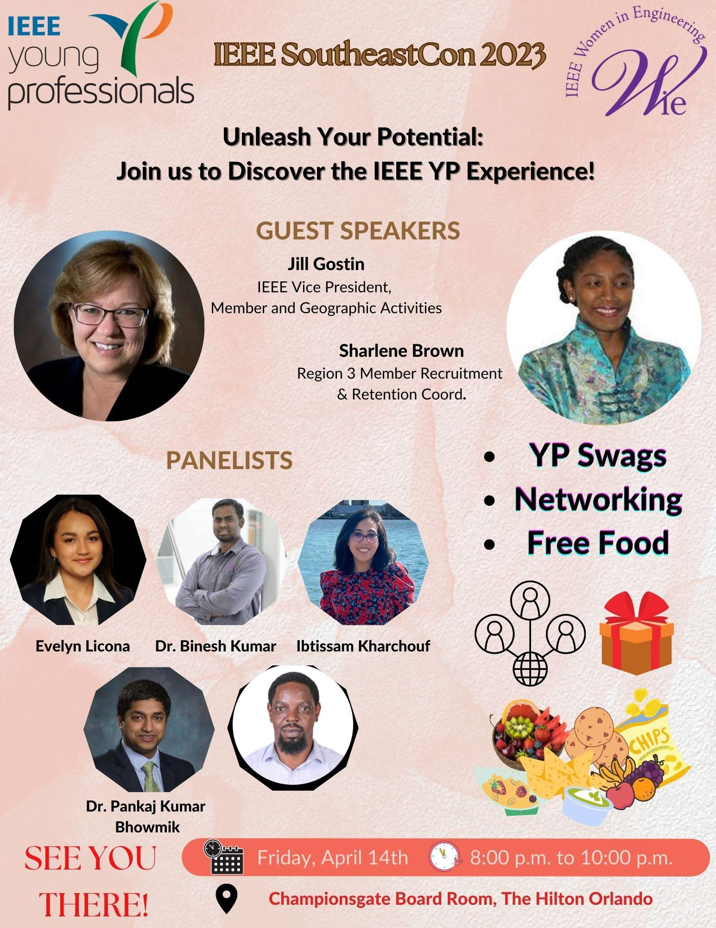
R3 Young Professionals
Binesh Kumar – Young Professionals Coordinator
Joint YP and WIE event to be held at SoutheastCon 23
Professional Development and Networking Sessions
Keynote talks
Panel sessions comprising of YP and WIEs
Inspiring students and YPs to join Affinity Groups
Leadership tips – Professionally and within IEEE

Slide 8
R3 Women in Engineering Evelyn Licona – WIE Coordinator
-Joint YP and WIE event at SoutheastCon
-WIE Global Meetings
-Regional WIE Meeting to take place after Southeastcon
-Part of the planning committee for WIE East Forum
-Virtual Webinars Joint AGs
Contact Evelyn Licona elicona@ieee.org – R3 WiE Coordinator.

Slide 9
R3 Women in Engineering Evelyn Licona – WIE Coordinator
elicona@ieee.org
elicona@ieee.org

Slide 10
R3 Senior Membership
Andrew Seely – Senior Membership Elevation Coordinator
2020-2021 Accomplishments
2022-2023 Plans and Goals
More than doubled 2021 elevations goal
Global WIE senior membership event
Regional YP senior membership event
Introduced virtual “roundups” to R3
Education and training to sections
Total elevations goal: Official goal is 200, stretch goal is 250
Sections engagement goal: 100%
Sections gaining own credit for their elevations: 50% overall, currently 19%
2023 Upcoming Schedule
Success Factors
A&A: 4/22, 6/17, 8/12, 9/23, 11/18
Roundups: 5/20, 7/29, 8/26, 10/28
Document a Region 3 standard process for Region-level engagement
Conduct 6 Senior Member Roundups
Conduct 2 Senior Member training sessions for Sections
Expand and codify the R3 Senior Membership Elevation Committee, subordinate to SSC
Establish an R3 “So What” activity to enhance value of Senior Membership

Slide 11
R3 Projects
Allen Jones – Projects Coordinator
2023 Theme: Climate Change
Grants up to $1000
Deadline to submit application: May 1, 2023
See https://bit.ly/ieee-r3-projects for more information

Slide 12
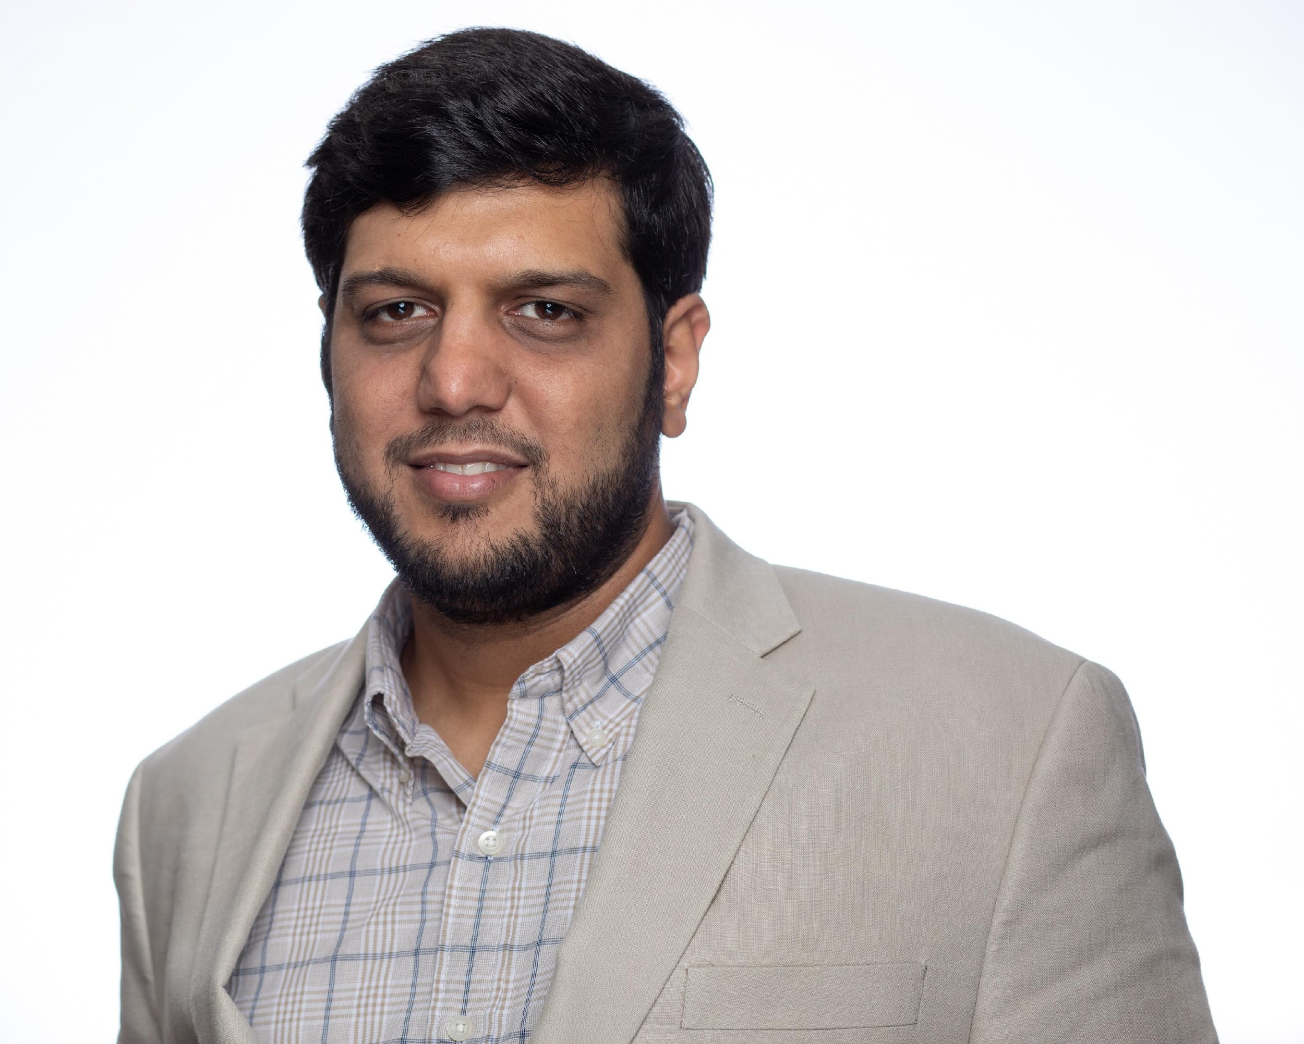
R3 Technical Activities
Tamseel Syed - Technical Activities Coordinator
Interface between the Technical Chapters in Region 3 and the Region 3 ExCom.
Establish communication with Section Chairs and/or Section Chapter Coordinators via Area Chairs.
Acts as a resource to the Chapter officers.
Help resolve outstanding issues for existing Chapters.
Assist/encourage Chapter officer training.
Facilitate new chapter formation.
Assist existing Chapters to host at least 2 meetings a year.
Promote inter-Section/inter-Region collaboration.

Slide 13
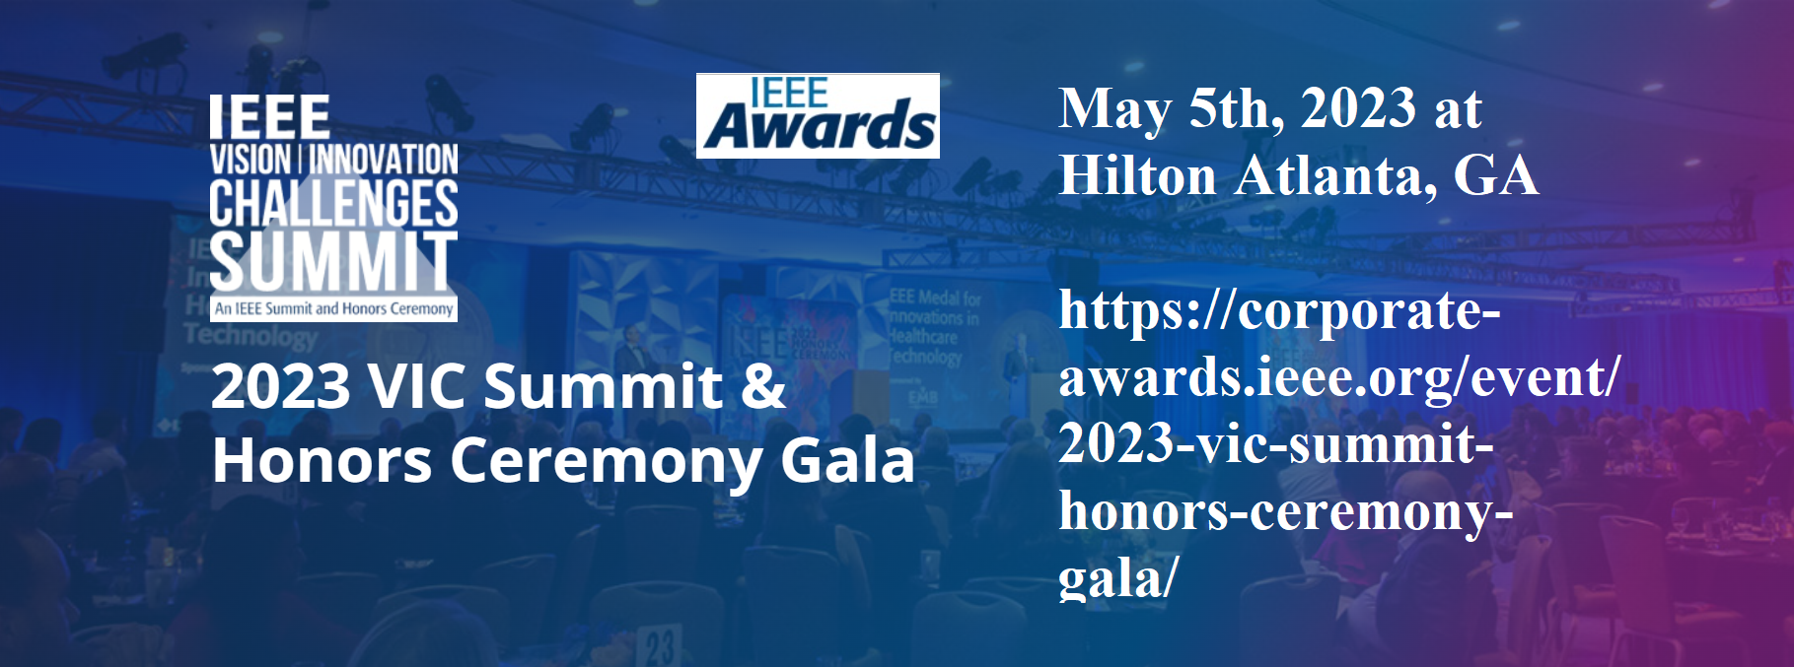
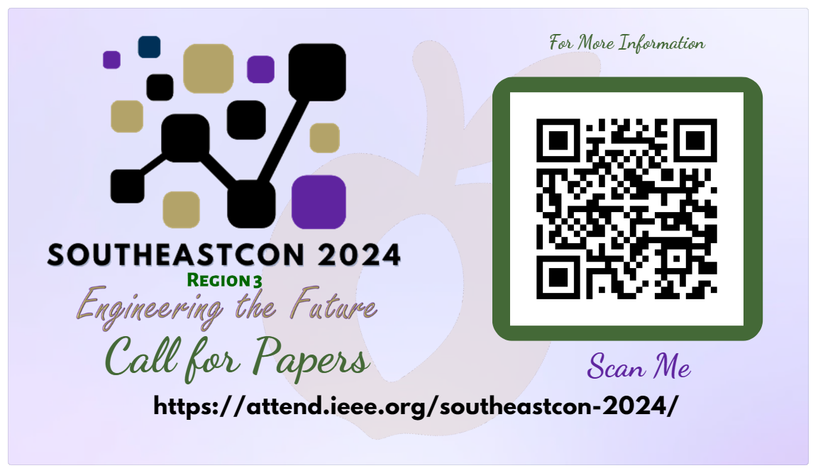
R3 Technical Activities
Save these Dates!!!

Slide 14
R3 Member Recruitment & Retention Sharlene Brown – Membership Recruitment & Retention Coordinator
Presenting on new vTools Engage! at SoutheastCon
Interactive Customer Relationship Management (CRM) solution
Enables volunteers to engage, track, and retain members, convert non-members to members, and provide volunteers the information they need to offer the best programs possible.
Assisting with formation of 2 new student branches
Recently hosted Formation Guidelines virtual event with one university in the FWCS
Will assist at least 2 struggling student branches with revitalization
Plans to host a virtual Regional recruitment event in July or August to university students on the benefits of becoming an IEEE member
Email: sharlenenbrown@ieee.org
14

Slide 15
R3 Educational Activities Damith Wickramanayake – Educational Activities Coordinator
Orientation for new educational activities chairs on May 25th
Regional SEOC – August 17th
Email: damithwick@ieee.org

Slide 16
R3 Section Operations
Mark Torres and Charles Lord – Operations Specialists
Provide training and logistics as needed for sections
Quarterly Q&A sessions planned, where Sections can submit their questions
Provide reminders and guidance on administrative activities (e.g., officer elections)
Work with the area chairs to help dormant and struggling sections and perform other duties as needed.
Support the Projects team
Work on developing the wiki and adding OU Analytics quick start as well as deep dive.
Survey volunteers to determine and then offer desired training

