Slide 1
Advanced IEEE OU Analytics
Vera Sharoff - Senior Director, MGA Information Technology

Slide 2
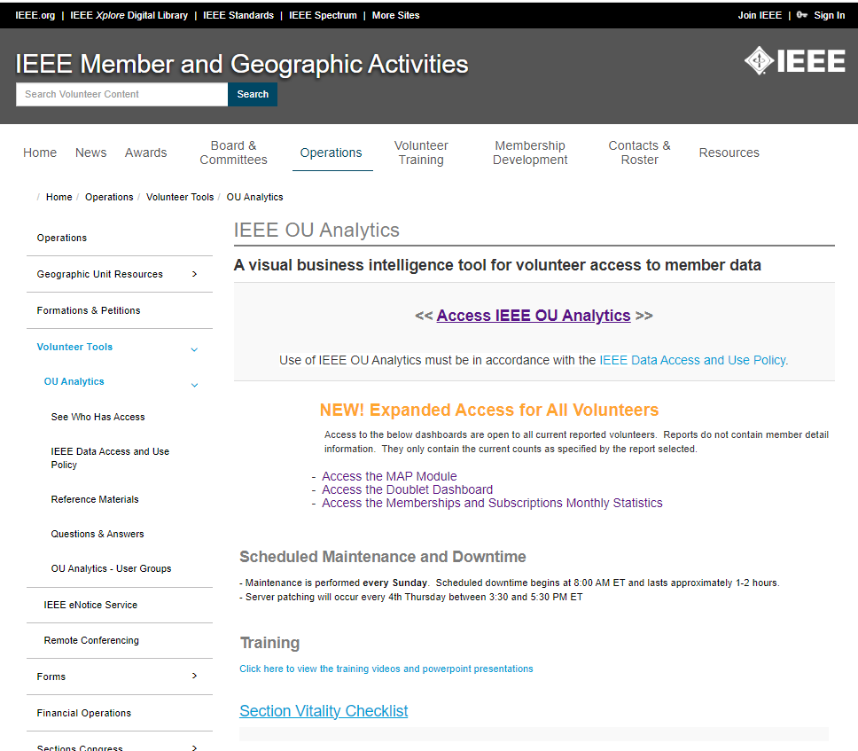
IEEE OU Analytics is …
A visual business intelligence tool which provides volunteer access to member data
http://www.ieee.org/oua

Slide 3
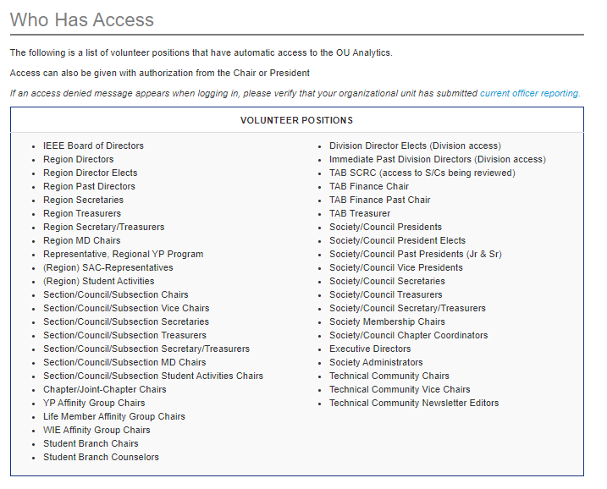
Who Can Access IEEE OU Analytics?

Slide 4
What data is available?
Data is limited to your Organizational Unit
Region - All members and affiliates who live in the Region
Section - All members and affiliates who live in the Section
Subsection - All members and affiliates who live in a Subsection
Example: Montgomery Subsection of the Alabama Section
Chapter/Joint Chapter/Affinity Groups - All members and affiliates who live in the Section(s) and are a member of the associated Society
Student Branches - All student members attending the school of the Student Branch
Student Branch Chapters/Student Branch Affinity Groups – All student members attending the school of the Student Branch and belonging to the associated Society
Society
Data includes:
Contact information
Grade and Grade History
School, HKN
Memberships – IEEE, Society, Affinity
Subscriptions
Volunteer Positions, including history
And much more

Slide 5
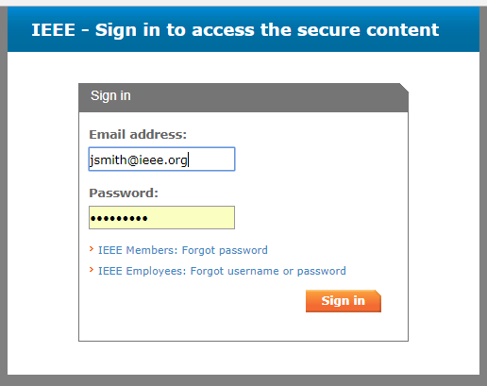
IEEE OU Analytics
Click “Access IEEE OU Analytics”
Use of IEEE OU Analytics must be in accordance with the IEEE Data Access and Use Policy.
Sign in with your IEEE Web Account Username and Password

Slide 6
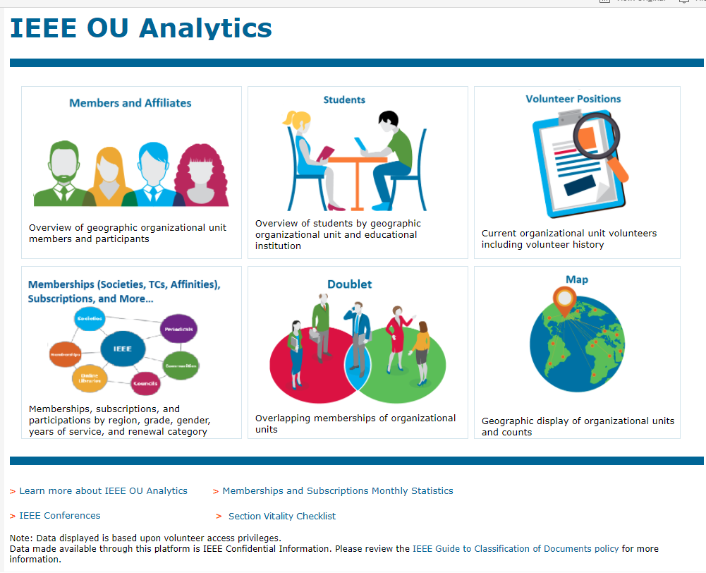
Landing Page
Six Modules
Members and Affiliates
Memberships
Students
Doublet
Volunteer Positions
Map

Slide 7
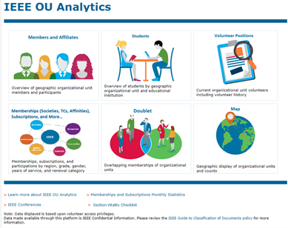
Members and Affiliates
Dashboard
Count By Region and Grade
Count by Gender (pie)
Count by Technology Focus
Count by Grade and Gender
Geographic Counts - by City / State / Province / Country/Grade
Employer Information
Member Activity
Detail

Slide 8
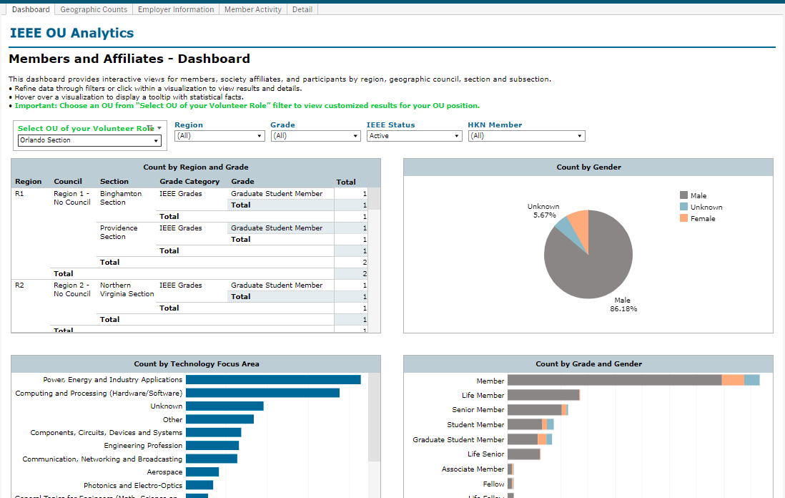
Includes Students that go to school in the Orlando Section

Slide 10
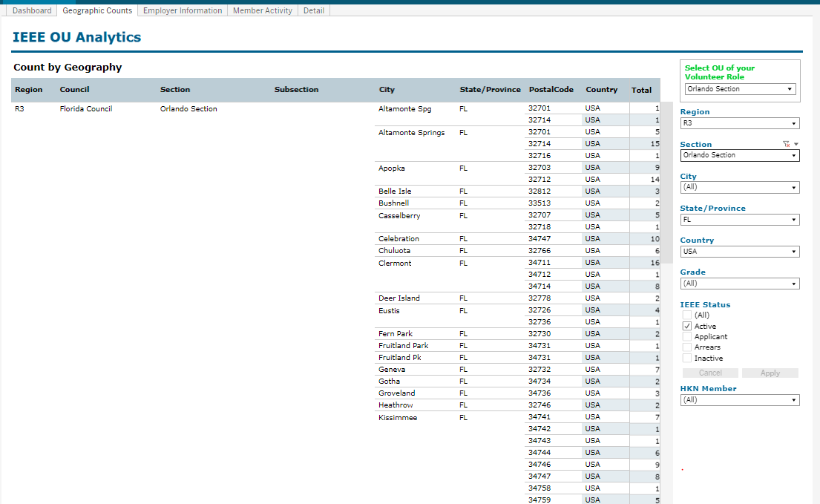

Slide 11
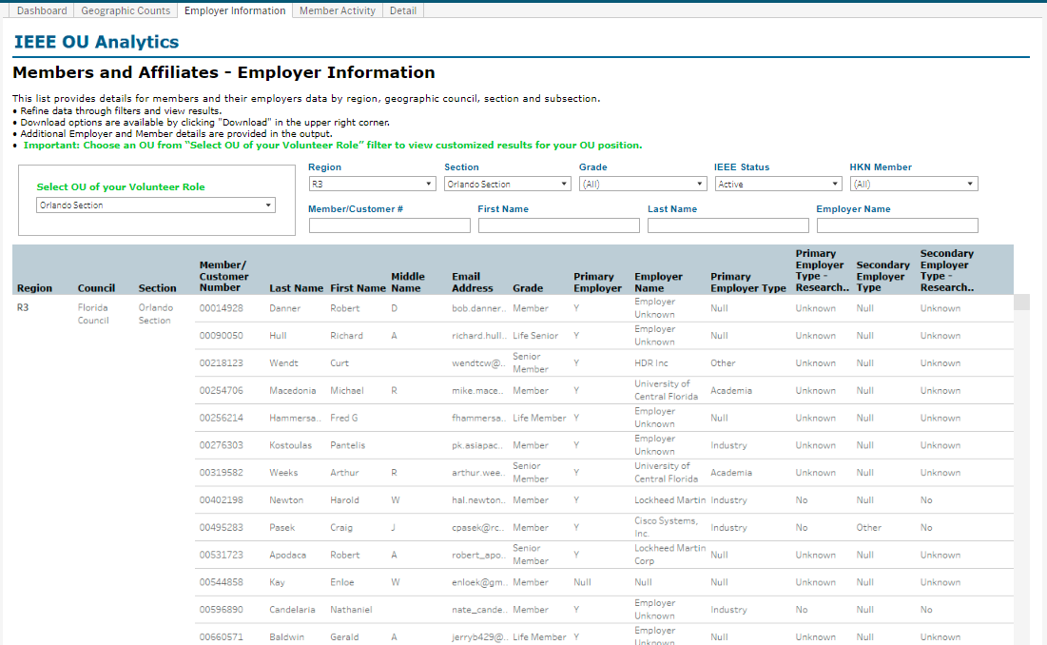
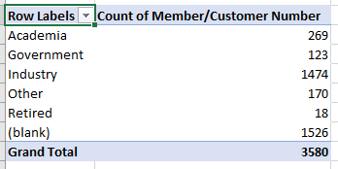

Slide 12
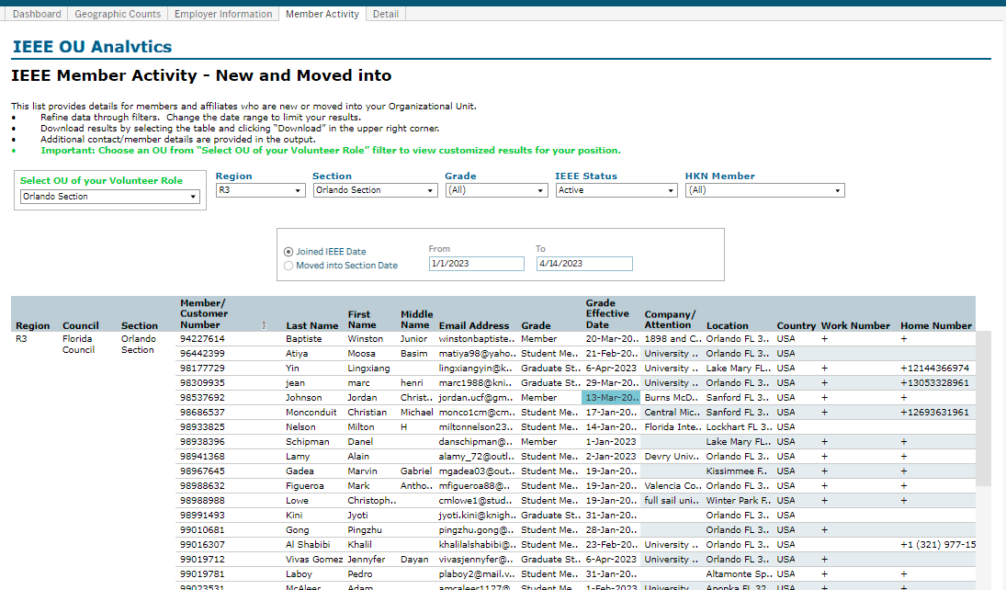

Slide 13
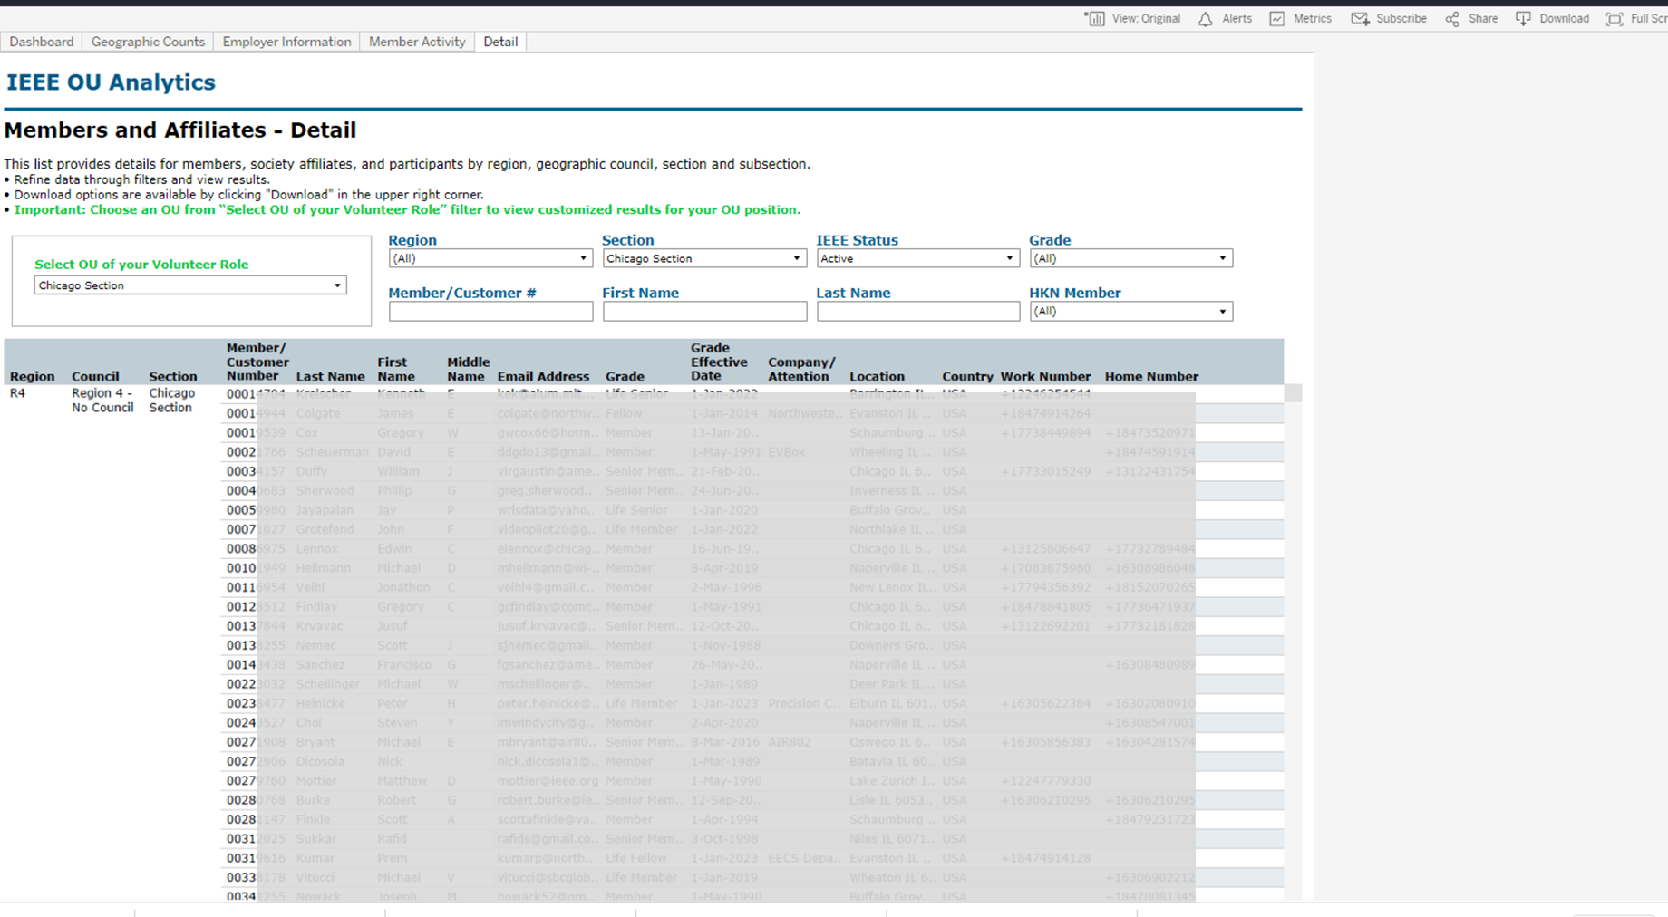

Slide 14
Memberships
(Societies, TCs, Affinities) Subscriptions, and More
Product Dashboard
Summary
Count by Grade (pie)
Count by Gender (pie)
Count by Grade and Years of Service
Product Summary by Region by Grade
Renewal Category Dashboard
Renewal Summary by Region by Grade
Detail

Slide 15
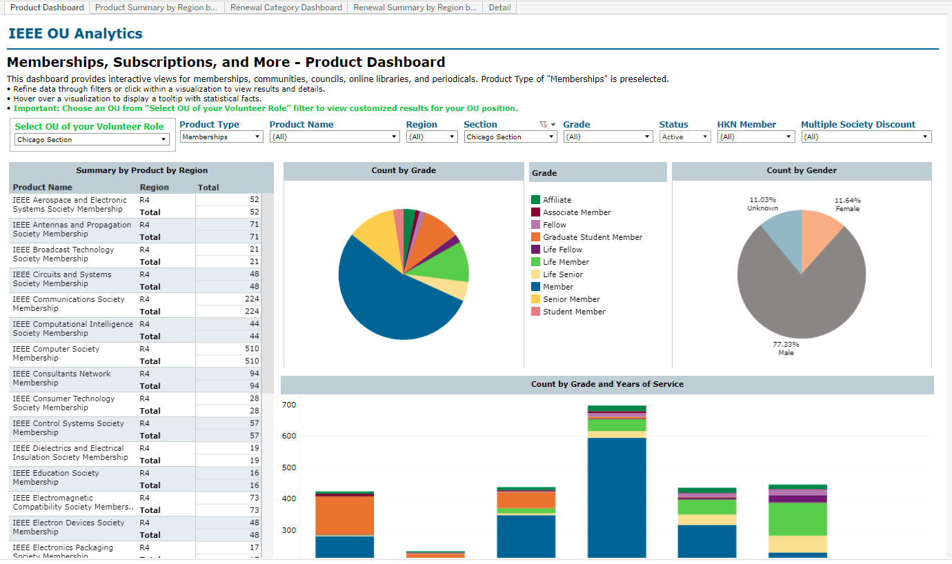
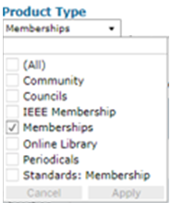

Slide 16
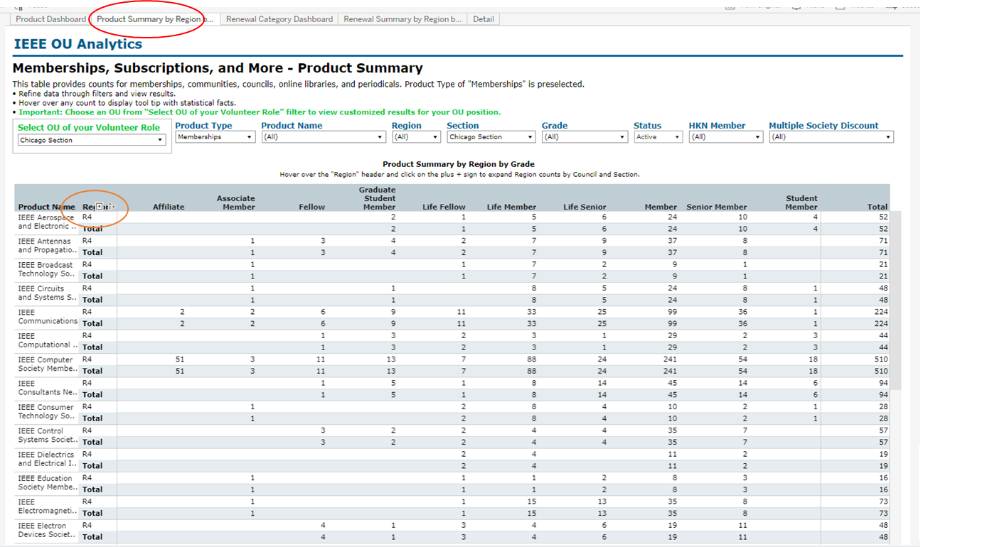

Slide 17
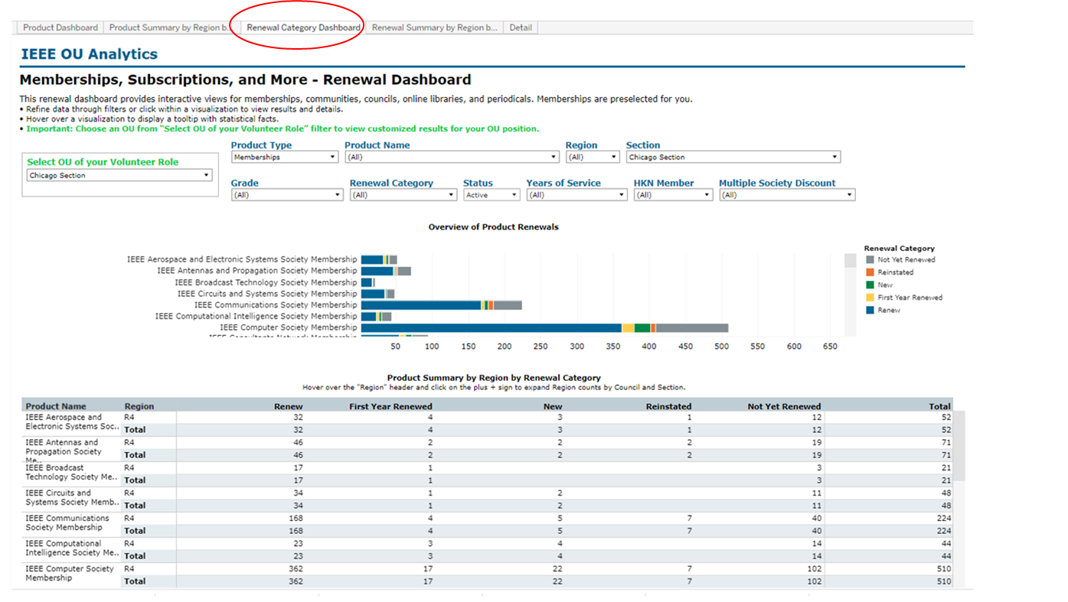

Slide 18
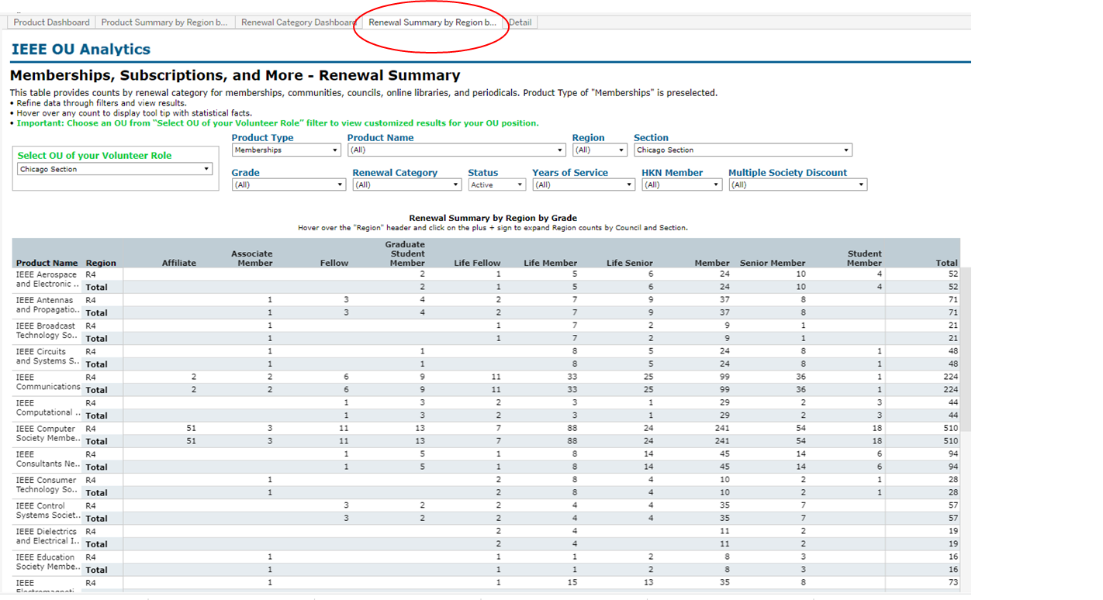

Slide 19
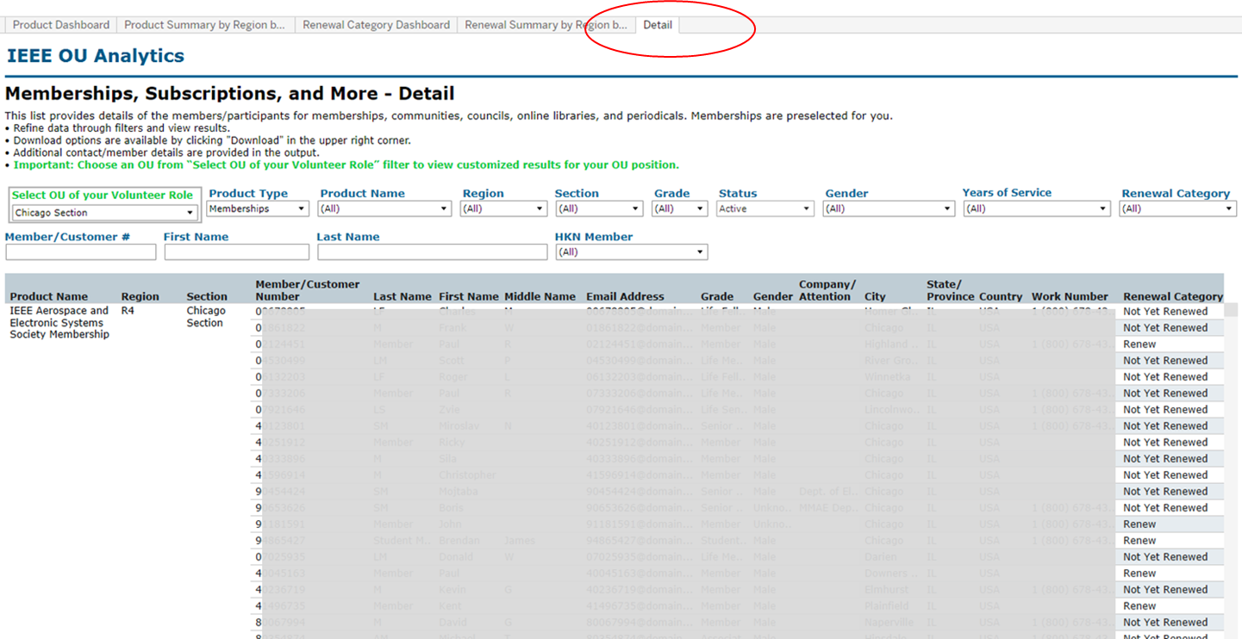

Slide 20
Dashboard
Student Count by Section and School
Student Count by Gender
Student Count by Grade
Student Count by Field of Study
Detail
Select OU
Where they live (primary address)
Where they go to School

Slide 21
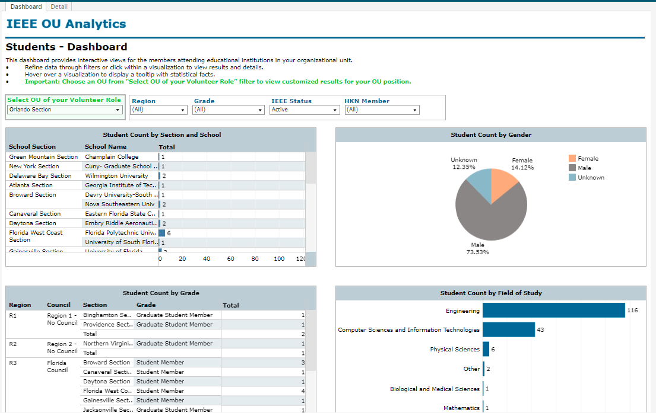
Attending Students

Slide 22
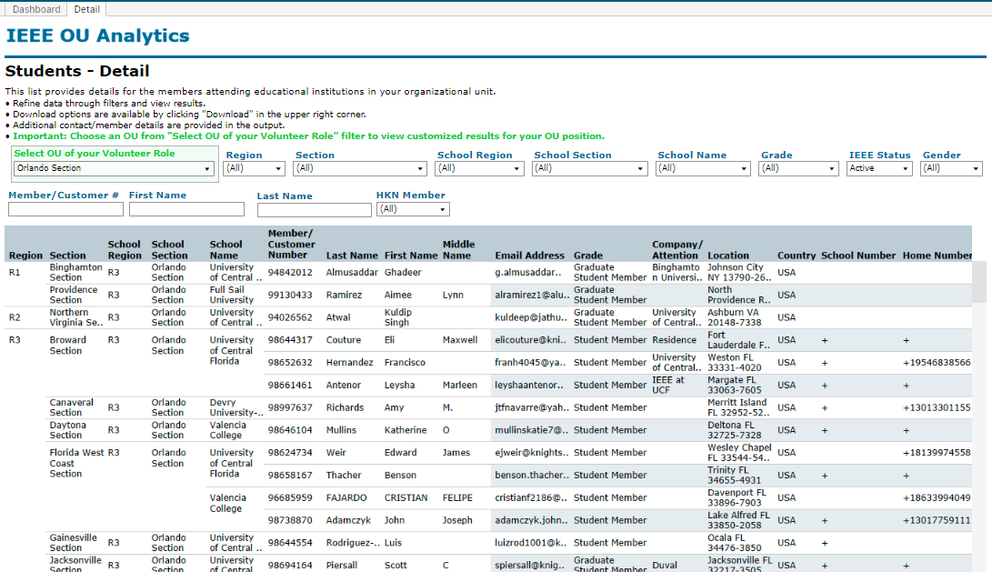

Slide 23
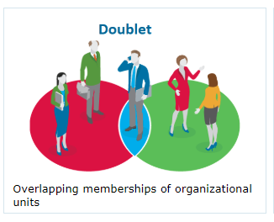
Doublet
Members with this society membership also have this membership

Slide 24
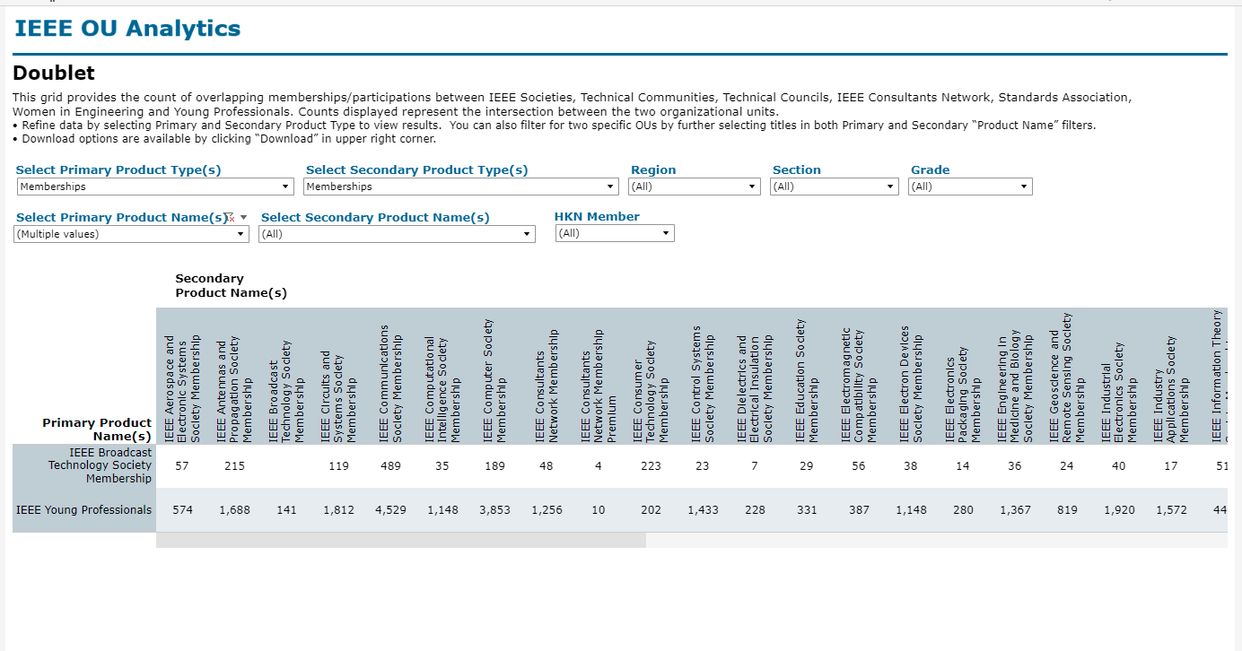

Slide 25
Volunteer Positions
Volunteer Positions in Related
Volunteer History

Slide 26
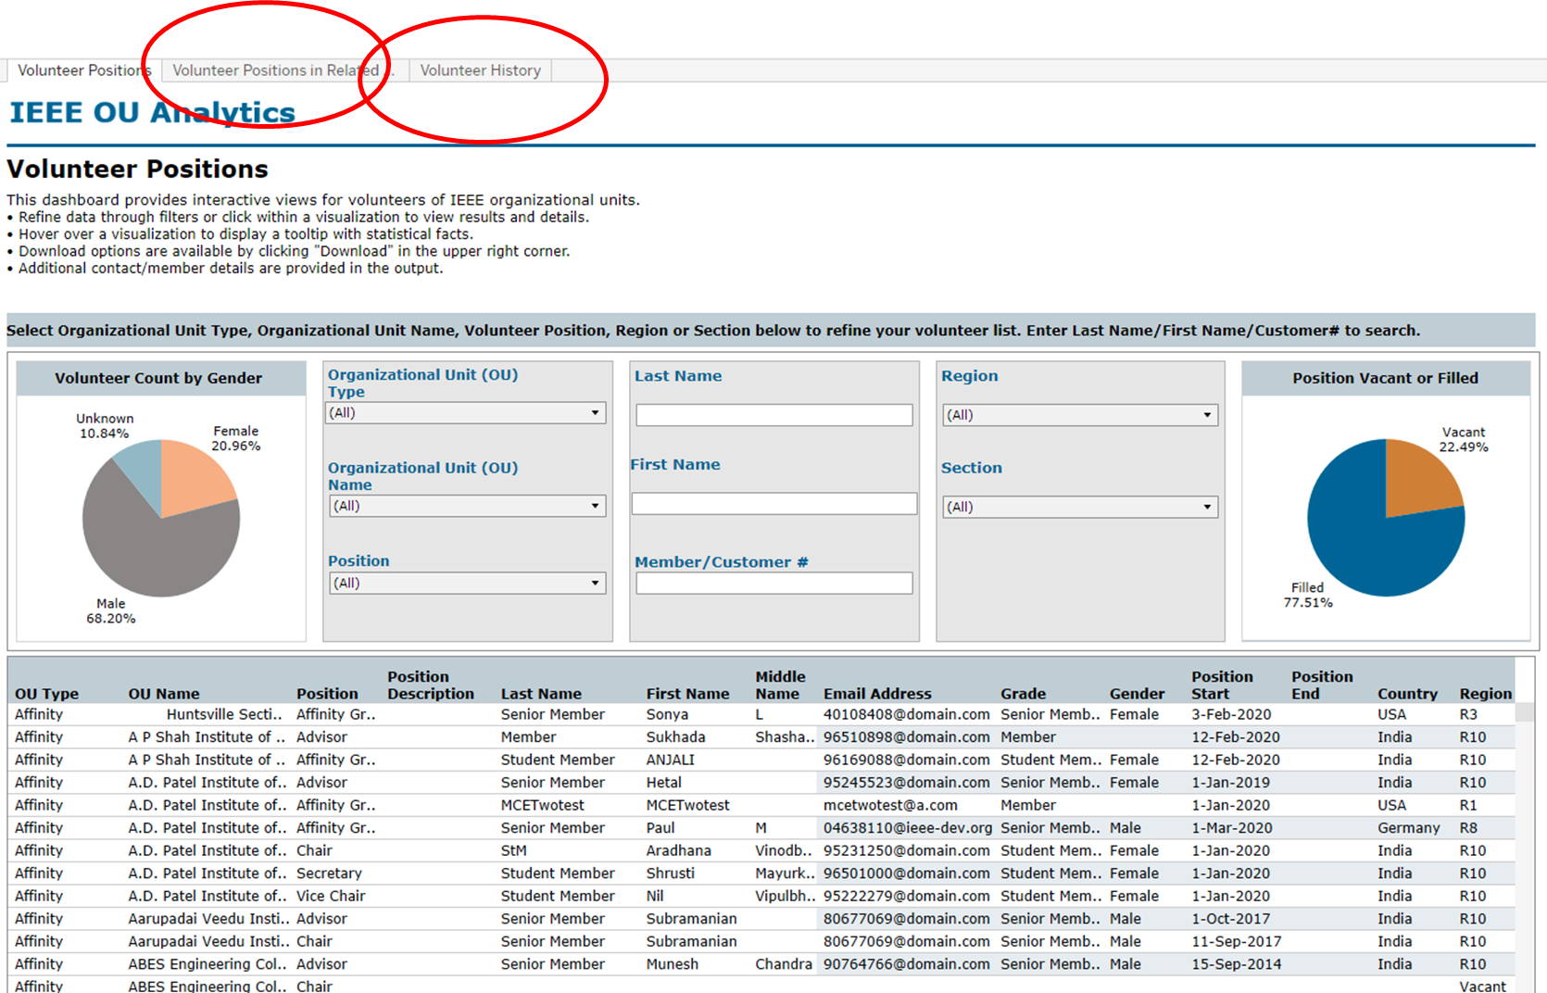

Slide 27
MAP
Region Summary
IEEE/Society Membership Summary
Chapter Summary
Member Count by Chapter
Potential Chapters
Affinity Group Summary
Student Branch Summary
Potential Student Branches

Slide 28
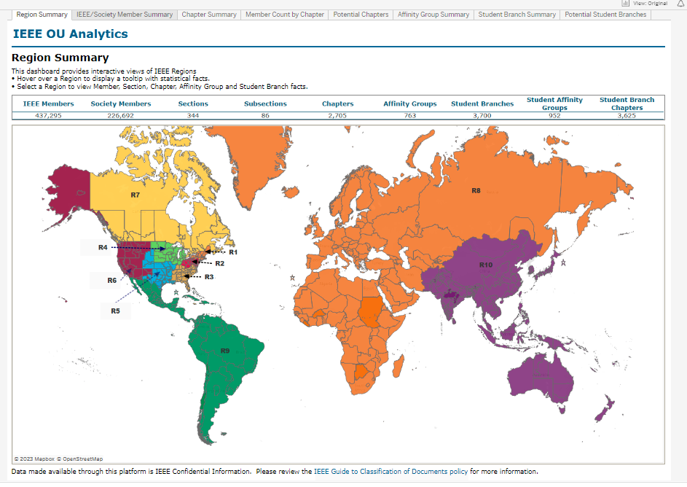

Slide 29
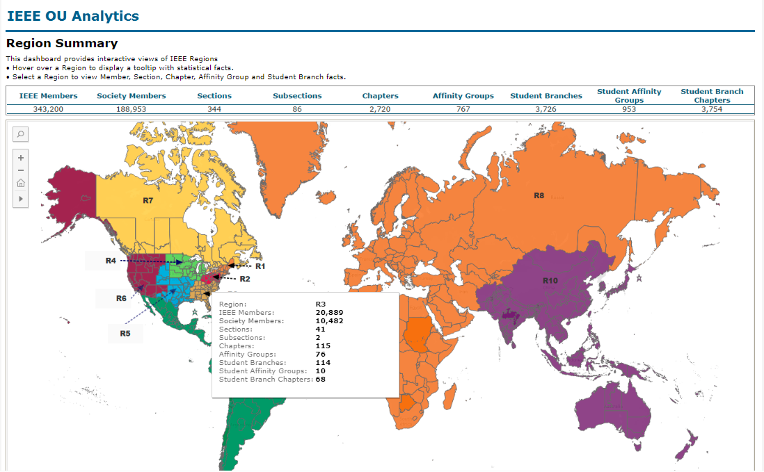

Slide 30
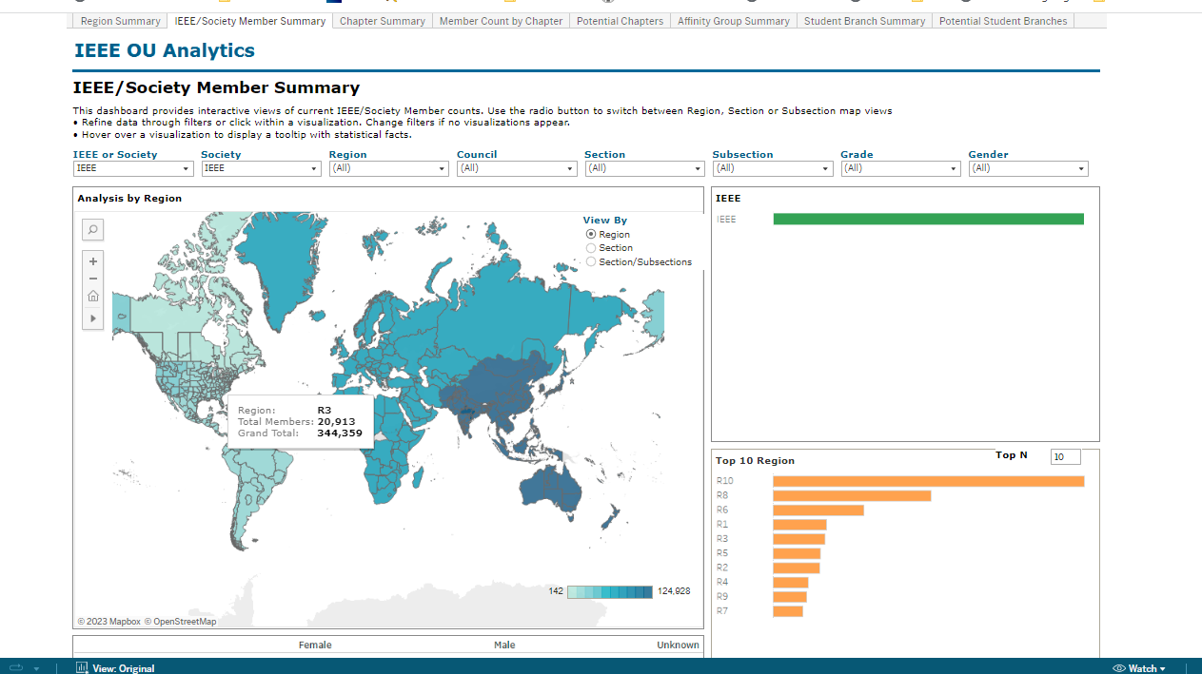
IEEE/Society Member Summary

Slide 31
Chapter Summary

Slide 32
Member Count by Chapter

Slide 33
Potential Chapters

Slide 34
What Else is there in MAP?
Affinity Group Summary
Student Branch Summary
Potential Student Branches

Slide 35
IEEE OU Analytics
Contacts
ouanalytics@ieee.org
Staff in Member and Geographic Activities and Technical Activities

Slide 36
Other Data
Membership and Subscriptions Monthly Statistics
Data from 2007
By Region, Council, Section, Subsection
By Society, Technical Council, Communities

Slide 37
Other Data
IEEE Annual Statistics
Ieee.org/stats
PDF files of statistics back to 2000

Slide 38
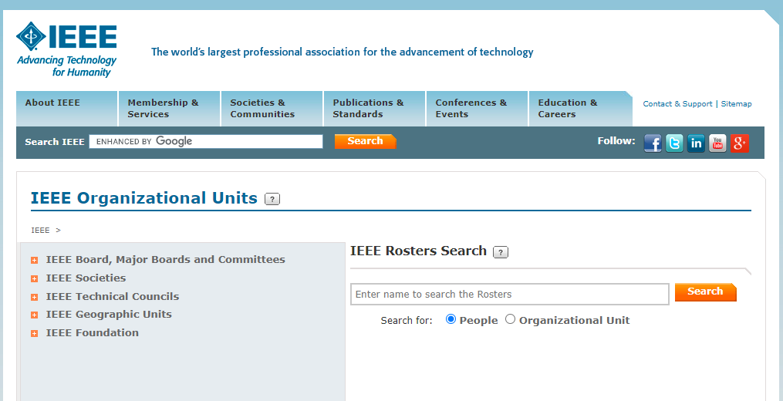
Other Data
The IEEE Organizational Roster
Also Available in:
OU Analytics
IEEE App
Collabratec
Only accessible by Volunteers

