Slide 1
Website Tips & Tricks
Melody Richardson

Slide 2
Reasons to Consider a Section Website
Platform
Keep Members Informed
Engage community
Creating a website is much easier than you think
Notes:
Gives Your Section a Platform
Shares Information about meetings, events, and conferences
Keeps Members Informed
Engage the community and potential members

Slide 3
Getting Started
Plan
Thoughtful Content
Section Information
Spell-checked and grammar proofed
Good Quality Pictures
At least 1024 pixels or 72 PPI
IEEE Photo Releases (if needed)
Notes:
Section Information
Leadership
Societies & Affinity Groups
Events
Outreach
Membership

Slide 4
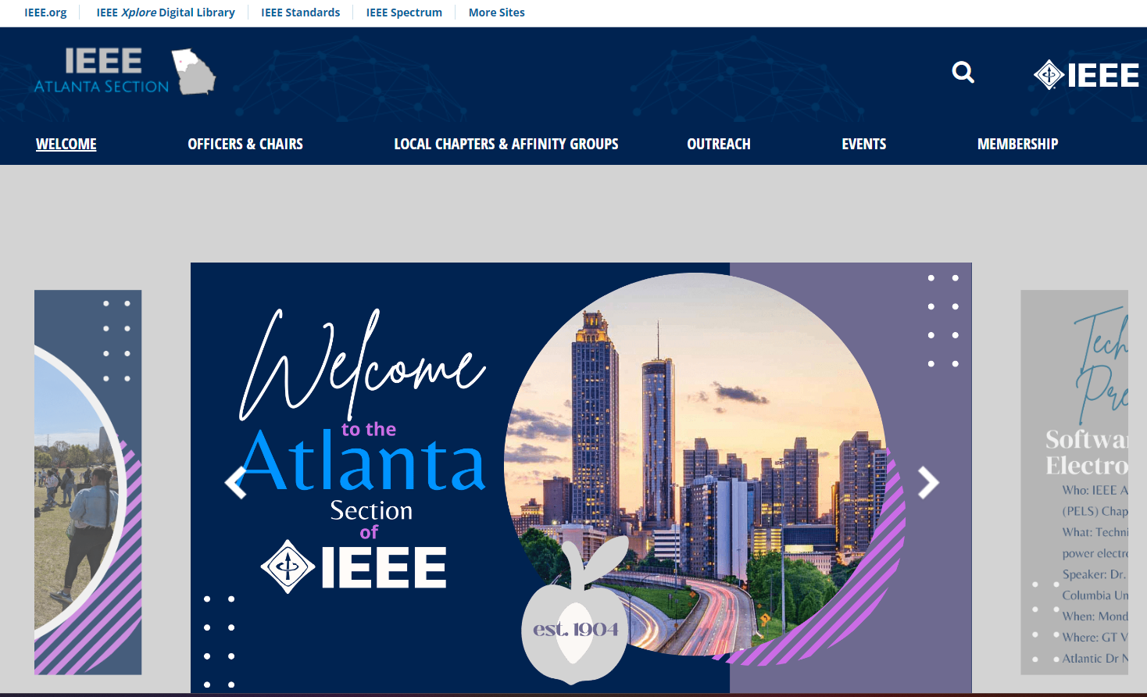
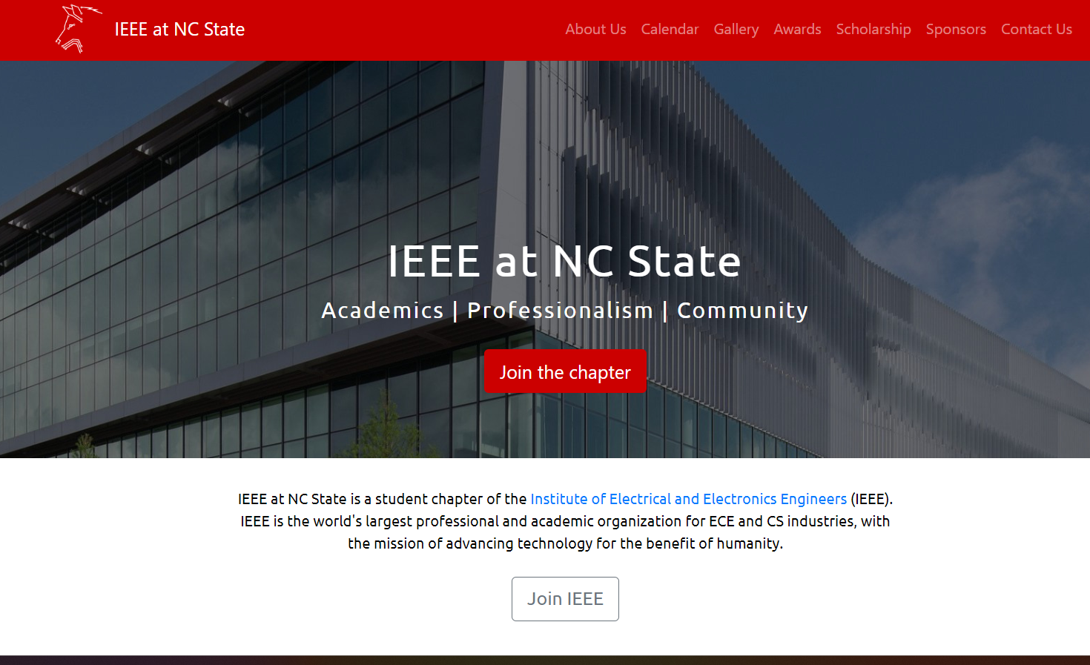
Determine Your Website’s Look and Feel
Consider what you want your website to look like
Think about how much time you’re willing to devote to keep the website up to date
Notes:
Do you want your website to be:
Dynamic with pictures
Posts
Hybrid
NC State Website: https://ewh.ieee.org/sb/nc/ncsu/
Atlanta Website: IEEE-atlanta.org
Coastal SC Website: https://site.ieee.org/coastalsc/

Slide 5
Getting Prepared
Choose a Platform
IEEE’s vTools
WEBINABOX
Notes:
WebinaBox:
Simple
Limited Options
Auto-population of Officer Information, Events Calendar, etc.
WordPress is:
User-Friendly
Flexible and Adaptable
Same Functionality as WebinaBox, but more Customizable

Slide 6
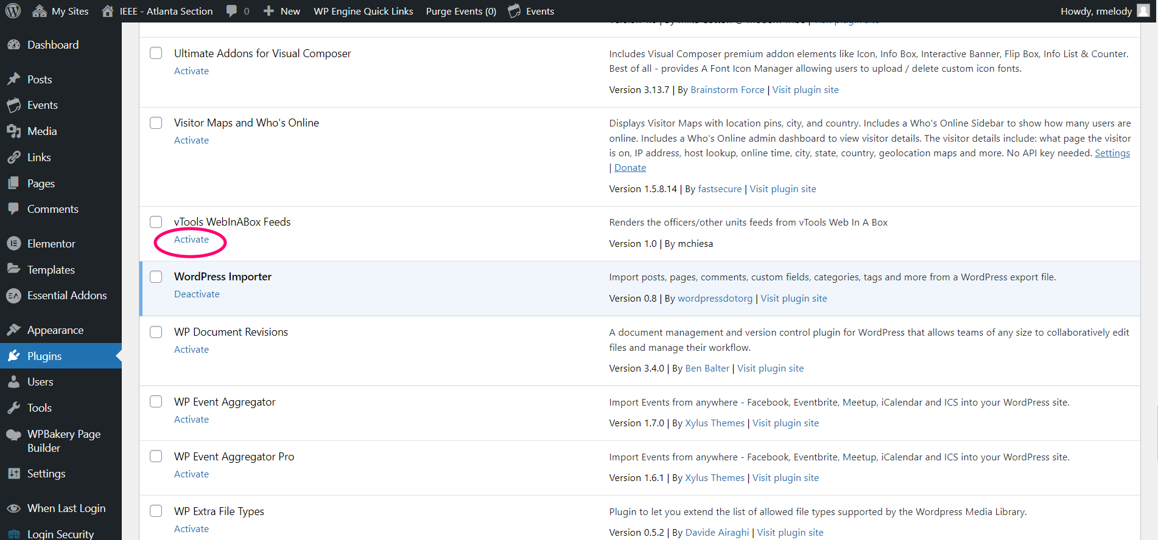
Getting Prepared - PlugIns
From the WordPress Dashboard, select PlugIns
Choose your plugin and Activate
Notes:
A PlugIn is a piece of software that “plugs into” your WordPress site. Plugins can add new functionality or extend existing functionality on your site.

Slide 7
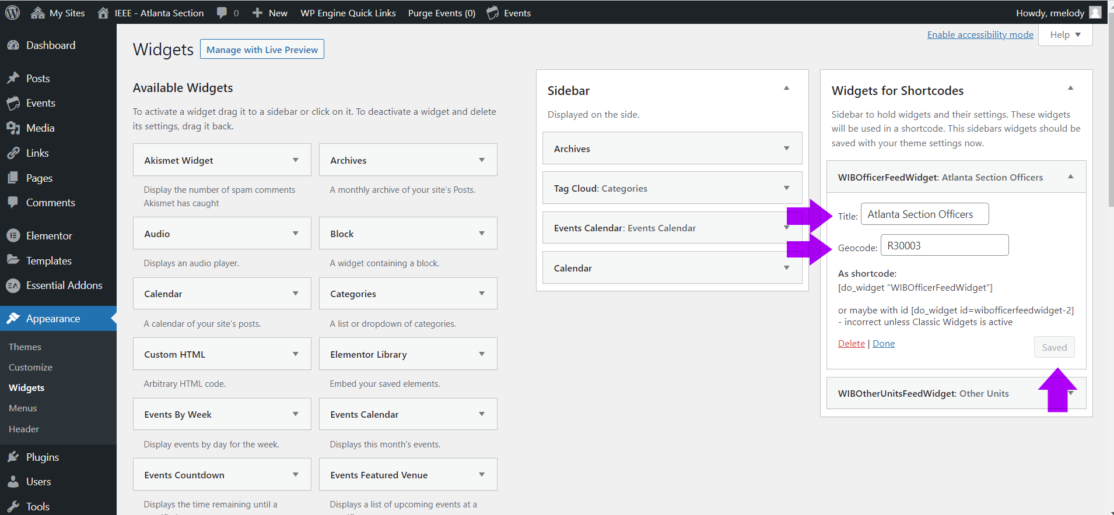
Getting Prepared - Widgets
From the WordPress Dashboard, select Appearance - Widgets
Choose your widget and fill in the appropriate information and Save
Notes:
A Widget is a modular element that enables you to add a specific feature to your website like an Events Calendar

Slide 8
Customize Your Website
Appearance
Utilize IEEE’s built-in templates and themes
Notes:
You can build website components from the ground up and customize each piece, or you can start with the “starter site” and customize from there

Slide 9
Build Your Website
Wordpress has different Page Builders to design your website
Two examples of Page Builders are WP Bakery Builder and Elementor
WP Bakery Builder
Elementor
Notes:
These tools allow you to design your website without development or coding skills. These Page Builders allow you to create:
Image Galleries & Sliders
Navigational Menus & Buttons
Posts and Much More!

Slide 10
Build Your Website
Create a Page
Notes:
A page is an area on your site where you can display content
Some of the most common pages on a website include Home, About, and Contact pages
You can add as many pages to your site as you would like, and you can update your pages as many times as you want
You can nest pages by customizing your menus (found on the Dashboard under Appearance)

Slide 11
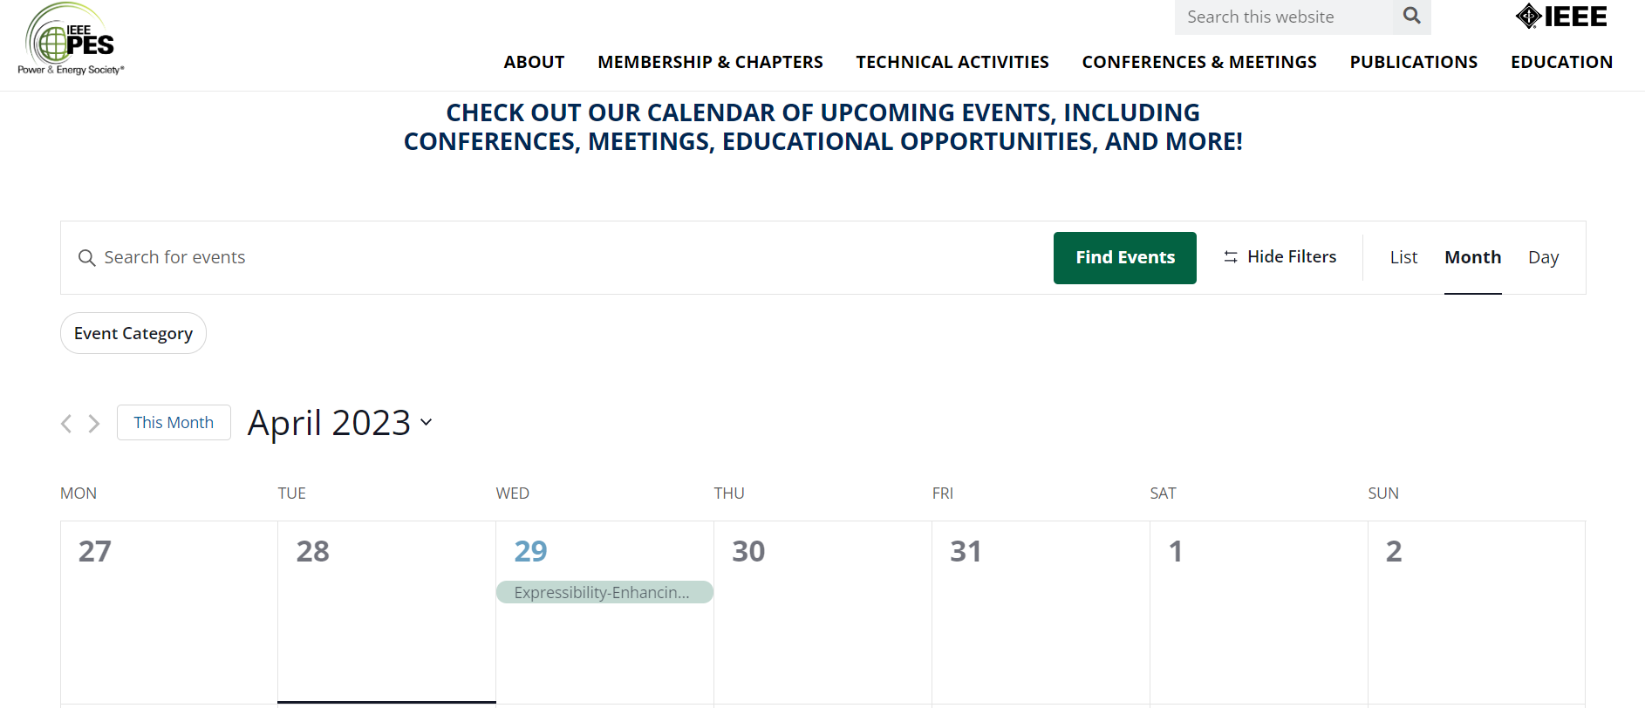
Build Your Page – Add the Events Calendar
In Elementor, add the (activated) Events Calendar to Your Page
Notes:
Earlier, we activated the Events Calendar plugin and now it is time for us to add it to the webpage. Remember, the Events Calendar plugin allows you to automatically show your section’s events listed in vTools.
You can use similar plugins to populate your section’s officers.

Slide 12
Show & Tell
https://ieee-atlanta.org/

Slide 14
Appendix – Links to Tutorials
Websites:
NC State Website: https://ewh.ieee.org/sb/nc/ncsu/
Atlanta Website: IEEE-atlanta.org
Coastal SC Website: https://site.ieee.org/coastalsc/
IEEE StyleGuide: https://brand-experience.ieee.org/guidelines/digital/style-guide/
WebPage Knowledge Base: https://kb.ieee.org/ewh/
Wordpress Detailed Tutorial: https://drive.google.com/file/d/1BT1fBzf6TXHvzK0CB0P-2wAJOX-TyiA7/view?usp=share_link
WebinaBox Detailed Tutorials: https://vtools.ieee.org/webinabox-tutorials/, or https://kb.ieee.org/vtools/blog/kb/intro-to-webinabox/
PlugIn Tutorial: https://drive.google.com/file/d/1BgegIQudNTZPUPM8Z7ZV0NP1zbI6ZzKs/view?usp=share_link
Widget Tutorial: https://wordpress.com/learn/get-flashy/
Website Tutorial: https://drive.google.com/file/d/1BT1fBzf6TXHvzK0CB0P-2wAJOX-TyiA7/view?usp=share_link
Page Tutorial: https://drive.google.com/file/d/1amwuLv3mpP3KtOG7fB2pELRvVERIXo6s/view?usp=share_link
Feeds for Wordpress (including Officers and Events Calendar Tutorial: https://site.ieee.org/files/2015/07/IEEE-vTools-Feeds-for-WordPress.pdf

