Slide 1
IEEE Operations Update
Sophie Muirhead, IEEE Executive Director & COO
IEEE Region 3 Committee Meeting
15 April 2023

Slide 3
3

Slide 4
Ethics and Member Conduct
IEEE Bylaw I-110. Misconduct Complaints and Support

Slide 5
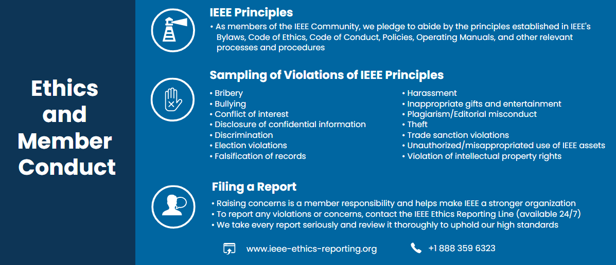
IEEE Constitution and Bylaws IEEE Code of Ethics IEEE Code of Conduct IEEE Ethics reporting

Slide 6
Recognition, Reach, and Impact

Slide 7
Explore the Applied Case Studies Online

Slide 10
Our 2023 Focus

Slide 11
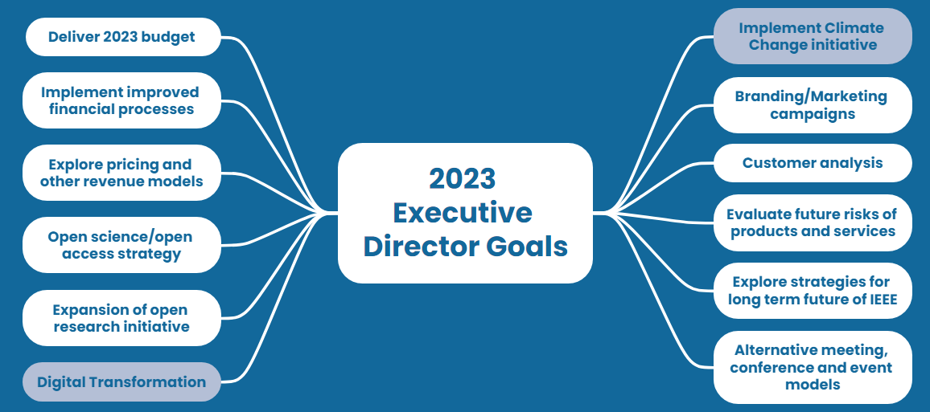

Slide 13
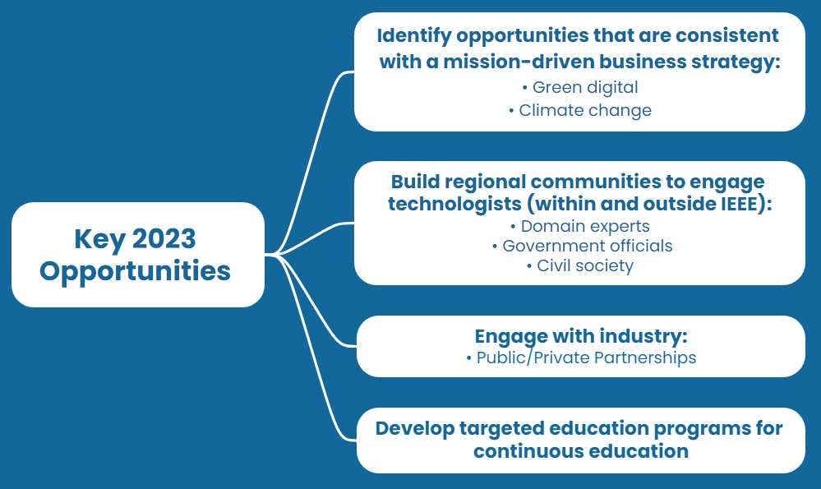

Slide 14
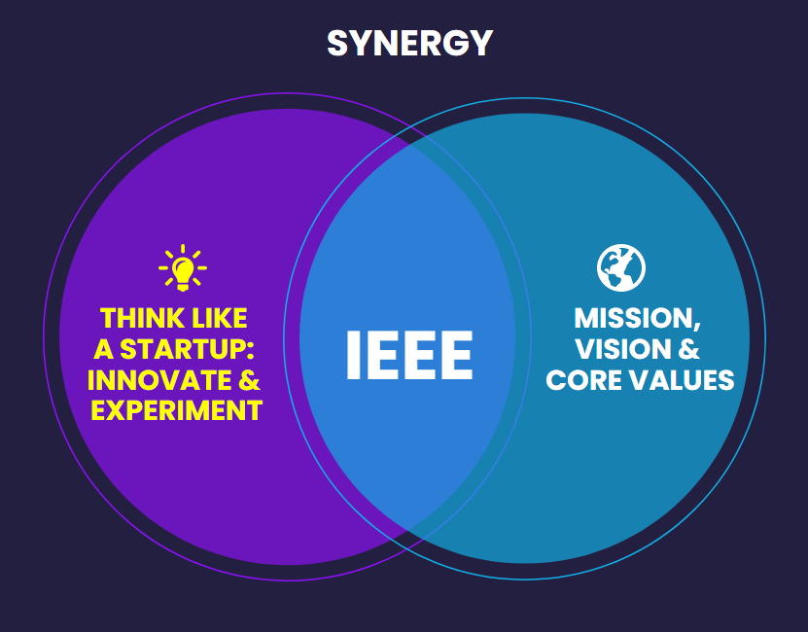
IEEE in 2050 and Beyond

