Slide 1
Professional Development
David Fillion
SoutheastCon 2023

Slide 3
Three Basic IEEE Areas covering Professional Development
Region 3 Professional Development Committee Corey
IEEE USA CPDC
SPAx

Slide 4
What is Professional Development?

Slide 5
Almost anything that is NOT technical.

Slide 6
Some Examples or Ideas
Resume Development
Interviewing Skills
Personal Networks
STEM
The Job Search
Public Speaking/Presentation Skills

Slide 7
Region 3 Professional Development Funds
You have an idea
But, is it Professional Development?
Criteria – does it cover anything technical?
If Yes, it is NOT Professional Development

Slide 8
Region 3 Professional Development Funds
Build the details of the Professional Development Activity
What specifically will the activity be?
How much will it cost? Write a budget

Slide 9
Region 3 Professional Development Funds
Complete the application for funds Excel Spreadsheet
Description of event
Financial Details – remember a 50% match up to $1,000
Section Chair must approve

Slide 10
Region 3 Professional Development Funds
Send Completed form to David Fillion – dfillion@ieee.org
When approved, Joe Pennisi, Region Treasurer, will be notified along with the Section
After receiving bank account details, the money will be transferred to the section

Slide 11
Region 3 Professional Development Funds
Have your event
Provide a report to David Fillion

Slide 12
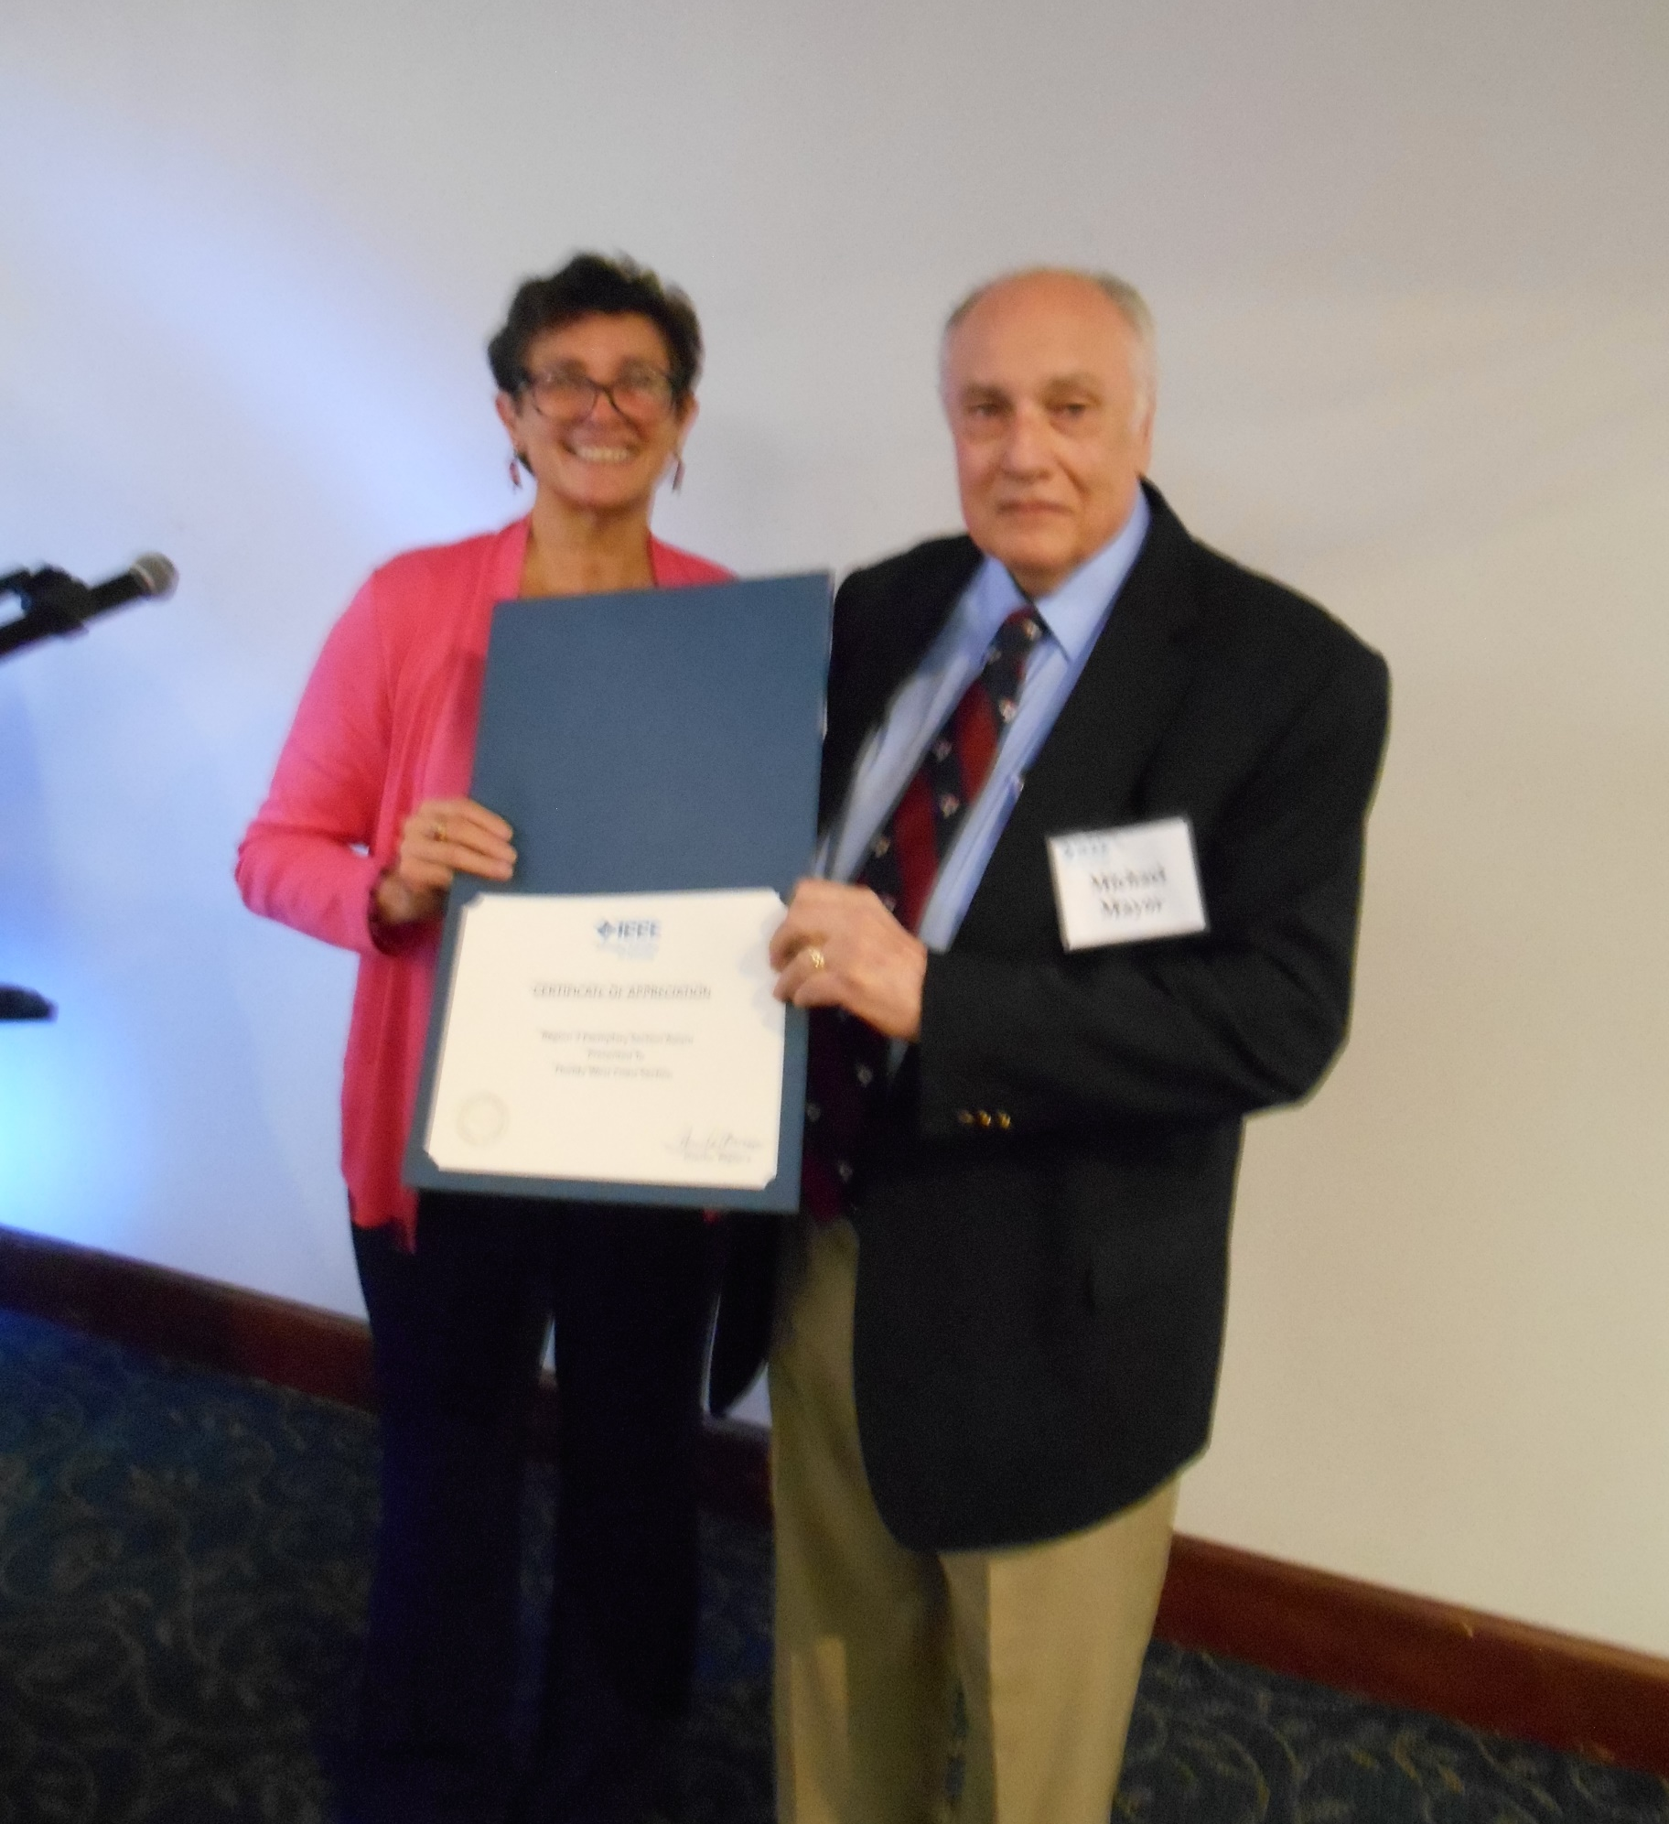
Region 3 Professional Development Funds
FWCS Senior Member Gala – November 5, 2022

Slide 13
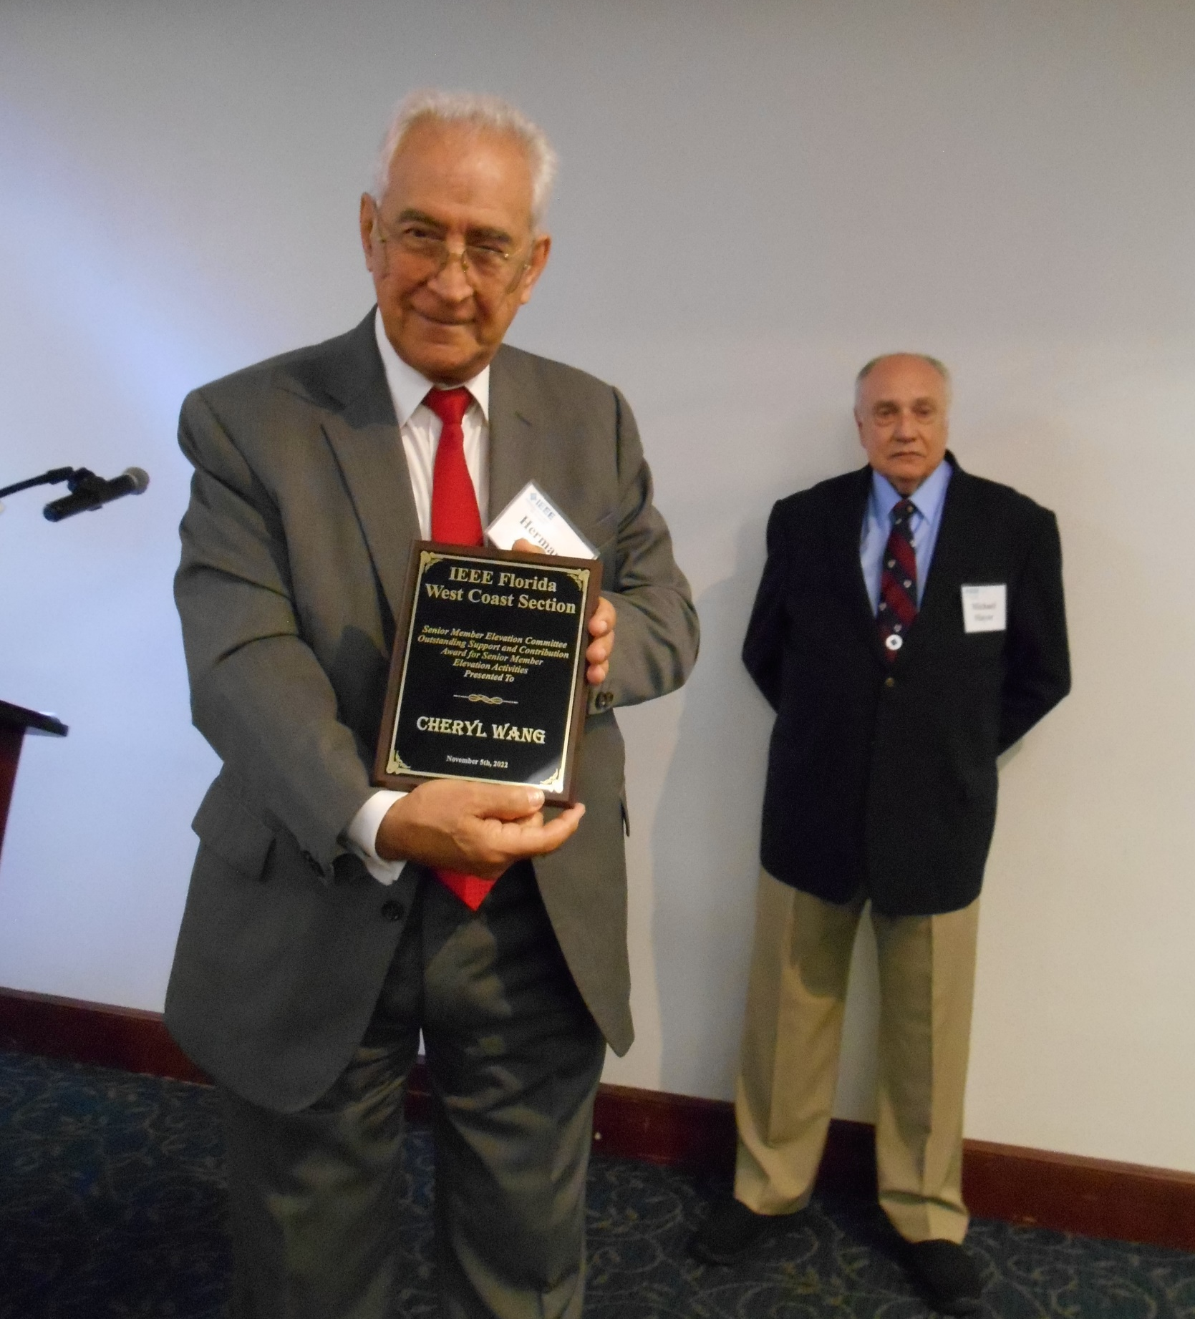
Region 3 Professional Development Funds
FWCS Senior Member Gala – November 5, 2022

Slide 14
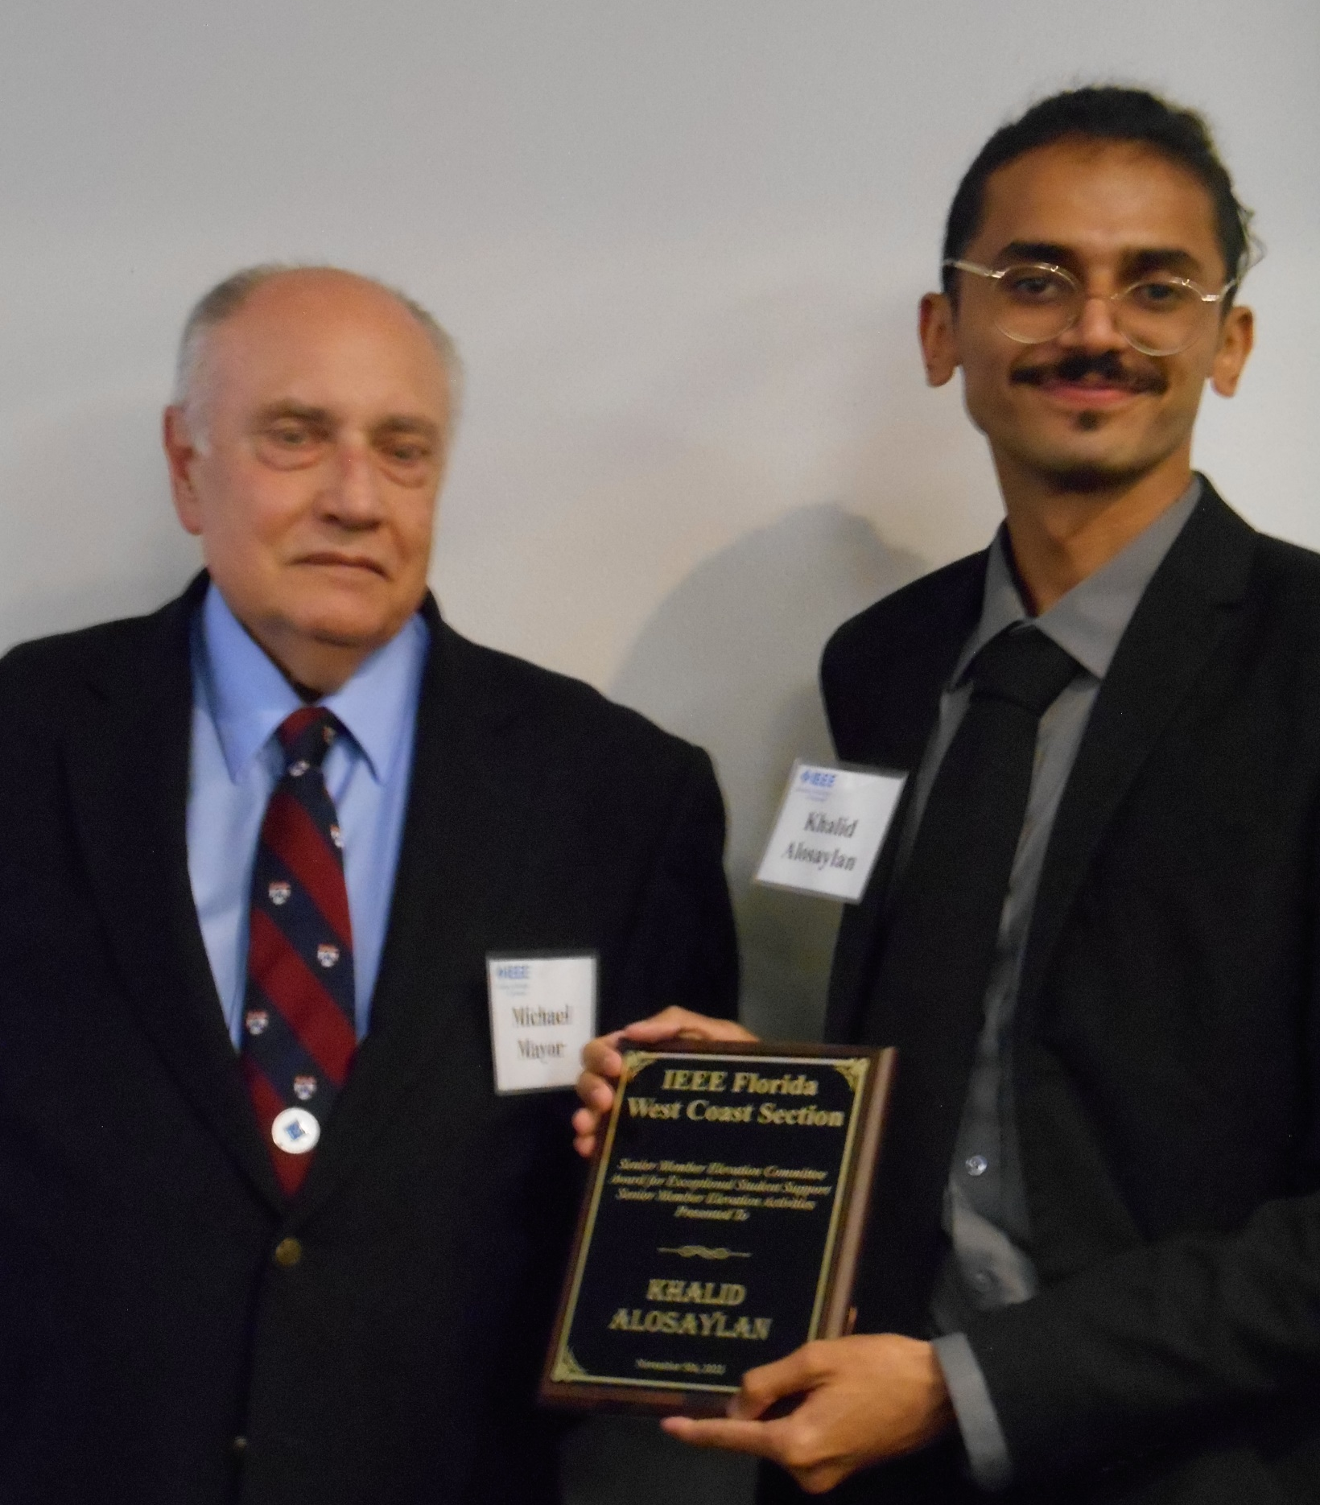
Region 3 Professional Development Funds
FWCS Senior Member Gala – November 5, 2022

Slide 15
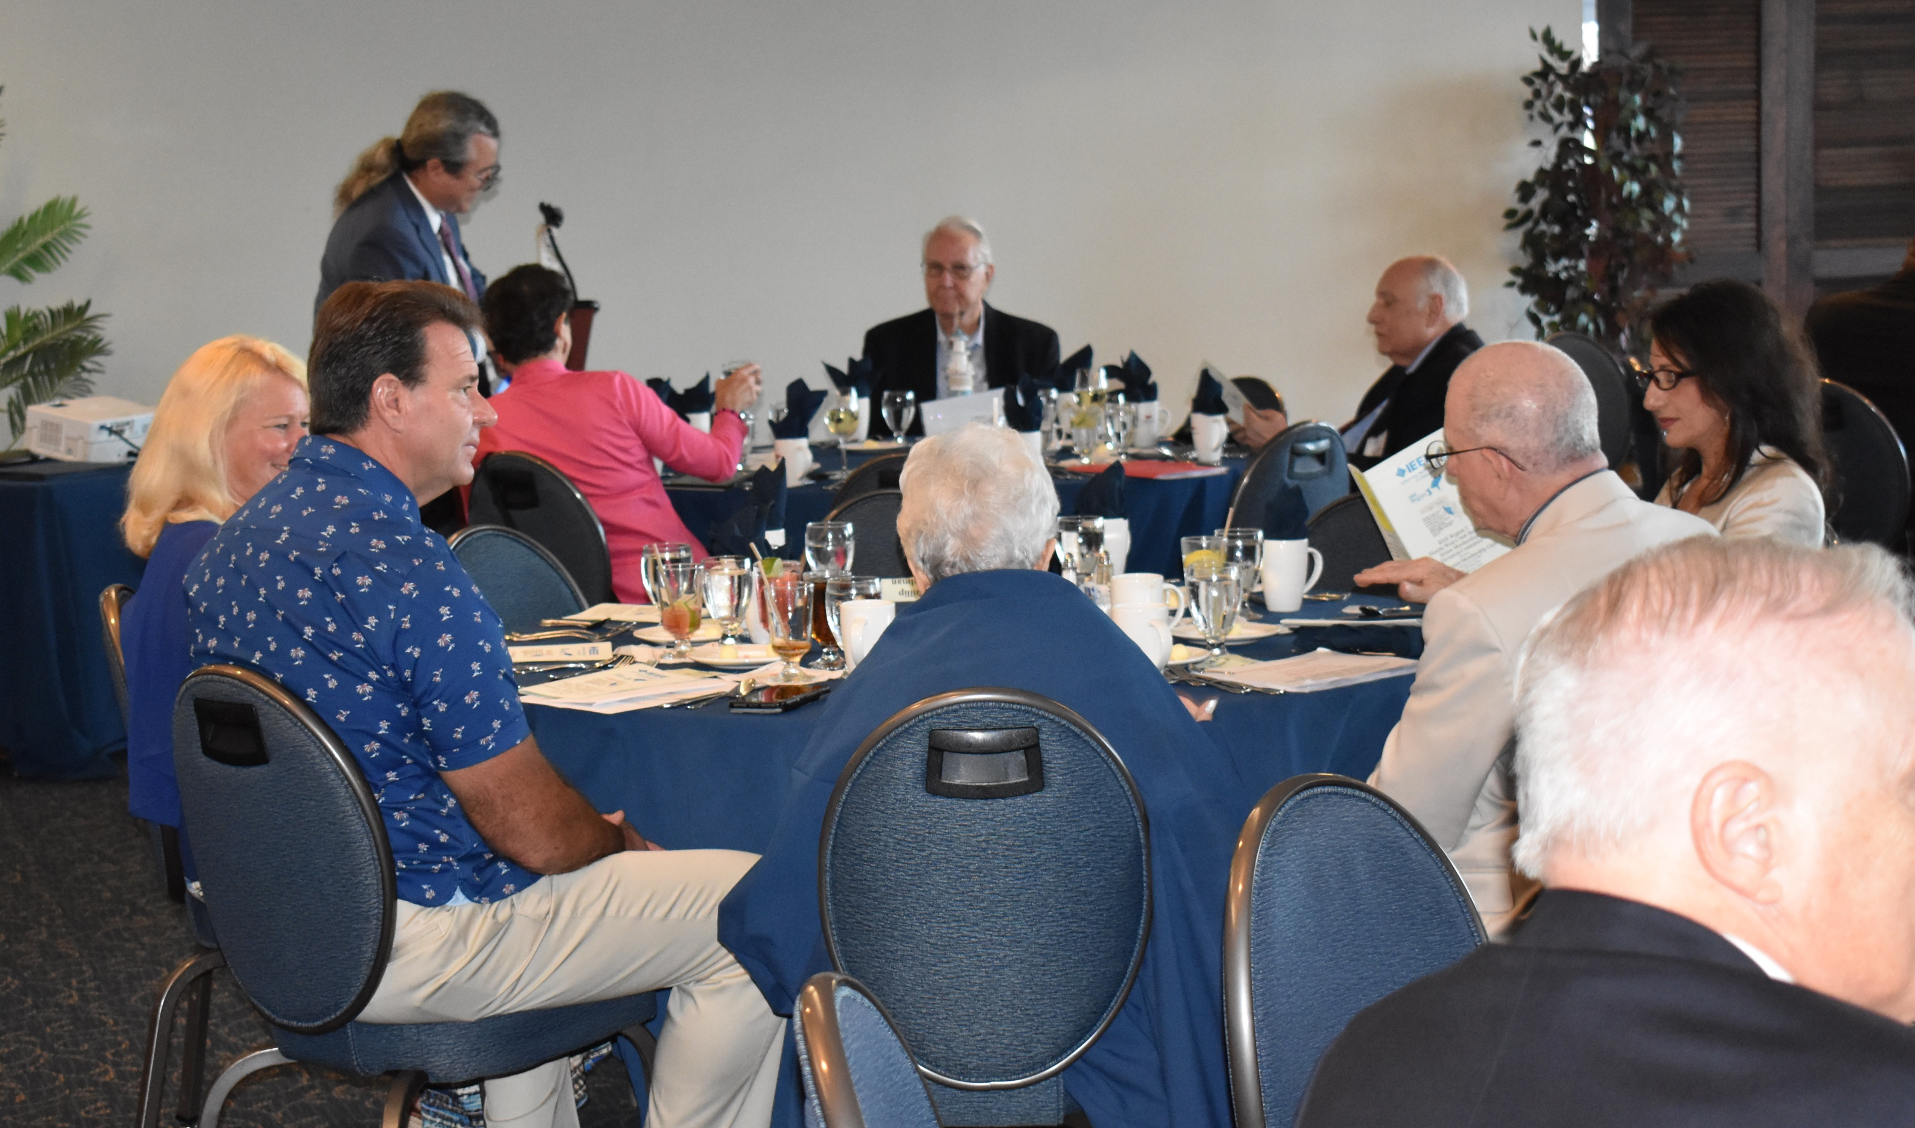
Region 3 Professional Development Funds
FWCS Senior Member Gala – November 5, 2022

Slide 16
CPDC Career and Professional Development Committee
David Iams, IEEE Staff Support
Professional Development Webinars
Salary Survey

Slide 17
CPDC Career and Professional Development Committee

Slide 18
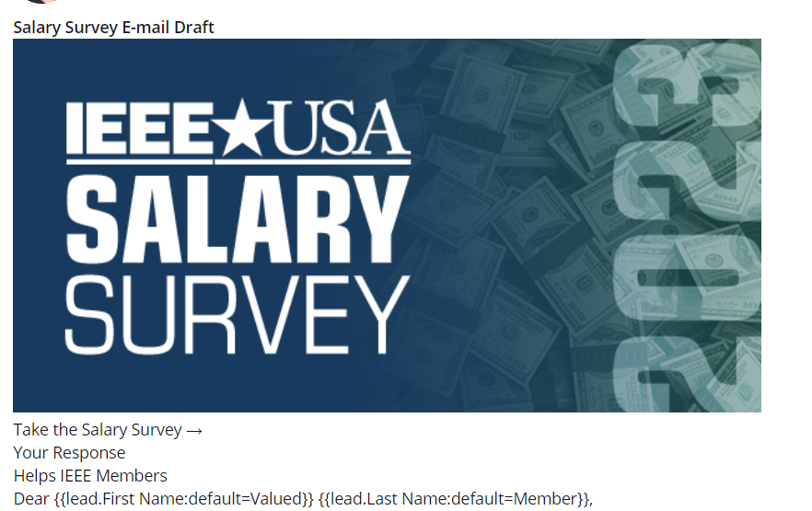
CPDC Career and Professional Development Committee

Slide 19
CPDC Career and Professional Development Committee

Slide 20
CPDC Career and Professional Development Committee

Slide 21
CPDC Career and Professional Development Committee

Slide 22
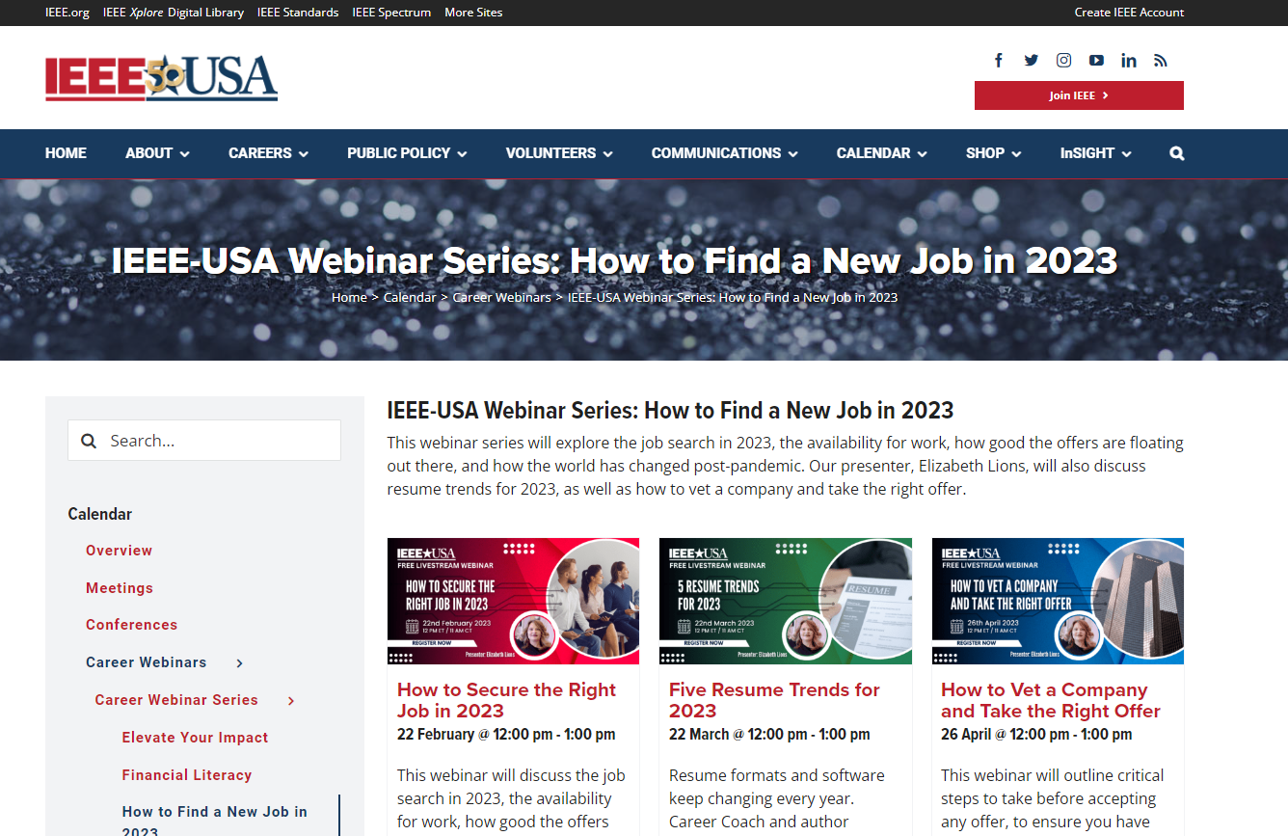
CPDC Career and Professional Development Committee

Slide 23
SPAx Student Professional Awareness

Slide 24
SPAx Student Professional Awareness

Slide 25
SPAx Student Professional Awareness

Slide 26
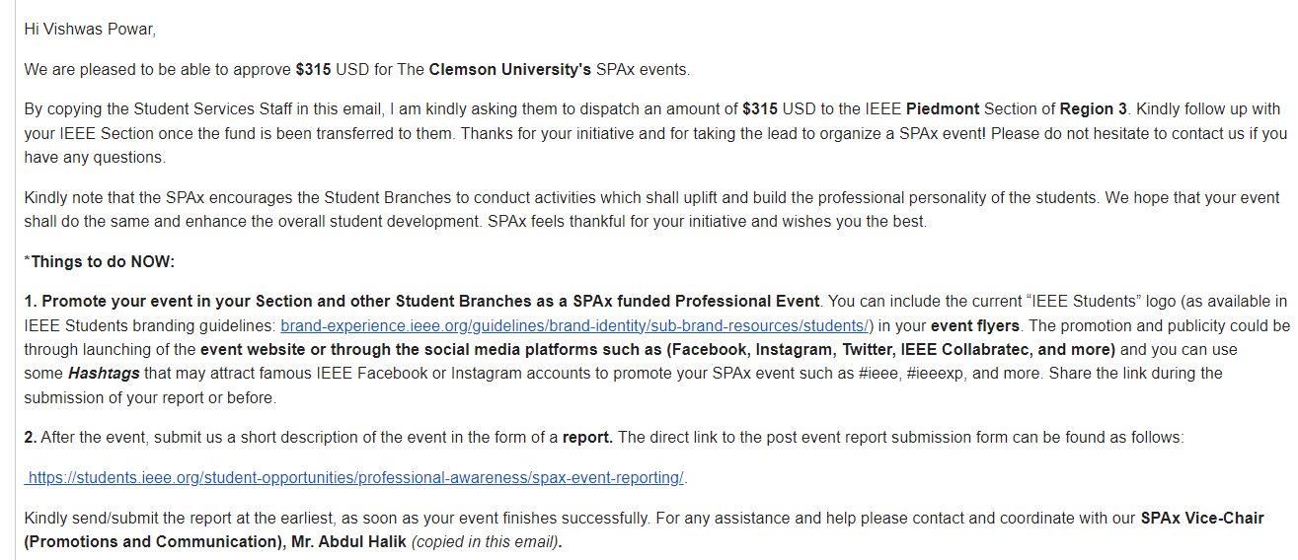
SPAx Student Professional Awareness

Slide 27
Region 3 Professional Development
- Professional Development Committee
CPDC
SPAx
Contact:
David Fillion dfillion@ieee.org

