Slide 1
NextGen 101
What you need to know to get started …
Joe Pennisi, Region 3 Treasurer
April 15, 2023

Slide 2
Agenda
How should I use NextGen
How do I logon
Balances & Transactions
WBS Tasks & Tagging
Budgets
Reports
Payments/Transfers (NextGen 201)
Expense Approvals (NextGen 201)

Slide 3
How should I use NextGen
NextGen is like your online bank portal
  Shows you what’s already happened, not what’s coming
Retrieve balances for any past day
View all existing transactions, with date filtering
Tag transactions* (there are caveats)
Generate data for reports
  Requires budget is setup and loaded to be meaningful
Payments/transfers* (Part of NextGen 201)
Region 3 On-Demand Report Spreadsheet* (Part of NextGen 201)
An ad hoc MGA Finance team is investigating changes

Slide 4
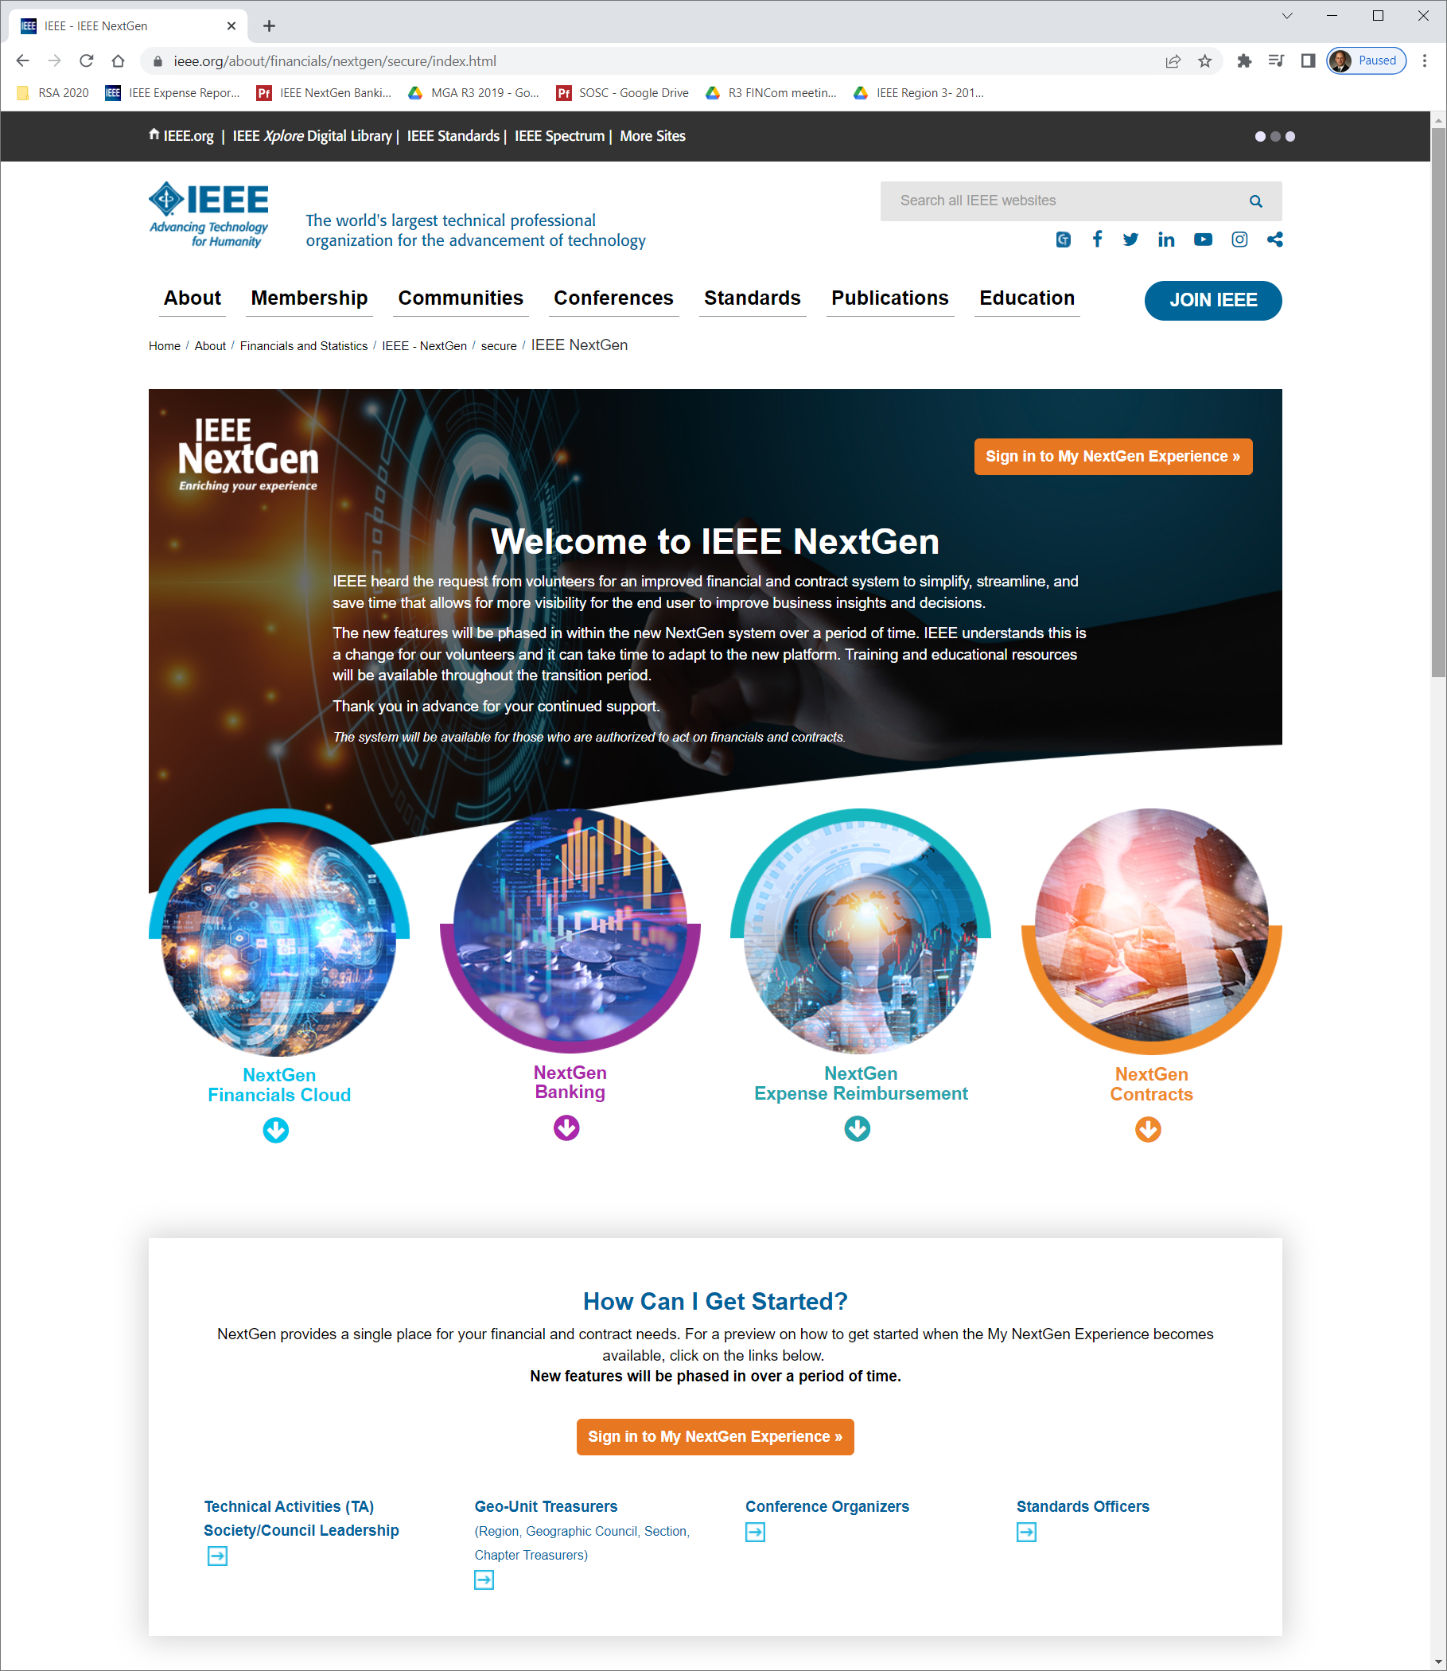
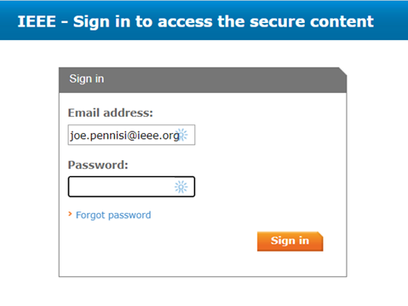
Logging in
https://www.ieee.org/nextgen

Slide 5
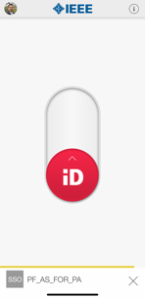
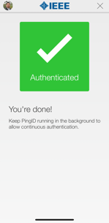
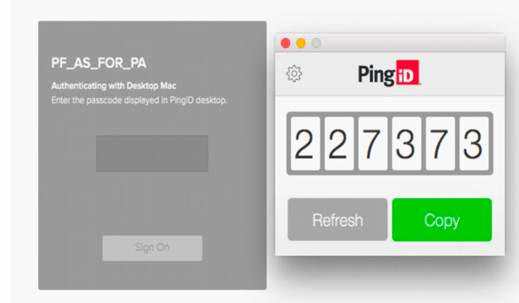
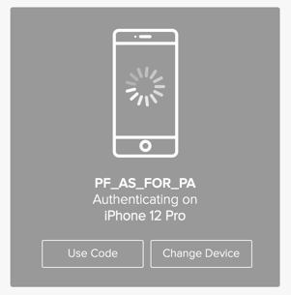
Extra Layer of Security - PingID
Mobile
Desktop
IEEE Proprietary

Slide 6

NextGen Tools Suite
Annual budget
Budget vs Actual reporting
Banking transactions
Payments
Concur Expenses
Expense report approval

Slide 7
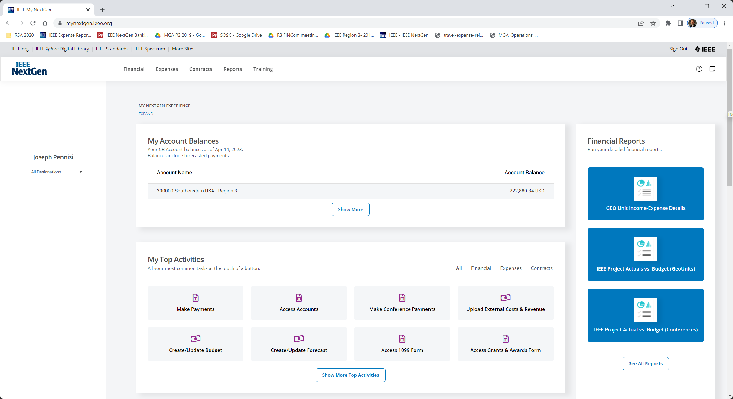
NextGen Banking Dashboard
NextGen Cloud:
B vs A Reporting
https://mynextgen.ieee.org/
Quick view of account balances
NextGen Banking: Account Activities
NextGen Expenses:
(opens Concur)

Slide 8
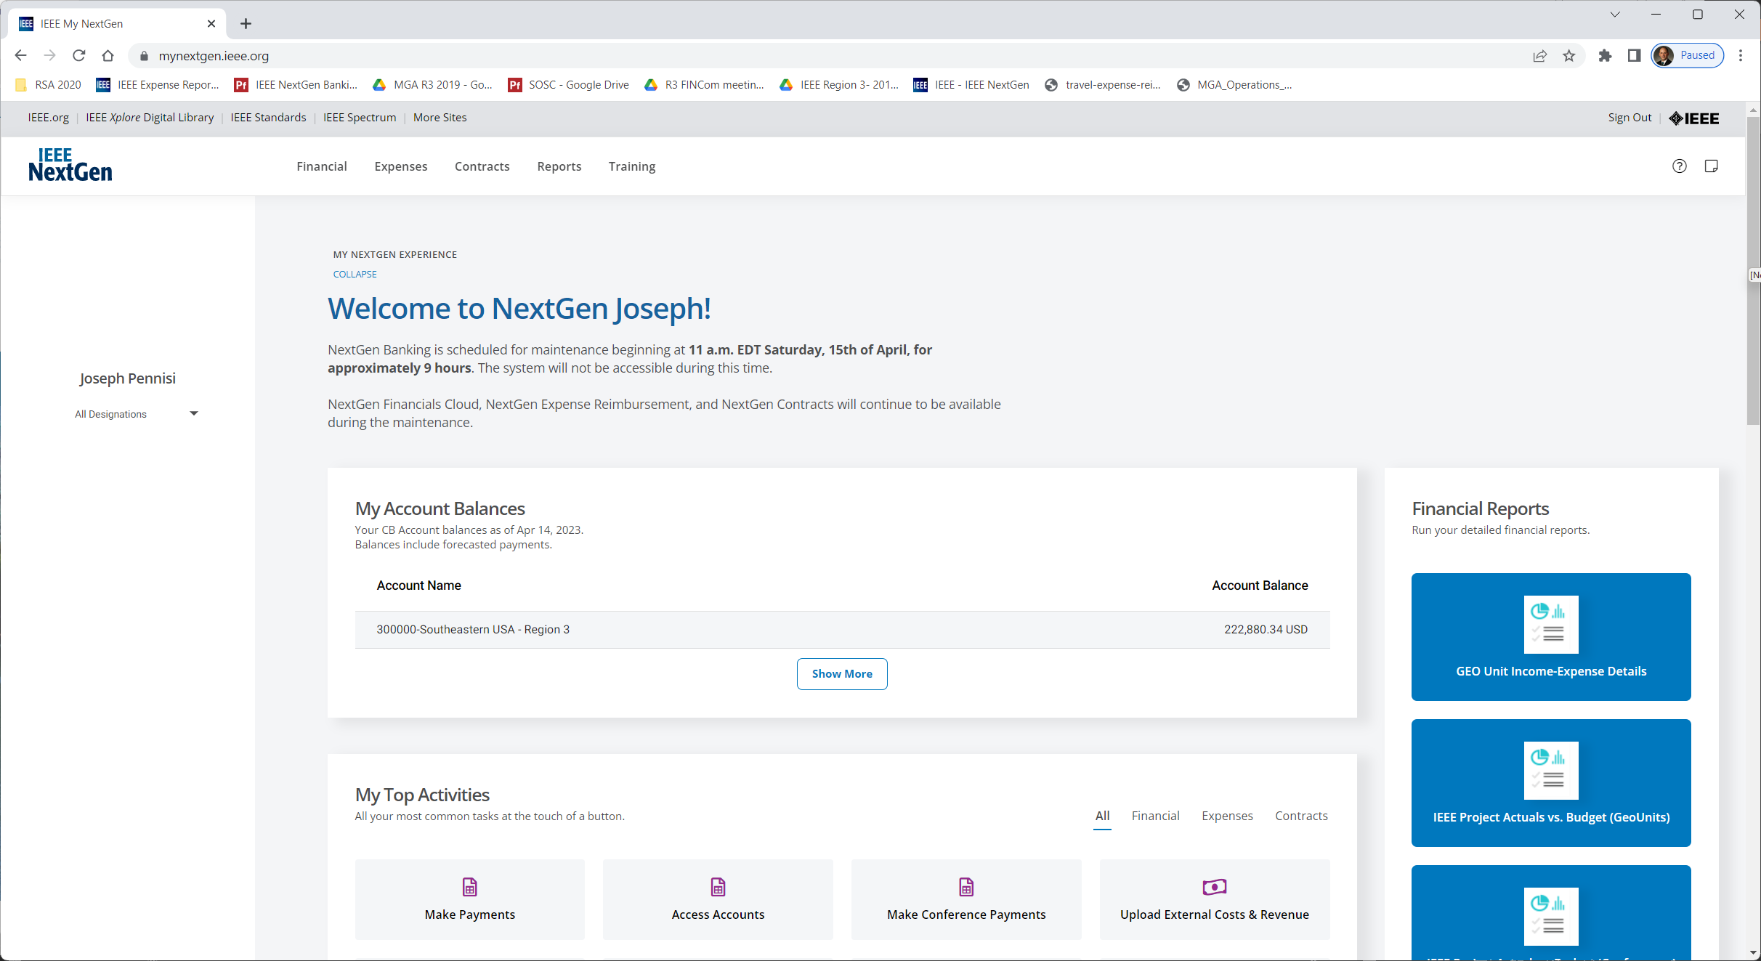
NextGen Demo – oops

Slide 9
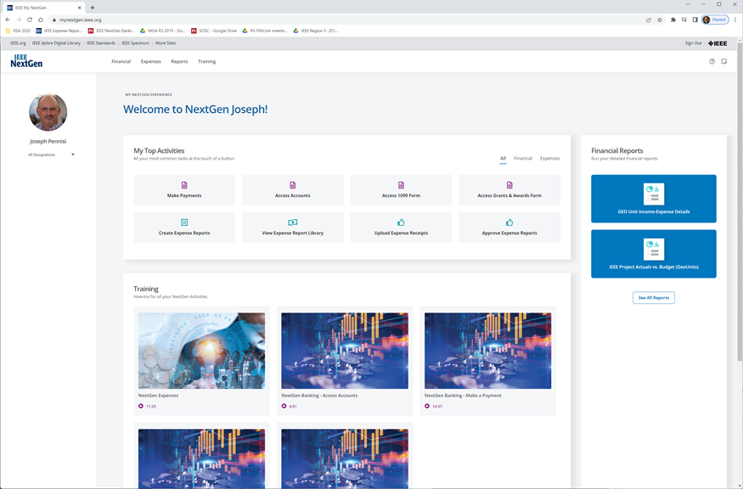
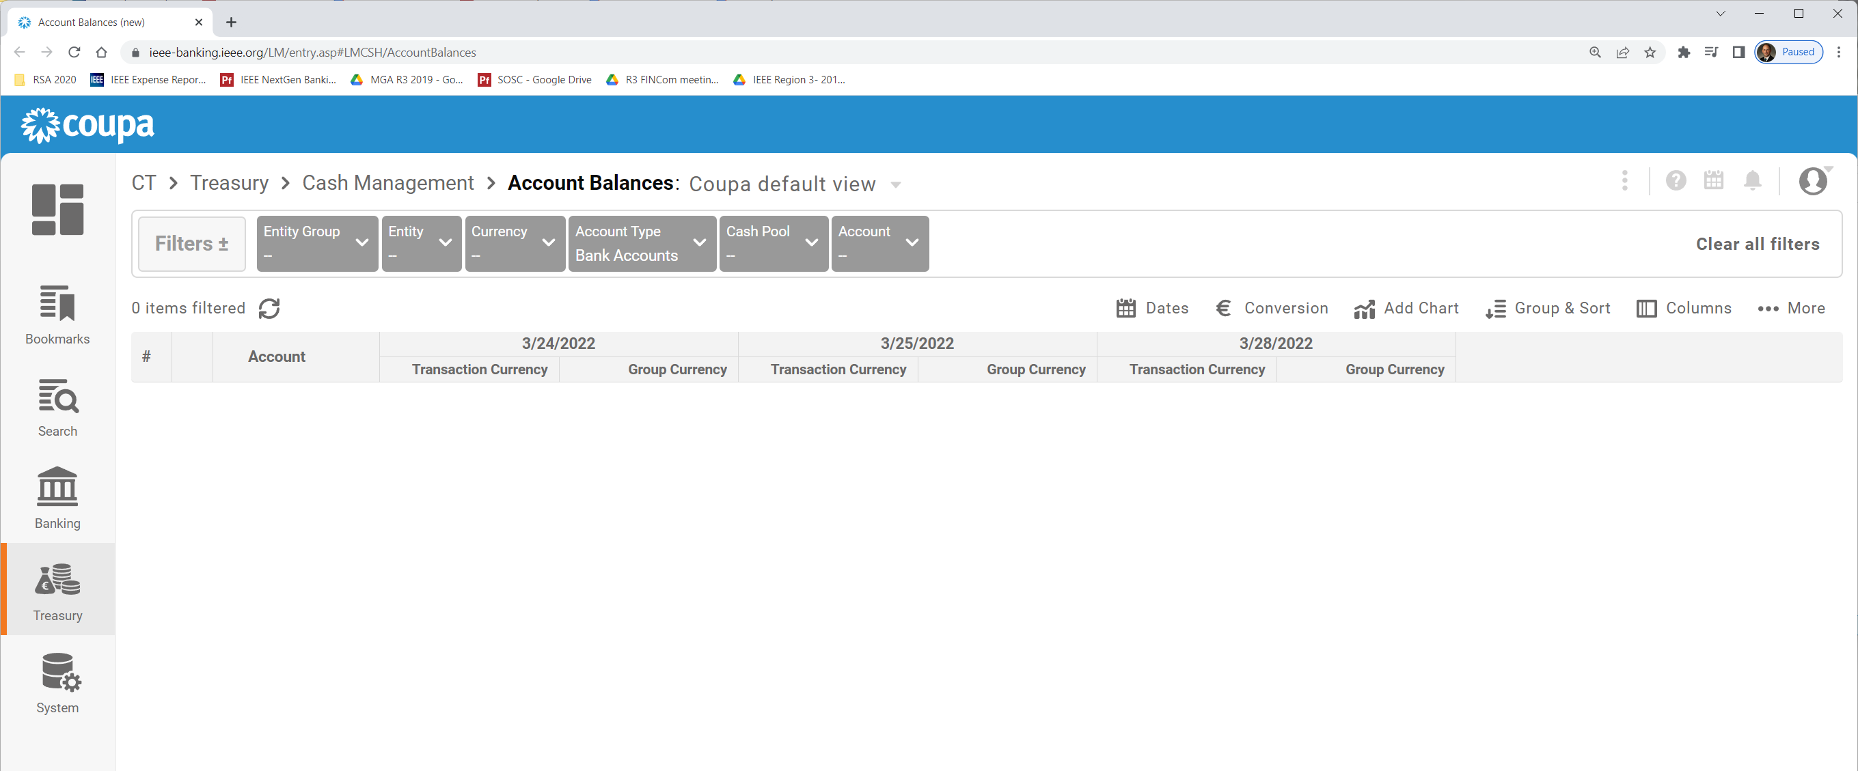
Account Balances
View all bank transactions through “Access Accounts”
Opens “coupa” dashboard to account balances
Clear out filters to see your account balances
Clear out filters to see your account balances
Change Dates here for balances on given dates

Slide 10
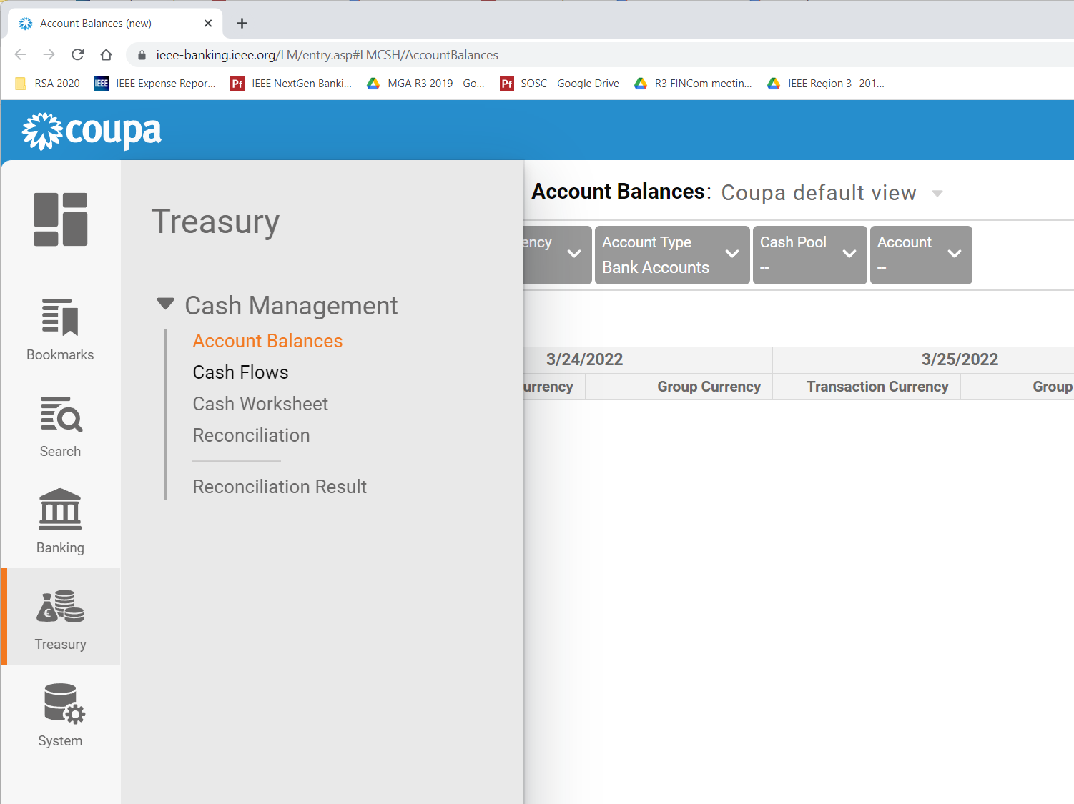
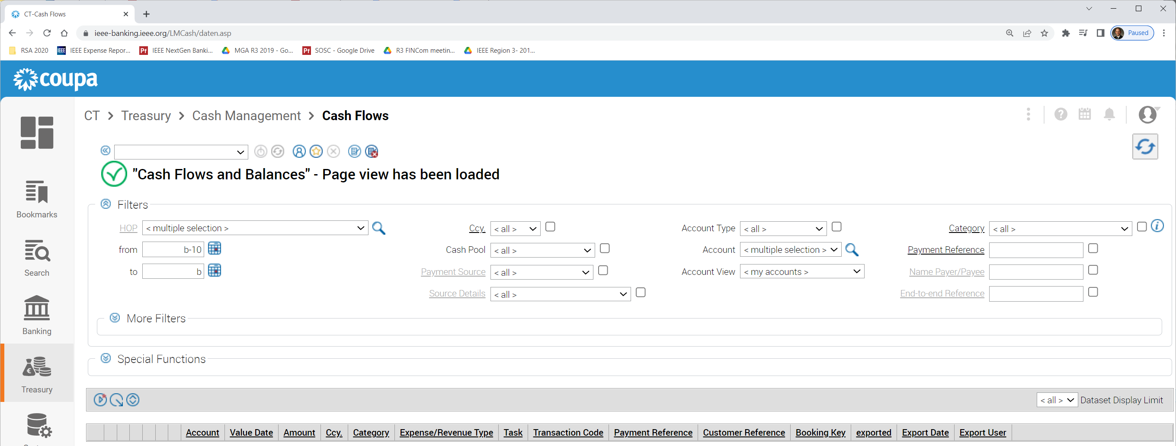
Bank Transactions
Need to set several fields before “update” to get data
Select “Cash Flows” to see all transactions
1
2
4
3
Select HOP from drop down
Select “all” for Account
Select start/end date of interest
Click “update”
Select HOP from drop down
Select “all” for Account
Select start/end date of interest
Click “update”
Select HOP from drop down
Select “all” for Account
Select start/end date of interest
Click “update”
Select HOP from drop down
Select “all” for Account
Select start/end date of interest
Click “update”
HINT: You’ll use the Update button frequently to refresh displayed data

Slide 11
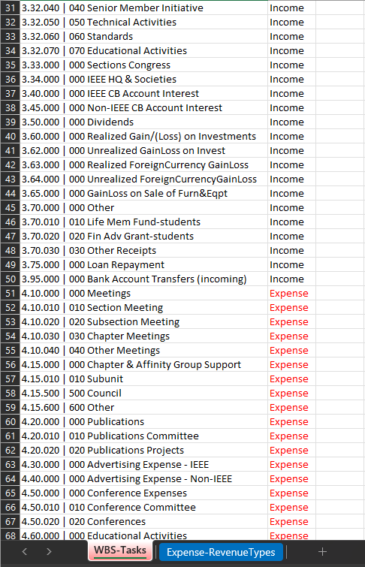
WBS Tasks
Work Breakdown Structure Tasks
  Key for categorizing transactions
  Key for budgeting & reporting
NextGen is organized into “projects”
  For MGA this is Regions, Sections, Chapters, Affinity groups, etc.
Each project has a set of assigned Tasks
  Some are common, some are unique
  Provided by MGA finance to each Treasurer in “WBS and Exp-Rev Types Listing” file
NextGen tagging makes superset available
  This is why tagging in NextGen currently isn’t officially sanctioned
MGA Finance request tagging via spreadsheet
  Requested periodically of treasurer (every 6 months)
  Limits Reporting frequency

Slide 12
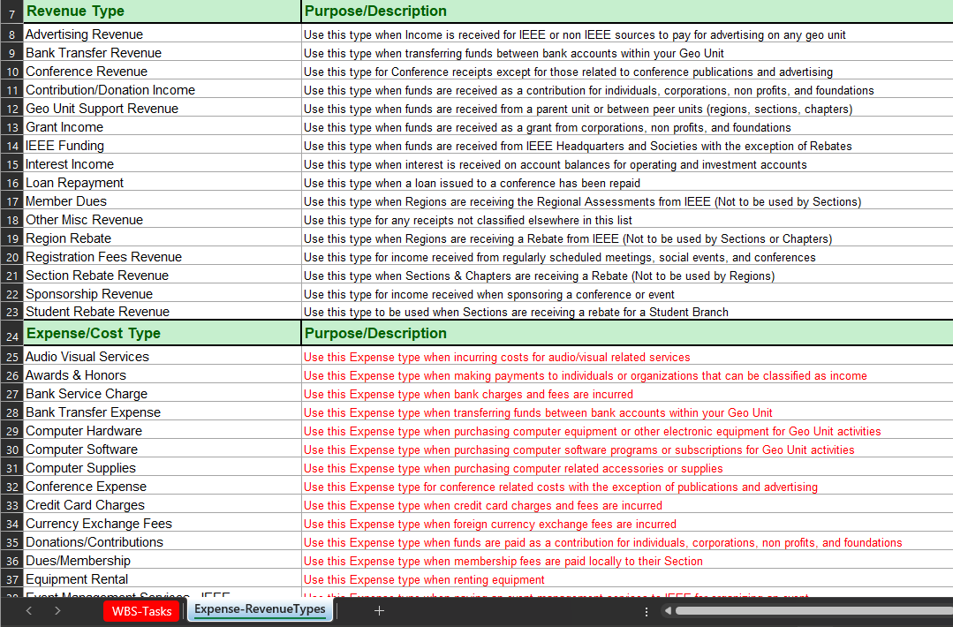
Expense-Revenue Types
For classifying transactions

Slide 13
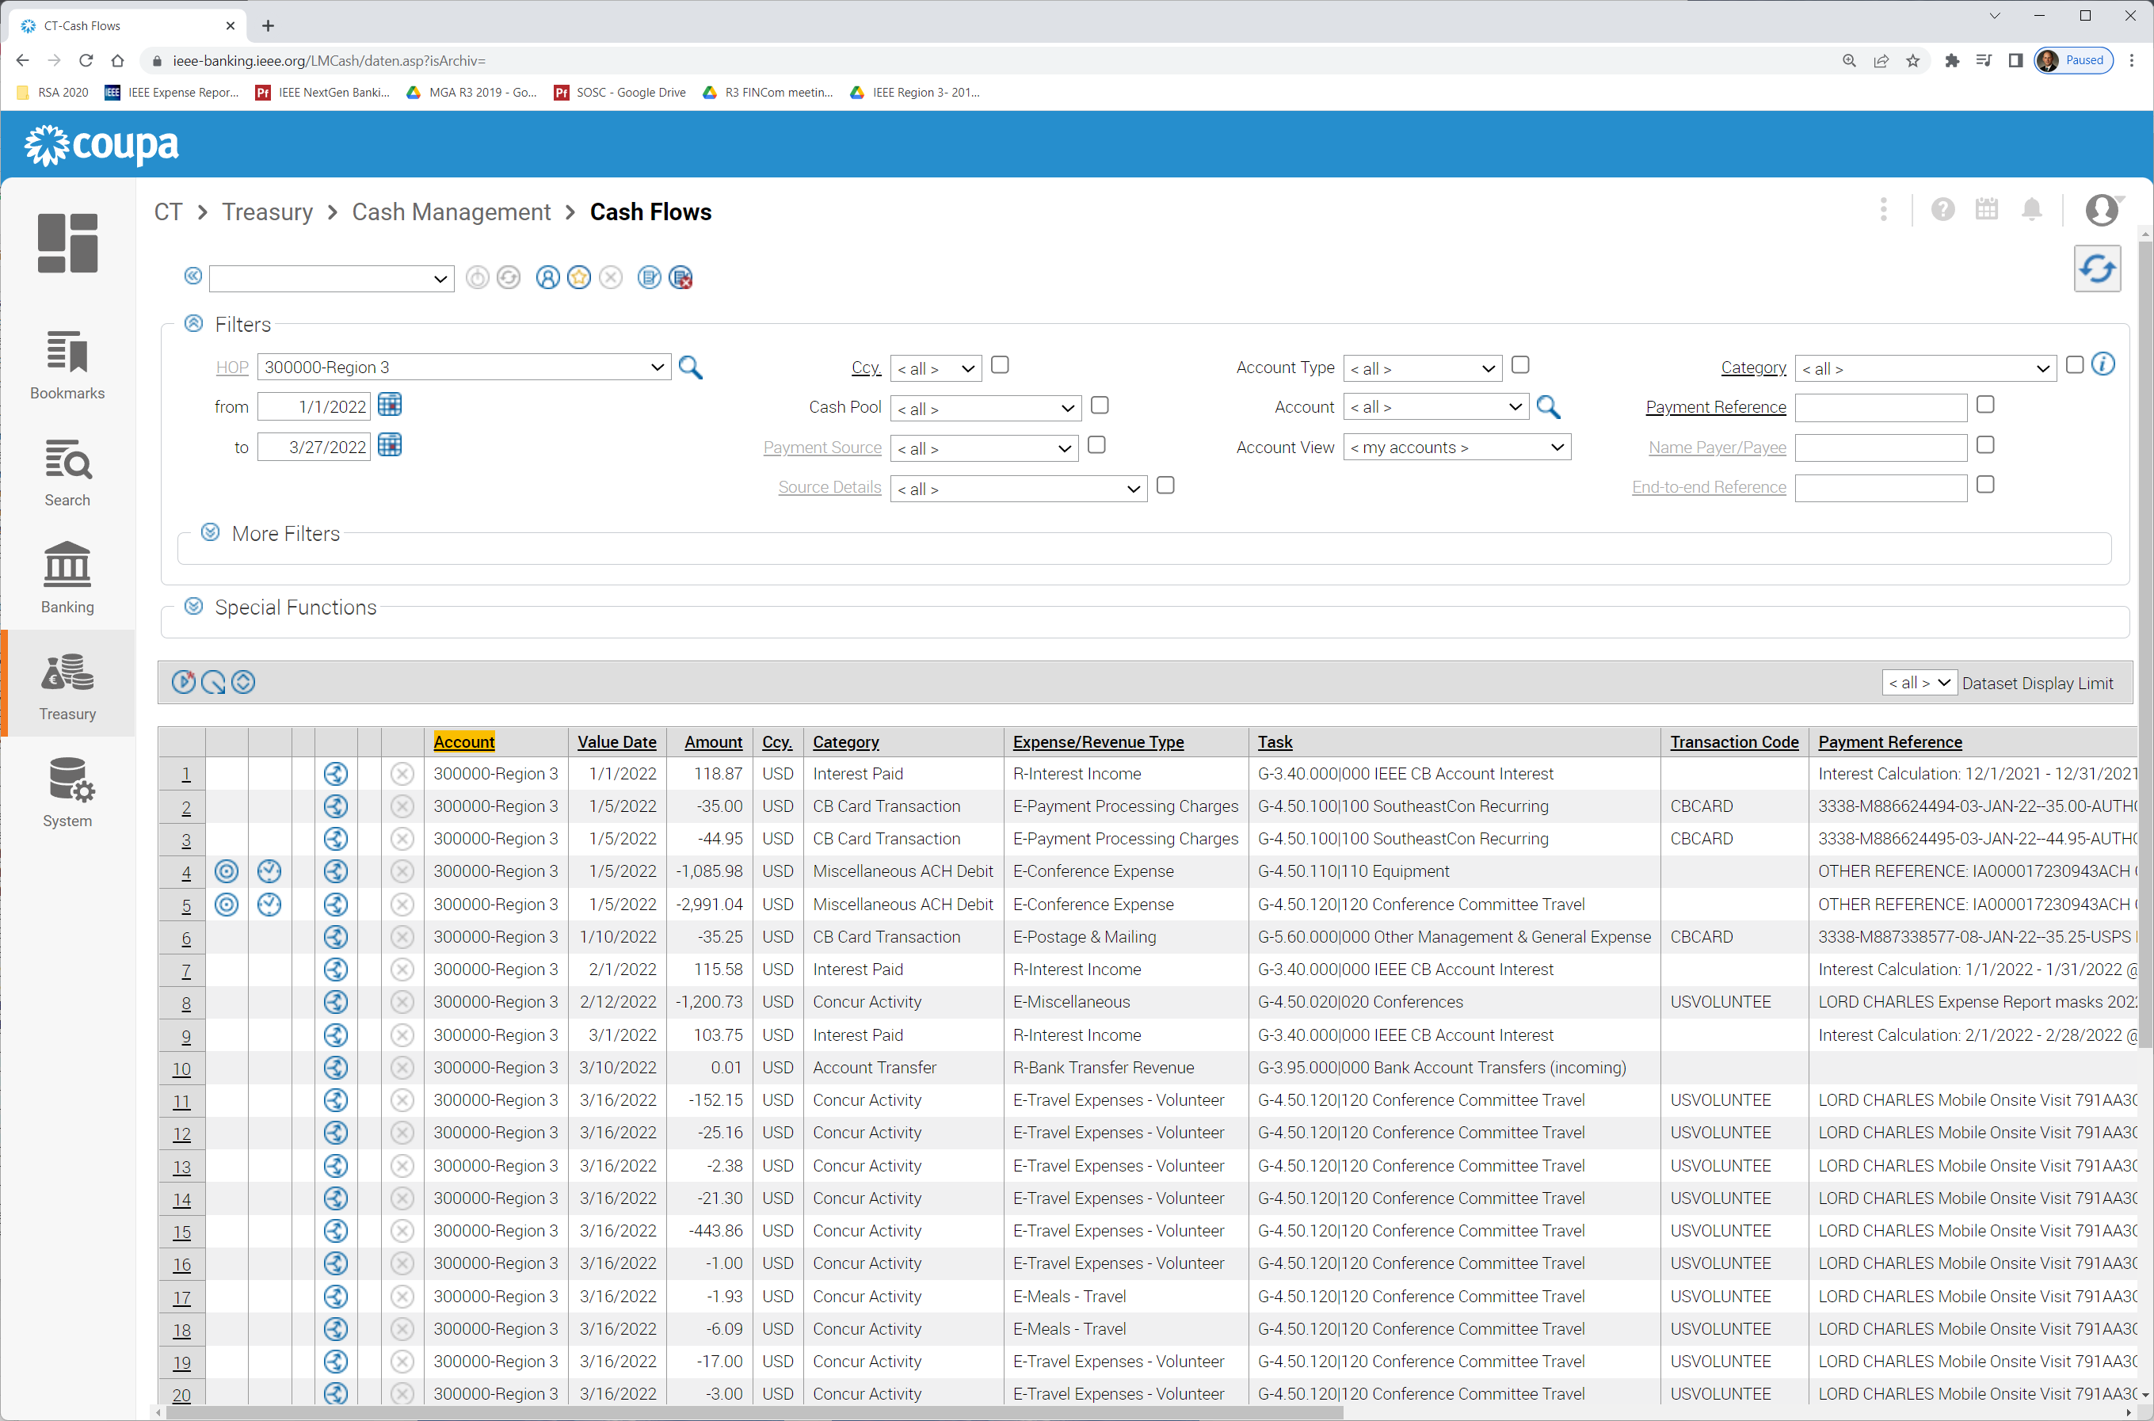
Bank Transactions
Note: Due to Current NextGen limitation that exposes more tasks to a treasurer than are valid, NextGen tagging does NOT sync with NextGen Cloud.
MGA Finance manually uploads each project from periodic Treasurer spreadsheet tagging process.
Currently a manual tagging and upload process is required to enable reports.
Treasurers CAN tag transactions as they appear in the list.
The key is tagging ONLY with tasks in your WBS list (obtained from file). This is manual, but beneficial for managing finances until tool updates provide this capability.
Transaction Tagging:
Category
Expense/Revenue Type
Task (task code)
Need to limit to GL codes in your WBS list
Export current view to spreadsheet CSV file for those inclined to work with those

Slide 14
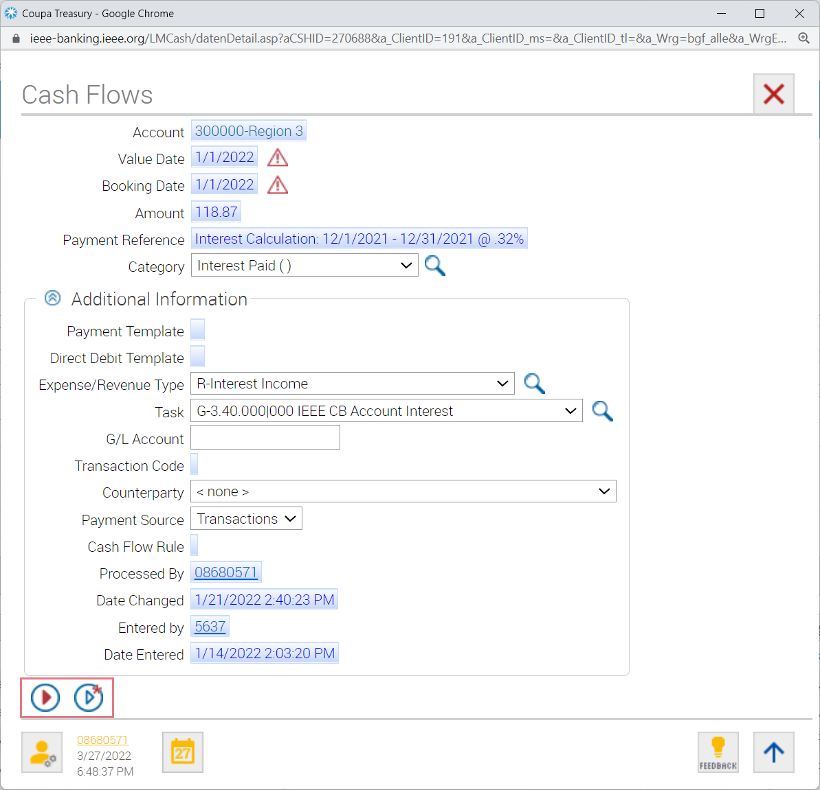
Tagging
Select number for transaction to tag
Select Type & Task from drop down
*Make sure to only use Task from budget
Click “save” when complete

Slide 15
Tagging (official)
Official transaction tagging requires manual upload by MGA Finance team
Finance team will send reports to treasurers to tag and return
Once these are uploaded by Finance team, B vs A reports will be accurate
However, if tagging performed in NextGen uses only applicable WBS tasks, they can use this data to upload – it is important that it is correct.
Frequent tagging makes the process easier than bulk tagging from spreadsheet & enables a simple method to create reports on demand
Note: Concur expense reports get automatically tagged

Slide 16
Budgets
Budgets are critical to proper finance management
These should be created and approved by each group with financial transactions before the start of the Fiscal Year (Jan – Dec)
All Sections SHOULD create, approve and track to a budget
  Provides for predictability, accountability and transparency
  Budget is developed by Treasurer with input from Section ExCom & others
  Best Practice – incoming ExCom ratifies approved budget
  Chapters, Affinity groups, etc. should have budgets as well – any group with a NextGen acct
Budgets are built from a template from MGA staff (using your WBS tasks)
  Likely only a small subset of tasks are used (common)
  Additional tasks may be added if needed (shown later)

Slide 17
Budgets
Once created and approved, budgets are manually loaded by MGA Finance staff
These budgets are used in Reporting section to provide B vs A reports
Example: Region 3 budget (revenue and expense section snippets)

Slide 18
Budgets
If your Section requires additional WBS tasks for specific tracking, these can be requested from MGA Finance – contact me for more info
MGA Finance team will include standard Task Codes
  You can request additional specific codes – example ENCS expense WBS Task Codes
Standard budget template 4.15.xxx
Custom ENCS budget template 4.15.xxx

Slide 19
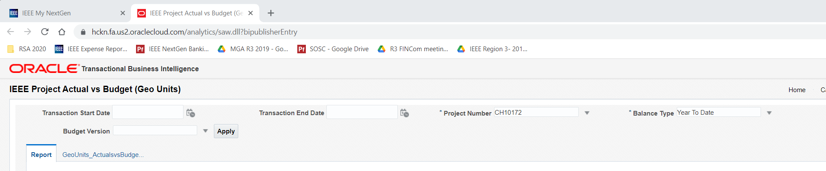
Reporting
Budget + transaction tagging upload => system generated report
Each report will contain any uploaded transactions & budget info
Select Start/End date (recommend 1/1/year & 12/31/year for report)
Select Project Number (Sections start with R and follow with HOP #)
Select the uploaded budget template (leave budget type “Year To Date”)
Press Apply
Important: Report is downloaded as XLS file, not shown on screen
Contains Summary and Detail tabs

Slide 20
Reporting – Self-service
Depending on your transaction volume, you can manually update the B vs A report in between uploaded tagged transaction files (this is what I currently do)
  Requires some proficiency working in Excel with formulas (if interested, I can provide a template)
  This utilizes the report output and requires an uploaded budget to perform B vs A
  This is helpful only if you also correctly tag transactions in NextGen Banking
This takes advantage of a useful feature from the Transaction page
This is the Sort and Subtotal tool
It enables you to export a list of all non-zero WBS tasks, with the total for each task
This can then be used with a blank report to generate an on-demand B vs A report.

Slide 21
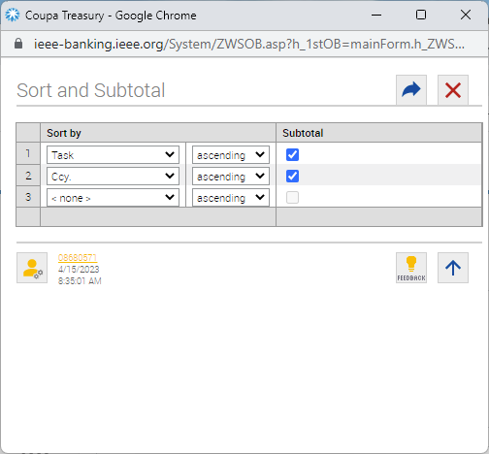
Reporting – Self-service
Depending on your transaction volume, you can manually update the B vs A report in between uploaded tagged transaction files (this is what I currently do)
  Requires some proficiency working in Excel with formulas (if interested, I can provide a template)
  This utilizes the report output and requires an uploaded budget to perform B vs A
  This is helpful only if you also correctly tag transactions in NextGen Banking
This takes advantage of a useful feature from the Transaction page
This is the Sort and Subtotal tool
It enables you to export a list of all non-zero WBS tasks, with the total for each task
This can then be used with a blank report to generate an on-demand B vs A report.
Select “Task” and “Ccy” (currency), and select subtotal check boxes.
Then press “Save and Close” blue curved arrow in upper right.

Slide 22
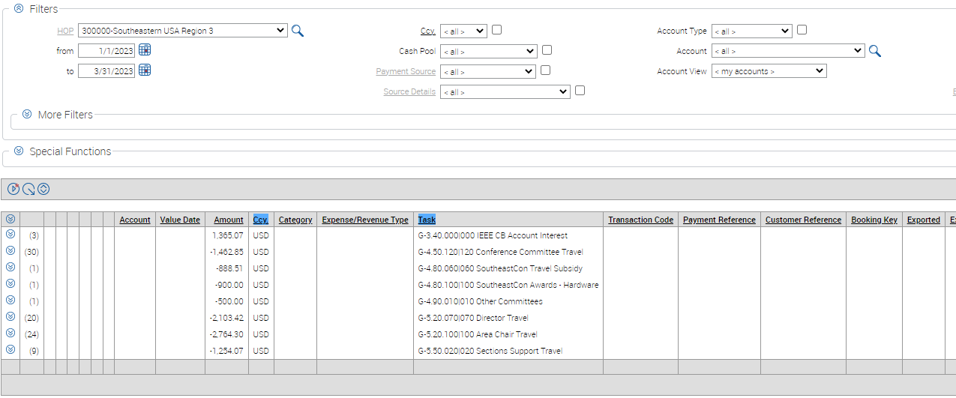
Reporting – Self-service
Depending on your transaction volume, you can manually update the B vs A report in between uploaded tagged transaction files (this is what I currently do)
Note the dates here:
1/1/2023 & 3/31/2023
This provides a financial report for Jan – Mar.
Now I have totals for each WBS tasks in my budget that I can paste into my report spreadsheet for an on-demand report.
Use the Export tool to export this to a csv file to use for generating a B vs A report.

Slide 23
Reporting – Self-service
This is a snapshot of the spreadsheet where I generate the report manually (until the tool catches up)
It’s designed to just cut/paste csv file into a tab and this report is auto-generated
It is manual, but I can generate an on-demand report in less than 10 minutes and print to a pdf for ExCom
More on this in NextGen 201 later today
Come see me if you are interested

Slide 24
Summary
NextGen supports your primary finance management tasks
  Planning – budget entry and tracking
  Banking – transaction tracking, payments & balances
  Reporting – Budget vs Actual reports
  Expenses – Expense report approval
Some manual processing with MGA Finance team currently required
  Automated reporting requires budget uploading and transaction tagging
  Updates/improvements in process, will roll out over time

Slide 25
NextGen 101
Questions?

Slide 26
NextGen 201
Payments and Expense Approvals

Slide 27
Agenda
How should I use NextGen
How do I logon
Balances & Transactions
WBS Tasks & Tagging
Budgets
Reports
Payments/Transfers (NextGen 201)
Expense Approvals (NextGen 201)

Slide 28
How should I use NextGen
NextGen is like your online bank portal
  Shows you what’s already happened, not what’s coming
Retrieve balances for any past day
View all existing transactions, with filtering
Tag transactions* (there are caveats)
Generate data for reports
  Requires budget is setup and loaded to be meaningful
Payments/transfers* (Part of NextGen 201)
Region 3 On-Demand Report Spreadsheet* (Part of NextGen 201)
An ad hoc MGA Finance team is investigating changes

Slide 29
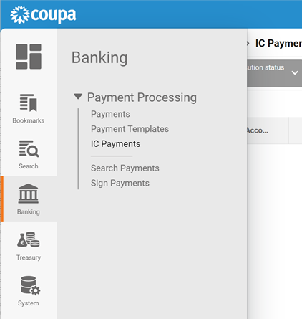
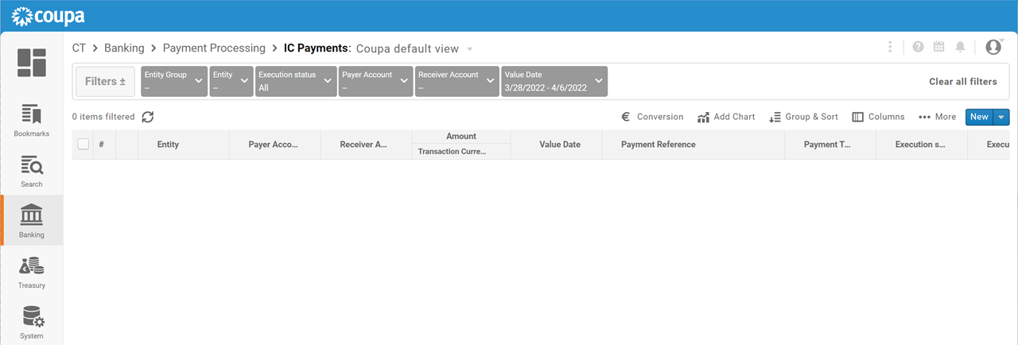
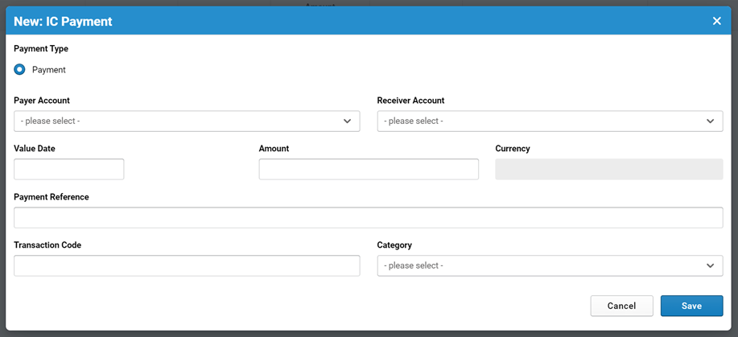
Payments
Common Task: Transfers between NextGen accounts
Click “New”
Select “IC Payments”
Enter your account & receiver account
Enter your account & receiver account
Payment Reference is free form
Note: You must be the owner of the Payer Account to use this transfer.
Date transfer is effective and amount
Date transfer is effective and amount

Slide 30
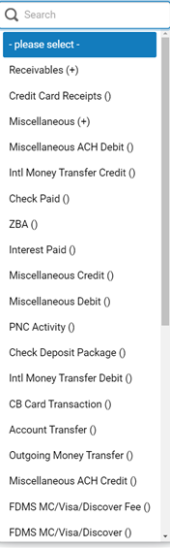
Payments
Common Task: Transfers between NextGen accounts
Click “New”
Select “IC Payments”
Enter your account & receiver account
Enter your account & receiver account
Payment Reference is free form
Note: You must be the owner of the Payer Account to use this transfer.
For Category, Account Transfer() is the most likely choice.
Date transfer is effective and amount
Date transfer is effective and amount

Slide 31
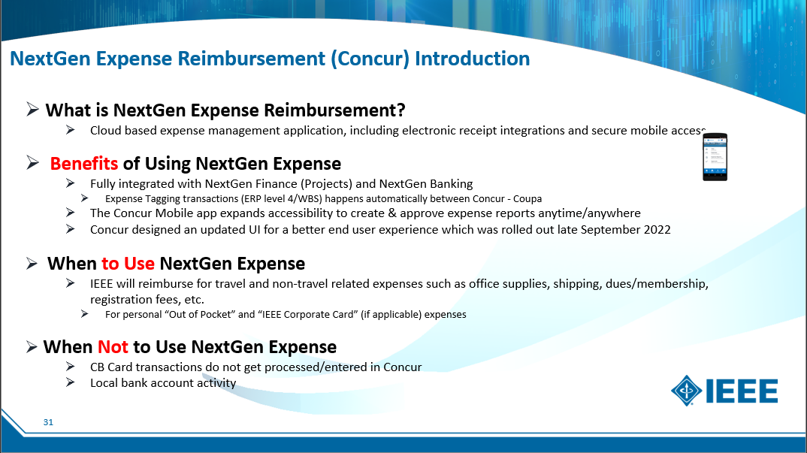
NextGen Expense (Concur)

Slide 32
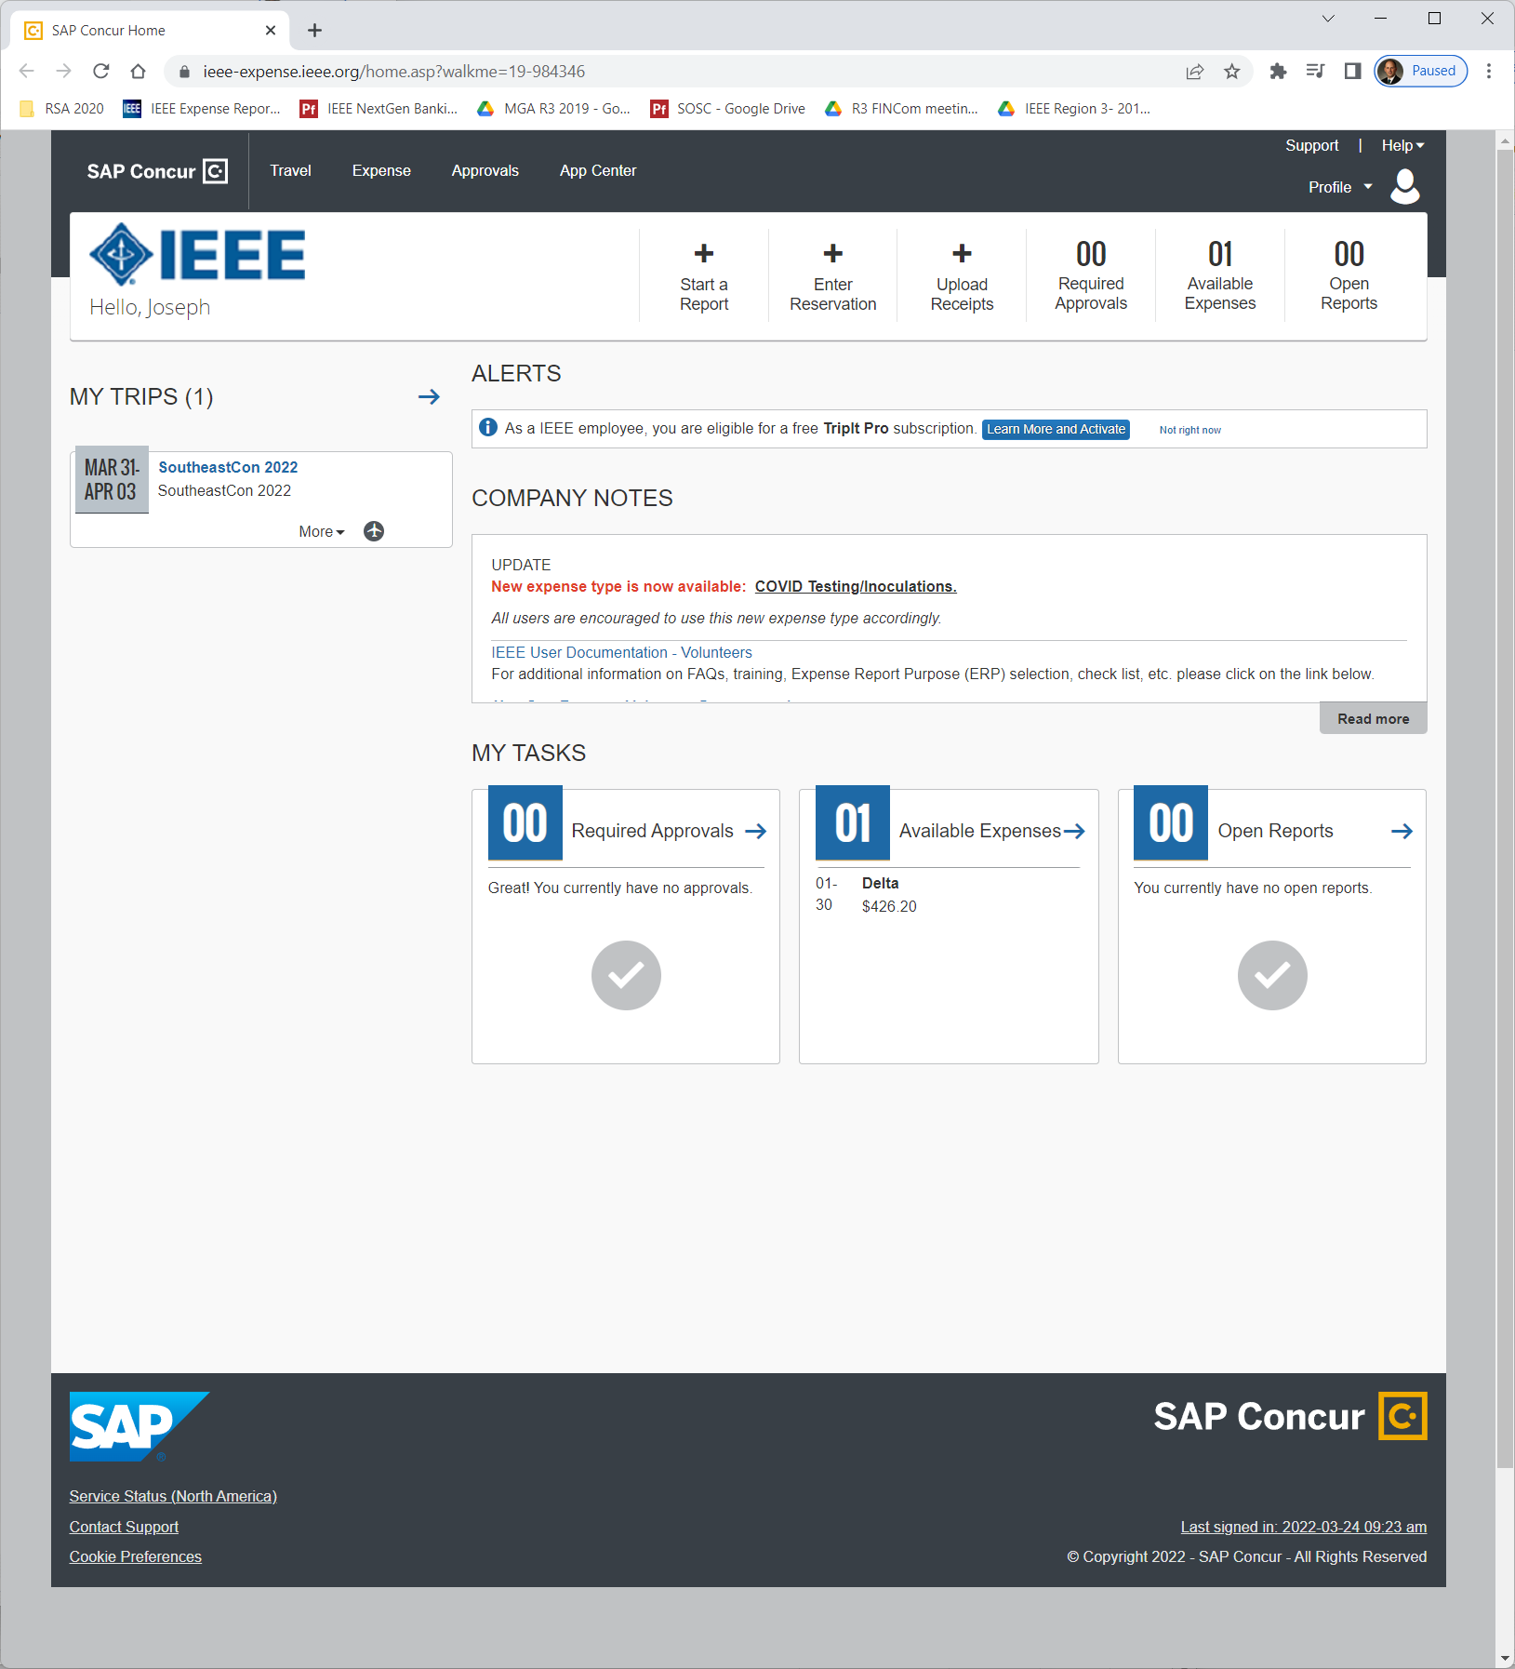
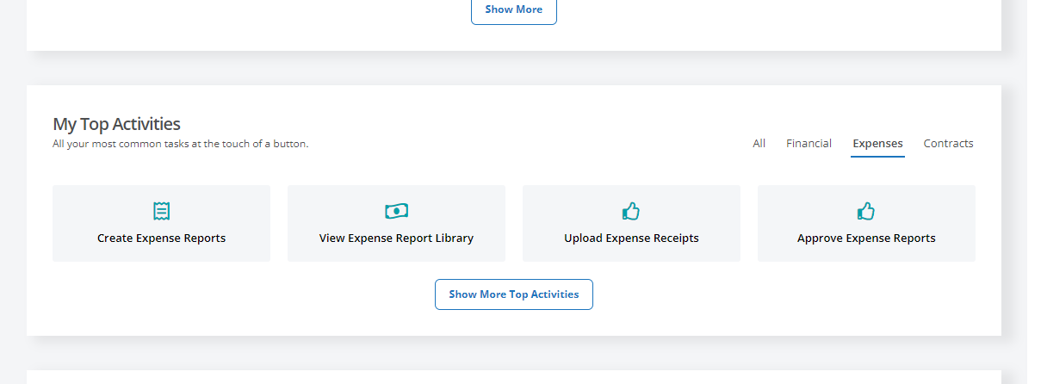
Expense Approval
All Expense activities will open Concur page
Note:
  Treasurer AND Chair MUST have a Concur account
  Needed to approve expenses
  Expense reports require 2 approvals – both Treasurer & Chair

Slide 33
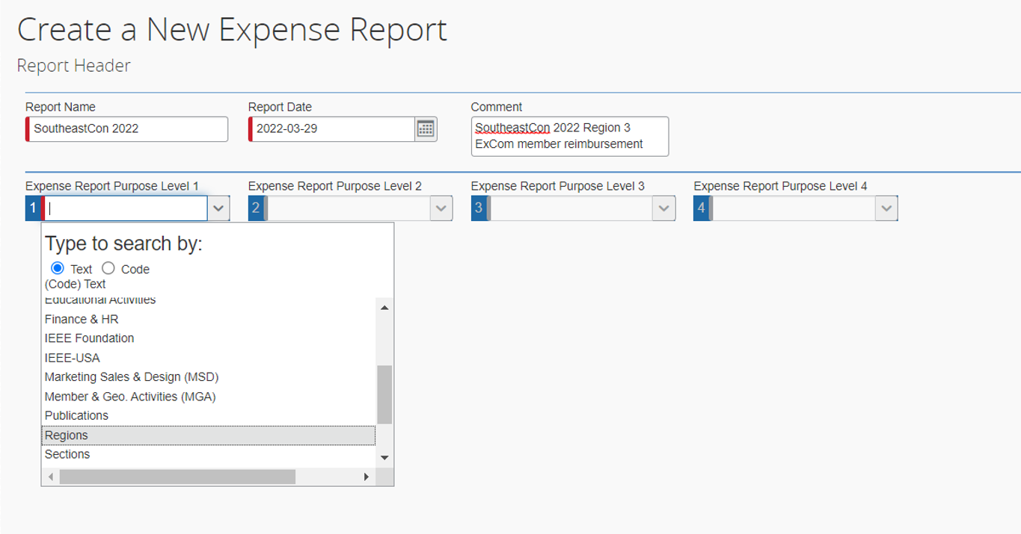
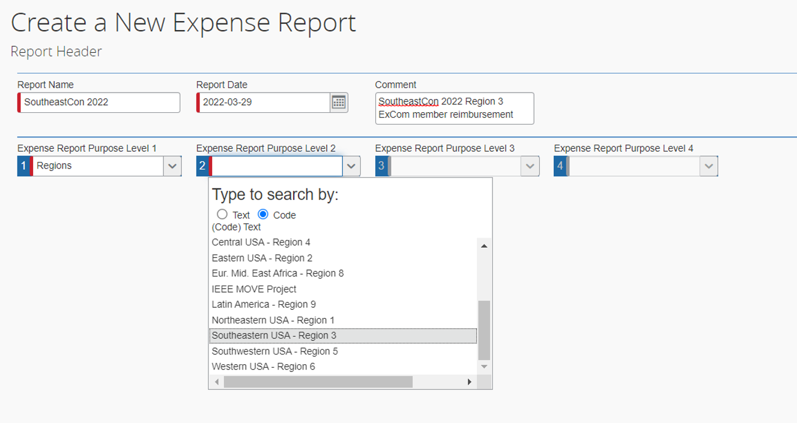
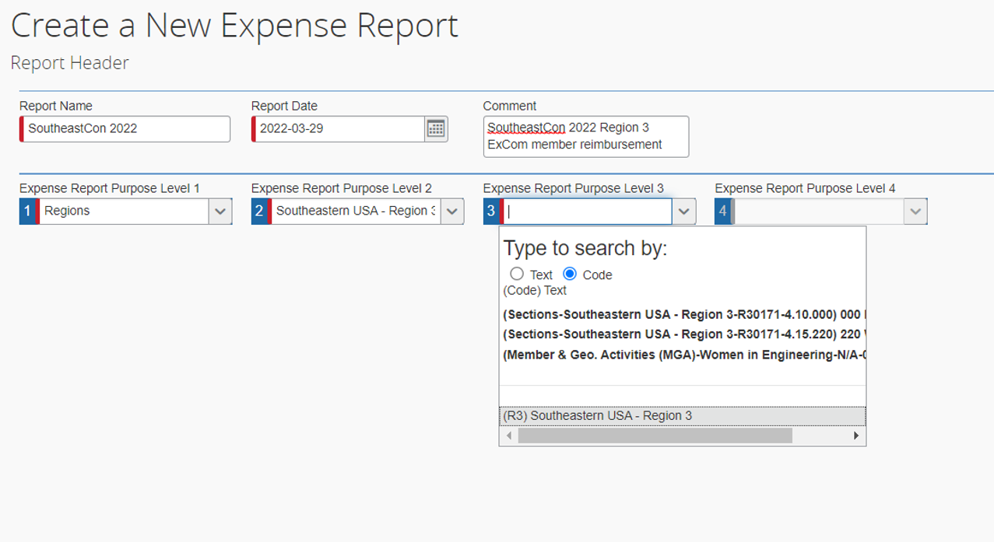
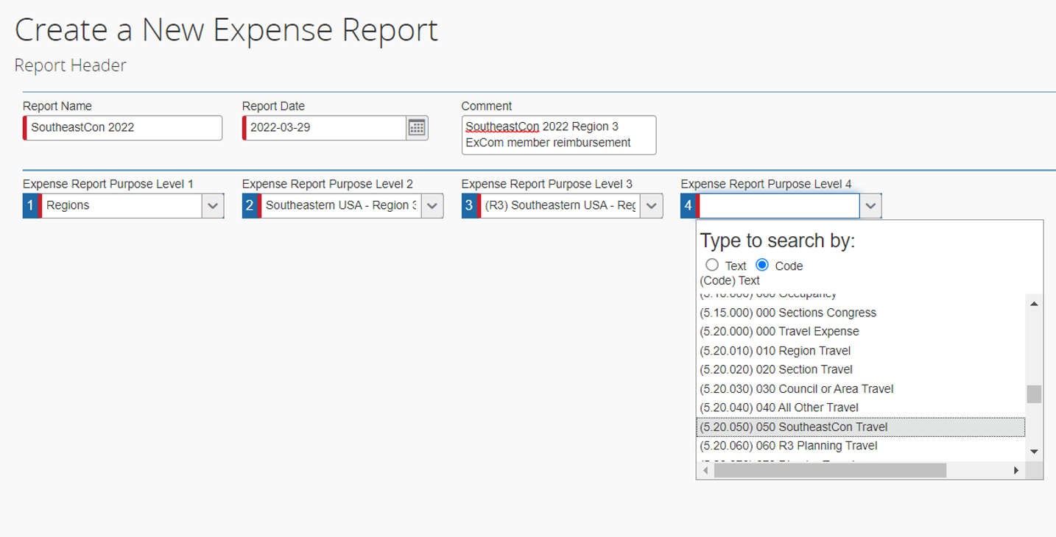
Expense Approval
Purpose Levels 1-4
Level 1 typically Region or Section
Level 2 – Region 3
Level 3 – Region 3 or your Section
Level 4 – match your NextGen WBS task code entries
These transfer into NextGen Banking directly

Slide 34
Expense Approval
Purpose Levels 1-4
Level 1 typically Region or Section
Level 2 – Region 3
Level 3 – Region 3 or your Section
Level 4 – match your NextGen WBS task code entries
These transfer into NextGen Banking directly

Slide 35
Expense Approval
Additional Expense Approval comments
Approvals must meet IEEE Travel reimbursement policy
Ensure line items dates and amounts match receipt dates and amounts
You MUST ensure you review (look at) each receipt that is submitted
Use this opportunity to ensure Purpose levels are all correct – especially Level 4
2 Approvers required for all payments
  Treasurer is First Approver
  Chair is typically Second Approver

Slide 36
Region 3 On-Demand Report
Show Spreadsheet

Slide 37
Summary
NextGen supports your primary finance management tasks
  Planning – budget entry and tracking
  Banking – transaction tracking, payments & balances
  Reporting – Budget vs Actual reports
  Expenses – Expense report approval
Some manual processing with MGA Finance team currently required
  Automated reporting requires budget uploading and transaction tagging
  Updates/improvements in process, will roll out over time

Slide 38
NextGen 201
Questions?

Slide 39
Thank you!
Joe Pennisi, joe.pennisi@ieee.org

