Slide 1
Introducing vTools Engage
Presenter: Sharlene Brown
R3 Member Recruitment & Retention Coordinator
15 April 2023

Slide 2
vTools Engage!
CRM
vTools Engage is an interactive Customer Relationship Management (CRM) solution that was developed by MGA to enable volunteers and staff to
Engage members
Track member activities
Retain members
Convert non-members to members
Phase 1 – Sections. Regions can see the Sections within. (Minimum Viable Product - MVP)

Slide 3
vTools Engage!
CRM Categories
Engagement
Recruitment
Retention
Members
Network
Actions
Contact
Available Actions:
View the list
Email
Print Mailing Labels (coming in a future version)
Download the list

Slide 4
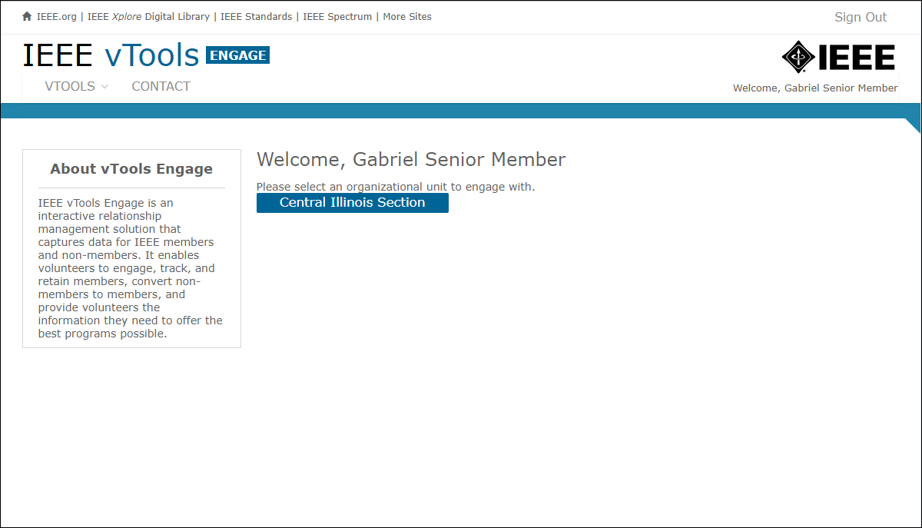
Sign in at: https://engage.vtools.ieee.org/
Section Officers will see only their Section.
Region officers will see the Sections within.

Slide 5
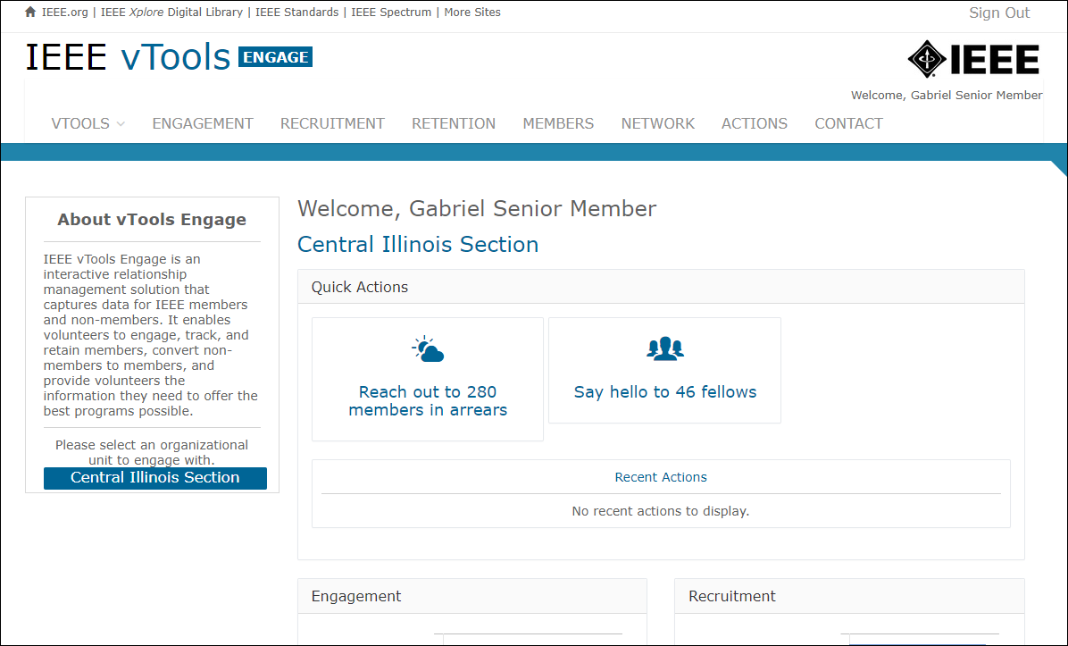
Quick Actions will automatically display here
Other Quick Actions include:
Welcome # new members
Remind # members to renew
Recent Actions will display here

Slide 6
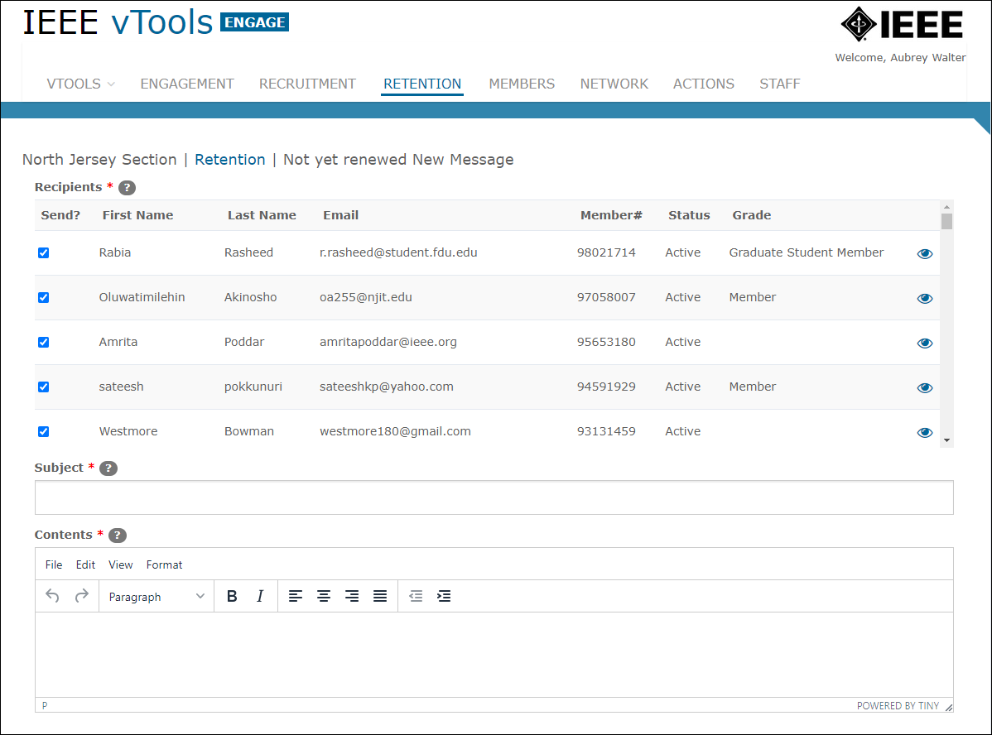

Slide 7
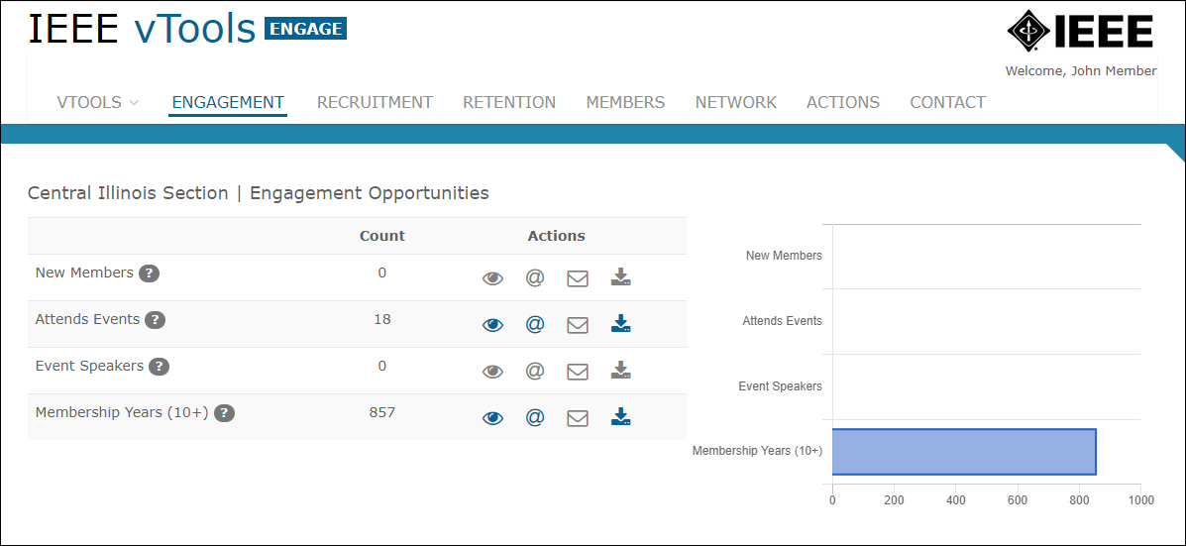
Print mailing labels (future)
View
Email
Download
Note: All emails sent from within Engage are GDPR/member communication compliant.

Slide 8
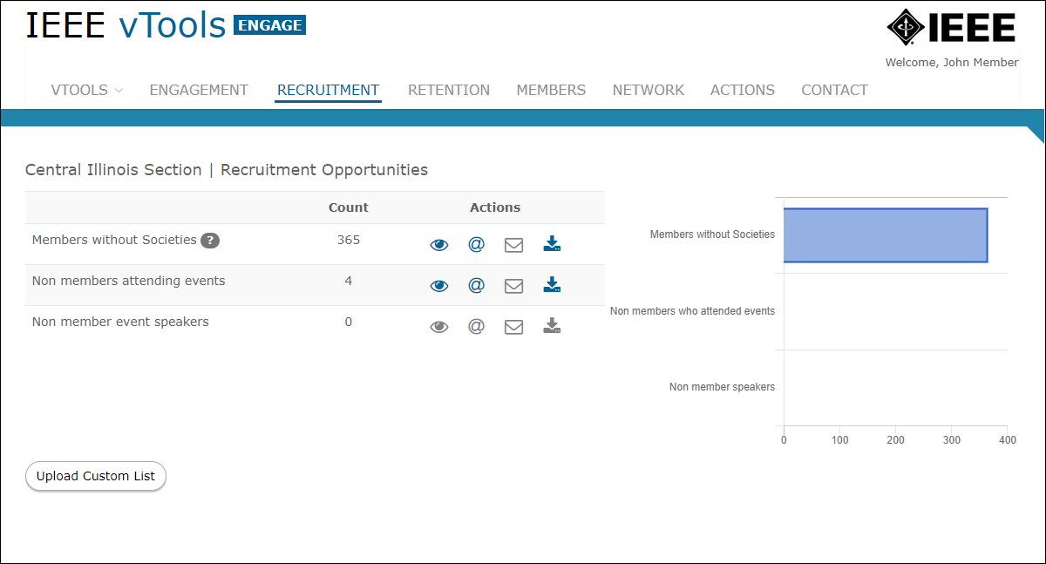
Same actions available here
Upload a custom list of contacts

Slide 9
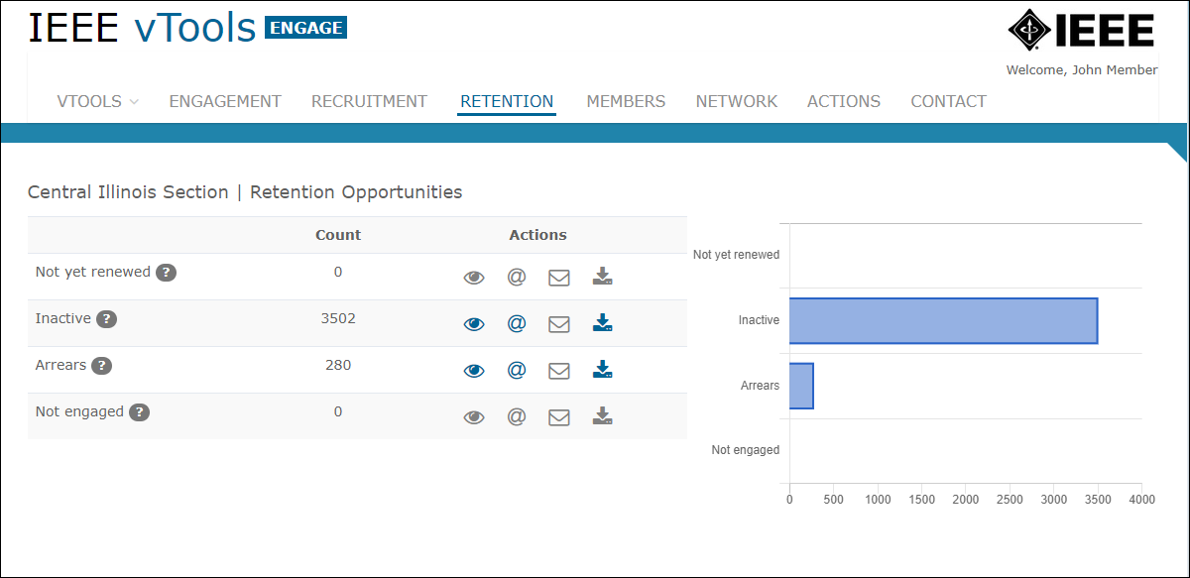
Same actions available here

Slide 10
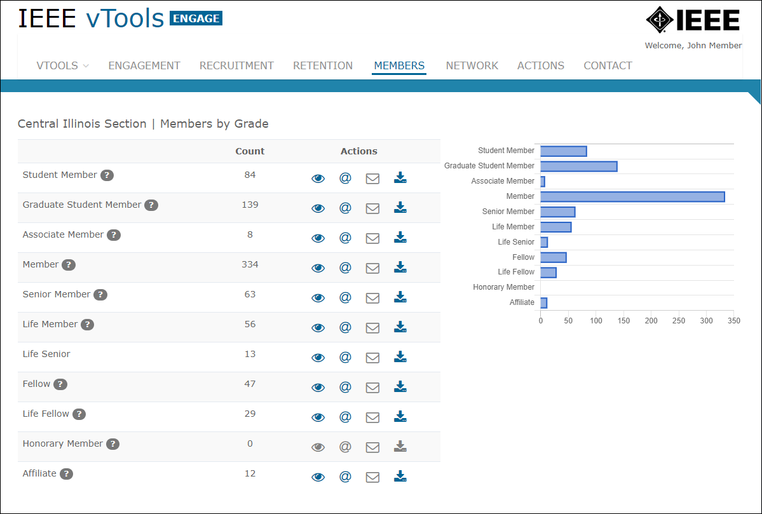
Same actions available here

Slide 11
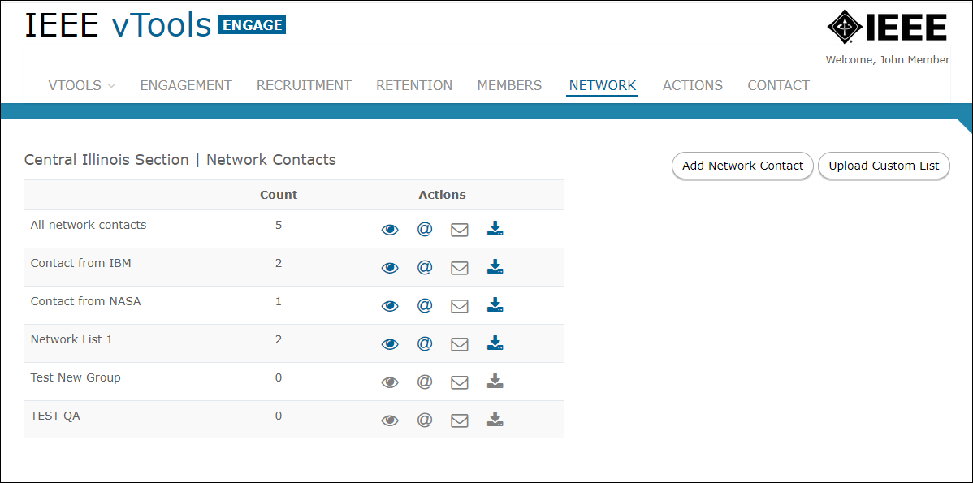
Keep track of your industry or institutional contacts
Same actions available here
Upload single contact or list of contacts

Slide 12
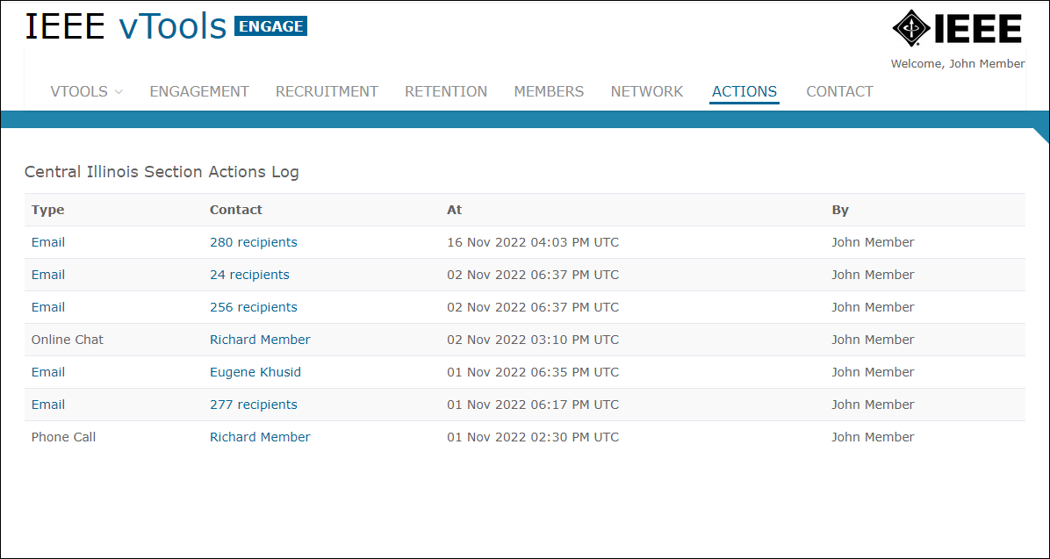
View recent activities taken within the CRM

Slide 13
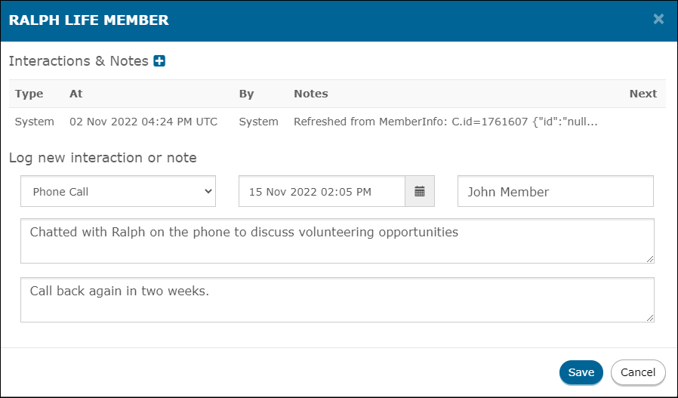
Record an interaction/note for a member or contact
Log of interactions

Slide 14
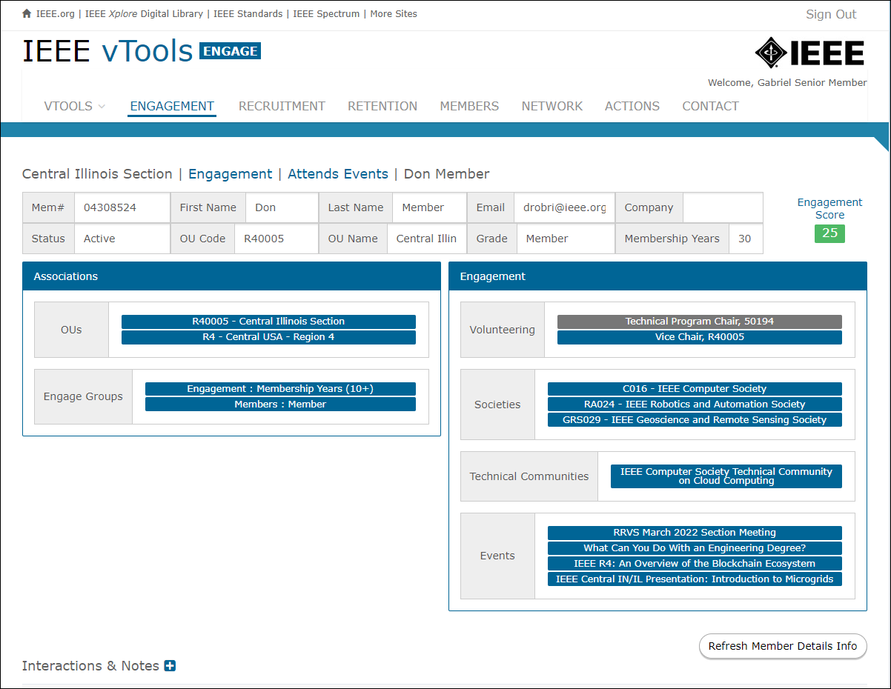
Individual member view example

Slide 15
Additional Information
View Tutorials here: https://kb.ieee.org/vtools/blog/kbtopic/engage/
Email:
sharlenenbrown@ieee.org
Questions?

