Slide 1
Data Migration / Workspaces
Vera Sharoff - Senior Director, MGA Information Technology

Slide 2
Today’s Update
Collabratec at a Glance
Today’s Focus: Data Migration & Workspaces

Slide 3
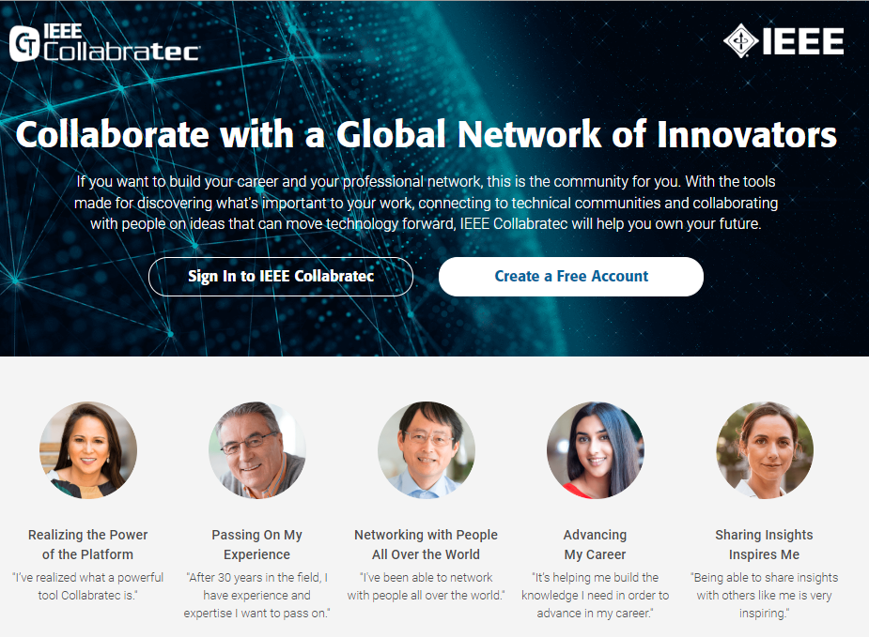
IEEE Collabratec – IEEE’s professional networking and collaboration platform
Mar ‘23
293,000 Registrants
77,000 IEEE Members
30,000 sessions monthly
Key Benefits to Users & the IEEE
Available to IEEE Members and non-Members Personalized services for users, some exclusive to Members Turn-key tools for networking and collaboration Fully integrated into the IEEE ecosystem Demonstrated impact to membership development Rich analytics aligned with IEEE status and affiliations

Slide 4
Collabratec delivers exclusive value for IEEE and Society Members
Verified identity of IEEE and Society Members, Volunteers
Distinct recognition badging for member grades, volunteer and mentor status
Personalized certificates of IEEE and Society memberships
IEEE & Society Membership Directories
Mentor / Mentee matching
IEEE Section, Student Branch hubs
Members Forum community
Automated profile updating for IEEE affiliations and volunteering
IEEE Contact Center chat

Slide 5
Collabratec is helping with Member retention
Post February’s Service Deactivation…
IEEE Member Retention Global Averages (Feb 2023) |  | Members on Collabratec | Members not on Collabratec
All Members | 60% | 75% | 55%
> Higher-Grade | 73% | 80% | 70%
> Students* | 27% | 52% | 23%
*Comparative retention data incorporates influence of Future50 participation, by student members on and not on Collabratec
IEEE PROPRIETARY

Slide 6
Today’s Focus:
Data Migration / Workspaces

Slide 7
Google / Data Storage
The Google offering for IEEE Members is “Google Workspace Enterprise for Frontline Workers” licenses. This service includes the following:
Core Google Workspace Services
Gmail, Calendar, Chat, Meet, Google Drive, Tasks, Keep and JamBoard
Non-Core Google Workspace Services
Such as Google Maps, Google Earth, Photos, YouTube, Play Store, Blogger
2GB of storage shared between Gmail, Google Drive & Photos
Transition is mandatory by 31 July.
There is no mechanism for individual members or IEEE administrators to assign or purchase additional storage

Slide 8
Google offers Shared Drives
Unlimited Storage
HOWEVER, we’ve learned that shared drives have limitations when used by Frontline worker accounts
Decision going forward is to build out Collabratec Workspaces
Available to IEEE members and volunteers
Unlimited storage
Easy process to move files from current ieee.org account
Workspaces can be for an OU or an individual
Release is coming on Tuesday 18 April that further simplifies for Workspace creation process
More enhancements will be made in Q2

Slide 9
Coming Soon - Organizational Workspaces
Augmented Workspaces-Creation Menu - Adding the option for creating an organizational unit workspace (OU Workspace). Only IEEE Volunteers will see the menu option for creating OU Workspaces.
Introduction of OU Workspaces - That will combine some of the best capabilities offered by Collabratec and package them for use by IEEE organizational units such as sections, chapters, councils, committees, etc. This will include:
Automatic access by only active volunteers of the organizational unit
Unlimited centralized file storage with collaborative editing for volunteer files (a perfect solution for the upcoming Google Drive size limit of 2 GB)
File archiving with automatic file deletion after user selected amount of time (a solution for the file archiving requirement for compliance) support for discussions
Training to be offered after release

Slide 10
What are Workspaces?

