Slide 1
Atlanta Section
Section Chair Report
Lightning Round

Slide 2
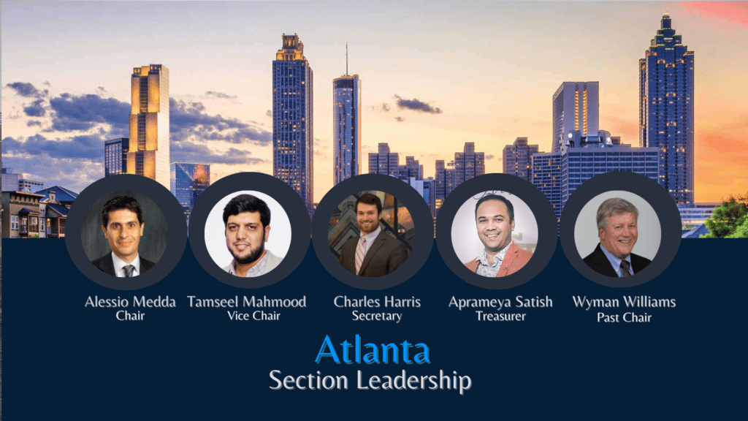
Atlanta Section Report
Section Officers:
2022 Major Successes:
108 meetings in 2022
Average attendance: 259 per event
IAS – most active chapter with 17 meetings
Excellent Pre-U student engagement via FSNs, Atlanta Science Expo, etc.
474 Senior Members currently
Supporting IEEE Awards and VIC Summit in May 2023
Atlanta selected for ComSoc School Series

Slide 3
Atlanta Section Report
2023 Goals:
Revitalize Georgia Tech, UGA, KSU, GSU, DeVry, GPTC, CAU
Formation of Technical and Student Chapters
Increase membership by 1%
Utilize Social Media to increase engagement
Support VIC Summit, ComSoc School Series
Excellent SoutheastCon 2024
Milestones: (Goal Progress YTD)
Multiple meetings with GT, KSU already held
At least 12 Senior Member Elevation Nominations
Increased social media presence
Well attended Meet-Ups
Excellent ComSoc School Series Program in September 2023
Obstacles:
Student, YP, and WIE engagement and coordination
Maintaining actively engaged volunteers
Industry engagement – Power Energy Society has highest number of IEEE members
Mediocre attendance at technical events

