Slide 1
Region 3 Meeting | 10 AUG
Ottawa, Canada | 11–13 AUG

Slide 2
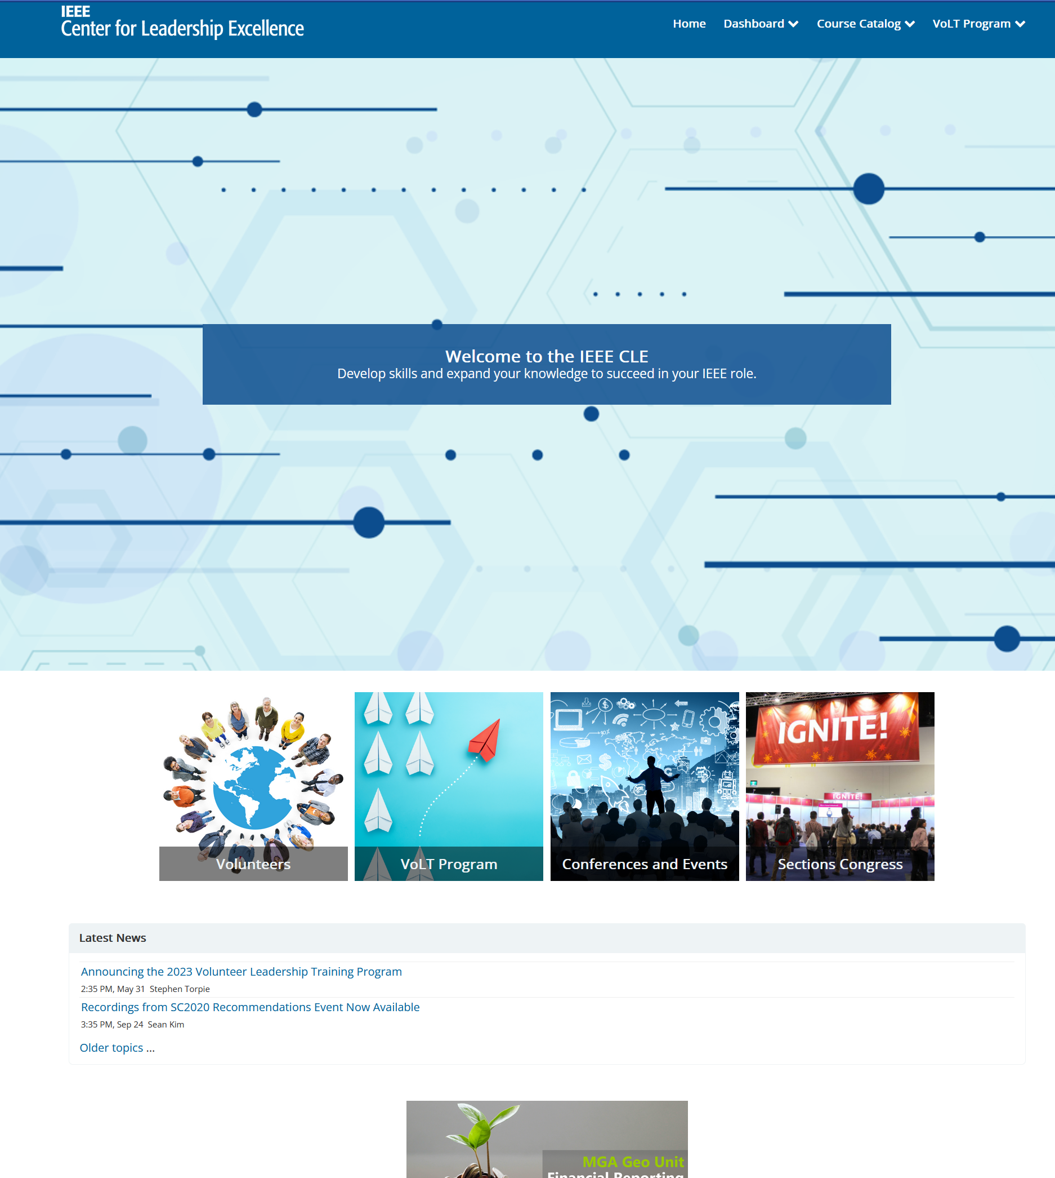
Center for Leadership Excellence
https://ieee-elearning.org/
The Center for Leadership Excellence offers a ‘one stop’ training solution designed to serve the multiple and diverse range of IEEE user communities. From volunteers, non-volunteers to students, members, and conference organizers, the site offers a simpler and effective learning experience.
Information categories include
Training for Section, Conference, and other positions
VoLT
Sections Congress
209 E-learning courses as of July 2023

Slide 3
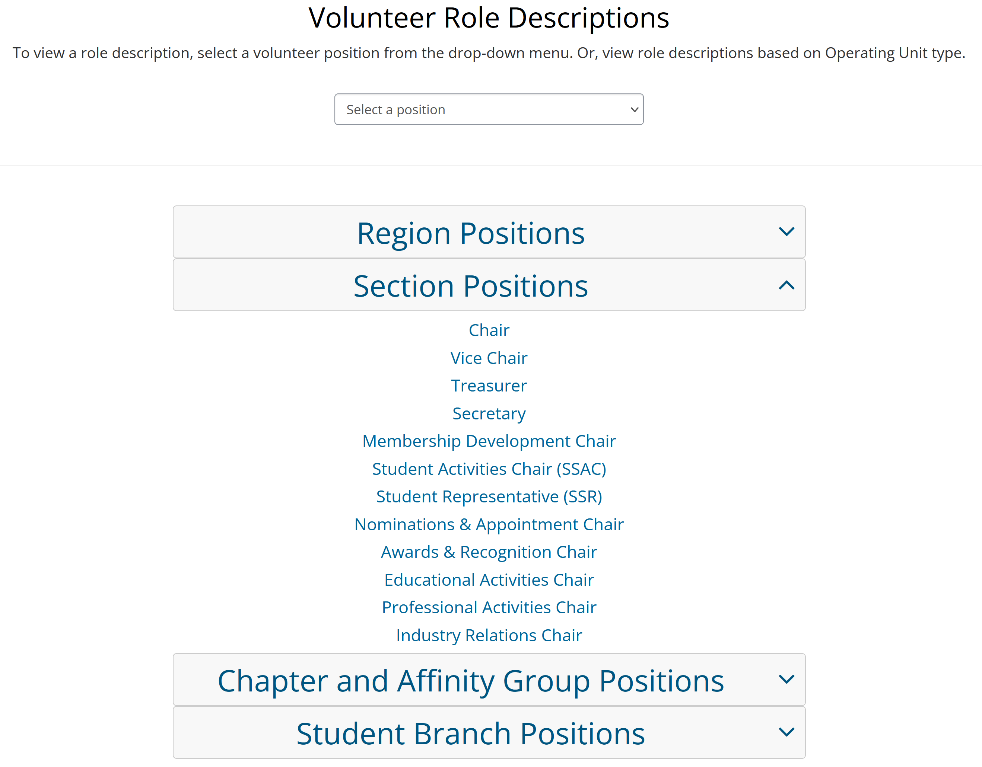
For Volunteers
Next two slides show Section Chair examples

Slide 4
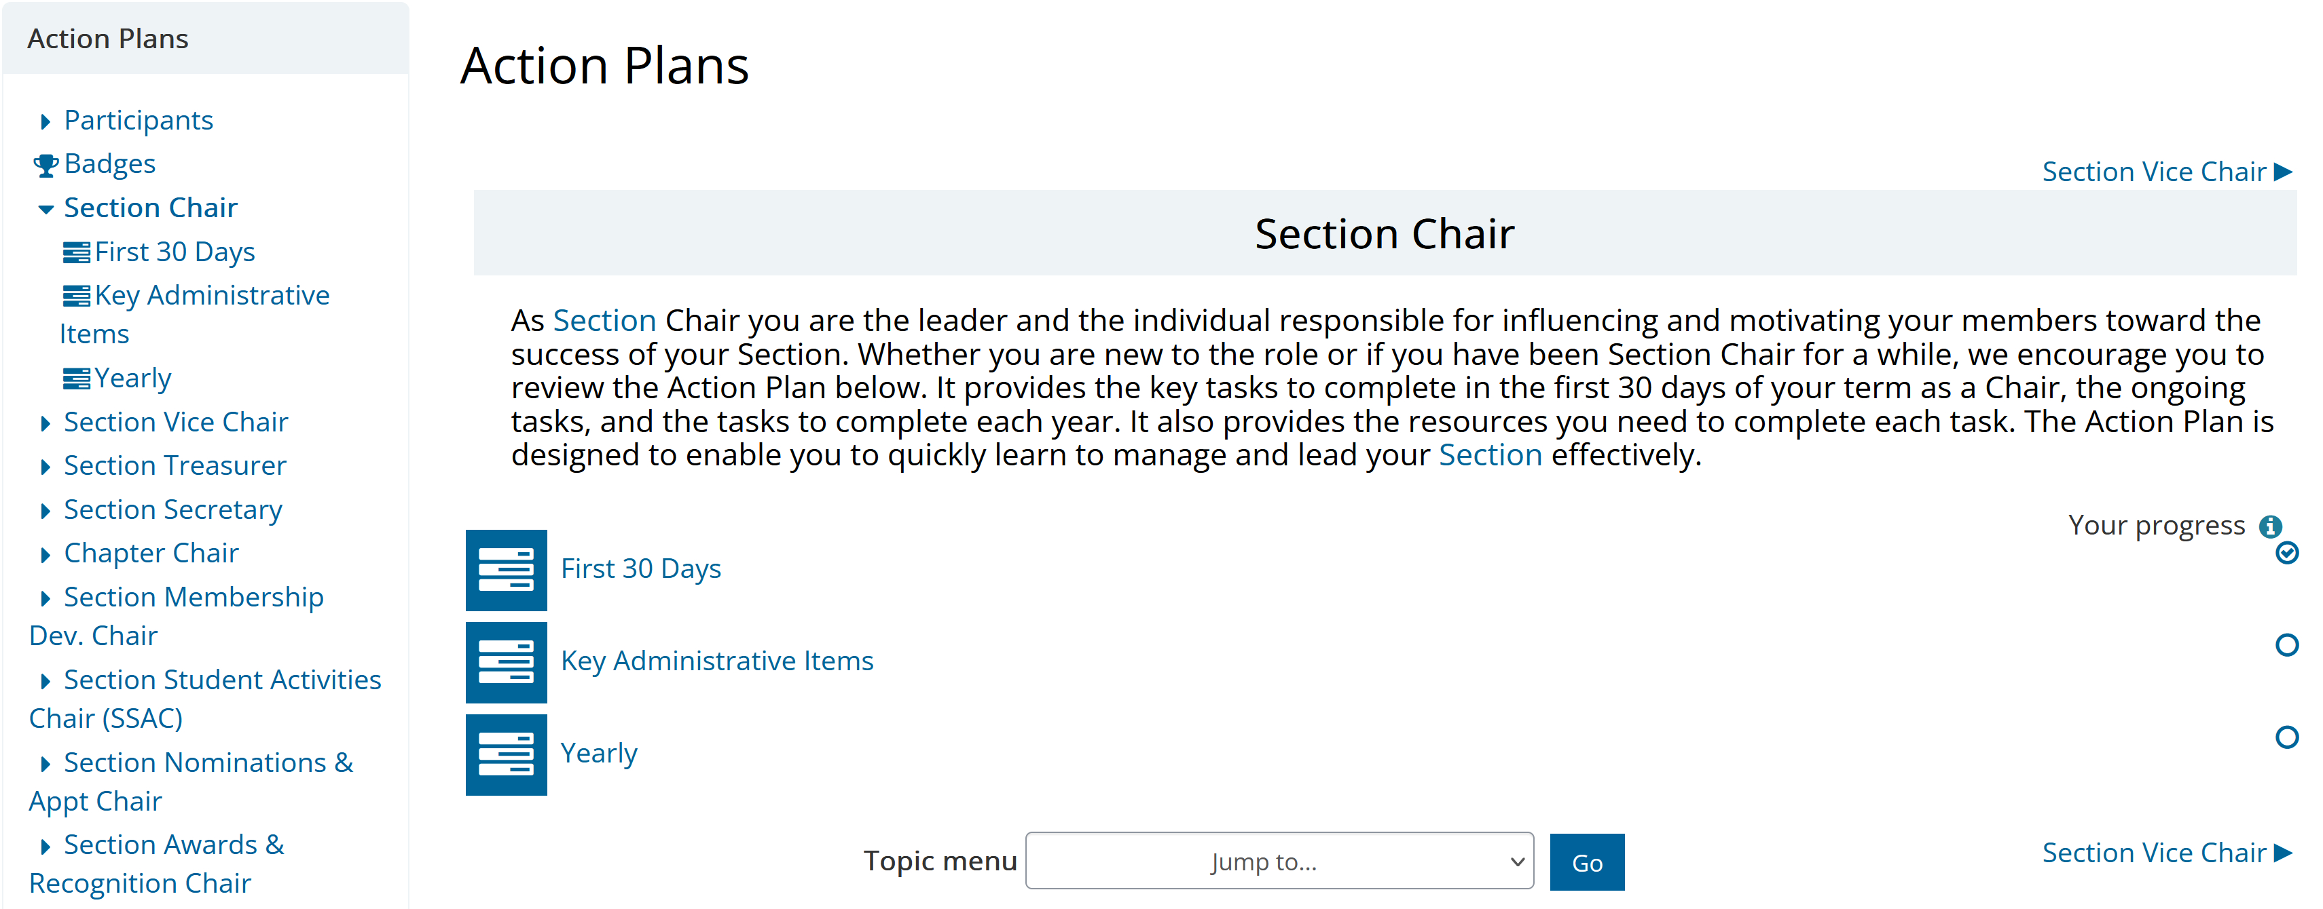
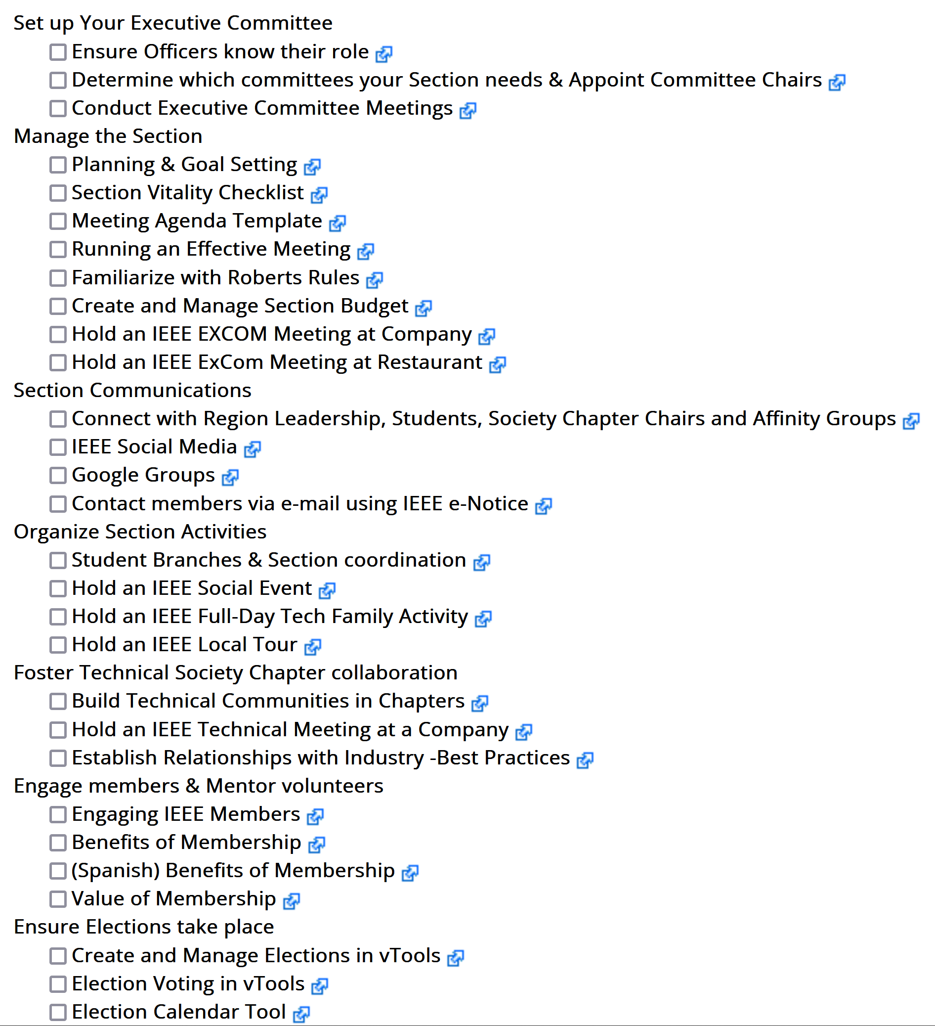
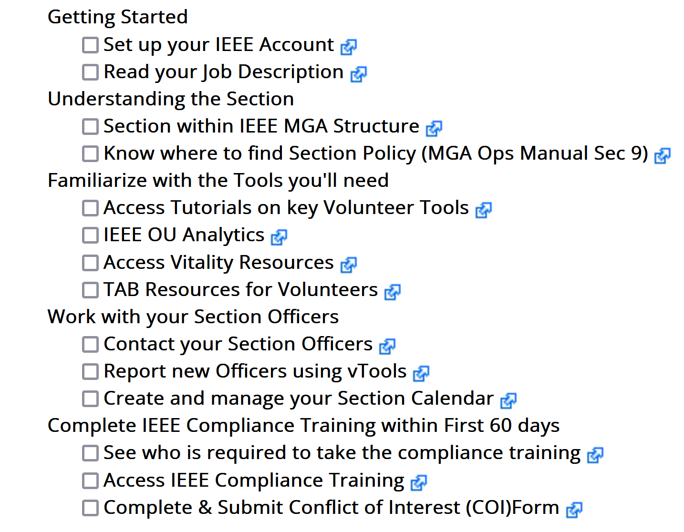
Volunteer Action Plans
Key Administrative Items
Yearly
Yearly
First 30 Days

Slide 5
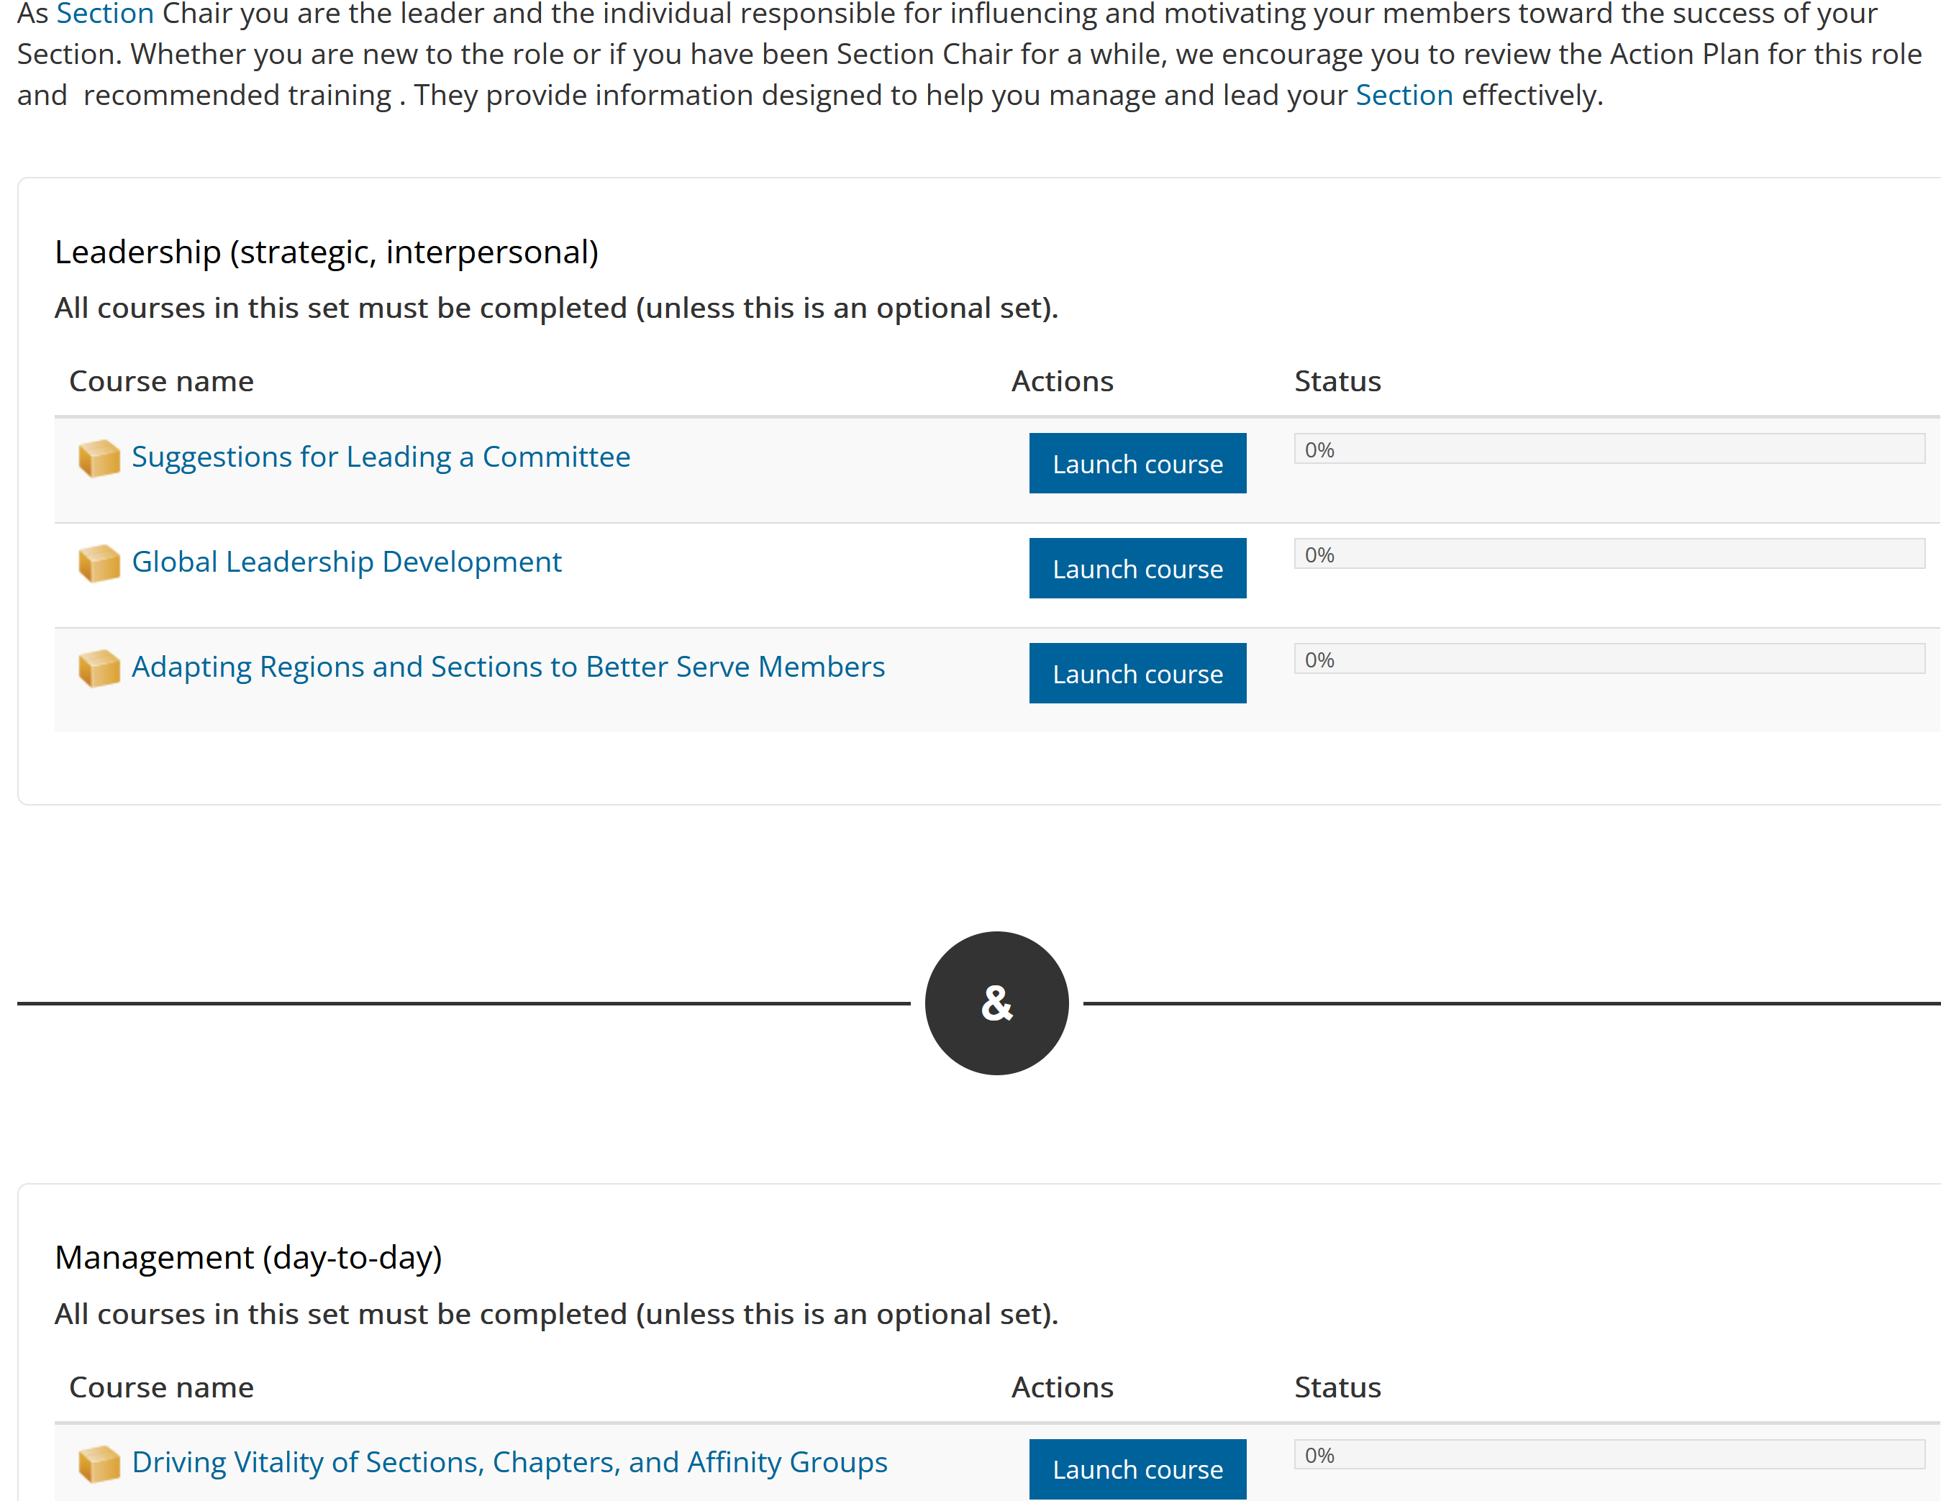
Recommended Training
For each position, recommended training modules are shown
Volunteers can take modules for any position to increase the depth of their knowledge

Slide 6
Volunteer Leadership Training (VoLT)
Similar time frame next year

Slide 7
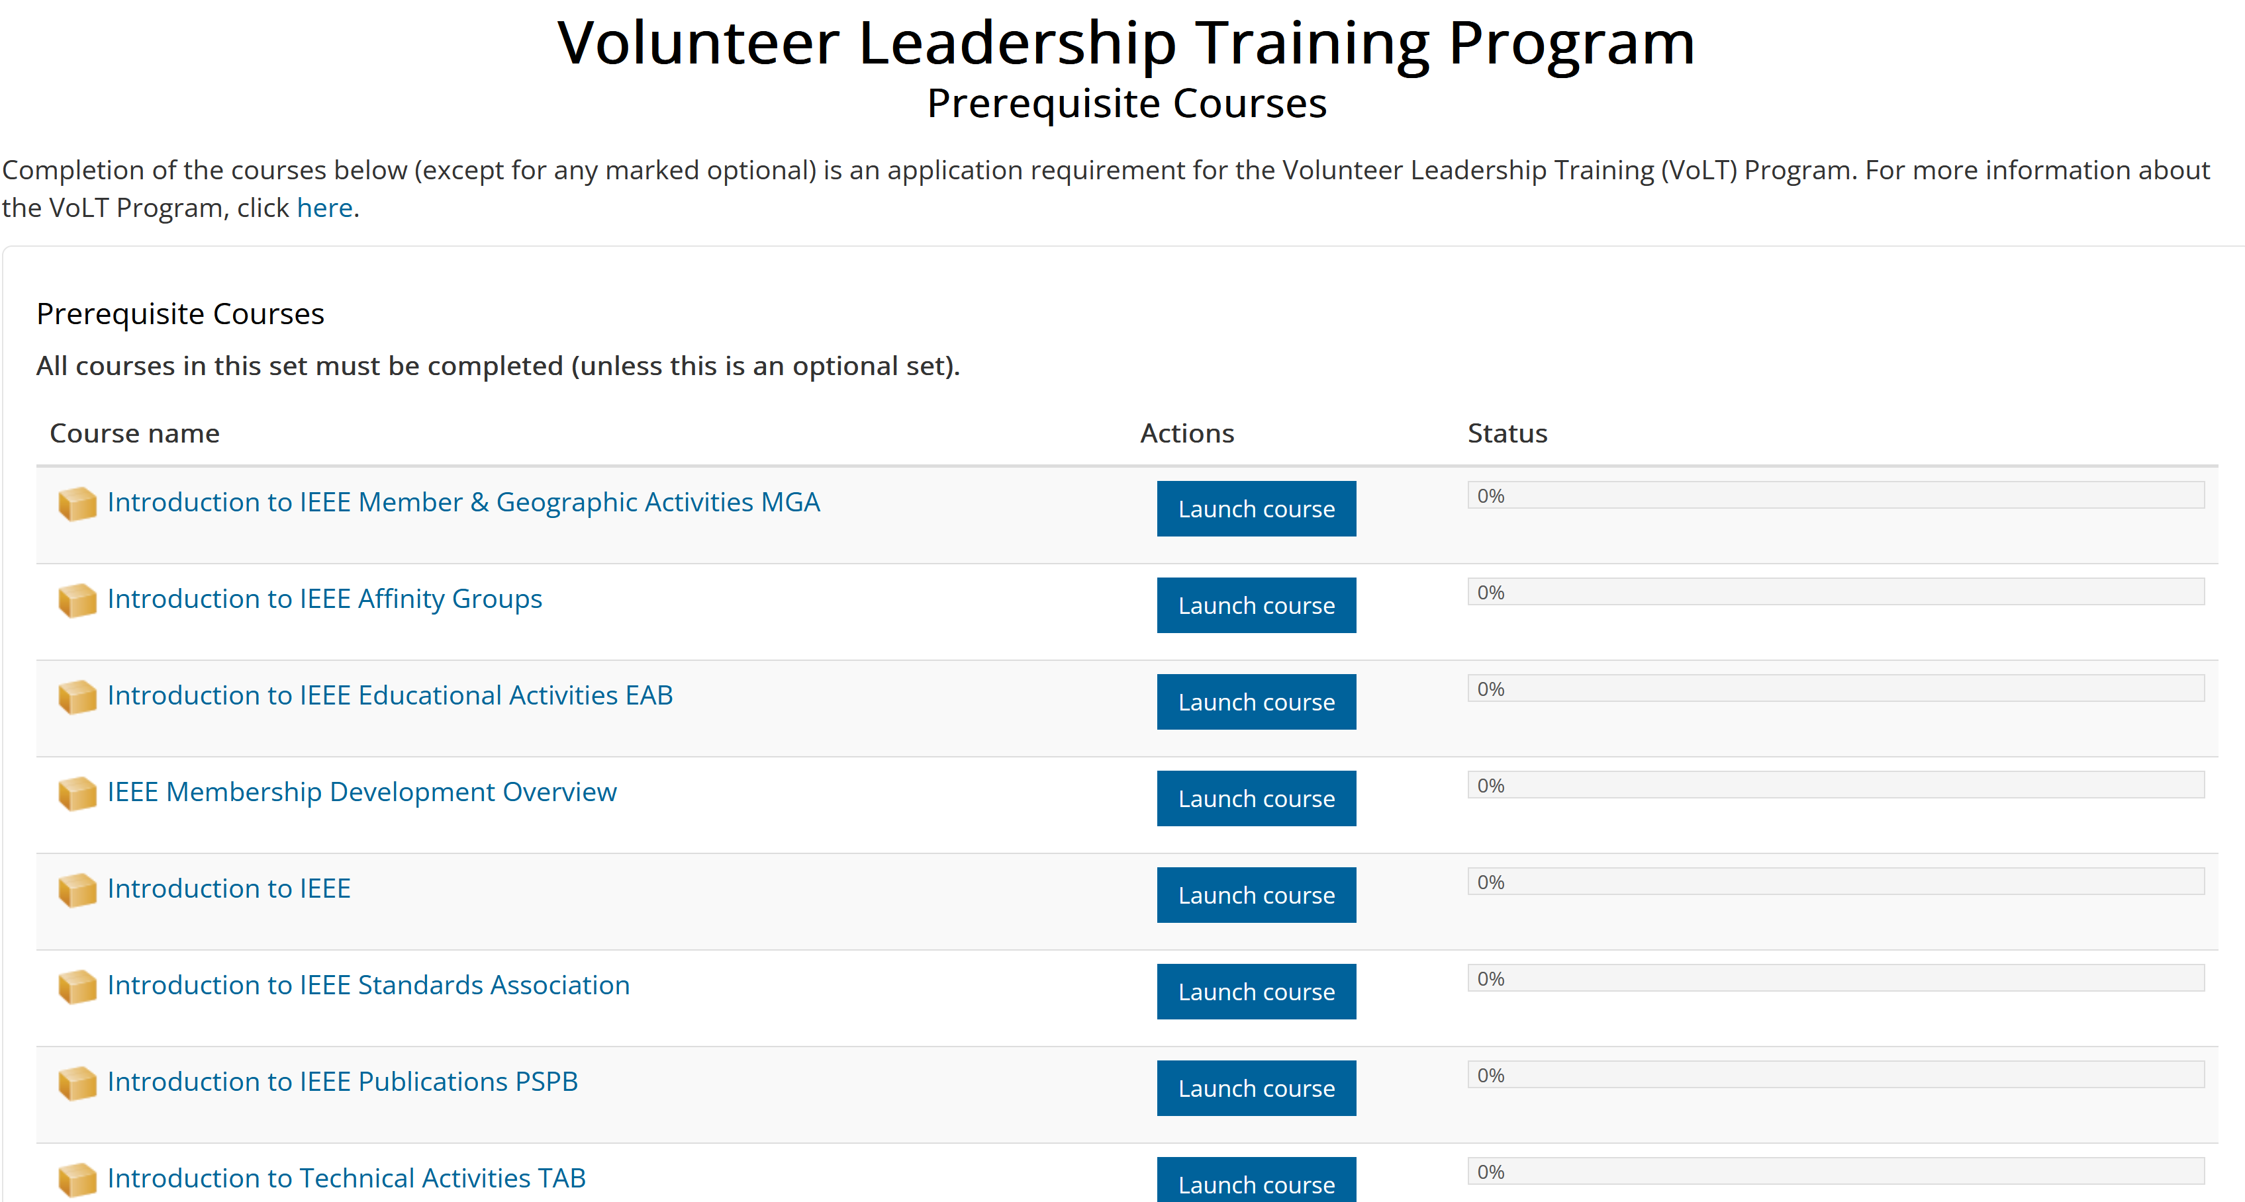
VoLT

Slide 8
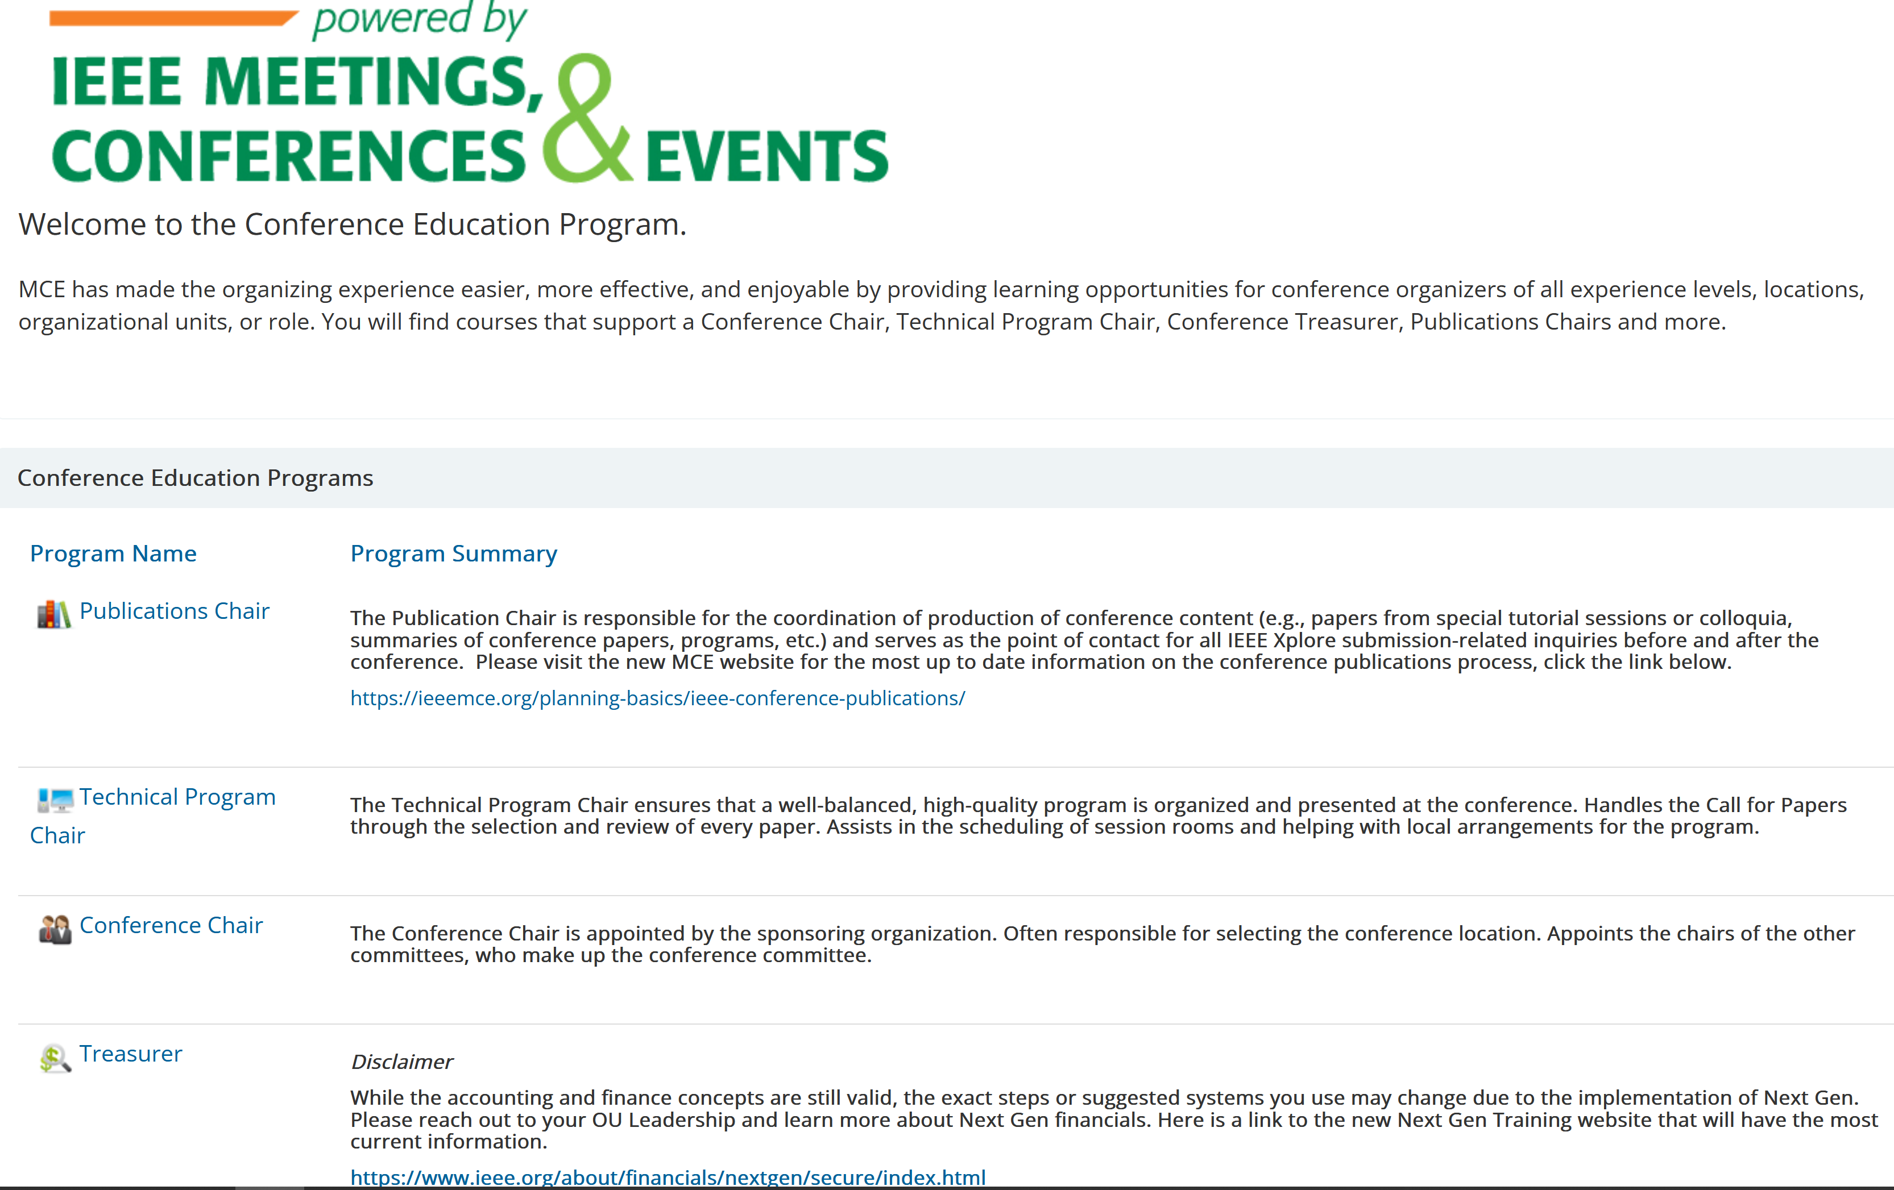
Conferences
Training for conference positions in a similar format to MGA volunteer positions
As a Section / local volunteer, recommend reaching out to the conference series “owner”, e.g., region, technical society and/or panel, in addition to the training here

Slide 9
Sections Congress

Slide 10
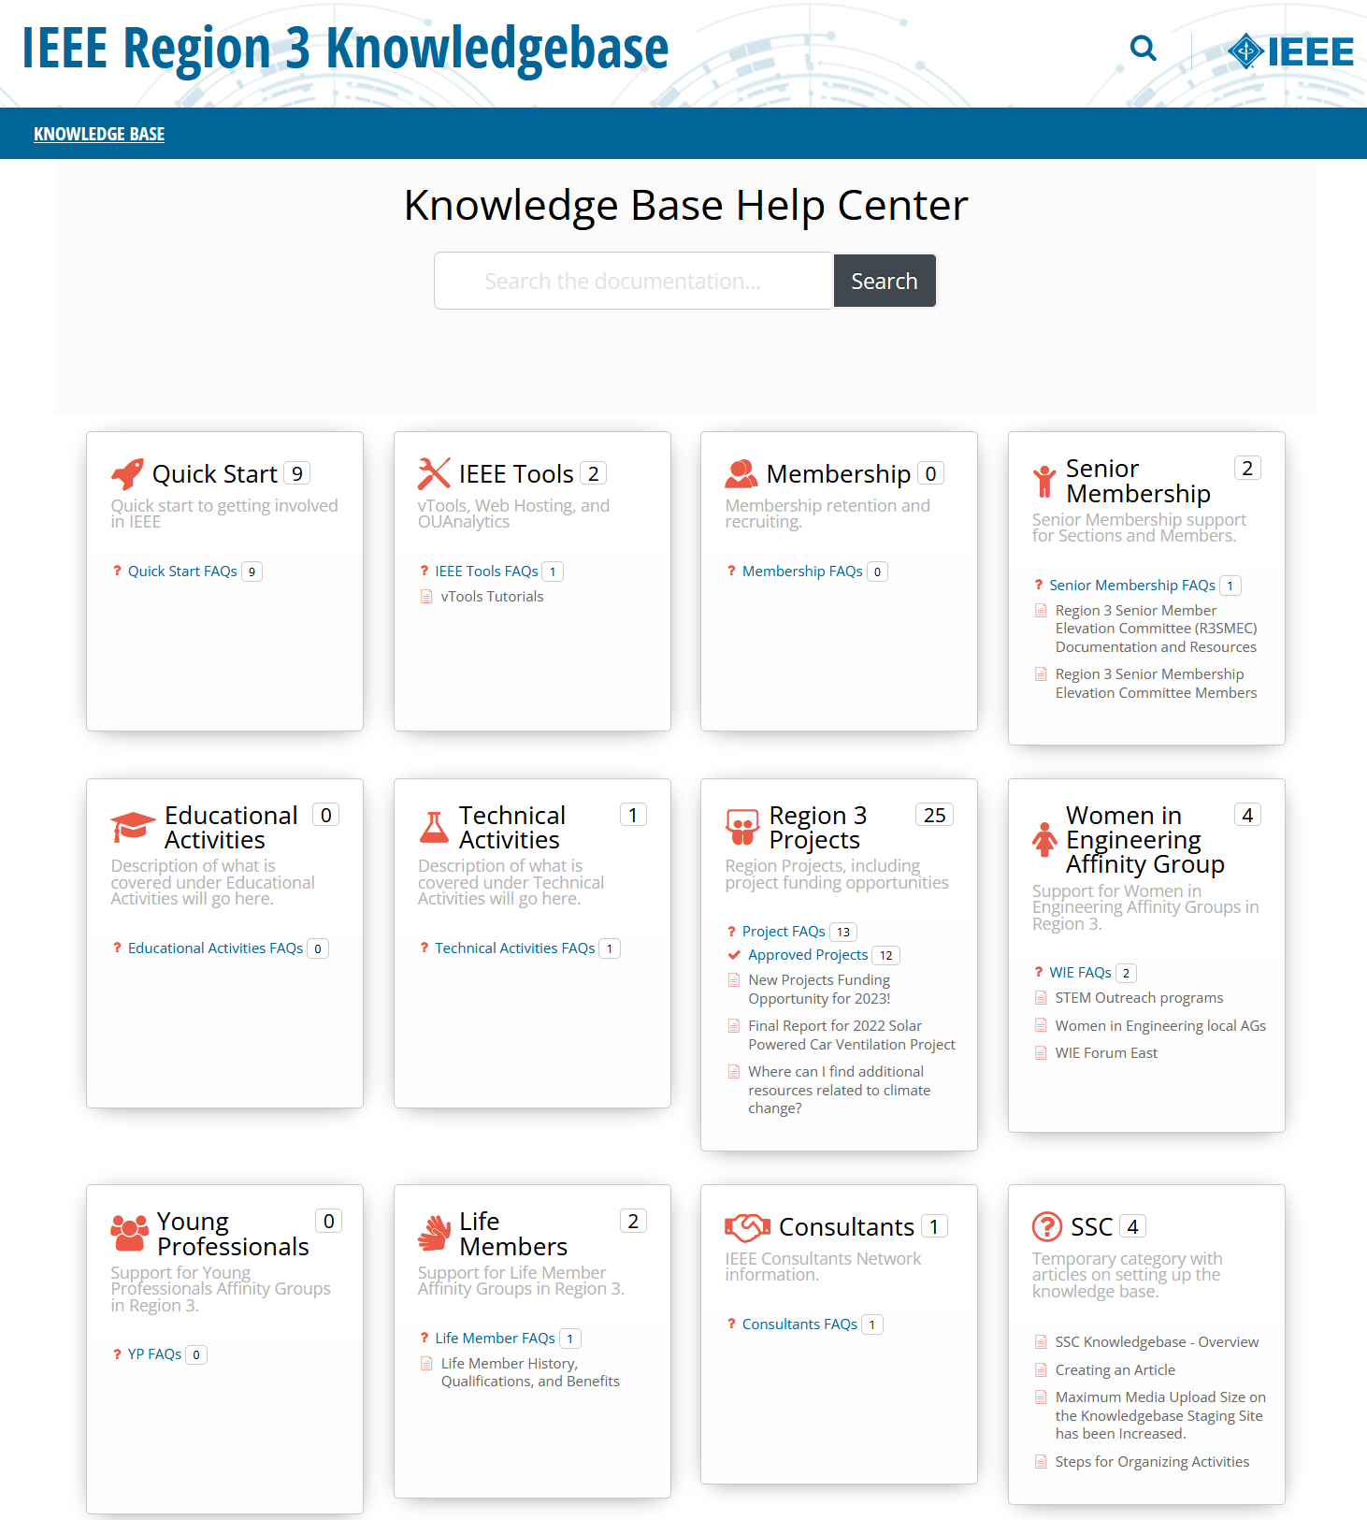
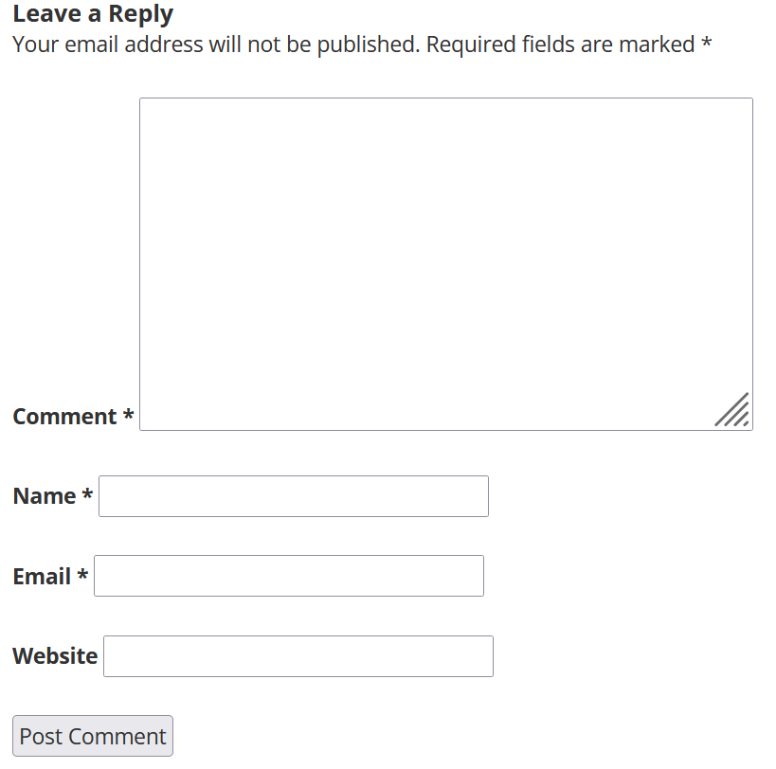
Want More? … Visit the R3 Wiki Knowledgebase
https://kb.ieee.org/r3/ or navigate from the Region 3 website under Resources
Created and updated by the R3 Section Support Committee
Feedback welcome: r3-ssc@ieee.org or on wiki itself

Slide 11
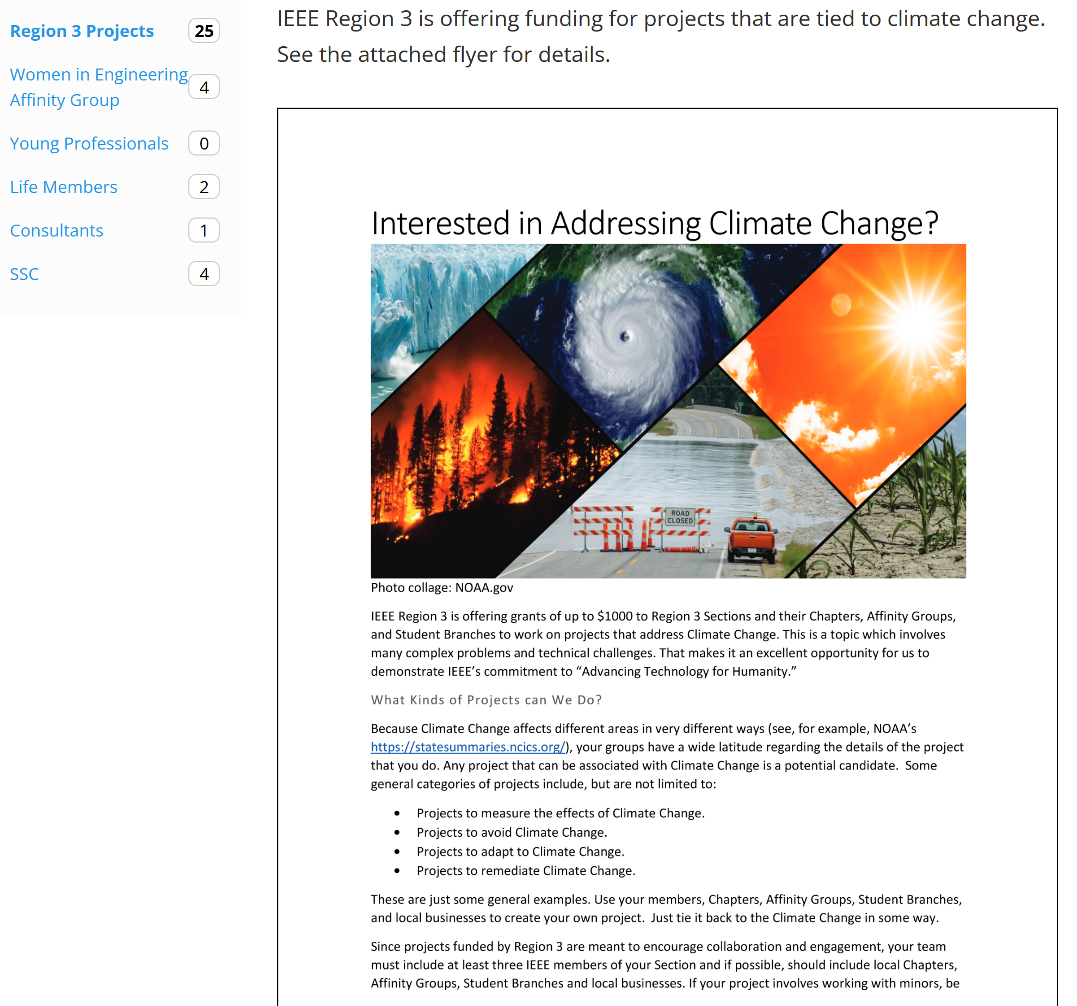
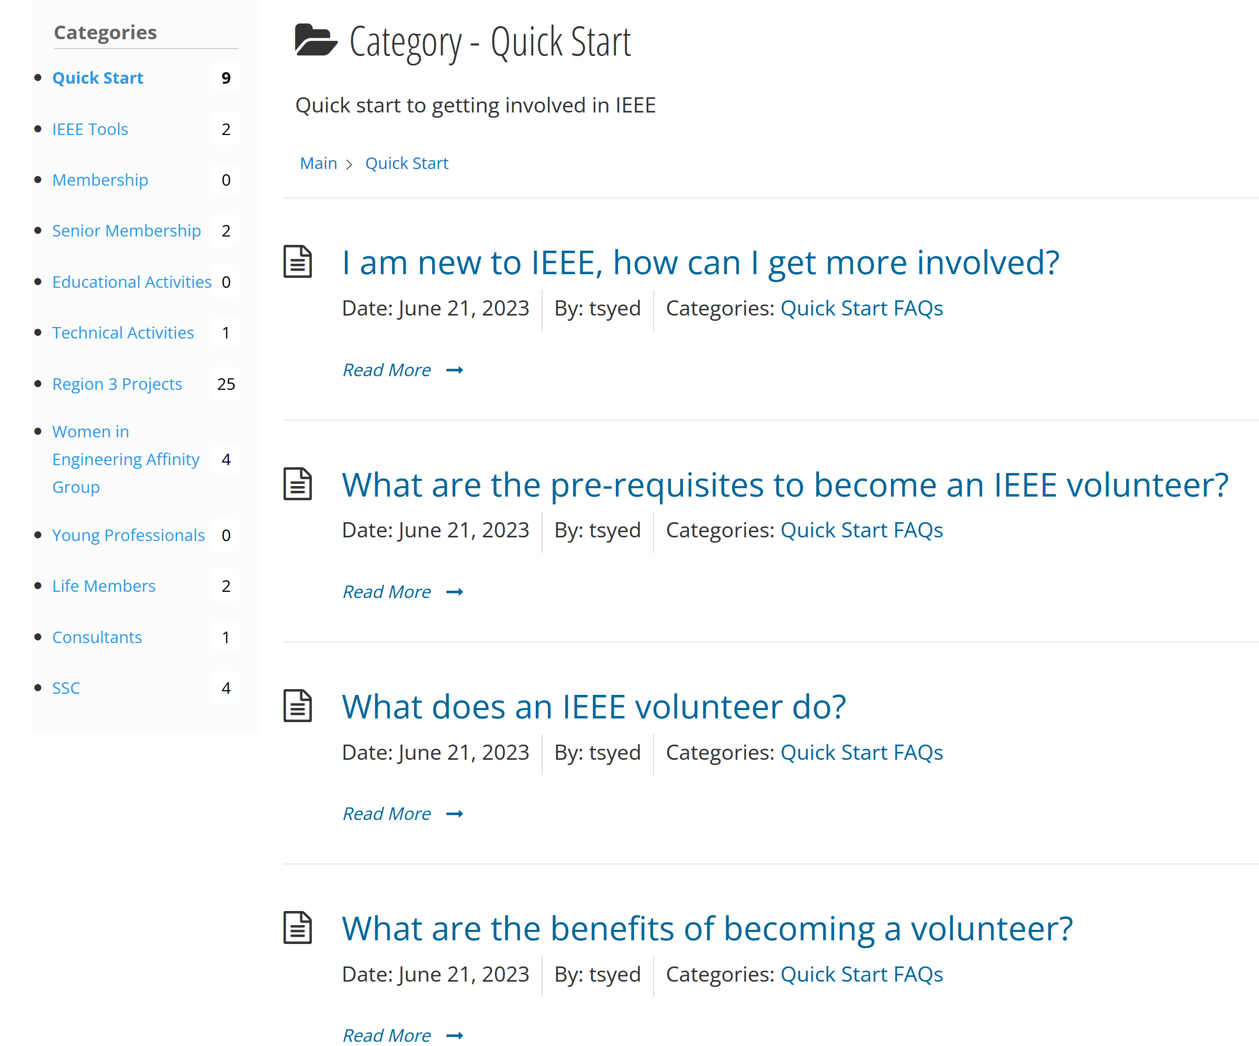
Example Content

