Slide 1
Engaging Student Branches
Pat Donohoe
Region 3 Secretary
Region 3 Committee Meeting
Sections Congress 2023
Ottawa, CA
11 August 2023

Slide 2
IEEE Section Org Chart
Section
Chapters
Affinity Groups
Sub-Sections
Student
Branch(es)
Section-Student Branch → Parent-Child Relationship

Slide 3
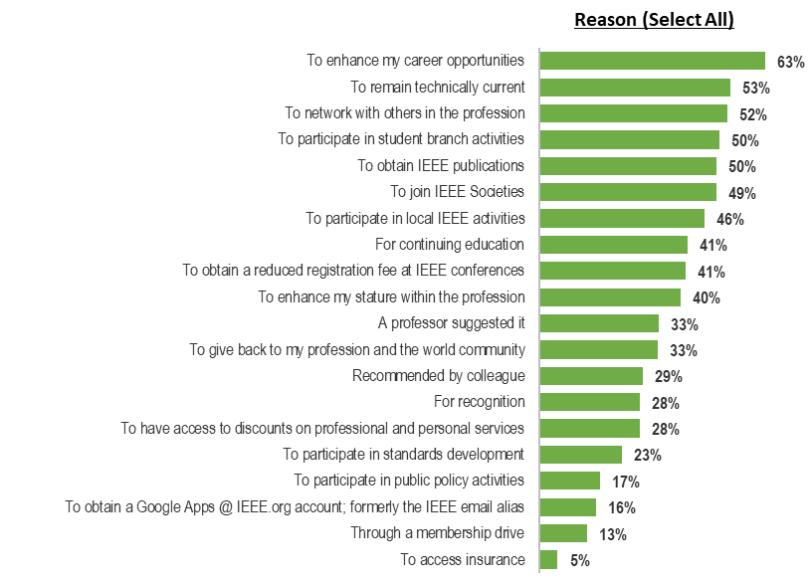
Student Members - Reasons for Joining IEEE
1. To enhance my career opportunities (63%)
2. To remain technically current (53%)
3. To network with others in the profession (52%)
4. To participate in Student Branch activities (50%)
5. To obtain IEEE publications (50%)
6. To join IEEE Societies (49%)
7. To participate in local IEEE activities (46%)

Slide 4
Student Branch members want to participate in Section Activities.
Sections must be proactive to develop an effective working relationship with the Student Branch.
Direct communication between Section leaders and Student Branch leaders (branch officers and branch counselor) is key to developing and sustaining an effective working relationship between the Section and Student Branch.
The interaction should be bidirectional.
Section
Student
Branch

Slide 5
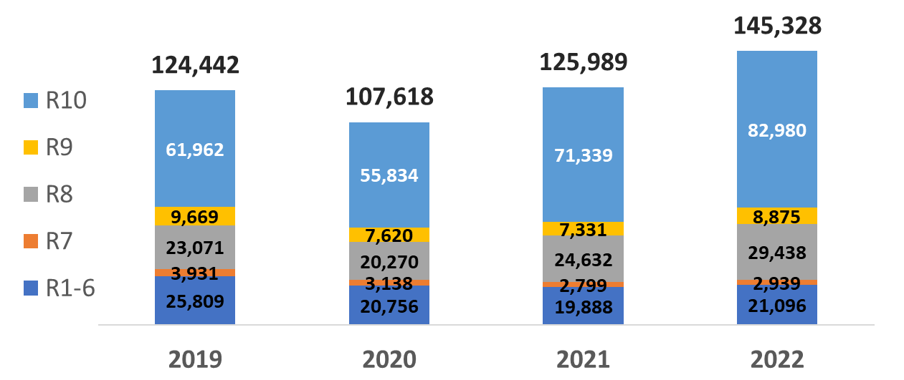
IEEE Total Student Membership (SM+GSM) – December Shapshot

Slide 6
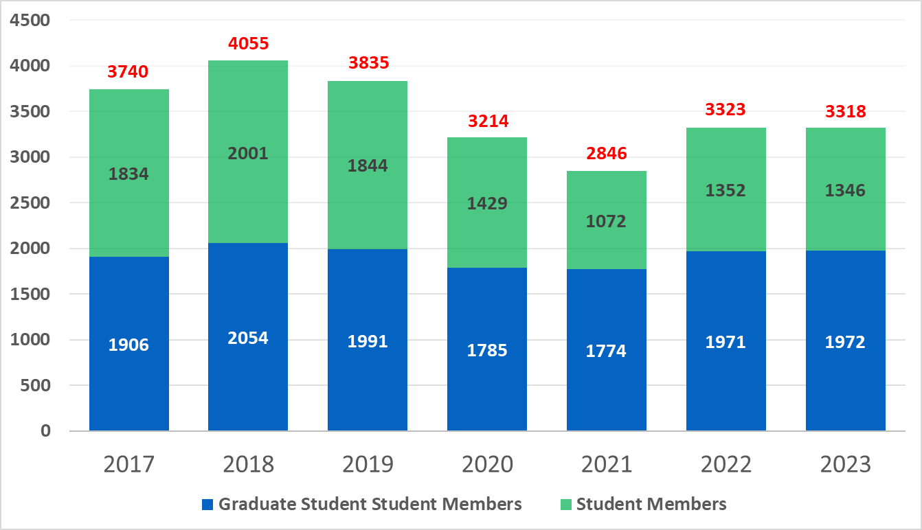
Region 3 Total Student Membership (SM+GSM) – June Shapshot

Slide 7
R3 Student Branches have not fully rebounded from the impacts of the pandemic.
Disruption in face-to-face meetings (prohibition of student gatherings) during the pandemic brought most student branches to a full stop.
Continuity of student branch operations (regular meetings, elections, etc.) was lost.
We may have lost experienced student branch counselors in the process, which makes restarting student branch activities that much harder.
Some student branches have not reactivated.

Slide 8
Region 3 Student Branches Set for Dissolution
Section | Student Branch
Alabama Section | Gadsden State Community College
Atlanta Section | Chattahoochee Technical College
Atlanta Section | Clark Atlanta Univ
Atlanta Section | Dekalb Tech
Atlanta Section | Westwood College – Atlanta
Central Savannah River Section | Augusta Technical College
Central Tennessee Section | Nashville State Technical Inst
Chattanooga Section | Chattanooga State Technical Community College
Coastal South Carolina Section | Horry-Georgetown Tech College
East Tennessee Section | Fountainhead College Of Tech

Slide 9
Region 3 Student Branches Set for Dissolution (cont.)
Section | Student Branch
Eastern North Carolina Section | Elizabeth City State University
Eastern North Carolina Section | Fayetteville Technical Inst
Lexington Section | Kentucky State University
Louisville Section | ITT Technical Institute-Louisville
Memphis Section | State Technical Inst-Memphis
Savannah Section | Savannah Technical College
Virginia Mountain Section | Southwest Virginia Community College
Virginia Mountain Section | Virginia Western Community College
Western North Carolina Section | Caldwell Community Coll & Tech Institute

Slide 10
Initiating Student Branch Engagement or
Revitalizing an Inactive Student Branch
Contact the Student Branch Counselor, Student Branch officers and (or) department chair. In a meeting with all constituents, stress that the students, the academic department, the school, the Section and IEEE all benefit from having a strong Student Branch.
For the case of revitalizing an inactive Student Branch, selection of the Branch Counselor is key. Ideally, the students select the Branch Counselor with the approval of the Section Chair and the department chair.
Section
Student
Branch
School

Slide 11
Initiating Student Branch Engagement or
Revitalizing an Inactive Student Branch
Student Branch Annual Plan
The Section works with the Student Branch officers and Branch Counselor in developing the Student Branch Annual Plan (meeting schedule, speakers, budget).
The Section can provide resources to the Student Branch (speakers, funding, etc.).
Joint activities are encouraged.

Slide 12
A question for every Section …
Are you a good parent?
Discussion/Questions

