Slide 1
Region 3 Meeting | 10 AUG
Ottawa, Canada | 11–13 AUG
The Power of Having a Website
Melody Richardson
IEEE-Atlanta

Slide 2
Why Having a Website is Important
Visibility
Public Facing
24/7 availability
Platform for Communication
Resource for Members
Promote Events
Share Accomplishments
Notes:
This is the place where you can direct others to go to find out more about your section.
Professional Development
Outreach
Potential Members
Events
Distinguished Lectures
Conferences
It’s also the place for you to brag about your section’s accomplishments.

Slide 3
But More Importantly…
When Folks don’t know about IEEE
Who We Are
Professional Opportunities
Outreach Events
It makes Melody Cranky.
Notes:
Or say I-E-E_E
A cranky Melody is never a good thing.

Slide 4
So, Let’s Make Melody Happy
Create a Section Website!
It’s easier than you think.

Slide 5
Build Your Website
The Easy Way!
IEEE’s vTools
WEBINABOX

Slide 6
The Easiest Way to Build Your Website
Generated Section Website in a Few Quick Steps
Simple Web Site Creation
Automatically Updated
Very little maintenance
Set It and Forget it!
IEEE’s vTools
WEBINABOX
Notes:
WebinaBox:
Simple, No Fuss website in minutes

Slide 7
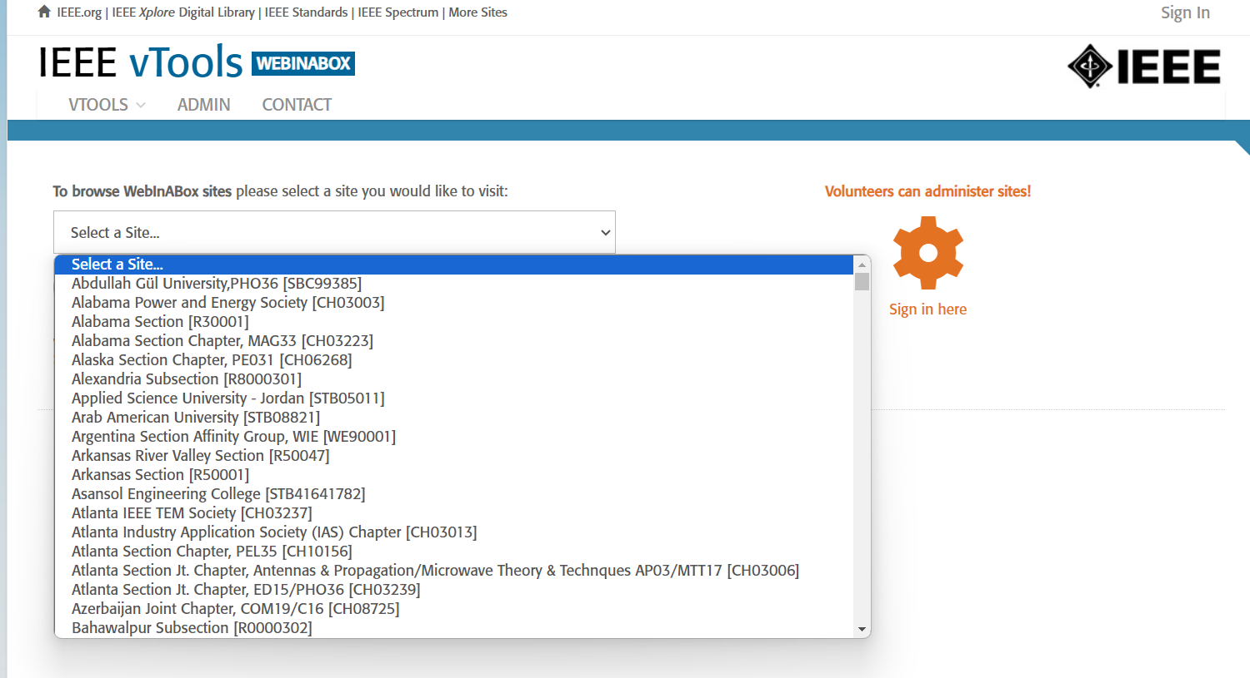
Getting Starting with WebInABox
From IEEE MGA vTools
Under Tools
Select vTools WebInABox
Select your Organizational Unit
Notes:
Detailed Tutorial: https://vtools.ieee.org/webinabox-tutorials/
https://kb.ieee.org/vtools/blog/kb/intro-to-webinabox/

Slide 8
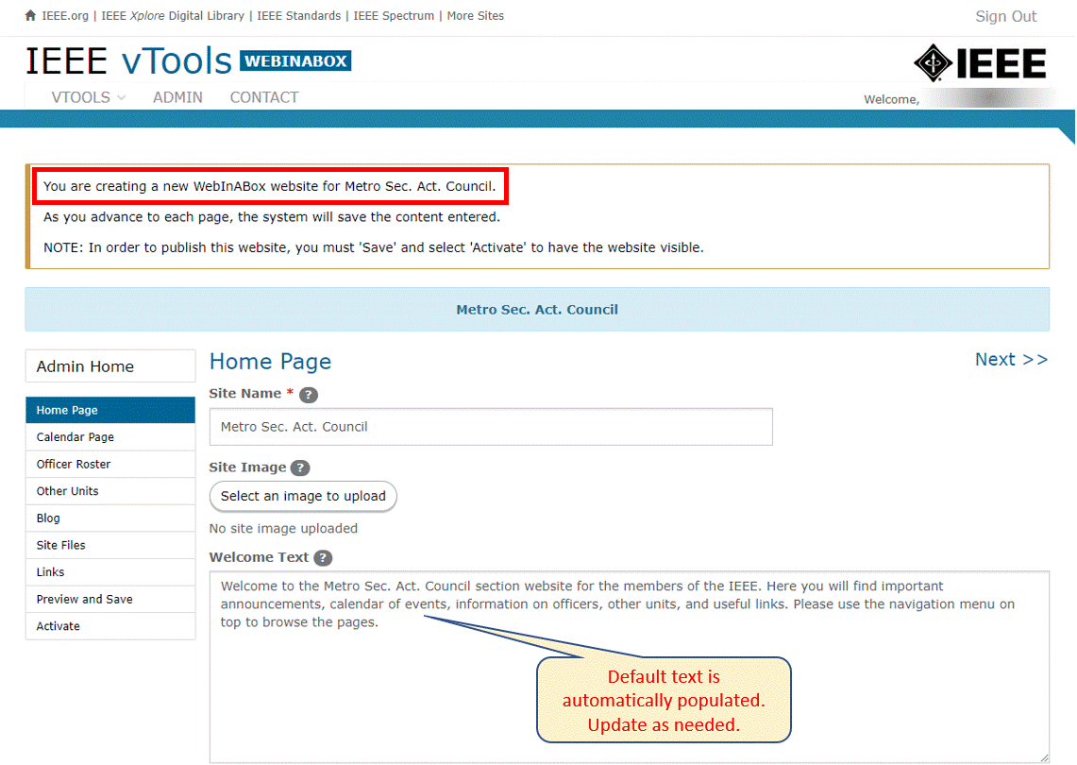
Edit Your Welcome Page
Notes:
Change the Site’s Name –(It’s what shows up in Google)
Select an Image to Display
Consider Canva - https://www.canva.com/
Add Text about your Section

Slide 9
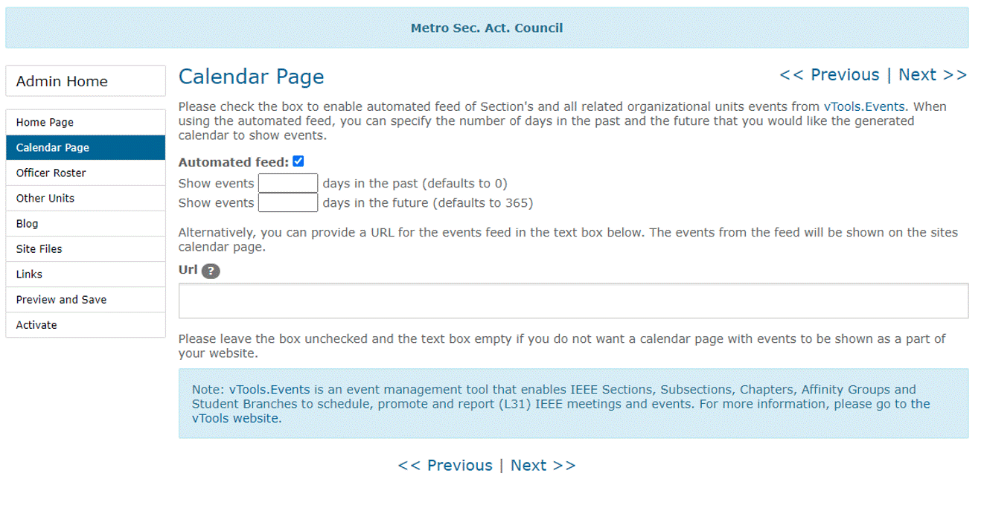
Add a Calendar of Events
Notes:
Automatically display section events
Shows events captured in vTools
Customizable
Date Range
Length of Time

Slide 10
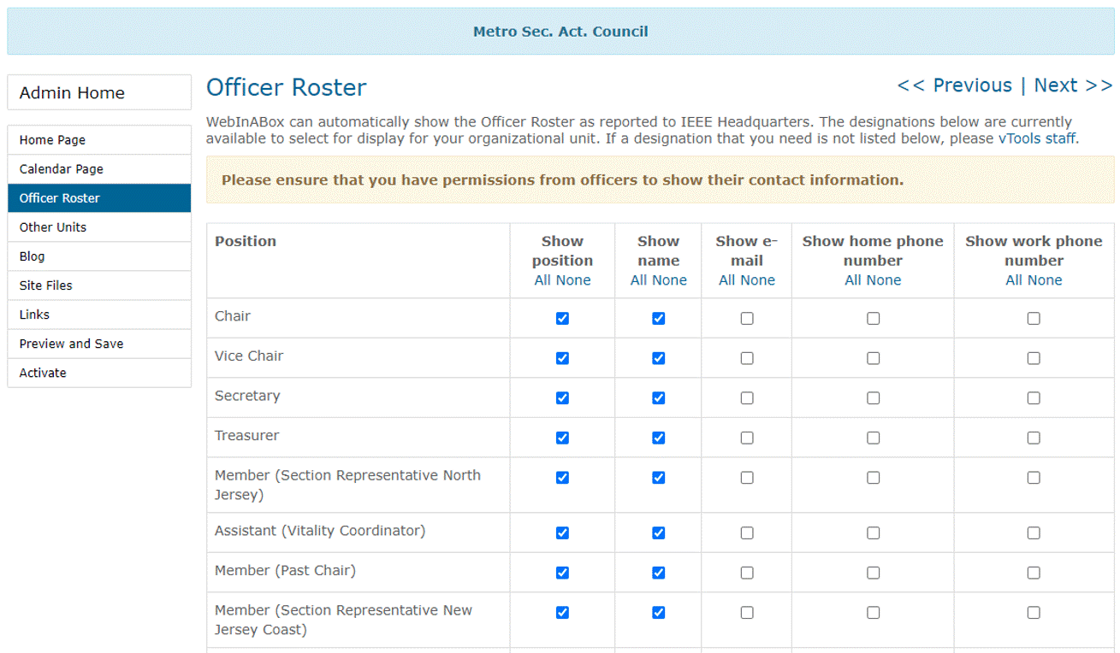
Add Section Officers
Notes:
Display Officers as reported to IEEE Headquarters
Customize what positions to display

Slide 11
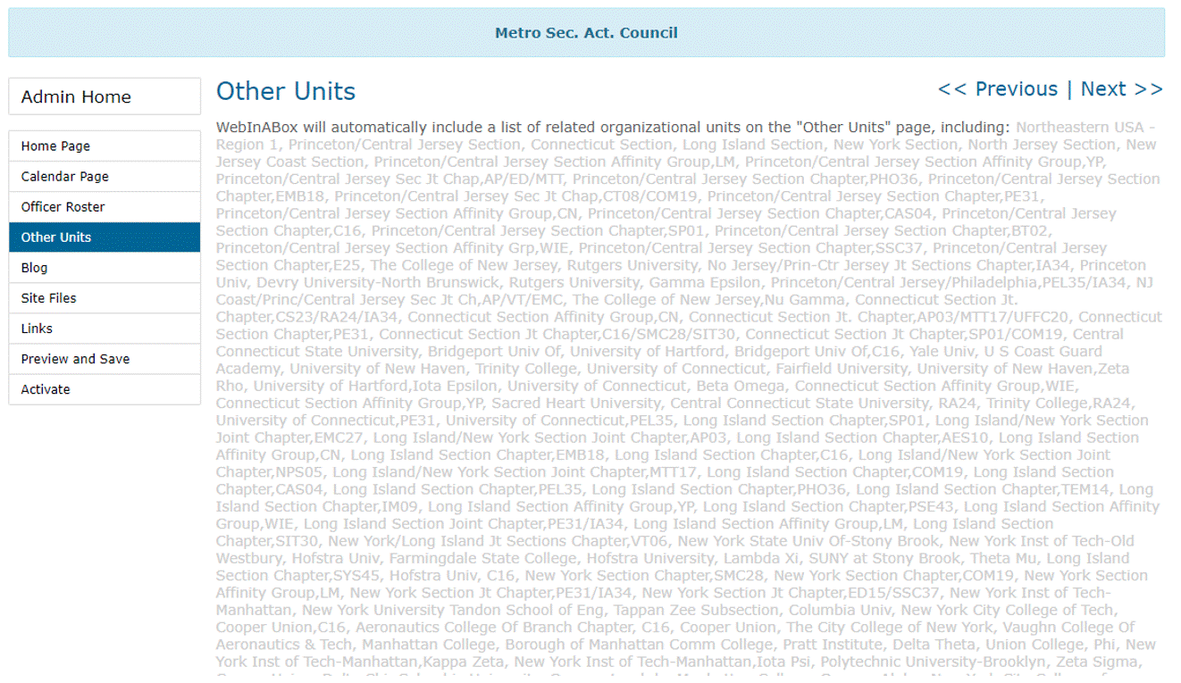
Add Additional OUs
Notes:
Display other units associated with your section
Customize what OUs to display

Slide 12
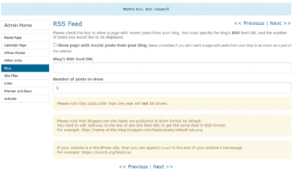
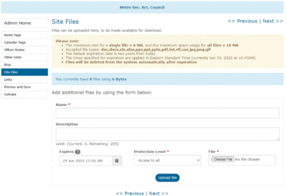
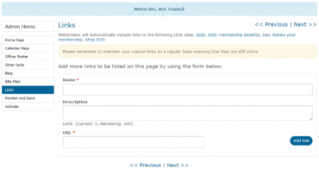
Add a Blog, Files, or Links
Notes:
Get as detailed as you like
Show recent posts from your blog.
Upload any files you want to be available to those who visit your website.
Add more links to this page as desired.

Slide 13
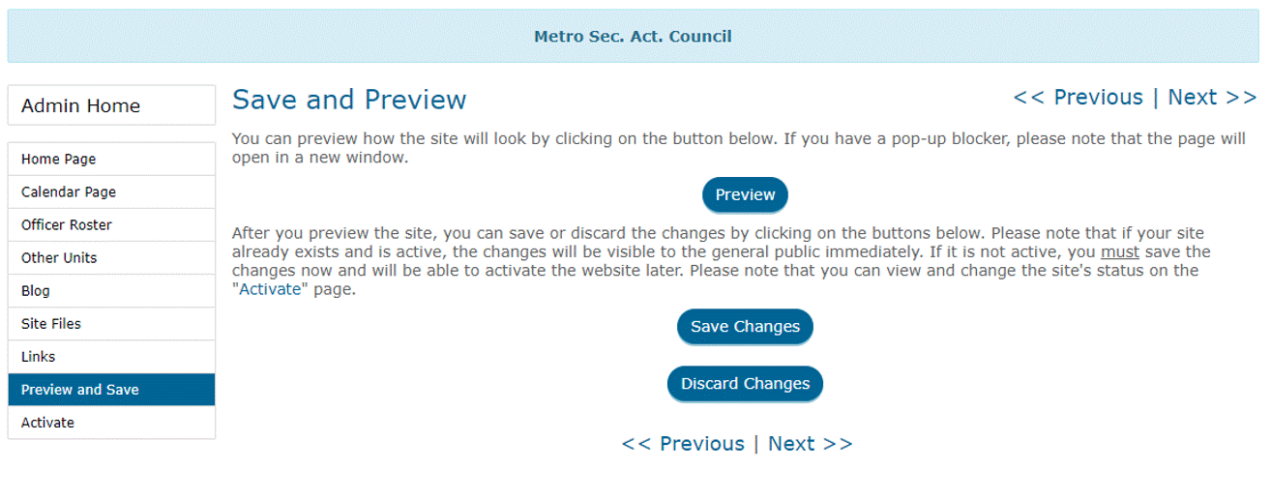
Save and Preview
Notes:
Preview your hard work, make any changes, and save. Your section website is now live.

Slide 14
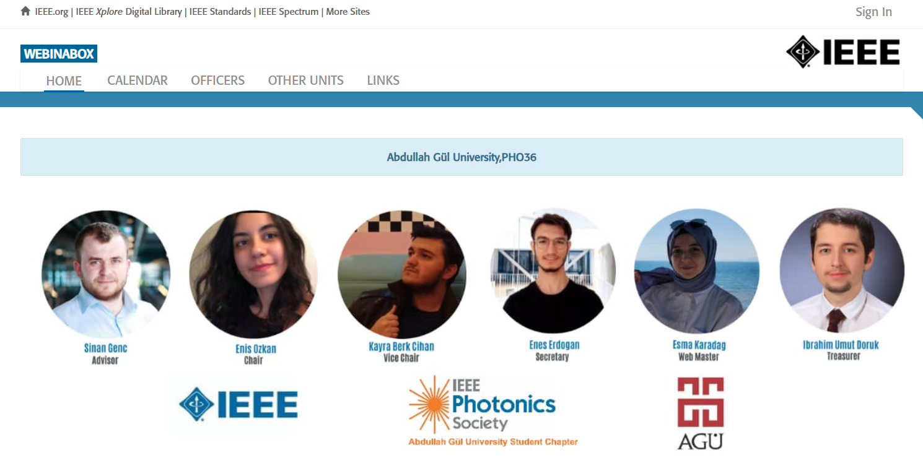
Your Section’s Website!
Notes:
And before you know it, you have a finished website

Slide 15
Make Melody Happy! (you know you want to!) Create or Update your Website
Notes:
Easy.

