Slide 1
Region 3 Meeting | 10 AUG
Ottawa, Canada | 11–13 AUG

Slide 2
Filing Expense Reports
What expenses are allowed
Accessing Concur
Starting a report
Adding expenses
What happens next
Tips & Common questions
What you need to know –
BEFORE and AFTER
– you incur reimbursable expenses

Slide 3
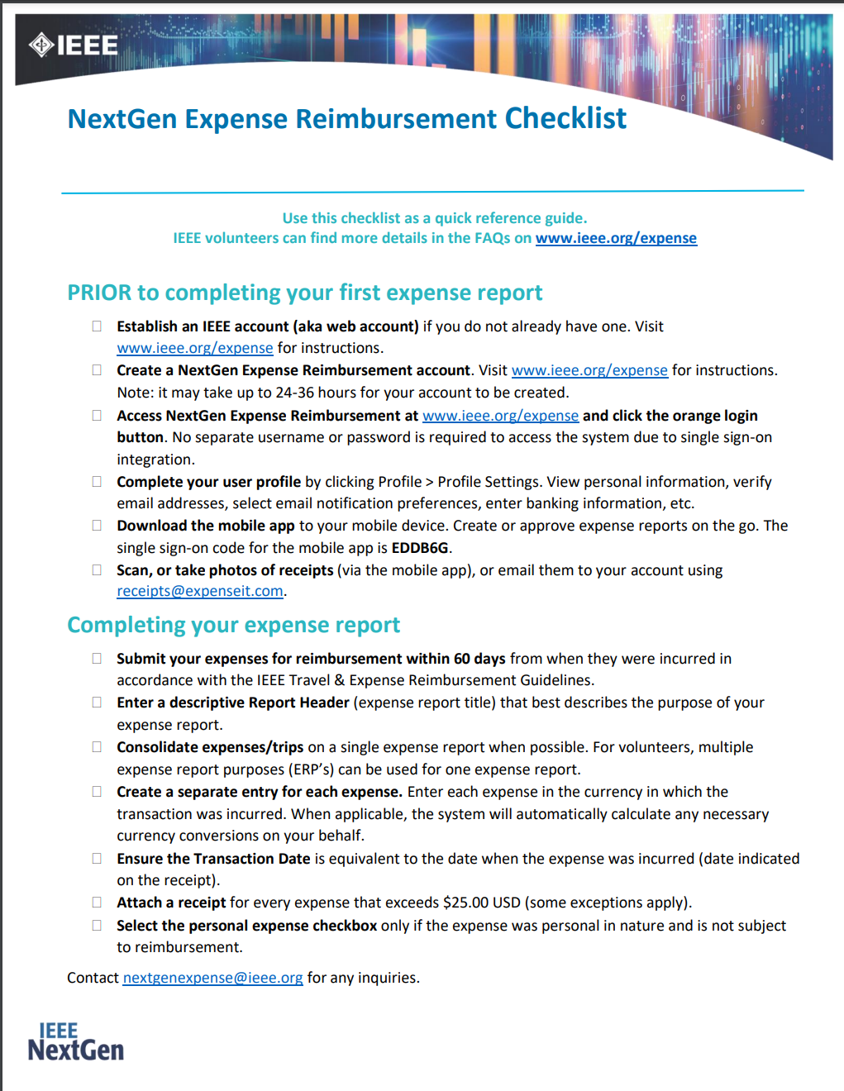
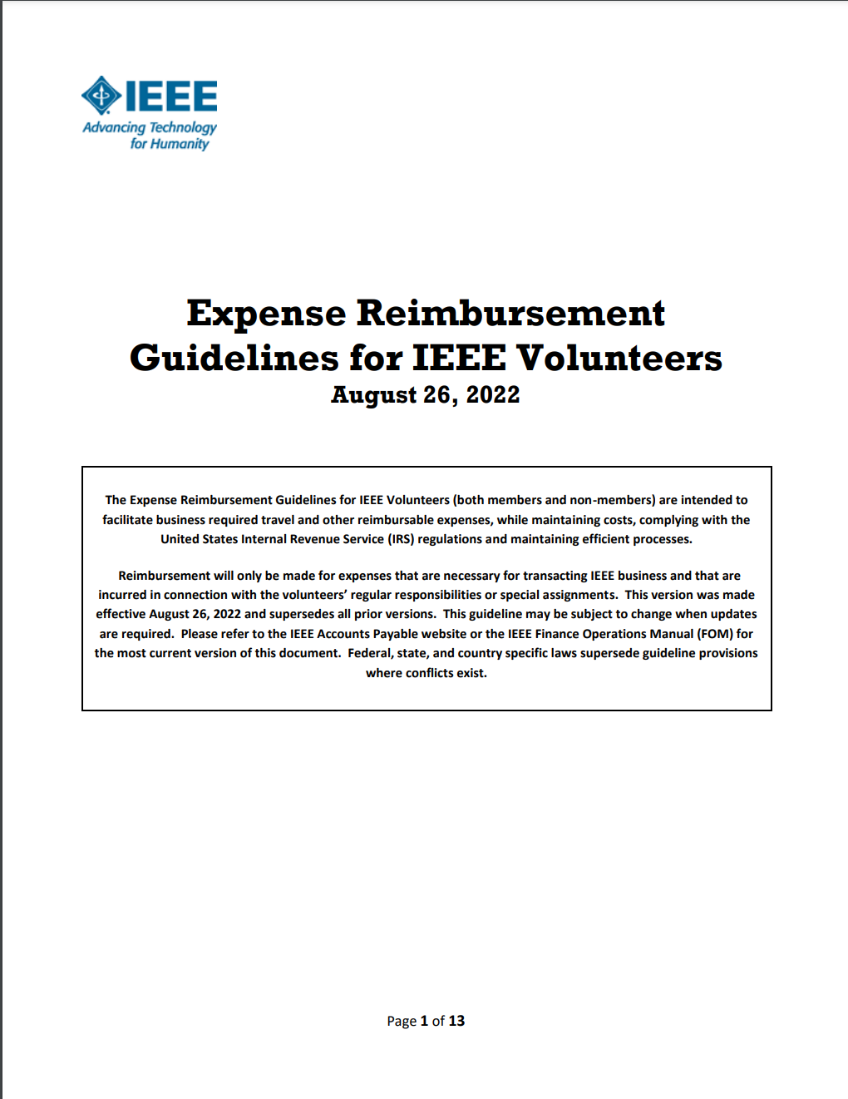
What Expenses are Allowed?
This is a handy checklist for filling out your first report.
https://corporate.ieee.org/images/files/finance/concur/NextGenExpenseReimb_Checklist_7feb2021.pdf
This explains everything that is allowed for reimbursement.
https://www.ieee.org/content/dam/ieee-org/ieee/web/org/travel-expense-reimbursement-guidelines.pdf
All IEEE expenses that are reimbursed to an individual are processed exclusively through Concur, the IEEE Corporate Expense Reporting tool.
Refer to these BEFORE incurring any expenses.
Now that you know what can be expensed – how do you do one?

Slide 4
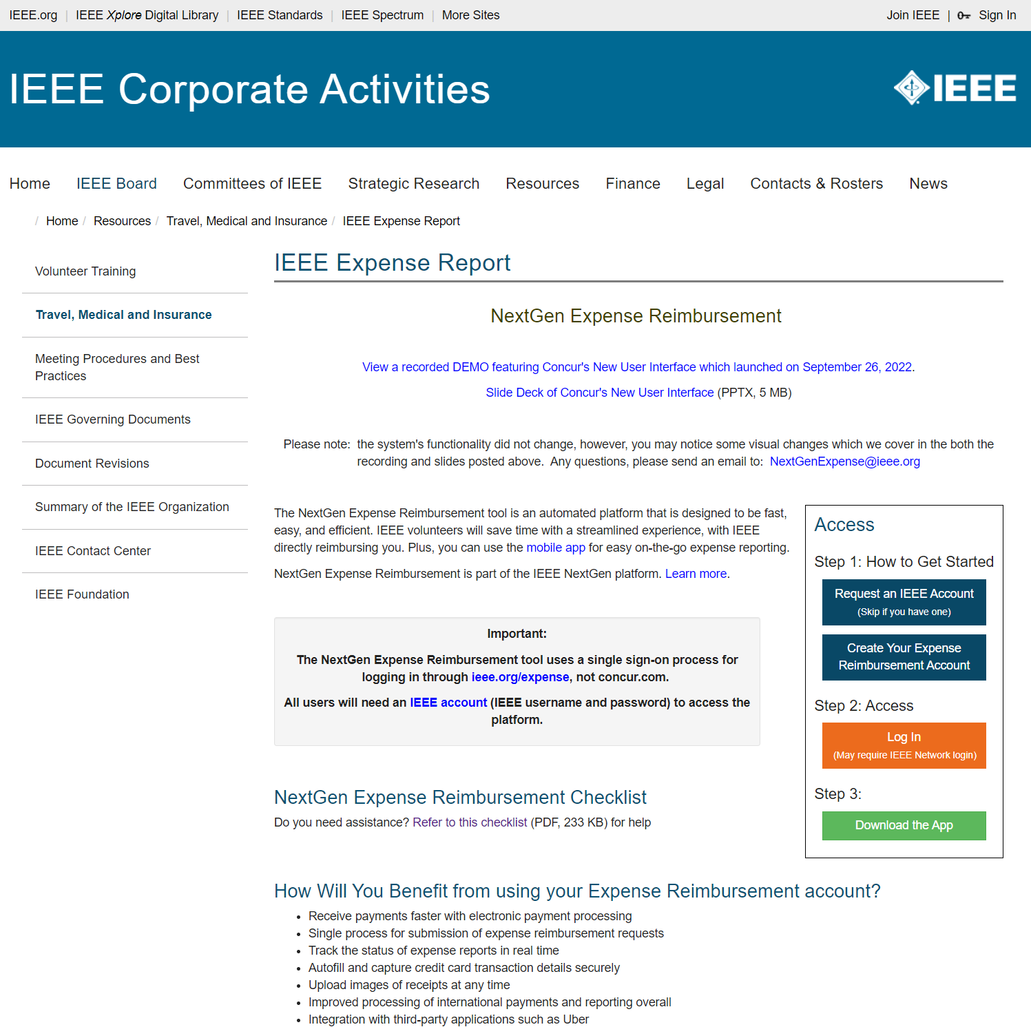
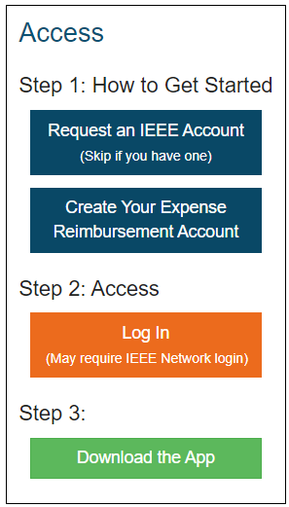
Accessing Concur
https://corporate.ieee.org/resources/travel-medical-and-insurance/ieee-expense-report
Create an IEEE account if you don’t have one (this should be rare for most of you)
Create a Concur account if you don’t have one – you will want to link in your bank for direct deposit
Launch the Concur web app – will use IEEE Single Sign On (SSO) for ID and Password
There is also a phone app (Apple & Google)

Slide 5
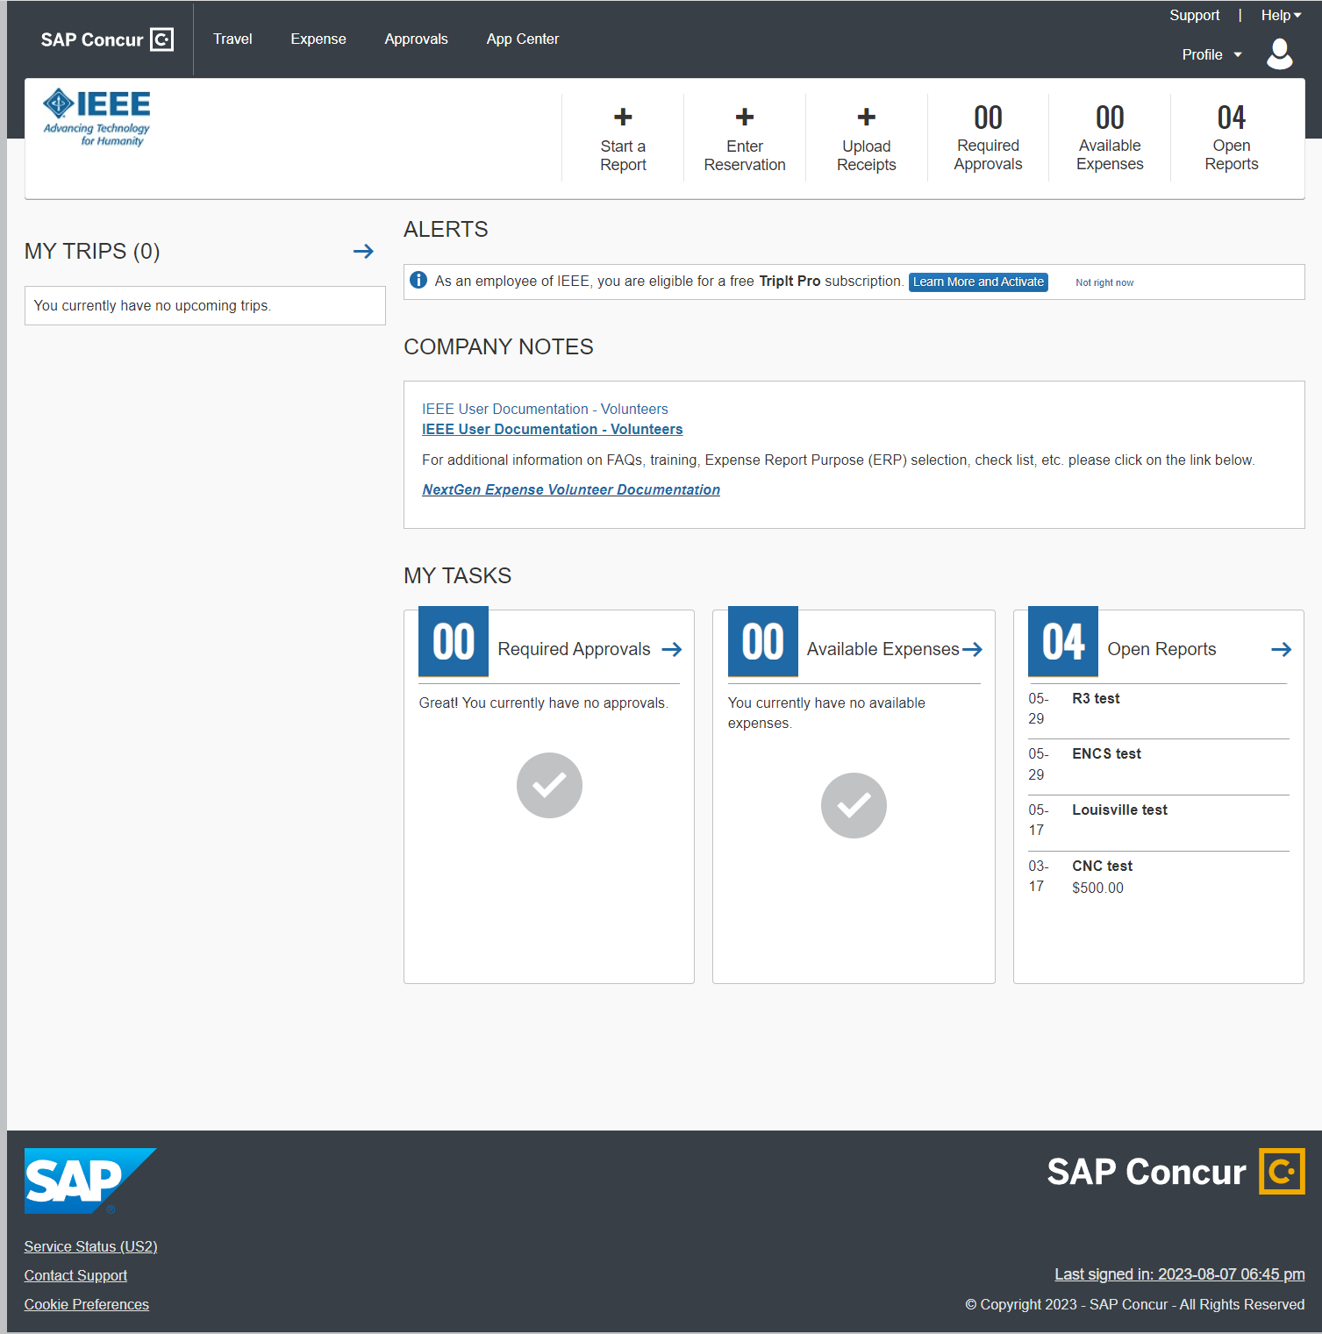
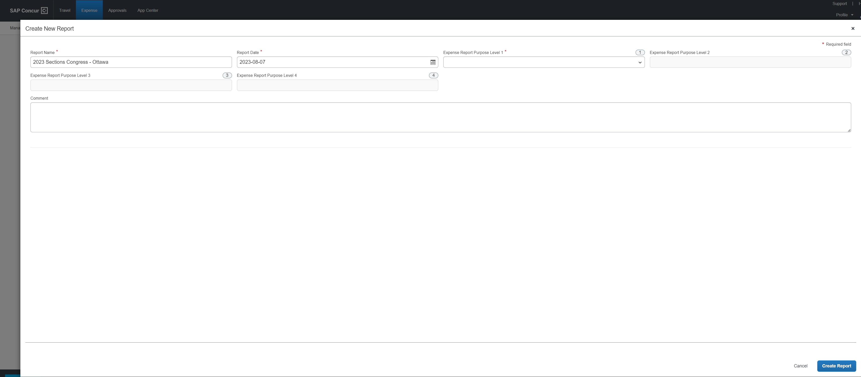
Starting a Report
1

Slide 6
Starting a Report
Give your report a meaningful name
Add comments to ensure its purpose is clear

Slide 7
Starting a Report
Expense Report Purpose Levels
These are critical to get correct so that your report gets routed to the appropriate approvers. When incorrect, the approver gets no notification
What is entered here becomes the default for all line items on the details page
Linked to MGA accounting system, so guessing the correct levels is not always easy
Ask the treasurer who will approve for the right level codes
Give your report a meaningful name
Add comments to ensure its purpose is clear

Slide 8
Starting a Report
Expense Report Purpose Levels
These are critical to get correct so that your report gets routed to the appropriate approvers. When incorrect, the approver gets no notification
What is entered here becomes the default for all line items on the details page
Linked to MGA accounting system, so guessing the correct levels is not always easy
Ask the treasurer who will approve for the right level codes
Give your report a meaningful name
Add comments to ensure its purpose is clear
Region 3 funded attendees will use
Level 1: Regions
Level 2: Southeastern USA – Region 3
Level 3: Southeastern USA – Region 3 (R3)
Level 4: 000 Sections Congress (5.15.000)
Section representatives will use a different set of Levels as you are funded by MGA directly for this conference – therefore it goes to a different approver.

Slide 9
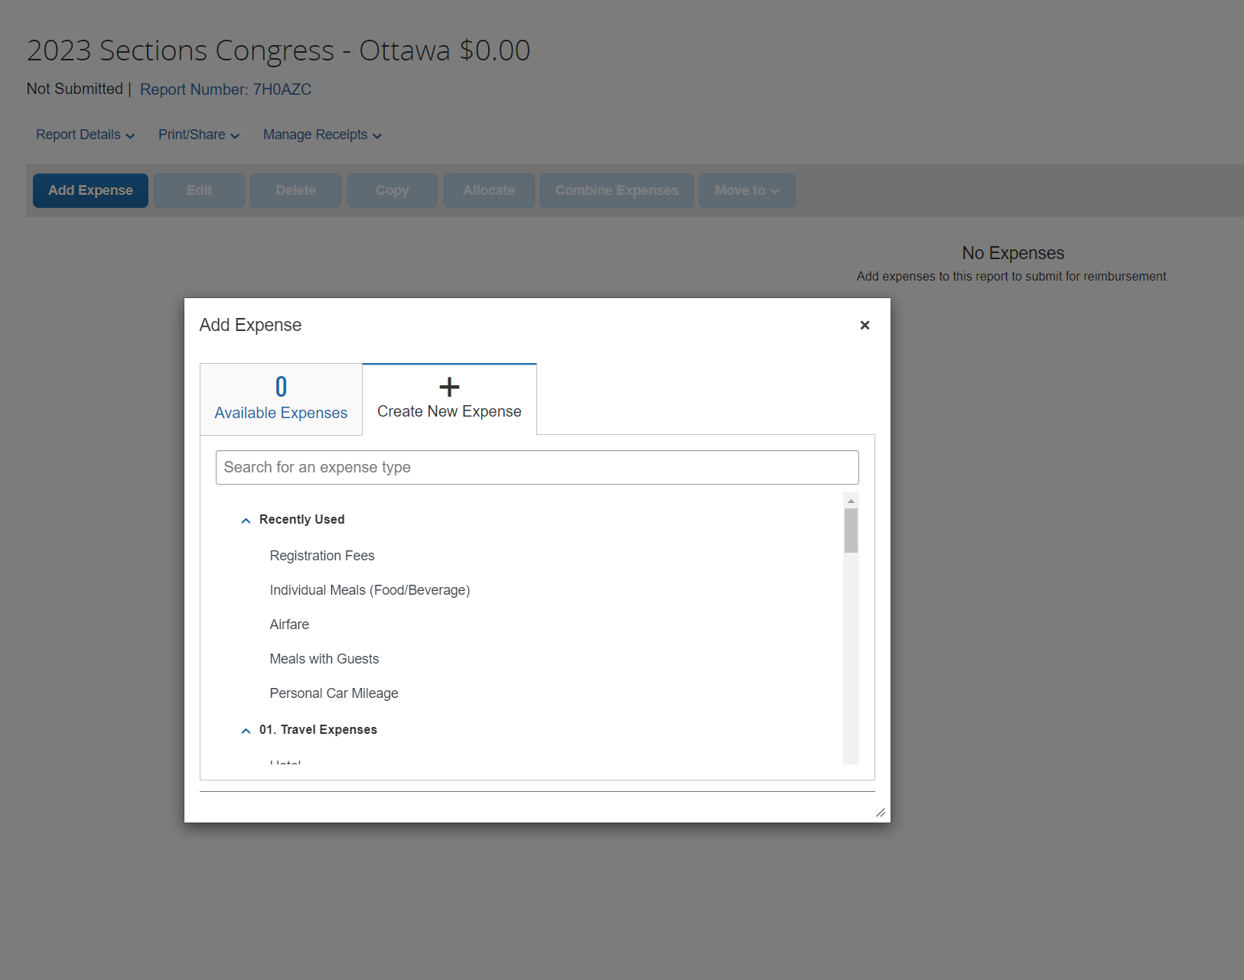
Adding Expenses
Now you’ll start adding expense line items
Select the best match for your expense
Make sure you complete ALL information
Ensure the date matches the receipt date
Add receipts whenever you can
Receipts are required over $25
Credit Card statements cannot be used as a receipt
A picture from your phone works perfectly well
There is a lost receipt process, if needed
Make sure you follow expense policy

Slide 10
Sample Expense Report
Sample from SoutheastCon
All details
Receipts where possible
Personal mileage
No Receipt needed
Tips (<$25)
No Receipt needed
No Personal expenses
Total Amount = Total Approved

Slide 11
What Happens Next?
Once you click “SUBMIT” on your expense report, the following occurs:
The first approver in the approval process flow is notified that an expense is ready – typically Treasurer
They review the report looking for the following:
All expenses are in line with reimbursement policy – any personal expenses are identified
All necessary receipts are attached – they will look at every receipt to ensure accuracy
They will make sure all necessary fields are filled in and that dates match receipts
They will ensure the correct Level 1 – Level 4 are used for each expense
For any issues, they may return it to the submitter with comments on what needs to be updated
If all looks good, they approve and it goes to second approver – likely Chair or Director
They perform similar review as an independent “set of eyes” – they will return if updates are needed
If all is good, they approve; it goes to the Concur auditors next – they will return for issues
If they approve, it gets sent for payment; these are processed and direct deposits are made
Time from submission to payment depends – approvers’ timeliness, report rejections, and 2-3 days to pay

Slide 12
Tips
Complete expense reports in a timely fashion
Policy recommends within 60 days – don’t risk forgetting or having reimbursement rejected for lateness
Make sure to fill out all fields
Vendor name is often forgotten and causes rejection, dates need to match receipts
Make sure to use the right Levels!
Ask the Treasurer who will approve for the right Level codes – when incorrect ones are used, approver is never notified
When in doubt, ask!
The IEEE Travel Reimbursement Policy document officially governs the process – refer to it first, but ask if unsure

Slide 13
Common Questions/Situations
Air Travel vs. Driving a car
IEEE encourages use of air travel in lieu of driving for extended distances
If driving is necessary, or fiscally responsible (e.g. carpooling), IEEE recommends renting a car and expensing rental car, fuel, tolls
If using a personal car, reimbursement is for mileage – but it will be limited to the average cost of a flight between destinations
When submitting, add something documenting flight cost for purchase 3 weeks in advance to make process go smoothly
Submit mileage that results in reimbursement equal to that flight cost – mileage is $0.655/mile
Rental car at destination
If you travel by air to a destination, rental car expense at the destination will not be reimbursed
if you feel there are extenuating circumstances, get pre-approval before renting (Treasurer and Director/Chair)
Covered hotel nights
For conferences, the number of nights the region covers is predefined and will be clearly communicated, only those will be reimbursed
If circumstances require more nights, that must be preapproved by Treasurer & Director

