Slide 1
Region 3 Meeting | 10 AUG
Ottawa, Canada | 11–13 AUG
Paul Kuban
Region 3 Area 4 Chair

Slide 2
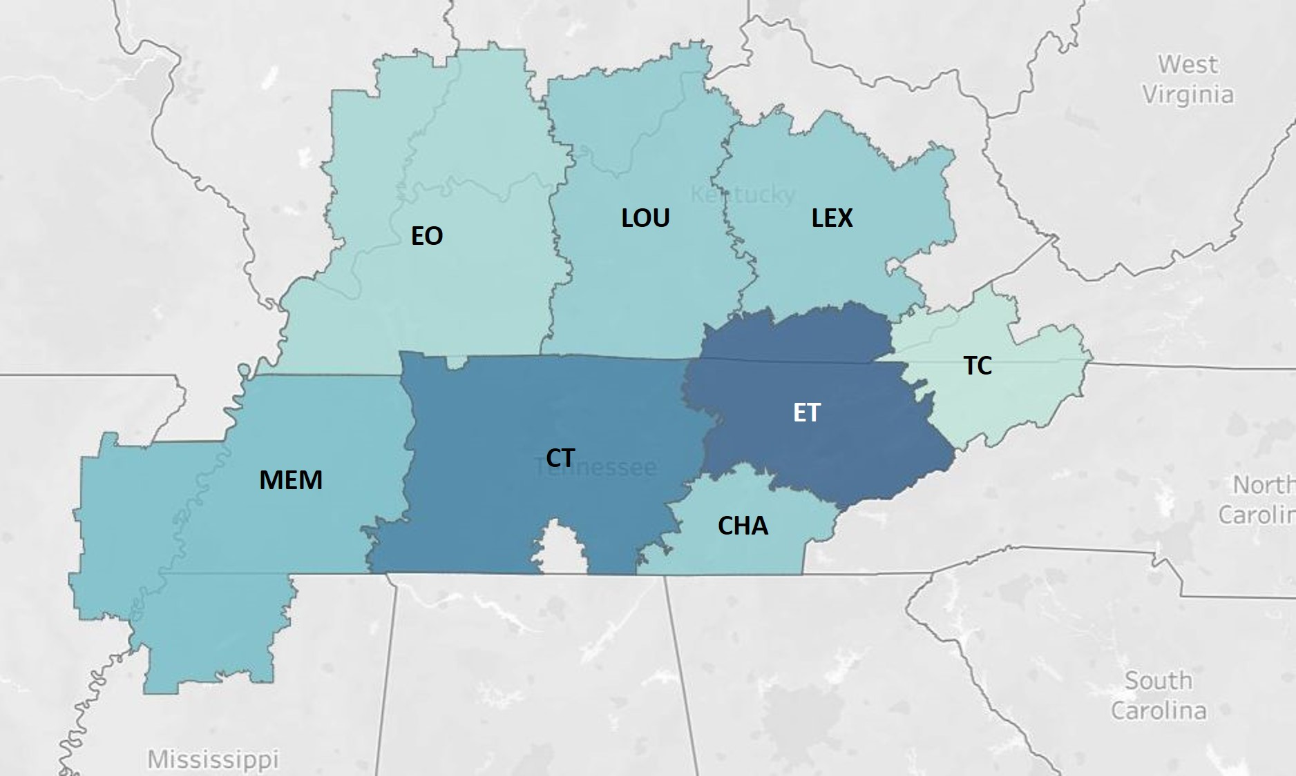
R3 Area 4 Section Locations

Slide 3
R3 Area 4 Section Members & Meetings
SECTION MEMBERSHIP/Mtgs. 2023
Central TN (Nashville) 802 / 8
Chattanooga, TN 285 / 11
East TN (Knoxville) 997 / 13
Evansville, IN & Owesboro, KY 161 / 5
Lexington, Ky 295 / 12
Louisville, Ky 317 / 9
Memphis, TN 339 / 9
Tri-Cities, TN, NC, VA 82 / inactive
Total A4 Membership 3278

Slide 4
Area 4 Section Interaction
REGION 3 AREA 4 - SECTION MEETING OPPORTUNITIES
EVANSVILLE-OWENSBORO – Have attended most meetings since it’s my local section. Also arranged for an expert POWER speaker from India to do a local meeting, which was also streamed.
LEXINGTON and LOUISVILLE – Attended their joint annual holiday gathering. Met with new officers and members from both sections.
CENTRAL TN, EAST TN, & CHATTANOOGA – Attempted to schedule a MOVE tour, but it was cancelled due to needing the MOVE truck for a disaster.
CHATTANOOGA – Attempted to become a technical sponsor for a conference. Found out that an AREA cannot be a sponsor (due to not having budget authority), and it required a SECTION sponsor. Chattanooga declined due to having all new officers. The event did find an IEEE sponsor eventually.

Slide 5
Questions or Comments?

