Slide 1
Region 3 Meeting | 10 AUG
Ottawa, Canada | 11–13 AUG
Patrick Kung
Area 5

Slide 2
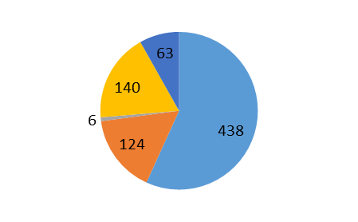
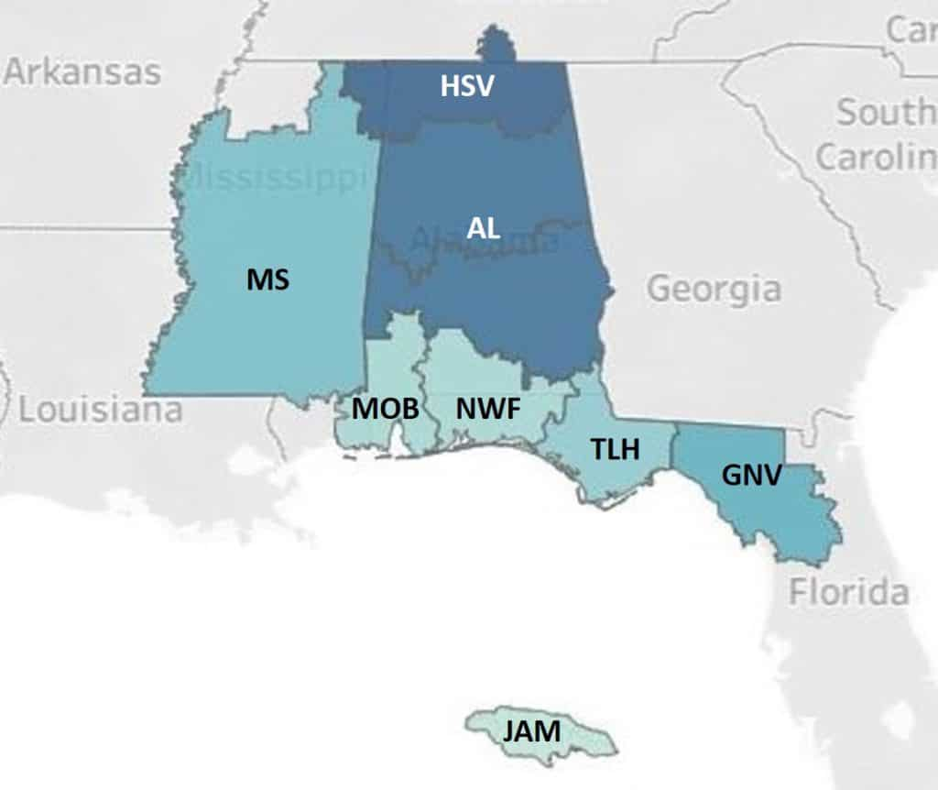
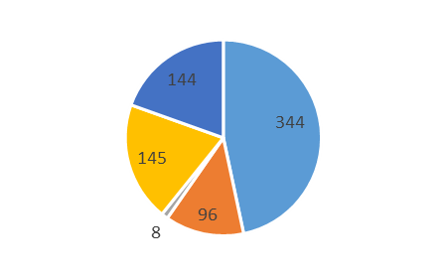
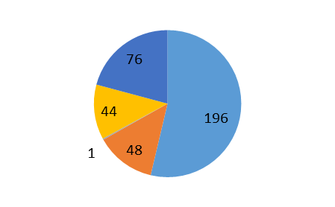
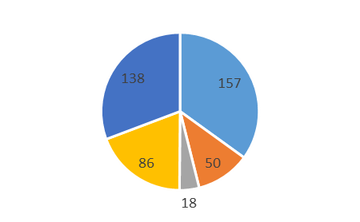
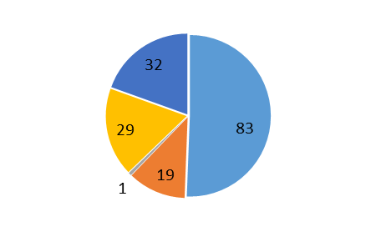
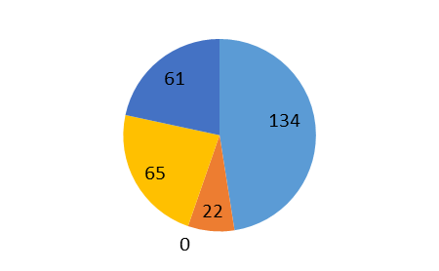
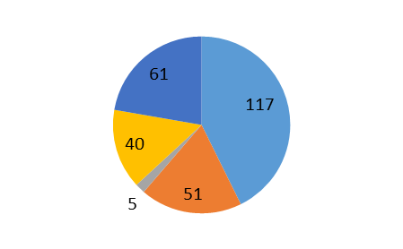
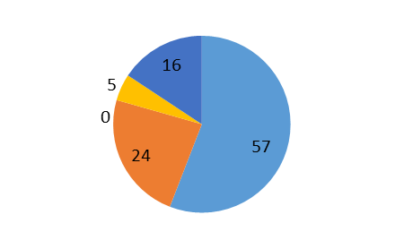
Area 5 - Membership
771
737
365
Members
Senior Members
164
449
Fellows
282
Life (Member, Fellow, Senior)
274
Students (all)
102

Slide 3
Area 5 – Society Chapters & Affinity Groups
AES10
AP03/MTT17/COM19
C16
CS23/RA24
EMC27
PE31
TEM14
LM
YP
WIE
Several chapters are at risk of becoming inactive, often due to officer fatigue
MS: new WIE (2022), new LM (2023)
C16
COM19
IA34
MAG33
PE31
LM
YP
PE31
LM
YP
WIE
PE31
C16/COM19
LM
PE31
LM
C16
COM19
E25
WIE

Slide 4
Area 5 – 2022 Reported Meetings (-ExCom, +joints)
15
TLH: active (FAM,FSU) student branch involvement with Section
NWF: active (U West Florida) student branch involvement with Section
15
8
6
18
22
3
0

