Slide 1
Show Me the Money
Jill Gostin, Past IEEE VP, MGA; Former R3 Director
Presented at SoutheastCon 2024

Slide 2
Outline
Introduction
Rebates
Region Funding Opportunities
Societies/Councils (for Chapters)
Students/Affinity Groups
MGA Surplus Projects
Conference/Workshop Surplus
Donations
IEEE Foundation Grants
IEEE SIGHT
New Initiatives
Helpful Info and Links
Conclusions and Q&A
2

Slide 3
Introduction
2023 IEEE VP, MGA; 2020-2021 Region 3 Director
Mathematician, Principal Research Scientist, Sensors and Electromagnetic Applications Lab at the Georgia Tech Research Institute
IEEE Service: Officer or Board member in Chapter, Section, Region, MGA, 2 Societies, 1 Council,, IEEE Board of Directors; Service on Committees: All of the above plus Technical Activities, HKN
Served as Treasurer and then VP Finance for Sensors Council; Served on TAB FinCom
3

Slide 4
REBATES: MGA rules
See MGA Operations Manual, Section 3.4, and Geounit Rebates web page
IEEE Bylaws I-108.5 specifies that 12% of member dues will be allocated to Geounits.
Sections in existence on 31 December and meeting minimum requirements receive a rebate (see next page)
10% Bonus for timeliness (financial, meeting, officer)
The Section’s subunits (Subsections, Chapters, Student Branches and Affinity Groups) will be notified about the amount to which their activities contributed to the rebate prior to the distribution of the rebate by 31 August.
4
Notes:
Only Regions, Sections, and Student Branches receive Rebates.

Slide 5
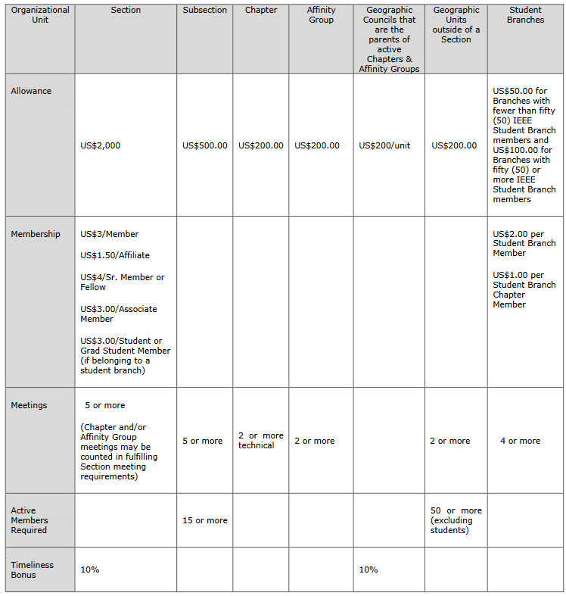
Table extracted from MGA Operations Manual Section 3.4.B
5

Slide 6
REBATES: Activity Bonus
Activity bonus to encourage local activities (funds are excluded from the 10% timeliness bonus):
All sections (subsections) reporting 10 meetings or more, at least five of which must be of a technical nature, receive an additional USD 200 (USD 100)
All chapters or affinity groups reporting 6 or more meetings (for chapters, 6 must be in the technical category) shall receive an additional USD 75
Meetings jointly hosted by more than one geounit will count toward the activity bonus of all units
Geounits must qualify for the timely reporting bonus in order to be eligible for an activity bonus
.

Slide 7
REBATES: Requirements (1 of 2)
Current officer report: Due 15 March each year, this includes reports of current section, subsection, chapter, and affinity group officers (use vTools for elections and officers are automatically reported!)
Financial report: Due 28 February each year. If the section is unable to obtain financial records from a subsection, chapter, or affinity group, it may opt to submit a statement that the subunit has failed to submit a timely financial report and waive its right to a rebate for that particular subunit.
Notes:
Comment on elections being automatically reported for officers, but does this include chapter/affinity group officer elections, too?

Slide 8
REBATES: Requirements (2 of 2)
Meeting Activity Report(s): Due 15 March each year. Meeting activity reports are key to unit maintenance and viability. See “File a Report for a Past Event” on vTools.
Bank signature card: The bank signature card(s) for the Section and all of its Subsections, Chapters, Student Branches, and Affinity Groups must be returned to the IEEE Operations Center for the signature of the IEEE Staff Director-Financial Services before the section rebate will be released.

Slide 9
REBATES: Improve Your Rebate!
Encourage members to apply for senior membership (see Benefits of Senior Membership)
Hold many meetings
Vary types of meetings
Try something new to bring in new members or uninvolved members
Encourage subunits to work towards increasing membership – even students
Determine if new chapters or affinity groups are possible
Meet reporting deadlines
Notes:
Recognition: The professional recognition of your peers for technical and professional excellence.
Senior member plaque: Since January 1999, all newly elevated Senior members have received an engraved Senior Member plaque to be proudly displayed for colleagues, clients and employers to see. The plaque, an attractive fine wood with bronze engraving, is sent within six to eight weeks after elevation.
US$25 coupon: IEEE will recognize all newly elevated Senior members with a coupon worth up to US$25. This coupon can be used to join one new IEEE society. The coupon expires on 31 December of the year in which it is received.
Letter of commendation: A letter of commendation will be sent to your employer on the achievement of Senior member grade (upon the request of the newly elected Senior member).
Announcements: Announcement of elevation can be made in section/society and/or local newsletters, newspapers and notices.
Leadership Eligibility: Senior members are eligible to hold executive IEEE volunteer positions.
Ability to refer other candidates: Senior members can serve as a reference for other applicants for senior membership.
Review panel: Senior members are invited to be on the panel to review senior member applications.
US$25 referral coupon: Newly elevated Senior members are encouraged to find the next innovators of tomorrow and invite them to join IEEE. Invite them to join and the new IEEE member will receive US$25 off their first year of membership.

Slide 10
Region Funding Opportunities
Professional Activities Funding
Saturday 11:15 am “Professional Activities Committee” session
Saturday 3:50 pm “Professional Development Events” session
Project Funding
Saturday 3:35 pm “Running Section Projects” session

Slide 11
Societies/Councils (for Chapters)
Chapters are supported by both MGA (Section, Region, or Geographic Council) and Technical Activities (Societies/Technical Councils)
Many Societies/Technical Councils have robust Chapter programs that include:
Financial support
Distinguished Lecturers
Mentorship / Support Resources
Outstanding Chapter Awards
Collaborate with Societies/Councils on Local Programs and Events
Reach out to your local Chapter Chairs
Communicate with your Student Branches and SB Chapters
Form new Chapters and Student Branch Chapters in your Section
Contact Society/Technical Council Chapter Coordinators for support
Sections, through their Chapter Chairs, will be able to access more support for their local members.
11

Slide 12
Societies/Councils (for Chapters)
Each Society/Council (S/C) has its own program -- Reach out to the (S/C) Chapter Coordinator
https://mga.ieee.org/volunteer-hub/geographic-unit-operations/geographic-units-and-groups/chapters/ieee-society-chapter-coordinators
Rebates for holding N meetings
Funds for specific activities – usually a template or webform to submit request
Utilize Distinguished Lecturer Programs
https://ta.ieee.org/operations/society-and-council-operations/ieee-distinguished-lecturer-program
12

Slide 13
Students/Affinity Groups
Support available for:
Young Professionals AGs
Students
WIE AGs
Life Members AGs
Funds are limited and frequently are depleted early in the year
Read guidelines well; request examples if needed
13

Slide 14
Students/Affinity Groups: YP and Student Activities Committees
Student Professional Awareness (SPAx) provides funding to IEEE Student Branches for the organization of events that assist students in their exploration of career development topics, up to $500 per event.
More info at:
Student Professional Awareness
Young Professionals Event Funding supports Affinity Groups and Societies hosting local activities, Student Transition and Elevation events (STEP), and Meetups at IEEE conferences up to $1,500 per activity.
More info at:
Young Professionals Event Funding
14
IEEE PROPRIETARY
Notes:
The blue underlined links in the slide above entitled “Young Professionals Event Funding” and “Student Professional Awareness” are clickable and lead to the event funding applications and instructions since the links are a bit long as below:
https://yp.ieee.org/volunteers/event-funding/
https://students.ieee.org/student-opportunities/professional-awareness/spax-events/

Slide 15
Students/Affinity Groups: IEEE WIE
IEEE Women in Engineering (WIE) encourages the development of local activities that add professional value to IEEE WIE members and are aligned with the WIE mission. https://wie.ieee.org/funding/
Initial Funding – Newly established WIE Affinity Groups (AG) and WIE Student Branch Affinity Groups (SBAG) are eligible to request up to US$200 in start-up funding.
Special Funding – WIE AGs and WIE SBAGs may request up to US$400 in funding for special projects or activities.
Sample activities include: IEEE WIE workshops, IEEE WIE panel sessions at IEEE Society conferences, joint IEEE WIE/Young Professionals activities, etc.
15
IEEE PROPRIETARY

Slide 16
Students/Affinity Groups: Life Members Committee
Leadership Congresses - Funds each Region up to $1,500 USD for region-wide leadership congresses for students and young professionals
Local Activities - Reimburses Life Member Affinity Groups for events serving Life members
More information about IEEE Life Members program available at life.ieee.org
16
IEEE PROPRIETARY

Slide 17
MGA Surplus Projects
If MGA has surplus funds from the previous year, and other requirements are met, a call is made for Regions to submit project ideas
Should include other Regions and shall be a new initiative
Show how it will become sustainable
Funds must be used in the calendar year received
Can’t be used for cash awards
A template will be provided when the call is issued
Work continuously to identify and socialize ideas for projects
17

Slide 18
MGA Surplus Projects
Guidelines on Requesting MGA Surplus Funding
Projects of less than $10,000 shall not be considered
As per the IEEE FOM, cash awards shall not be funded as part of this project
Preference will be given to cross-Region projects with benefits for multiple Regions and broad groups of members and that support member retention
Review Process for Submitted Projects
Initial screening: MGA FinCom
Project evaluation: MGA OpCom and the immediate past Treasurer
Ranks all projects and recommends projects to MGA Board for approval
Number of projects shall be limited by total funds available for that year
Project Tracking & Reporting
Each project will provide a progress report after 3 months and a final report at year end
IEEE Proprietary Do Not Distribute
18
IEEE Proprietary

Slide 19
Conference/Workshop Surplus
Sponsorship opportunities with Societies, Sections, other Chapters
See Meetings-Conferences-Events (MCE) web page for more information:
http://www.ieee.org/conferences_events/conferences/organizers/index.html
Locate conferences coming to your city!
https://ieeemce.org/organize-an-event/search-ieee-conferences/
Consider Tutorials and workshops for locals that need PDHs or CEUs for certifications
https://ieeemce.org/planning-basics/event-planning-logistics/certificates-and-digital-badges/
19

Slide 20
Donations
IEEE Policy permits Sections and Chapters to accept donations for activities of scientific or technical nature
The IEEE Development Office supports/coordinates fundraising
“Solicitation” must be approved in advance. Discuss approval process with IEEE Development Office (varies by amount)
Establish a Foundation Fund https://www.ieeefoundation.org/about/establish-an-ieee-foundation-fund/
Submit Fund Establishment Document; must align with Foundation mission
Three Phases
The Idea (Scope, Cost, Funding Sources, Fundraising Plan, Initiative details, Metrics/Assessment)
Approvals (Program/Initiative Approvals, Funding Approvals)
IEEE Foundation Board Approvals
20

Slide 21
IEEE Foundation Grants
https://www.ieeefoundation.org/funding-requests/
Proposal types that could be funded include, but are not limited to:
New projects or programs that improve access to technology, enhance technological literacy, and/or support technology education where the OU lacks sufficient funding
Existing projects or programs that improve access to technology, enhance technological literacy, and/or support technology education in need of funding to scale up activity
Workshops intended to bring together like minded individuals to work on societal issues that could benefit from technology and then disseminate the results to a larger audience
Fundraising dollar match opportunities for established IEEE programs who have a fund/funds with the Foundation to drive donor giving
21

Slide 22
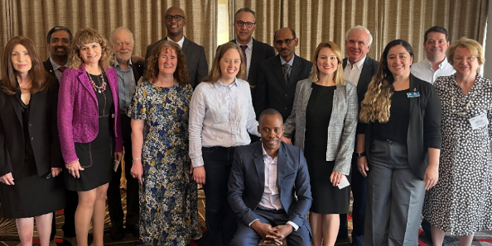
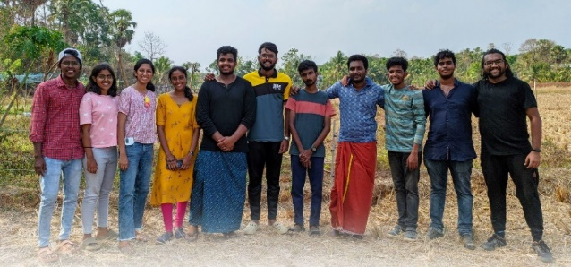
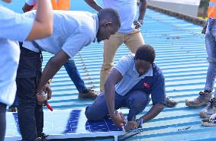
IEEE SIGHT
INDIVIDUAL MEMBERS
Submit a project to a call for proposals
Add free SIGHT membership to your IEEE membership
Form a SIGHT Group to assess needs in your local community, apply for financial resources, and implement a sustainable technological solution
Read the Annual Report and Success Story Portfolio – your story may be published!
Take part in the free, online courses on humanitarian technology and sustainable development topics on the IEEE Learning Network (ILN)
Donate to the IEEE SIGHT Fund of the IEEE Foundation. Your contribution of any amount helps HTB/SIGHT transform the lives of individuals and communities around the world
IEEE ORGANIZATIONAL UNITS
Identify ideas for collaboration and joint programs
Publicize HTB|SIGHT opportunities so your members can benefit from them
22

Slide 23
NIC Definitions of a New Initiative
New Initiatives
An IEEE initiative is a new program, service, or product … that will provide significant benefit to members, the public, the technical community, or customers, … or which could have lasting impact on IEEE or its business processes
Initiatives must be of strategic importance to IEEE
Initiatives are not operational necessities at the time of their initiation
Projects that can be funded by appropriate baseline budget reductions within the unit are not classified as initiatives
NIC looks for projects that will further IEEE’s strategic goals.
23

Slide 24
IEEE New Initiatives Program Seed Grant Process – Two Phases
New Initiatives: Seed Grants
Seed Grant: Funds innovative or pilot projects that require US $40,000 or less and take 12 or fewer months to complete
An idea is submitted
NIC provides feedback for consideration via email
Phase 1: Project Description
Phase 2: Seed Grant Proposal
A proposal is submitted
NIC meets to vote to fund or not to fund at their next meeting
If approve, funding is granted immediately
*Funding to work with a business consultant early on to create a project plan is available through this process
24

Slide 25
New Initiatives Process – Three Phases
New Initiatives: Large-Scale Projects
New Initiatives: Large–scale projects typically seeking US $100K or more for up to three 12–month periods
An idea is submitted
NIC provides feedback for consideration via email
Phase 1: Project Description
Preliminary Proposal is submitted
NIC meets and votes whether to invite a Full Proposal and Business Plan
Phase 2:
Preliminary Proposal
Full Proposal and Business Plan
NIC meets and votes whether to recommend to the IEEE Board of Directors to fund the initiative
Phase 3: Full Proposal and Business Plan
25

Slide 26
Helpful Info and Links: R3 Volunteers who can help
Conferences (Joe Juisai)
Finance (Joe Pennisi)
Professional Activities (Sharlene Brown)
Section Support (Kristin Bing)
Student Activities (Bailey Heyman)
Projects (Allen Jones)
Area Chairs:
Jamie Imanian
Wyman Williams / Alessio Medda
Raul Ortega
Paul Kuban
Danial Diaz

Slide 27
Helpful Info and Links: Section Finances
Session this weekend on Section Budgets & Funding (2:15 pm Friday; slides available)
See MGA Operations Manual Section 3.0, 9.5.G, 9.5.H, and 9.5.J
IEEE Financial Operations Manual
https://mga.ieee.org/volunteer-hub/geographic-unit-finances
Review Sections 11 and 16 of the Policies https://www.ieee.org/content/dam/ieee-org/ieee/web/org/about/corporate/ieee-policies.pdf

Slide 28
Helpful Info and Links: Broader Resources
Center for Leadership Excellence https://ieee-elearning.org/CLE/
IEEE Governing Documents https://www.ieee.org/about/corporate/governance/index.html
MGA Homepage https://mga.iee.org
IEEE Finance Operations Manual (FOM) https://www.ieee.org/content/dam/ieee-org/ieee/web/org/financial-ops-manual.pdf
IEEE Volunteer Hub https://mga.ieee.org/volunteer-hub
IEEE Proprietary

Slide 29
Conclusions and Q&A
Money is available, mostly from rebates
Money is available from various units across IEEE
You must report meetings
You must report new officers
You must submit meeting reports
Consider sharing activities with other Sections
Your rebate is larger if you are more active and you submit reports early
Q&A

