Slide 1
New Volunteer Orientation
Jill Gostin, Past IEEE VP, MGA
Cecelia Jankowski, Managing Director, MGA
Presented at SoutheastCon 2024

Slide 2
Outline
Introduction
Overview of IEEE
Overview of Member and Geographic Activities Board
Overview of Region 3
Running a Section successfully
Concluding Remarks and Q&A
Shorten a lot of this.

Slide 3
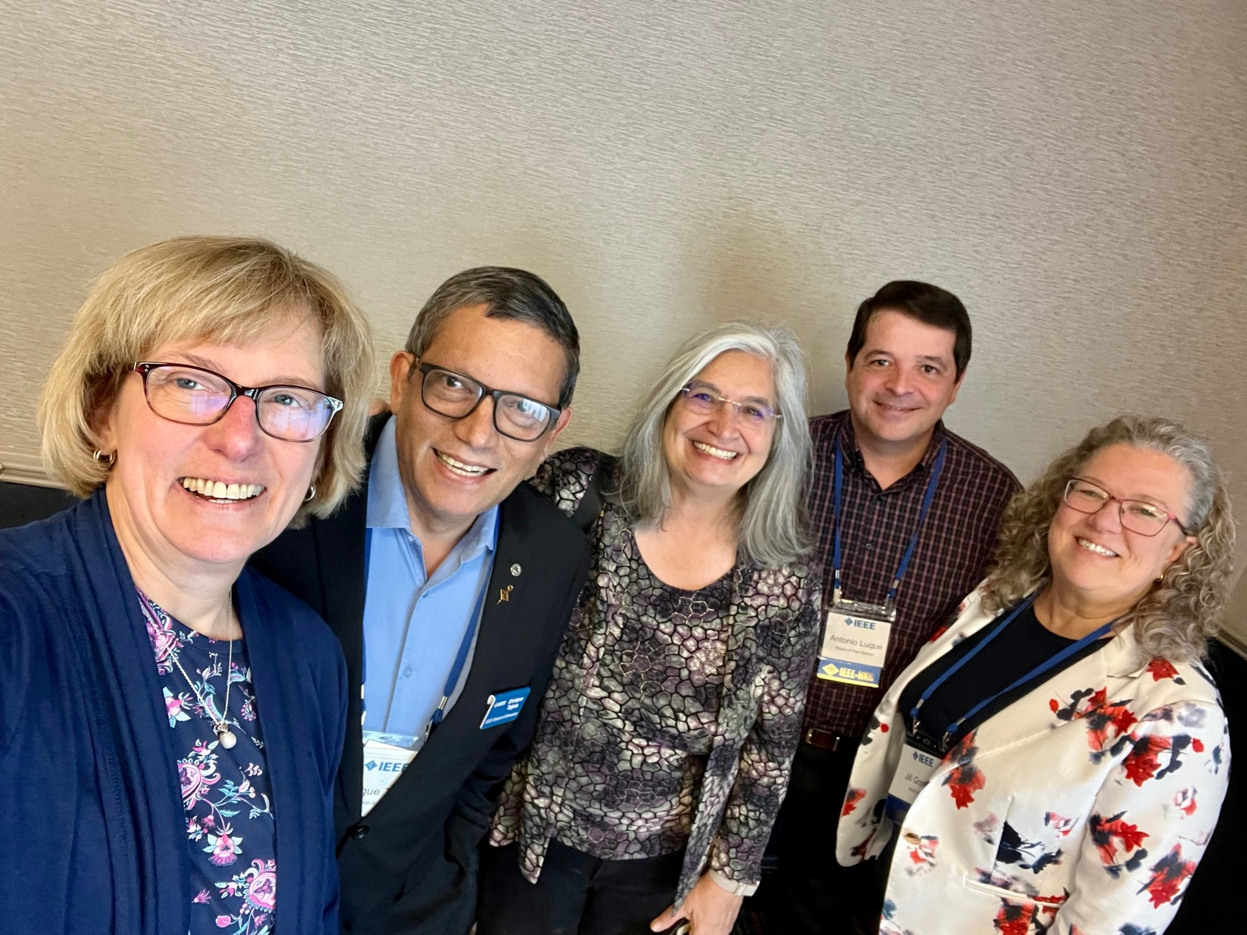
Jill Gostin / Cecelia Jankowski
Jill – Past IEEE VP, MGA; Past-past Region 3 Director
Cecelia – Managing Director, MGA (staff)

Slide 4
Overview of IEEE

Slide 5
What is IEEE?
IEEE is the world's largest technical professional organization dedicated to advancing technology for the benefit of humanity
IEEE and its members inspire a global community through publications, conferences, standards, and professional and educational activities
IEEE is member-driven. Members
  support the mission
  introduce technology careers to students
  build technical communities
  network with each other using tools like IEEE CollabratecTM and through multiple types of meeting opportunities
  share technical innovation with each other through Conferences and Workshops

Slide 6


Slide 7
IEEE Organization
Members are grouped geographically reflecting where members live and work …
… and technically based on members technical fields of interest (both global and local)

Slide 8
IEEE Simplified Structure
IEEE Board
of Directors
10 Region Dirs, 10 Div Dirs, 3 Ps
BoD
Member & Geographic
Activities Board
Assembly
IEEE-USA
EAB
TAB
PSPB
SAB
MGAB
47 Societies
and Councils
10 Regions
344 Sections
MGA - ensure quality member opportunities for continuous engagement.
Notes:
IEEE Major Boards have elected volunteer leadership.
Six subordinate boards govern major areas of IEEE interest:
Member and Geographic Activities (MGAB),
Technical Activities (TAB),
Educational Activities (EAB),
Publication Services and Products Board (PSPB),
Standards,
IEEE-USA.
There are a number of Committees that report either to BoD or to the Boards.
IEEE is governed by volunteers for volunteers, with the help of a reduced number of qualified staff members.

Slide 9
IEEE Leadership
IEEE Officers
  Voting members of IEEE elect a President each year.
  Serves for three years:
    President-Elect,
    President and CEO,
    Past-President.
President also leads IEEE governing bodies:
  IEEE Board of Directors (31 voting members: 3 “Presidents” + 6 Vice Presidents + Secretary + Treasurer + 10 Regional Directors + 10 Division Directors),
  IEEE Assembly (23 voting members: 3 P + 10 RD + 10 DD).

Slide 10
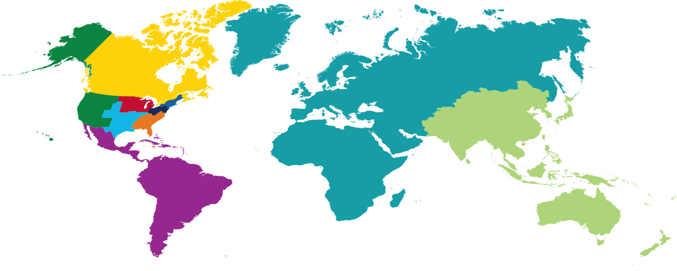
IEEE Membership by Region
31 December 2023
R7 – 14,500
R10 – 187,221
R1-6 – 153,204
R8 – 84,337
R9 – 21,447
10
TOTAL MEMBERSHIP: 460,709

Slide 11
Membership geographic profile varies by member grade
Data: as of 12-31-2020
11
Data as of December 2023

Slide 12
IEEE Section – the basic GeoUnit
Sections provide a local community of colleagues
Members build a network through activity in
  Sections
  Chapters within the Section
  Student Branches within the Section
Volunteers develop new skills and experience:
  Management
  Teamwork
  Leadership
Volunteers:
  Gain recognition
  Recognize achievements of others

Slide 13
IEEE Affinity/Other Groups
Members may also associate via non-technical interests or affinities.
The following have been approved as parent organizational units of local affinity groups:
  Consultants Network , CN
  Life Members , LM
  Women in Engineering , WIE
  Young Professionals , YP
Other groups are:
  IEEE Entrepreneurship ( http://entrepreneurship.ieee.org/ )
  Special Interest Group on Humanitarian Technology (https://sight.ieee.org/) and other groups focusing on humanitarian efforts
  Local Groups (covered later, and available for multiple uses)
  Multiple virtual communities

Slide 14
IEEE Quick Facts (1)
Over 460,000 members in more than 190 countries, 34% live in the US (R1-R6), 66% in R7-R10
More than 171,000 Student members
344 Sections in 10 geographic Regions worldwide
2,709 Chapters that unite local members with similar technical interests
3,635 Student Branches at colleges and universities in over 100 countries
4,194 Student Branch Chapters of IEEE technical Societies
639 Affinity Groups; non-technical sub-units, Young Professionals (YP), Women in Engineering (WIE), Life Members (LM), IEEE-USA Consultants Network

Slide 15
IEEE Quick Facts (2)
39 Societies and 8 technical Councils representing the wide range of IEEE technical interests (see list by Division in Backup)
More than 6 million documents in the IEEE Xplore® Digital Library
1,144 active standards, more than 1,018 projects under development
Publishes more than 200 transactions, journals, and magazines
Sponsors more than 2,000 conferences and events in 190 countries
  Contributed over 4 million total conference papers to IEEE Xplore since 1936
  More than 200,000 new papers added annually
Notes:
Updated from http://www.ieee.org/about/today/index.html 2015-03-28

Slide 16
The 7 Grades of Membership: 460,709 total members
1 | 2 | 3 | 4 | 5 | 6 | 7
Honorary 37 (0.01%) | Fellow 7,995 (1.8%) | Senior Member 56,107 (12.2%) | Member 219,842 (47.7%) | Associate Member 5,672 (1.2%) | Graduate Student Member 57,550 (12.5%) | Student Member 113,506 (24.6%)
Voting Members – 341,531 (74.1%)
Higher-Grade Members – 289,653 (62.9%)
Life Members – 37,756 (8.2%)
Notes: 1) Higher Grade Members – columns 1-5 above; 2) Voting Members – columns 1-4 and 6 above; 3) Society Affiliates are not members of IEEE.
Data as of 12-31-2017
Data as of December 2023
Notes:
Life member: Member who has reached the age of 65 years and who has been a member of IEEE (or one of its predecessor societies) for such a period that the sum of his/her age and his/her years of membership equals or exceeds 100 years.
Basic dues and assessments are waived for those achieving Life member status.
Young Professionals: Members who are within 15 years of receiving their first professional degree with an option to participate beyond the 15-year time span.
Society Affiliates: Members of an IEEE Society who are not IEEE members and are not entitled to any IEEE benefits or services that are reserved solely for IEEE members.
All affiliate benefits and services come directly from the individual IEEE Society offering affiliation.
For each Society one is affiliated with, the applicant pays a separate annual affiliate fee plus that IEEE Society's annual membership dues.
Not all Societies offer affiliation.

Slide 17
Benefits of membership (1)
Rely on the trusted voice of IEEE
Connect with a global community
Profession:
  Keep technically current
  Utilize career resources and opportunities for recognition
  Professional networking
  Continuing education
  Build / expand leadership skills
Member discounts
Participate in Humanitarian programs
Notes:
Benefits is a link to benefits on the IEEE.org website.

Slide 18
Benefits of membership (2)
IEEE membership benefits include:
  IEEE Spectrum magazine subscription
  IEEE Collabratec member exclusive access
  Members-only IEEE.tv programming
  Exclusive ieee.org email account
  IEEE Xplore Digital Library discounts
  IEEE Mentoring Program
  Conference discounts
See Global Benefits Finder

Slide 19
Overview of Member and Geographic Activities (MGA) Board

Slide 20
IEEE Simplified Structure
IEEE Board
of Directors
10 Region Dirs, 10 Div Dirs, 3 Ps
BoD
Member & Geographic
Activities Board
Assembly
IEEE-USA
EAB
TAB
PSPB
SAB
MGAB
46 Societies
and Councils
10 Regions
344 Sections
MGA - ensure quality member opportunities for continuous engagement.
Notes:
IEEE Major Boards have elected volunteer leadership.
Six subordinate boards govern major areas of IEEE interest:
Member and Geographic Activities (MGAB),
Technical Activities (TAB),
Educational Activities (EAB),
Publication Services and Products Board (PSPB),
Standards,
IEEE-USA.
There are a number of Committees that report either to BoD or to the Boards.
IEEE is governed by volunteers for volunteers, with the help of a reduced number of qualified staff members.

Slide 21
Member and Geographic Activities
IEEE Member and Geographic Activities (MGA) is focused on meeting the members' needs through supporting local volunteers and on IEEE membership recruitment and retention strategies and implementation.
IEEE local geographic organizational units (Sections, Chapters, Affinity Groups, and Student Branches) provide unique opportunities for members to attend technical presentations, create strong peer-to-peer connections, and participate in leadership opportunities that can make a positive distinction in IEEE members' jobs and careers.
The IEEE Member and Geographic Activities Board (MGA Board) is responsible to the IEEE Board of Directors, has oversight of IEEE geographic organizational units, and is responsible for IEEE membership and member development.

Slide 22
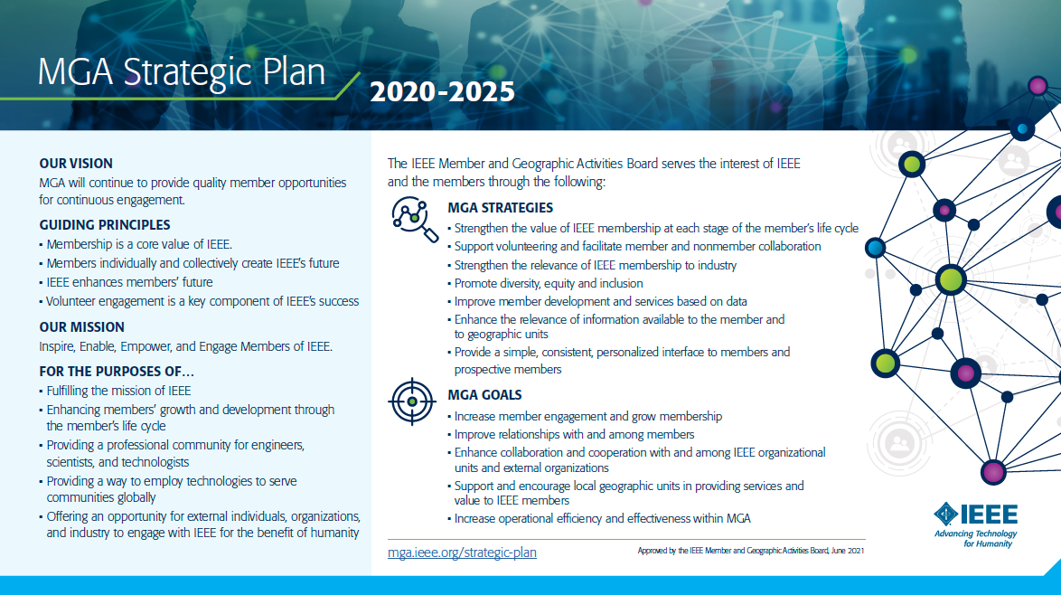
Vision
  MGA will continue to provide quality member opportunities for continuous engagement.
Mission
  Inspire, Enable, Empower and Engage Members of IEEE
  For the purposes of:
    Fulfilling the mission of IEEE
    Enhancing the members growth and development through their life cycle
    Providing a professional home

Slide 23
MGA Operations Manual
https://mga.ieee.org/board-committees/operations-manual
Introduction
Member and Geographic Activities Board
MGA Financial Matters
MGA Committees
MGA Operations Committee
MGA Assembly
MGA Nominations and Appointments Process
Member and Geographic Activities Awards
Geographic Organizational Units
Conferences
MGA Publications
Revisions to the MGA Operations Manual

Slide 24




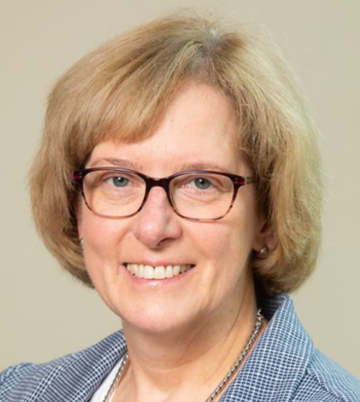
2024 MGA Board
Antonio Luque
MGA VP-Elect
Region 8
Deepak Mathur
IEEE VP, MGA
Region 10
Jill Gostin
MGA Past Chair
Region 3
Greg Gdowski
MGA Treasurer
Region 1
Cecelia Jankowski
MGA Secretary
IEEE MGA Staff
MGA Board Members
MGA Board Chair (VP)
Chair-Elect
Past Chair
Treasurer
Secretary (nonvoting)
Vice Chair, Geographic Unit Operations
Vice Chair, Member Development
Vice Chair, Information Management
10 Region Directors
2 Zone Representatives (Regions 8 & 10)

Slide 25
2024 MGA Efforts
2024 Priority Projects: Support MGA strategic areas and goals
  Membership
  Geographic Unit Vitality
  Major IEEE-wide and MGA-led initiatives:
    Sections Congress 2023 Recommendations
    NextGen Adoption
    Region Realignment Implementation
  Digital Strategy and Initiatives:
    vTools for Chapters
    vTools Single Candidate Slate Approval Automation
Continuation of MGA Miniseries: 18-21 April 2024; San Antonio, TX, USA
Student, YP, WIE Committees collaboration meeting: 15-17 March 2024; Lisbon, Portugal
MGA Surplus funding: Proposals are invited from Regions, last date to receive the proposal is 14 April 2024.

Slide 26
Key MGA Committees Supporting Local Units and Volunteers
Geographic Unit Operations Support Committee, “GUOS”
Chapter Operations Support Committee, “ChOS”
Training Committee
Member Engagement and Life Cycle Management, “MELCC”
    IEEE Admission and Advancement
    Awards and Recognition
    IEEE Life Members
    Student Activities
    Women in Engineering
    Young Professionals
vTools
Operations Manual Compliance

Slide 27
MGA Department (Staff)
Cecelia Jankowski
Michael Kreisberg
Member Experience
Vera Sharoff
Information Management
Christie Giambalvo
Geographic Activities
Matt Plotner
Member Operations
Fellows
Lori Keller
MGA Finance
Contact Center
Member Dev/Mkt
Member Products
Member Data/Research
Membership year
Affinity Groups
Events (Xtreme, IEEE Day, WIE ILC)
vTools
Requirements (Member, Web)
OU Analytics
Tools/platforms
eNotice
Membership infrastructure support
Data Privacy/GDPR
Geographic Unit Activities & Operations
MGA Board Admin
MGA Conferences
Volunteer Training
Awards
Ethics/Compliance
Sections Congress
Membership Processing & Payments
Geounit Formations
Senior Member Elevations
Current Fellow Process
Fellow Application SW Operation & Support
Fellow Ad Hoc Recommendations
MGA Finances
GeoUnit Finances
MGA Conference Finances

Slide 28

Active Geographic Units as of January 2024
Regions | R1 | R2 | R3 | R4 | R5 | R6 | R7 | R8 | R9 | R10 | Total
Section | 22 | 20 | 41 | 23 | 27 | 35 | 21 | 59 | 36 | 60 | 344
Subsection | 2 | 2 | 2 | 3 | 4 | 2 | 2 | 13 | 15 | 42 | 87
Council | 1 | 0 | 4 | 0 | 0 | 2 | 0 | 1 | 5 | 6 | 19
Chapter* | 183 | 101 | 111 | 101 | 101 | 212 | 150 | 645 | 258 | 848 | 2,710
Affinity Group | 48 | 27 | 53 | 41 | 39 | 52 | 52 | 129 | 70 | 128 | 639
Student Branch | 91 | 87 | 97 | 65 | 96 | 89 | 61 | 762 | 513 | 1,781 | 3,642
Student Branch Chapter | 63 | 32 | 69 | 51 | 67 | 68 | 50 | 640 | 907 | 2,278 | 4,225
Student Branch Affinity Group | 4 | 7 | 10 | 4 | 4 | 5 | 17 | 169 | 187 | 478 | 885
Total | 414 | 276 | 387 | 288 | 338 | 465 | 353 | 2,418 | 1,991 | 5,621 | 12,551
*A Joint Chapter of two or more Sections and/or two or more Societies are counted as one Chapter
See Backup for descriptions of Geographic Units

Slide 29
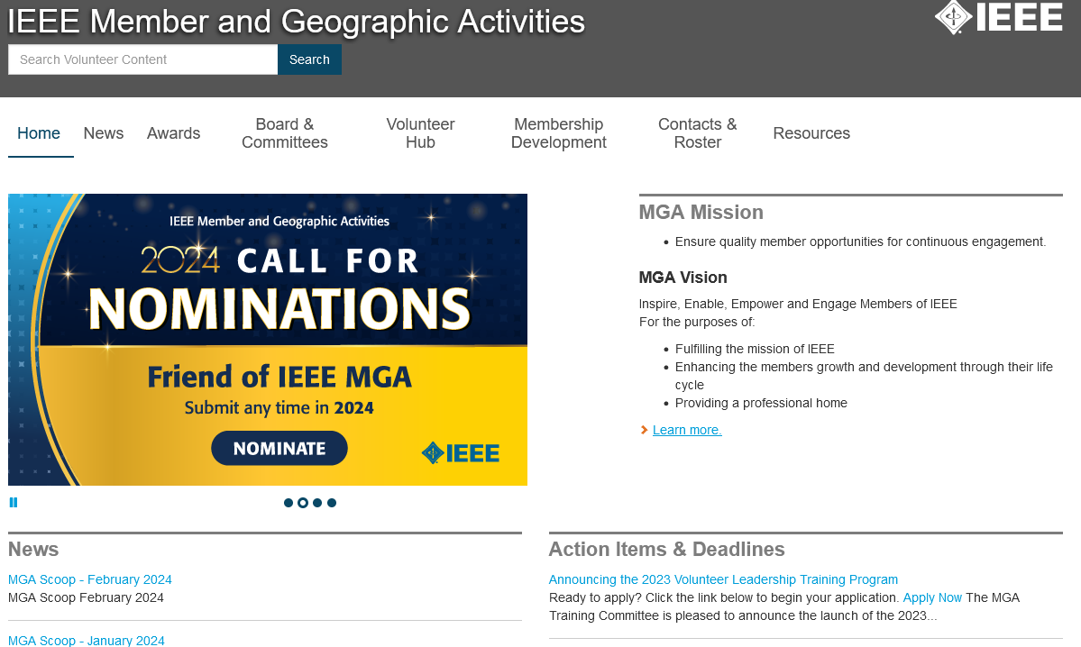
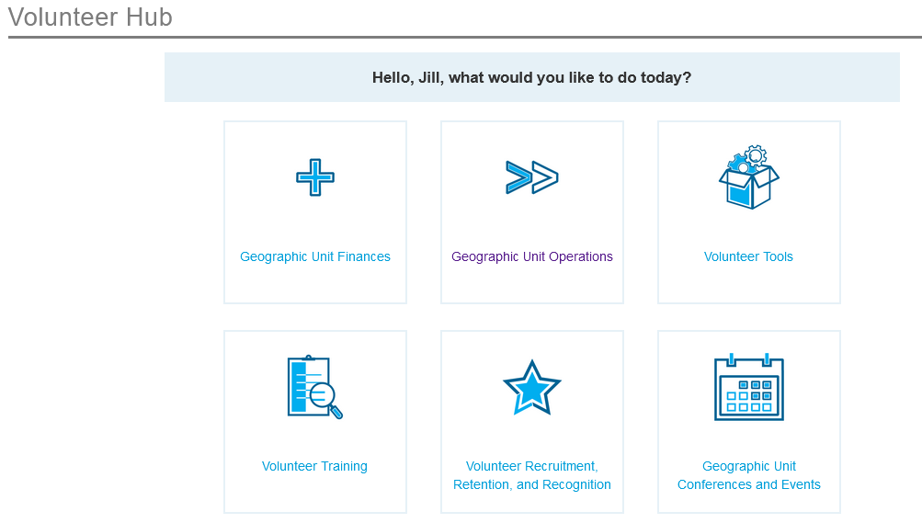
Member and Geographic Activities
https://mga.ieee.org
Notes:
Lots of info here. Example shown is the Volunteer Hub, which has
Geographic Unit Finances
Geounit Operations
Volunteer Tools
Volunteer Training
Volunteer Recruitment, Retention, and Recognition
Geounit Conferences and Events

Slide 30


Sections Congress
IEEE Sections Congress is a triennial gathering of Section leadership sponsored by the MGA Board.
Brings together the global grassroots-leaders of IEEE to share ideas, concerns, and solutions.
Provides a forum where Section Chairs speak as the collective voice of IEEE members, expressing ideas about how IEEE can better serve its members, both now and going forward. Recommendations from all Regions are reviewed, and the top 3 selected for further investigation and possible implementation.
Sections Congress 2026 is being planned for Glasgow, Scotland (pending contract negotiations)

Slide 31

What is a Local Group?
Intended to be an agile and efficient forum to serve the interests of members and potential members in a local area
Is not a Geographic Unit and shall not duplicate or replace the efforts of any existing IEEE Geographic Unit (Section, Chapter, Affinity Group)
Comprises a minimum of two (2) IEEE members one of which has to be a voting member, both of whom must be members of the geographic unit involved
Established by petition to the Section, or the Region involved if there is no Section in the area
Shall exist as long as the topic they were created to address remains relevant and they meet the annual reporting requirements
*** MGA Operations Manual Section 9.12 - Local Group Activities Within Geographic Units, Approved by MGAB on 17 Feb 2024

Slide 32
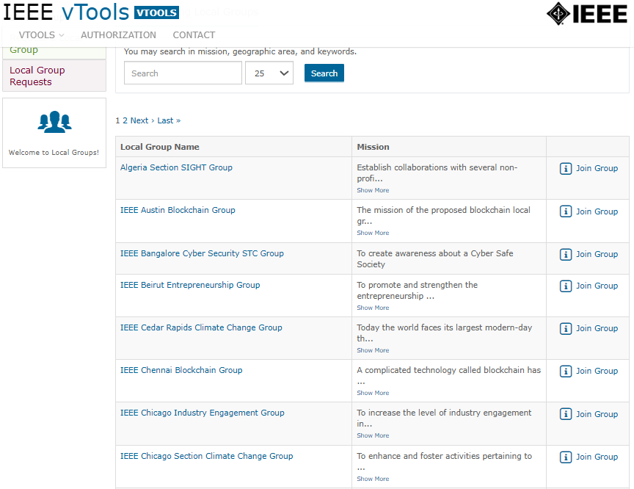
Latest developments in Local Groups
49 Local Groups are approved, more are waiting in line to be approved (list is in backup)
Covering all Geographic Areas
21 Local Groups are on Blockchain
3 Local Groups on Climate Change
Local Groups can use vTools Events, vTools Officer Reporting and other tools
Local Groups webpage: Local Groups - IEEE Member and Geographic Activities, still under construction
IEEE Proprietary
See Backup for additional information about Local Groups

Slide 33
Overview of Region 3

Slide 34

Region 3 covers
Southeastern US plus Jamaica

Slide 35
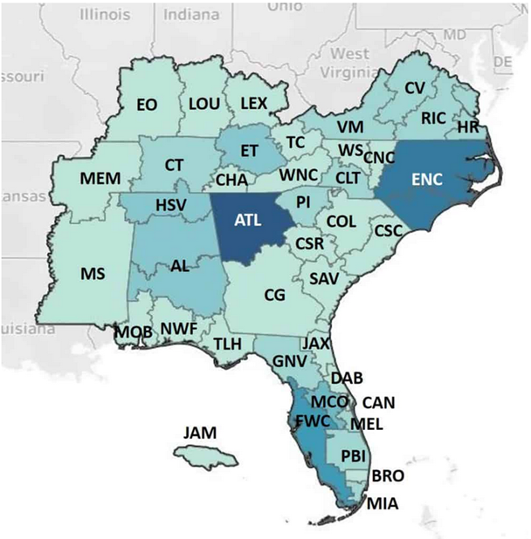
Region 3 Map
Members: 20,637 (Dec 2023)
Sections: 41
Subsections: 2
Chapters: 112
Affinity Groups: 76
Student Branches: 97
Student Affinity Groups: 11
Student Branch Chapters: 69

Slide 36
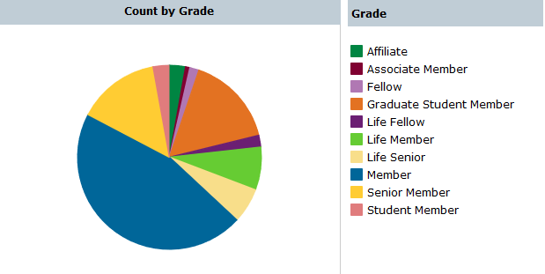
Region 3 Distribution by Grade

Slide 37
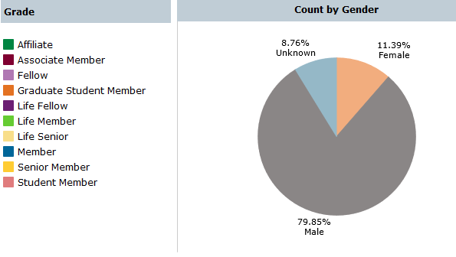
Region 3 Distribution by Gender

Slide 38
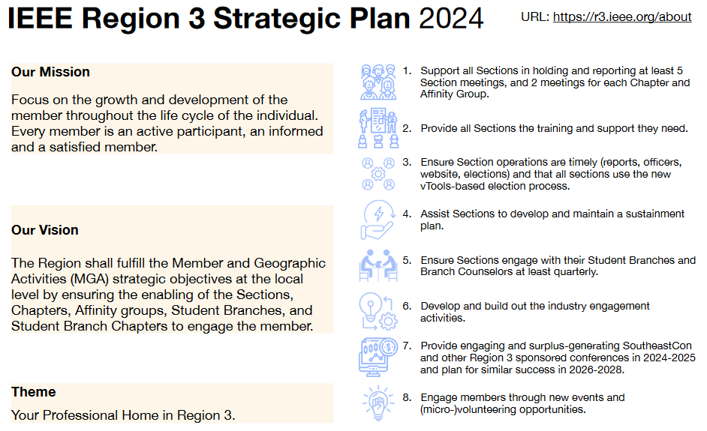
Key steps to realize the mission

Slide 39

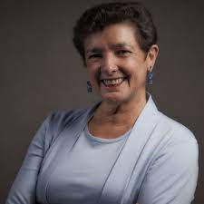

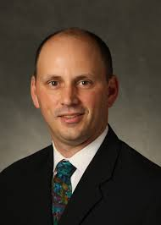


R3 Officers
https://r3.ieee.org/
2024 Volunteers listed in Backup
Sonya Dillard
Director-Elect
Theresa Brunasso
Past Director
Eric Grigorian – Director
Joe Pennisi
Treasurer
Pat Donohoe
Secretary

Slide 40
R3 Committees
Awards and Recognitions (Nelson Lourenco through SoutheastCon)
Conference (Joe Juisai)
Finance (Joe Pennisi)
Member Communications (Andy Seely)
Nominations and Appointments (Theresa Brunasso)
Operational Audit (Gregg Vaughn)
Professional Activities (Sharlene Brown)
Section Support (Kristin Bing)
Strategic Operations and Support (David Green)
Student Activities (Bailey Heyman)
See Backup for full list of committee members

Slide 41

R3 Areas
Area 1 – Jamie Imanian
  Central NC, Central VA, Charlotte, Eastern NC, Hampton Roads, Richmond, VA Mountain, Western NC, Winston-Salem
Area 2 – Wyman Williams / Alessio Medda
  Atlanta, Central GA, Central Savannah River, Coastal SC, Columbia, Jacksonville, Piedmont, Savannah
Area 3 – Raul Ortega
  Broward, Canaveral, Daytona, FL West Coast, Melbourne, Miami, Orlando, Palm Beach
Area 4 – Paul Kuban
  Central TN, Chattanooga, East TN, Evansville-Owensboro, Lexington, Louisville, Memphis, Tri-Cities
Area 5 – Danial Diaz
  AL, Gainesville, Huntsville, Jamaica, MS, Mobile, Northwest FL, Tallahassee

Slide 42
R3 ExCom and R3 Committee
ExCom – 18 voting members:
  5 Officers
  5 Area Chairs
  8 Chairs of Standing Committee (note – 2 Standing Committee are chaired by officers)
Committee – 60 voting members:
  5 Officers
  43 Ex Officio members (41 Section Chairs + SAC Chair + PAC Chair)
  12 selected appointments (.25*(5+43), see MGA OpsMan 9.1.F.3.a.iii)
      5 Area Chairs
      Remaining 6 Standing Committee Chairs (2 are officers, 2 are SAC/PAC)
      YP Chair is Region Dir Grigorian’s selection for additional appointment

Slide 43
What does R3 Committee do?
Conducts at least on meeting per year with the Region’s leadership:
  coordination of Region 3 business,
  ultimate decision body for matters under Region responsibility
  training for new volunteers
  held at SoutheastCon
Sometimes holds a virtual meeting for activities that don’t align with SoutheastCon (e.g., selection of Director-Elect slate)
Supports activities of local Organizational Units
Coordinates meetings for technical and professional purposes in the Region
Coordinates Student, Young Professionals and Women in Engineering events
Coordinates activities between R3 and OUs from other regions
Engages in member development
Web site: https://r3.ieee.org

Slide 44
A typical R3 committee meeting
What will happen this weekend:
Region Committee members are the focus of the meetings. Everything will be presented, reported, or asked to you.
During the meeting you can expect to receive some training, hear reports from the different R3 officers and committee chairs, see presentations from invited IEEE leaders and staff, and of course take some time to watch the student competitions.
The Region Director will chair the meeting and will take care of the order, timing, and progress of items.
Sunday morning will be the formal business meeting of the R3 Committee, with potential motions to vote on.
Don’t be shy! Participate, share your opinion, and listen to others!

Slide 45
SoutheastCon Sunday: Business Meeting
The meeting will start with a roll call.
Voting members will be asked to approve the Agenda. The Agenda has been posted and shared by the Secretary.
Next is the approval of the Consent Agenda, which contains items of a non-controversial nature. Review these ahead of time. You may ask now to take items out of the consent agenda if you feel that something needs to be discussed.
The Agenda will drive the meeting. Rules of order will be followed.
There will be breaks. Make use of them to meet new people!
Sections will each give a very brief presentation – listen for best practices you can use, or opportunities to share your suggestions

Slide 46

Rules of order
Rules of order, also known as
standing orders or rules of procedure,
are the written rules of parliamentary procedure adopted by a deliberative assembly, which detail the processes used by the body to make decisions.
IEEE Bylaws I-300. Management
Robert's Rules of Order shall be used to conduct business at meetings of the IEEE Board of Directors, Major Boards, Standing Committees and other organizational units of the IEEE unless other rules of procedure are specified in the Not-For-Profit Corporation Law of the State of New York, the IEEE Certificate of Incorporation, the IEEE Constitution, these Bylaws, the IEEE Policies, resolutions of the IEEE Board of Directors, or the applicable governing documents of those organizational units provided such organizational documents are not in conflict with any of the foregoing.

Slide 47
Rules of order in R3 Committee
All members of the Committee have equal rights to participate and take part in debate, except that non-voting members do not have the right to vote.
Substantial parts of the meeting are organised in an informal way.
Formal parts of the meeting are normally conducted in accordance with Robert’s Rules.
The Chair should enable an orderly debate to take place on all issues, and allow equal and fair rights to all members of the Committee.
During formal debates, the Chair must take a neutral position and may only vote in the case of secret vote or to break a tie.
See backup for additional information about Robert’s Rules of Order

Slide 48
Motions
A motion is a request for the body (the R3 Committee) or some of its members (committees, appointed persons, officers) to do something. As such, a motion always has to have an element of action.
Motions will be presented, discussed, and voted.
Only those with voting rights will be allowed to vote.
Non-controversial motions could be voted on by General Consent (“Is anyone opposed to the motion on the floor”)
Potentially controversial or more significant motions will be voted on via raised hands, ballot, or voice

Slide 49
Running a Section Successfully

Slide 50
Section Vitality
Vital organizational units (Sections, Chapters, Affinity Groups and Student Branches) better serve their members
IEEE Member and Geographic Activities views Section Vitality as a priority
In order to have all the Sections vibrant and active, IEEE needs many enthusiastic volunteers on all levels and especially on the Section level
https://mga.ieee.org/volunteer-hub/geographic-unit-operations/vitality includes Region Vitality Coordinators, Section Election Calendar Tool, and a Section Vitality Checklist

Slide 51
Example Section Volunteer Positions
Officers: Chair, Vice Chair, Secretary, Treasurer (or Secretary/Treasurer)
Industry Engagement Coordinator
Nominations and Appointments
Newsletter Editor
Professional Activities
Educational Activities
Student Activities, or Student Branch Coordinator
Young Professionals
Women in Engineering
Historian
OU Analytics
Awards and Recognitions
Chapter Coordinator
Membership Development
Communications Coordinator
Chapter Chairs
Affinity Group Chairs
Conference Coordinator
Etc.
Notes:
Varies by location, needs, section size, chapter activities, etc.

Slide 52
What a Section Chair does
Assembles and motivates the team
Runs the Section
Is a voting member of the Region Committee
Participates in SoutheastCon and Sections Congress!
Identifies and supports future leaders
Is a role model
Inspires and mobilizes people
Organizes Administrative meetings of the Section leadership
Supports other activities:
  Professional
  Technical
  Non-technical (including social)
Reports new officers – important!
  So they receive e-mail, info material, have appropriate access, etc.
Notes:
Talk about importance of participation in SoutheastCon and Sections Congress

Slide 53
Why and how to report change of Officers and/or election results?
All officers shall be elected annually or biannually
Term of office is 1 January to 31 December
An officer should not serve in the same position for more than four consecutive years, or for more than six years in total
It is recommended that all Sections use vTools for Nominations and Elections
Using vTools for elections will automatically report officers, once results are certified
See MGA Operations Manual, Section 9.5.F and 9.13

Slide 54
Section Finances
Session this weekend on managing Section Finances
Session this weekend on sources of funding
See MGA Operations Manual Section 9.5.G, 9.5.H, and 9.5.J, and the IEEE Financial Operations Manual
See Backup for MGA rules/requirements for rebates

Slide 55

Key Elements of a Successful Election
Review Election Policies and Procedures
  Determine election timeline & qualifying date
  Appoint your Nominating Committee
  Review communication plans
Follow the Process
  Call for Nominations
  Select slates of candidates
  Facilitate Petition Process
  Finalize and communicate slate of candidates
Afternoon Session today at 2:55 on Elections!
  Run the election
  Announce results
Run the Election
*** MGA Operations Manual Section 9.13 – Geographic Unit Elections, Approved by MGAB on 17 Feb 2024

Slide 56
Chapter Support and Collaboration
Chapters are supported by both MGA (Section, Region, or Geographic Council) and Technical Activities (Societies/Technical Councils)
Many Societies/Technical Councils have robust Chapter programs that include:
  Financial support
  Distinguished Lecturers
  Mentorship / Support Resources
  Outstanding Chapter Awards
Collaborate with Societies/Councils on Local Programs and Events
  Reach out to your local Chapter Chairs
  Communicate with your Student Branches and SB Chapters
Form new Chapters and Student Branch Chapters in your Section
  Contact Society/Technical Council Chapter Coordinators for support
Sections, through their Chapter Chairs, will be able to access more support for their local members.
https://mga.ieee.org/volunteer-hub/geographic-unit-operations/geographic-units-and-groups/chapters

Slide 57
Useful links
IEEE Membership. link
Questions / FAQ’s. link
OU Analytics: Web-based query tool that provides volunteers access to member data. Authorized volunteers can query, report, and download membership data. link (information) link (access OU Analytics)
vTools: Suite of web-based software tools developed by volunteers for IEEE members and volunteers to assist with managing local activities and with member development. link

Slide 58


Geographic Unit Operations Resources
IEEE Center for Leadership Excellence – Training for Geographic Unit Leaders: https://ieee.org/cle
Information for geographic units: https://mga.ieee.org/volunteer-hub/geographic-unit-operations/geographic-units-and-groups
IEEE Organization Roster http://www.ieee.org/roster
vTools eNotice, Events, Engage, Local Groups, quicklinks to OU Analytics, etc.: vtools.ieee.org
Request for letter to employer: https://mga.ieee.org/volunteer-hub/geographic-unit-operations/request-for-letter-to-employer
Notes:
Reference upcoming talk on Tools for sections

Slide 59
Concluding Remarks and Q&A

Slide 60
Backup / Additional Information

Slide 61
IEEE Divisions
39 Societies and 8 Technical Councils grouped
in 10 Divisions (same number as for Regions):
Circuits and Devices (CAS, ED, SSC; CEDA, Nano)
Industrial Applications (CPMT, DEI, IA, IM, PEL, UFFC)
Communications Technology (Com)
Electromagnetics and Radiation (AP, BT, CE, EMC, Mag, MTT, NPS; CRFID, CSC)
Computer (C)
Engineering and Human Society (E, IE, PSE, PC, R, SIT, TEM)
Energy and Power Engineering (PE)
Computer (C)
Signals and Applications (AES, GRS, IT, ITS, OE, SP, VT)
Systems and Control (CIS, CS, EMB, Pho, RA, SMC; Bio, Sen, Sys)
New Technical Council:
IEEE Transportation Electrification

Slide 62
IEEE Member and Geographic Activities Board Committees (2024)
MGA VP
MGA Secretary
MGA Staff
Vice Chair
Member
Development
Vice Chair
Geographic
Unit Operations
Vice Chair
Information Management
MGA Past Chair
MGA VP-Elect
MGA Treasurer
Member
Engagement and Life Cycle Committee
Geographic Unit Operations Support Committee
IT Coordination and Oversight
Committee
Strategic Planning
Nominations and Appointments
Operations Manual Compliance
Operations Committee
Admission and Advancement (IEEE)
Chapter Operations Support
vTools
Finance
Awards and Recognition
IEEE.tv Advisory
Member Benefits Portfolio Advisory
Life Members
(IEEE)
Membership Recruitment and Recovery
Student
Activities
Women in Engineering (IEEE)
Potentials Editorial
Sections Congress
Young Professionals
(IEEE)
Training

Slide 63
Geographic Units (1)
A Region is a geographic unit consisting of a part of one, or of one or more countries, established by the MGA Board as a basic operating organizational unit of IEEE for management and administrative purposes to represent and fulfill the needs of the IEEE members and the missions of IEEE within the territory prescribed.
A Council may be formed by agreement of a group of contiguous Sections, and it exists at their pleasure. It is intended to act as a subordinate committee of the Sections, and they have the right to direct its operation. It is formed by the Sections to do only those delegated tasks that can be best done together by the Sections rather than singly by each Section. The Sections retain their recognition as the basic operating, executive, and administrative unit of IEEE. The Region Director and the MGA Board shall approve the formation of a Council.
A Section is the basic operating organizational unit of IEEE, constituted by a minimum of fifty (50) IEEE voting members and established with the approval of the MGA Board by petition of those who live/work in relatively close proximity to be served by activities that meet their needs and further the missions of IEEE.
A Subsection shall be a part of a Section or Region, constituted by a minimum of twenty (20) IEEE voting members, and established with the approval of the MGA Board by petition of those who live/work in relatively close proximity to be served by the activities that further the mission of IEEE.

Slide 64
Geographic Units (2)
A Chapter shall be a technical subunit of a Region, one or more Sections, or a Geographic Council. There may be single Society Chapters, joint Society Chapters, and Technical Council Chapters.
Affinity Group is defined in IEEE Bylaw I-402.10; an Affinity Group shall be a non-technical subunit of a Region, one or more Sections, or a Geographic Council. An Affinity Group shall comprise a minimum of six (6) IEEE voting members, who are members of the geographic unit(s) involved, and established by petition to the parent organizational unit(s) or committee concerned to fulfill the mission of IEEE. “Parent organizational unit” as used in this manual refers to an organizational unit or committee.

Slide 65
Geographic Units (3)
A Student Branch is a basic operating organizational unit of an IEEE Section or Region, constituted by a minimum of twelve (12) IEEE members of Student Member or Graduate Student Member grade at a particular college, university, or technical institute, to represent and fulfill the needs of the members and the missions of IEEE. Each Branch shall conduct its activities within the IEEE Constitution, IEEE Bylaws, IEEE Polices, MGA Operations Manual, and other rules externally imposed, which by law affect the membership and activities of IEEE
A Student Branch Chapter is a technical subunit of a Student Branch constituted by a minimum of six (6) IEEE members of Student Member or Graduate Student Member grade of a Society and established by petition to the parent Student Branch and Society concerned to represent and fulfill the needs of the members and the missions of IEEE. A Student Branch Chapter functions in a manner similar to a committee of the Student Branch.
An Affinity Group, as a unit of an IEEE Student Branch, is permitted. The administration of such Affinity Groups shall follow the process for Student Branch Chapters, Section 9.8. Signatures of at least six (6) IEEE members of Student Member or Graduate Student Member grade are required to establish a Student Branch Affinity Group. In the case of an IEEE Women in Engineering Student Branch Affinity Group, each IEEE member shall also be a member of IEEE Women in Engineering. The Region Director, the Affinity Group Chair, the Region Student Activities Chair, and the Regionl Student Representative shall be informed of the Student Branch Chapter approval.

Slide 66

IEEE Local Groups
Why do we need Local Groups?
  A new local interest
  A company-industry group or campus
  A local specialized need
  Multidisciplinary subject
  A new technical trend
  Not enough members to start a Technical Chapter
  Involve members and non members

Slide 67

Key Advantages of a Local Group
A flexible and agile method to start, create, engage
Only two (2) IEEE members needed to start it
Easy to set up and easy to sunset when not needed
Technical and Non-technical interests
Non IEEE members can participate
Easy to discover, explore and track new trends
Opens a new channel for IEEE Involvement and membership
Could have multiple similar groups within a Section in different locations
Strengthen and recognize industry/academic/government collaboration
Focus on Local Interests but also connect with worldwide similar groups
67

Slide 68

Examples of Local Groups
Blockchain
Climate Change
Entrepreneurship
STEM
Industry Engagement
Artificial Intelligence
Impact of EVs
Technology History
Cyber Security
68

Slide 69
49 Current Local Groups across IEEE
IEEE Tunisia CyberSecurity Group
Open Source Digital Radio Group
IEEE Saudi Arabia Section Quantum Computing Group
IEEE Rock River Valley Climate Change Group
IEEE Houston Blockchain Group
IEEE Florida West Coast Section Blockchain Group
IEEE Austin Blockchain Group
IEEE Chennai Blockchain Group
IEEE Toronto Blockchain Group
VICRAM (VIT Centre for Research on Advanced Microgrid) Group
IEEE Pune Blockchain Group
IEEE Thailand Blockchain Group
IEEE Cedar Rapids Climate Change Group
IEEE Thailand Section Quantum Information Technology
vTools Labs
IEEE Oman Blockchain Group
IEEE Indonesia Broadcasting Industry and Technology Group
IEEE Indonesia Climate Change Group
IEEE Madras Quantum Cybernetics Group
IEEE Algeria Section SIGHT Group
IEEE Tunisia Blockchain Group
IEEE Torino Icarus-RA Group
IEEE Disaster Anticipation, Mitigation and Recovery Group
IEEE Shanghai Blockchain Group
IEEE Knoxville Quantum Computing/Quantum Information Group
IEEE Raipur Blockchain Group
IEEE Region 9 Brand Experience Group
IEEE Chicago Industry Engagement Group
IEEE Colombia Blockchain Group
IEEE Colombian Caribbean Blockchain Group
IEEE Hong Kong Blockchain Group
IEEE Spain Blockchain Group
IEEE Silicon Valley Blockchain Group
IEEE Silicon Valley Technology History Group
Voluntarios y Amigos de IEEE USACH Group
IEEE UK and Ireland Quantum Group
IEEE UK and Ireland Future Networks Group
IEEE Romania Blockchain Group
IEEE Elkins Robotics and Electronics Club Group
IEEE Beirut Entrepreneurship Group
IEEE Finland Blockchain Group
IEEE Taipei Blockchain Group
IEEE Kitchener-Waterloo Blockchain Group
IEEE Delhi Blockchain Group
IEEE New Hampshire Section Admin Group
IEEE Madras Integrated RF and Photonics Technology Group
IEEE Madras Tech Track Group
IEEE Madras Power Electronics Society Group
IEEE Bangalore Cyber Security STC Group
IEEE Proprietary

Slide 70

2024-2025 R3 Team (1 of 9)
*Denotes voting member of R3 ExCom
Denotes Director-added voting member of R3 Committee

Slide 71
2024-2025 R3 Team (2 of 9)

Slide 72
2024-2025 R3 Team (3 of 9)
2

Slide 73
2024-2025 R3 Team (4 of 9)

Slide 74
2024-2025 R3 Team (5 of 9)

Slide 75
2024-2025 R3 Team (6 of 9)

Slide 76
2024-2025 R3 Team (7 of 9)

Slide 77
2024-2025 R3 Team (8 of 9)

Slide 78
2024-2025 R3 Team (9 of 9)

Slide 79
Member Grades (1 of 5)
Student: At least 50% of a normal full-time academic program as a registered undergraduate or graduate student in a regular course of study in IEEE-designated fields.
Graduate Student Member: At least 50% of a normal full-time academic program as a registered graduate student in a regular course of study in IEEE-designated fields.
The total cumulative period for a member to hold the Student member grade and/or the Graduate Student member grade is limited to eight years.
Student members or Graduate Student members, upon graduation or upon reaching the total cumulative eight-year limit as a Graduate Student member (whichever occurs first), will be transferred automatically to member grade.
Notes:
Could just put a short list of all of these member grades and talk to it, then move these detailed descriptions to backup?

Slide 80
Member Grades (2 of 5)
Associate Member: Technical and non-technical individuals who do not meet the qualifications for member grade but who wish to benefit from membership and partnership in IEEE, and for those who are progressing, through continuing education and work experience, toward qualifications for member grade.
Student members outside of the IEEE-designated fields, upon graduation or upon reaching the eight-year limit (whichever occurs first), will be transferred to Associate Member grade.

Slide 81
Member Grades (3 of 5)
Member: Those who have satisfied IEEE-specified educational requirements and/or who have demonstrated professional competence in IEEE-designated fields of interest. For admission or transfer to the grade of member, a candidate may be either:
  An individual who has received a three- to five-year university-level or higher degree from an accredited institution or program and in an IEEE-designated field,
  An individual who has received a three- to five-year university-level or higher degree from an accredited institution or program and who has at least three years of professional work experience engaged in teaching, creating, developing, practicing, or managing in IEEE-designated field,
  An individual who, through at least six years of professional work experience, has demonstrated competence in teaching, creating, developing, practicing, or managing within IEEE-designated fields.

Slide 82
Member Grades (4 of 5)
Senior Member: Highest grade for which application may be made. Requires experience reflecting professional maturity. A candidate shall be an engineer, scientist, educator, technical executive, or originator in IEEE-designated fields and shall have been in professional practice for at least ten years and shown significant performance over a period of at least five of those years, such performance including one or more of the following:
  Substantial responsibility or achievement in IEEE-designated fields,
  Publication of papers, books, or inventions in IEEE-designated fields,
  Technical direction or management of important work with evidence of accomplishment in IEEE-designated fields,
  Recognized contributions to the welfare of the professions encompassed by IEEE-designated fields,
  Development or furtherance of important courses in one or more of the IEEE-designated fields at an institution in the REP list,
  Contributions equivalent to those of the above areas related to IEEE-designated fields, provided these contributions serve to advance progress substantially in IEEE-designated fields.

Slide 83
Member Grades (5 of 5)
Fellow: Recognizes unusual distinction in the profession and is conferred only by invitation of the Board of Directors upon a person with an extraordinary record of accomplishments in any of IEEE’s designated fields of interest.
  The candidate shall hold Senior member grade at the time the nomination is submitted.
  Normally, the candidate shall have been a member in any grade for a period of five years or more preceding 1 January of the year of election; however, the five-year membership requirement may be waived for a Fellow candidate who has been engaged in professional practice (as needed to qualify for Senior member grade) in a geographical area where, in the judgment of the Board of Directors, it was difficult to become a member previously, as evidenced by the absence of a Section previously and the recent formation of a new Section to cover that geographical area. In such case, membership of five years or more in a recognized local electrical, electronics, or computer-engineering society may substitute for the five-year IEEE membership requirement, when the nomination is submitted within four years after the formation of the new Section.

Slide 84
Your IEEE Membership Dues & Assessments – 2022
Base Member Dues
$5 European Public Policy (EU/EFTA countries only)
Higher Grade
Full = $153
E-membership (regular) = $80
E-membership (low income) = $29
Special Circumstances = $76.50
Other Assessments
(as applicable)
Region 1: $ 5
Region 2: $ 2
Region 3: $ 2
Region 4: $ 3
Region 5: $ 5
Region 6: $ 3
Region 7: $19
Region 8: $13
Region 9: $ 4
Region 10: $ 5
Japan: R10 + $25=$30
$47 IEEE-USA Assessment (Regions 1-6, excl. Jamaica) only
$3 ABET
(Regions 1-6, excl. Jamaica) only
Region Assessments (One of the following)
Students (No Assessments)
Regions 1-7 = $32
Regions 8-10 = $27
Your higher-grade dues payment is the sum of 3 components: Base dues, local activities in your Region/Section and local professional programs
Note: Dues and assessments are waived for IEEE Life Members

Slide 85
MGA rules for rebate (1)
See MGA Operations Manual, Section 3.4
All Sections in existence on 31 December and meeting minimum requirements receive a rebate according to the Table
10% Bonus for timeliness (financial, meeting, officer)
The Section’s subunits (Subsections, Chapters, Student Branches and Affinity Groups) will be notified about the amount to which their activities contributed to the rebate prior to the distribution of the rebate by 31 August.

Slide 86
MGA rules for rebate (2)
Activity bonus to encourage local activities:
All sections (subsections) reporting 10 meetings or more, at least five of which must be of a technical nature, receive an additional USD 200 (USD 100),
All chapters or affinity groups reporting
6 or more meetings of a technical nature shall receive an additional USD 75,
Meetings jointly hosted by more than one geounit will count toward the activity bonus of all units
Geounits must qualify for the timely reporting bonus in order to be eligible for an activity bonus
.

Slide 87
MGA rules for rebate (3)
Current officer report: Reports of current section, subsection, chapter, and affinity group officers must be submitted within 20 days following the election and/or appointment of officers
Financial report: summary of previous year's financial activities must be submitted annually. If the section is unable to obtain financial records from a subsection, chapter, or affinity group, it may opt to submit a statement that the subunit has failed to submit a timely financial report and waive its right to a rebate for that particular subunit.
Notes:
Comment on elections being automatically reported for officers, but does this include chapter/affinity group officer elections, too?

Slide 88
MGA rules for rebate (4)
Bank signature card: The bank signature card(s) must be returned to the IEEE Operations Center for the signature of the IEEE Staff Director-Financial Services before the section rebate will be released.
This is required for all bank accounts for Units outside of the US where banking and legal restrictions will allow.
Meeting Activity Report(s): Meeting activity reports are key to unit maintenance and viability. See “File a Report for a Past Event” on vTools.

Slide 89

Robert’s Rules of Order (RRO): Origins
Henry Martyn Robert:
Pocket Manual of Rules of Order for Deliberative Assemblies, February 1876.
Loosely modelled after rules used in the United States House of Representatives.
Robert was an active member of several organizations. To help simplify and organise meetings, he decided to write a manual that would enable organizations to adopt a parliamentary procedure.

Slide 90

RRO: Main Ideas
Rules of order are used to simplify the parliamentary procedure, not to complicate it.
Everyone has the right to speak once if they wish, before anyone may speak a second time.
Everyone has the right to know what is going on at all times.
Only urgent matters may interrupt a speaker.
The members discuss one thing at a time.

Slide 91

Summary of RRO
You may INTERRUPT a speaker for these reasons only:
to get information about business – point of information
to get information about rules – parliamentary inquiry
if you can't hear, safety reasons, comfort, etc. – question of privilege
if you see a breach of the rules – point of order
if you disagree with the chair's ruling – appeal
You may influence WHAT the members discuss:
if you would like to discuss something – motion
if you would like to change a motion under discussion – amend
You may influence HOW and WHEN the members discuss a motion:
if you want to discuss the topic at another time – postpone
or lay it on the table
if you think people are ready to vote – call the question

Slide 92
Summary of RRO Actions (1 of 2)
To: | You say: | Interrupt Speaker | Second Needed | Debat ~able | Amend ~able | Vote Needed
Adjourn | "I move that we adjourn" | No | Yes | No | No | Majority
Recess | "I move that we recess until…" | No | Yes | No | Yes | Majority
Complain about noise, room temp., etc. | "Point of privilege" | Yes | No | No | No | Chair Decides
Suspend further consideration of something | "I move that we table it" | No | Yes | No | No | Majority
End debate | "I move the question" | No | Yes | No | No | 2/3
Postpone consideration of something | "I move we postpone this matter until…" | No | Yes | Yes | Yes | Majority
Amend a motion | "I move that this motion be amended by…" | No | Yes | Yes | Yes | Majority
Introduce business (primary motion) | "I move that…" | No | Yes | Yes | Yes | Majority

Slide 93
Summary of RRO Actions (2 of 2)
To: | You say: | Interrupt Speaker | Second Needed | Debat ~able | Amend ~able | Vote Needed
Object to procedure | "Point of order" | Yes | No | No | No | Chair decides
Request information | "Point of information" | Yes | No | No | No | None
Ask for vote by actual count | "I call for a division of the house" | Must be done before new motion | No | No | No | None unless someone objects
Object to considering some matter | "I object to consideration of this question" | Yes | No | No | No | 2/3
Take up matter previously tabled | "I move we take from the table…" | Yes | Yes | No | No | Majority
Reconsider something | "I move we now (or later) reconsider our action relative to…" | Yes | Yes | Same as original motion | No | Majority
Vote on a ruling by the Chair | "I appeal the Chair’s decision" | Yes | Yes | Yes | No | Majority

Slide 94
Some common acronyms 1
AIEE : American Institute of Electrical Engineers
A&R : Awards and Recognition
BoD : Board of Directors
CLE : Center for Leadership Excellence
EAB : Educational Activities Board
EPICS : Engineering Projects in Community Service
ExCom : Executive Committee (in Section or Regions)
GSM : Graduate Student Member

Slide 95
Some common acronyms 2
IBP : IEEE Business Platform
IEL : IEEE/IET Electronic Library
IET : Institution of Engineering and Technology
IRE : Institute of Radio Engineers
MD : Membership Development
MGA : Member and Geographic Activities
N&A : Nominations and Appointments
NIC : New Initiative Committee
OpCom : Operating Committee
OU : Organizational Unit

Slide 96
Some common acronyms 3
PA : Professional Activities
PSPB : Publication Services and Products Board
RSR : Region Student Representative
SA : Standards Association
SAC : Student Activities (sub)Committee
S/C : Society/Council
SPC : Strategic Planning Committee
SSR : Section Student Representative

Slide 97
Some common acronyms 4
STEM : Science, Technology, Engineering, Mathematics
STEP : Student Transition and Elevation Partnership
TAB : Technical Activities Board
TCS : Technical Co-Sponsorship/ed
TISP : Teacher In-Service Program
VC : Vice Chair
VP : Vice President
WiE : Women in Engineering
YP : Young Professionals

