Slide 2
Tools for Sections
Vera Lee Sharoff, MGA Sr Director Information Management

Slide 3
Agenda
Who We Are
Who We Support
Tools for Sections
Questions

Slide 4
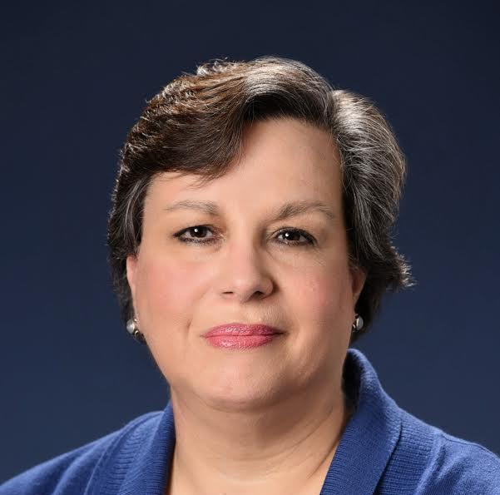
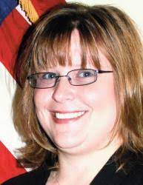
Who We Are - Staff
Vera Sharoff Senior Director MGA Information Management
Aubrey Walter vTools Project Manager | Ray Umali EWH, Surveys, Open Water | Kimberly Dante Oracle Service Cloud
Eugene Khusid – ITCO Staff Support, IBP, Collabratec | Jesse Mueller vTools Developer | Dorothy Norman Operations Specialist
Mona Li Project Manager | Terence Martinez OU Analytics, eNotice, WebEx | Stacey Waters Project Manager
Vera Sharoff
IEEE Member and Geographic Activities
Sr. Director Information Management
Aubrey
Eugene
Mona
Ray
Jesse
Terence
Kim
Dorothy
Stacey

Slide 5
Who We Are - Volunteer Leadership
Adriaan Van Wijngaarden MGA Vice Chair – Information Management & ITCO Committee Chair
Chris Gunning vTools Committee Chair

Slide 6
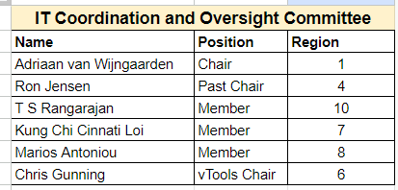
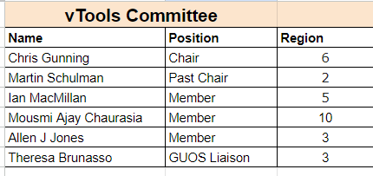
Who We Are – Committee Members

Slide 7
Who we support – Geographic Units
Regions | R1 | R2 | R3 | R4 | R5 | R6 | R7 | R8 | R9 | R10 | Total
Sections | 22 | 20 | 41 | 23 | 27 | 35 | 21 | 59 | 36 | 60 | 344
Subsections | 2 | 2 | 2 | 3 | 4 | 2 | 2 | 12 | 15 | 42 | 86
Councils | 1 | 0 | 4 | 0 | 0 | 2 | 0 | 1 | 5 | 6 | 19
Chapters* | 181 | 106 | 114 | 105 | 117 | 208 | 153 | 644 | 246 | 828 | 2702
Affinity Groups | 50 | 27 | 48 | 41 | 43 | 56 | 52 | 121 | 70 | 126 | 634
Student Branches | 90 | 86 | 114 | 67 | 100 | 89 | 61 | 746 | 572 | 1775 | 3700
Student Branch Chapters | 61 | 31 | 68 | 50 | 65 | 67 | 51 | 565 | 838 | 1829 | 3625
Student Branch Affinity Groups | 4 | 7 | 10 | 4 | 4 | 5 | 17 | 158 | 181 | 445 | 835
Total | 411 | 279 | 401 | 293 | 360 | 464 | 357 | 2306 | 1963 | 5111 | 11945
*A Joint Chapter of two or more Sections and/or two or more Societies are counted as one Chapter

Slide 8
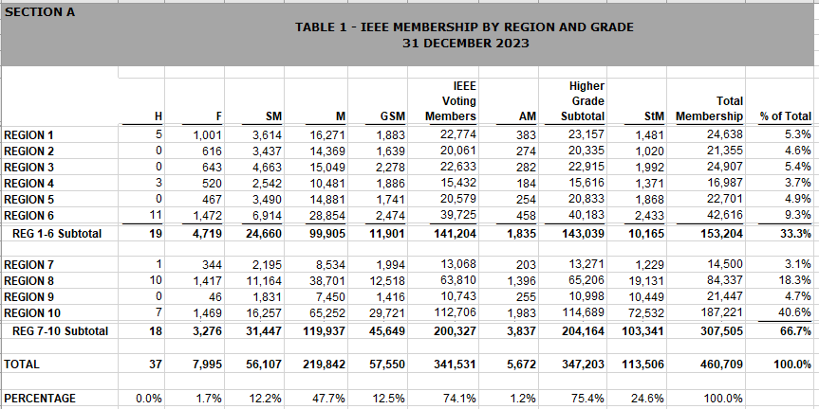
Who We Support - Members

Slide 9
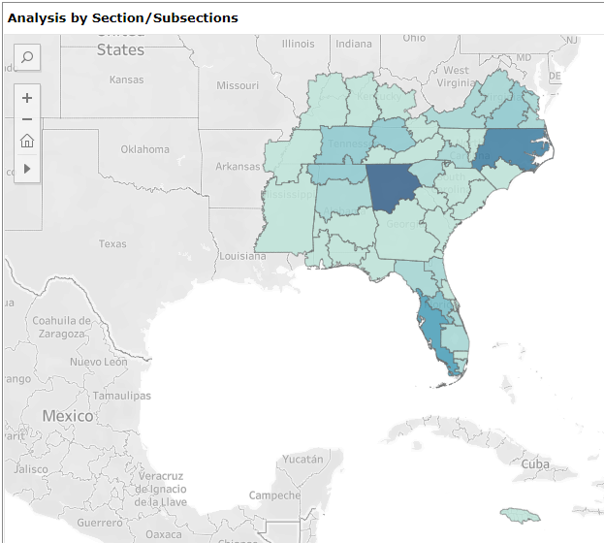
Who We Support - Members
Currently
20,702 After Service Deactivation
~3500 Students/GSMs

Slide 10
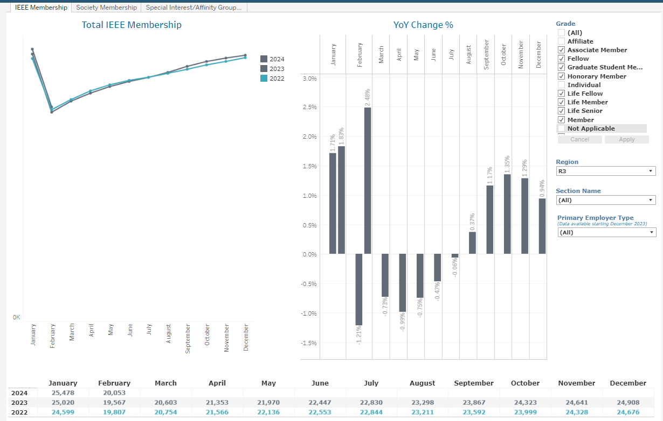

Slide 11
Tools For Sections

Slide 12
Tools
10 vTools Applications – vTools.ieee.org
Engage
eNotice
Events
Local Groups
Nominations
Officer Reporting
Voting
WebInABox
Student Branch Reporting
Xtreme Registration

Slide 13
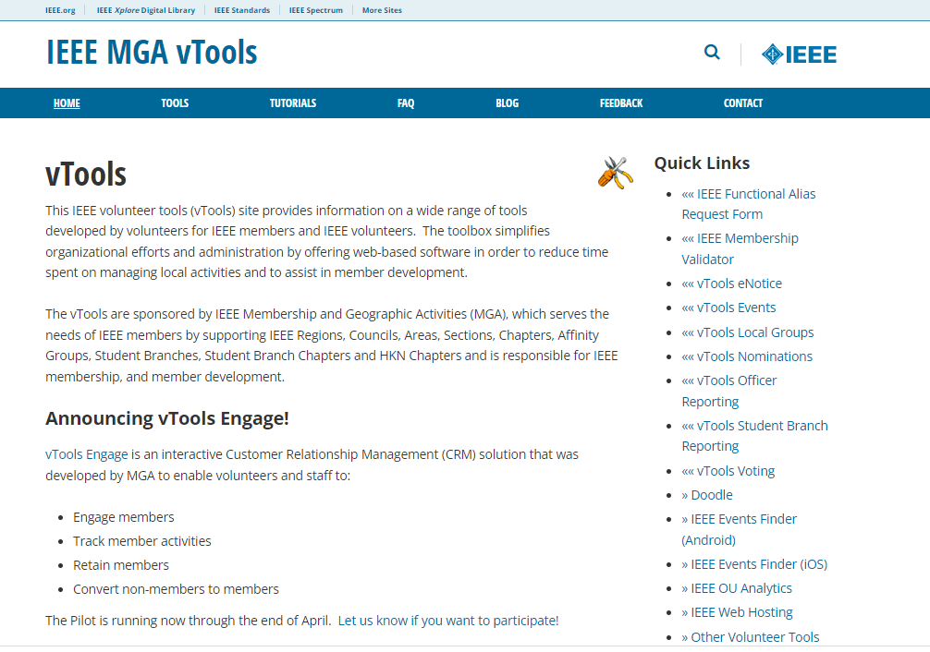
vTools.ieee.org

Slide 14
vTools - Who can access vTools?
Automatic access is granted for the following:
Region Executive Committee Members
Region-level Representatives (eg. Students, YP, WIE)
Region Directors
Section, Chapter, Affinity Group Executive Committee Members
Chair, Vice Chair, Secretary, Treasurer
Newsletter Editors#
Webmasters#
Membership Development (MD) Chair
SAMIEEE Recipient
Council Chairs
Student Branch and HKN Executive Committee Members
Includes Advisor, Counselor
vTools Coordinator#
eNotice Coordinator - access limited to eNotice only
To report officers in order to have access to vTools, use vTools.Officer Reporting
# does not require active IEEE membership

Slide 15
1. vTools Engage
vTools Engage is an interactive Customer Relationship Management system (CRM) that was developed by MGA to enable volunteers and staff to:
Engage members
Track member activities
Retain members
Convert non-members to members
Available to all Sections
engage.vtools.ieee.org

Slide 16
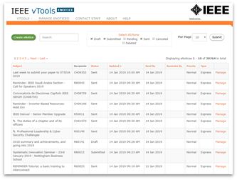
2. eNotice
An electronic newsletter subscription service that has been developed for IEEE organizational units to facilitate email distribution of newsletters, meeting notices, social events and IEEE conference materials.
Source of email address IEEE Membership database
Volunteers email their members about local events
Supports - Regions, Councils, Sections, Chapters, Affinity Groups,
Student Branches, Societies
All recipients included are GDPR and member communication preferences compliant
Features
Express delivery within two (2) hours
Create eNotice content using Event information
Send email reminders to event attendees (registered and attended guests
Supports Attachments (i.e. speaker notes, flyers)
Supports Personalization (First Name, Last Name, Section Name, Email Address, Grade, Membership Status)
Customization of eNotice ‘From’ and ‘Reply-to’
Preview of Draft and Express versions
Footer includes
Target OU’s URL (if available)
Option to manage their communication preferences
Send Test eNotice - eNotice sent to volunteer
https://enotice.vtools.ieee.org

Slide 17
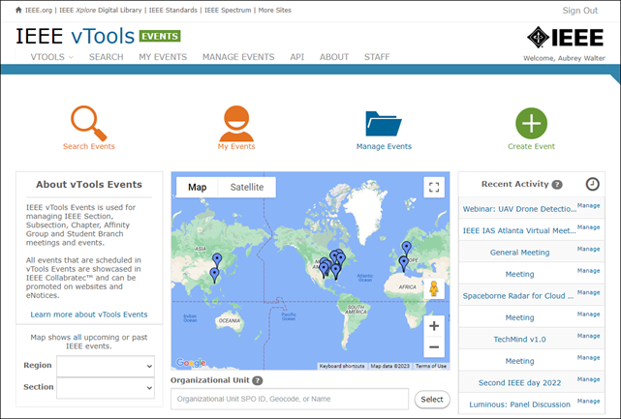
3. Events
vTools Events is used to create and manage local events. Officers can create meeting announcements by entering all relevant meeting information in one central place. Each event is accessible at the vTools Events website and are automatically exported to various sites - IEEE Collabratec and the IEEE App.
Registration, with or without payment
Credit Card payments for R1-R7 with deposits to Concentration Banking (support for R8-R10 using USD)*
@Event - on-site check in provides quick one click ‘sign in’ for attendees
Event-eNotice Integration
Create eNotice from Event information
Send email reminders to event attendees (registered and attended guests) for a single event (@Event)
Feeds (RSS, HTML, XML) -Collabratec, IEEE mobile app, Section site
Report meetings to IEEE headquarters (L31)
NEW! File Report option - one click to submit one report for all HOSTs
Reports submitted into Annual Section Rebate vTools application
https://events.vtools.ieee.org

Slide 18
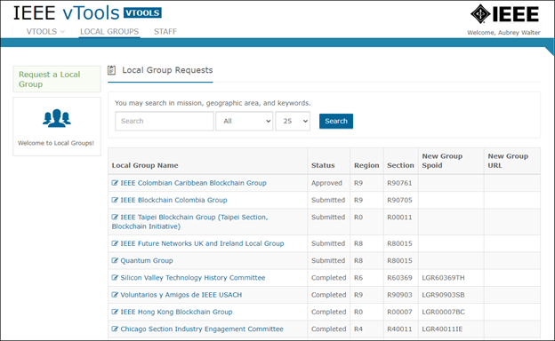
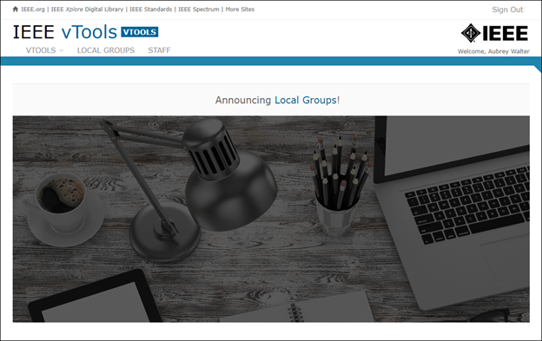
4. Local Groups
New application launched in Q4 2021.
A Local Group is a new IEEE Organizational Unit that is a sub-unit of a Section, focused on a specified local interest.
A Local Group shall comprise a minimum of two (2) IEEE members, one of whom must be an IEEE voting member, and both of whom must be members of the geographic unit involved.
Local Groups require approval by the Section Chair.
Both IEEE members and non-members may be participants of the Local Group.
https://vtools.vtools.ieee.org

Slide 19
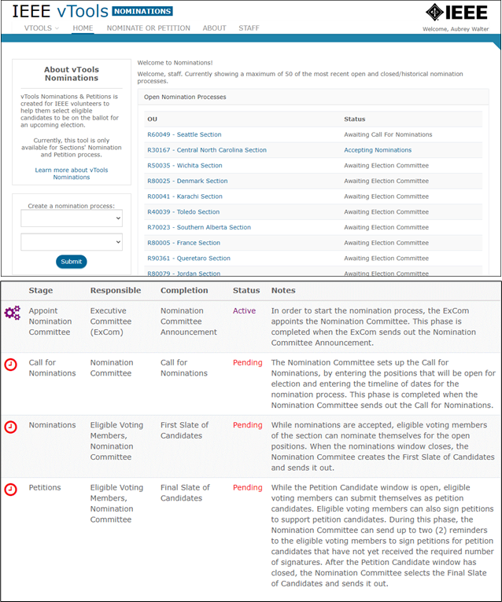
5. Nominations
Enables Section volunteers to manage the nomination/petition process
Step by step, easy to follow
Section Officers Appoint Nominating Cmte
Nominating Committee
Establishes timing
Sends call for nominations
Prepares 1st slate of candidates
Reviews petition candidates
Send out final slate of candidates
Built-in validations
Built-in email function and editable templates
Integration with vTools Voting
nominations.vtools.ieee.org

Slide 20
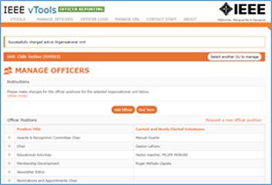
6. Officer Reporting
An online officer reporting tool that enables authorized volunteers to make modifications to the officer roster for a given region, council, section or chapter. The tool provides automatic validation and updates the central IEEE database.
Online officer reporting
Supports: Regions, Councils, Sections, Subsections, Chapters, Affinity Groups, Student Branches, IEEE Eta Kappa Nu
Updates OU Analytics and the IEEE organizational roster (overnight)
Instantaneously updates the IEEE Membership database when submitted by authorized volunteers
Officers have automatic access once report saved
Features
View organizational roster
Automatic validation of
Valid Member Grade, Resides in OU
Add and/or End term* of an officer
View Officer Logs of organizational roster changes
Update Organizational Unit URL (website)
officers.vtools.ieee.org

Slide 21
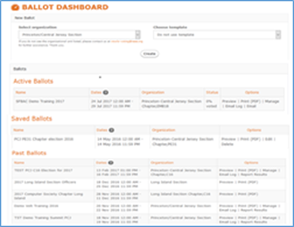
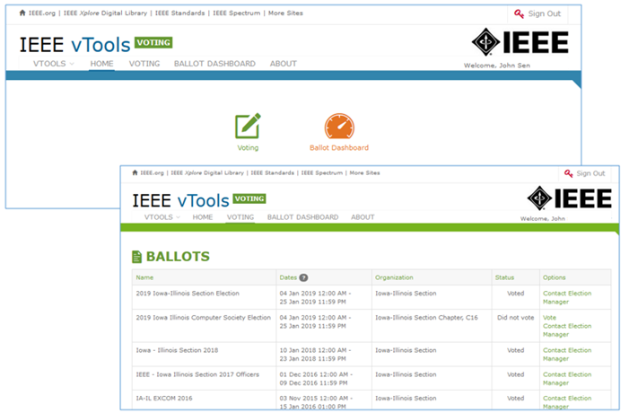
7. Voting
Create ballots/motions for local geo unit elections for:
Regions, Geographic Councils, Sections, Subsections, Chapters, Affinity Groups, Student Branches, Student Branch Chapters, Student Branch Affinity Groups Technical Committees
Features
Dashboards - Active, Draft, Past
Ballot/Motion*
Creation of multiple positions with multiple candidates
Auto-load voter list of eligible members for Organization holding election
Preview online ballot as DRAFT
Ballots and Motions now include explicit option to abstain
PDF /Print versions of ballot available
Once election is open,
Organizer emails voters directly from tool
Once election has closed
Review election results
Members sign in with IEEE Account for secure access to online ballot
Integration with vTools Officer Reporting
voting.vtools.ieee.org
*Please note that this is different from the general IEEE elections.

Slide 22
8. WebInABox
Basic web site “WebInABox” with wizard-like interface for creation
No webmaster skills required
Enables a common look and feel compliant with IEEE web presence guidelines
Integrates with Events - includes upcoming and past events
Data driven with auto updates from central IEEE database
Provides Officer Roster
Provides file storage
Supports Sections, Chapters, Affinity Groups and Student Branches
Not meant to compete with or replace complex content management systems such as WordPress
webinabox.vtools.ieee.org

Slide 24
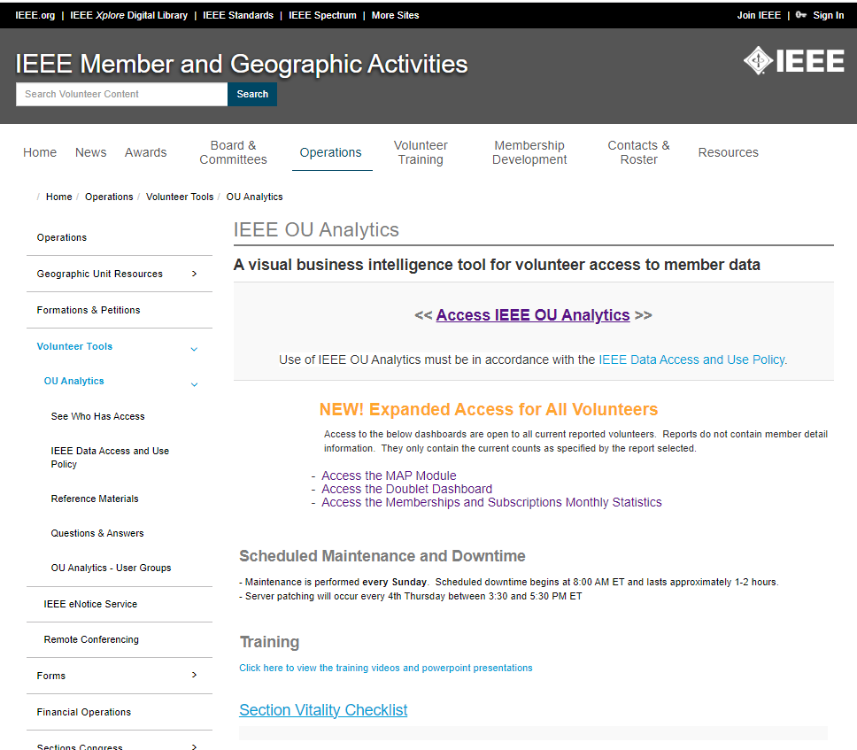
Tools
IEEE OU Analytics
A visual business intelligence tool which provides volunteer access to member data
OU Analytics User group
ieee.org/oua

Slide 25
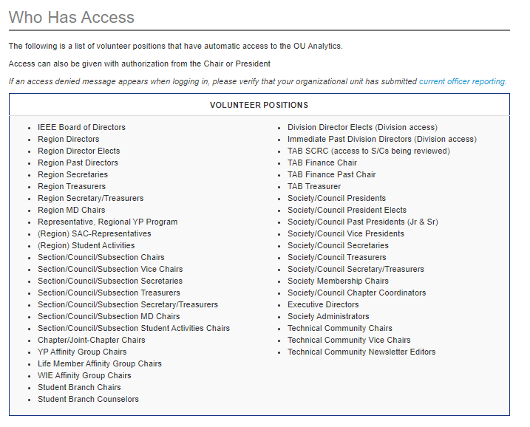
Who Can Access IEEE OU Analytics?

Slide 26
What data is available?
Data is limited to your Organizational Unit
Region - All members and affiliates who live in the Region
Section - All members and affiliates who live in the Section
Subsection - All members and affiliates who live in a Subsection
Example: Montgomery Subsection of the Alabama Section
Chapter/Joint Chapter/Affinity Groups - All members and affiliates who live in the Section(s) and are a member of the associated Society
Student Branches - All student members attending the school of the Student Branch
Student Branch Chapters/Student Branch Affinity Groups – All student members attending the school of the Student Branch and belonging to the associated Society
Society
Data includes:
Contact information
Grade and Grade History
School, HKN
Memberships – IEEE, Society, Affinity
Subscriptions
Volunteer Positions, including history
And much more

Slide 27
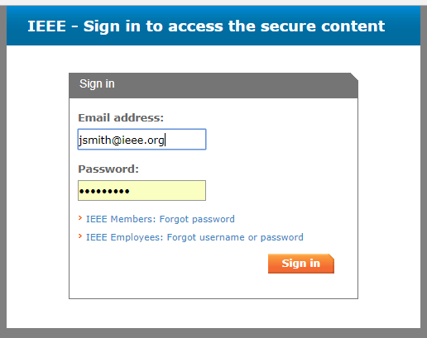
IEEE OU Analytics
Click “Access IEEE OU Analytics”
Use of IEEE OU Analytics must be in accordance with the IEEE Data Access and Use Policy.
Sign in with your IEEE Web Account Username and Password

Slide 28
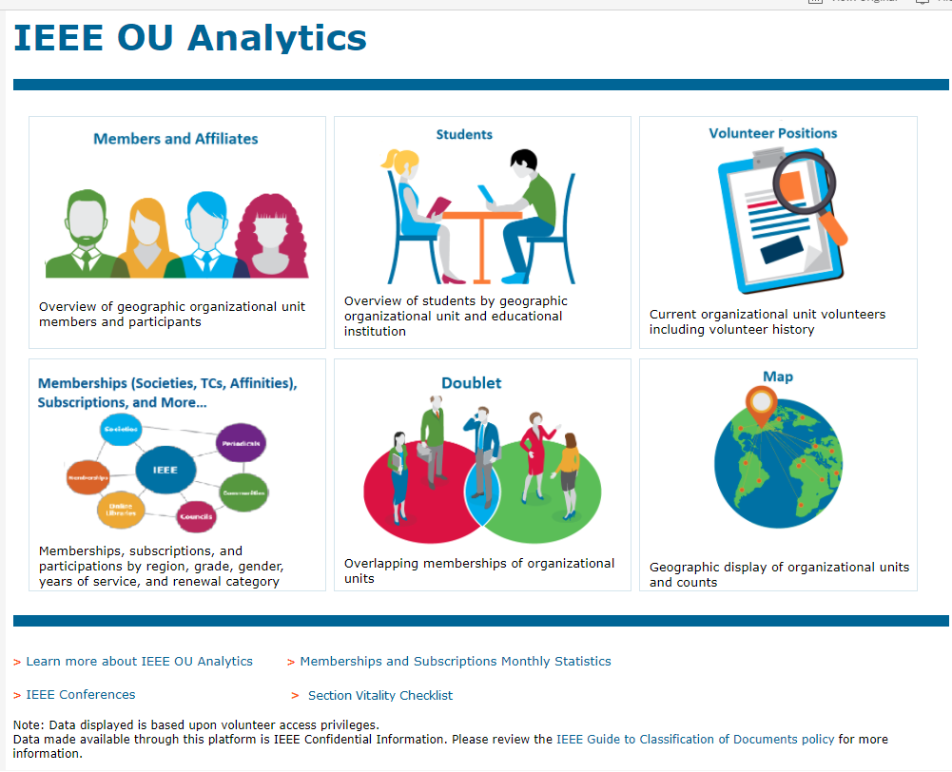
Landing Page
Six Modules
Members and Affiliates
Memberships
Students
Doublet
Volunteer Positions
Map

Slide 29
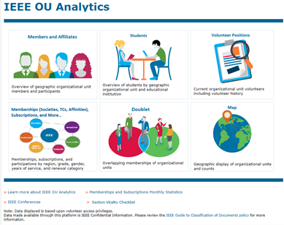
Members and Affiliates
Dashboard
Count By Region and Grade
Count by Gender (pie)
Count by Technology Focus
Count by Grade and Gender
Geographic Counts - by City / State / Province / Country/Grade
Employer Information
Member Activity
Detail

Slide 30
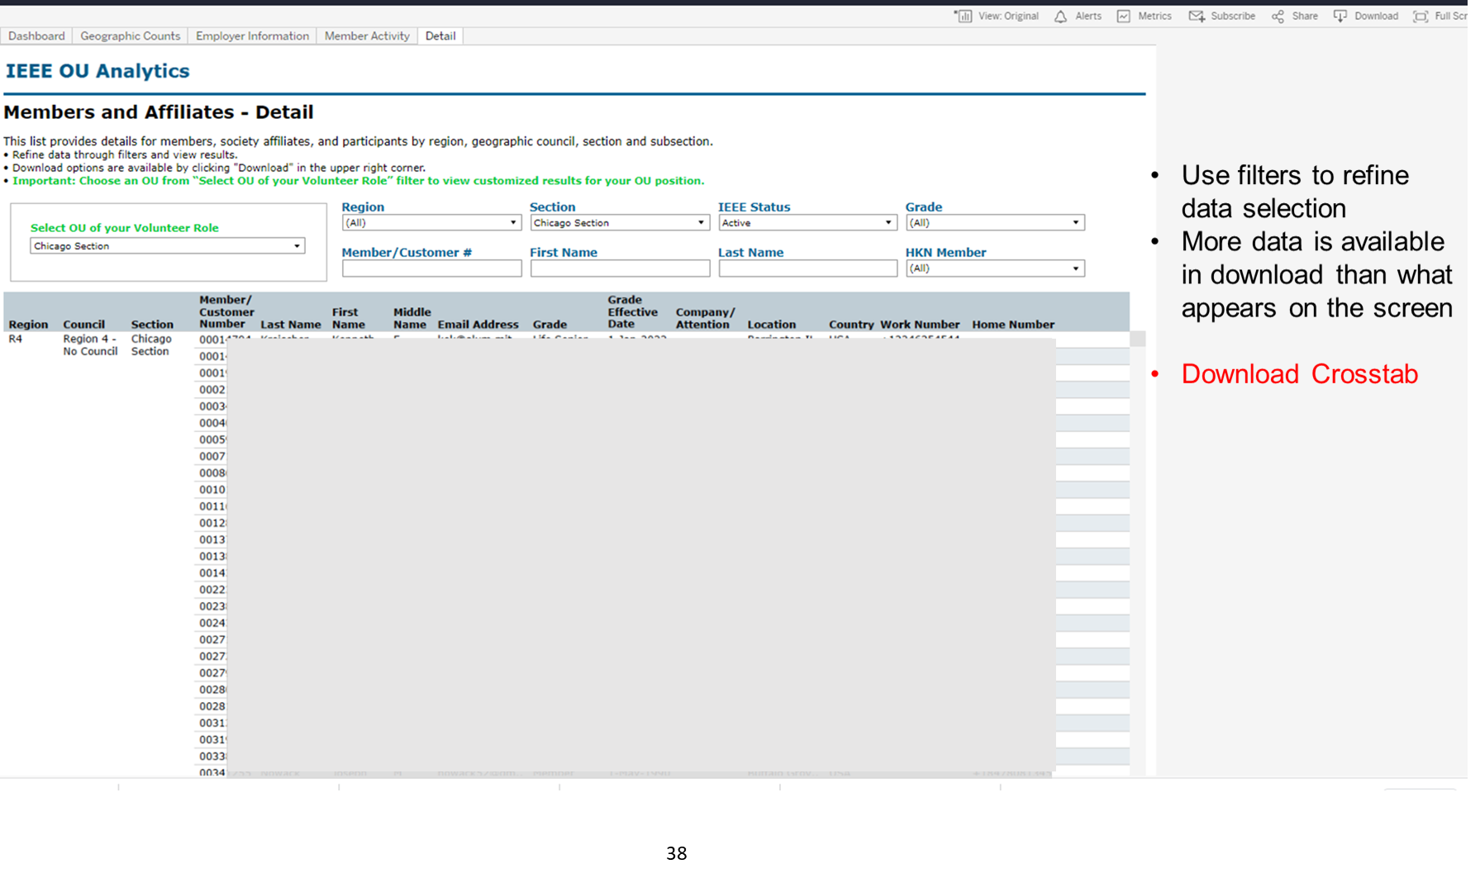

Slide 31
Memberships
(Societies, TCs, Affinities) Subscriptions, and More
Product Dashboard
Summary
Count by Grade (pie)
Count by Gender (pie)
Count by Grade and Years of Service
Product Summary by Region by Grade
Renewal Category Dashboard
Renewal Summary by Region by Grade
Detail

Slide 32
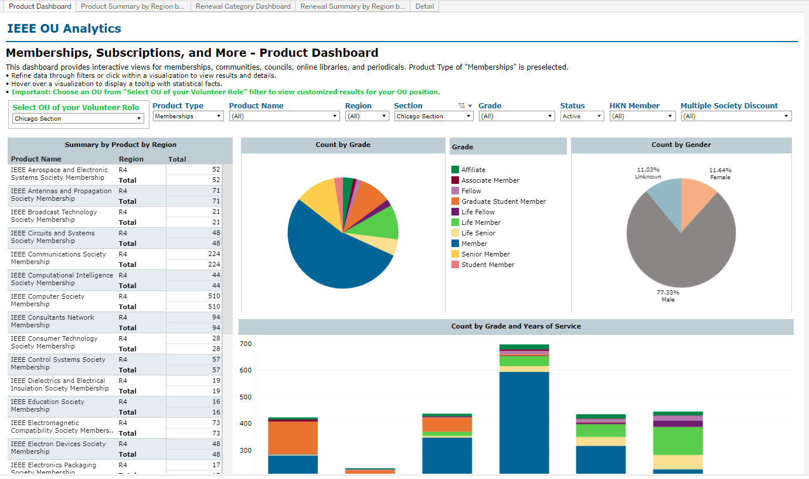
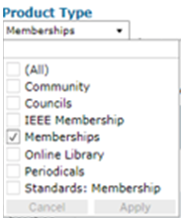

Slide 33
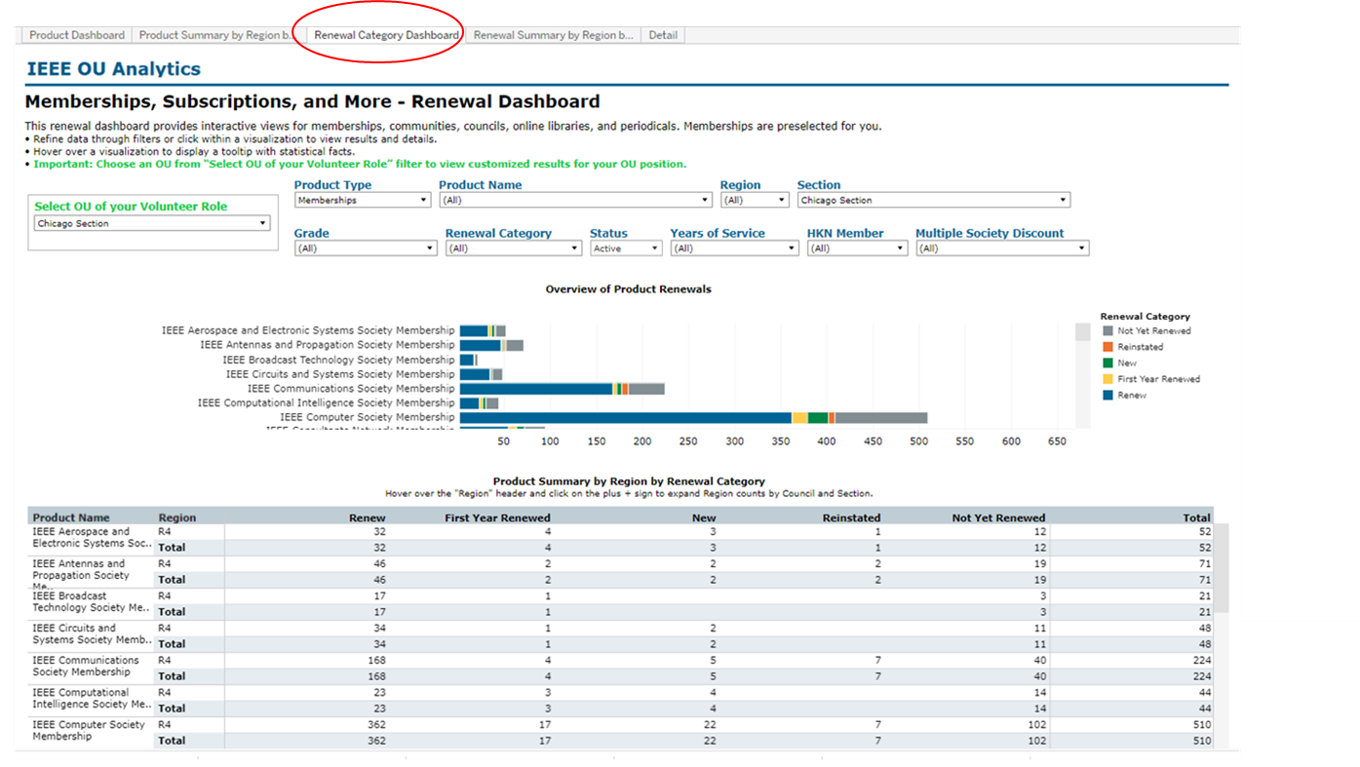

Slide 34
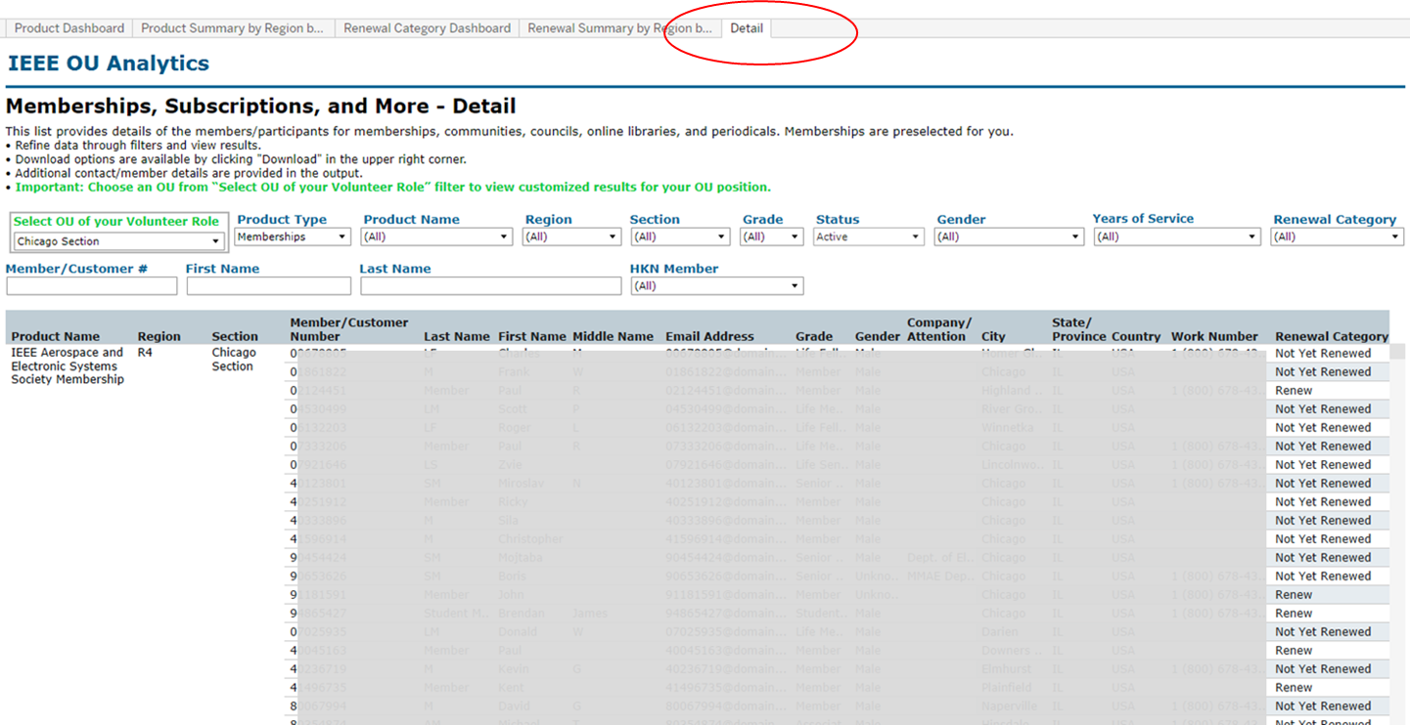

Slide 35
Dashboard
Student Count by Section and School
Student Count by Gender
Student Count by Grade
Student Count by Field of Study
Detail
Select OU
Where they live (primary address)
Where they go to School

Slide 36
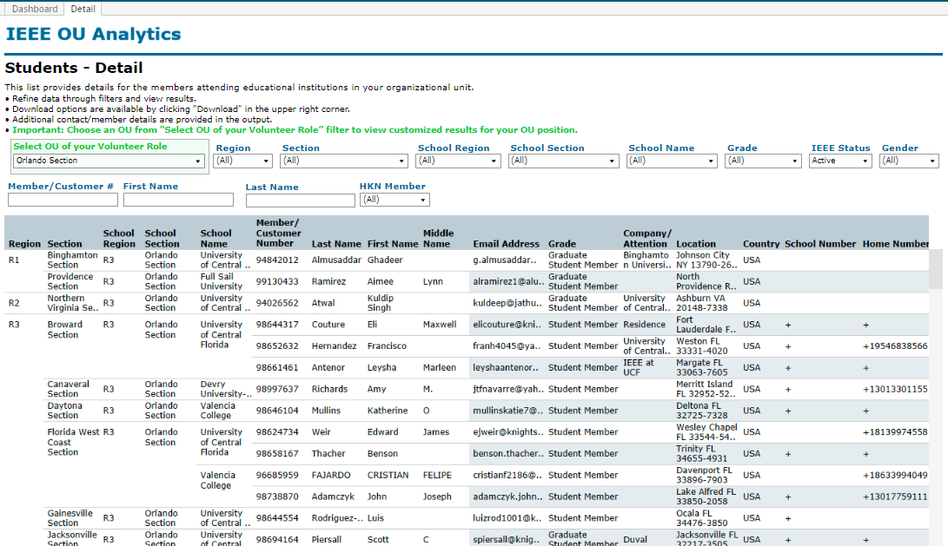

Slide 37
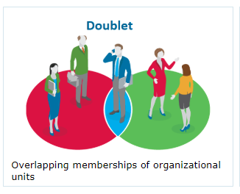
Doublet
Members with this society membership also have this membership

Slide 38
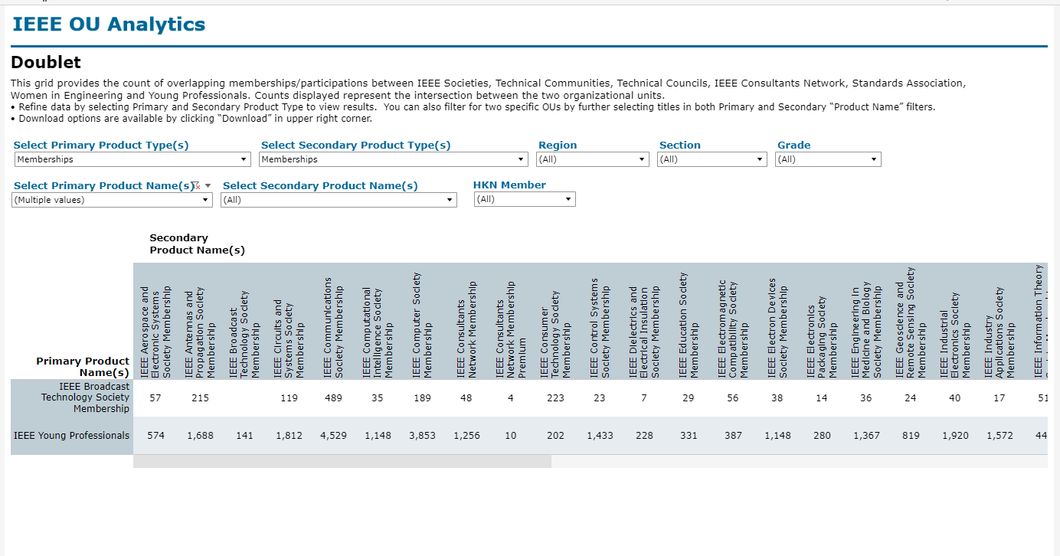

Slide 39
Volunteer Positions
Volunteer Positions in Related
Volunteer History

Slide 40
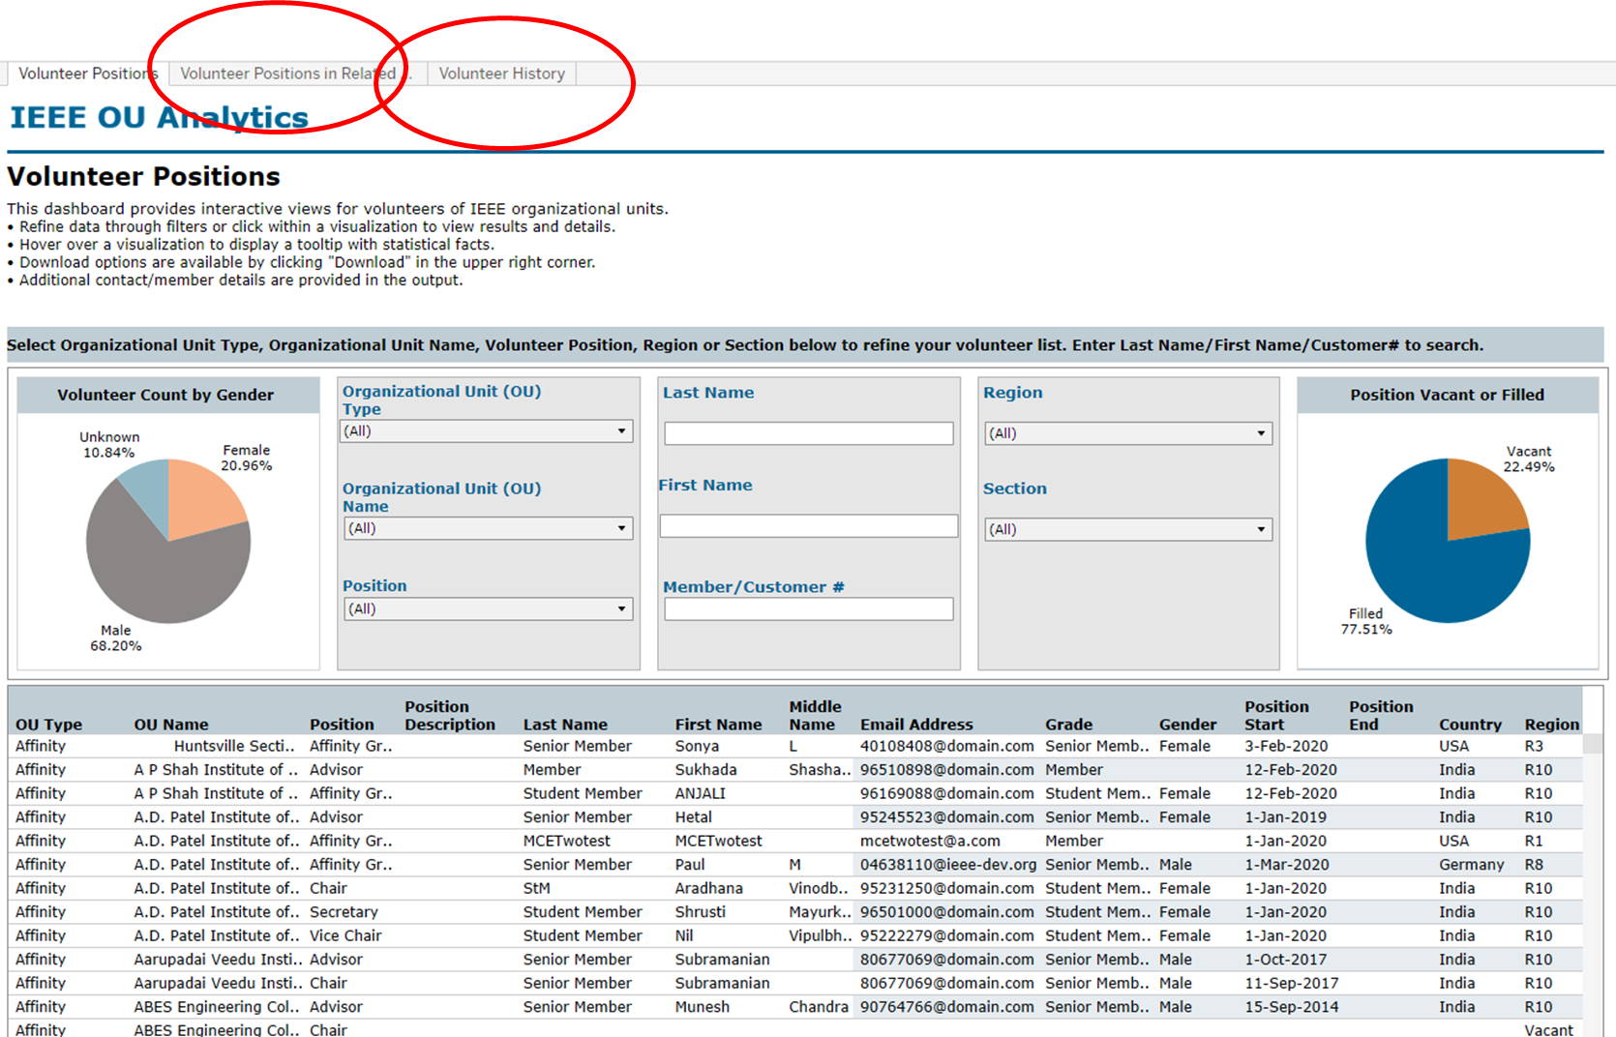

Slide 41
MAP
Region Summary
IEEE/Society Membership Summary
Chapter Summary
Member Count by Chapter
Potential Chapters
Affinity Group Summary
Student Branch Summary
Potential Student Branches

Slide 42
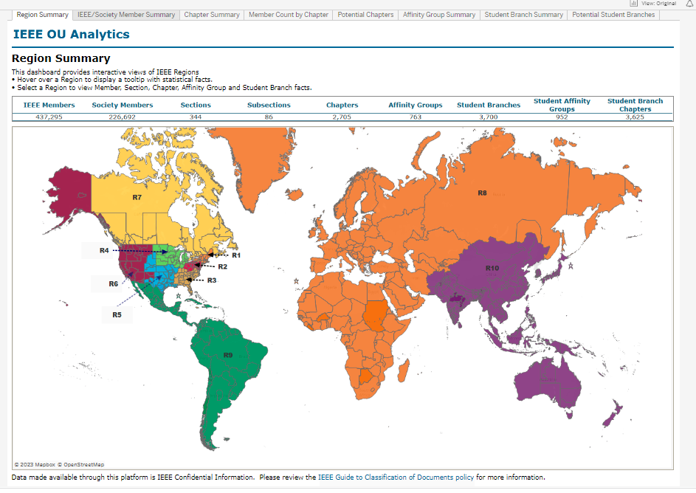

Slide 43
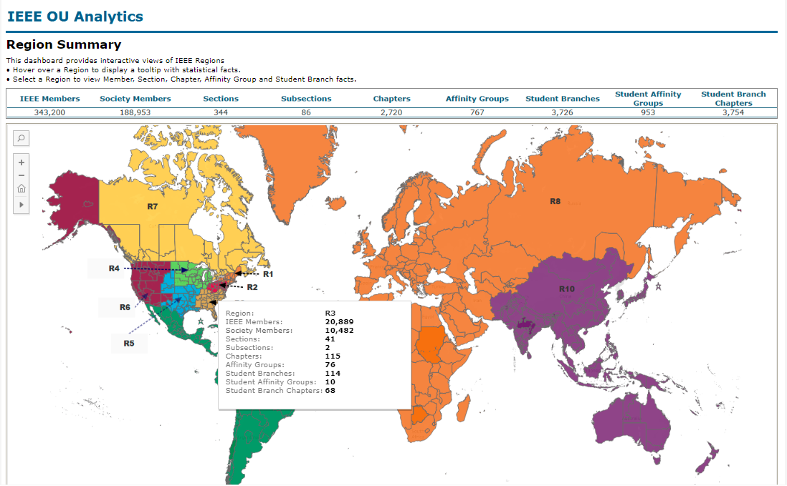

Slide 45
Tools
IEEE Membership and Subscriptions Monthly Statistics https://tblanalytics.ieee.org/#/site/IEEE/projects/62
IEEE Annual Statistics - ieee.org/stats
Year end snapshot
IEEE Organization Roster – rosters.ieee.org
IEEE Center for Leadership Excellence – ieee.org/cle

Slide 46
Tools
IEEE Membership Validator
an online utility that allows volunteers and staff to easily and securely check IEEE member status, grade, and society memberships and offer discounts available exclusively to IEEE members. ieee.org/mv
UI and API for integration with Conferences
Web Hosting for IEEE Organizational Units
6,000+ IEEE OU Websites – ewh.ieee.org

Slide 47
Tools
GoogleApps@ieee
FrontLine Worker (Free Member Benefit)
Google Enterprise License (Fee Based)
Google Shared Drives
Remote Conferencing – WebEx, GoogleMeet
General Usage Accounts
Section Supported Accounts
Committee Accounts
Surveys – Survey Sparrow

Slide 48
Questions

Slide 49
Appendix

Slide 50
ITCO Committee Charter
IT COORDINATION AND OVERSIGHT COMMITTEE
GENERAL: The MGA Information Technology Coordination and Oversight (ITCO) Committee shall report to the MGA Board through the Vice Chair – Information Management.
SCOPE: The Committee shall be responsible for collecting IT requirements for MGA and coordinating/advocating their design, development, deployment, training, and usage.
FUNCTIONS:
Provide leadership, coordination, and oversight for automation projects to support membership and the geographic unit structure.
Provide oversight for enterprise solutions such as Entity Web Hosting.
Consult on business rules

Slide 51
vTools Committee Charter
GENERAL: The MGA vTools Committee shall report to the MGA Board through the MGA IT Coordination and Oversight Committee (ITCO).
SCOPE: The Committee shall work with the MGA ITCO and MGA Geographic Unit Operations Support (GUOS) Committee to develop solutions to assist geographic unit volunteers, develop and deliver training modules for developed solutions, and migrate solutions to normal IEEE IT operations. Additionally, it shall provide technical support to all MGA committees as requested.
FUNCTIONS Develop solutions compatible with the standard IEEE IT operations and support model for member and volunteer needs. Develop and provide training and advocacy for developed solutions. Work closely with Region Information Management Coordinators (IMCs) to deploy the solutions and the training

Slide 52
Proposed 2024 MGA Priority Projects
Priority Projects support MGA strategic areas and goals
Membership - A core MGA responsibility and strategic focus. These projects build on key member strategies and sustaining operations. They add specific focus due to particular ad hoc efforts from the IEEE BoD and MGA
Major IEEE-wide and MGA-led initiatives that will require significant volunteer and staff efforts to achieve successful completion.
Sections Congress 2023 Recommendations
MGA Finances
NextGen Adoption
Region Realignment Implementation
Expanding the IEEE Membership Prospect Universe
Develop Strategic Roadmaps and Action Plans
Improve Student Retention and Student to YP Transition
Digital Strategy and Initiatives ensure MGA and the Geo Units have the necessary tools and related resources to meet current needs, and support online IEEE program/service delivery.
Geographic Unit Vitality – A competitive advantage of IEEE and MGA’s strategic focus. These projects define new capabilities that are underway or being created to strengthen the resources available to local geo units for engaging members and the public.
vTools for Chapters
vTools Single Candidate Slate Approval Automation
MGA Volunteer Training Strategic Planning

Slide 53
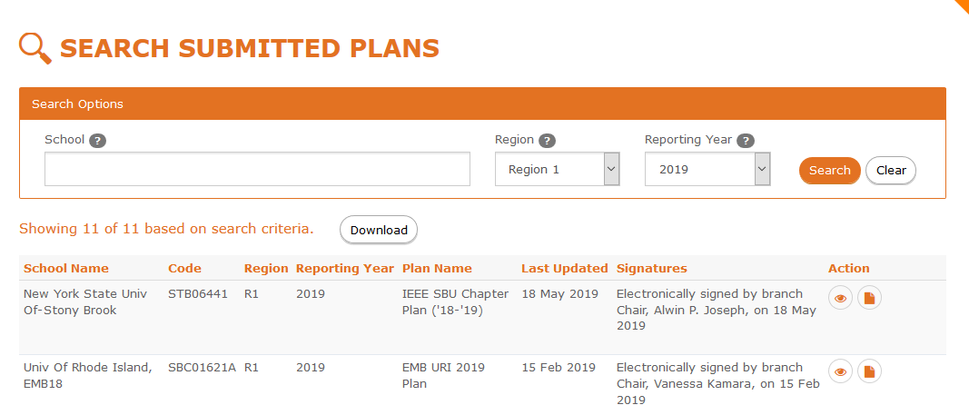
9. Student Branch Reporting
Student Branch Officers submit plans for upcoming year
Features
Student officers (Branch Chair, Counselor, Section Chair, Region Student Representative) provide approval of submitted plans
Plan details (i.e. Branch Operations / Function, Goals, Activities planned)
Search submitted plans, download PDF versions of a plan
sbr.vtools.ieee.org

Slide 54
10. Xtreme
IEEEXtreme is an annual global challenge in which teams of IEEE Student members—advised and proctored by an IEEE member, and often supported by an IEEE Student Branch—compete in a 24-hour time span against each other to solve a set of programming problems
vTools provides registration process for teams
Team information provided to competition platform host /vendor
Features
Member eligibility - Student and Graduate Student Members
Proctor Registration
Proctor Validation
Email confirmations to team admins, proctor and team members
xtreme.vtools.ieee.org

Slide 55
Other Tools
Member Join/Renew/Profile
Memberships and Subscriptions Catalog
Senior Member Elevation Application
Fellows Nomination System
Geo Petitions
Volunteering (New)
IEEE Collabratec
IEEE App

